Slide 1
Adding Modularity Afterward with Embedded OSGi

Slide 2

About Me – Bob Paulin
@bobpaulin/bob@bobpaulin.com/http://bobpaulin.com
Independent Consultant
  Web Centric Platforms
  Business Enablement
  Continuous Delivery
Chicago Java Users Group (CJUG) Community Leader
Mentor
Want to Present in Chicago? present@cjug.org

Slide 3

Regret
Notes:
I want to start this talk of with tail of regret. I was building a application for a masters project to simulate players alignments on a field using an an cognitive modeling language called SOAR. As with any project getting started was tough but once I got going everything started getting easier and I got it to start positioning players and measuring the complexity of the instructions that they were receiving. However as I started to add features other parts of the program started breaking. So I started to move slower because I started recognizing the places that I needed to check. But still there were issues. So then I realized there were parts of the application that I probably shouldn't be changing at all...in the end I dropped the project.

Slide 4
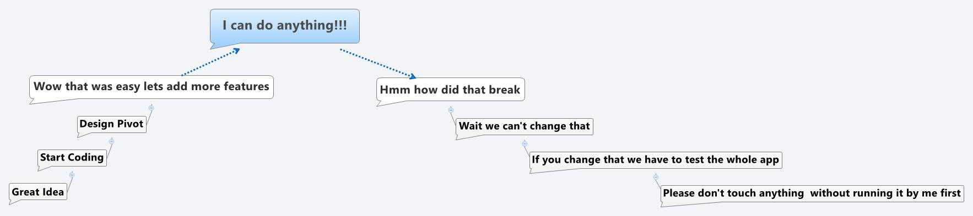
Application Development Cycle
Notes:
Does this sound familiar? We start projects with an abundance of hope and great aspiration.. Then when we finally cross the threshold of “getting something useful” we find that we often become a victim of our own success.

Slide 5
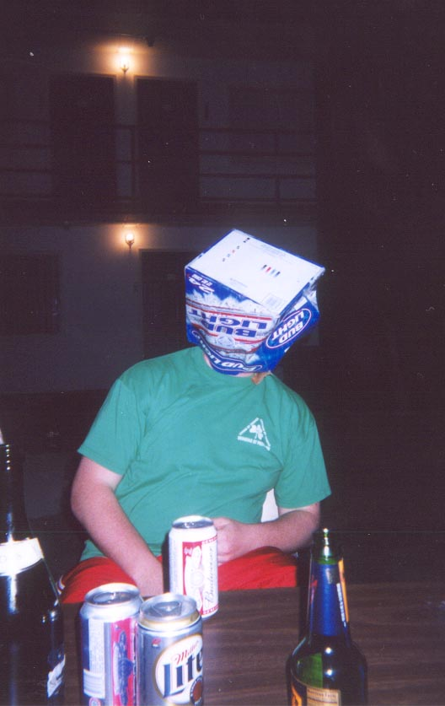
Hope?
Notes:
So when this happens is there hope? Can these applications be saved? I think they can be! And that is the core concept that I'd like to continue with today.

Slide 6
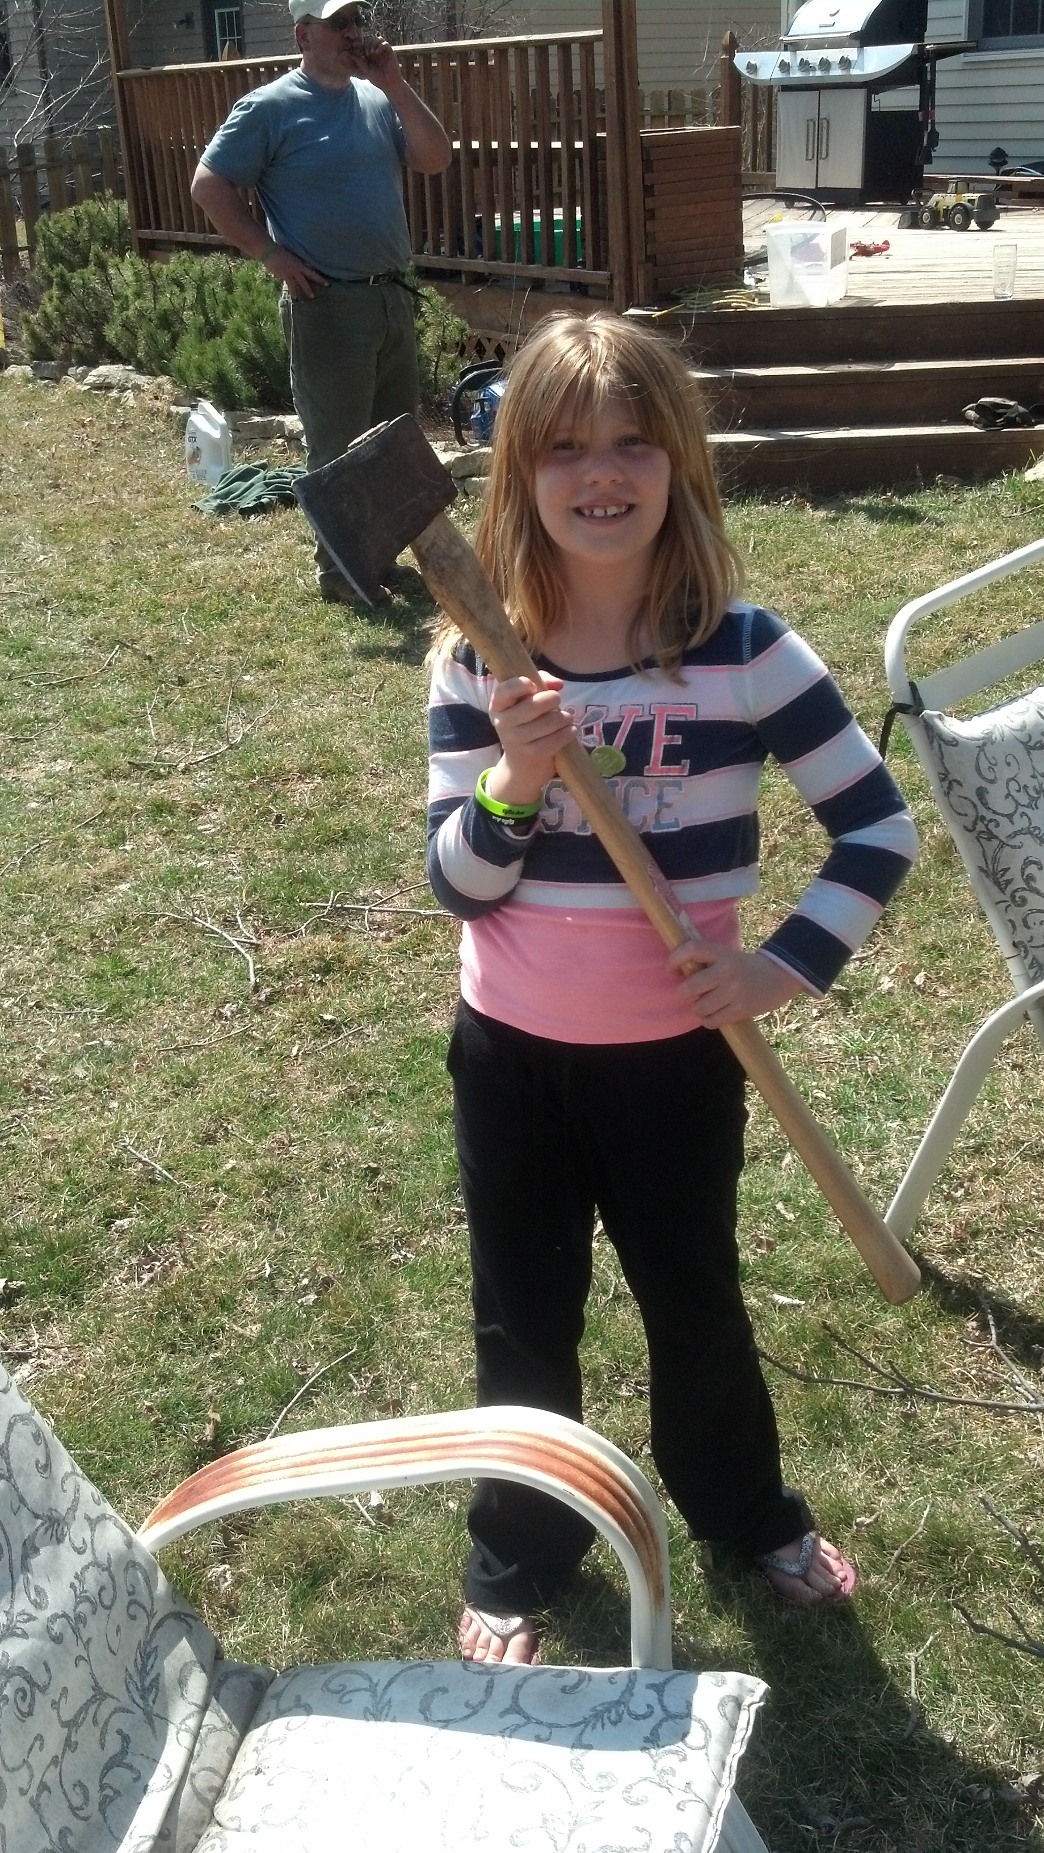
If we could start over what would we want?
Notes:
So lets start with a question about if we could do a full rewrite what would we want. What is the second system effect after a project like this?
Better Separation (loose coupling)
Decoupled Physical Architecture
Ability to rollback
Ability to evolve parts of the application separately.

Slide 7
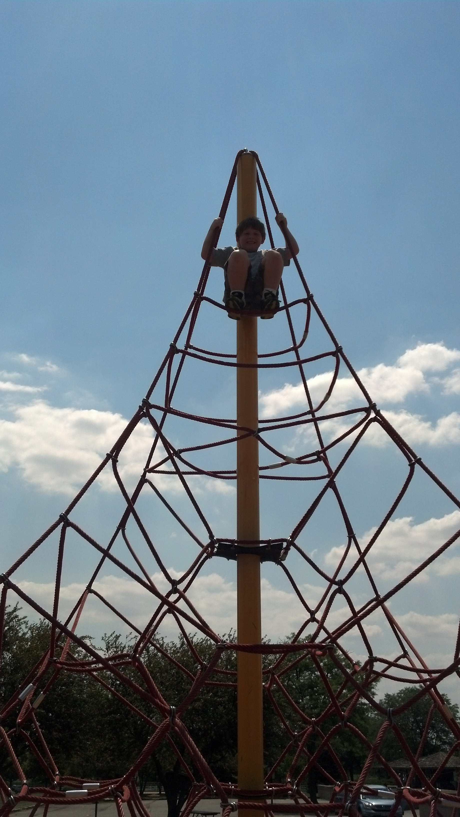
Modularity
Notes:
Many of these demands can be solved by developing applications more modularly. Modularity breaks an application down into pieces that can be swapped out, versioned, and extended.
This is usually the part in a modularity talk where you see a picture of a puzzle piece. I think a web is a better analogy
A good modularity framework is like a network of strings that tie the application together. But unlike glue strings can be untied and rewoven when things change without disturbing the rest of the structure.

Slide 8

Options?
Notes:
So what options do we have when it comes to building a modular application. I'm specifically going to discuss options on the java platform for this talk. Which one you select largely depends on what your needs are.

Slide 9
OSGi
Mature 10+ Years
Tools
Modularity is enforced
Versioning
Complex Classloading
Runtime
Notes:
Of all the things out there OSGi is the most mature in the Java space.
Being mature there has been ample time for folks to build great tools around the specification such as BNDTools, Maven plugins, Apache ACE.
It's the only one that is structured in such a way that doing things in a non-modular way is harder than just doing the right thing.
Semantic Versioning is baked in.
With maturity generally comes some complexity. To achieve some of the cool features such as supporting multiple versions of a jar requires some behind the scenes magic with classloading. This can be complex if you start doing reflection across bundles.

Slide 10
Inversion of Control (IoC)
Lightweight
Easily added to existing systems
Tools
Modularity not enforced (DIY)
No Versioning
Notes:
Another popular options is to use Spring.
Spring integrates into most stacks fairly easily (as long as you don't use different versions of any of their jars).
Lots of tools working with spring Sping IDE.
Modularity is not enforced. The IoC pattern encourages you to build to interfaces and separate behavior from the contracts but spring doesn't make it hard to do bad things.
Also you are on the hook for versioning

Slide 11
Jigsaw
Java 7....8...9??
Versioning
Interoperability with OSGi (Penrose)
Notes:
Project Jigsaw was proposed as early as Java 7 but has been pushed back to now be on for Java 9.
It's come a long way but does a lot of the same good things that OSGi does with respect to versioning and encouraging library type development.
It's vision includes interoperability with OSGi.
But even if it does make it into 9 it's going to take time for tools and adoption to pick up. So OSGi is still likely to be the only game in town for some time.

Slide 12
OSGi: Start with One big Bundle?
Notes:
So you've decided to go with OSGi is the solution you want to go with and rewriting is not an option.
Recommended approach is to create one big bundle. Apache Tuscany did this a few years back.
This means taking all your dependencies and embedding them in your bundle and slowly teasing things out as you go.

Slide 13
OSGi: When does embedding make sense?
Notes:
The problem with one big bundle is it doesn't always work.

Slide 14
Want an Isolated Third-Party Container
Notes:
What if your requirements say you just need a client runtime for third parties to build on. Then you might consider just building the client runtime with OSGi.

Slide 15
Licensing/Proprietary Code
Notes:
I am not an attorney.
Creating one big bundle may require you to mix license types together.

Slide 16
No Budget/Time/Desire for full OSGi
Notes:
Modular design is hard!
Many folks learn to hate OSGi because they try to modularize their app all at once.
The problem is that modular design is hard and it's important to learn to walk before you run. Embedding allows you to try before you buy.

Slide 17
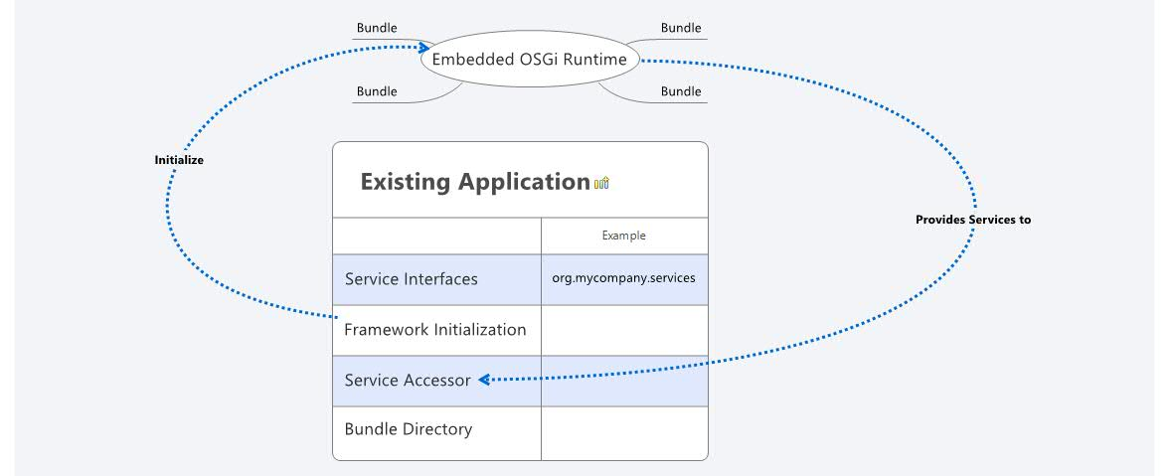
Embedded Design/Implementation
Notes:
Several different components worth highlight.
All of these exist within a single JVM.
In addition to your existing application's code there are service interfaces, framework initialization code which includes a bundle activator for the framework, a method to access OSGi services, and a directory for startup bundles.

Slide 18
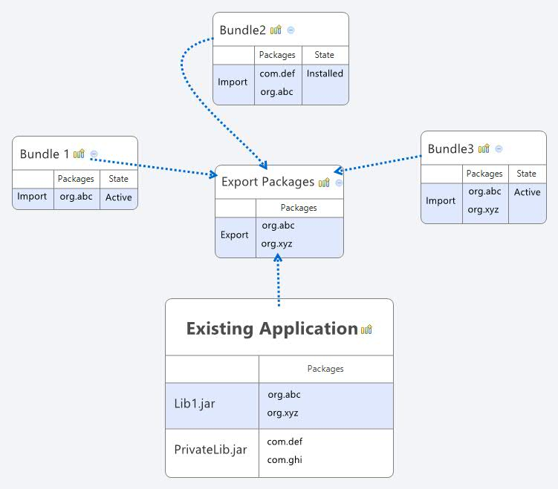
Exposing packages to the framework via System Packages
Notes:
So your first task is determing what classes should be available (in addition to the JDK classes) to the OSGi container.
These are exposed via System packages and they are explicitly spelled out.
There are other ways to do this such as Boot Delegation.
Boot delegation does not require the bundles to import the classes. It's as if they're a part of the JDK.
System allows more control and works hand in hand with bundle dependency management.

Slide 19
Minimum required bundles
Felix Framework
Notes:
For the absolute basic setup only one bundle is required! The felix framework bundle has classes required to initialize the framework and start loading bundles.
This should be on your main application classpath.

Slide 20
A few more to consider...
A few more to consider...
Felix Config Admin
Gogo Shell
Web Console + HTTP
SCR + Annotations
Apache ACE Management Agent
Notes:
However to take advantage of all of OSGi has to offer I'd recommend a few more.

Slide 21
Good places to start
Configuration
Factories
Resources
Notes:
Configuration – OSGi when combine with the web admin or config files can be a great way to standardize your application's configuration.
Factories – With features that allow multiple implementations to bind to an interface that can be added dynamically makes OSGi a good fit for creating object factories that can be updated without turning off the app.
Resources – So many apps have static resources and images all over the place. If you've got the memory to handle it you can wrap all these things in a JAR which can allow them to be swapped in and out easliy.

Slide 22
Caveats
Framework creates threads
Use only one Framework Instance
Requires some IDE tricks
Package Tangling may get worse before it gets better
Notes:
Ok so what are some things to watch out for.
The framework creates threads so your services and your application code will be running in separate theads. It's important to realize this when you're dealing with stateful objects.
Don't mix this with containers that provide OSGi already.
There are some IDE tricks required to get bundles to pull classes from the existing application code.

Slide 23
Talk is Cheap.
Time for an example.

Slide 24
An Embedded Usecase With Tanks
SOAR
Written in C++ with Java Bindings
Swing with SWT
Multi-Game Grid
Notes:
Here's a good example of an app that fits the embedding use case.

Slide 25
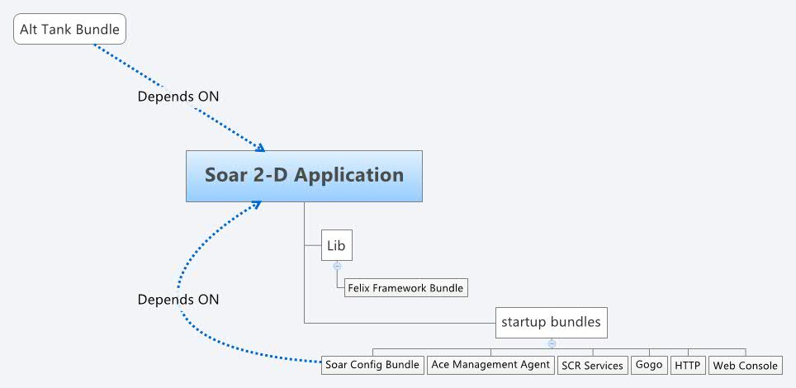
Embedded Design/Implementation
Notes:
So here's what we want to do.

Slide 26
Exposing packages to the framework via System Packages
configMap.put(Constants.FRAMEWORK_SYSTEMPACKAGES_EXTRA,
"edu.umich.soar,edu.umich.soar.gridmap2d.config," +
"edu.umich.soar.modules.services," +
"edu.umich.soar.gridmap2d,edu.umich.soar.gridmap2d.world," +
"edu.umich.soar.gridmap2d.visuals," +
"org.eclipse.swt.widgets,org.eclipse.swt.graphics; version=0.0.1");

Slide 27
Supplying Services to the Non-OSGi code
public <S> S getService(Class<S> serviceClass)
{
ServiceReference<S> ref = m_activator.getContext()
.getServiceReference(serviceClass);
return m_activator.getContext().getService(ref);
}
Notes:
This allows the Existing application to use services the live inside the embedded OSGi container.
Do more digging on how this works when bundles are reloaded!

Slide 28
Setting up the Framework
//Yup it's that easy!
m_felix = new Felix(configMap);
m_felix.start();
Notes:
So not much to see here which is cool!
Once the framework is started you can start installing bundles.

Slide 29
DEMO!
Notes:
Explain program
Show Old program
Run through structure of the new program
Run new Program
Add Cats with Apache Ace
Sonar?

Slide 30
Summary
Modularity is often an afterthought
Some projects have difficulty being fully OSGi
Embedding OSGi can provide many of the same benefits

Slide 31
References
Adding Modularity Afterwards with Embedded OSGi (Talk and Code)
Felix Embedded Documentation

Slide 32
Bob Paulin
@bobpaulin/bob@bobpaulin.com/http://bobpaulin.com

