Slide 1
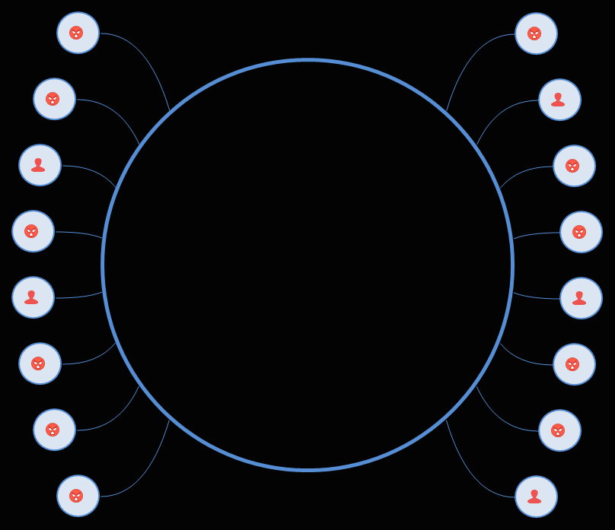
Microservice Networking
In Anger

Slide 2
Bob
Paulin
Independent Consultant
ASF Member
Java Champion
Chicago JUG CFO
Offheap & Java Pubhouse Podcast

Slide 3
Why so
Angry??

Slide 4
Networking
It just works

Slide 5
Things are about to get
Strange

Slide 6
Networking
The Upside Down

Slide 7
Network ==
Module boundaries

Slide 8
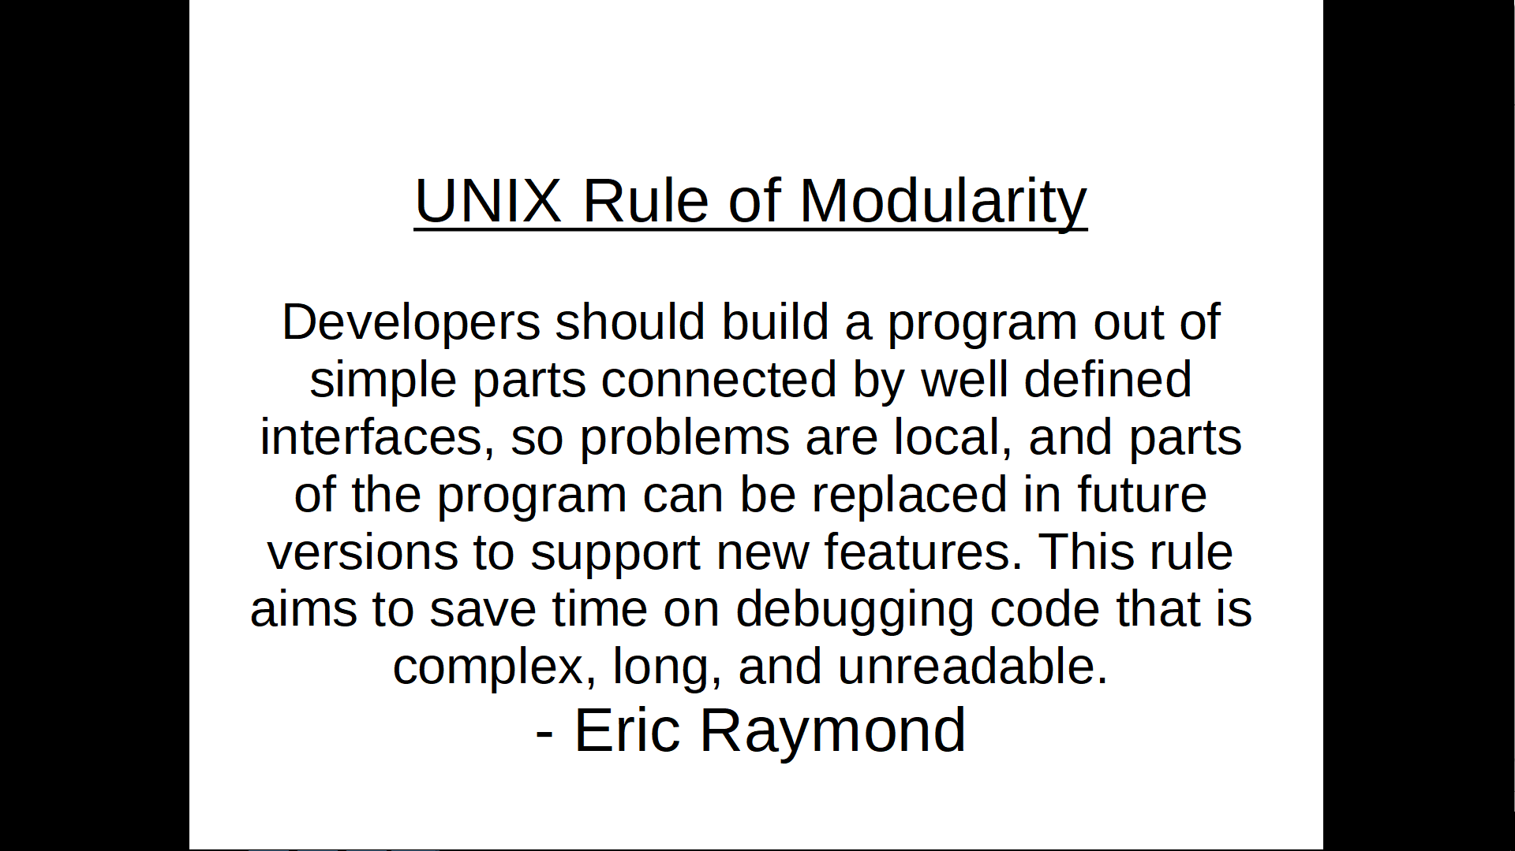

Slide 9
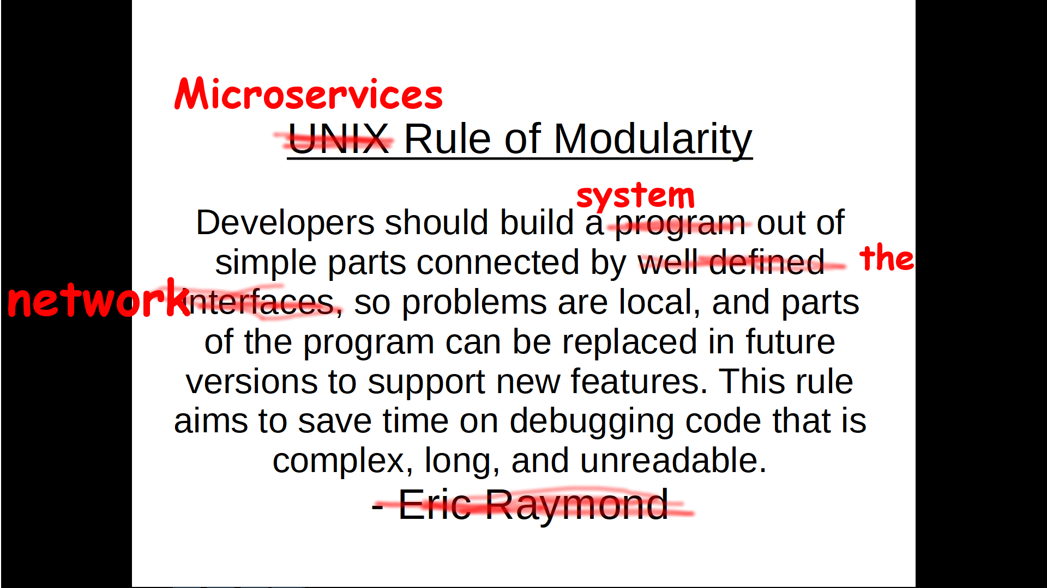

Slide 10
Chapter 1
The Tools of the Trade

Slide 11
TCP Dump and Wireshark
Seeing in the Upside Down

Slide 12
Apache Bench
Torture by HTTP

Slide 13
Chapter 2
The TCP and the UDP

Slide 14
UDP
Fire and Forget

Slide 15
TCP
Guaranteed Delivery
OR
Guaranteed Error :)

Slide 16
Chapter 3
The Network Flayer

Slide 17
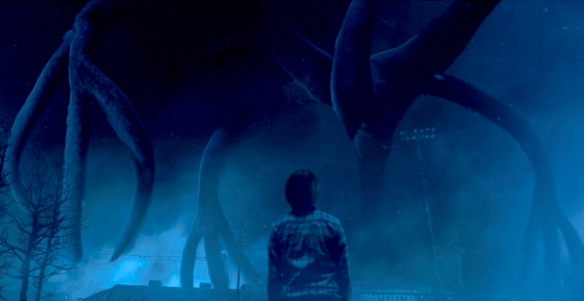
Wreck Havoc on your network
sudo tc qdisc add dev lo root netem loss 10.0%
http://strangerthings.wikia.com/wiki/The_Mind_Flayer

Slide 18
Chapter 4
1..2..3 Timeout!

Slide 19
OMG Errors
Make them go away!

Slide 20
OMG I’m out of threads
How did this happen!

Slide 21
Fail Fast
And Retry

Slide 22
Types of Timeouts
Connection
Read
Execution

Slide 23
Chapter 5
The Websocket and the Proxy

Slide 24
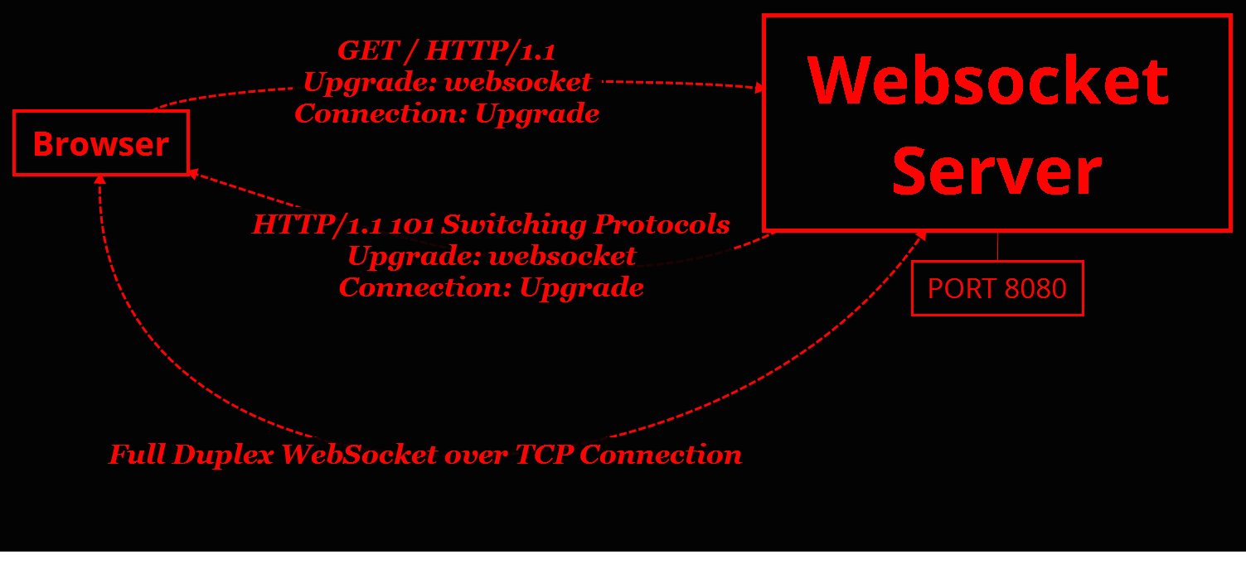

Slide 25
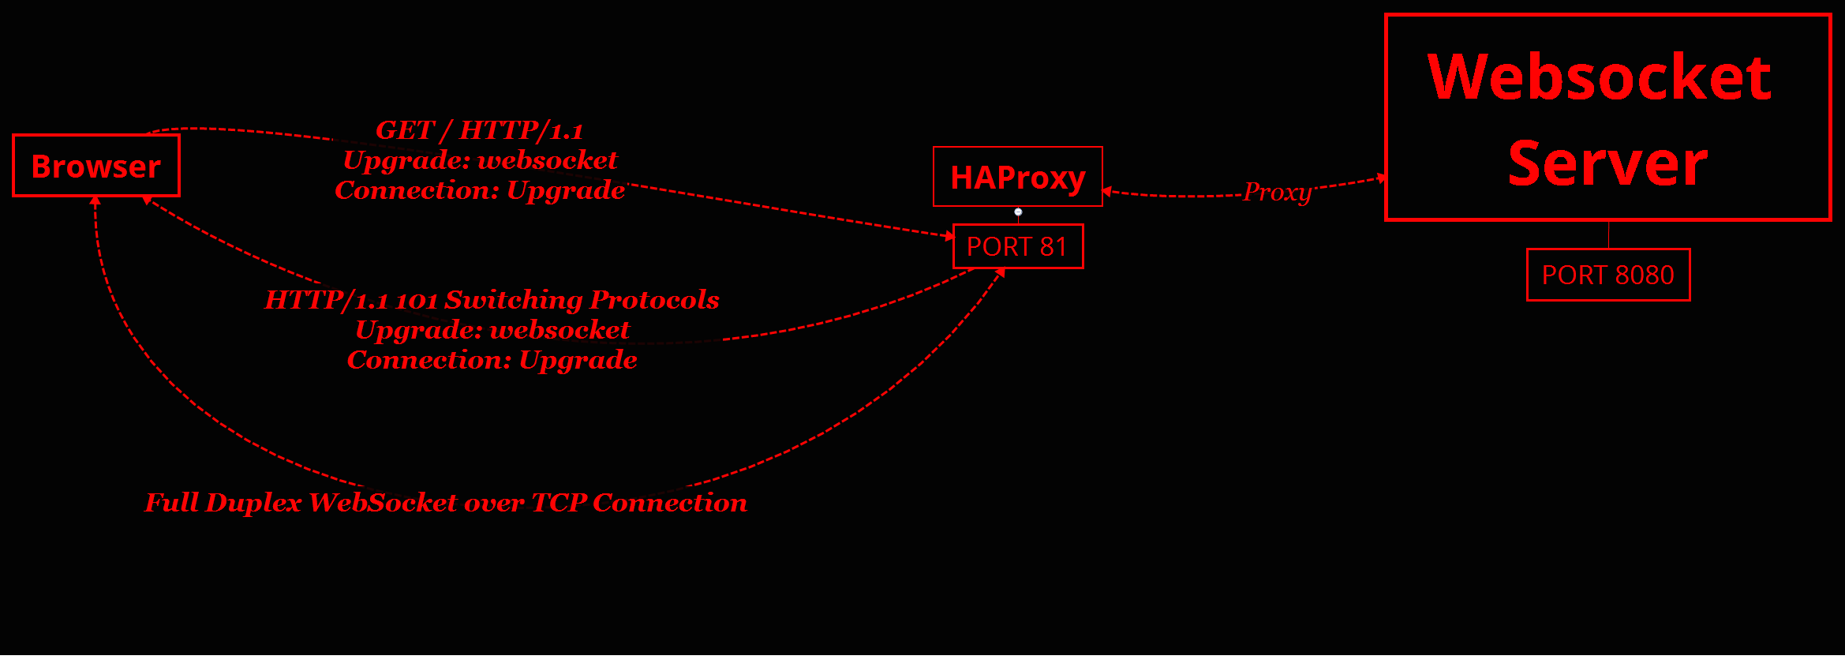

Slide 26
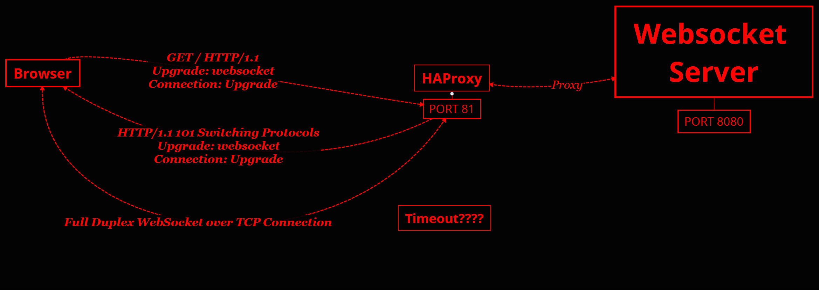

Slide 27
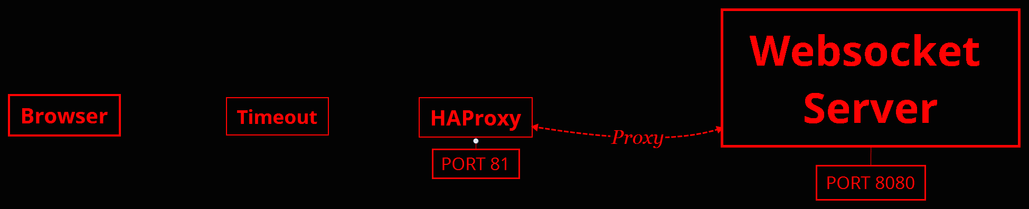

Slide 28
Yet another timeout setting
timeout tunnel 3600s

Slide 29
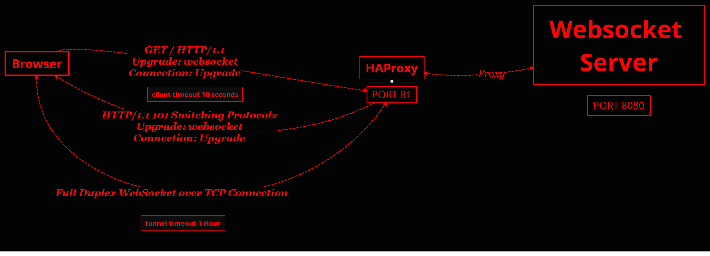

Slide 30
Chapter 6
It’s all about Presentation

Slide 31
JSON
Browser Friendly
Simple Marshal/Unmarshal

Slide 32
Java Serialization
No Libs needed
Metadata included

Slide 33
ProtoBuf
Compact Binary Format
Code Gen Required

Slide 35
Chapter 7
TLS, Node, and the JVM

Slide 36
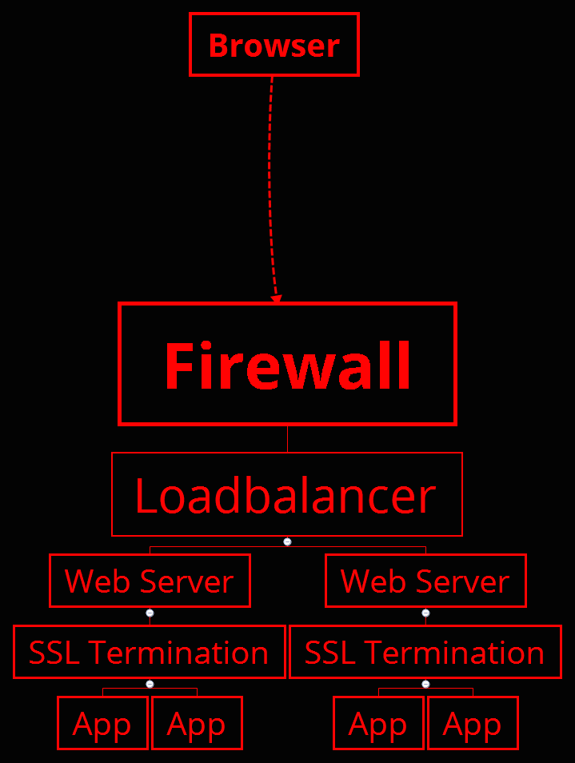

Slide 37
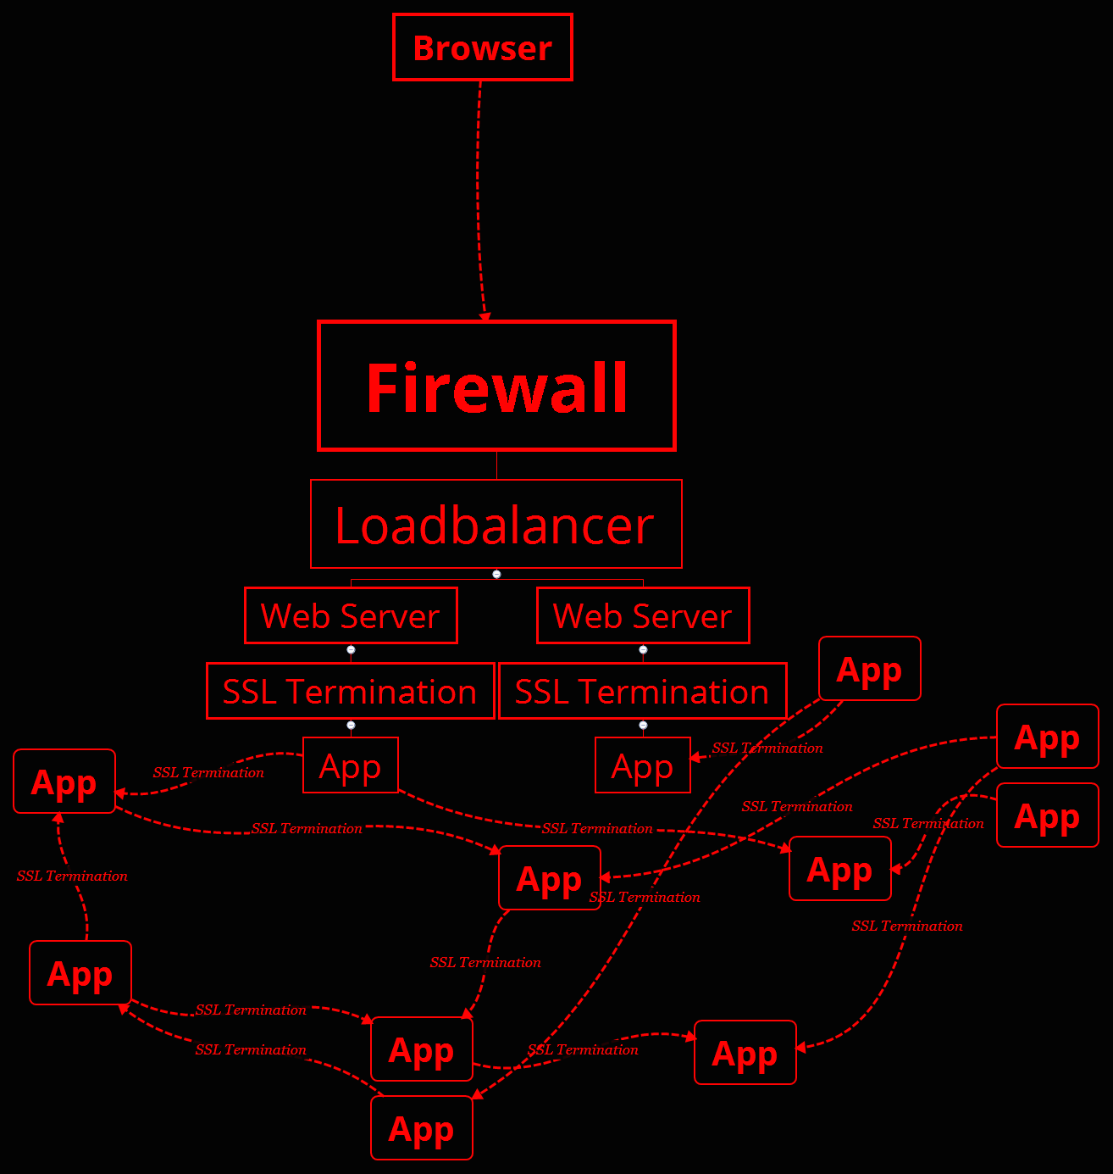

Slide 38
Chapter 8
Discovery with Docker Multicast

Slide 39
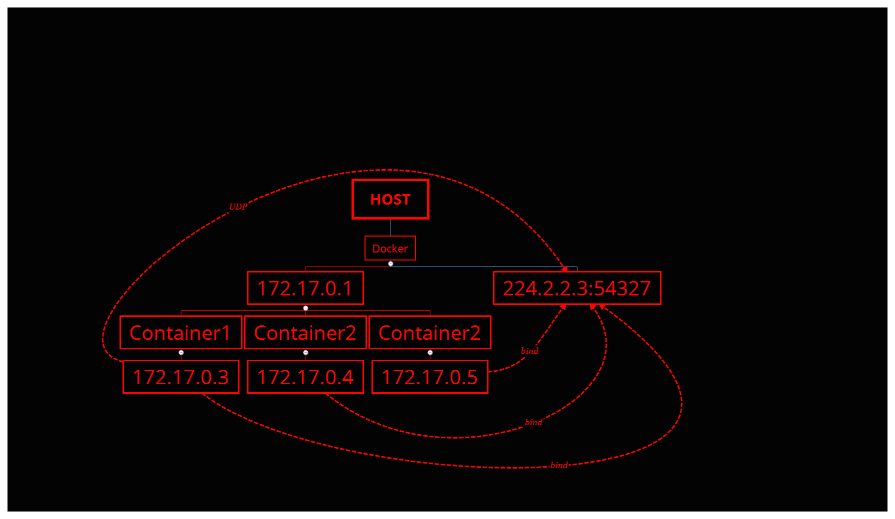

Slide 40
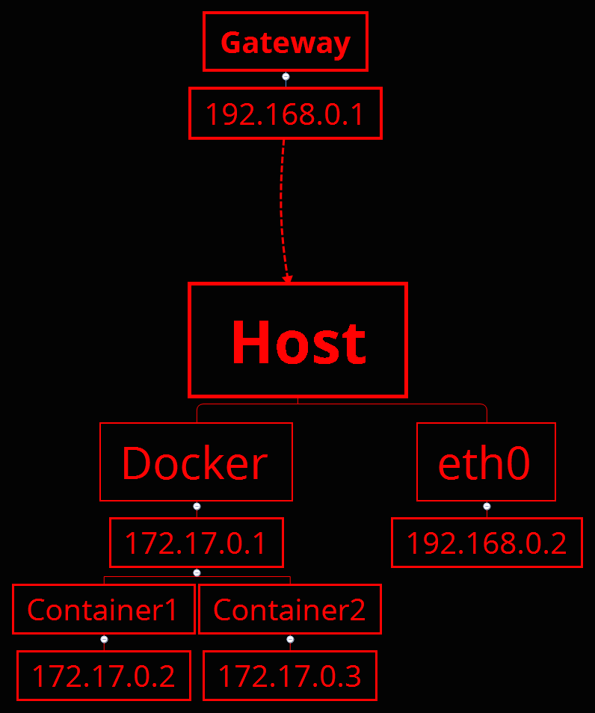

Slide 41
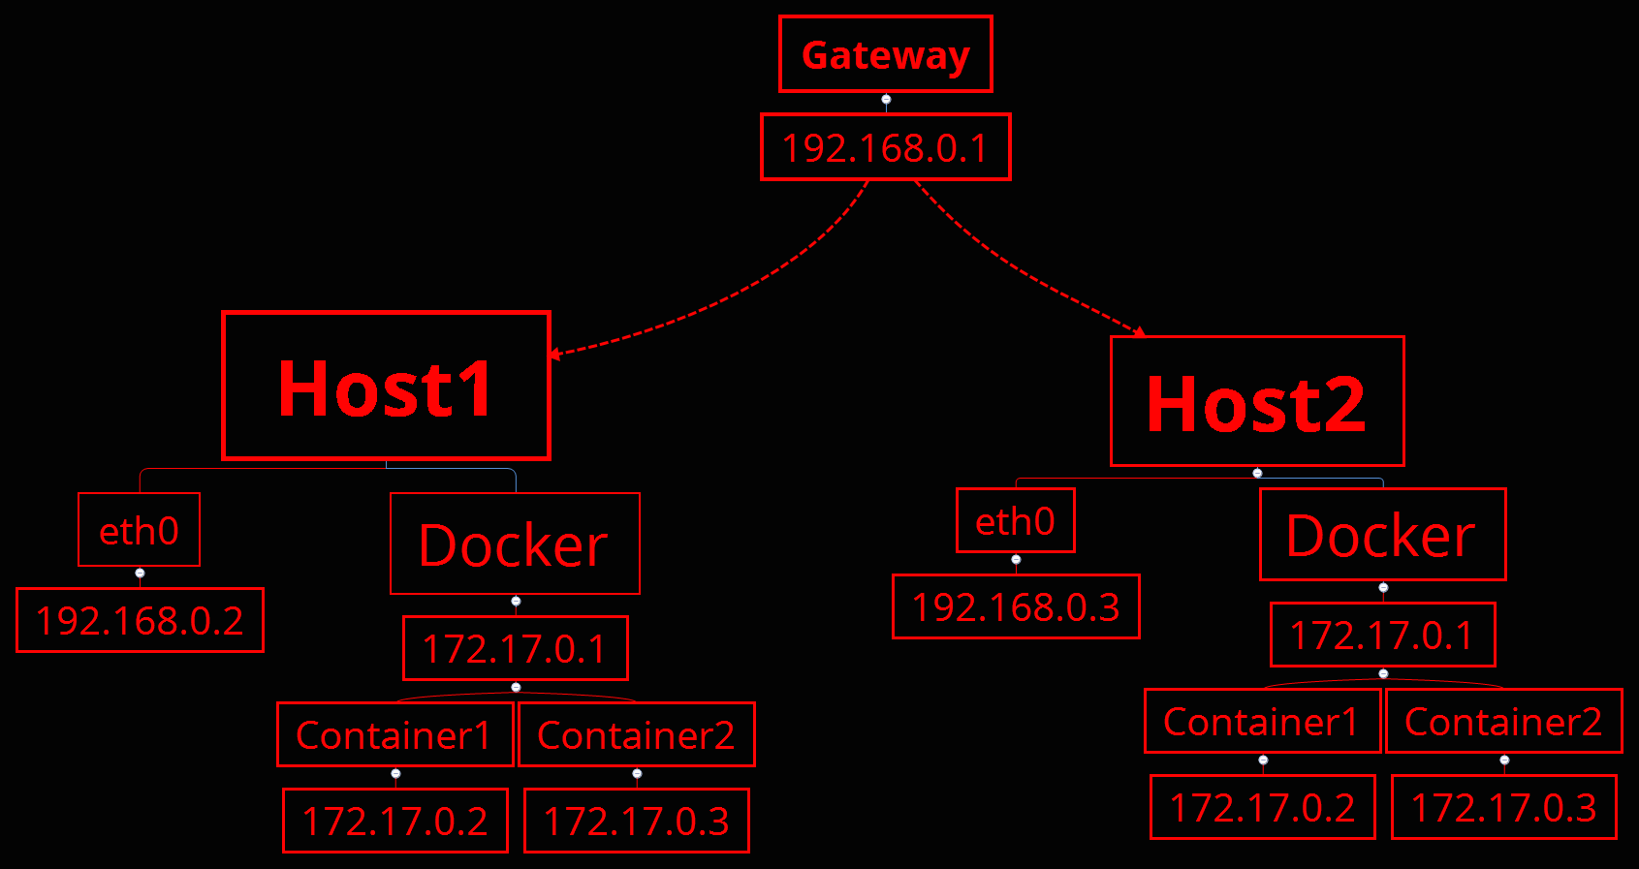

Slide 42
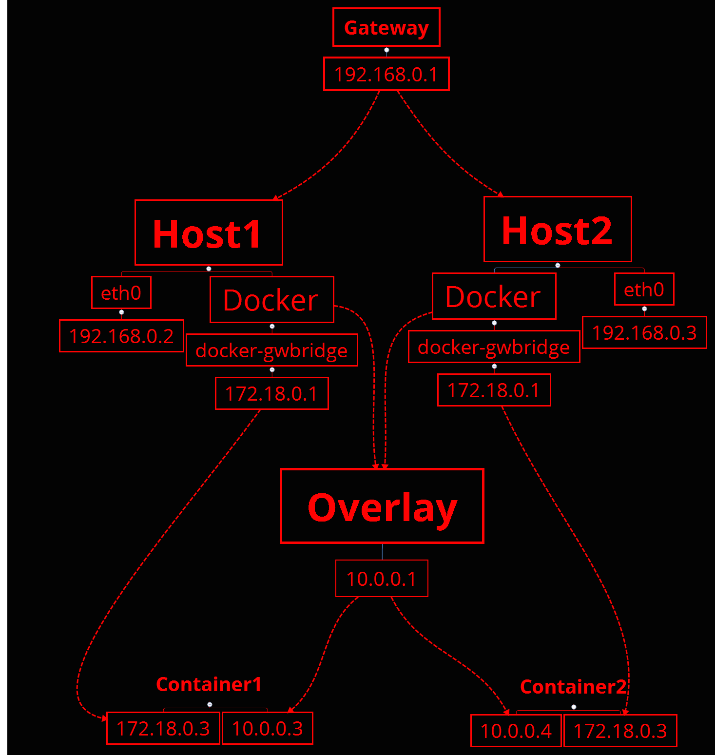

Slide 43
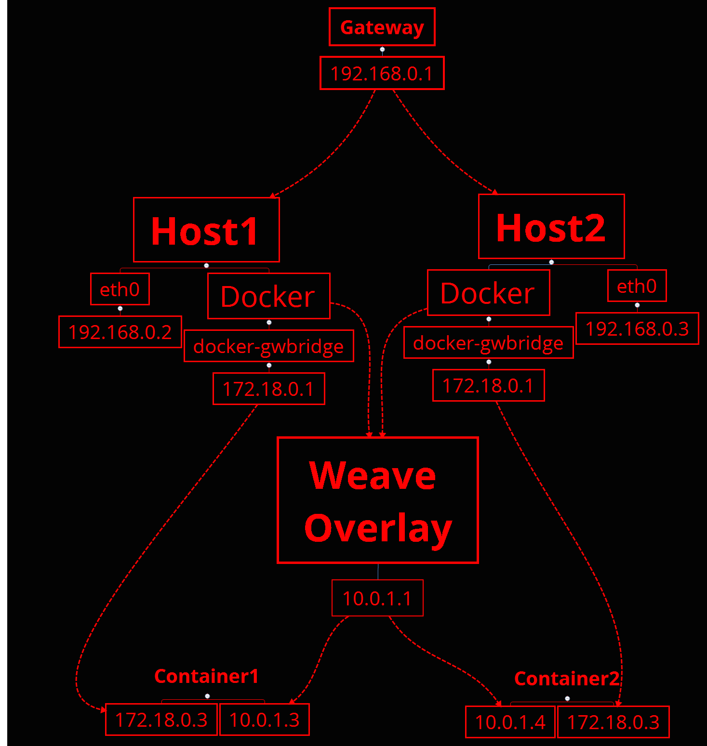

Slide 44
FIN
Bob Paulin
@bobpaulin

