Slide 1
What's my Modularity

Slide 2

“The bearing of a child takes nine months, no matter how many women are assigned”
- Fred Brooks

Slide 3
But could we make 9 babies in 9 Months….

Slide 4

What is Modularity?

Slide 5
UNIX Rule of Modularity
Developers should build a program out of simple parts connected by well defined interfaces, so problems are local, and parts of the program can be replaced in future versions to support new features. This rule aims to save time on debugging code that is complex, long, and unreadable.
- Eric Raymond

Slide 6
What makes a module?

Slide 7

Identifiable

Slide 8
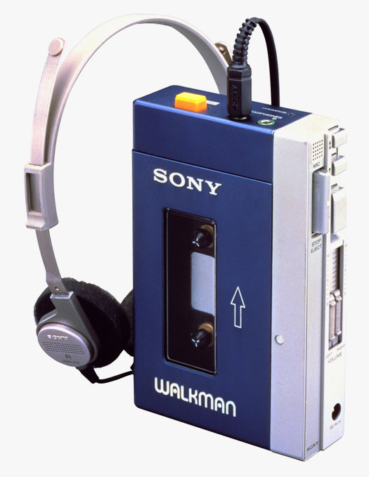
Portable

Slide 9
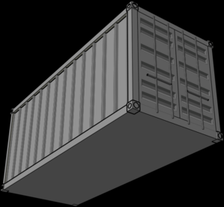
Containable

Slide 10
Designing Modules

Slide 11

Identifiable
Portable

Slide 12
Containable
Package Private
Private
Interface

Slide 13
The modularizations include the design decisions which must be made before the work on independent modules can begin.
- David Parnas

Slide 14
Changeability

Slide 15
Independent Development

Slide 16
Comprehensibility

Slide 17
What's Missing in Java?

Slide 18
Versioning

Slide 19
Protection for Internal Classes

Slide 20
How Do We Deal?

Slide 21
Dependency Injection with interfaces is a start

Slide 22
We need to start thinking in deployable units

Slide 23
Project JIGSAW
JEP 200: The Modular JDK
JEP 201: Modular Source Code
JEP 220: Modular Run-Time Images
JSR 376: Java Platform Module System

Slide 24
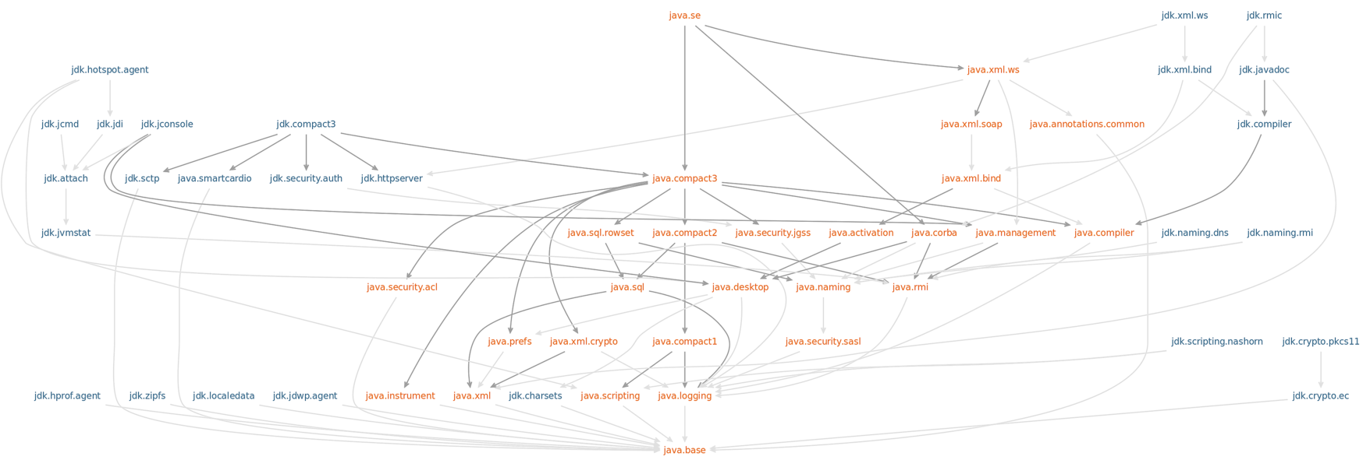

Slide 25
OSGi

Slide 26
How OSGi provides modularity

Slide 27
MANIFEST.MF
Bundle-SymbolicName: detection-module
Bundle-Version: 1.0.0
Bundle-Name: detection-module
Bundle-ManifestVersion: 2
Export-Package: com.bobpaulin.modularity.detect;version="1.0.0";uses:=
"com.bobpaulin.modularity.api",com.bobpaulin.modularity.detect.intern
al;version="1.0.0";uses:="com.bobpaulin.modularity.api,com.bobpaulin.
modularity.detect,groovy.lang"
Import-Package: com.bobpaulin.modularity.api;version="[1.0,2)",groovy.
lang;version="[2.3,3)",org.apache.tika;version="[1.0,2)",org.codehaus
.groovy.reflection;version="[2.3,3)",org.codehaus.groovy.runtime;vers
ion="[2.3,3)",org.codehaus.groovy.runtime.callsite;version="[2.3,3)",
org.codehaus.groovy.runtime.typehandling;version="[2.3,3)"

Slide 28
Identifiable
Bundle-Name + Bundle-Version
Bundle-SymbolicName: detection-module
Bundle-Version: 1.0.0

Slide 29
Portable
Bundle File
Service Registry

Slide 30
Containable
Package Based Whitelist
Export-Package: com.bobpaulin.modularity.detect;version="1.0.0";uses:=
"com.bobpaulin.modularity.api",

Slide 31
Converting the Ball Of Mud to OSGi

Slide 32
Containers

Slide 33
Docker

Slide 34
Identifiable
Container Name + Version

Slide 35
Portable
Docker Image

Slide 36
Containable
File and Network Isolation

Slide 37
Demo
Converting single JVM OSGi to Containers

Slide 38
Why does this look easy?

Slide 39
No cyclical dependencies

Slide 40
Implementations separate from Interfaces

Slide 41
Interfaces are simple

Slide 42
I cheated.
(design was prepared over several days)

Slide 43
References
Parnas, D. L. On the criteria to be used in decomposing systems into modules. Commun. ACM 15, 12 (December 1972), 1053-1058. DOI=10.1145/361598.361623 http://doi.acm.org/10.1145/361598.361623
Knoernschild, Kirk. Java Application Architecture: Modularity Patterns with Examples Using OSGi Addison-Wesley Professional 2012
Brooks, Fred. The Mythical Man-Month: Essays on Software Engineering Addison-Wesley 1975

Slide 44
Links
Sonar http://www.sonarqube.org/
Sonar Source Dashboard http://nemo.sonarqube.org/dashboard/index
Docker https://www.docker.com/
Apache Felix http://felix.apache.org/
Amdatu Remote http://www.amdatu.org/components/remote.html
Gradle https://gradle.org/
Gradle Templates https://github.com/townsfolk/gradle-templates
Apache Tika https://tika.apache.org/
Tess4J http://tess4j.sourceforge.net/

Slide 45
Bob Paulin

