Slide 1
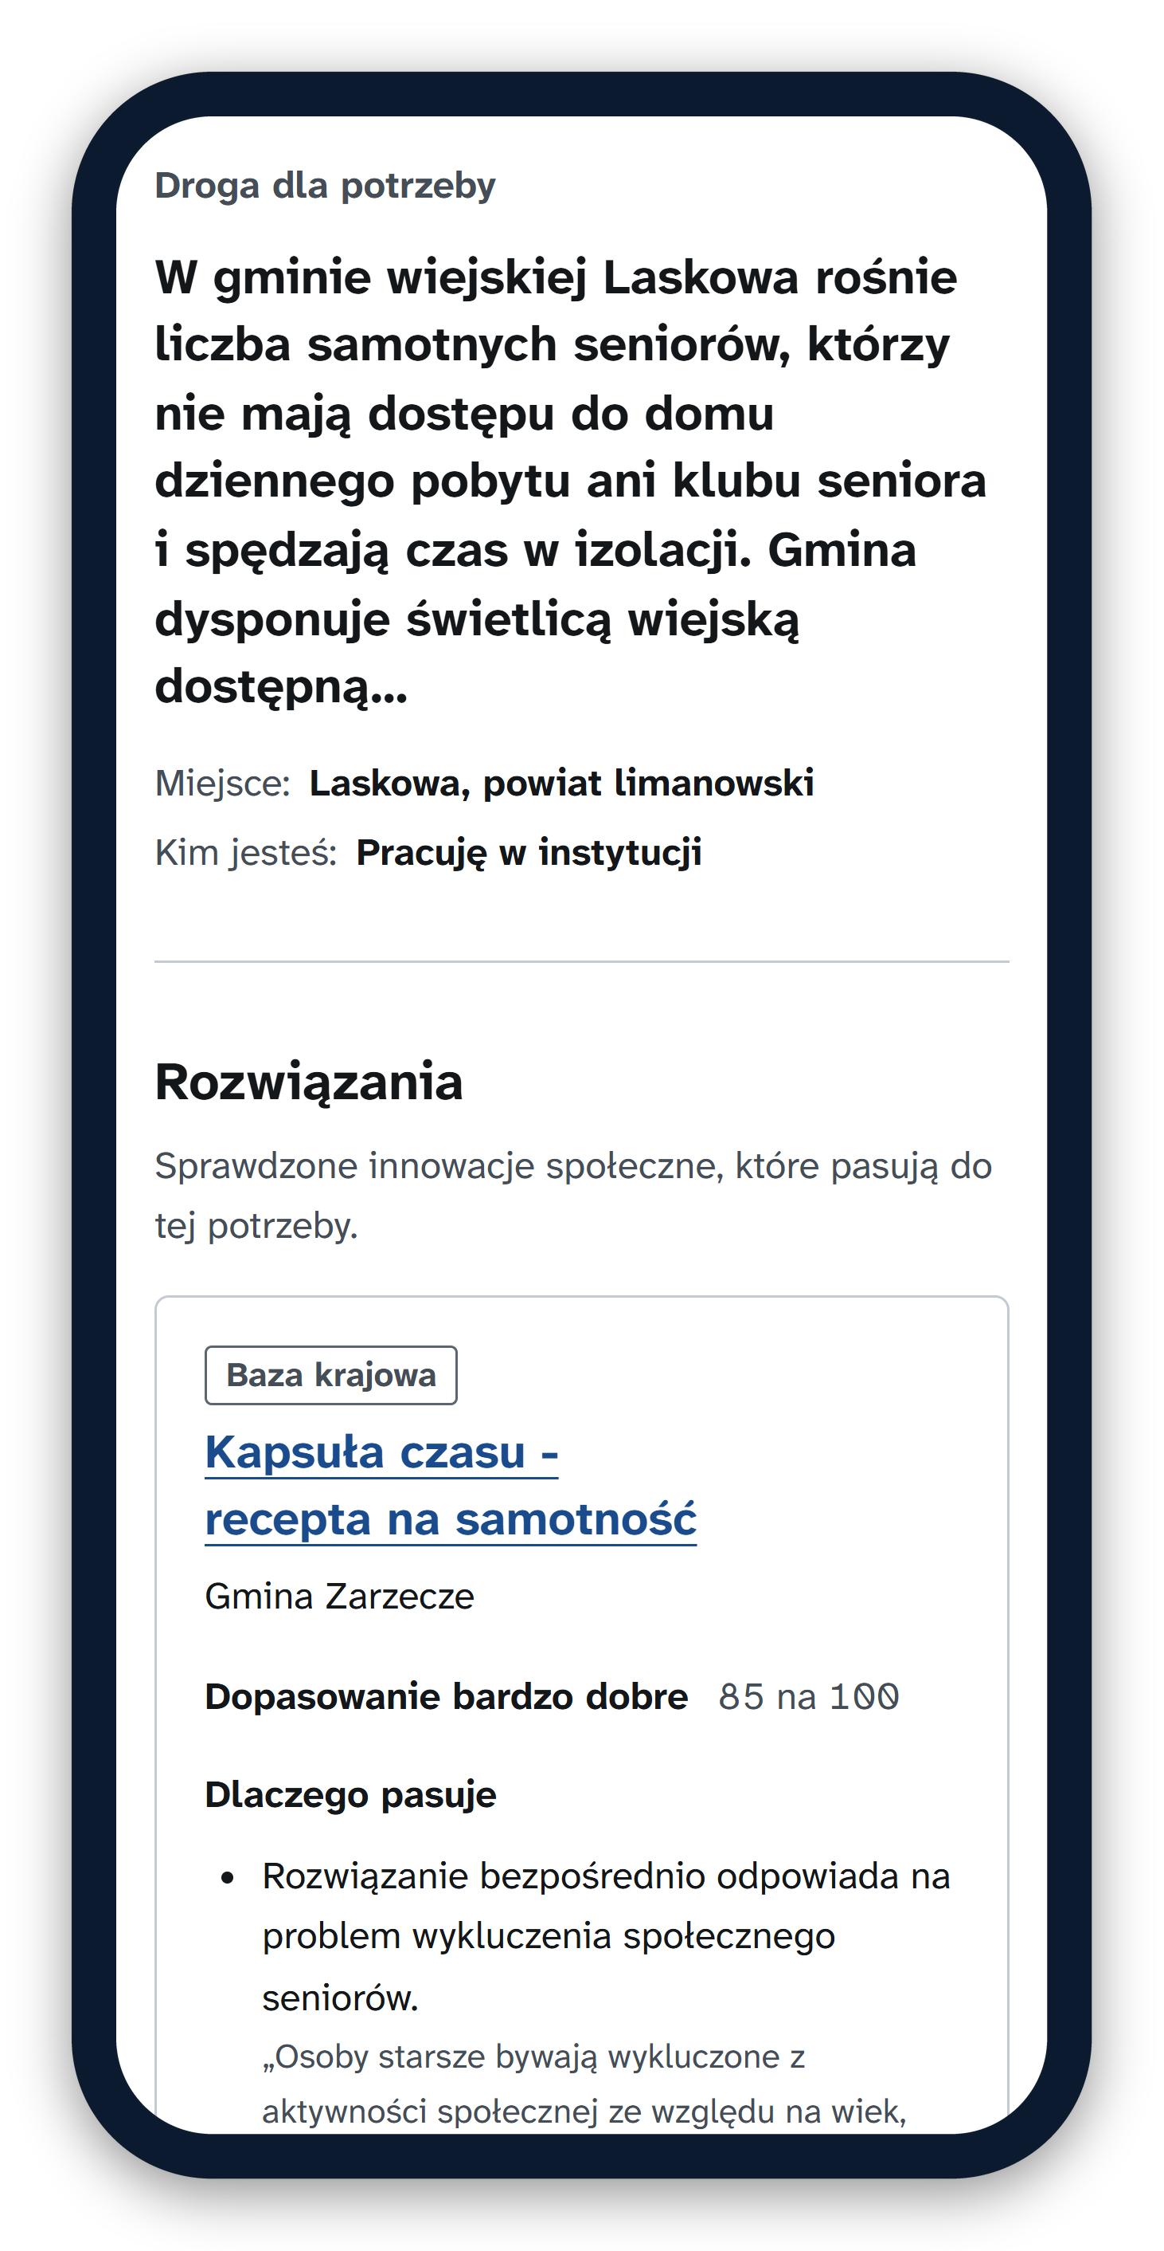
HACKYEAH 2026 · HUBMI.PL PARTNER TASK · ROPS KRAKÓW
HubMI: from need
to solution
A route, not a catalogue.
A working pilot of the end-user side of the digital core that ROPS Kraków plans for the Małopolska Social Innovation Hub: a need that a resident, a social worker, an NGO leader or a municipal official describes in plain Polish becomes a route to proven solutions, knowledge, people and funding, not a list of links or a chatbot answer. The service around it is a proposed roadmap, not yet built.
TEAM
Alexander Bobrovský · Anton Myshelov · Dmytro Chernikov
Dmytro Ushakov · Krzysztof Zając
Notes:
HubMI.pl is the name ROPS Kraków gave the digital core of its planned Małopolska Social Innovation Hub. We built its end-user side as a working pilot; the service around it is a proposed roadmap, not built yet. One idea: a person describes a need in plain Polish and gets a route, not a list. The phone shows a real route from the pilot.

Slide 2
Proven solutions exist, but they do not reach the places that need them
“
~200
social innovations created in Małopolska in the last ten years (ROPS)
Nie chcemy kolejnego portalu, katalogu ani wyszukiwarki. Chcemy narzędzia, które potrafi połączyć problem z istniejącym rozwiązaniem, wskazać właściwą wiedzę i ludzi, a gdy rozwiązania jeszcze nie ma, pomóc znaleźć drogę do jego stworzenia.
“We don't want another portal, catalogue or search engine. We want a tool that connects a problem to an existing solution, points to the right knowledge and people and, when no solution exists yet, helps find a way to create one.”
ROPS Kraków, the HubMI.pl task
300
innovations in the national base innowacjespoleczne.pl, 115 in the ROPS library
183
gminas in Małopolska, each with its own needs and none with a guide to what already works
The gap. The catalogues are browsed by title and category, and none of them takes a local problem as the question. The incubators choose their next topics without a record of the needs nobody could meet.
2 / 10
Notes:
The partner's brief in their own words: not another catalogue, a tool that connects a problem to a solution, knowledge and people, and helps when no solution exists yet. The knowledge is there: about 200 innovations from Małopolska, 300 in the national base. What is missing is the link from a need in one of 183 gminas to what already works, and a record of the needs nothing answers.

Slide 3
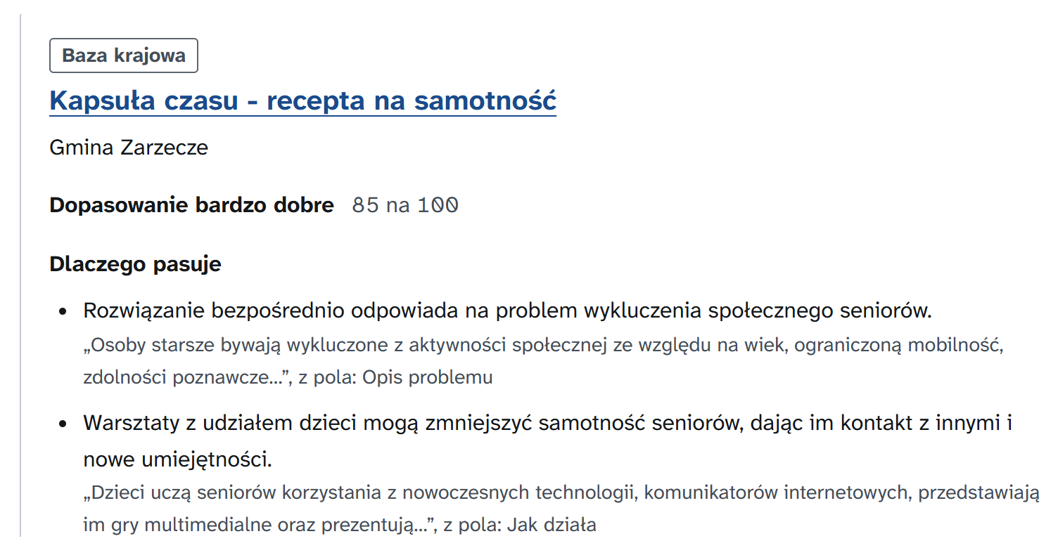
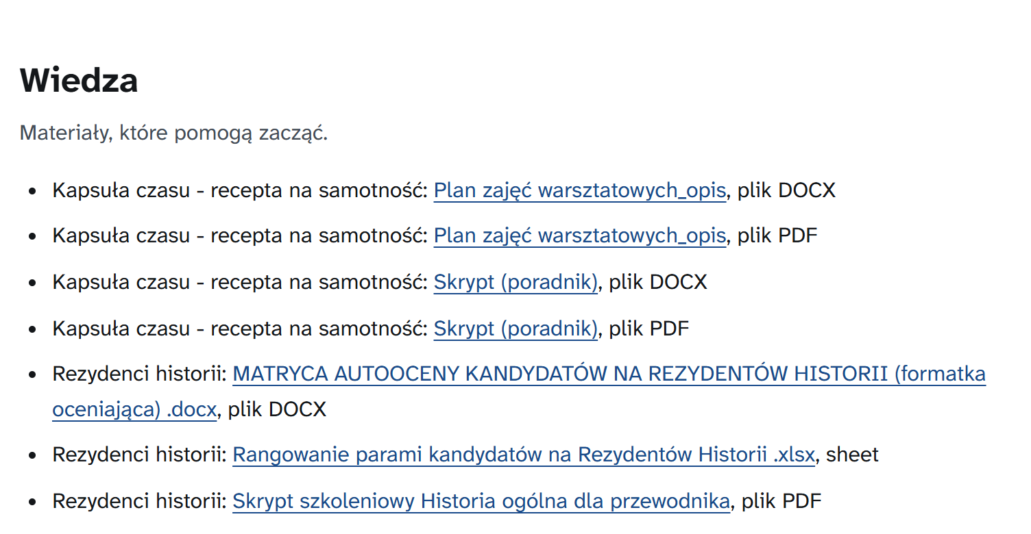
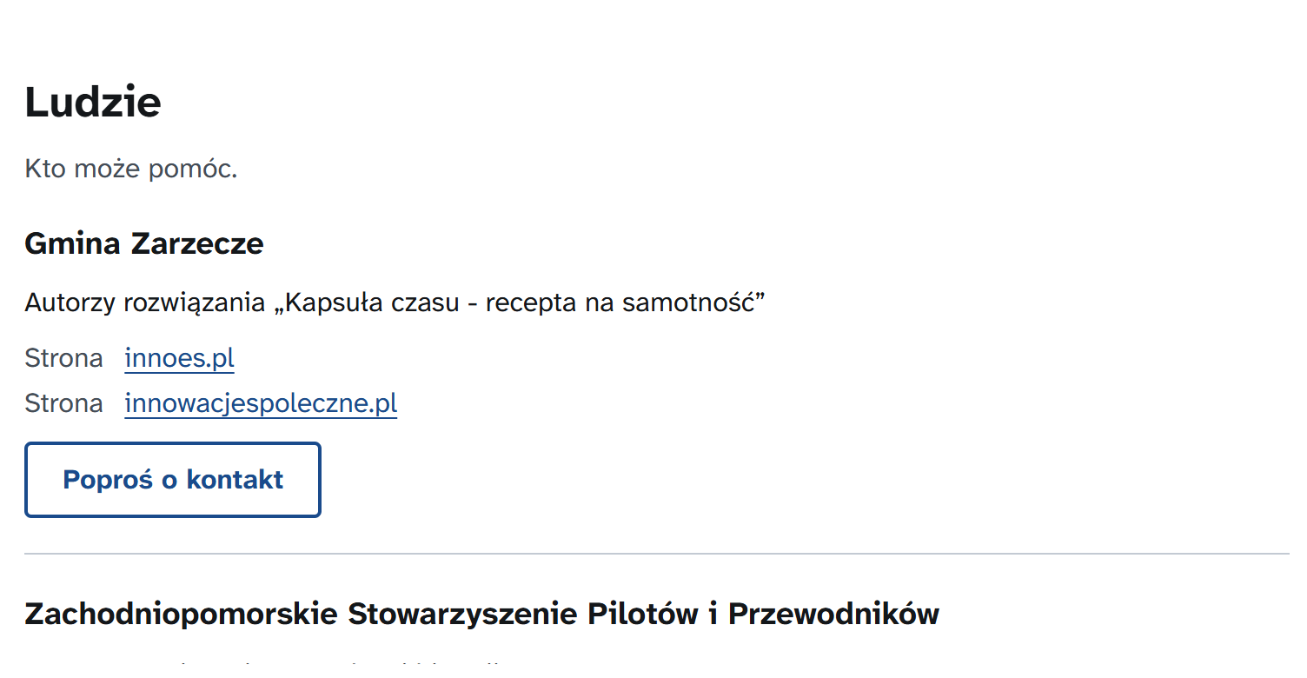
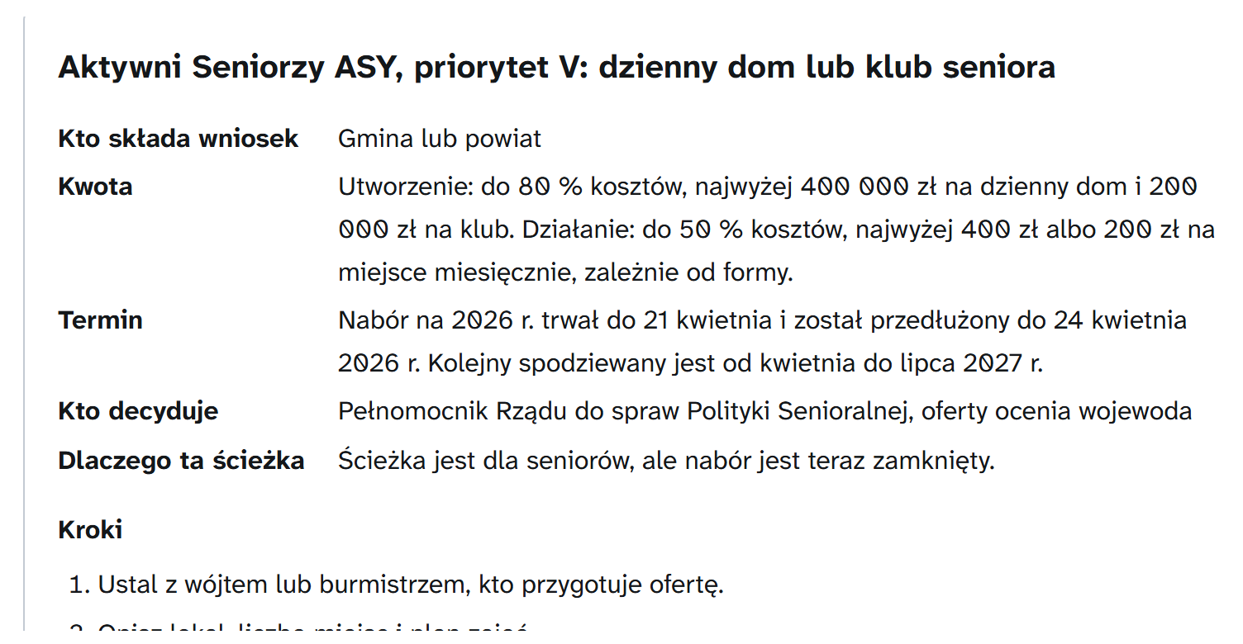
Describe a need, get a route
A live result of the prototype: one need, one place, four blocks and three next steps
THE NEED · TEST PROBLEM P01
1
Solutions why each fits, what it takes
2
Knowledge manuals and models to start
„Coraz więcej samotnych seniorów w naszej gminie. Nie ma domu dziennego pobytu ani klubu seniora, a sąsiedzi zgłaszają, że starsze osoby nie wychodzą z domu i nie mają z kim porozmawiać. Gmina ma świetlicę wiejską wolną trzy dni w tygodniu.”
Lonely seniors stay at home, no day centre or club; a village hall is free three days a week.
3
People authors, ROPS advisor, helpers
4
Implementation path funding and steps
Place gmina Laskowa
Who a social worker
Every quote is checked against its entry. Generated text is labelled.
3 / 10
Notes:
This is a real route from the prototype for our test problem P01: lonely seniors in the rural gmina Laskowa. It has four blocks. Solutions: two proven innovations, each with why it fits, quoted from its source entry, and what it takes. Knowledge: the manuals and the ROPS models. People: the authors, the ROPS category advisor, people who registered to help. Implementation path: the programmes that can fund it, with amounts, deadlines and steps. It is not a list of search results; it is what to do next.

Slide 4
Not a search engine, not a chatbot over documents
Retrieval is one step of five. A route comes from curated data, rules and people, not from a generated answer.
 | Web search | Chatbot with RAG | HubMI
What you get | A list of links | A fluent paragraph | A route: up to three proven solutions, knowledge, people, a funding path and three next steps
When nothing fits | Still a list | Still an answer | It says so: below a fit of 45 out of 100 there is no route, and the need goes to the needs bank and the incubator
Amounts, deadlines, legal basis | Whatever the pages say | Written by the model from what it retrieved | From a curated table of 30 funding and legal paths, each with its source; the model never sees an amount
The place | A keyword | A keyword | GUS indicators of the gmina, implementers within 50 km, a map of where a solution is missing
The model's role | Ranks pages | Writes the answer | Selects and explains; code checks every identifier and every quote and decides whether the fit is good enough
Before and after | Nothing | Nothing | Before: a screening gate, and a person in crisis gets human help. After (roadmap): ROPS relays contacts and turns needs into call topics
4 / 10
Notes:
A fair question: is this just search, or a chatbot over the catalogue? No. Search gives links and a RAG chatbot gives a paragraph, and both answer every question. HubMI builds a route from curated data by rules: the funding amounts, deadlines and legal bases come from a table of thirty paths the model never sees; people and places come from data. The model only picks and explains, and code checks every identifier and every quote. Most important, it can say no: below a fit of 45 there is no route, and the need goes to the incubator instead.

Slide 5
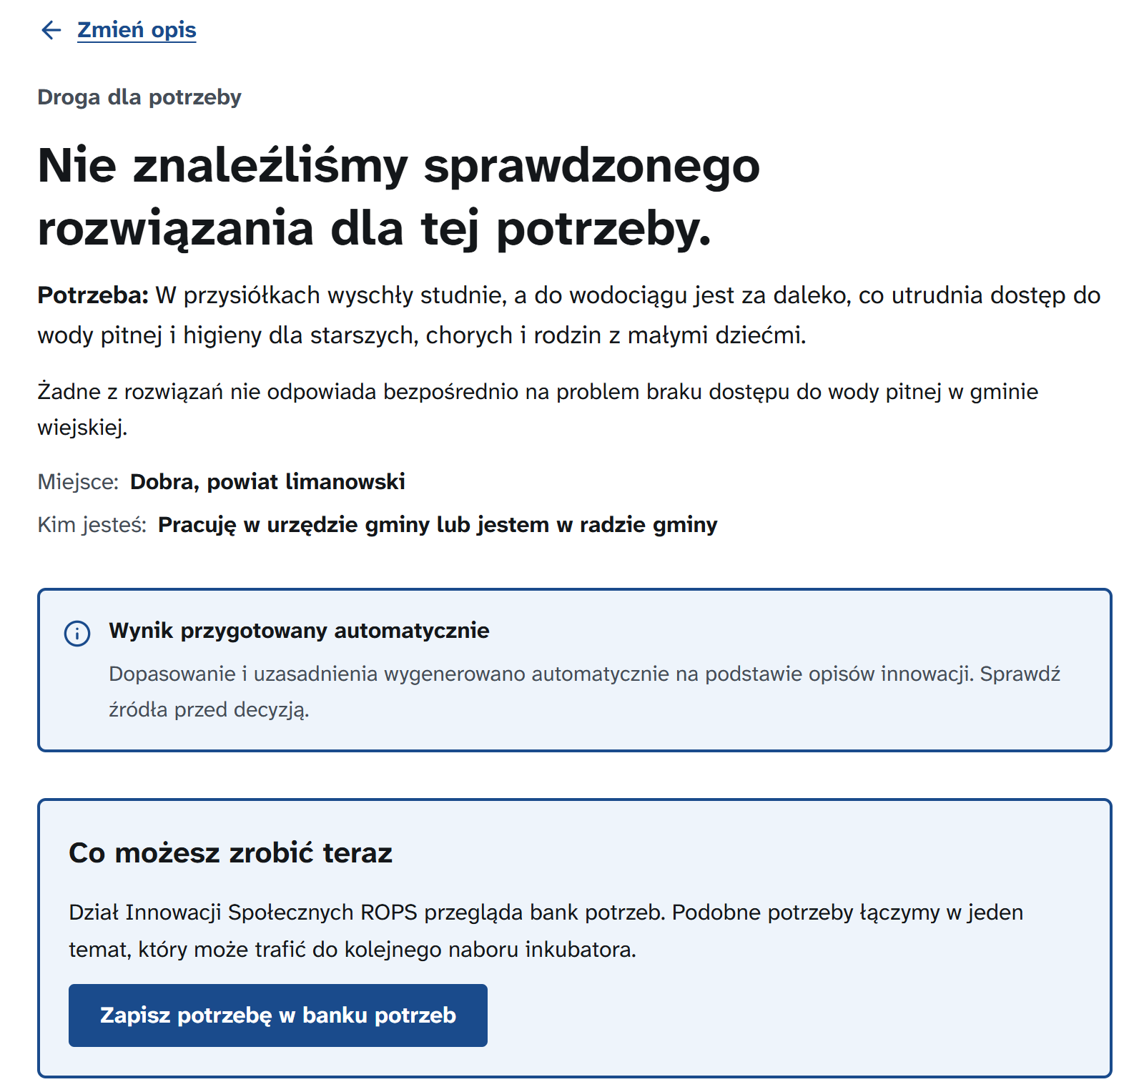
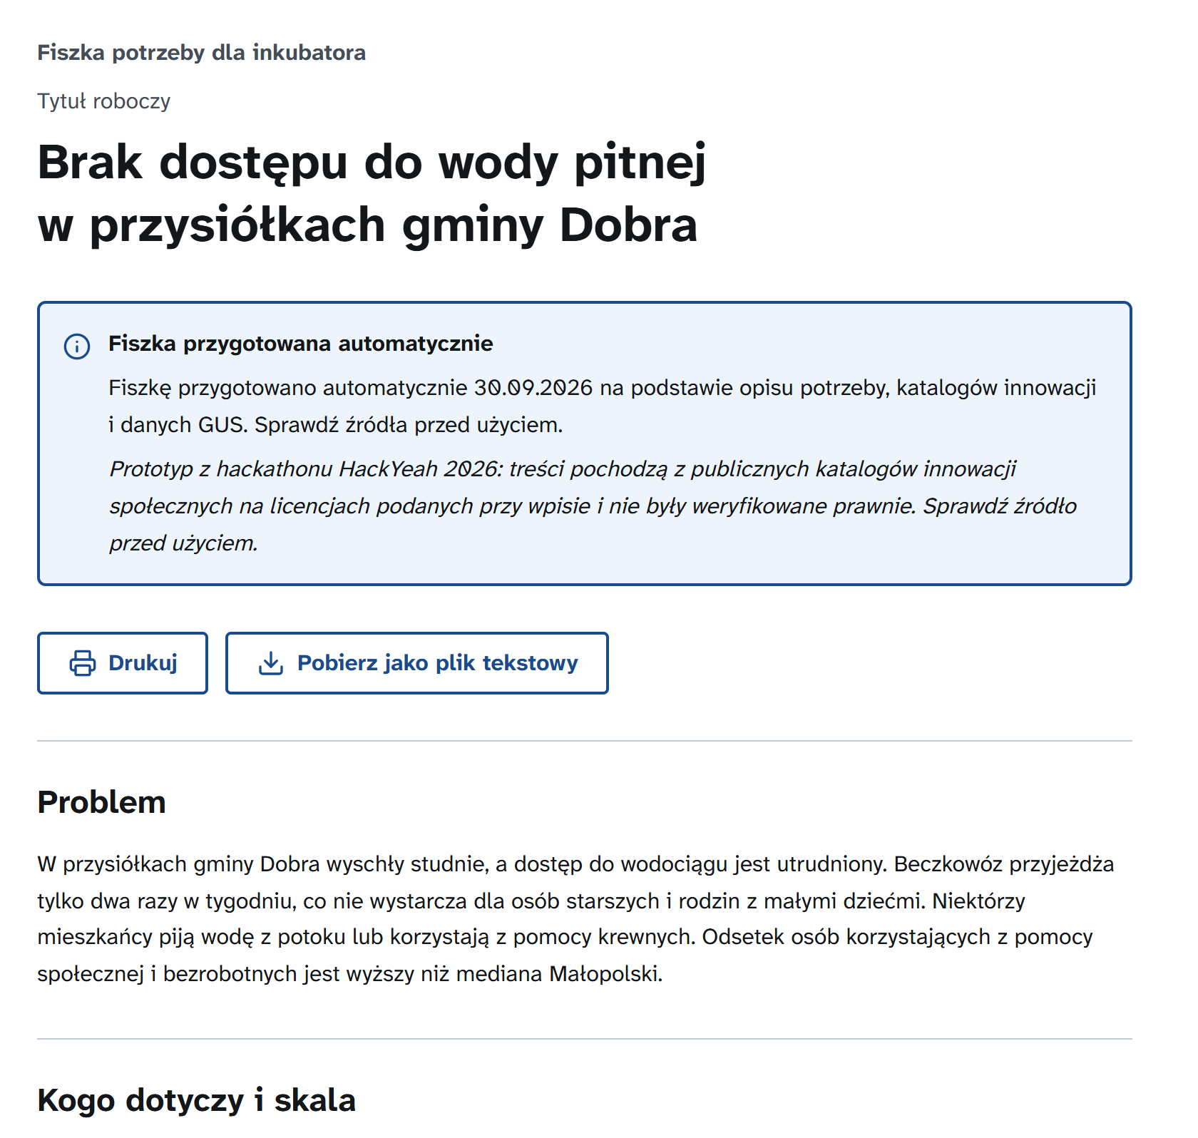
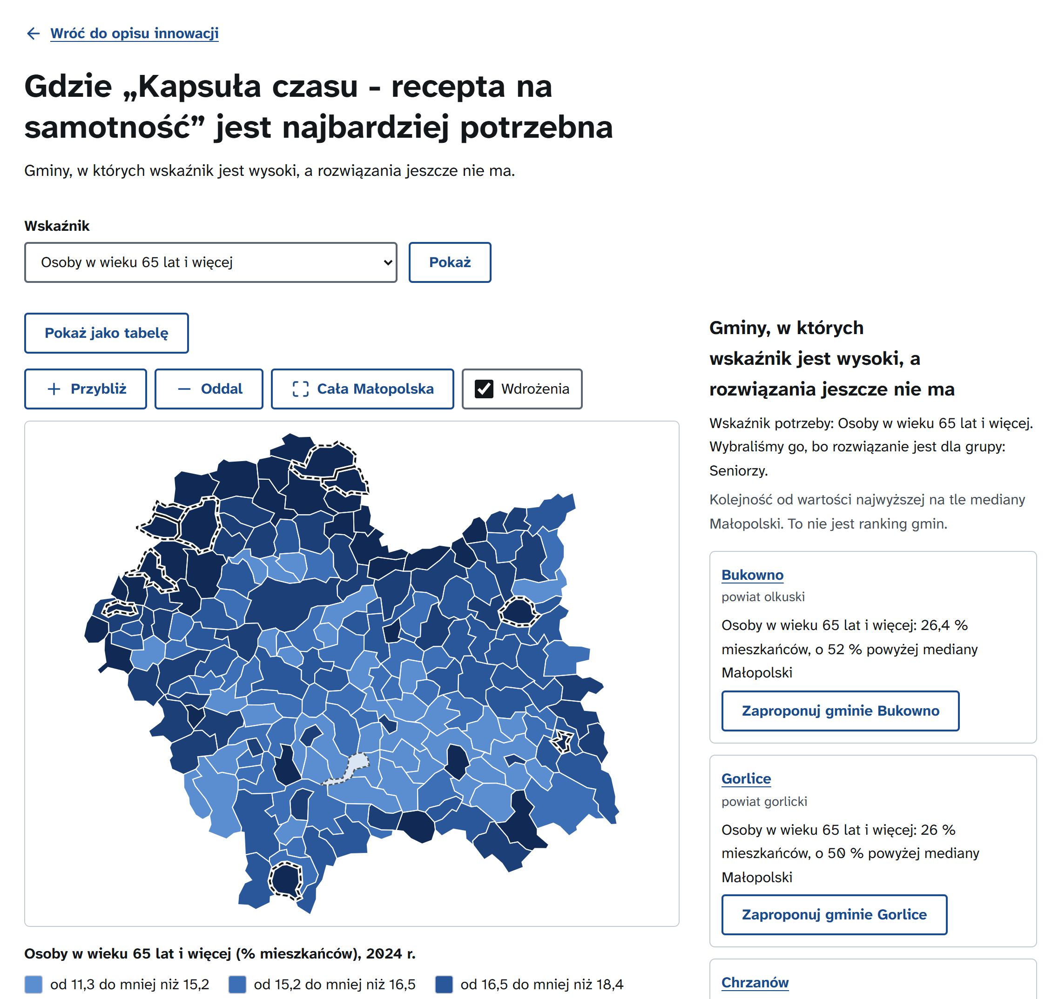
When nothing fits, it says so and drafts the incubator's next topic
1
No proven match
Said out loud, never padded with weak results
2
Needs bank → incubator brief
Drafted today; merging needs is roadmap
3
Where it is needed most
Gminas with high need and no implementation
1: a live result for dried-up wells in gmina Dobra, summer 2026. 2: the same need saved to the needs bank, as the brief for the incubator.
3: where the seniors' solution of slide 3 is needed most.
5 / 10
Notes:
The partner asked what happens when no solution exists yet. This summer's drought dried up the wells in the hamlets of gmina Dobra; nothing in the catalogues fits, and the tool says so instead of showing weak matches. The need goes into the needs bank and the tool drafts the brief for the next incubator call, listing the nearest existing innovations; in the roadmap, ROPS merges similar needs into call topics. The third screen is the reverse direction: for a proven innovation, the gminas where the indicators show need and where it does not run yet.

Slide 6
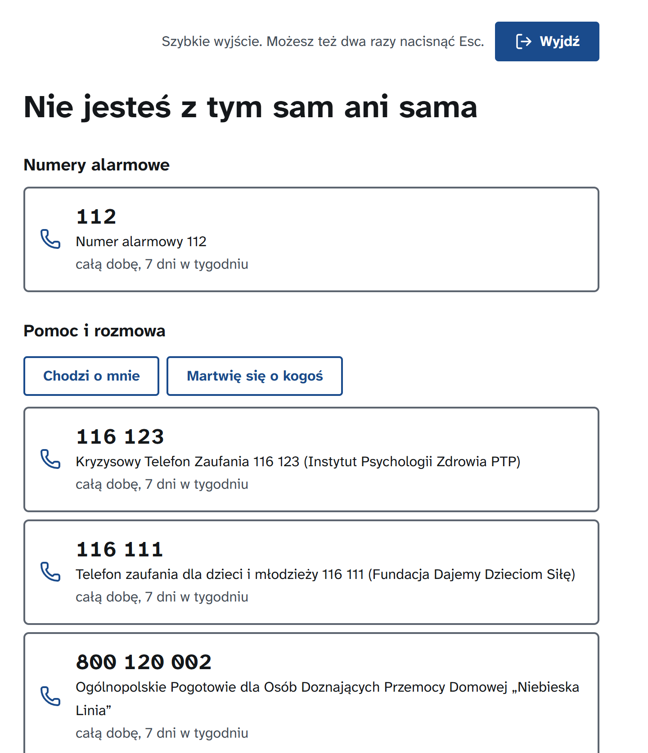
Empathy before technology
The screening gate comes first. The model selects and explains; people decide.
1 Screening gate
rules first, then the model
2 Retrieval
PolDense-400M: 40 nearest of 381
3 Rerank and reasons
Bielik 11B v3.0, the Polish open model
4 Composer
knowledge, people, paths, next steps
5 ROPS console
a person moderates: roadmap, not built
Both models chosen by measurement before the hackathon: Bielik against 4 other language models, PolDense against 5 other embedding models.
✓
A person in crisis gets a person
Signs of a crisis lead to verified helplines and the local social assistance centre, never to innovations, and nothing is stored. A request meant to exclude or demean is declined, with a reason and a way to appeal.
✓
Nothing invented
Solutions, organisations and people come only from the catalogues; amounts, deadlines and legal bases only from the curated paths. Every identifier and quote is checked, and generated text is labelled.
✓
People stay in the loop
The tool sends nothing to anyone: contact requests and registrations wait for a ROPS moderator, in the console of the roadmap. PESEL numbers, phone numbers and addresses are removed before storage and before any prompt. The tool decides nothing about an individual.
What a person in crisis sees instead of a route
6 / 10
Notes:
The partner's teaser is called 'from empathy to technology'. So every text first passes a screening gate: a community need is routed; a person in crisis gets helplines and the local social assistance centre, not a list of innovations; a request meant to exclude people is declined politely, with a way to appeal. Then retrieval with the Polish PolDense model, and Bielik, the Polish open model, picks and explains. We did not pick them by name: before the hackathon we measured Bielik against four other language models on Polish screening and matching cases, and PolDense against five other embedding models on all 381 records; the evidence is in the repository. It cannot invent a solution or a funding amount: every identifier and quote is checked, and amounts come from a curated table. Anything that involves a real person waits for a ROPS moderator; the console for that is the roadmap, not built yet, and the tool sends nothing to anyone.

Slide 7
A pilot today, a service ROPS can run from Monday
Built: the end user's search for a solution. Roadmap, not built yet: the roles, the loops and the console
BUILT · A PILOT FOR THE END USER
Describe a need and get a route to proven solutions, knowledge, people and funding; when nothing fits, the needs bank and a brief for the incubator. Everything on the slides before this one runs today.
ROADMAP · NOT BUILT YET
Three roles in the ROPS Social Innovation Unit
Three loops the tool would close
Category advisor
the named person on every route; receives the contact requests
1
Need → route → contact → new implementation
Catalogue editor
keeps entries true, checks with innovators yearly, records implementations
2
Need → no match → needs bank → call topic → new innovation
Needs-bank coordinator
reviews needs weekly, merges them into call topics
3
Innovation → map of need → grants where it is absent
Counted already: routes, contact requests, needs filed, briefs generated. The page that shows them to ROPS is part of the roadmap.
About $55 a month, plus $8 per 1 000 routes
Server app + Polish embedding model, 4 GB
$24 / month
Database PostgreSQL + pgvector, RDS 2 GB
$30 / month
Model call Bielik 11B on Hugging Face, ~5k tokens
$0.002
Route 4 calls, ~21k tokens
$0.008
7 / 10
Notes:
The brief asks for a concept, not only software. What you have seen is the pilot for the end user: a need in, a route or a brief out; that is what runs today. The service around it is our proposed roadmap, not built: ROPS would run HubMI with three roles, which can be three people or one: a category advisor who is the human face of every route, a catalogue editor, and a needs-bank coordinator, with a console where every decision waits for a person. The tool would close three loops: a need becomes an implementation; an unmet need becomes an incubator topic and later a new innovation; a proven innovation is taken to the places that need it. The tool already counts routes, contact requests, needs and briefs; the page that shows them is part of the roadmap. Running it is cheap: one 4 GB server for the app and the Polish embedding model, 24 dollars a month on AWS Lightsail; for production, PostgreSQL with pgvector on RDS, about 30 dollars a month (the pilot keeps its entries in one file). A model call to Bielik through Hugging Face is about five thousand tokens at 40 cents per million, a fifth of a cent; a whole route is four calls, under one cent.

Slide 8
Next: pupils' hands for local needs, with DoBro
Roadmap, not built yet: needs become tasks for school volunteers, with a HackYeah 2025 winner
3 / 200
THIS PILOT · HUBMI.PL TASK
HACKYEAH 2025 WINNER
HubMI brings the need
DoBro brings the hands
recruitment points for secondary school, for volunteering entered on the primary-school certificate
Each school sets the hours, often 20 to 60. Schools need real tasks.
Real needs from 183 gminas, checked by a person at ROPS
A proven method from the catalogue for each task
The map shows where the help landed
+
Young volunteers, schools and organisations in one place
Recommendations by the pupils' interests
Built for the City of Kraków's digital volunteering centre
1 Need filed
by a resident, an organisation or a gmina
2 ROPS moderates
and marks it fit for pupils
3 Open task feed
method, age band, responsible organisation
4 DoBro matches
pupils through the school coordinator
5 Hours confirmed
the outcome returns to the needs bank and the map
DoBro, by team Szybkie Palce, won the City of Kraków task at HackYeah 2025. An invitation, not yet an agreement.
8 / 10
Notes:
What comes next, and this is an idea, not a promise. Pupils finishing primary school get three of the two hundred recruitment points for volunteering written on their certificate, so every school looks for real tasks, and our needs bank is full of them. We do not want to build another volunteering app: last year the City of Kraków's task at HackYeah was won by DoBro, built by the team Szybkie Palce, a platform that connects young volunteers, schools and organisations. HubMI brings the need, checked by ROPS, with a proven method; DoBro brings the hands. A need is filed, ROPS marks it fit for pupils, it goes into an open task feed, DoBro matches pupils through the school coordinator, and the hours and the outcome come back to the needs bank and the map. Children first: we never hold pupils' data, and only organisations with child-protection standards get a task. We would like to invite the DoBro team to build this with us.

Slide 9
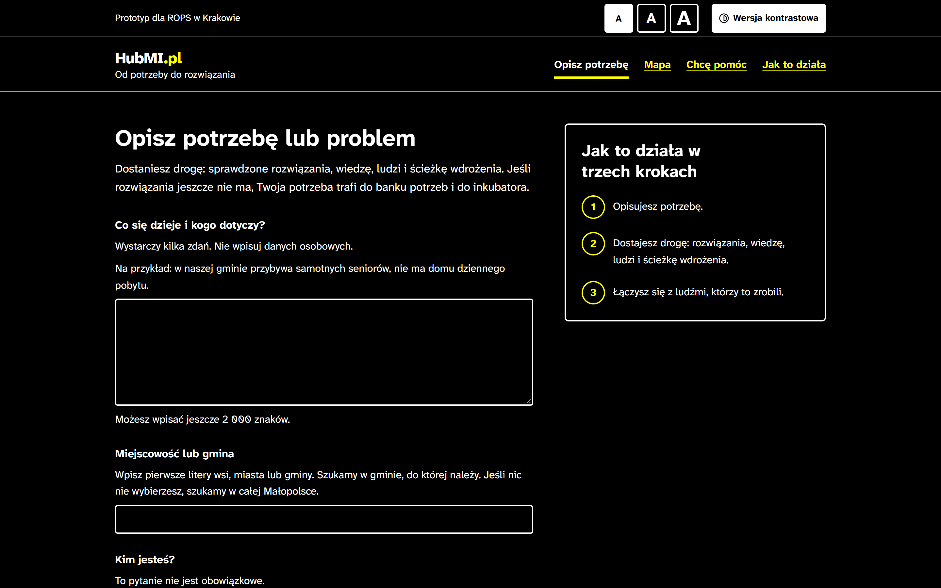
Built for everyone, built on open data
Accessibility above the legal bar; every fact linked back to its open source
Data, models and credits
Innovations | 300 from the national base innowacjespoleczne.pl (Fundacja Stocznia) and 115 from the ROPS library; 34 duplicates joined into 381 records. CC BY 4.0 or the MIIS terms, with attribution on every entry
Places | GUS: TERC register, Local Data Bank 2024 indicators, PRG boundaries
Models | Bielik 11B v3.0 (SpeakLeash) on the Hugging Face router; Claude (Anthropic) as the fallback; retriever PolDense-400M (OPI PIB)
Software | Next.js, TypeScript, Tailwind CSS, MapLibre GL JS, GOV.UK Design System form patterns; a Python data pipeline
AI agents | Claude Code (Anthropic) wrote code, texts and tests under the team's direction; every human decision is documented in the project's decision log, open for review; the team reviewed every Polish text
The contrast theme, one of three display themes
A typeface designed for low vision
7:1 text contrast
WCAG 2.2 AA plus three AAA criteria
Text size, three themes, phone layout
Keyboard and screen-reader use
Automated axe check of every screen
Code github.com/bobrovsky420/hackyeah2026 Apache License 2.0
9 / 10
Notes:
Built for everyone: ROPS ran an accessibility incubator, so we set our own bar above the legal one: a typeface designed for low vision, 7:1 contrast, three themes, full keyboard use and an automated check of every screen. A blind person can describe a need and file it with a screen reader: every field is labelled, each waiting step is announced, and a required consent says so before the first try. Everything the tool shows comes from open data, linked back to its source with its licence; the catalogues stay the systems of record. AI coding agents helped build it; the idea and the decisions are ours, and every decision we took is written down in the project's decision log, open for review. Thank you.

Slide 10
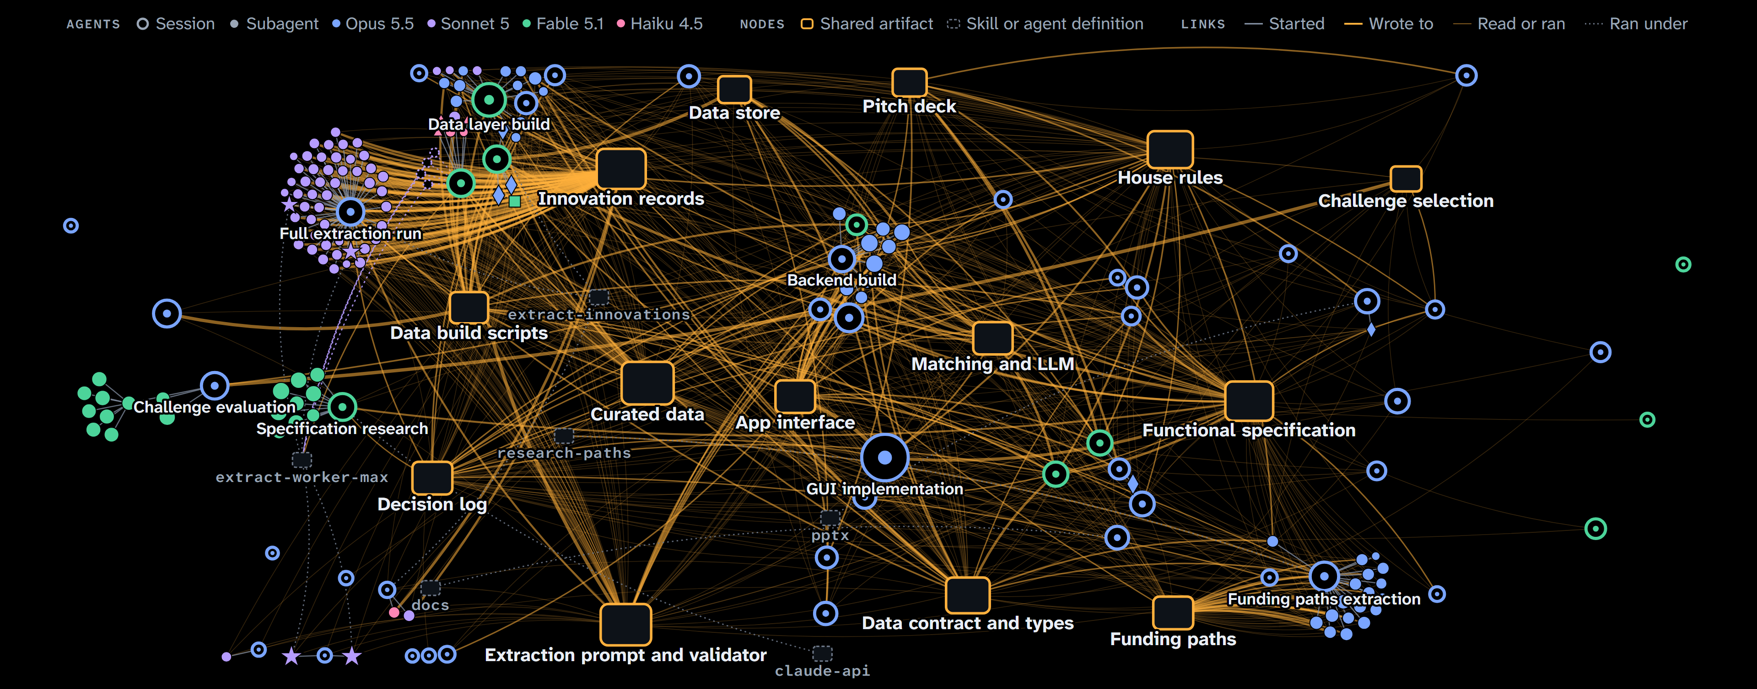
How AI agents built HubMI
Every Claude Code session and subagent, linked by who started whom, who wrote which files and who read them
177
AI agents: 50 sessions and 127 subagents
993
links between them, 847 of them data flow
14
shared artifacts they wrote and read
50
subagents in a single extraction run
4
Claude models: Sonnet, Opus, Fable, Haiku
10 / 10
Notes:
Finally, how it was built. Every dot is an AI agent: the 50 Claude Code sessions we ran and the 127 subagents they started, 177 in all. The amber boxes are the files they passed work through: the specification, the innovation records, the funding paths, the data contract. The lines show who started whom, who wrote what and who read it, 993 links in total. The largest cluster is a single extraction run with 50 workers. The agents did the work; the direction and every decision are ours, and each decision is written down in the project's decision log.

