Slide 1


Predicted Structures for C-Type Cytochromes Based on Protein Sequence Comparison with Cytochrome c’-β from Methylococcus capsulatus (Bath)
Sarah Evans

Slide 2
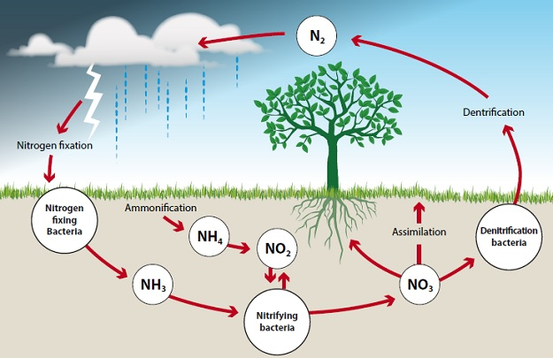
Introduction
Methylococcus capsulatus Bath – methanotroph, ammonia oxidizing nonlithotrophic bacteria
src = “https://www.studyacs.com/blog-nitrogen-cycle-37.aspx”
Notes:
Elmore, B. et al. (2007) 'Cytochromes P460 and c’-beta; A new family of high-spin cytochromes c', Federation of European Biochemical Societies, 581, pp. 911-916.
Bergman, D. & Hooper, A.. (2003) 'Cytochrome P460 of Nitrosomonas europaea: Formation of the heme-lysine crosslink in a heterologous host and mutagenic conversion to a non-crosslinked cytochrome c’', Federation of European Biochemical Societies, 270, pp. 1935-1941.
Zahn, J. et al. (1996) 'Cytochrome c’ of Methylococcus capsulatus Bath', Federation of European Biochemical Societies, 240, pp. 684-691.
Adams, H. et al. (2019) ‘One fold, two functions: cytochrome P450 and cytochrome c’-β from the methanotroph Methylococcus capsulatus (Bath)’, Chemical Science. 10, pp. 3031-3041.
RCSB Protein Data Bank (2018) Cytochrome P460 from Methylococcus capsulatus (Bath). Available at: http://www.rcsb.org/3d-view/6HIU/1
Bergman, D. et al. (2000) ‘Primary structure of cytochrome c’ of Methylococcus capsulatus Bath: evidence of a phylogenetic link between P460 and c’-type cytochromes’, Arch Microbiology. 173, pp. 29-34.
Stevens, C. (2019) ‘Nitrogen in the environment’. Science. 363(6427), pp. 578-580.
Simkin, S. et al. (2016) ‘Conditional vulnerability of plant diversity to atmospheric nitrogen deposition across the United States’. PNAS. 113 (15), pp. 4086-4091.
Gilbert, N. (2012) ‘Dirt poor: the key to tackling hunger in Africa is enriching the soil. The big debate is how to do it’. Nature. 483, pp. 525-527.
Gruber, N., & Galloway, J. (2008) ‘An Earth-system perspective of the global nitrogen cycle’, Nature. 451, pp. 293-296.
RCSB Protein Data Bank (2018) Nitrosomonas europaea HAO. Available at: http://www.rcsb.org/3d-view/4N4N/1
RCSB Protein Data Bank (2018) Cytochrome c prime beta from Methylococcus capsulatus (Bath). Available at: https://www.rcsb.org/3d-view/6HIH/1

Slide 3
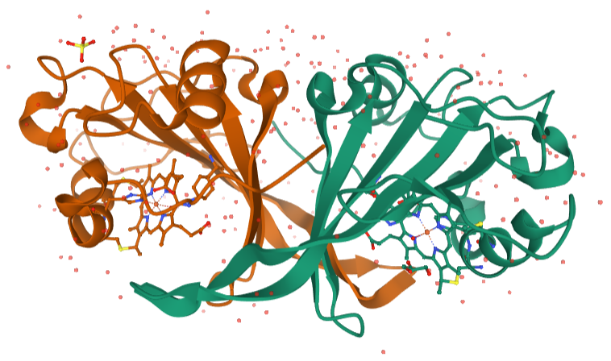
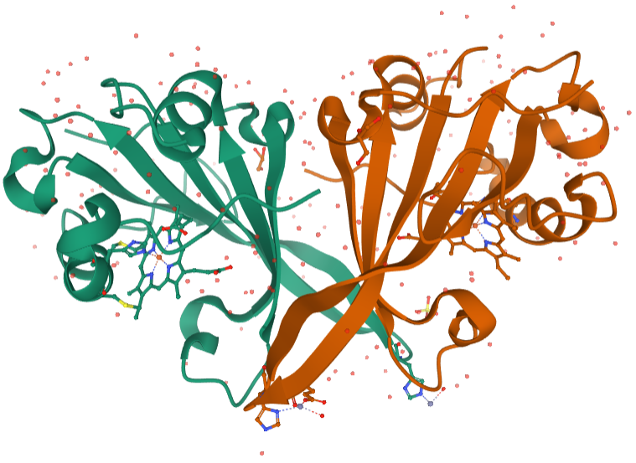
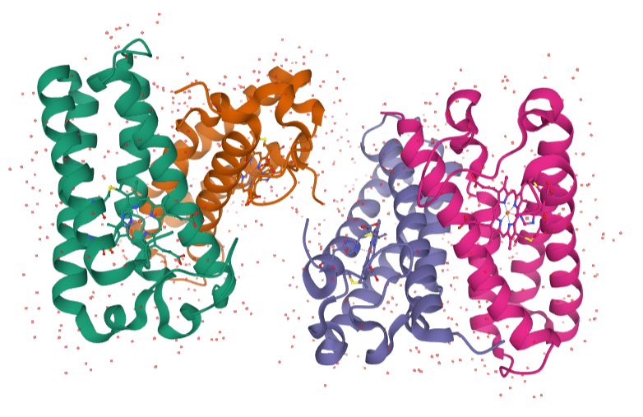
Introduction
Cytochrome P460
catalyzes the oxidation of hydroxylamine to nitrite
characterized by a lysine-heme crosslink
Cytochrome c’-β
initial electron acceptor for cytochrome P460
optimized for ligand binding as a result of hydrophobic residues present in the heme pocket
Differs from other c-type cytochromes as a result of its primarily beta-sheet structure
Cytchrome c’-α from Thermophilic Hydrogenophilus thermoluteolus
Primarily α helical
Like cytochrome c’-β, absence of lysine crosslink
Notes:
Elmore, B. et al. (2007) 'Cytochromes P460 and c’-beta; A new family of high-spin cytochromes c', Federation of European Biochemical Societies, 581, pp. 911-916.
Bergman, D. & Hooper, A.. (2003) 'Cytochrome P460 of Nitrosomonas europaea: Formation of the heme-lysine crosslink in a heterologous host and mutagenic conversion to a non-crosslinked cytochrome c’', Federation of European Biochemical Societies, 270, pp. 1935-1941.
Zahn, J. et al. (1996) 'Cytochrome c’ of Methylococcus capsulatus Bath', Federation of European Biochemical Societies, 240, pp. 684-691.
Adams, H. et al. (2019) ‘One fold, two functions: cytochrome P450 and cytochrome c’-β from the methanotroph Methylococcus capsulatus (Bath)’, Chemical Science. 10, pp. 3031-3041.
RCSB Protein Data Bank (2018) Cytochrome P460 from Methylococcus capsulatus (Bath). Available at: http://www.rcsb.org/3d-view/6HIU/1
Bergman, D. et al. (2000) ‘Primary structure of cytochrome c’ of Methylococcus capsulatus Bath: evidence of a phylogenetic link between P460 and c’-type cytochromes’, Arch Microbiology. 173, pp. 29-34.
Stevens, C. (2019) ‘Nitrogen in the environment’. Science. 363(6427), pp. 578-580.
Simkin, S. et al. (2016) ‘Conditional vulnerability of plant diversity to atmospheric nitrogen deposition across the United States’. PNAS. 113 (15), pp. 4086-4091.
Gilbert, N. (2012) ‘Dirt poor: the key to tackling hunger in Africa is enriching the soil. The big debate is how to do it’. Nature. 483, pp. 525-527.
Gruber, N., & Galloway, J. (2008) ‘An Earth-system perspective of the global nitrogen cycle’, Nature. 451, pp. 293-296.
RCSB Protein Data Bank (2018) Nitrosomonas europaea HAO. Available at: http://www.rcsb.org/3d-view/4N4N/1
RCSB Protein Data Bank (2018) Cytochrome c prime beta from Methylococcus capsulatus (Bath). Available at: https://www.rcsb.org/3d-view/6HIH/1

Slide 4
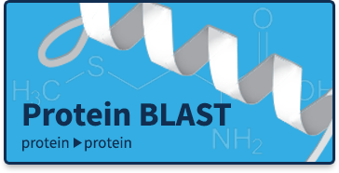
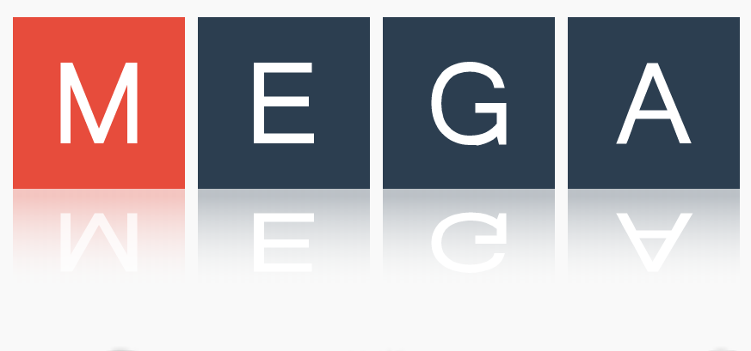


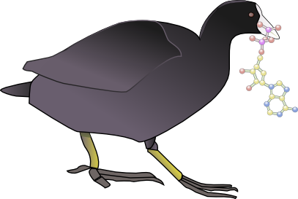
Methods and Materials
Homolog Search – A blastp search was performed using the accession number for Cytochrome c’- β from Methylococcus capsulatus Bath in order to obtain the sequences of similar c-type cytochromes.
Multiple Sequence Alignment – MEGA7 was used to align the sequence of Cytochrome c’- β with chosen sequences from the BLAST search, the first step in visualization of conserved regions.
Analysis at Key Positions – WebLogo is a tool developed by UC Berkeley to help visualize amino acid conservation at each position across multiple aligned sequences. A simple Python program will then be used to determine the amino acid present at certain key positions in each individual protein sequence.
Structure Prediction – Used to create initial structure predictions before modifications are made based on AAs present at key positions
Structure Visualization – The programs COOT (Crystallographic Object-Oriented Toolkit) and PyMOL will be used to visualize predicted protein structures and explore how those proteins are likely to interact with different ligands.

Slide 5
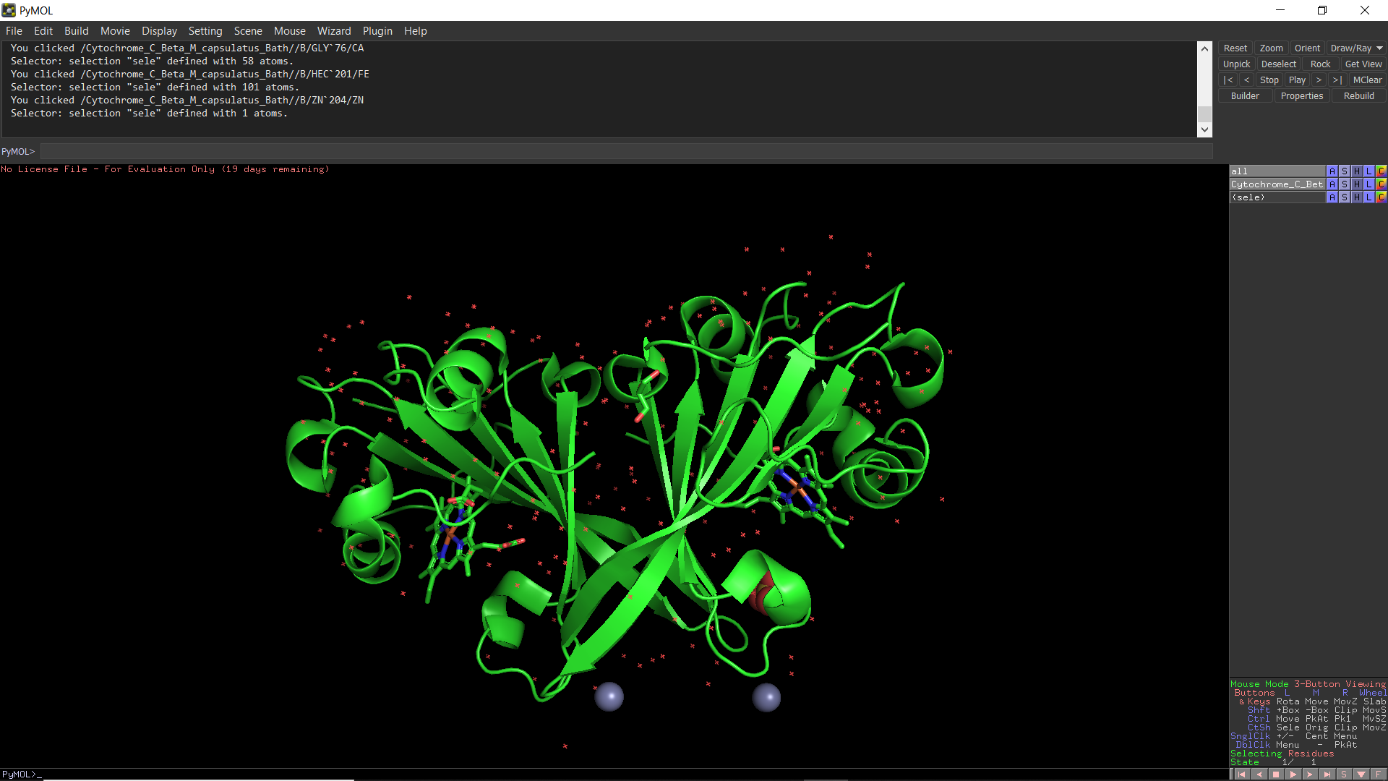
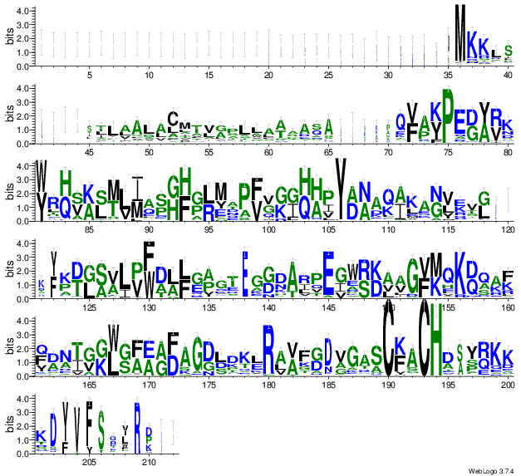
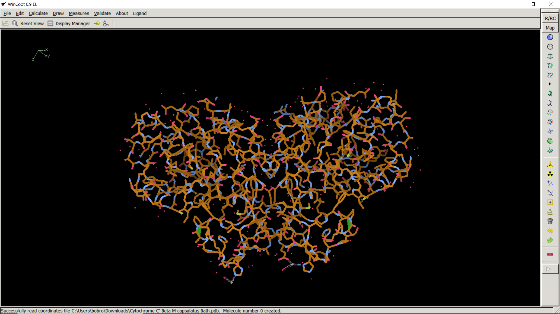
Results/Expected Results

Slide 6
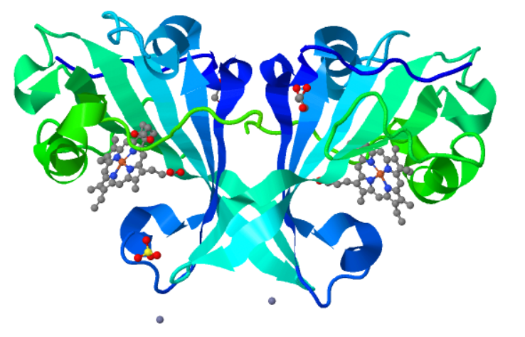
Discussion and Conclusions
A more thorough understanding of the structures and functions of these c’ proteins not only helps us to better understand the way that those organisms function, but may also open up possibilities for their future use in the production of certain biosynthetic products.
Potential to function as sensors for CO and NO, as proteins change color in response to certain gasses.
Hopefully, the predicted structures that result from this project will allow future teams to produce some of these structures in the wet lab.

Slide 7
Acknowledgements
I would like to thank my supervisor, Dr. Mike Hough, for his continued guidance and support
I would also like to thank all my peers for their dedication and teamwork when putting on this conference!

Slide 8
Thank you for listening.
Any Questions ?

