Slide 1
Logo
Group
Album
Artists
About
Product 1
Product 2
More
More
Product 3
Product 4
More
More

Slide 2




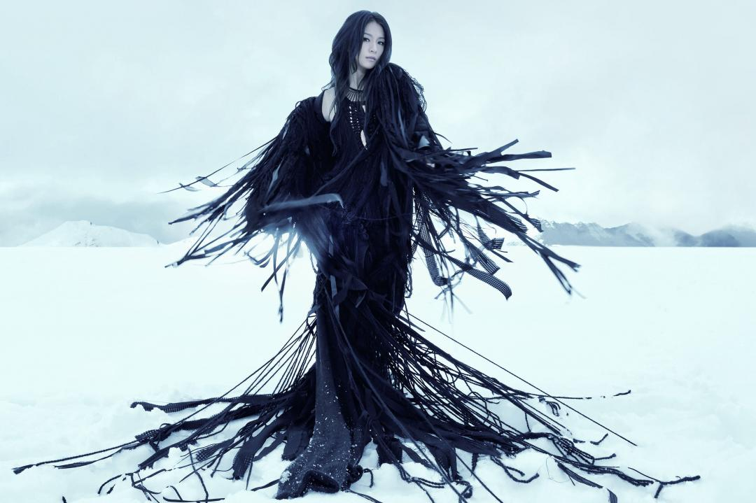
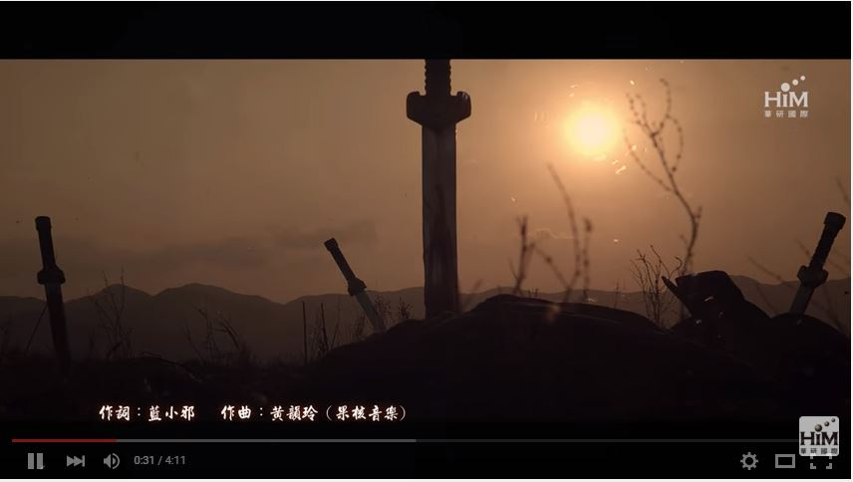


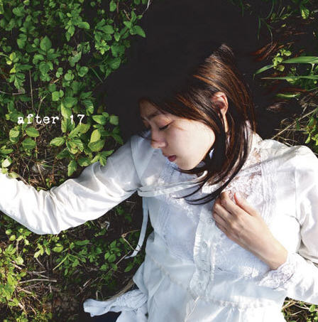

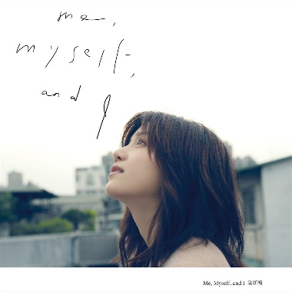


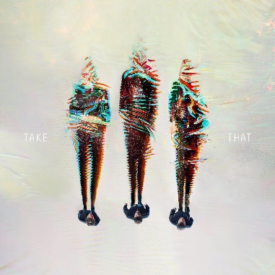
Music
Group
Album
Artists
About
SawanoHiroyuki[nZk]:mizuki
- 「A / Z」
Hebe – 渺小
More
More
陳綺貞 – after 17
Product 4
More
More
非官方授權，不得使用本網站的所有信息資料

