Slide 1
A+ Computer Science
Java maps

Slide 2
Map
Sub
Interfaces
-extends
Collections
Collection
Implementing
Classes
SortedMap
Sub
Interfaces
-extends
HashMap
HashTable
Implementing
Classes
List Set
Sub
Interfaces
-extends
Implementing
Classes
TreeMap
SortedSet
Implementing
Classes
ArrayList
LinkedList
Vector
TreeSet
AbstractSet
HashSet
LinkedHashSet

Slide 3
Java Map Class
The Map interface does not extend any
other interface.
Map
HashMap
SortedMap
TreeMap

Slide 4
Java Map Class
A Map stores pairs of keys and values.
Each key – value pair is unique.
A translation program could be
written using a map.
Maps cannot store duplicates.

Slide 5
Java Map Class
Key | Value
restroom | bano
cat | gato
boy | muchacho
house | casa
toad | sapo
water | agua

Slide 6
Java Map Class
Because Map is an interface, you cannot instantiate it.
Map bad = new Map(); //illegal
Map hash = new HashMap(); //legal
Map tree = new TreeMap(); //legal
hash and tree store Object references.
Notes:
Map is an interface; thus, it cannot be instantiated.
Map bad = new Map(); //illegal
HashMap and TreeMap are children of Map. Map can be used as a reference to any of its children.
Map hash = new HashMap();
Map tree = new TreeMap();

Slide 7
Java Map Class
With Java 5, you can now specify which
type of references you want to store in the TreeMap or HashMap.
Map<String, Integer> hash;
hash = new HashMap<String, Integer>();
Map<String, Set> tree;
tree =
new TreeMap<String, TreeSet<String>>();

Slide 8
Java Map Class
HashMap – a map ordered by each
item’s hashCode that is extremely time efficient.
TreeMap – a naturally ordered map that is very efficient, but not as efficient as HashMap.

Slide 9
Java Map Class
HashSet and HashMap were both
created around hash tables.
A hash table is a giant array. Each
item is inserted into the array
according to a hash formula.
0 1 2 3 4

Slide 10
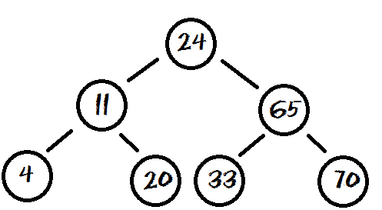
Java Map Class
TreeSet and TreeMap were built around balanced binary trees.
A Binary Tree is a group of nodes that contain left and right references. Each item is inserted into the tree according to its relationship to the other nodes.

Slide 11
Map Methods

Slide 12
Map frequently used methods
Name | Use
put(x,y) | adds the <x,y> pair to the map
get(x) | gets the value for key x
clear() | removes all items from the set
size() | returns the # of items in the set
keySet() | returns a set of all keys in the map
containsKey(x) | checks if key x is in the map

Slide 13
Java TreeMap
Map<Integer,String> map;
map = new TreeMap<Integer,String>();
map.put(1,"aplus");
map.put(2,"comp");
map.put(3,"sci");
map.put(4,"is");
map.put(5,"the");
map.put(6,"best");
System.out.println(map.get(1));
System.out.println(map.get(5));
System.out.println(map.get(7));
OUTPUT aplus the null
Notes:
The put() method is used to put a key,value pair into the map.
The put() returns a reference to the key that is being replaced.
The get() method returns a reference to the value associated with the specified key.
If the key specified is not present, the get() method returns null.

Slide 14
Java TreeMap
Map<Integer,Double> map;
map = new TreeMap<Integer,Double>();
map.put(5,2.5);
map.put(8,6.7);
map.put(11,5.9);
map.put(6,4.2);
map.put(17,1.5);
System.out.println(map.put(8,9.5));
System.out.println(map.put(6,6.6));
System.out.println(map.get( 6 ));
System.out.println(map.get( 11));
System.out.println(map.get( 7 ));
OUTPUT 6.7
4.2
6.6
5.9
null
Notes:
The put() method is used to put a key,value pair into the map.
The put() returns a reference to the key that is being replaced.
If the key, value pair was not present, null is returned.
The get() method returns a reference to the value associated with the specified key.
If the key specified is not present, the get() method returns null.

Slide 15
Java HashMap
Map<Integer,Double> map;
map = new HashMap<Integer,Double>();
map.put(5,2.5);
map.put(8,6.7);
map.put(11,5.9);
map.put(6,4.2);
map.put(17,1.5);
System.out.println(map.put(8,9.5));
System.out.println(map.put(6,6.6));
System.out.println(map.get( 6 ));
System.out.println(map.get( 11));
System.out.println(map.get( 7 ));
OUTPUT 6.7
4.2
6.6
5.9
null
Notes:
The put() method is used to put a key,value pair into the map.
The put() returns a reference to the key that is being replaced.
If the key, value pair was not present, null is returned.
The get() method returns a reference to the value associated with the specified key.
If the key specified is not present, the get() method returns null.

Slide 16
basicmapone.java
basicmaptwo.java basicmapthree.java

Slide 17
Map put() method
Map<Character,Integer> map;
map = new TreeMap<Character,Integer>();
String s = "apluscompscirockscomputerscience";
for(char c : s.toCharArray())
{
if(map.get(c)==null)
map.put(c,0);
map.put(c,map.get(c)+1);
}
System.out.println(map.get('a'));
System.out.println(map.get('x'));
System.out.println(map.get('c'));
System.out.println(map.get('t'));
OUTPUT 1 null 6
c is not in the map.
bump up the count
Notes:
In the code above, the loop iterates over the String s one character at a time.
The if checks to see if the current character c is present. If the char is present, the count value is increased by one.
If char is not present, the char is put in the map with the value 1.
Because get() returns null for a key that is not present, the return value for get() can be used to determine if a key is present.
A null return for get() indicates that the map does not contain that key.

Slide 18
treemapputone.java

Slide 19
Map put() method
Map<Character,Integer> map;
map = new TreeMap<Character,Integer>();
String s = "cabcdefghihabcdc";
for(char c : s.toCharArray())
{
if(map.containsKey(c))
{
map.put(c,map.get(c)+1);
}
else
{
map.put(c,1);
}
}
System.out.println(map.get('a'));
System.out.println(map.get('x'));
System.out.println(map.get('c'));
OUTPUT 2 null 4
c is in the map.
c is not in the map.
Notes:
In the code above, the loop iterates over the String s one character at a time. The if checks to see if the current character c is present. If the char is present, the count value is increased by one. If char is not present, the char is put in the map with the value 1.
Because containsKey() returns false for a key that is not present, the return value for containsKey() can be used to determine if a key is present. A false return for containsKey() indicates that the map does not contain that key.

Slide 20
treemapputtwo.java

Slide 21
Map Output
Iterator<Character> it;
it = map.keySet().iterator();
while(it.hasNext())
{
char c = it.next();
System.out.println(c+" - "+map.get(c));
}

Slide 22
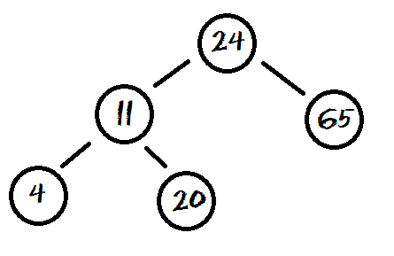
Map Output
for(char c : map.keySet())
{
System.out.println(c+" - "+map.get(c));
}

Slide 23
treemapoutput.java treemapoutputforeach.java

Slide 24
Output Map Values
for(double d : map.values())
{
System.out.println(c);
}
Key | Value
a | 7.0
b | 2.0
c | 6.0
OUTPUT 7.0 2.0 6.0

Slide 25
treemapoutputvalues.java hashmapoutput.java

Slide 26
Work on Programs!
Crank
Some Code!

Slide 27
A+ Computer Science
Java maps

