Slide 1
A+ Computer Science
HEAPS

Slide 2
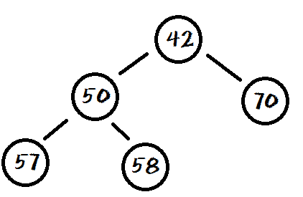
What is a heap?
The heap is essentially an array-based
binary tree with either the biggest
or smallest element at the root.

Slide 3
What is a heap?
Every parent in a Heap will always be
smaller or larger than both of its children.
This rule will hold true for every level of
the heap.

Slide 4
What is a complete tree?
In a complete tree, every level that can
be filled is filled. Any levels that are not
full have all nodes shifted as far left
as possible.

Slide 5
What is a heap?
A Heap is a complete tree.

Slide 6
What is a min heap?
A min heap is a binary tree that has
a root smaller than all of its children.

Slide 7
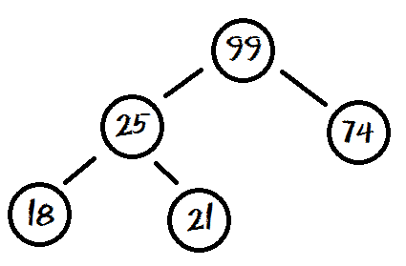
What is a max heap?
A max heap is a binary tree that has
a root larger than all of its children.

Slide 8
What is a heap?
root
15
11
10
7
8
9
root
15 | 11 | 10 | 7 | 8 | 9

Slide 9
What is a heap?
Because a heap will always be a
complete tree, it makes sense to
use an array to store the values.
root
15 | 11 | 10 | 7 | 8 | 9

Slide 10
What is a heap?
root
15 | 11 | 10 | 7 | 8 | 9
left = i*2+1 right=i*2+2
left child of root = [0 *2 + 1]
right child of root = [0 *2 + 2]

Slide 11
Adding to a heap
The easiest way to add a new item to a
heap implemented with an array is to add the new value at the end of the array and then move the new item up the tree
as far as it needs to go.
add will use swapUp to restructure
the tree so that it remains a heap.

Slide 12
Adding to a heap
root
15
11
10
7
8
9
12
root
15 | 11 | 10 | 7 | 8 | 9 | 12

Slide 13
Adding to a heap
root
15
11
12
7
8
9
10
root
15 | 11 | 12 | 7 | 8 | 9 | 10

Slide 14
Adding to a heap
int bot = length-1
while( bot>0 )
{
int parent = (bot-1)/2
if list[parent] < list[bot]
swap list[parent] and list[bot]
bot = parent
else
stop
}

Slide 15
Adding to a heap
swapUp starts access at the bottom of tree
swapUp checks to see that the bottom index has not
gone past the root of tree. The root is at index position 0.
Next, locate bottom’s parent = (bot–1) / 2.
Check if bottom is larger than its parent
If it is → swap bottom and parent
Finally, set bottom to parent and start the process over.
This method can be written iteratively or recursively.

Slide 16
Removing from a heap
When you remove from a Heap, you are taking off
the largest value or value with the highest priority.
You just take the top value off and save it.
Next, you move the last item in the tree to the root
and move the new root down the tree as far as it
can go.
remove will use swapDown to restructure the tree
so it remains a heap.

Slide 17
Removing from a heap
int root=0;
while(root<list.size())
define max and left and right indexes
if left child exists
if right child exists
find max
else
max is left
else stop
if max > root
swap
root = max
else stop

Slide 18
Removing from a heap
swapDown starts access at the root
swapDown first generates the index values of the root’s
children. root * 2 + 1 root * 2 + 2
Make sure root is less than bottom
Find the largest child
Determine if largest child is larger than root
If it is → swap largest child and root
Root is set to the index of the largest child and the process
starts over again.
This method can be written iteratively or recursively.

Slide 19
Work on Programs!
Crank
Some Code!

Slide 20
What is a Priority Queue?
A PriorityQueue is a queue structure that organizes the data inside by the natural ordering or by some specified
criteria.
The Java PriorityQueue is a min heap
as it removes the smallest items first.
The Java PriorityQueue stores Comparables.

Slide 21
PriorityQueue frequently used methods
Name | Use
add(x) | adds item x to the pQueue
remove() | removes and returns min priority item
peek() | returns the min item with no remove
size() | returns the # of items in the pQueue
isEmpty() | checks to see if the pQueue is empty

Slide 22
What is a Priority Queue?
PriorityQueue<Integer> pQueue;
pQueue = new PriorityQueue<Integer>();
pQueue.add(11);
pQueue.add(10);
pQueue.add(7);
out.println(pQueue);
OUTPUT
[7, 11, 10]

Slide 23
What is a Priority Queue?
PriorityQueue<Integer> pQueue;
pQueue = new PriorityQueue<Integer>();
pQueue.add(11);
pQueue.add(10);
pQueue.add(7);
out.println(pQueue); out.println(pQueue.remove());
out.println(pQueue);
OUTPUT
[7, 11, 10] 7 [10, 11]

Slide 24
pqadd.java pqremove.java

Slide 25
What is a Priority Queue?
PriorityQueue<Integer> pQueue;
pQueue = new PriorityQueue<Integer>();
pQueue.add(11);
pQueue.add(10);
pQueue.add(7);
while(!pQueue.isEmpty())
{
out.println(pQueue.remove());
}
OUTPUT
7 10 11

Slide 26
pqueueisempty.java

Slide 27
Work on Programs!
Crank
Some Code!

Slide 28
A+ Computer Science
HEAPS

