Slide 1


XML Document Mining Challenge
Bridging the gap between Information Retrieval and Machine Learning
Ludovic DENOYER – University of Paris 6

Slide 2
Outline
Description
Context
Machine Learning and Information Retrieval
Tasks
The first part (INEX 2005)
The current part
Conclusions

Slide 3
What is XML DM Challenge ?
Challenge between two networks of excellence (DELOS and PASCAL)
  DELOS
    INEX : Information Retrieval with XML (2002)
    About 40 teams
    Different tasks
      Search engine
      Relevance feedback, entity retrieval, multimedia, …
      XML Document Mining
  PASCAL Challenge
    Machine Learning
    Learning with structures

Slide 4
What is the XML DM Challenge ?
Two parts :
  1st Part (INEX 2005): June 2005 to November 2005
  2nd Part : January 2005 to June 2006
  Extended to INEX 2006 (december 2006)
http://xmlmining.lip6.fr

Slide 5
Context
New type of data : Structured data
  « Single » structures/Relationnal data
    Sequences, trees, graphs
  Structures with content
    Web (HTML, graph of web pages)
    XML
    ….
In a large variety of domains
  Electronic Document
  Web Mining
  Information Retrieval
  BioInformatics
  Computer Vision

Slide 6
How to learn with structures ?
Very recent field of interest
  For example : Structured output classification
Only a few models
  Mainly for “structure only” data
Need:
  Extend existing models
  Create new models

Slide 7
Tasks with structured data
Revisit classical tasks
  What is categorization of structured documents
    Categorization of whole documents ?
    Categorization of parts of document (multi-thematic case) ?
    Categorization of the document in different structure families ?
  Find and deal with new “structure specific” tasks
    Structure mapping

Slide 8
Context: ML and IR
Why : « Bridging the gap between Information Retrieval and Machine Learning »
Example :
  Categorization of XML Documents

Slide 9
ML and IR
Machine Learning :
  Existing models are not able to handle large amount of data in a large space
  Example:
    Classification of XML
      Size of the vocabulary is more than 2 millions words, more than 100,000 millions nodes, more than 200 possible node labels
    Structure mapping
      Find the « best » tree structure for a document: Exact inference impossible

Slide 10
ML and IR
Information Retrieval :
  Models are not « learning models »
    The developped models are « IR specific »
  Some tasks can ’t be done without learning:
    Categorization
    Clustering
    Structure Mapping
    …

Slide 11
Idea of the challenge
Use Information Retrieval problems as an applicative context for the development of new Machine Learning models able to deal with:
  Structure+content data
  Large amount of data
  Solve new generic problems that will be used in a large variety of domains
    Structure mapping
      Document conversion
      Heterogenous Information Retrieval
      …
    classification of parts of graphs
      Information Extraction
      Web Spam
      …

Slide 12
Description of the challenge
Tasks and Goals

Slide 13
Tasks
Two main tasks:
  Categorization
  Clustering
… of XML Documents
One new « prospective » task:
  Structure Mapping

Slide 14
Categorization/Clustering
Task : Discover « Families » of documents
  Content families (topics)
  Structural families
Idea : The use of content AND structure can be helpful (comparing to use only content or only structure)
Goal : Develop «discriminant » models for structured data able to learn ghow to use the structure information.

Slide 15
Example
 | Euronews | EuroSport
Politics
Soccer

Slide 16
Example
 | S1 | S2 | S3 | S4 | S5
T1
T2
T3
T4
T5

Slide 17
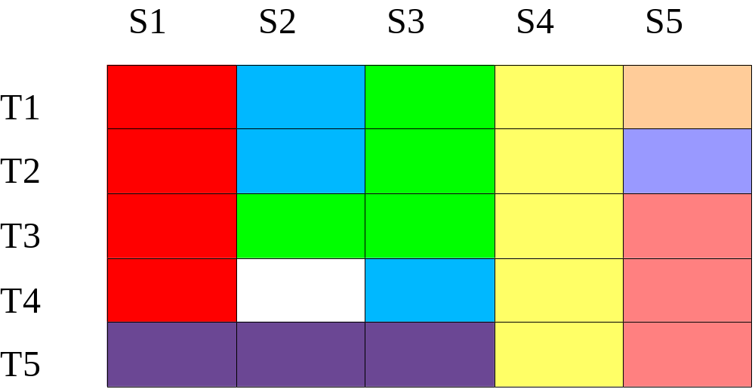
Example

Slide 18
Difficulties
The « weight » between structure and content depends on the family to detect
Large dimension
  Vocabulary
  Number of possible trees
Large amount of data
  170,000 documents : more than 4Gb
  How to learn ?

Slide 19
Structure Mapping
Learn to « change » the structure of a document
<Restaurant> <Nom>La cantine</Nom> <Adresse> 65 rue des pyrénées, Paris, 19ème, FRANCE </Adresse> <Spécialités> Canard à l’orange, Lapin au miel </Spécialités> </Restaurant> |  | <Restaurant> <Nom>La cantine</Nom> <Adresse> <Ville>Paris</Ville> <Arrd>19</Arrd> <Rue>pyrénées</Rue> <Num>65</Num> </Adresse> <Plat> Canard à l’orange </Plat> <Plat> Lapin au miel </Plat> </Restaurant>

Slide 20
Difficulties
The number of possible structures is very large.
Exact inference seems impossible
Current « Structured output » models can’t handle this type of data

Slide 21
First part of the challenge
Ended in december 2005

Slide 22
Description
7 participants => 7 models
8 different corpora
  Two types of tasks
    Structure only categorization/clustering (detect structural families)
    Structure+Content categorization/Clustering (detect topics or more)
  Two types of data
    one artificial corpus
    One real corpus : INEX 1.3 Corpus
      Articles from different journals
6 structure only methods :
  3 for categorization and 4 for clustering
Only 1 model for structure+content (mine)
Mainly IR researcher

Slide 23
Description
7 participants => 7 models
8 different corpora
  Two types of tasks
    Structure only categorization/clustering
    Structure+Content categorization/Clustering
  Two types of data
    one artificial corpus
    One real corpus : INEX 1.3 Corpus
6 structure only methods :
  3 for categorization and 4 for clustering
Only 1 model for structure+content (mine)
Mainly IR researcher

Slide 24
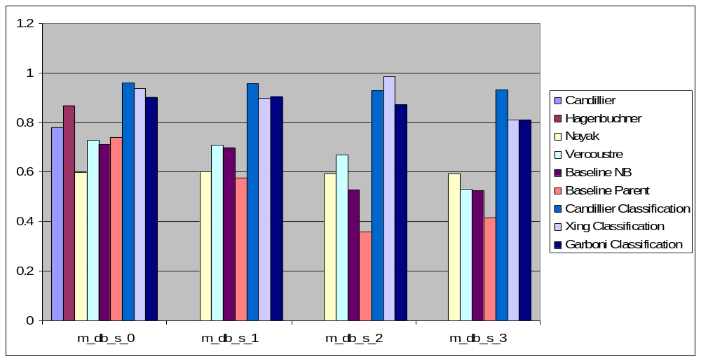
Example of Results (structure only)
The Structure Only tasks were too easy !

Slide 25
INEX Structure+Content Categorization
F1 micro
F1 macro
NB
0.59
0.605
Structure model
0.619
0.622
SVM TF-IDF
0.534
0.564
Fisher kernel
0.661
0.668
Discriminant learning
0.575
0.600
Structure helps in finding the category of a document !

Slide 26
Conclusion about the results
Detection of « structural » families seems to be very easy
Handling content and structure is more difficult

Slide 27
Conclusion about the first part of the challenge
Only « structure only » models
Only a few participants (7 – 4 french teams)
Mainly Information Retrieval participants
Too many tasks/corpora – too complicated

Slide 28
For the next part
Only « structure only » models
Too many tasks/corpora – too complicated
  Remove « structure only » tasks
  Simplify the challenge (less corpora/tasks)
  => 3 corpora, 3 tasks
Only a few participants (7 – 4 french teams)
Mainly Information Retrieval participants
  I need to have a better organization and promote the challenge
  Improve my english !
  Propose the structure mapping task
    Related to « Structured output »
    Very active field of interest

Slide 29
To convince Machine Learning Researchers
Handling XML Documents is a very challenging task for theoritical ML – (particularly structure mapping)
  How to learn to map a structure to another (structured output classification) ?
    How to learn with structures
    How to make inference into such large spaces ?
  How to deal with such a large amount of data ?

Slide 30
What is the second part ?
Categorization/Clustering of structure and content
  2 corpora
Structure mapping
  Flat to XML : 2 corpora
  HTML to XML : 1 corpus
Categorization+Clustering+Structure Mapping = 7 runs

Slide 31
Wikipedia XML Corpus
Main set of collections
  Based on Wikipedia
  Currently 8 different languages (more if asked) – en, de, du, sp, ch, jp, ar, fr
  More than 1.5 millions documents
  In a hierarchy of categories (about 100,000 categories)
Additionnal collections
  Categorization collections (english – 70 classes, 530,000 documents)
  Entity Collection (<actor>Silverster Stalonne</Actor>)
  Cross-Language collection
  Multimedia Collection (about 350,000 pictures)
  QA Collection ? (for QA at CLEF – 2006)
  For RTE 3 ?
http://www-connex.lip6.fr/~denoyer/wikipediaXML

Slide 32
Wikipedia XML Corpus for XML DM
170,000 documents
Each document talks about 1 single topic (35 topics)
Goal : Detect the different topics

Slide 33
INEX Corpus for XML DM
12,100 documents
Each documents is an article from one of the 18 IEEE journals
Goal : Detect the journals of an article
  Need to use structure and content
  Some journals have the same topic

Slide 34
Structure Mapping Corpus
WikipediaXML and INEX
  Find the XML document having only a segmented/flat document
Movie
  1000 movies in XML and HTML
  Find the XML using the HTML

Slide 35
Currently
More than 60 persons on the mailing list….
20 participants have downloaded the corpora
10 more participants at INEX 2006
  How many « real » participants ?
We are trying to organize a workshop in a ML conference (in september/october 2006)

Slide 36
Conclusion
One Web site :
  Challenge : http://xmlmining.lip6.fr
Questions ?
Wikipedia XML :
http://www-connex.lip6.fr/~denoyer/wikipediaXML

