Slide 1
PLB 812 Plant Genomics
8-28-24
Introduction to high performance computing and the MSU HPCC
Dr. Bob VanBuren

Slide 2
Why can’t we use our laptops to do everything in bioinformatics?
It’s pretty easy to align one sequence (read) to the genome
This read aligns here!
Your favorite genome
What if we need to align 400 million reads/sequences?

Slide 3
Goals of todays lecture and activity
Learning objectives:
Develop a basic understanding of high-performance computing including the advantages and challenges over working locally on your computer
Understand the general architecture of the MSU HPCC and what terms like node, core, processor, or thread mean
Introduce Linux command line and the bash programing language
Discuss file storage, directories, and permissions
Understand the queuing system and how SLURM works
Log on to the MSU HPCC using OnDemand

Slide 4
Why do we use HPCC?
Advanced Computing Resources
Data-Intensive Workloads
High performance computing utilizes powerful, specialized hardware and software to tackle complex, data-intensive computational tasks beyond the capabilities of standard desktop computers.
HPC systems are designed to efficiently process and manage enormous amounts of data, often in parallel, to accelerate the discovery of insights and knowledge from vast datasets.
Solving Complex Problems
Distributed Computing
HPC enables researchers, scientists, and engineers to model, simulate, and analyze large-scale problems in fields such as climate science, molecular biology, physics, and engineering.
HPC clusters typically utilize a network of interconnected computers, known as nodes, that work together to distribute computing tasks and resources, providing increased processing power and speed.

Slide 5
Why do we use HPCC for genomics/bioinformatics?
Data Volume and Complexity: Genomics involves massive datasets. Sequencing a single human genome can generate hundreds of gigabytes of data. With projects aiming to sequence thousands or even millions of genomes, the data quickly scale to petabytes. HPC enables the processing and analysis of these vast datasets efficiently.
Computational Intensity: Genomic analyses involve complex computational tasks like sequence alignment, genome assembly, variant calling, and phylogenetic analyses. These tasks require significant computational resources that HPC environments are well-equipped to provide.
Speed: Genomic research often requires rapid turnaround times, particularly in medical settings where patient outcomes can depend on quick analysis. HPC can dramatically reduce the time needed for processing, from weeks or days to hours or minutes, facilitating faster advances in research and quicker clinical decisions.
Scalability: Genomics research can vary in scale from small projects involving a few genomes to large-scale studies involving many species or large populations. HPC environments can scale up to meet increased demand without the need for significant reconfiguration.
Advanced Algorithms and Simulation: HPC allows researchers to use more sophisticated algorithms that are more computationally demanding, including machine learning and simulations of evolutionary scenarios, which can be critical for understanding complex genetic interactions and evolutionary dynamics.

Slide 6
Challenges of using high performance computing systems
Accessibility and Cost: HPC resources can be expensive and may not be readily accessible to all researchers, especially those from smaller institutions or in developing countries. This contrasts with the relative affordability and accessibility of laptops.
Complexity of Use: HPC systems often require specialized knowledge to use effectively, including familiarity with specific programming languages, parallel computing techniques, and system-specific software. This is a higher barrier to entry compared to the more user-friendly interfaces and software commonly used on laptops.
Software Compatibility: Some software, particularly specialized scientific applications, might not be optimized for HPC environments or might require significant modification to run efficiently on an HPC system.
Job Scheduling: Unlike a laptop where you can start a task immediately, jobs on HPC systems are often queued and scheduled based on priority and resource availability. This can introduce delays and requires users to plan and possibly adapt their workflow.
Maintenance and Upkeep: HPC systems require significant maintenance to ensure they operate efficiently and effectively. This includes both hardware and software maintenance, which can be resource-intensive and require specialized staff.
Data Management: The large datasets typically handled in HPC environments can present challenges in data management and storage. Ensuring data integrity, security, and efficient access requires robust data management systems and practices, which can be complex and costly to implement.

Slide 7
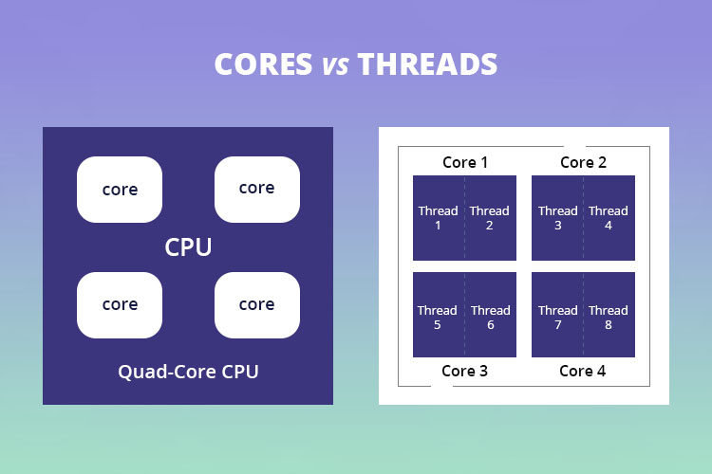
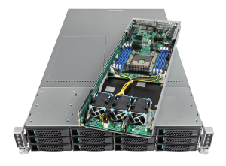
Terminology in parallel computing: CPUs, threads, cores, and nodes
Cores and CPUs: a central processing unit (CPU) is a physical device, and cores are relatively independent units that have their own program counter. One CPU can have multiple cores.
Thread: a single set of instructions from a program. Technically, one core can have multiple threads running, but this often doesn’t speed things up too much.
Node: can mean different things but is usually a single configured component in a distributed application system (e.g. a cluster of CPUs)
This whole thing is a node

Slide 8
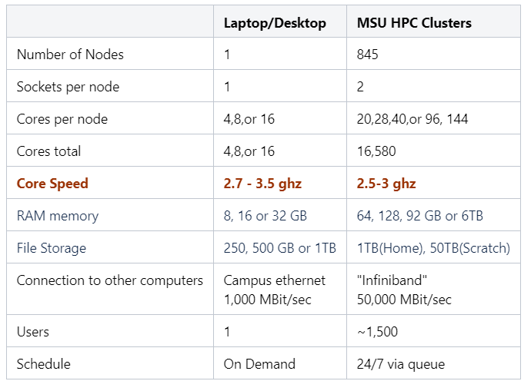
Comparing your laptop to the MSU HPCC

Slide 9
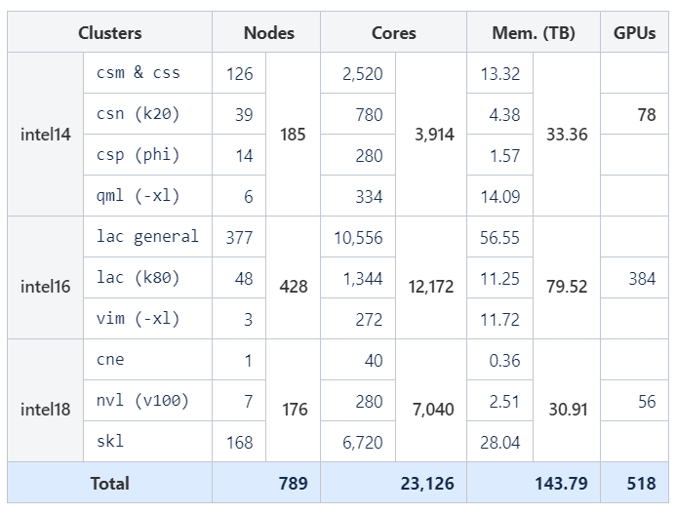
HPCC has a lot of resources
This is an outdated estimation, HPCC has more resources now

Slide 10
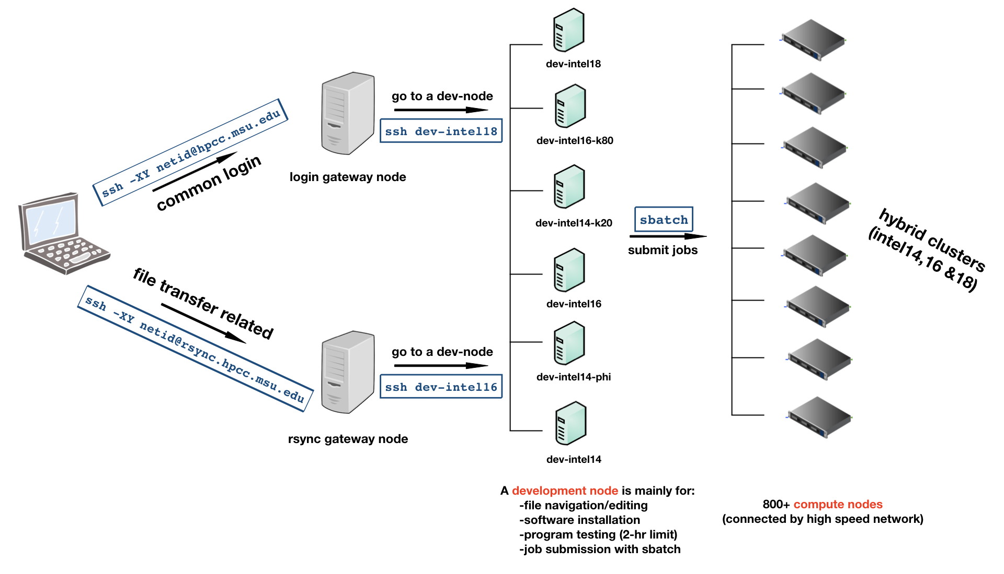

How do we communicate with the MSU HPCC?
plantresilience.msu.edu

Slide 11

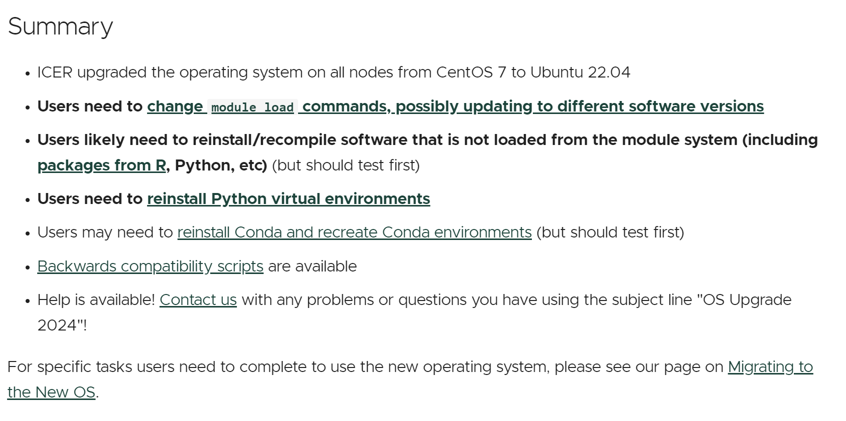
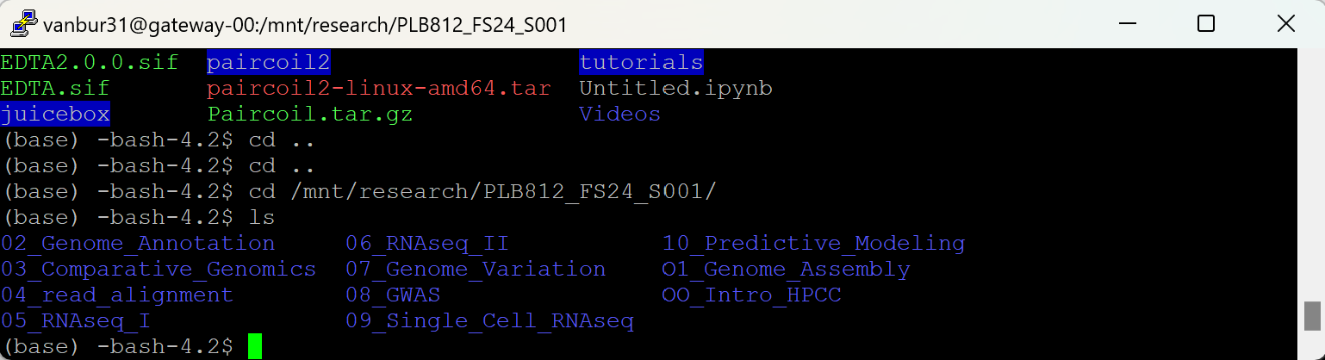
Linus operating systems
The HPCC uses a Linux based operating system
Linux is an open-source operating system known for its stability and flexibility, widely used across servers, desktops, and embedded systems due to its robust security features and strong support for networking and development.
We use the command line to interact with HPCC
The command line is your direct access to a computer. It's where you ask software to perform hardware actions that point-and-click graphical user interfaces (GUIs) simply can't ask.
plantresilience.msu.edu

Slide 12
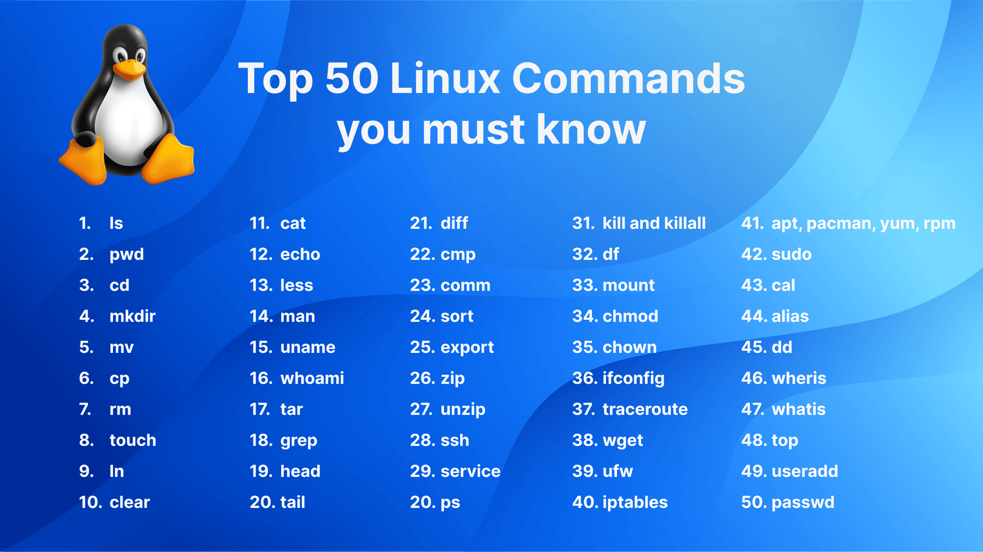
Linus operating systems, bash
We use the bash programing language for writing code and functions and for giving HPCC comands
Bash stands for Bourne Again SHell, is a command language interpreter that functions as both a scripting language and a command processor, widely used on Linux and UNIX systems. Bash is the default shell in most Linux distributions and macOS, providing powerful programming features like arrays, functions, and control-flow constructs, enabling users to execute and automate tasks efficiently.
plantresilience.msu.edu

Slide 13
Linus operating systems, bash
Bash allows for the following tasks:
Command Execution: Bash allows users to execute commands directly on the Unix/Linux system, interacting with the operating system and its files.
Scripting: Bash is not just a shell but also a scripting language. You can write scripts to automate repetitive tasks, manage system operations, or even create complex programs.
Pipelining: Bash supports the use of pipes (|), which allow you to use the output of one command as the input to another. This enables complex data processing workflows right from the command line.
Redirection: Bash can redirect input and output streams, which means you can send the output of a command to a file, or read the input for a command from a file.
Job Control: Bash provides job control, allowing users to start, stop, resume, and manage multiple jobs (processes) from a single command line (e.g., Slurm)
Environment Management: Bash allows users to control the programming environment by setting environment variables which can influence the behavior of software on the system.
•Programming Constructs: Bash includes programming features such as loops (for, while, until), conditionals (if, case), and arrays, which make it powerful enough to handle complex logic and data manipulation tasks.
Networking: Using tools available in Unix/Linux, Bash can facilitate simple network operations like downloading files (using wget or curl), transferring files (using scp or rsync), or checking network connections.
Interactive Use: Bash is not only for scripting but also for interactive use. Users can manually enter commands, get immediate feedback, and work interactively with programs.
Text Processing: Bash integrates well with Unix text processing tools like grep, sed, awk, and others, allowing users to perform sophisticated text analysis and file manipulations.

Slide 14
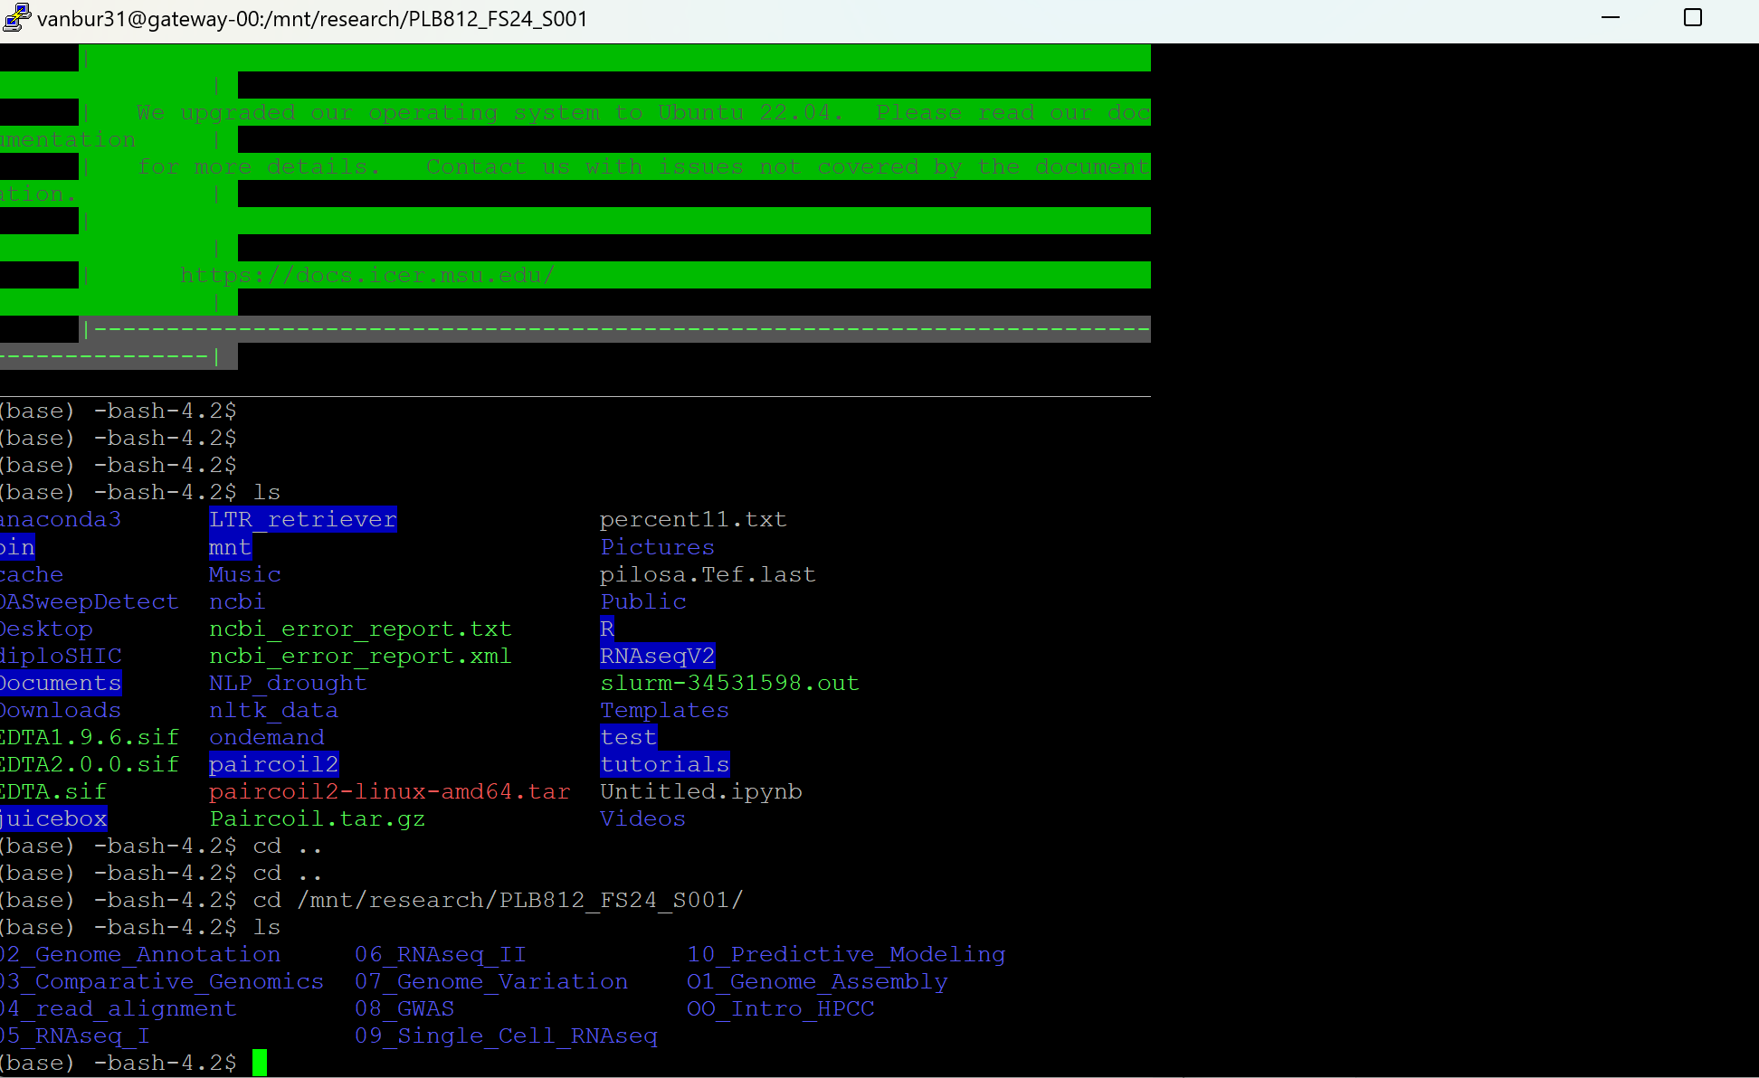
Using command line to do things on HPCC

Slide 15
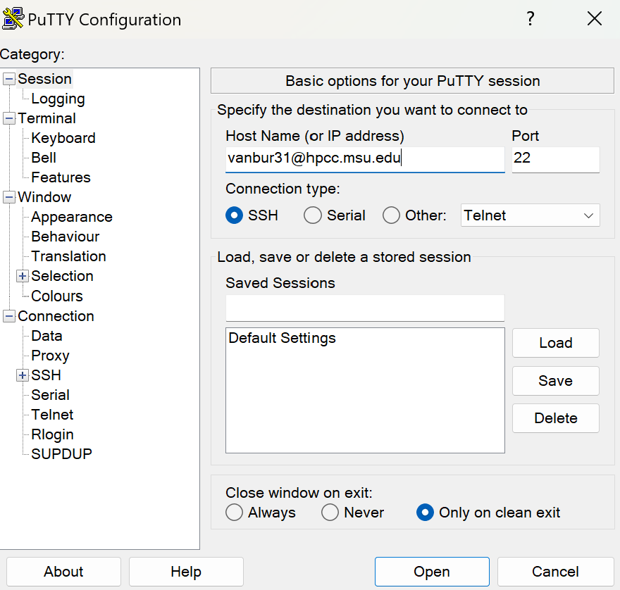
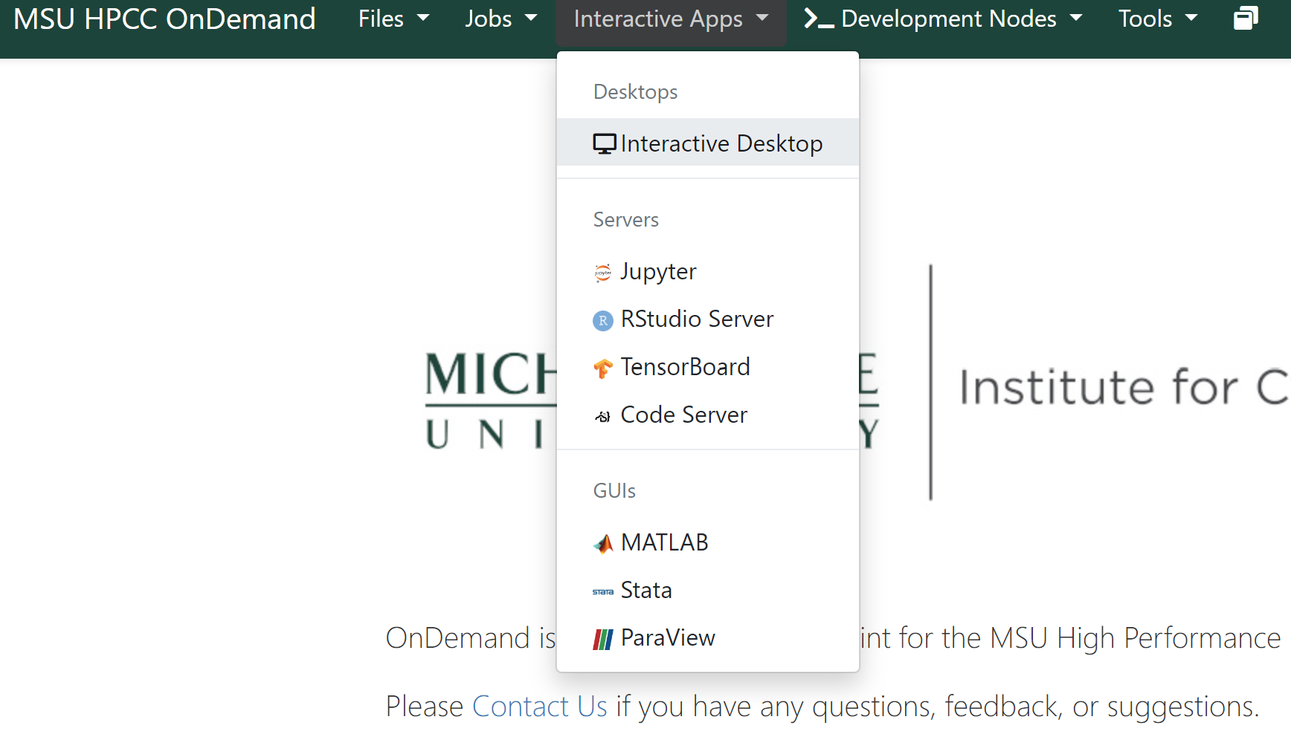
How do we access the HPCC?
We can use a terminal to access the HPCC, through ssh. SSH stands for Secure Shell. It is a cryptographic network protocol used primarily for accessing remote servers securely over an unsecured network.
For Mac and Linux operating systems, a terminal is installed by default. For a Windows system, you need to download a GUI terminal such as putty.
We can also use the GUI OnDemand to access HPCC, submit jobs, look at files, and launch various other applications such as R studio, Jupyter, whatever!

Slide 16
What is the system architecture of HPCC?
File Storage Types in HPCC for This Course:
Home Space: Upon logging into HPCC, you'll start in your /home/$USER directory. Use the pwd command to confirm your location. Each user receives a personal home space with a default storage limit of 50 GB, expandable to 1 TB and up to 1 million files, accessible only to you.
Research Space: You will have access to the shared research space /mnt/research/PLB812_FS24_S001 for this course, and possibly additional spaces for specific labs. These spaces are visible to all associated users, with permissions varying to include read, write, or execute access, ensuring controlled sharing and protection of files.
Scratch File Systems: HPCC offers "scratch" space for temporary data during computations, not suitable for long-term storage. Data in scratch spaces are automatically deleted after 45 days of inactivity. Use scratch for tasks that generate large intermediate files like genome assembly, but always transfer valuable data to your home or research space to avoid data loss. You can use scratch for this course, but remember to move any important files to your home or research space or THEY WILL BE LOST TO THE VOID FOREVER.
These storage options are designed to support various aspects of our course, from secure personal storage to collaborative research environments and temporary computational workspaces.
plantresilience.msu.edu

Slide 17
SLURM Job scheduler at HPCC
~1,500 people use the HPCC daily. Resources need to be distributed fairly. We can use a job scheduler and queuing system to optimize performance.
Most of the HPCC's resources are in the form of compute nodes. These compute nodes are accessed by running batch jobs.
The HPCC uses SLURM (Simple Linux Utility for Resource Management) to manage compute node resources. SLURM is an open-source, fault-tolerant, and highly scalable scheduling system. It has been employed by a large number of national and international computing centers.
Users can submit batch jobs to the SLURM scheduler from the command line. Job requests include a specification of desired resources as well as the commands necessary for your program(s) to run. These job requests can either be in a job script or entered on the command line.

Slide 18
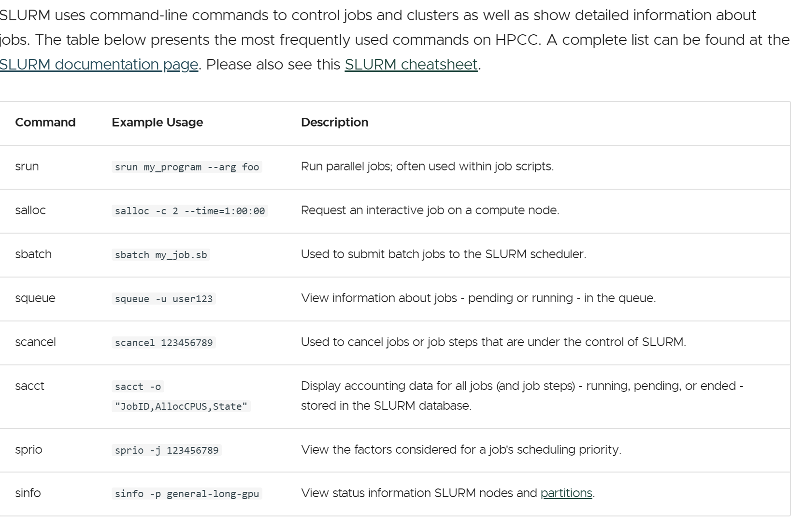
SLURM commands

Slide 19
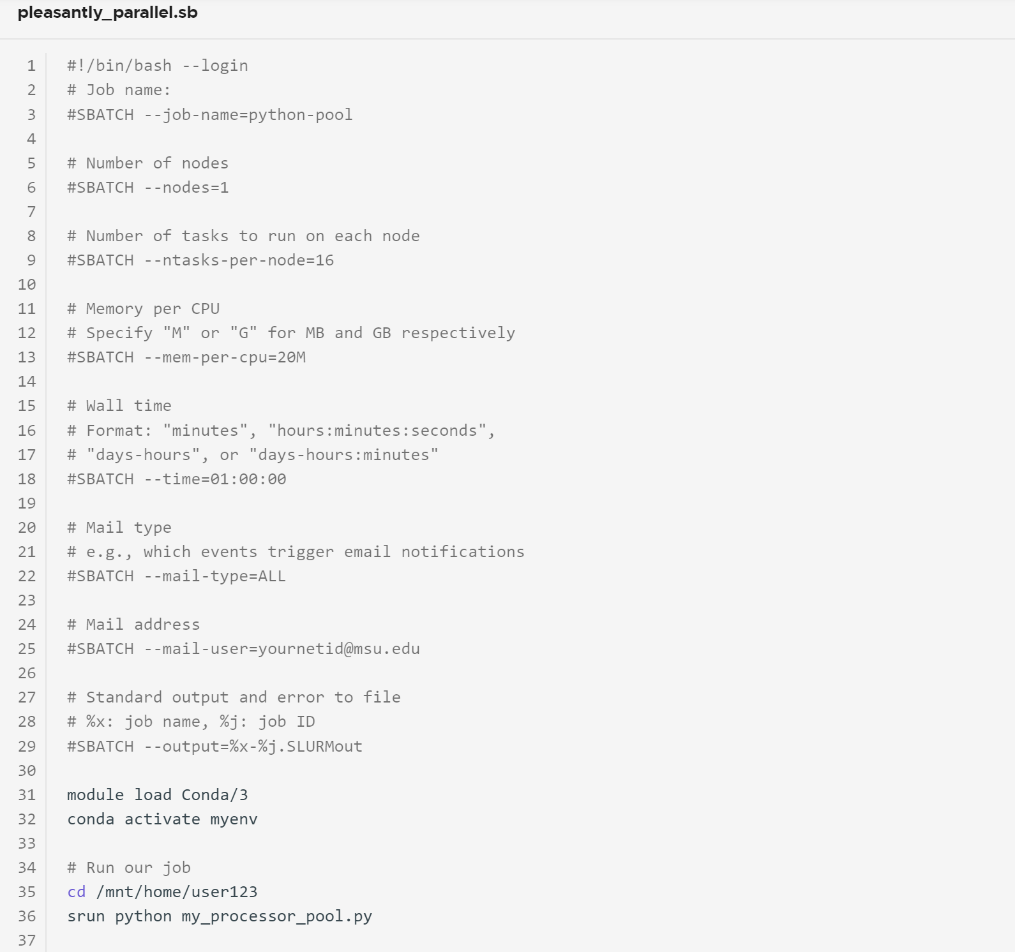
Example SLURM submission script

Slide 20

Looking forward

Slide 21
Let’s see if everyone can access OnDemand!
https://ondemand.hpcc.msu.edu/

