Slide 1
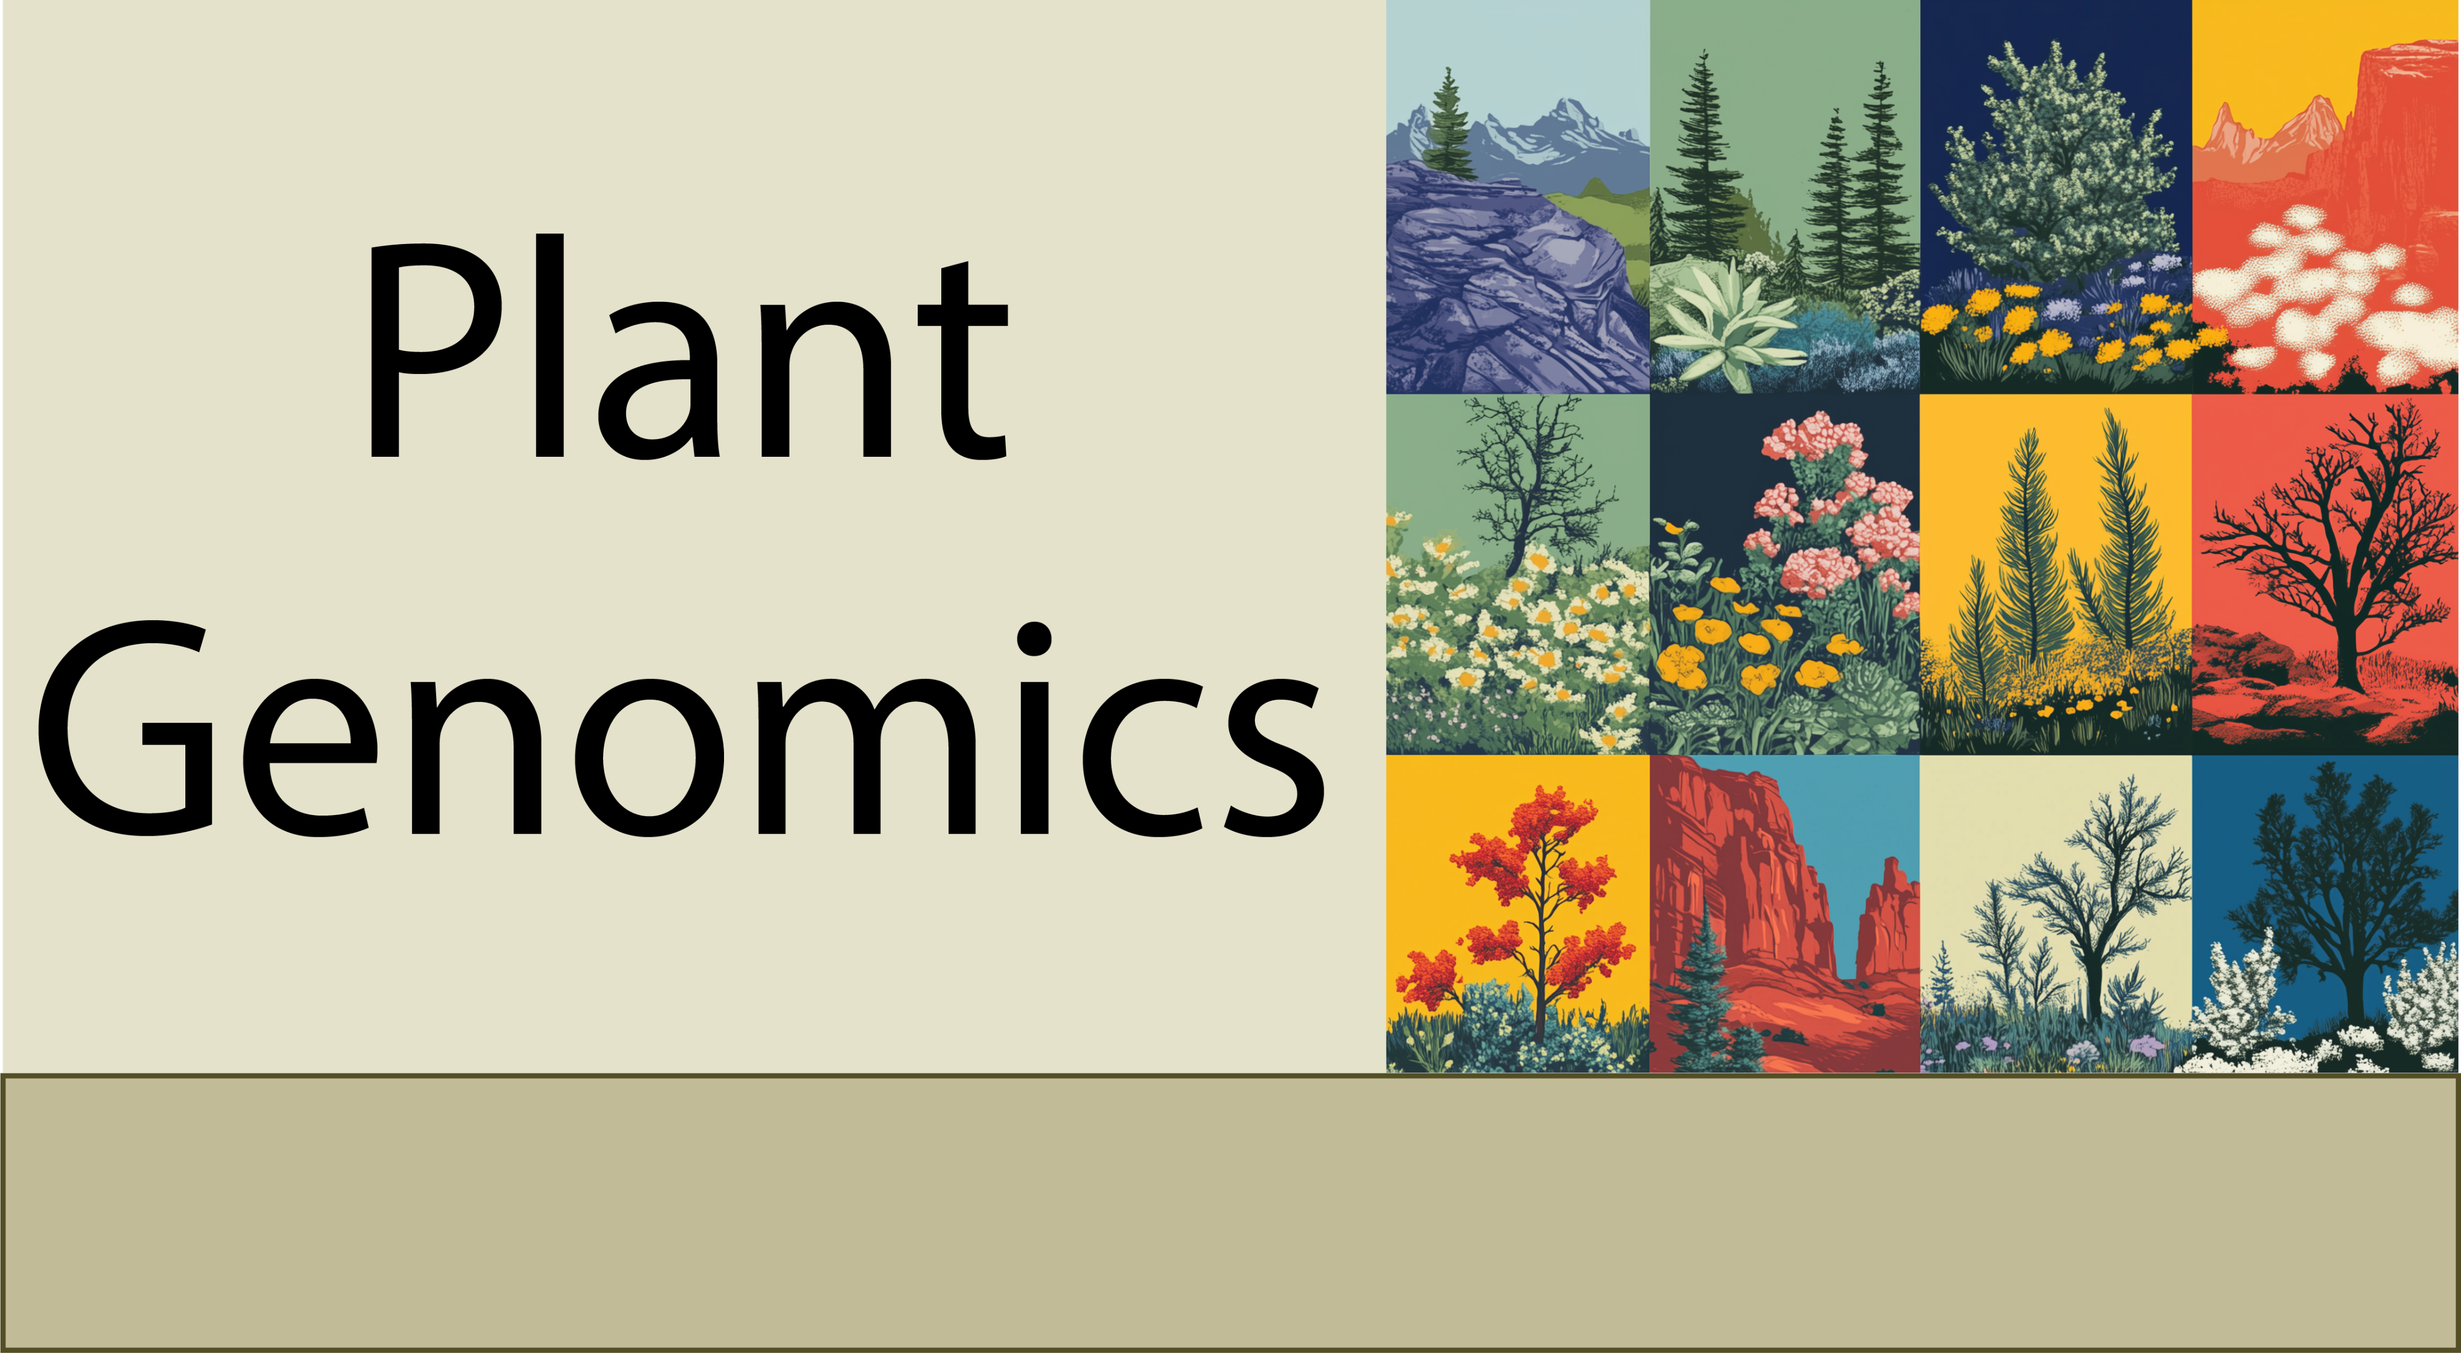
Comparative Genomics
9-22-25

Slide 2
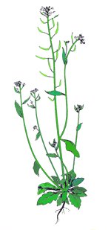
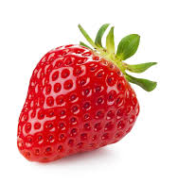
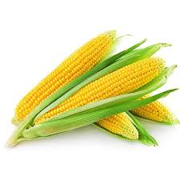
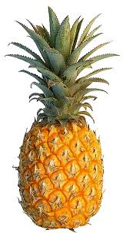
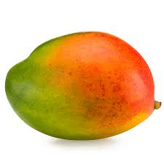
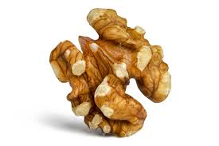
Basic discovery on gene function in Arabidopsis
How do we translate basic discoveries from models to crop species?

Slide 3
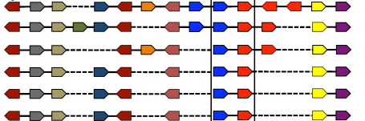
Comparative genomics: Synteny
Each of the boxes represent genes along chromosomes
Plant genomes are broadly collinear meaning the same genes or ‘syntenic orthologs’ are in the same relative order in the genome.

Slide 4
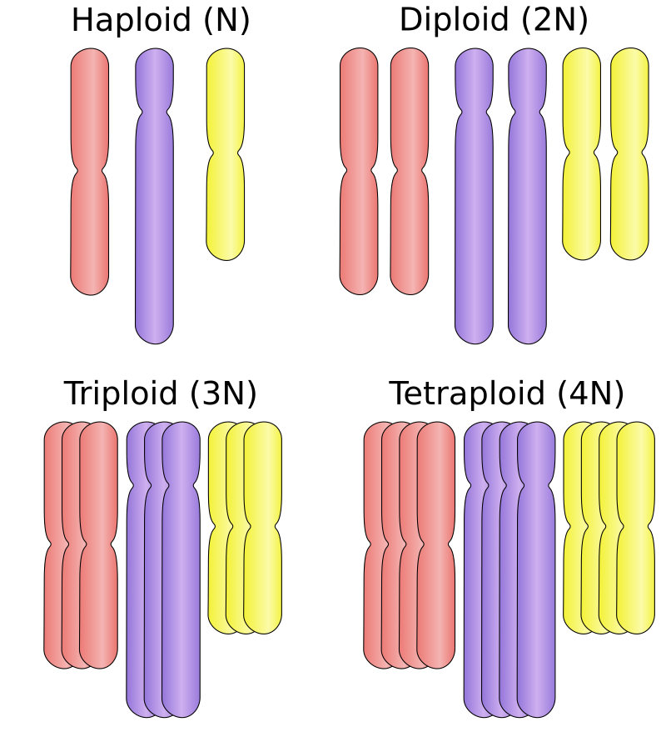
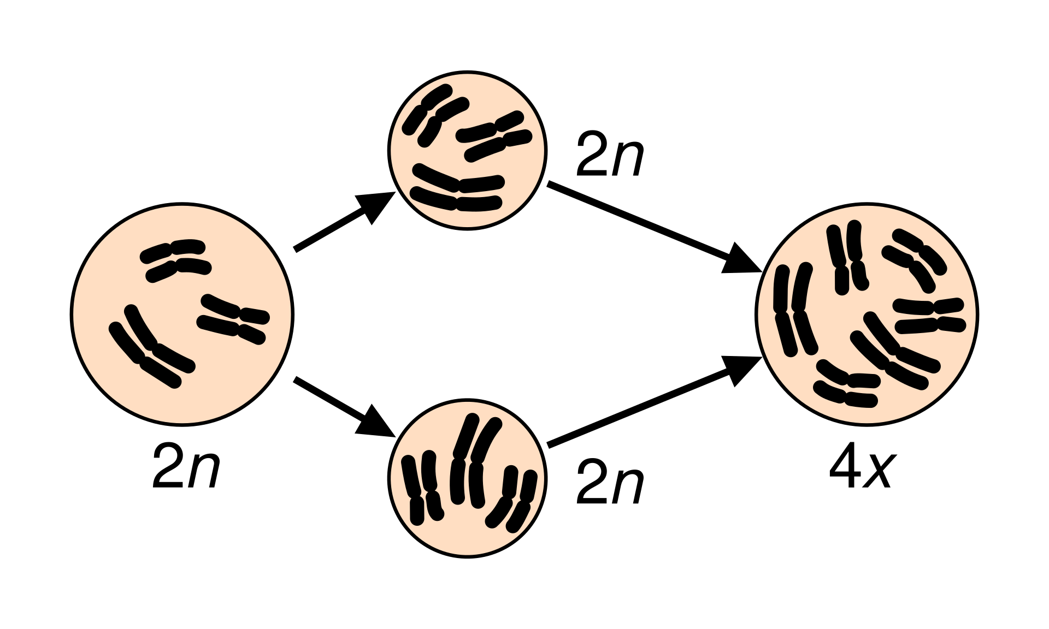
Polyploidy
Polyploidy typically occurs via meiotic or mitotic failures and the fusion of unreduced gametes

Slide 5
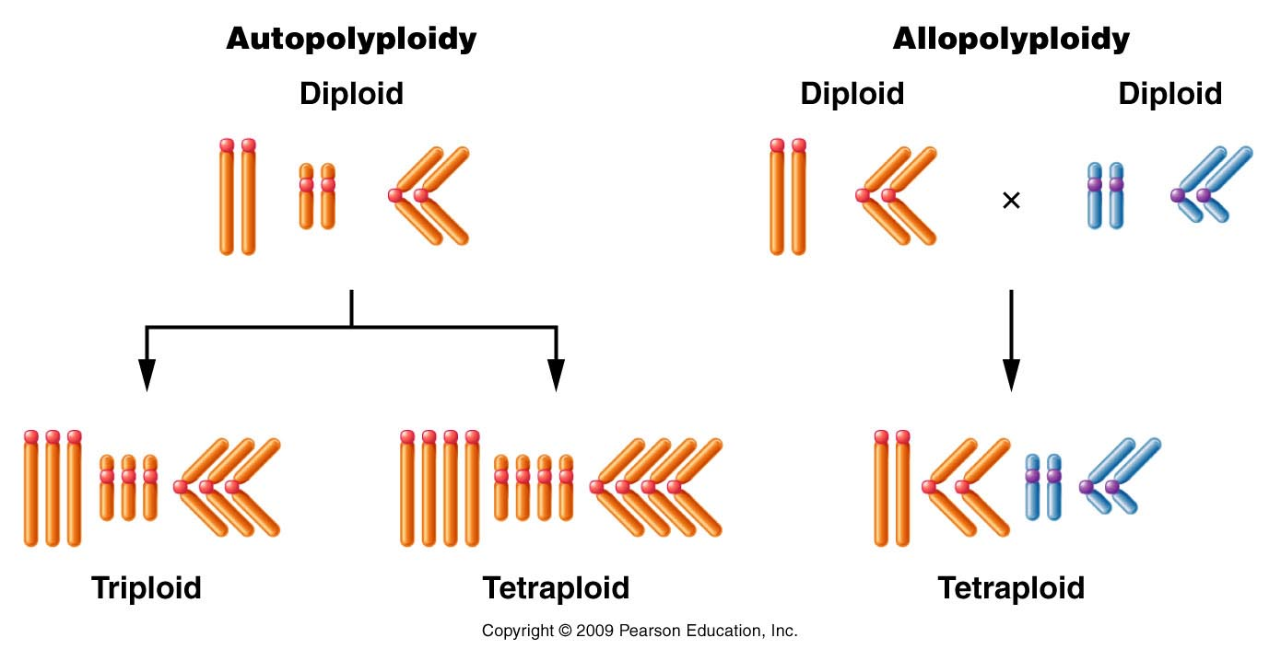
Allo vs auto polyploidy

Slide 6
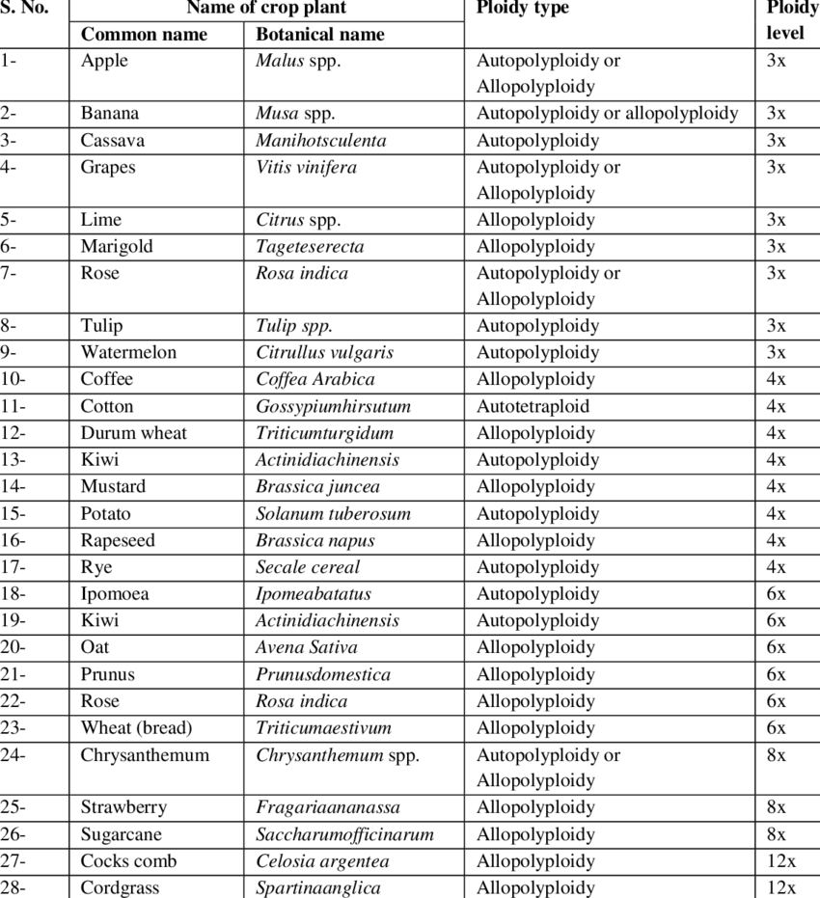
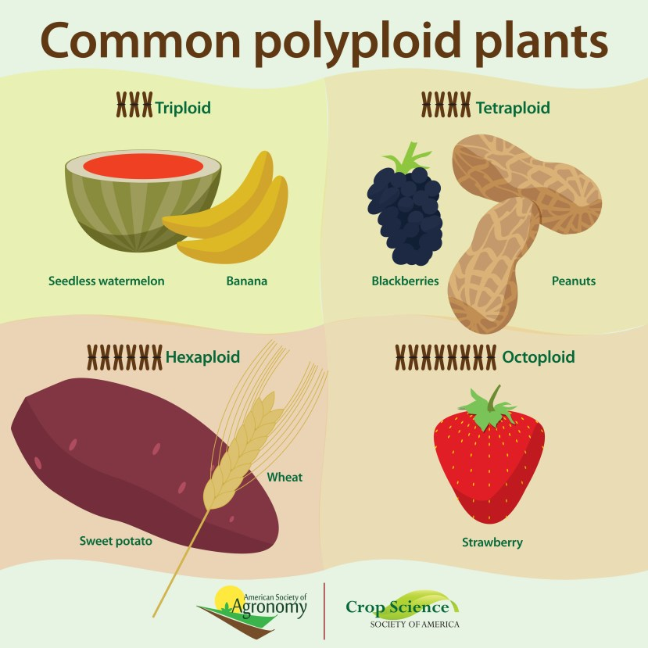
Many crops are complex polyploids
Many wild and crop plants are polyploid, ranging from triploid (3x) to dodecaploid (12x) or higher)
Adder's-tongue fern is probably the most polyploid plant, with estimates of 126x ploidy.

Slide 7
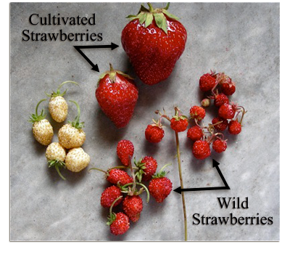
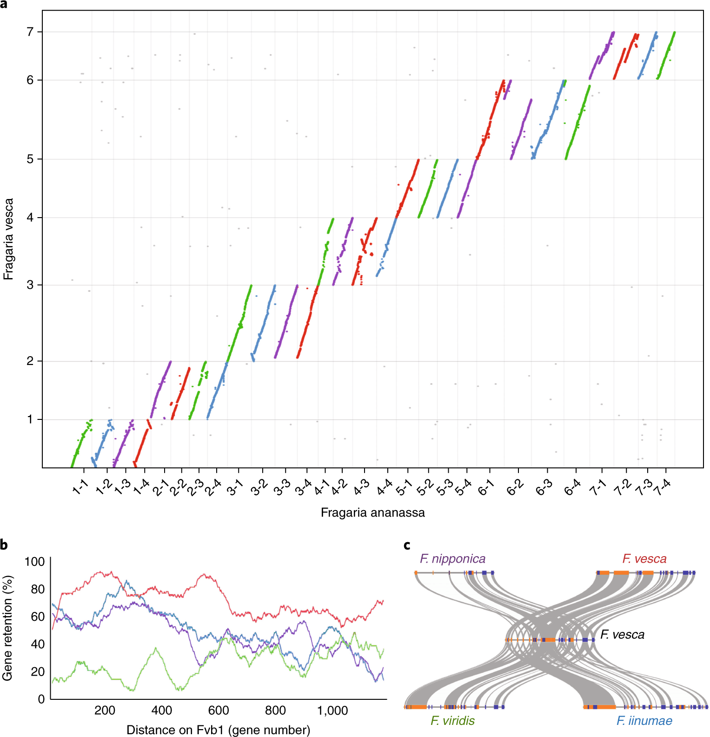
Comparative genomics of polyploids
Cultivated strawberry is an alloctoploid (8x), with likely 4 diploid progenitors
Wild strawberries (diploid, 2x)

Slide 8
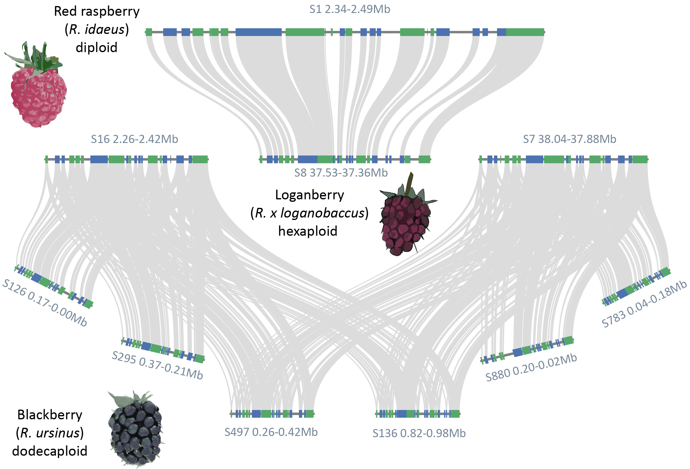
Comparative genomics of polyploids

Slide 9
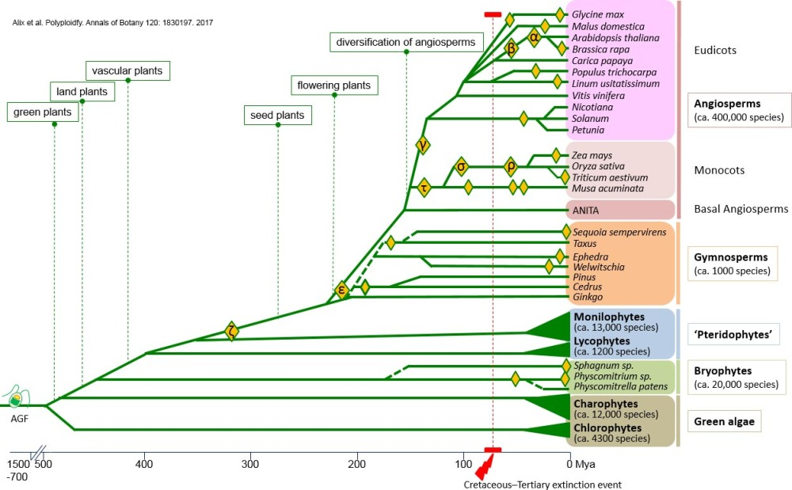
All plants are ancient polyploids
Ancient polyploidy events or whole genome duplications have shaped the evolution of the green lineage.
Zeta (ζ) and epsilon (ε) WGD events occurred between 300–350 million years ago and ~200 MYA, enabled the diversification of land plants.
Gamma WGD (γ) event occurred around 160–200 million years ago, before the diversification of core eudicots.
Alpha (α) and Beta (β)WGD events occurred in the lineage leading to Arabidopsis and other Brassicaceae.
Tau (τ) and sigma (σ) WGD events ~110 and 70 million years ago are linked to the evolutionary success and global spread of the grass family.

Slide 10
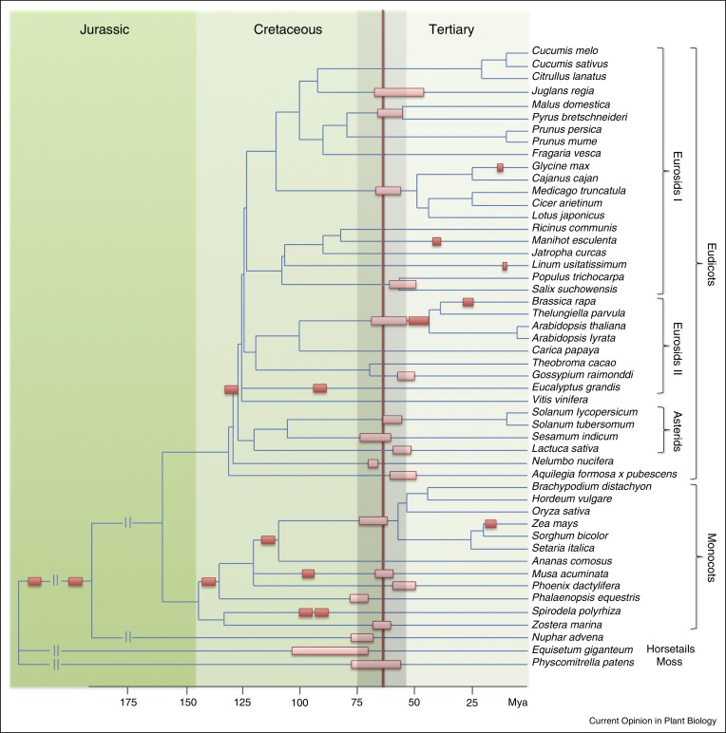

Did polyploidy save plants from the dinosaur killing asteroid?
Many whole genome duplications seem to be clustered in time around the K/Pg boundary.

Slide 11
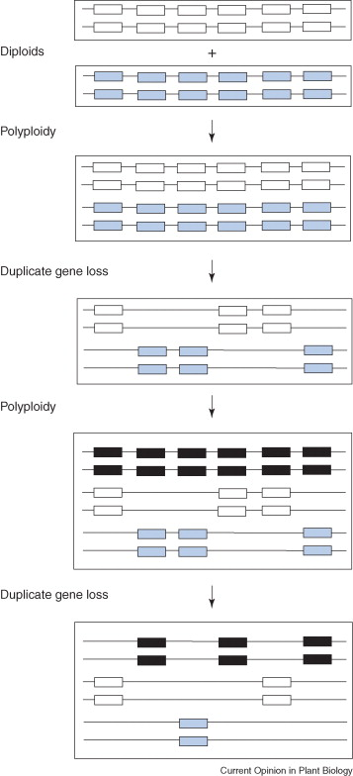
How does a plant go from polyploid to diploid again?
Two diploids merge
Recurrent polyploidization
Over time, ‘diploidization’ occurs.
Redundant duplicated genes are lost through fractionation. Genes are silenced then deleted.
Some duplicates are retained and take on new functions (sub or neofunctionalization)
Chromosomes rearrange and fuse, genome gets smaller, becomes more diploid like
Allopolyploid is formed
Many lineages have recurrent polyploidy or WGD events, so there is a lot of raw material for innovation!

Slide 12
Arabidopsis is a complex ancient polyploid!
125 Mb genome
Arabidopsis has experienced at least three polyploidy events in its history:
Gamma WGD: 140–200 million years ago (MYA) (triplication 6x)
Beta WGD: 100-120 MYA (duplication, 12x)
Alpha WGD: 30-65 MYA (duplication, 24x)
Single ancestral genes could have up to 24x gene copies, making room for a lot of innovation!
This is also why there is so much gene redundancy in Arabidopsis

Slide 13
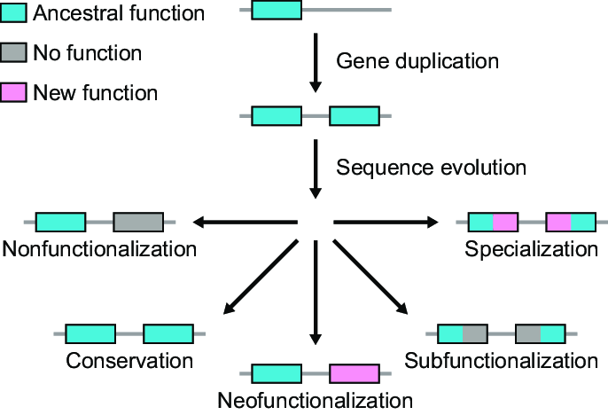
Genome evolution
Neofunctionalization occurs when one copy of a duplicated gene acquires a new function that was not present in the ancestral gene.
Subfunctionalization occurs when the duplicated genes divide the original functions of the ancestral gene between them.

Slide 14
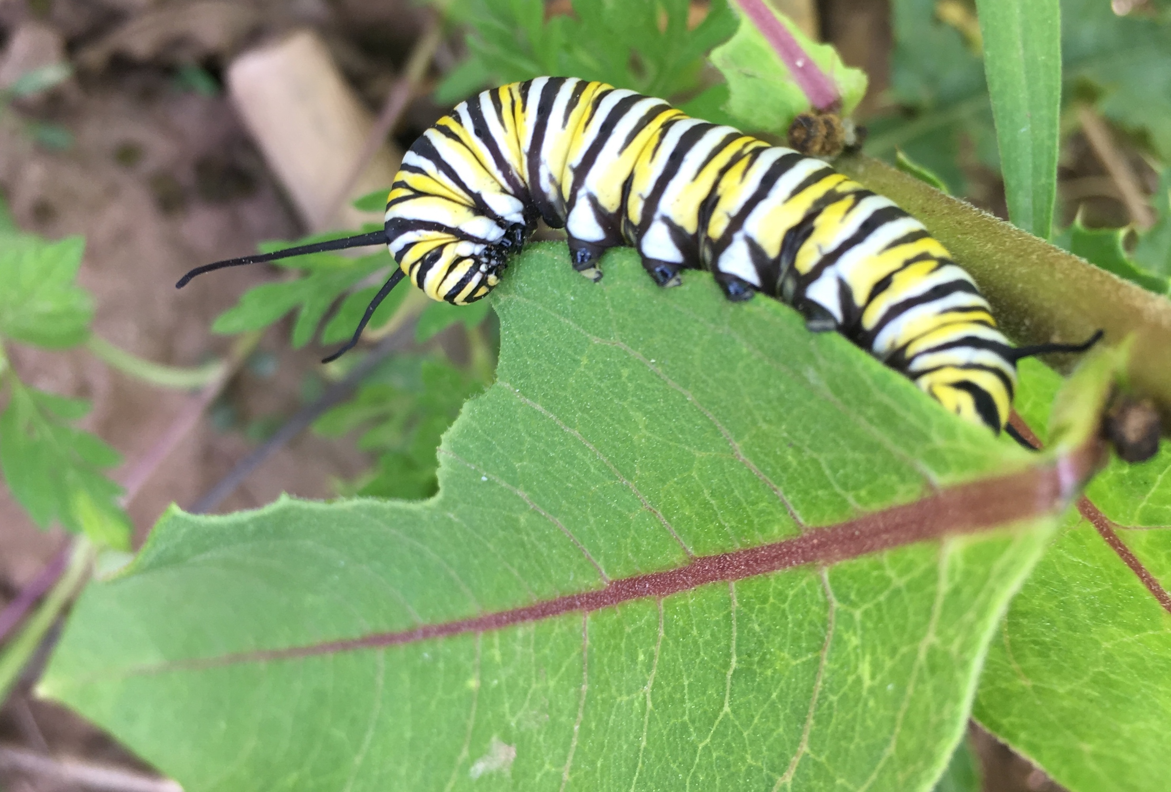
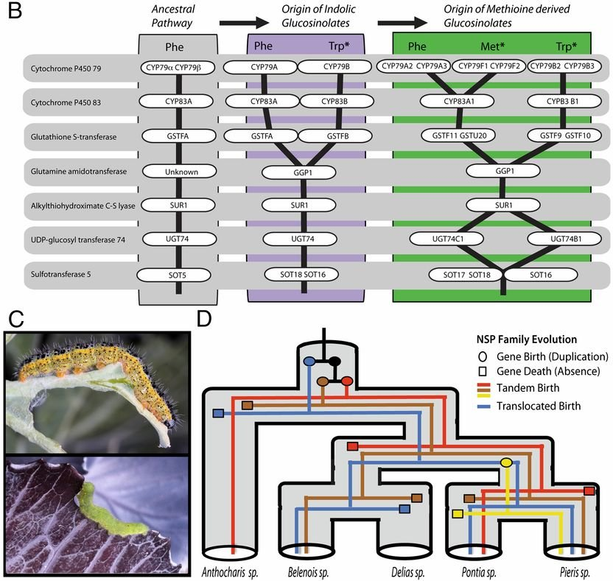
The butterfly plant arms race
Each time a plant evolves a new chemical defense (e.g., P450 enzyme gene duplication to make a novel glucosinolate) the insect duplicates a different P450 gene that evolves to detoxify it

Slide 15
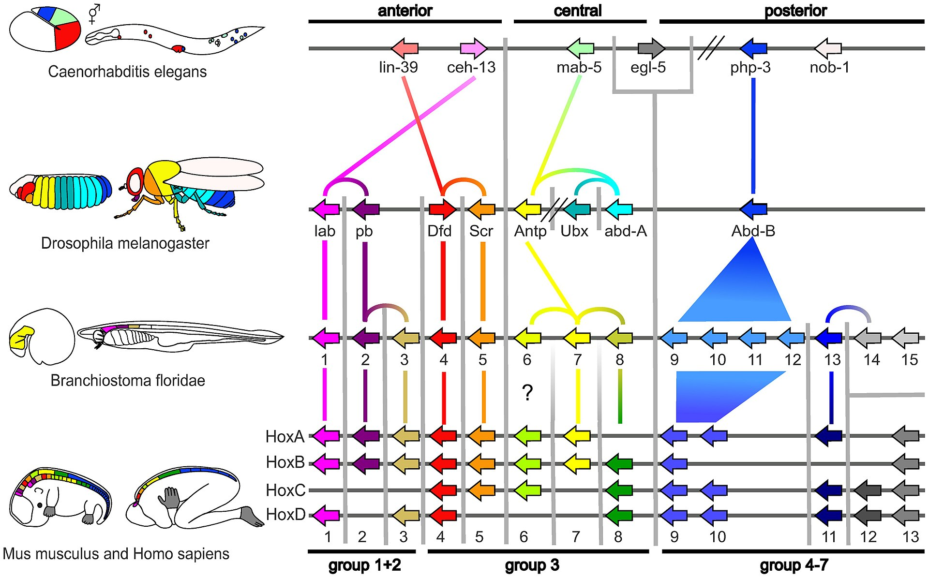
Synteny in Hox genes for animal development

Slide 16
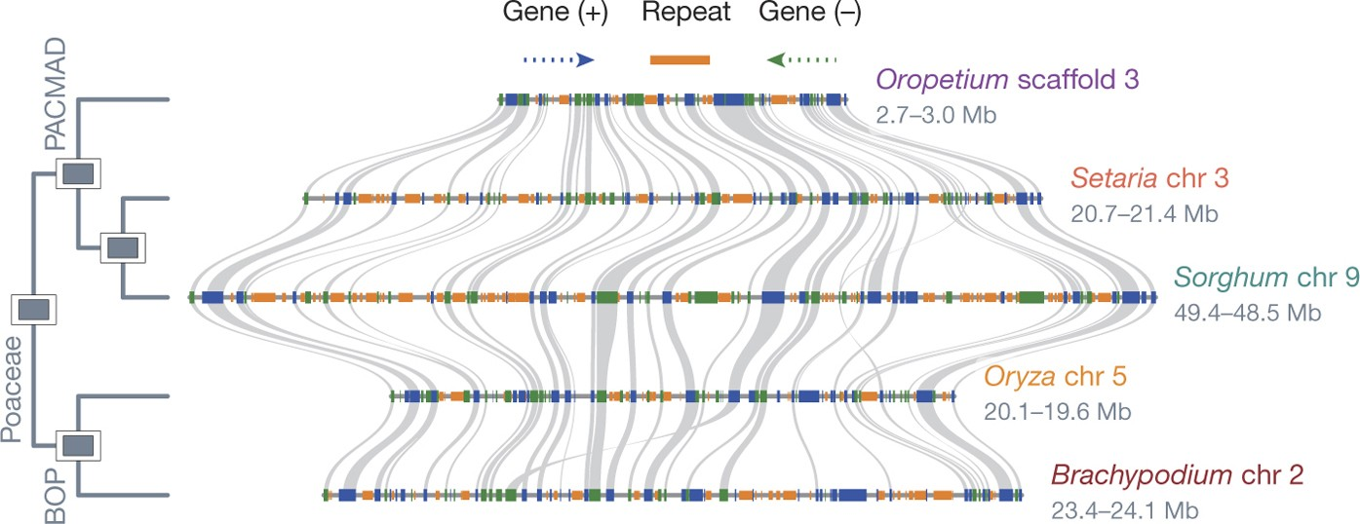
Microsynteny between grasses
Smallest grass genome
(240 Mb)
Sorghum genome
(730 Mb)
Microsynteny refers to the conservation of the gene order and genomic organization in small, localized regions of chromosomes across different species

Slide 17
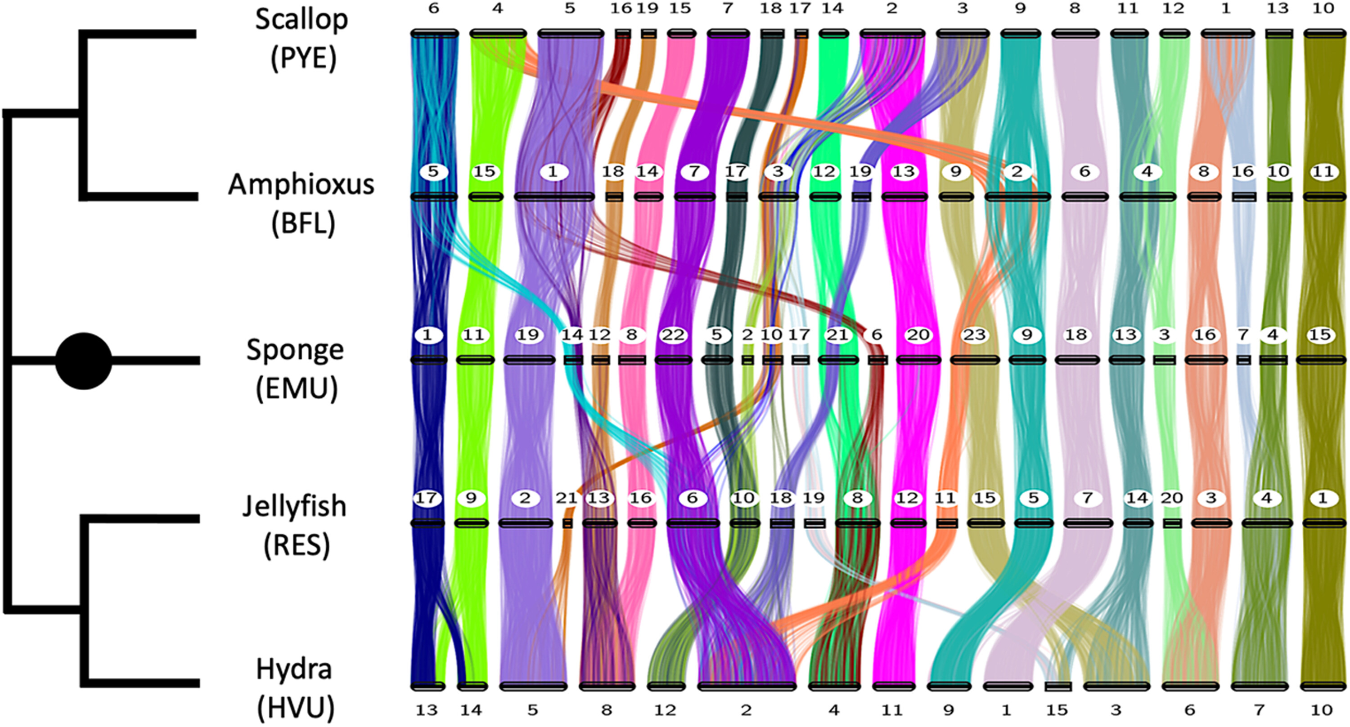
Macrosynteny in animals
Macrosynteny refers to the conservation of large-scale chromosomal structure or gene order across species or within genomes over long evolutionary timescales

Slide 18
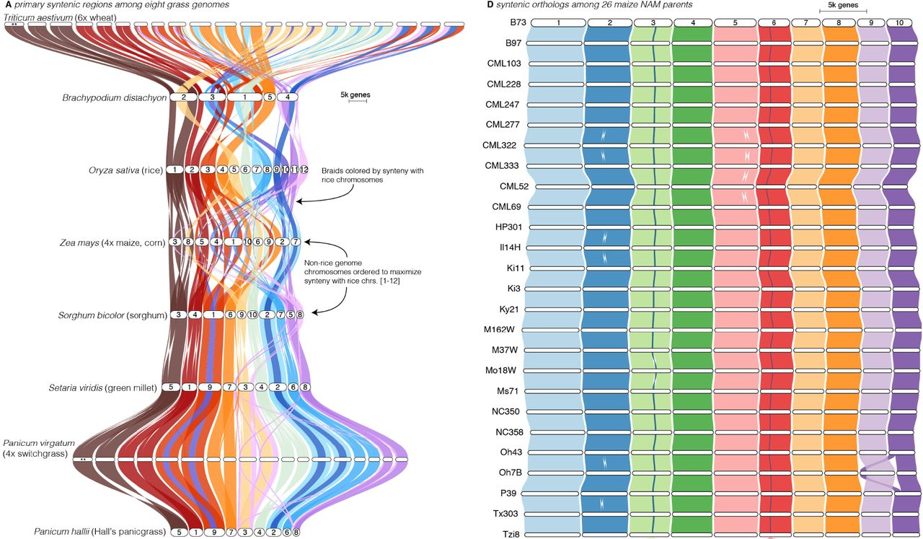
Macrosynteny in plants

Slide 19
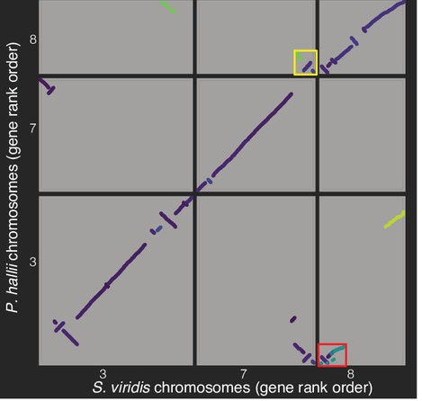
Visualizing genomes using macrosyntenic dot plot
A typical dot plot compares two genomes against each other. One genome is plotted on the x-axis, and the other genome is plotted on the y-axis.
Each point (or "dot") on the plot represents the position of a gene or a genomic region in both species or genomic contexts being compared.
Syntenic regions (conserved blocks of genes) between the genomes appear as diagonal lines or blocks of aligned dots. This indicates that the gene order in that region has been conserved between the two genomes.
Non-syntenic regions or regions with chromosomal rearrangements (such as inversions or translocations) will break the continuity of the dots or show dots in a different orientation.

Slide 20
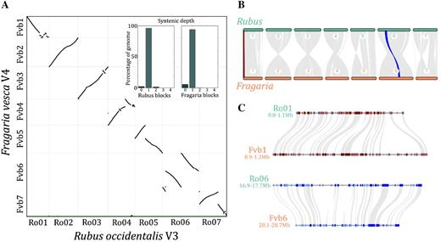
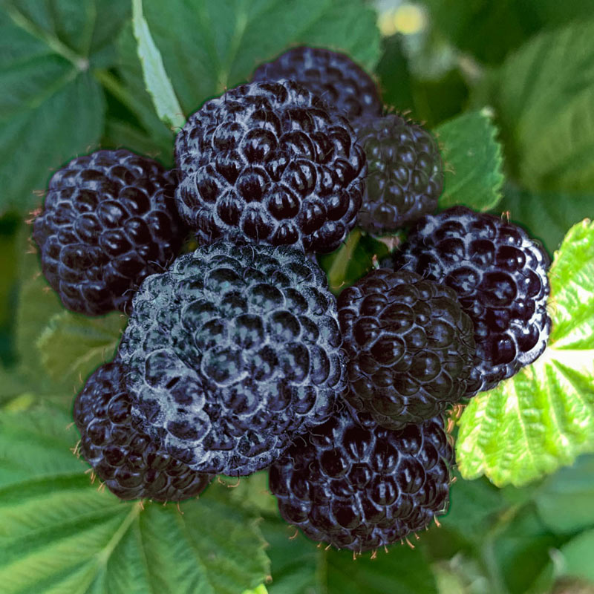
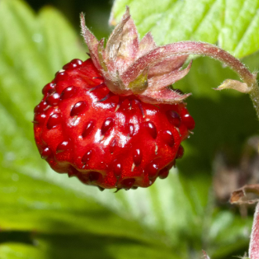
Visualizing genomes using macrosyntenic dot plot

Slide 21
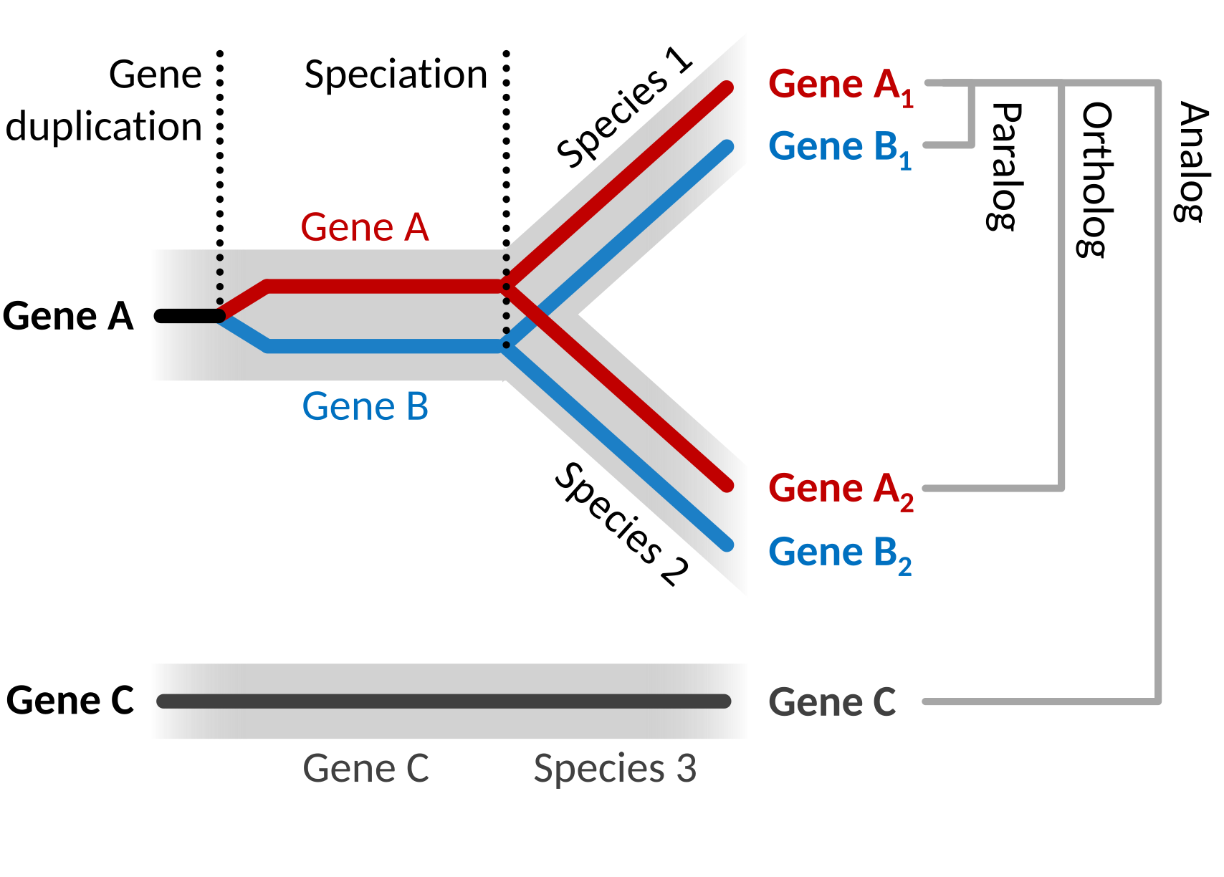
Phylogenetics: establishing orthology
Paralogs and orthologs are two types of homologous genes that arise from different evolutionary processes.
Orthologs are genes in different species that originated from a single ancestral gene through a speciation event.
Paralogs are genes that arise through gene duplication within the same genome.
Recently duplicated genes in a single species are usually paralogs.

Slide 22
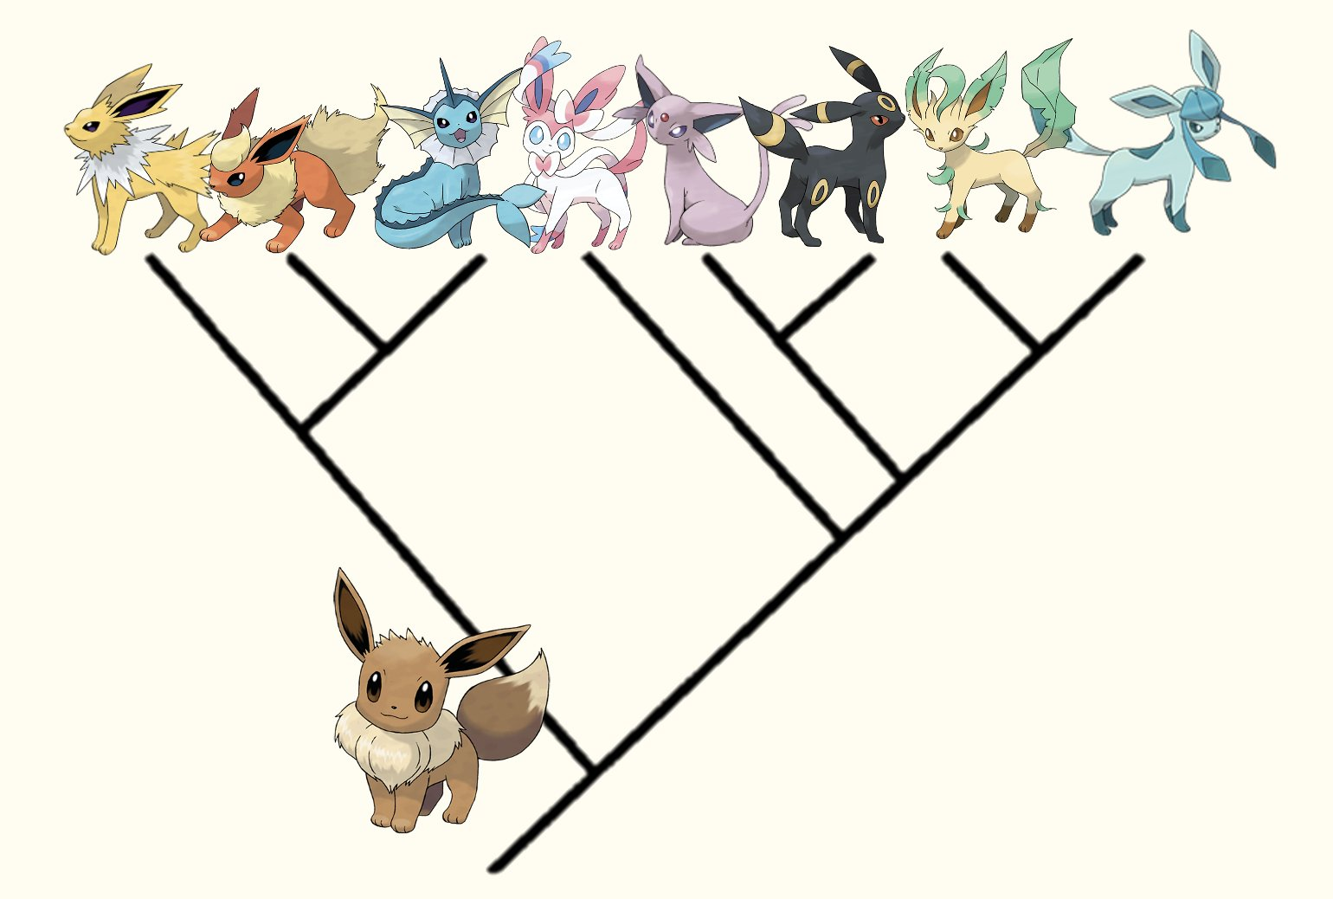

Reading evolutionary trees
Which evolved form (Eeveelutions) is Eevee most closely related to?

Slide 23
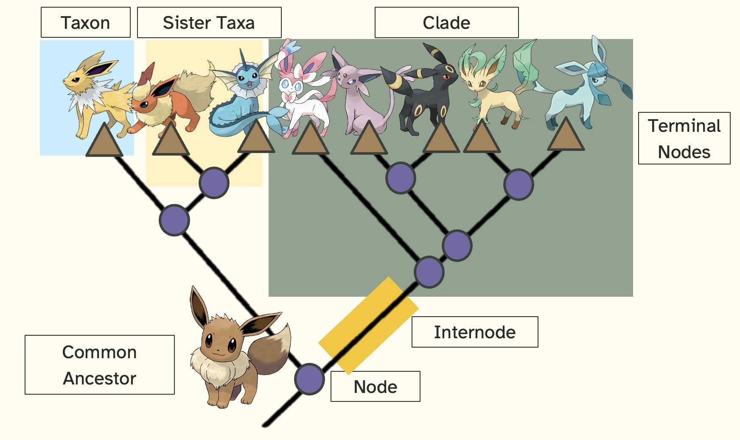
Reading evolutionary trees

Slide 24
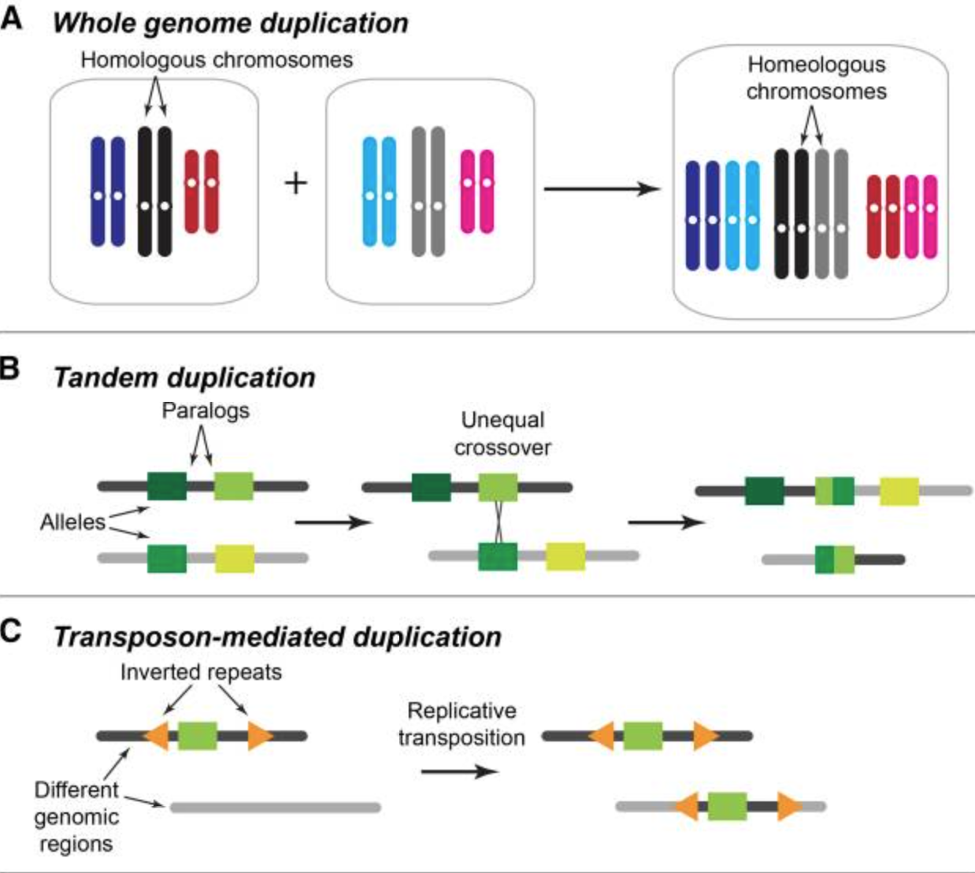
Plant Gene Families
Most plant genes are found in gene families, groups with similar function and a shared common ancestor
Plant genes duplicate rapidly, through tandem, segmental, or whole genome duplications
NBS-LRR Genes (Nucleotide-binding site-leucine-rich repeat). Involved in disease resistance ~100-2,000 genes
MYB transcription factors regulate secondary metabolism, cell differentiation, stress responses. ~150-500 genes
Cytochrome P450s involved in the synthesis of secondary metabolites and detoxification ~250-2,000 genes

Slide 25
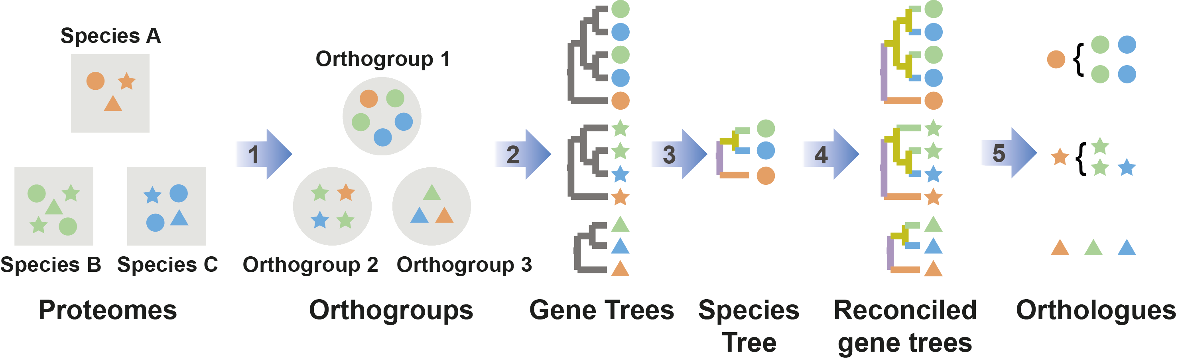
Establishing orthology between species: Orthofinder

Slide 26
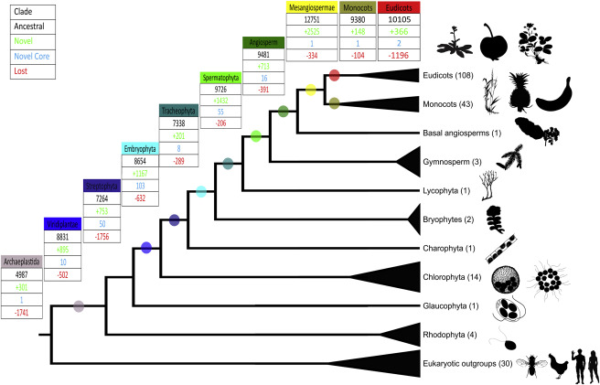
Establishing orthology between species: Orthofinder
Most genes are deeply conserved across the green lineage with ancestral origin hundreds of millions to billions of years old.
~8,800 conserved genes (gene families) within the green lineage, ~10,000 in flowering plants (angiosperms)

Slide 27
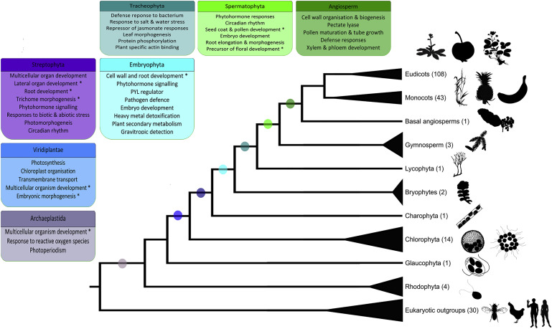
Gene duplications drive evolutionary innovations

Slide 28
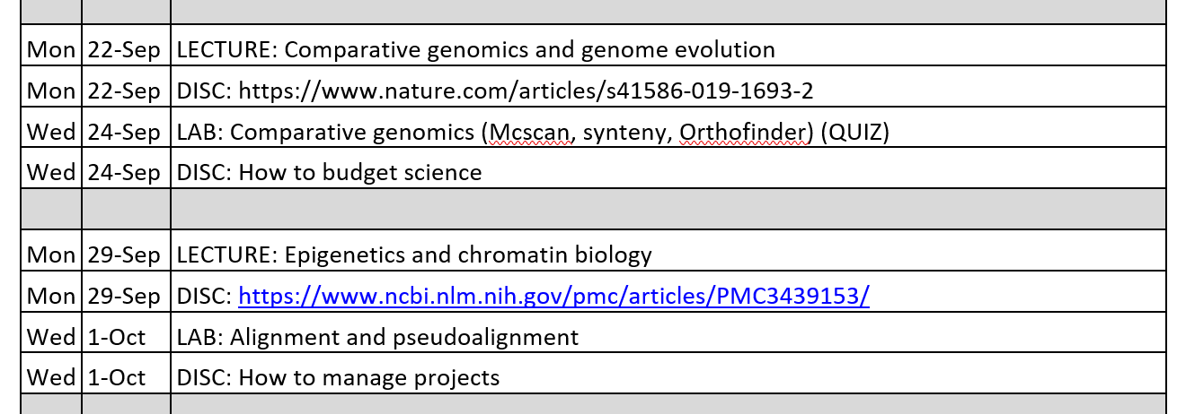
Looking forward

