Slide 1

Epigenetics, gene regulation, and chromatin biology
10-6-25

Slide 2
How are genetic elements regulated?
What factors control when, where, and how much your favorite gene is expressed?
Your favorite gene

Slide 3
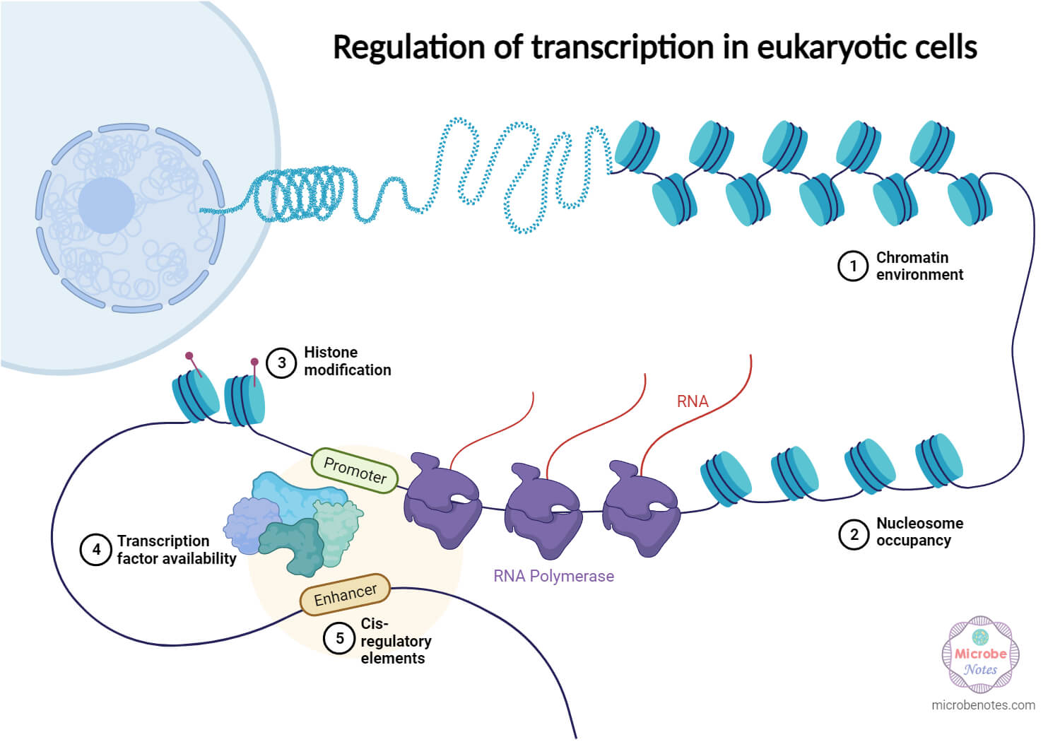
How are genetic elements regulated?

Slide 4
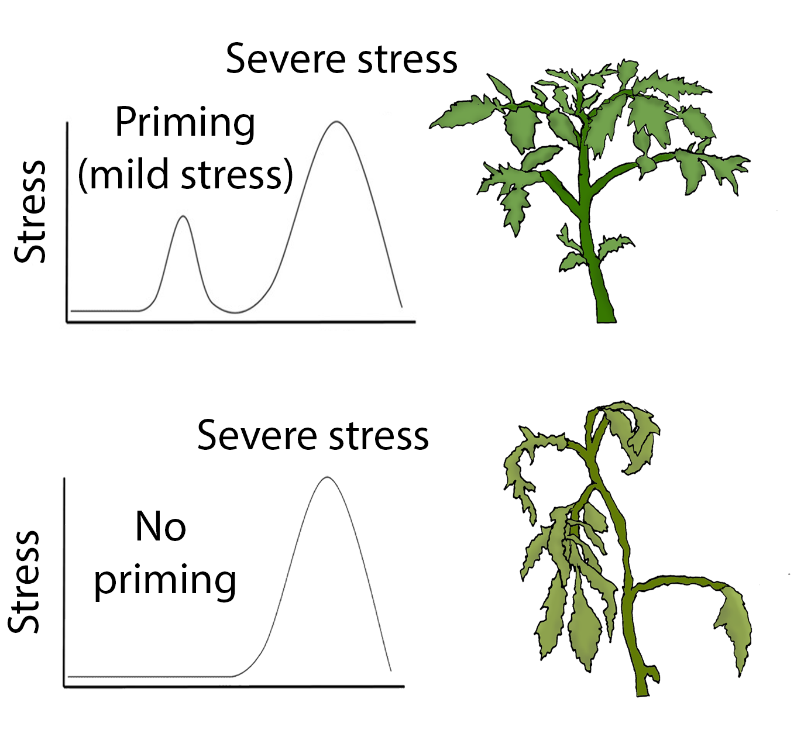
Stress memory in plants is controlled by ‘epigenetics’
Stress memory in plants refers to the ability of plants to "remember" previous exposure to stress conditions (e.g., drought, heat, or pathogen attack) and respond more effectively to subsequent stress events. This memory is established through epigenetic modifications (e.g., DNA methylation, histone modifications), transcriptional reprogramming, and metabolic changes that prime the plant for faster or stronger responses in future stress encounters. Stress memory can be transient, lasting only a few days, or long-term, persisting across developmental stages or even being transmitted to offspring.
‘stress memory’ and epigenetics more broadly are open and contentious areas of research
There are a lot of complex and sometimes confusing patterns

Slide 5

DNA is not stored like a bowl of spaghetti in the nucleus

Slide 6
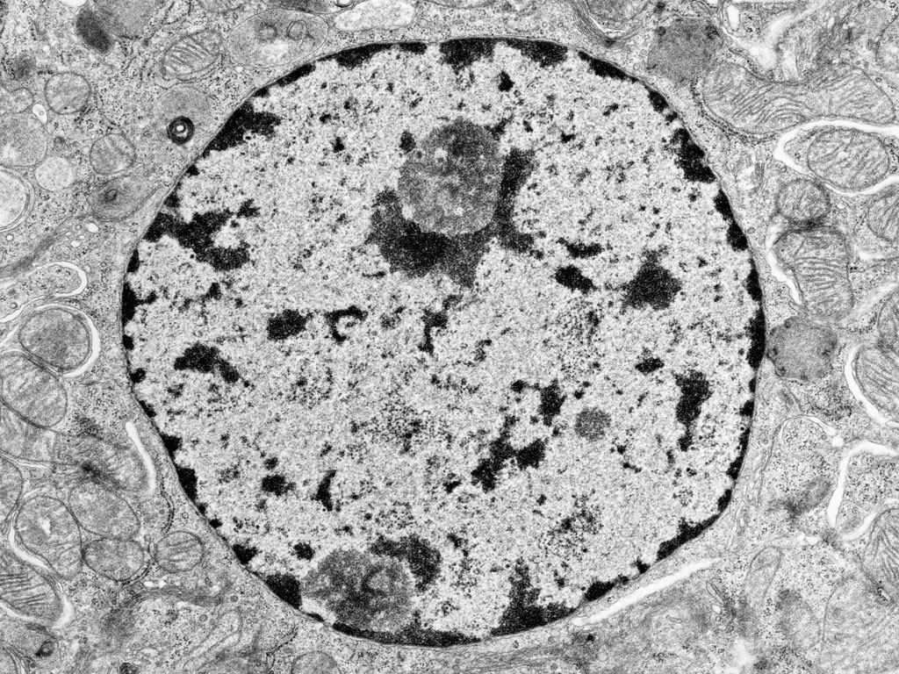
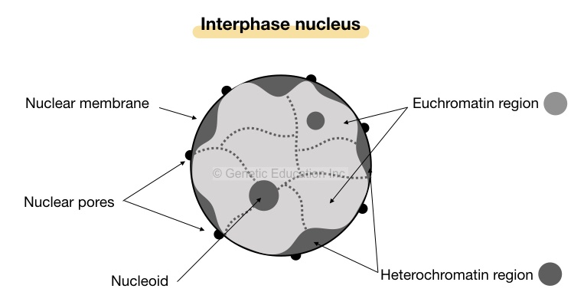
DNA is not stored like a bowl of spaghetti in the nucleus
In plants, euchromatin is a loosely packed form of chromatin that is transcriptionally active and enriched for genes, while heterochromatin is densely packed, gene-poor, and typically transcriptionally silent. Heterochromatin is often found at centromeres and telomeres and is enriched for transposable elements and repressive epigenetic marks.

Slide 7
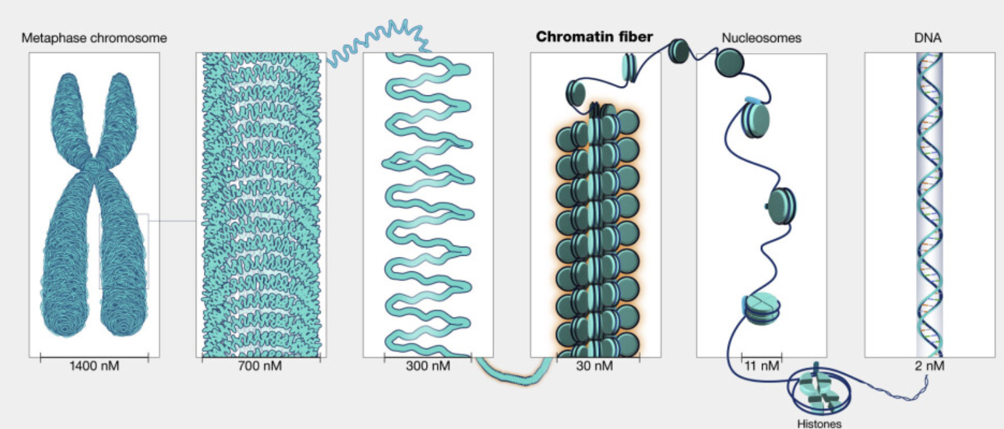
DNA is packed in several layers of increasing complexity

Slide 8
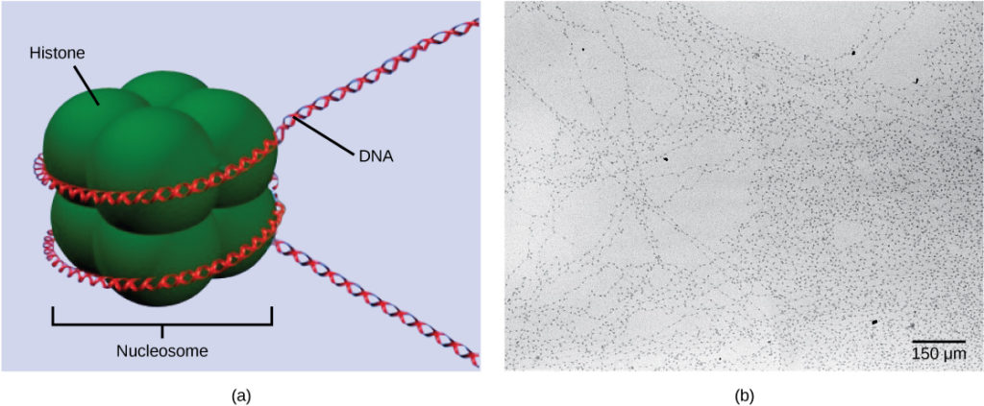
DNA is packed in several layers of chromatin
DNA is wrapped around histone proteins to form nucleosomes, which together, make up chromatin
This histone wrapped DNA is often referred to as ‘beads on a string’

Slide 9
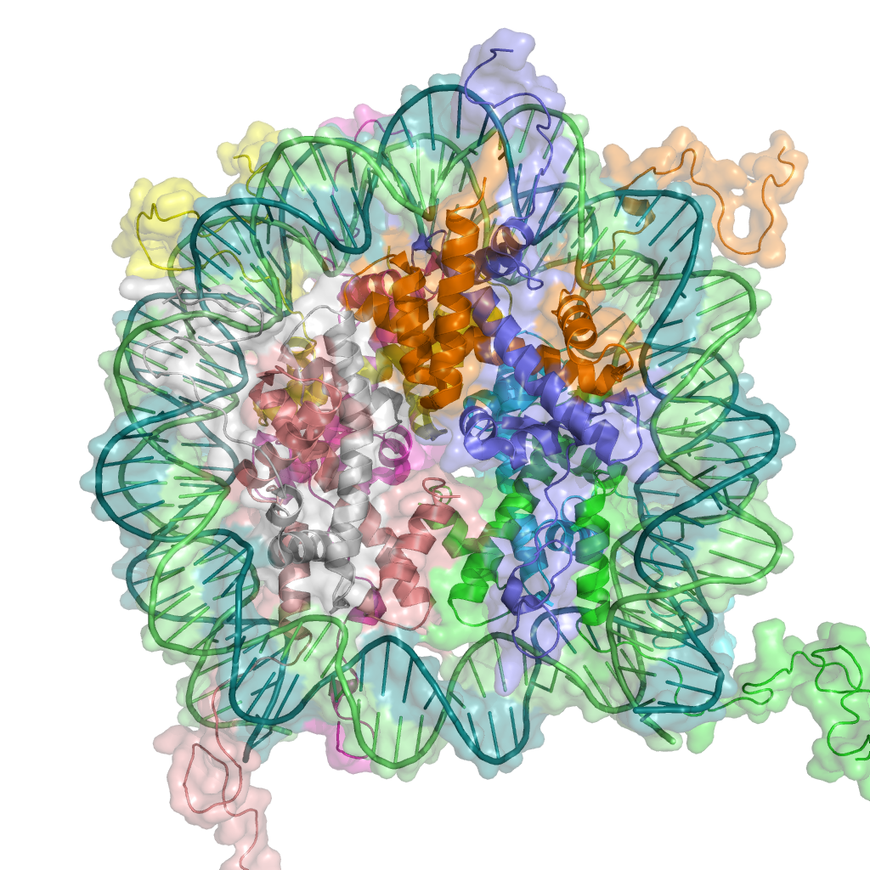
Histones and gene regulation
Histones are proteins that package and organize DNA into chromatin in eukaryotic cells. The core histones (H2A, H2B, H3, and H4) form an octamer around which DNA is wrapped, creating a nucleosome structure.
Common Histone Modifications in Plants:
Acetylation (e.g., H3K9ac, H3K27ac): Addition of acetyl groups, typically associated with transcriptional activation by loosening chromatin and making DNA more accessible to transcription factors.
Methylation (e.g., H3K4me3, H3K27me3): Can be associated with either gene activation (e.g., H3K4me3) or repression (e.g., H3K27me3) depending on the site and number of methyl groups added.
Phosphorylation (e.g., H3S10ph): Often linked to chromatin condensation and regulation of gene expression during cell division or in response to stress.
Impact on Gene Regulation:
Modifications such as acetylation open chromatin, promoting transcription, while methylation can either repress or activate genes depending on the context.
Histone modifications can recruit chromatin remodelers and other proteins that change chromatin structure, affecting gene accessibility.
Histone modifications interact with DNA methylation and non-coding RNAs to establish stable gene expression patterns and responses to environmental stimuli.

Slide 10
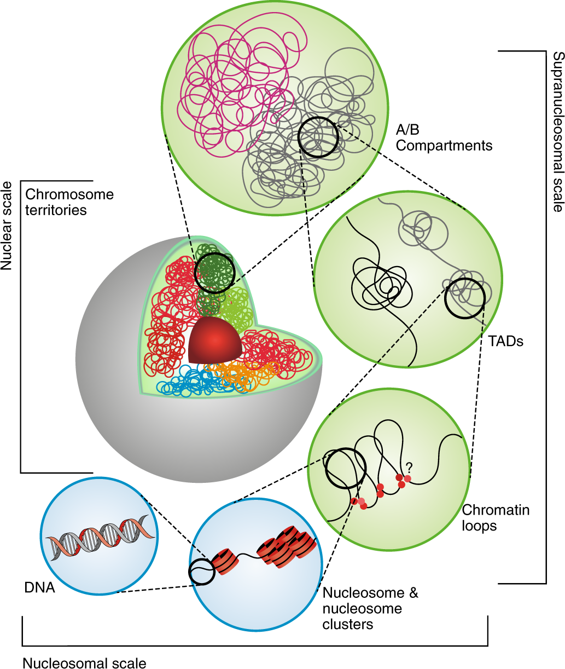
Higher order regulation of gene expression
Nucleosome Structures: Basic unit of chromatin, where DNA wraps around histone proteins, regulating DNA accessibility and gene expression.
Chromatin Loops: DNA loops that bring distant regions into proximity, enabling regulatory interactions between enhancers and promoters.
Topologically Associating Domains (TADs): Self-interacting chromatin domains that compartmentalize the genome, maintaining distinct regulatory environments. TAD boundaries act as insulators, preventing interactions between genes and regulatory elements in different domains.
A/B Compartments: Large chromatin regions (A = active, B = inactive) that organize the genome into transcriptionally active or repressive areas.
Chromosome Territories: Spatially distinct regions in the nucleus occupied by individual chromosomes, influencing inter-chromosomal interactions and gene expression.

Slide 11
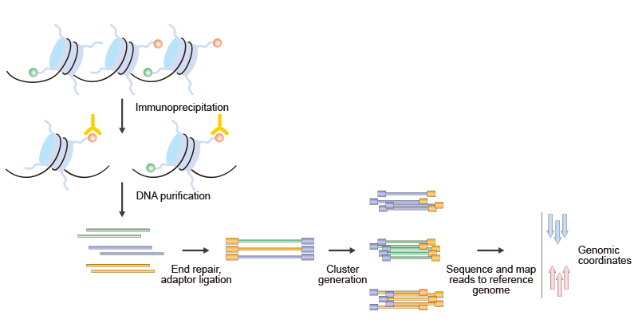
Measuring histone modifications ChIPseq
ChIP-Seq (Chromatin Immunoprecipitation Sequencing) is a powerful method used to study histone modifications in plants by mapping the binding sites of histone proteins with specific post-translational modifications across the genome.

Slide 12
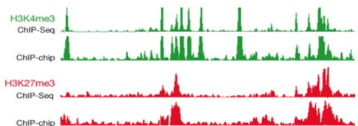
Measuring histone modifications ChIPseq
H3K4me3 (trimethylation of histone H3 at lysine 4) is generally associated with gene activation.
H3K27me3 (trimethylation of histone H3 at lysine 27) is associated with gene repression. It is a mark of facultative heterochromatin and is linked to transcriptional silencing of genes.

Slide 13
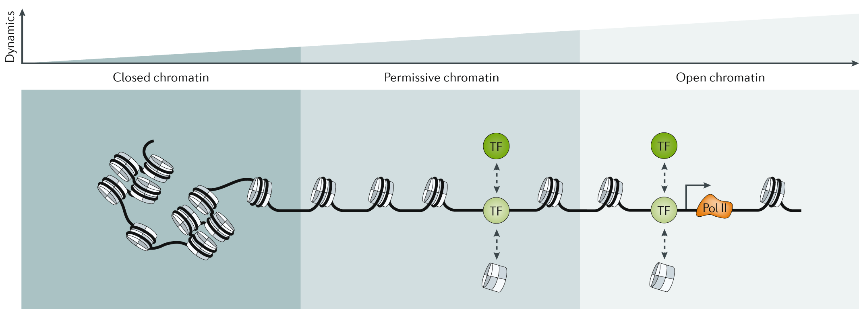
Discerning how open chromatin is
Klemm et al. 2019

Slide 14
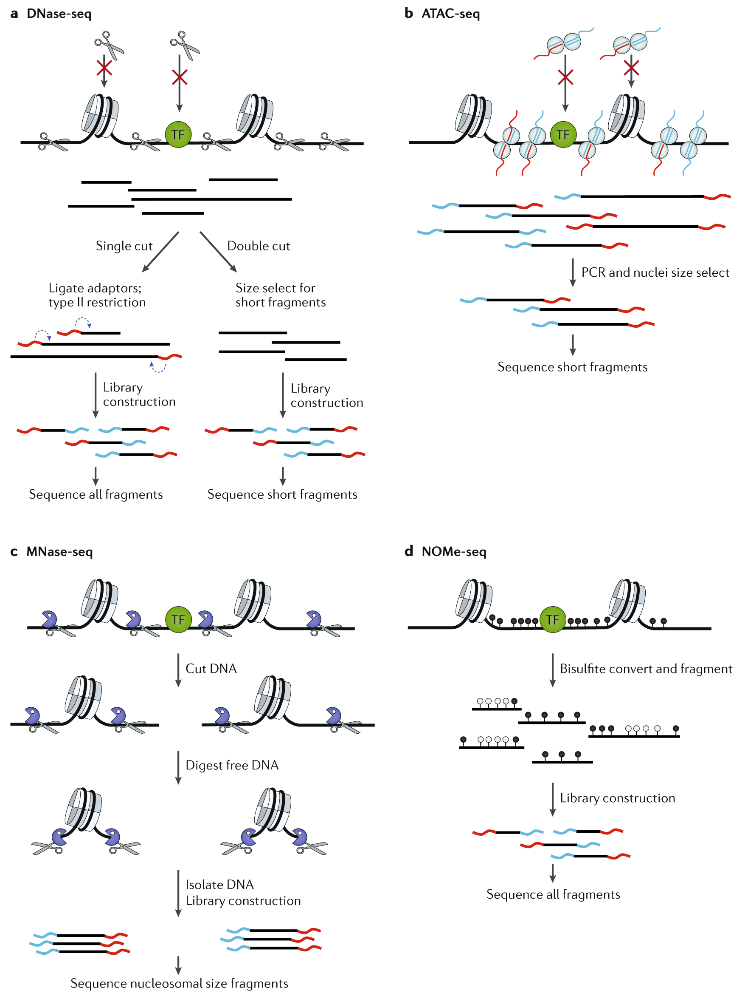
Profiling accessible chromatin: DNase-seq
DNase-seq for profiling open/accessible chromatin
Isolation of Nuclei: Cells are lysed to isolate intact nuclei, preserving the native chromatin structure and ensuring that DNase I can access the DNA in its natural chromatin state.
DNase I Digestion: Isolated nuclei are treated with DNase I, which preferentially cuts DNA at regions of open chromatin (e.g., promoters, enhancers) that are accessible and not tightly bound by nucleosomes or other proteins.
Purification and Size Selection: The digested DNA is purified and size-selected to isolate small fragments (typically 100–500 base pairs) that correspond to DNase I hypersensitive sites.
Library Preparation and Sequencing: The selected DNA fragments are processed into a sequencing library and sequenced using a high-throughput platform like Illumina.
Data Analysis and Mapping: Sequencing reads are aligned to the reference genome, and regions with high read density are identified as DNase I hypersensitive sites, indicating regions of open chromatin.
Klemm et al. 2019

Slide 15
Profiling accessible chromatin: ATACseq
Klemm et al. 2019
ATACseq for profiling open/accessible chromatin
Chromatin Accessibility: Isolated nuclei or intact cells are treated with Tn5 transposase, an enzyme that preferentially inserts sequencing adapters into accessible regions of the chromatin.
Tagmentation: Tn5 simultaneously cuts (cleaves) and inserts sequencing adapters into open chromatin regions (e.g., promoters, enhancers), creating small DNA fragments that are ready for sequencing.
Purification and Size Selection: The tagmented DNA fragments are purified and size-selected to enrich for small fragments (typically 50–500 base pairs) that represent open chromatin regions.
Library Preparation and Sequencing: The tagmented fragments, already containing sequencing adapters, are directly amplified by PCR and then sequenced using a high-throughput platform like Illumina.
Data Analysis and Mapping: Sequencing reads are aligned to a reference genome, and regions with high read density are identified as accessible chromatin sites, providing insights into chromatin accessibility, regulatory element positions, and nucleosome positioning.

Slide 16
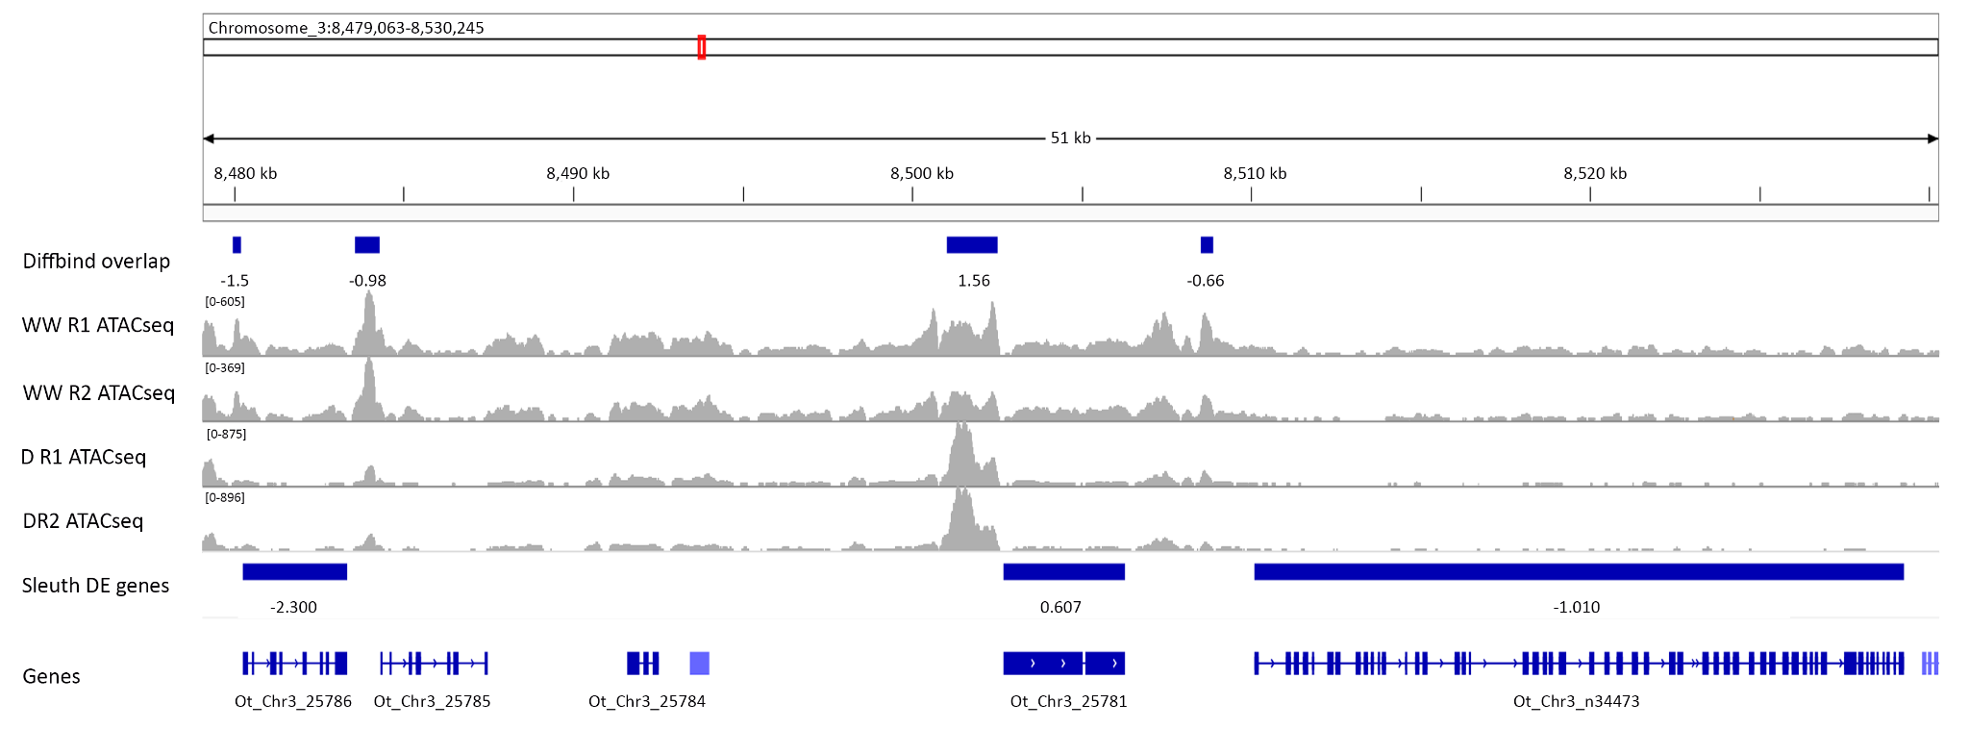
Profiling accessible chromatin: ATACseq
The ATAC-seq signal is shown as a series of peaks along the genome, where each peak indicates an open chromatin region. These peaks are regions where the Tn5 transposase inserted adapters, reflecting chromatin accessibility.
Taller peaks indicate higher accessibility or increased chromatin openness, suggesting a greater probability of transcription factor binding or active regulatory elements.
Peaks often appear over promoter regions (just upstream of genes, as highlighted in orange) and enhancers, indicating active or poised regulatory elements.
Can be integrated with gene expression (RNAseq) or other chromatin profiles to draw more meaningful conclusions.
We can look for TF motifs or cis-regulatory elements within these accessible regions.

Slide 17
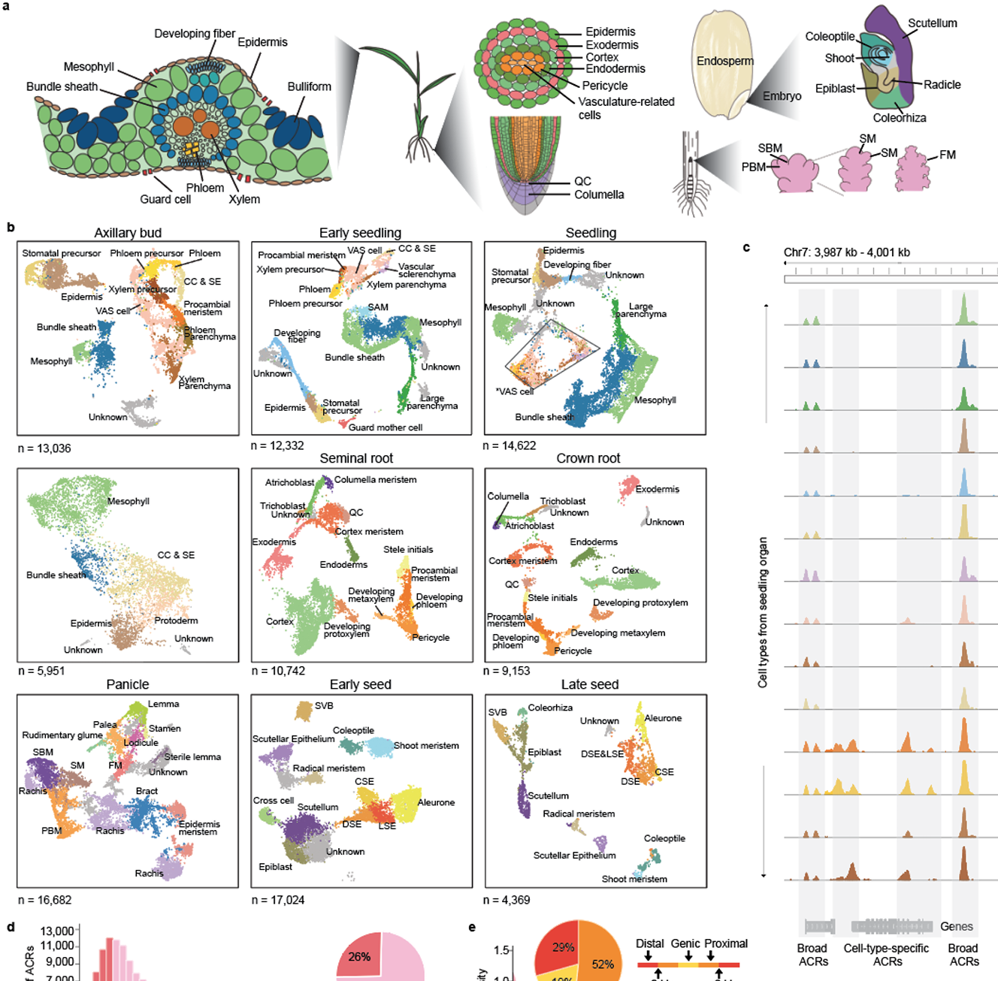
Single cell ATACseq

Slide 18
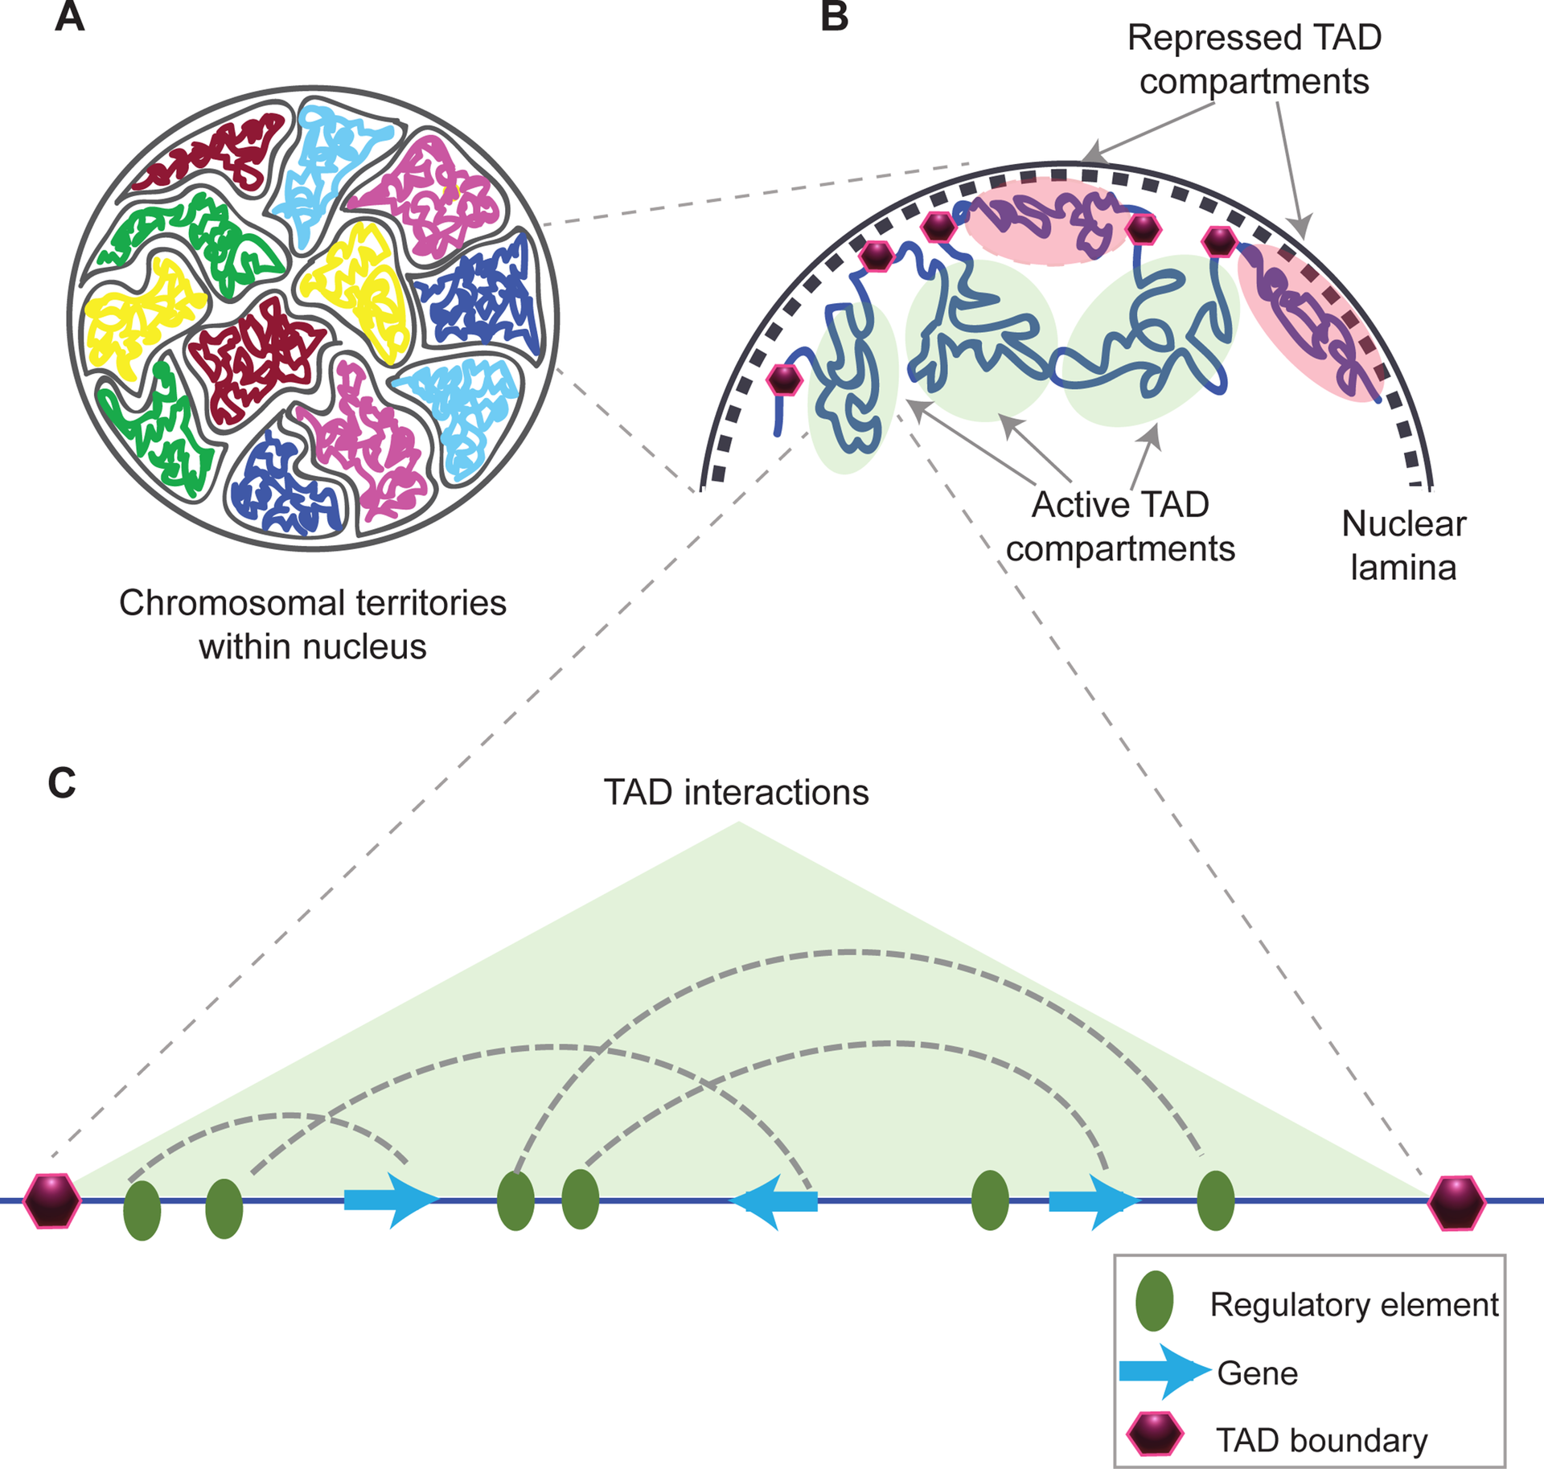
Surveying chromatin interactions- Hi-C
Topologically Associating Domains (TADs): Self-interacting chromatin domains that compartmentalize the genome, maintaining distinct regulatory environments. TAD boundaries act as insulators, preventing interactions between genes and regulatory elements in different domains.
TADs are really important for long-range gene regulation in animals, but the existence or function of TADs is still (mostly) unknown in plants

Slide 19
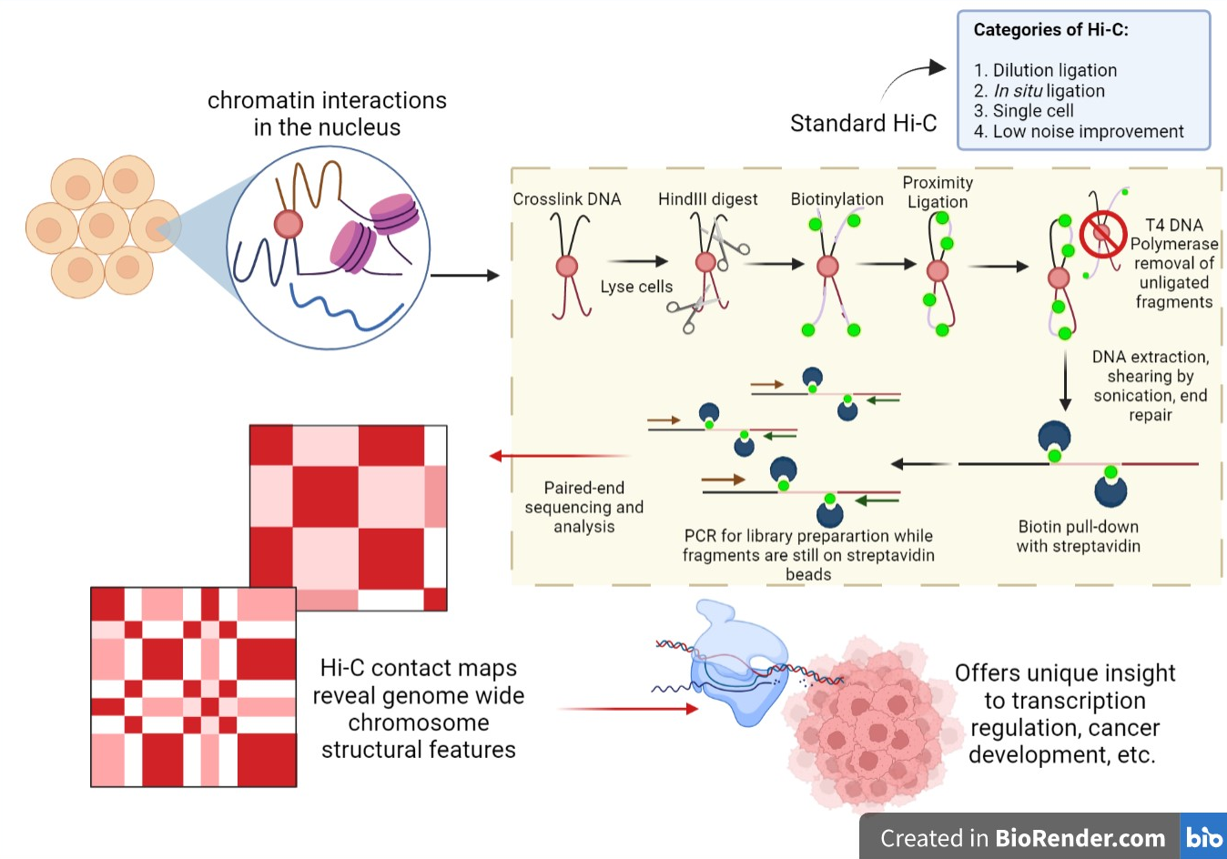
Surveying chromatin interactions- Hi-C
High-throughput Chromosome Conformation Capture (Hi-C) is a technique used to profile chromatin accessibility by capturing spatial interactions between distant genomic regions, allowing researchers to map the three-dimensional organization of the genome and identify topologically associating domains (TADs), chromatin loops, and interactions that influence gene regulation and accessibility.

Slide 20
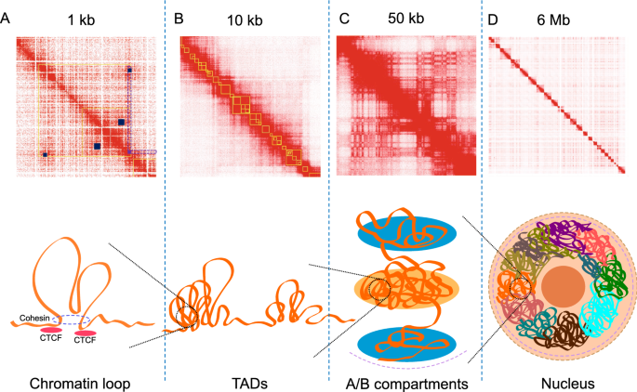
Surveying chromatin interactions- Hi-C

Slide 21
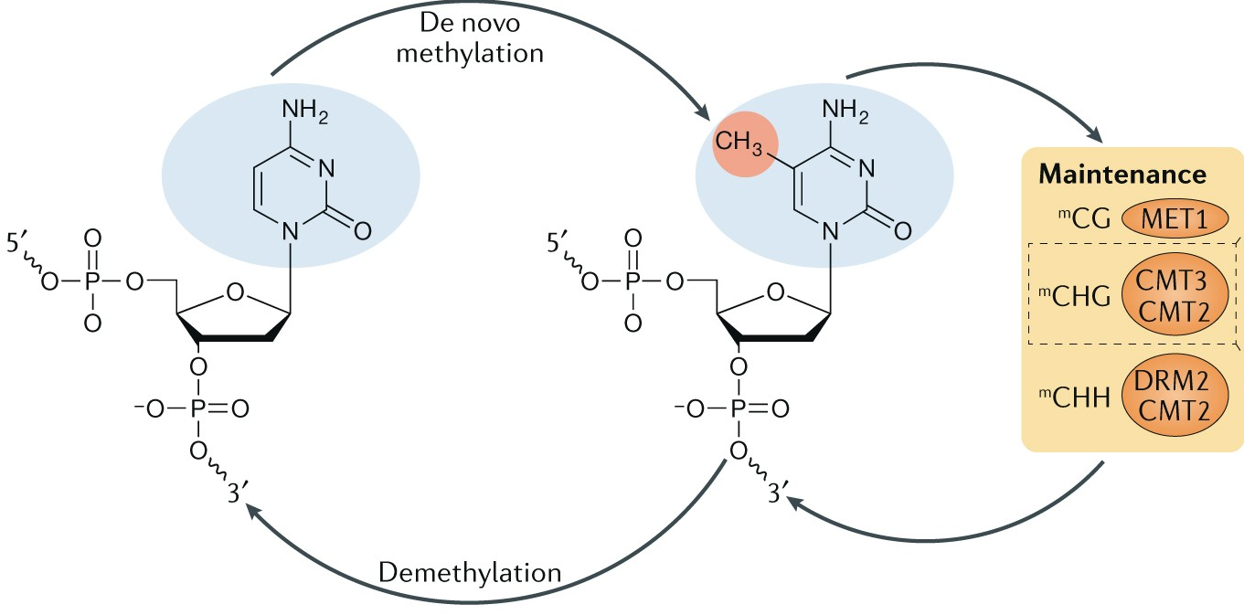
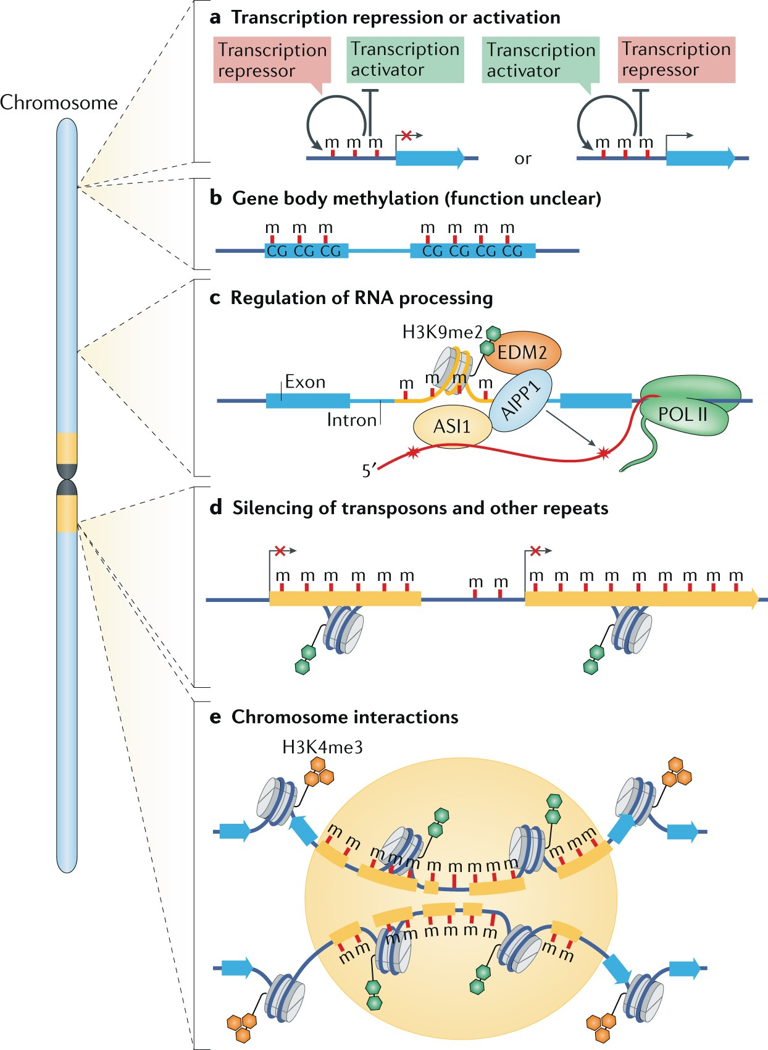
The function of DNA methylation in plants
Gene Expression Regulation: DNA methylation in gene promoter regions, represses transcription and regulates gene expression, helping control developmental processes and responses to environmental cues.
Transposable Element Silencing: Methylation of transposable elements prevents their mobilization and maintains genome stability.
Epigenetic Memory and Inheritance: DNA methylation serves as an epigenetic mark that can be stably inherited through cell divisions and sometimes across generations, allowing plants to "remember" environmental conditions or stress exposures.
Genomic Imprinting and Seed Development: Methylation contributes to genomic imprinting in seeds, ensuring the proper expression of genes depending on their parental origin.

Slide 22
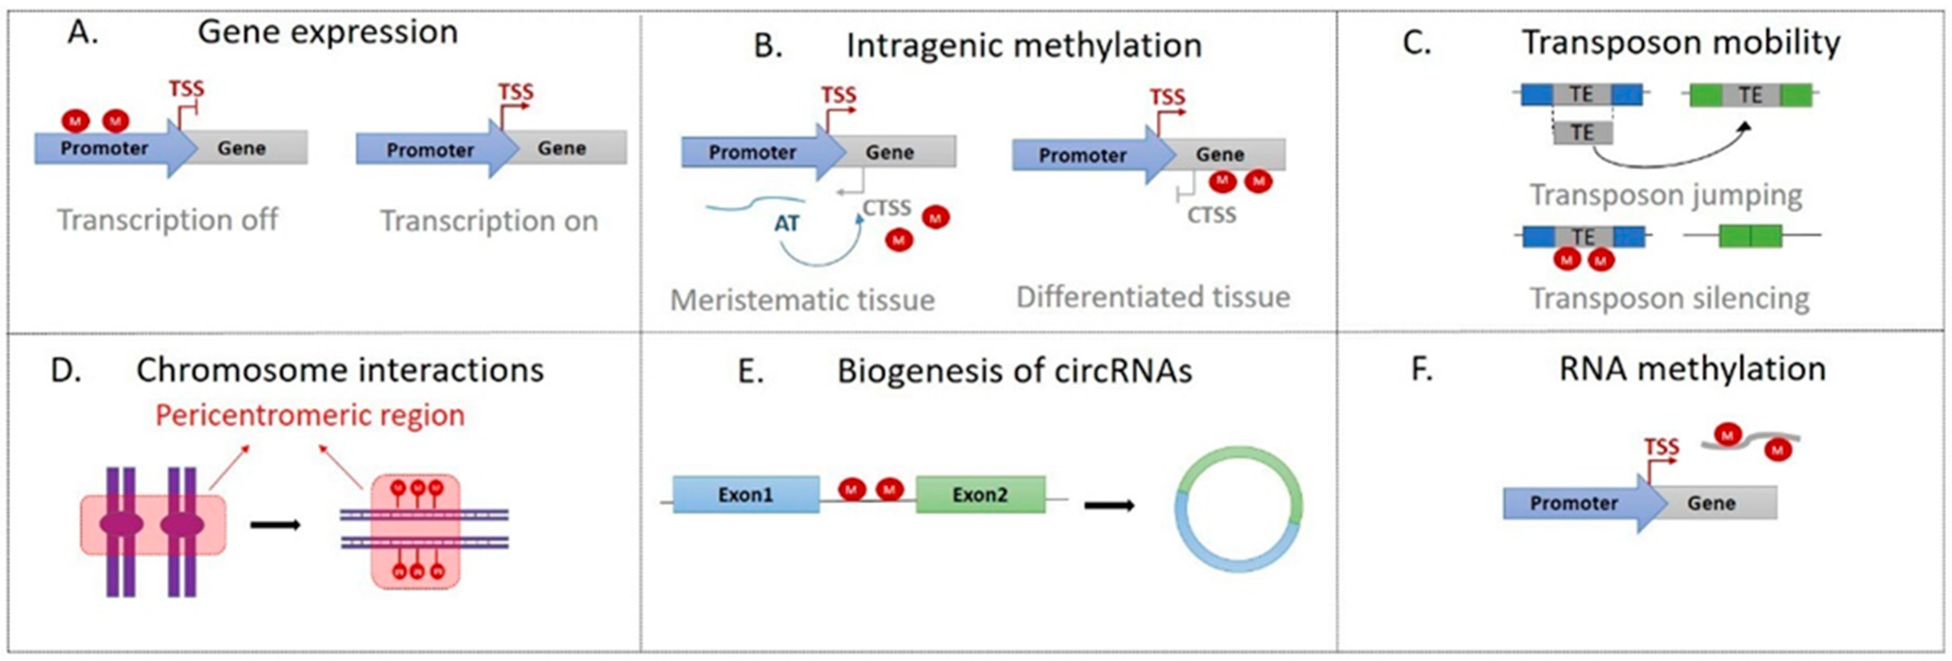
The function of DNA methylation in plants

Slide 23
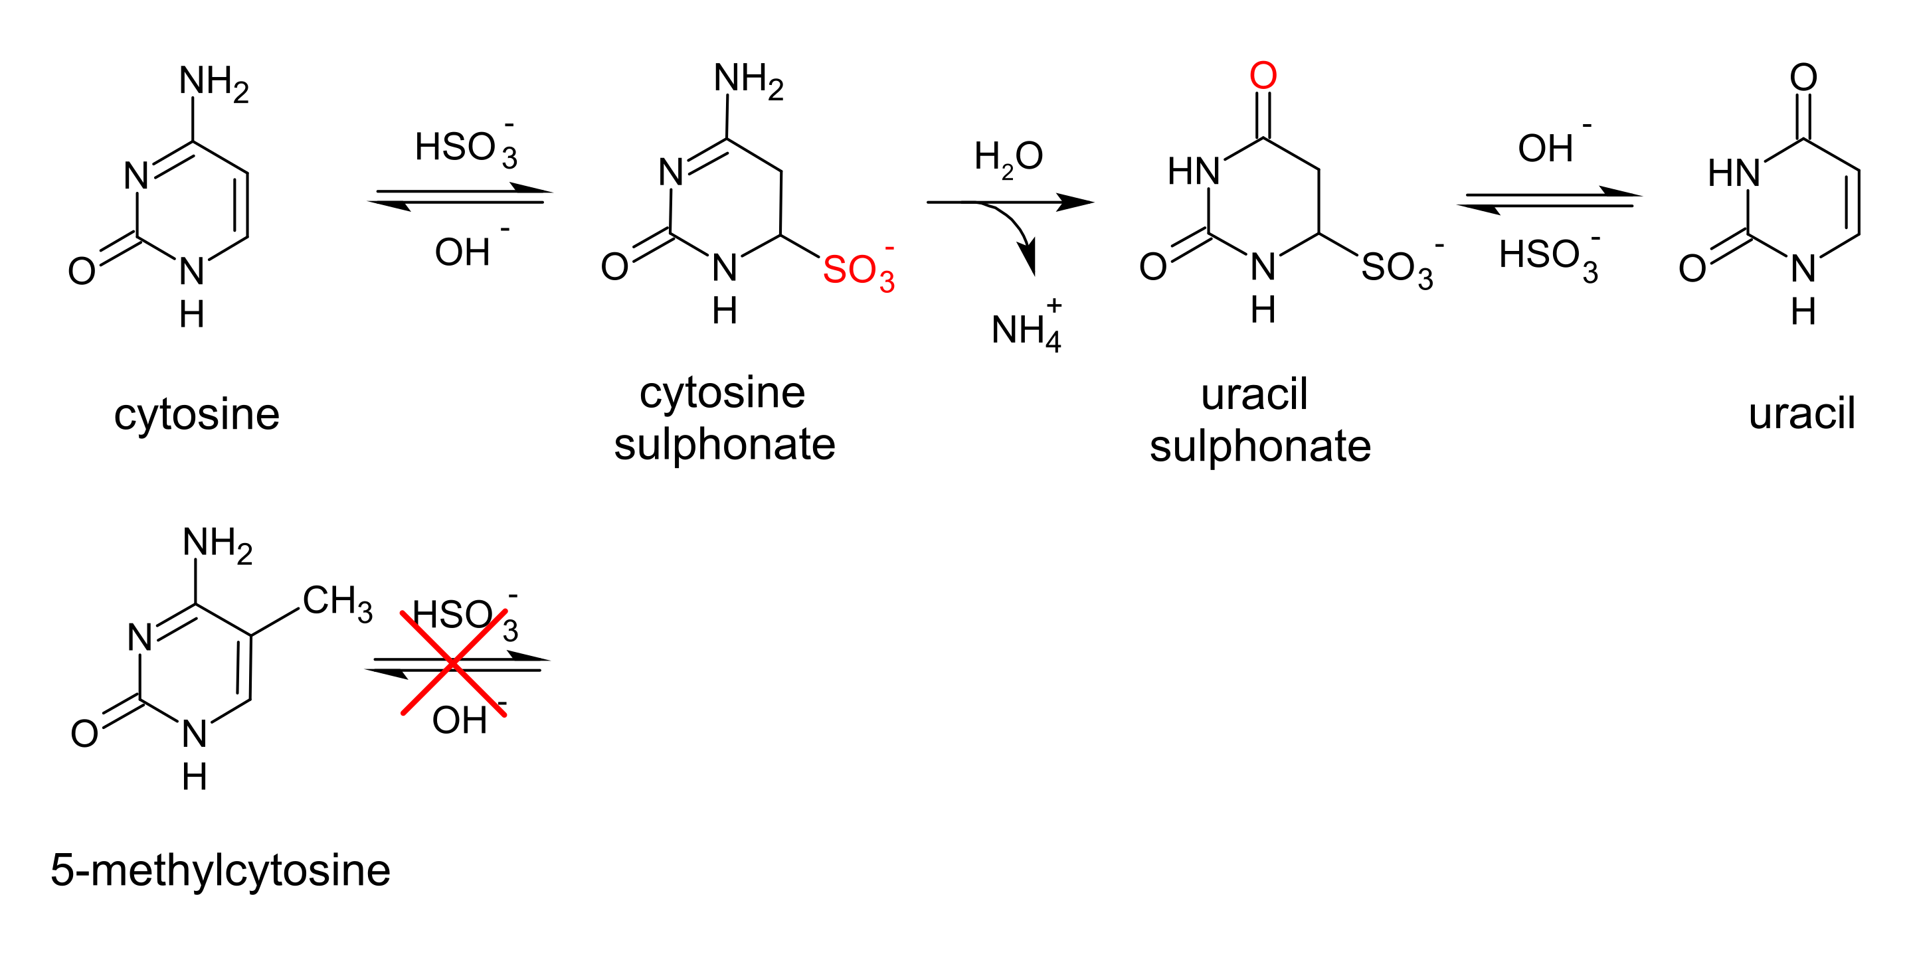
Bisulfite-seq: Measuring gene methylation

Slide 24
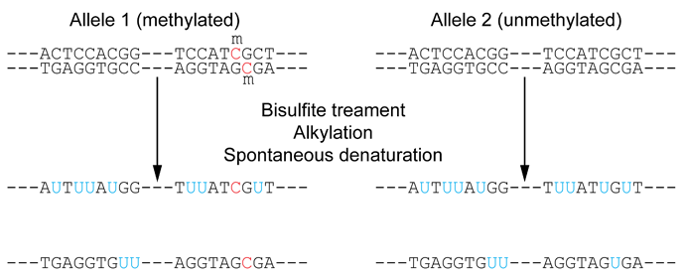
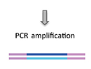
Bisulfite-seq: Measuring gene methylation
Bisulfite Conversion: Genomic DNA is treated with sodium bisulfite, converting unmethylated cytosines to uracil while methylated cytosines remain unchanged. This conversion allows for discrimination between methylated and unmethylated cytosines.
Library Preparation: Converted DNA is fragmented and adapters are added to both ends to create a sequencing library compatible with Illumina platforms.
Amplification and Sequencing: Libraries are amplified using PCR and then sequenced on an Illumina platform (e.g., HiSeq or NovaSeq), generating short reads (~100-150 bp) that include bisulfite-converted sequences.
Read Alignment: Sequencing reads are aligned to a reference genome, accounting for bisulfite-induced changes (e.g., treating uracil as thymine).
Methylation Analysis: Methylation status is determined by comparing the proportion of C (methylated) vs. T (unmethylated) at each cytosine position in the reference genome.

Slide 25
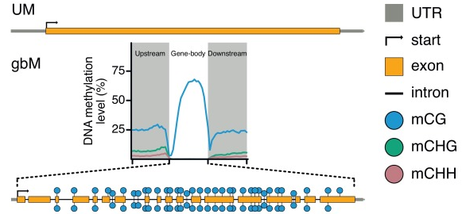
Bisulfite-seq: Measuring gene methylation
The function of gene body methylation is largely unknown, and varies heavily by species

Slide 26
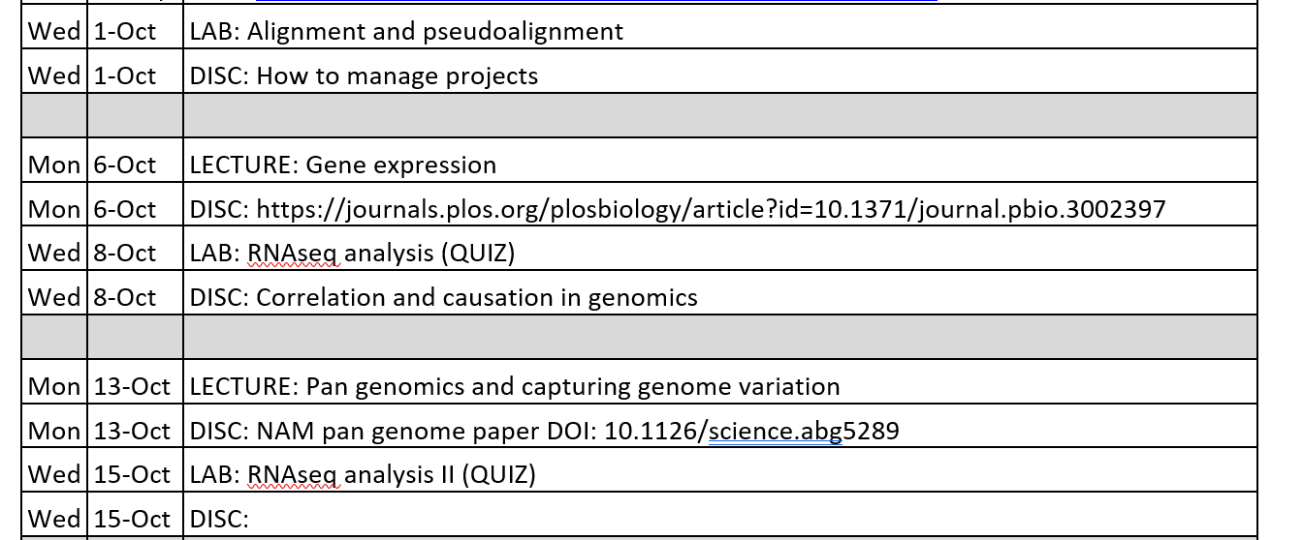
Looking forward

