Slide 1

Pan genomics and capturing genome variation
10-13-25

Slide 2
Announcements
Please fill in a one-paragraph summary and 2–3 aims by the end of the day on Wednesday, October 15th

Slide 3
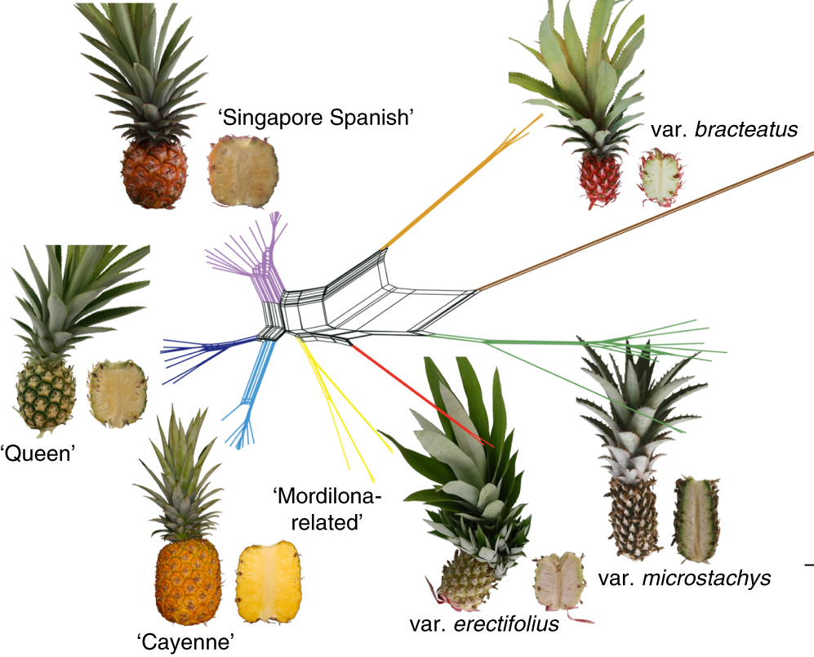
How do we quantify genetic variation?

Slide 4
How much variation is there within the genome?
How similar are the human and Chimpanzee genomes?
98.8% sequence homology
Humans
46 chromosomes. Chromosome 2 was formed by fusion of two ancestral chromosomes.
Large pericentric inversions in chromosomes 1 and 18
Deletion of 510 conserved regions.
134 genes increased copy numbers, 6 decreased
Alu (repeats): ~ 5000 unique copies
Chimpanzees
48 chromosomes, including chromosomes 2a and 2b
Large pericentric inversions in chromosomes 4, 5, 9, 12, 15–17
Deletion of 334 conserved regions
37 genes increased copy numbers, 15 – decreased
Alu (repeats): ~ 1500 unique copies

Slide 5
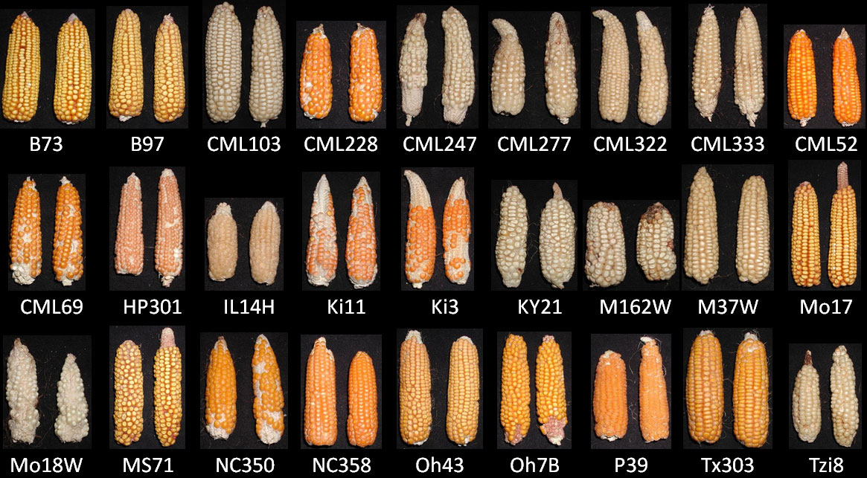
How much variation is there within the genome?
How similar are different maize genomes?
The maize NAM (Nested Association Mapping) population is a diverse set of recombinant inbred lines created by crossing 25 different maize inbred lines with a common reference line.

Slide 6
How much variation is there within the genome?
How similar are different maize genomes?
Only 58% of maize genes are ‘core’, or conserved across all accessions
Only 60% of transposable element families are conserved across maize diversity
Most transposable elements are specific to one inbred line
791,101 large structural variants (> 100 bp) across the 26 maize NAM founders
How to we identify and quantify this variation within plants?

Slide 7
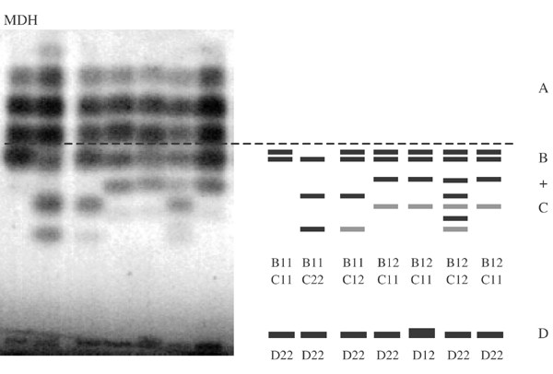
A step back in time, how did we measure genetic variation?
Allozyme variation (1980s-early 2000s)
In allozyme analysis, proteins from different individuals are separated based on their movement through a gel in response to an electric current. Since slight changes in the amino acid sequence (due to different alleles) can alter the charge or shape of a protein, we can detect genetic diversity by observing the movement of proteins in the gel.

Slide 8
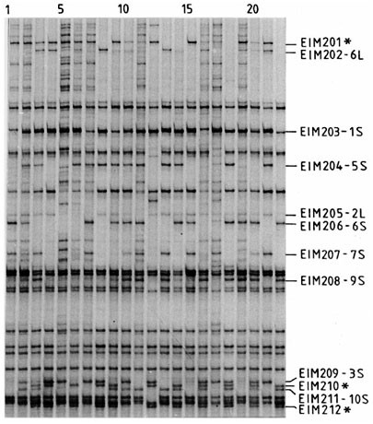
A step back in time, how did we measure genetic variation?
DNA based markers (1980s-present)
Restriction fragment length polymorphisms (RFLPs) are variations in DNA sequences that result in different fragment lengths when DNA is cut with specific restriction enzymes, often used as markers for genetic mapping.
AFLPs (Amplified Fragment Length Polymorphisms) are a genetic marker technique that involves cutting genomic DNA with restriction enzymes, then selectively amplifying fragments using PCR.

Slide 9
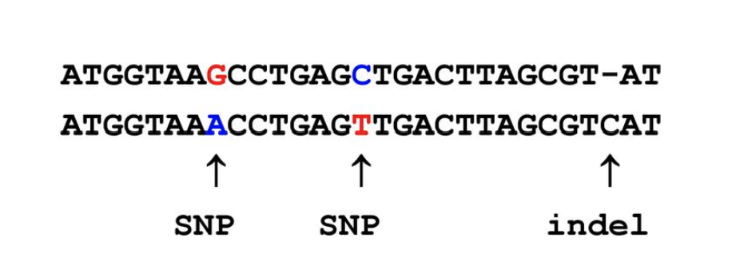
Types of variation in the genome
SNPs (Single Nucleotide Polymorphisms) are single base-pair changes in the DNA sequence that can occur at specific positions within the genome, serving as highly informative genetic markers.
Indels (Insertions and Deletions) are small segments of DNA that are either inserted or deleted from the genome, causing variations in the length of sequences between individuals.

Slide 10
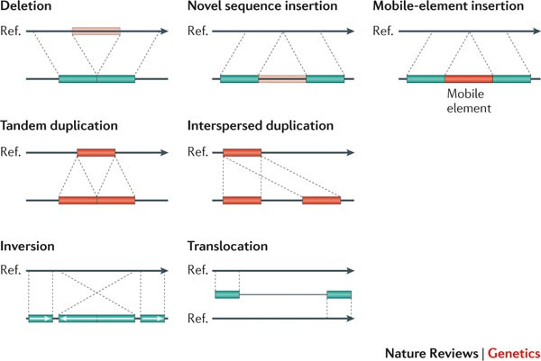
Complex variants in the genome: structural variants

Slide 11
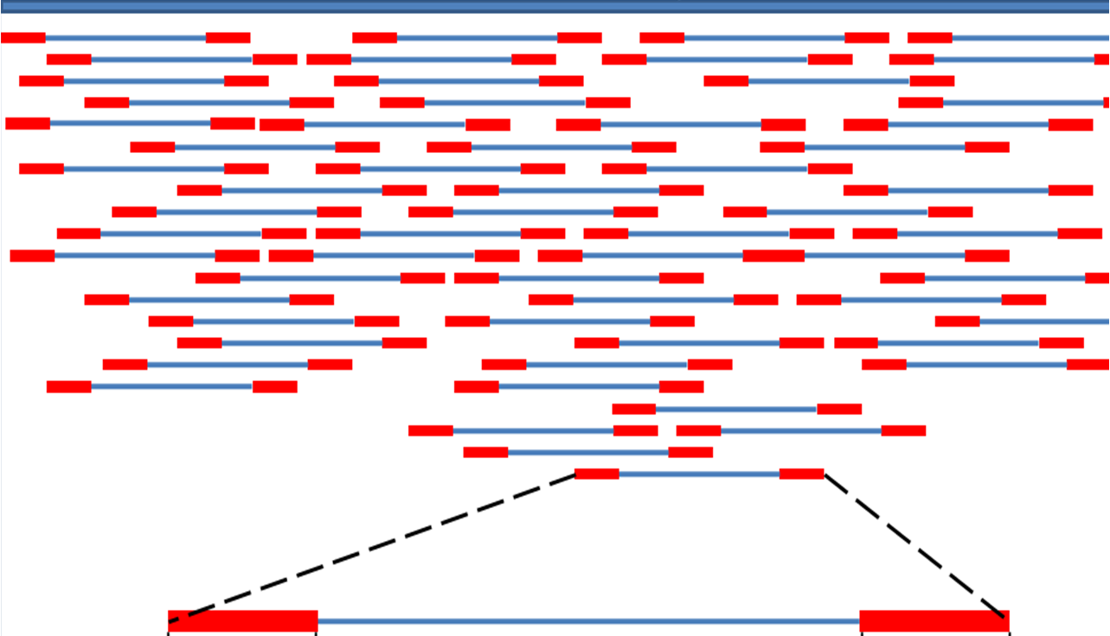
Whole genome resequencing
Reference genome

Slide 12
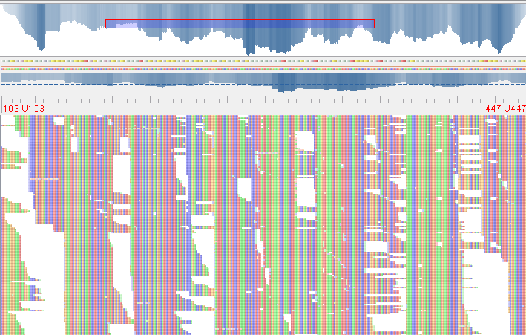
How much coverage do we need?
How much sequencing data do you need?
Skim coverage (e.g., 0.5-2x) is suitable for population studies where the goal is to estimate allele frequencies, identify large structural variants, or perform genome-wide association studies (GWAS) across many individuals without needing full, accurate individual genomes.
Low coverage (e.g., 5-15x) is used for identifying SNPs and performing genetic mapping when the focus is on detecting variants across the genome with moderate confidence, balancing cost and coverage for larger sample sizes.
High coverage (e.g., 30x or more) is necessary for de novo genome assembly, variant calling with high accuracy, or detecting rare variants in individual genomes, as it provides deep data for precise analysis of small variants like SNPs, indels, and structural variations. Also clinical applications.

Slide 13
Reduced representation sequencing: RADseq and GBS
Genome
RADseq (Restriction site-associated DNA sequencing) involves cutting DNA with restriction enzymes, sequencing the regions around the cut sites, and is used to identify and genotype genome-wide SNPs, especially in non-model organisms for population genetics, phylogenetics, and marker discovery.
GBS (Genotyping by Sequencing) is a similar technique that uses restriction enzymes to reduce genome complexity, but with a simpler library preparation process, and is commonly used for high-throughput SNP genotyping in large populations for marker-assisted breeding, genetic mapping, and diversity studies.
Both methods are cost-effective for studying genetic variation in species with large or poorly characterized genomes.

Slide 14
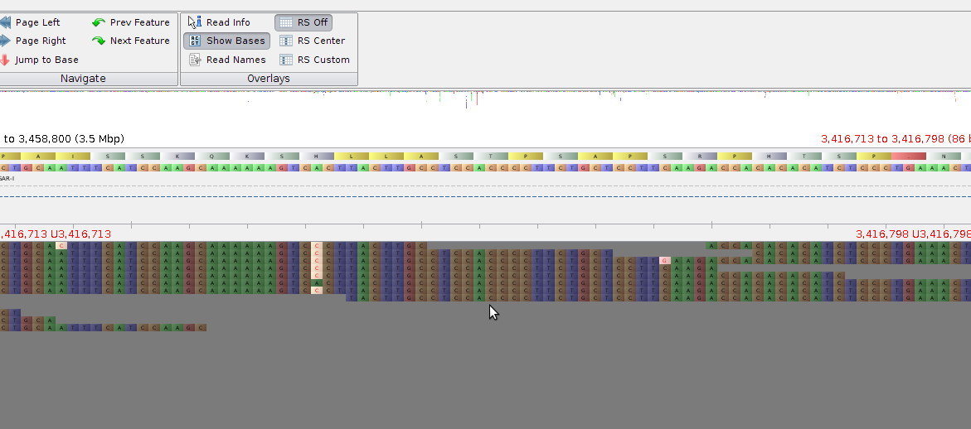
Calling single nucleotide polymorphisms (SNPs)
SNP A -> C, CC or 1/1

Slide 15
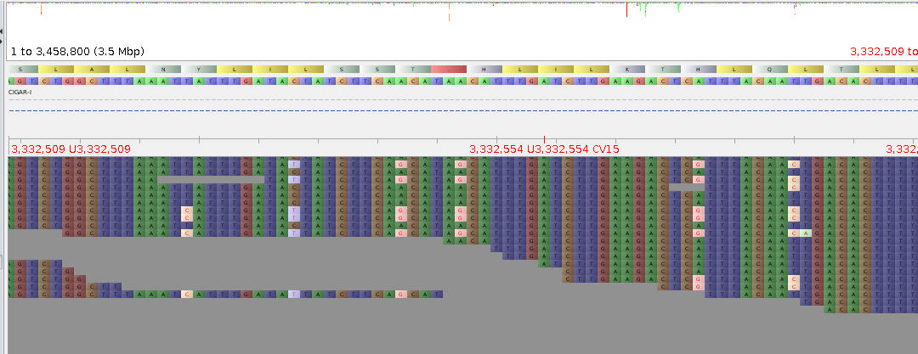
Homozygous vs heterozygous SNPs
Heterozygous SNP, one allele matches the reference, the other doesn’t. A/C or 0/1

Slide 16
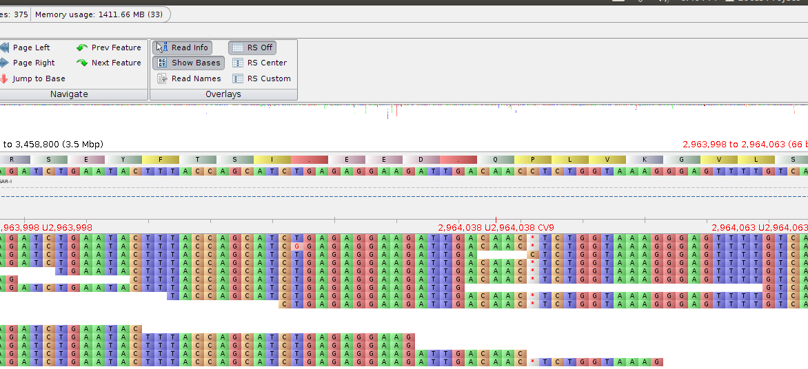
Calling small insertions/deletions (indels)
Indel (in this case a deletion) C → N/A

Slide 17
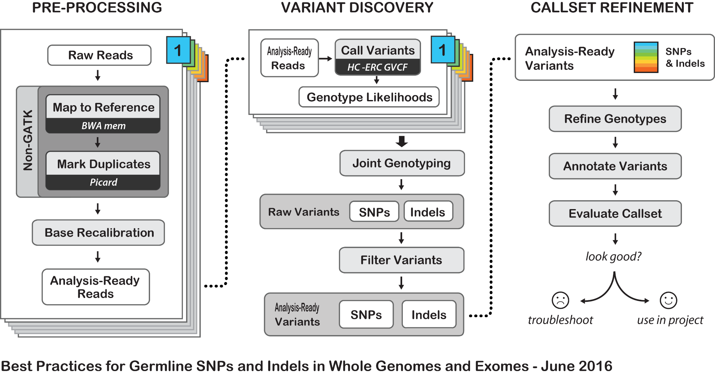
Identifying variants using short read data: GATK

Slide 18
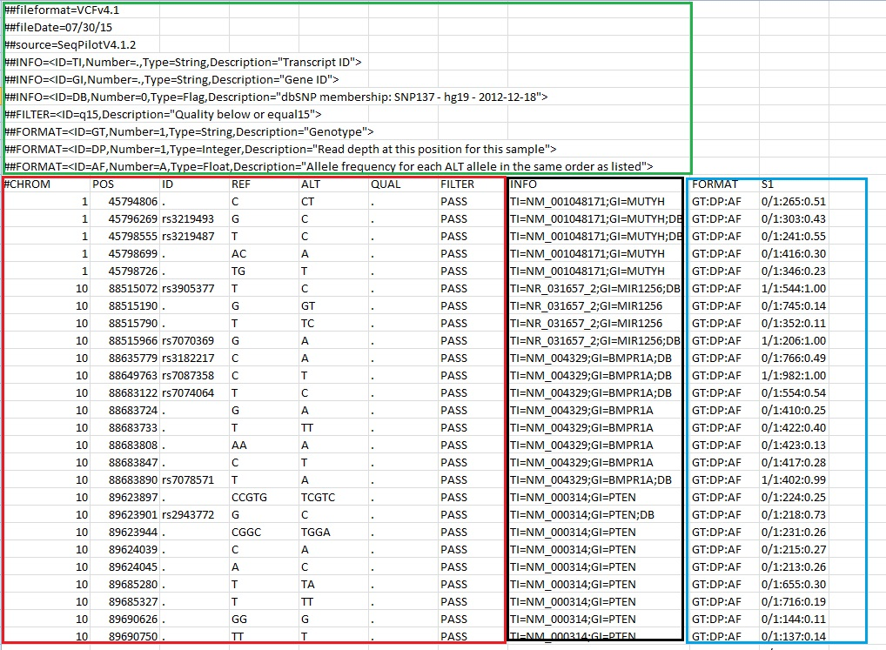
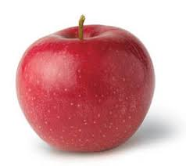

File format for showing variants: VCF
The Variant Call Format (VCF) is used to store information about genetic variants such as SNPs, indels, and structural variations detected in genome sequencing data.
Reference = AA
Alternative = CC
0/0 = reference
(A/A)
0/1 = hemizygous
(A/C)
1/1 = Alternate
(C/C)

Slide 19
Resequencing provides a poor estimate of true genetic variance
Whole genome resequencing has some limitations
Reference bias: Reference-based sequencing aligns reads to a single reference genome, which can miss or misinterpret variants not present in that reference, leading to underrepresentation of genetic diversity, especially in structurally variable regions.
Limited variant detection: It may fail to capture large structural variations, gene content differences, or novel sequences that exist in other populations or species but are absent in the reference genome.
Incomplete representation of diversity: Pangenomics, which incorporates multiple genomes to represent the full genetic diversity of a species, provides a more comprehensive view, while reference-based approaches only show how individuals vary from a single genome, potentially overlooking unique genes or alleles.
Poor performance with divergent populations: If the reference genome is from a population that is genetically distant from the sample being sequenced, reference-based analysis may struggle with alignment accuracy, leading to erroneous variant calls.

Slide 20
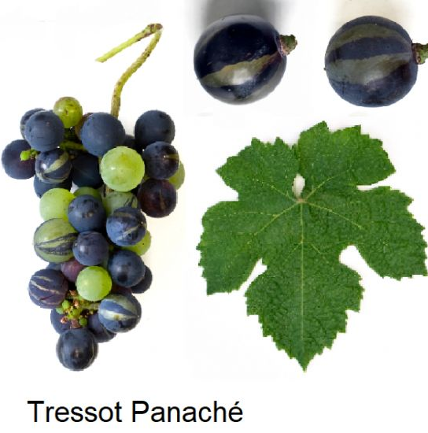
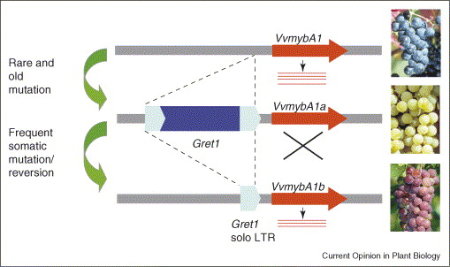
Short read data cannot accurately capture large scale structural variants
Transposable elements underly many important agronomic traits or interesting phenotypes, especially somatic mutations or sports

Slide 21
What is a pangenome?
A pangenome represents the complete set of genes and genetic sequences found across all individuals of a species, encompassing both core sequences shared by all and variable sequences present in only some individuals.
It integrates multiple genome assemblies, capturing genetic diversity by including structural variations, insertions, deletions, and gene presence/absence that may be missed in a single reference genome.
The pangenome is often visualized as a graph, where nodes represent sequences, and paths through the graph represent individual genomes, highlighting both shared and divergent regions.
Pangenomics provides a more comprehensive framework for studying evolutionary biology, population genetics, and the functional implications of genetic diversity within species.

Slide 22
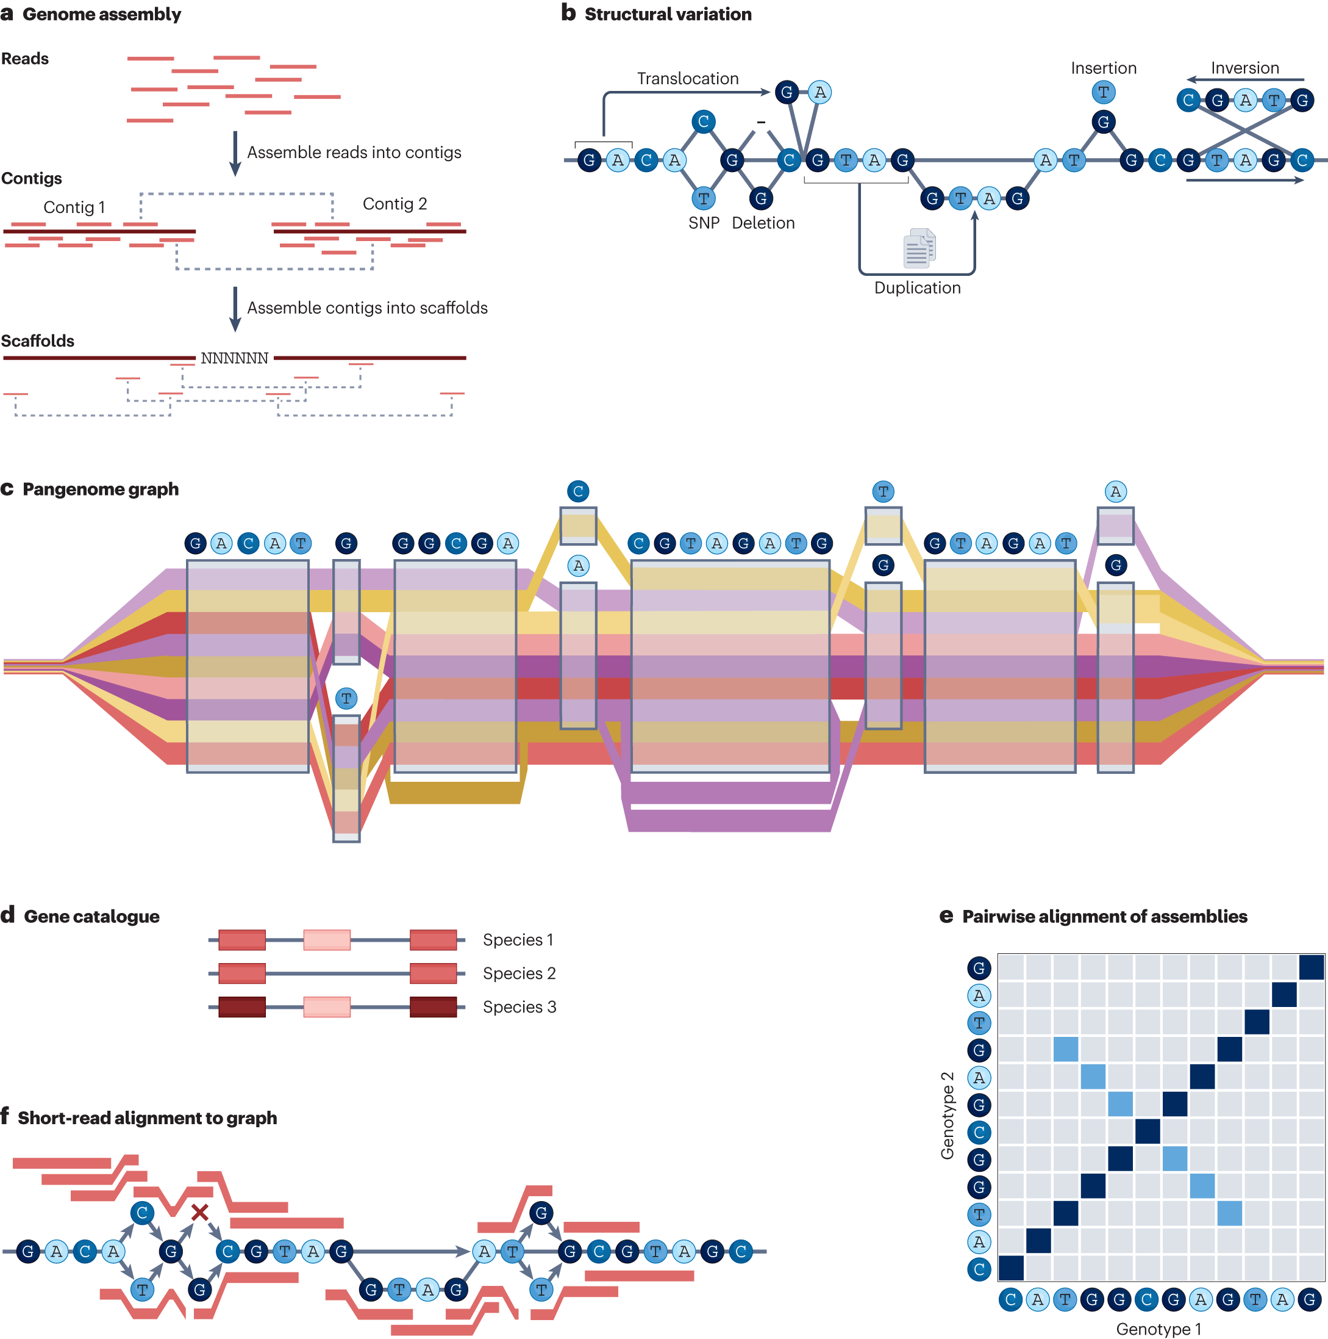
Constructing a pangenome
Long read sequences (PacBio HiFi or Nanopore) are generated from multiple diverse individuals and assembled into contigs or scaffolds
The assembled genomes are compared to each other, revealing the full spectrum of sequence variation, including SNPs, indels, and structural variations. These differences highlight the genetic diversity present within the species.

Slide 23
Constructing a pangenome
The multiple genome assemblies are computationally represented in a pangenome graph, where each path through the graph represents the genome of an individual. In this graph, shared sequences are represented as common paths, while variant sequences are represented as branches. This allows visualization of genomic similarities and differences across individuals, though constructing such graphs at single base pair resolution for entire genomes remains computationally challenging.
A gene-centric view focuses on regions of the genome that encode genes, simplifying the graph and reducing complexity by focusing on biologically important regions.

Slide 24
Constructing a pangenome
For population-scale studies, short-read sequencing data can be integrated with the pangenome by aligning these reads to the pangenome graph. This allows the detection of variants within populations using more cost-effective short-read data while leveraging the structural insights from the pangenome.
Note: this is an open area of research, and this type of analysis is a computational challenge

Slide 25
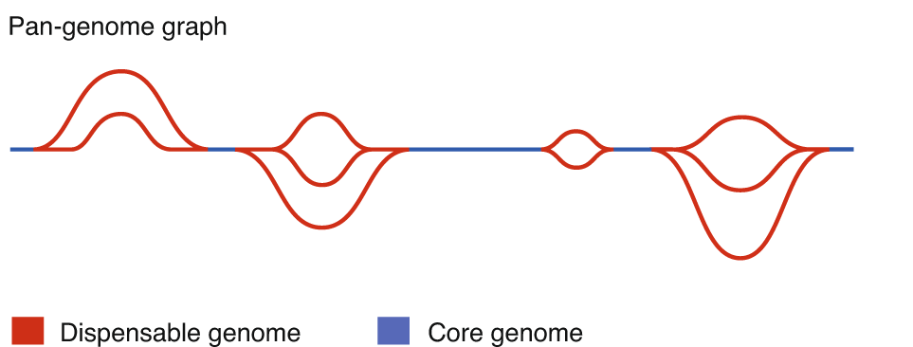
Constructing a pangenome
The core genome consists of genes or sequences shared by all individuals within a species, essential for basic functions, while the dispensable genome (or accessory genome) includes genes that are present in only some individuals, contributing to genetic diversity and often associated with adaptive or agronomic traits

Slide 26
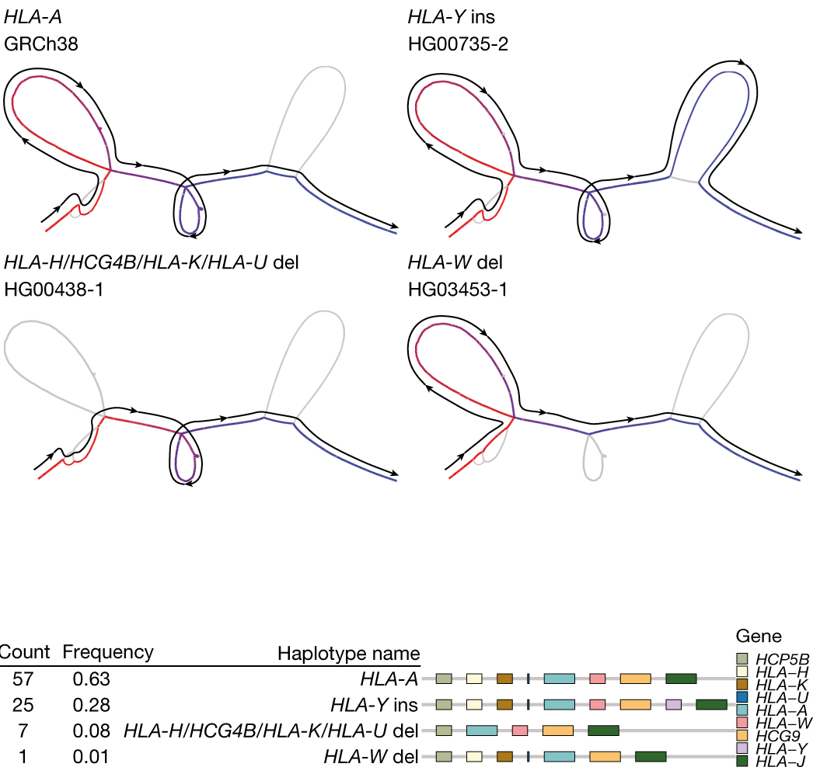
The human pangenome
The human pan-genome is not interesting
The human pangenome contains 47 phased, diploid assemblies from a cohort of genetically diverse individuals
1,115 gene duplications relative to the existing reference GRCh38.
Using the draft pangenome to analyse short-read data reduced small variant discovery errors by 34% and increased the number of structural variants detected per haplotype by 104% compared with GRCh38-based workflows
Liao et al. 2023, Nature

Slide 27
The maize pan-genome
The maize NAM (Nested Association Mapping) population is a diverse set of recombinant inbred lines created by crossing 25 different maize inbred lines with a common reference line.

Slide 28
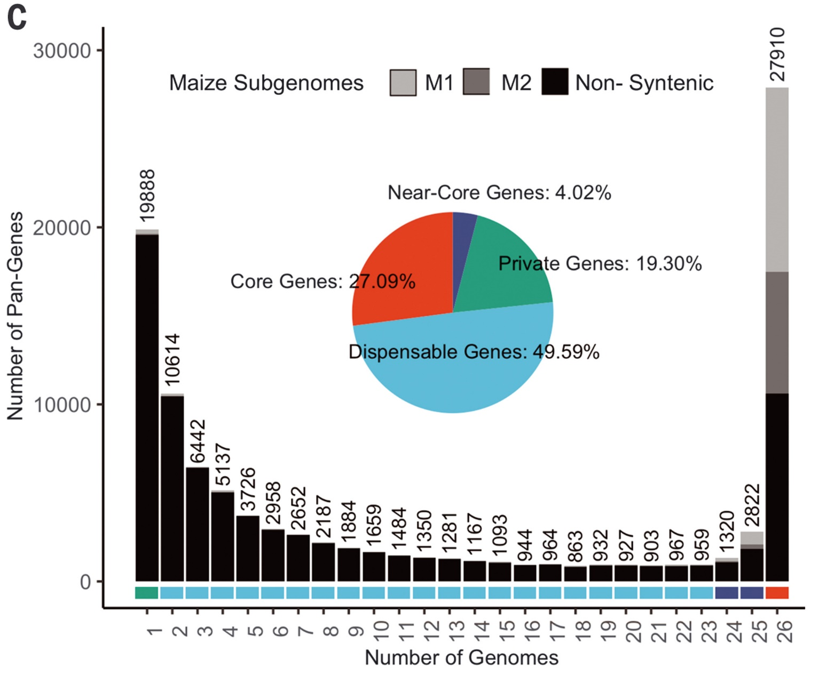

The maize pan-genome
Each maize genome has an average of 40,621 genes
The pan-genome has 103,033 genes, with the number plateauing as more genomes are added
32,052 genes are core or nearly core (found in all/nearly all NAM lines)
Most ‘dispensable’ genes are in only one genotype

Slide 29
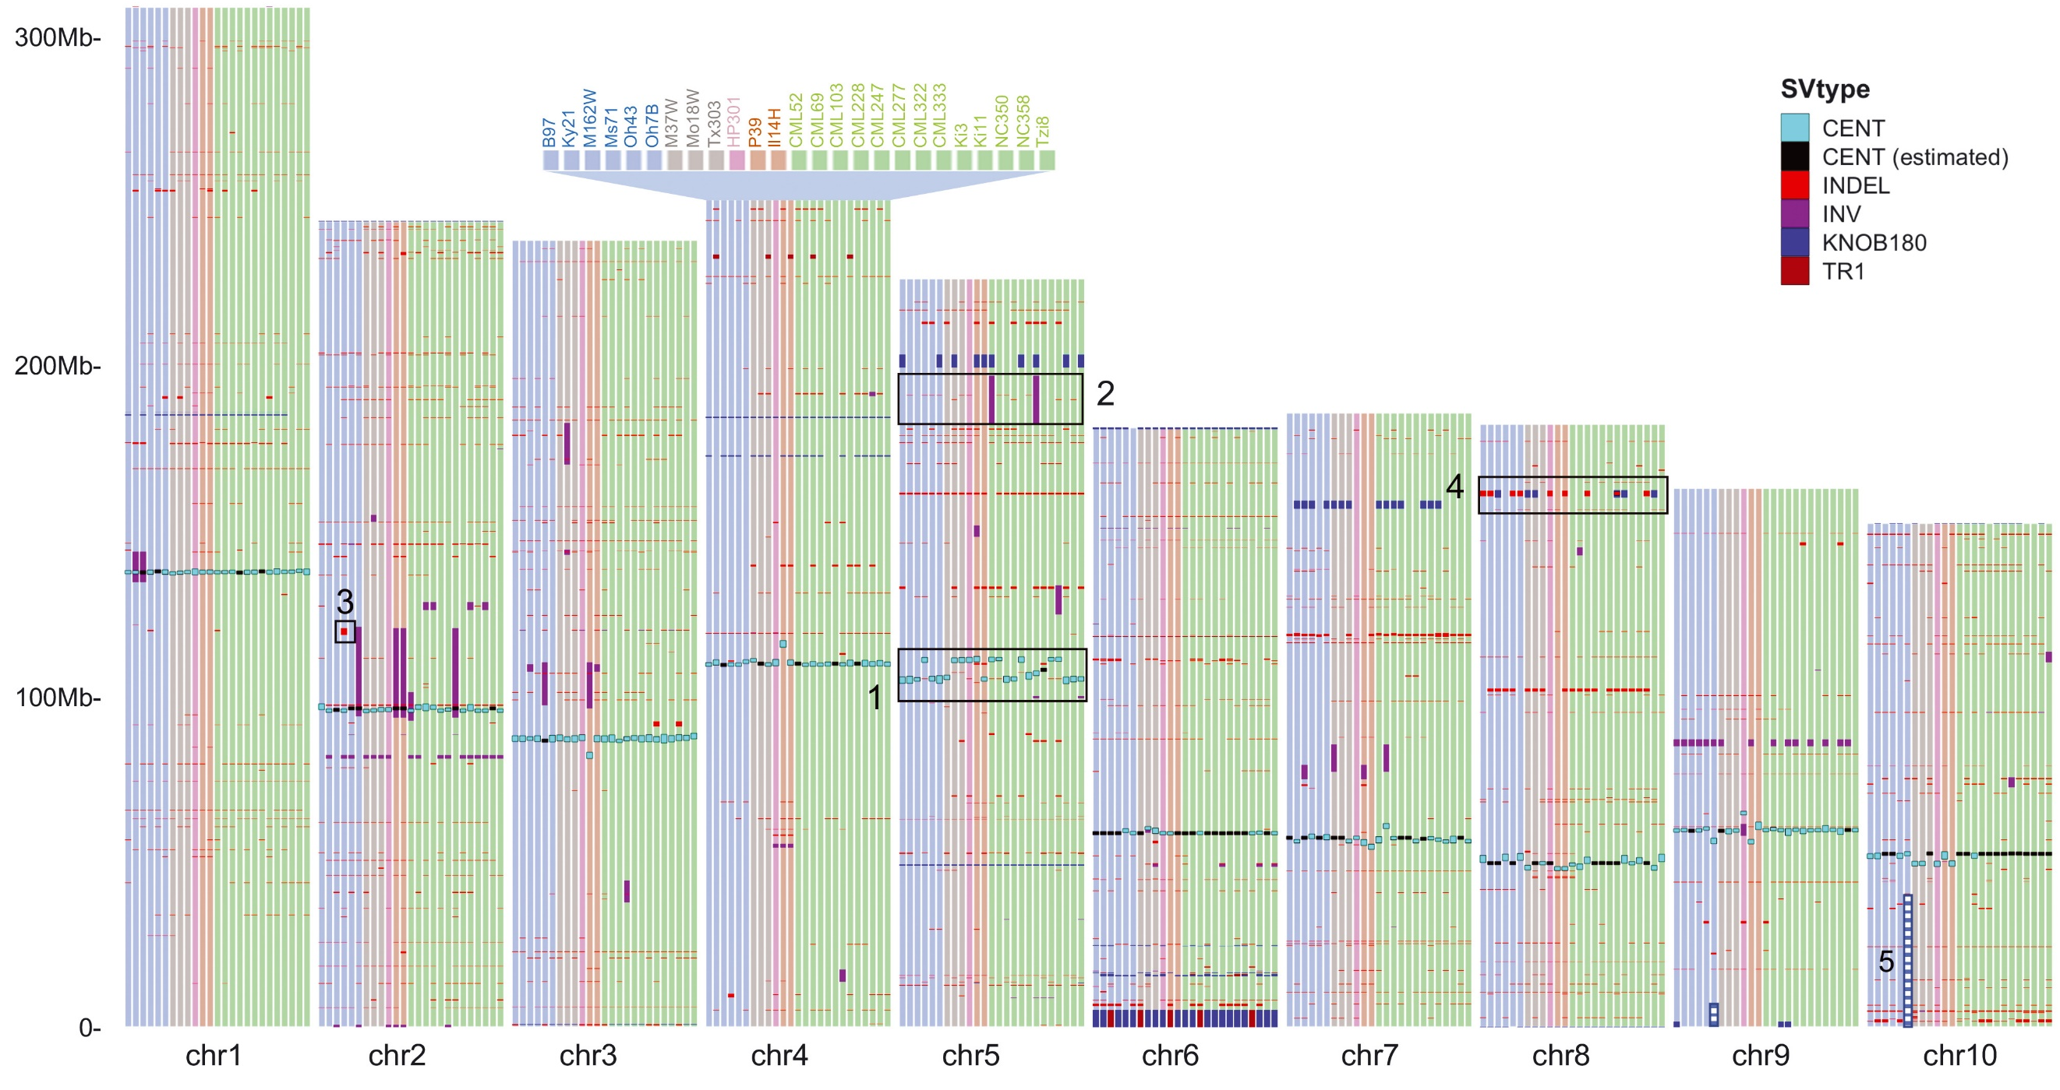
The maize pan-genome
Comparative analyses among the NAM genotypes to B73 revealed a cumulative total of 791,101 structural variants (SVs) >100 bp in size.
Almost half (49.6%) of SVs were <5 kbp in size.
14.6-Mbp inversion on chromosome 5 in the CML52 and CML322 lines
A very large reciprocal translocation (involving >47 Mbp of DNA) between the short arms of chromosomes 9 and 10 in Oh7B

Slide 30
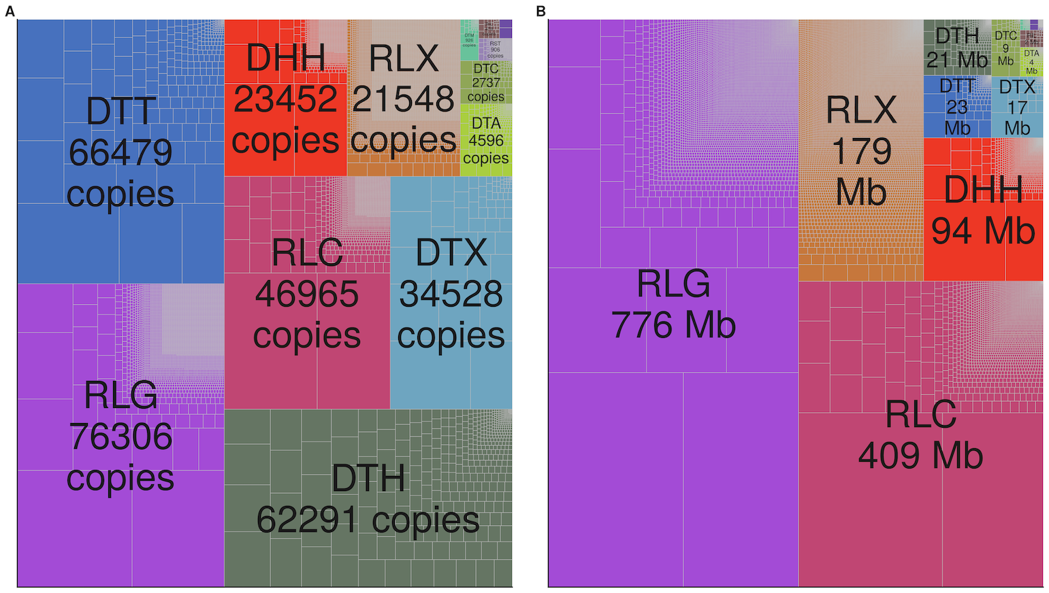
90% of the Maize genome is transposable elements
Skitzer et al. 2021 PLoS Genetics
A total of 27,228 TE families were included in the pan-genome TE library, of which 59.7% were present in all 26 NAM founders, and 2.5% were specific to one genome
Each NAM founder has 10s of thousands of unique TE insertions
Copy number of different transposable element families
Total size of TEs within the maize genome

Slide 31
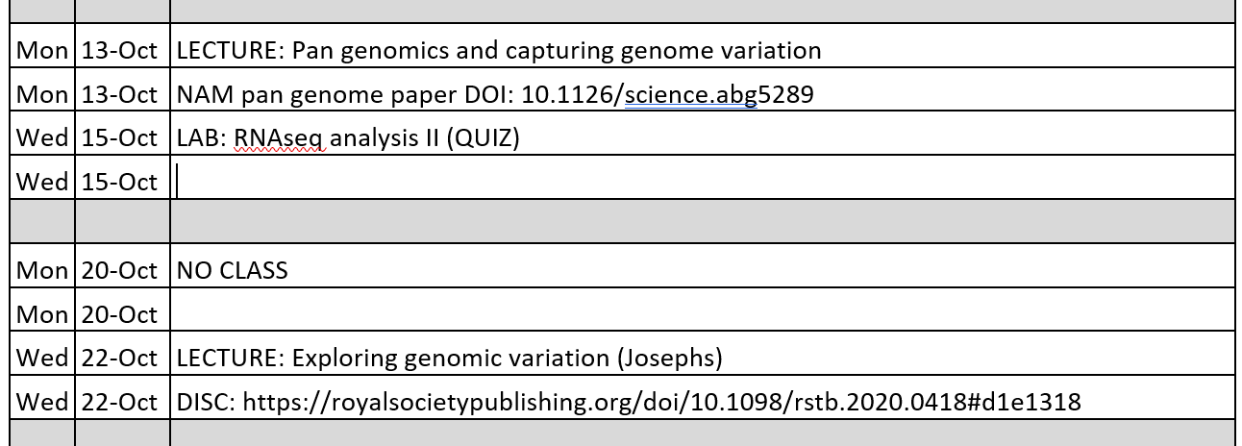
Looking forward

