Slide 1
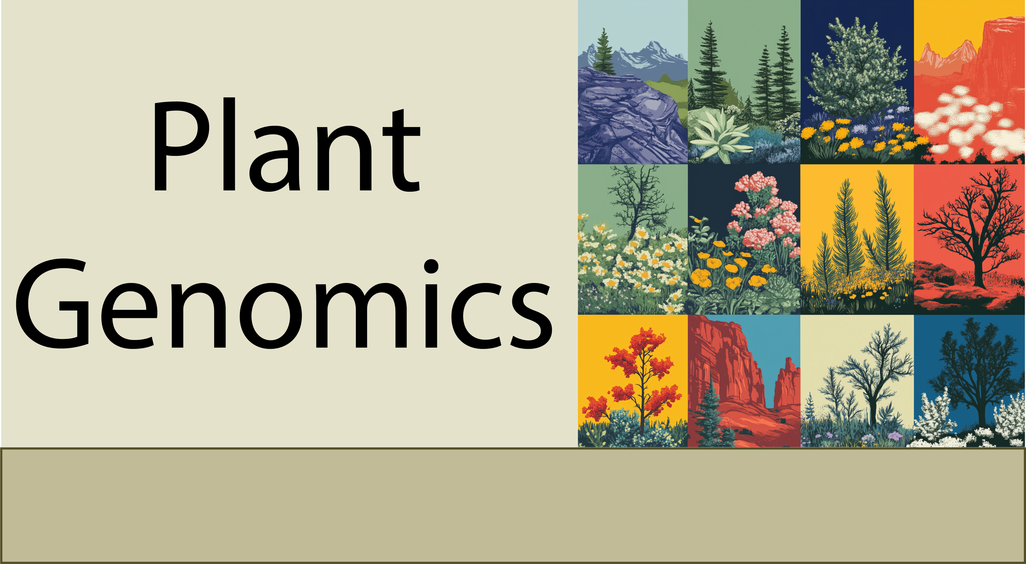
The functional elements of genomes
9-15-25

Slide 2

What’s in a genome?
What are the functional elements in the genome?
How do we identify or annotate functional elements?

Slide 3
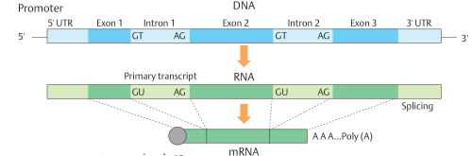
What’s in a genome: Genes
The average plant gene is ~2,000-5,000 bp and contains 4-6 exons. Genes can also be a few hundred base pairs with a single exon.
The largest eukaryotic gene is human Titin (a muscle protein) that’s 1.2 million base pairs has 363 exons, and 27,000 amino acids. We have almost a full pound of Titin protein in our bodies.

Slide 4
How many genes are in a typical plant genome?
Small Genomes: Plants like Arabidopsis thaliana (a model plant with one of the smallest genomes among flowering plants) have about 27,000 genes.
Medium-Sized Genomes: Plants like rice (Oryza sativa), which has a moderately sized genome, contain around 35,000 to 40,000 genes.
Larger Genomes: Maize (Zea mays) has a large genome with an ancient polyploidy event and has around 40,000 to 50,000 genes.
Polyploid Plants: Some polyploid species (such as wheat (6x), strawberry (8x), sugarcane (10-20x), can have 100,000-300,000 genes.

Slide 5
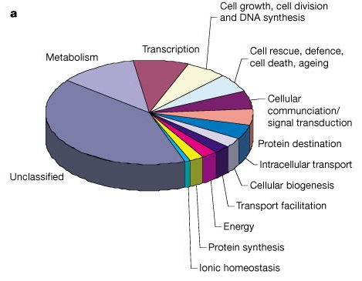
What are all these genes doing?
After the completion of the Arabidopsis genome sequence in 2000, a coordinated multinational effort was launched to “determine the function of every gene in Arabidopsis” by the year 2010. Named the Arabidopsis 2010 program.
The program cost ~$300 million USD and was hugely successful, but the function of ~20-30% of Arabidopsis genes is still unknown.
From the Arabidopsis genome paper in 2000

Slide 6
Reasons for Unknown Gene Function:
Lack of Homology: Some genes may not have homologs in other well-studied species, making it difficult to infer their function based on sequence similarity.
Redundancy: Many plants, including Arabidopsis, have gene families where multiple genes can perform similar functions, making it hard to determine the specific role of individual genes.
Conditional Expression: Some genes may only be expressed or active under certain environmental conditions or developmental stages, making their function hard to identify in typical laboratory conditions.
Non-Coding RNAs: Some regions previously thought to be "genes" might actually encode non-coding RNAs, and their roles in gene regulation can be harder to discern.

Slide 7
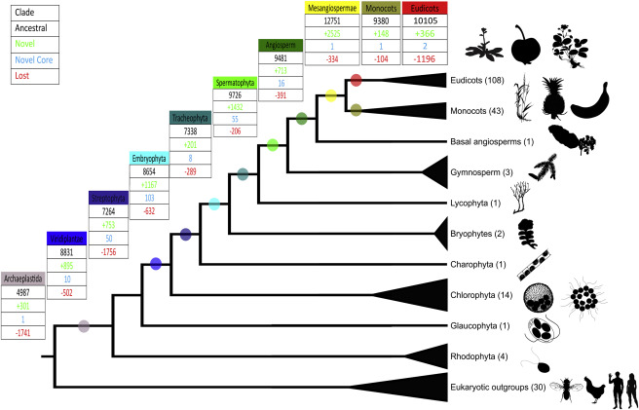
How conserved are genes?
Most genes are deeply conserved across the green lineage with ancestral origin hundreds of millions to billions of years old.
~8,800 conserved genes within the green lineage, ~10,000 in flowering plants (angiosperms)

Slide 8
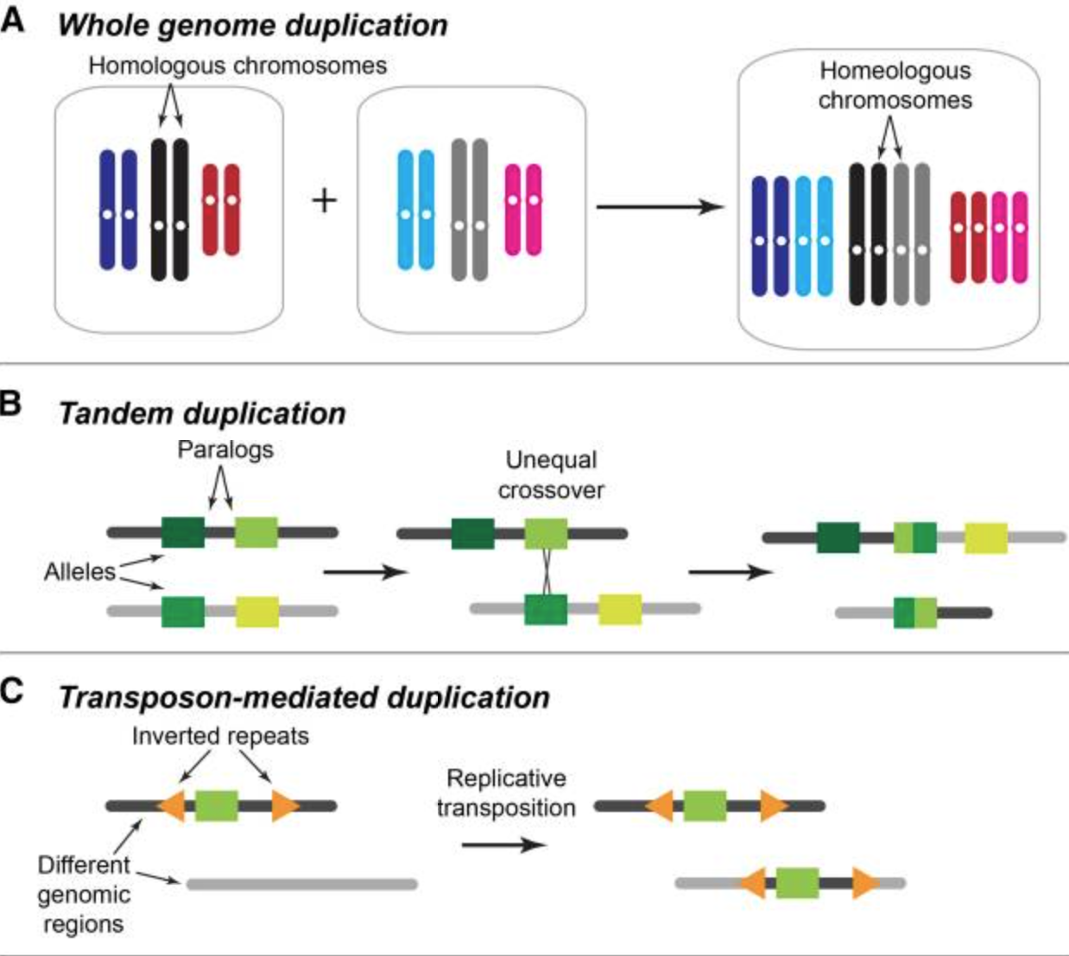
Plant genes duplicate rapidly
Most plant genes are found in gene families, groups with similar function and a shared common ancestor
Plant genes duplicate rapidly, through tandem, segmental, or whole genome duplications
NBS-LRR Genes (Nucleotide-binding site-leucine-rich repeat). Involved in disease resistance ~100-2,000 genes
MYB transcription factors regulate secondary metabolism, cell differentiation, stress responses. ~150-500 genes
Cytochrome P450s involved in the synthesis of secondary metabolites and detoxification ~250-2,000 genes

Slide 9
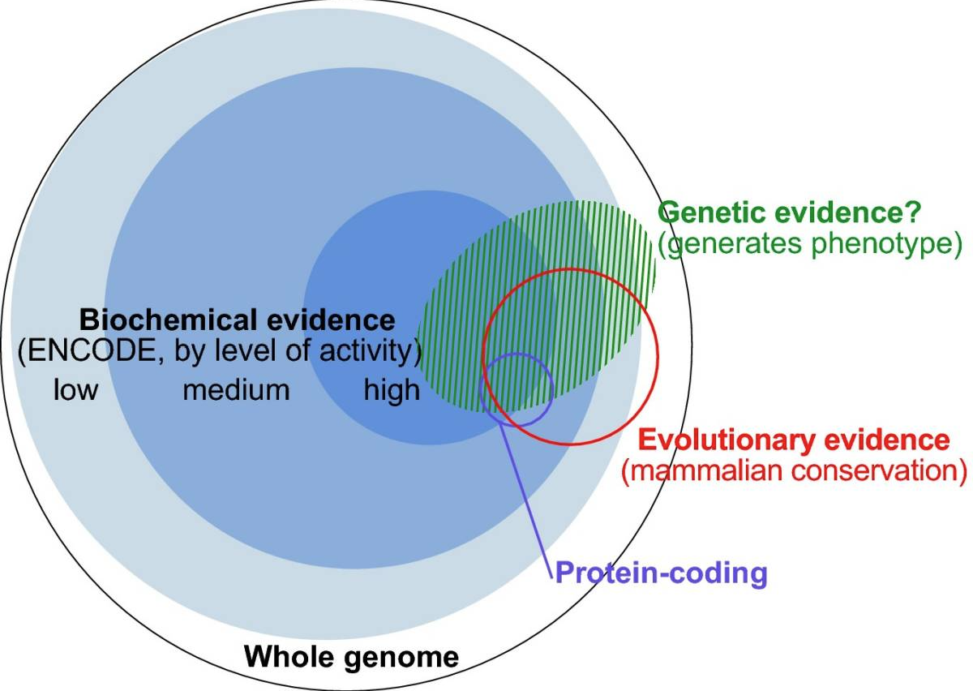
What else is in the genome?
Genes (introns, exons, and UTRs) only make up 1-20% of a typical plant genome. What else is in there?
Gene Regulatory Elements: Promoters, Enhancers, Silencers, cis-Regulatory Elements regulate gene expression.
Transposable Elements (TEs): Retrotransposons and DNA Transposons make up over 50% of most genomes.
Non-Coding RNAs (ncRNAs): microRNAs (miRNAs), small interfering RNAs (siRNAs), Long Non-Coding RNAs (lncRNAs), tRNAs, rRNAs, snRNAs.
Repetitive DNA Sequences: Simple Sequence Repeats (SSRs or microsatellites), Tandem Repeats,, Satellite DNA.
Centromeres and Telomeres. Centromere repeats have thousands of 150-200 bp units, and Telomeres (e.g., TTAGGG) are found at the end of chromosomes.
Pseudogenes: Non-functional Gene Copies that are partial or have stop codons.
Mitochondrial and Chloroplast DNA: Chunks of the Chloroplast and mitochondrial DNA can move to the nuclear genome.
Kellis et al. 2014, PNAS

Slide 10
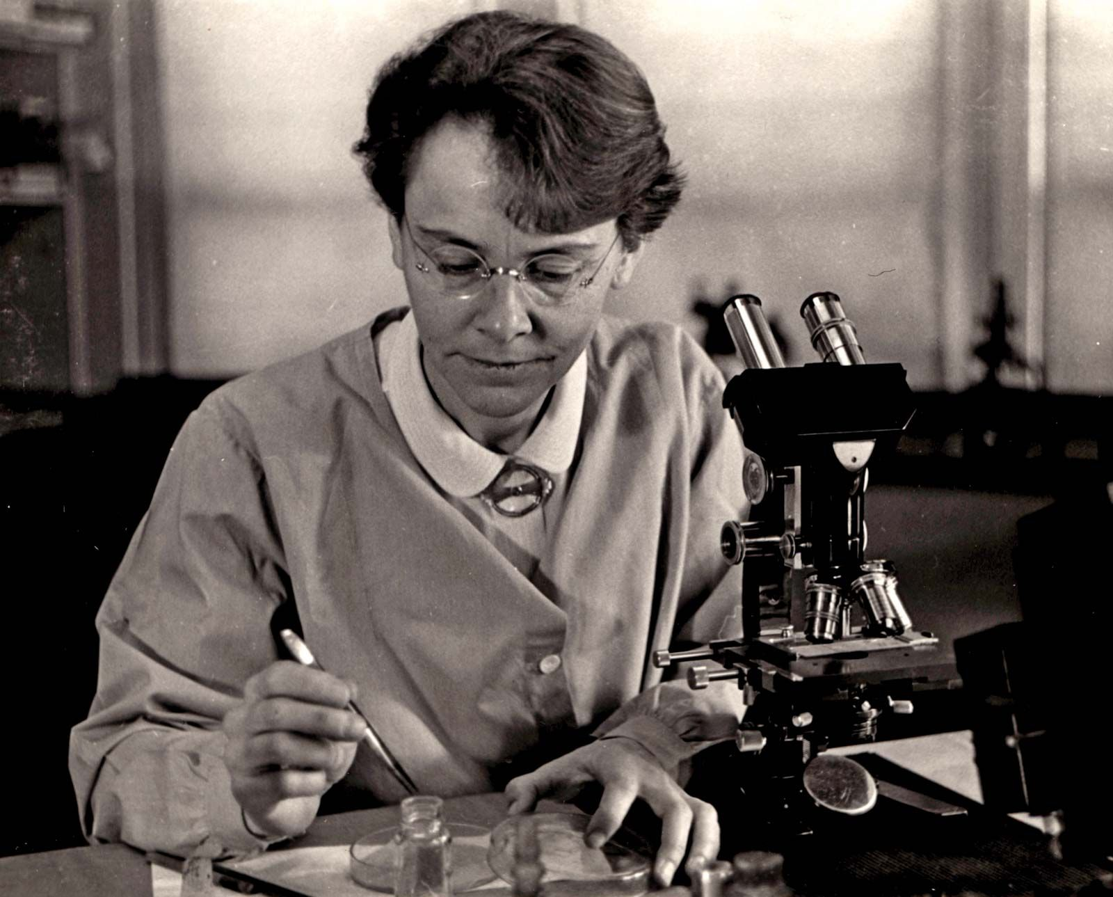
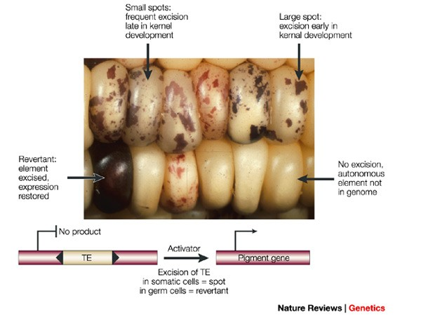
Transposable elements
Transposable elements, or "jumping genes," are DNA sequences that can move from one location to another within a genome, affecting gene function and contributing to genetic diversity and evolution.
Ac/Ds transposable elements move around the maize genome when the Activator (Ac) element makes a transposase that helps both Ac and Dissociation (Ds) elements move or transpose.
Barbara McClintock won the Nobel Prize in Physiology or Medicine in 1983 for her discovery of mobile genetic elements, (e.g., transposable elements)

Slide 11
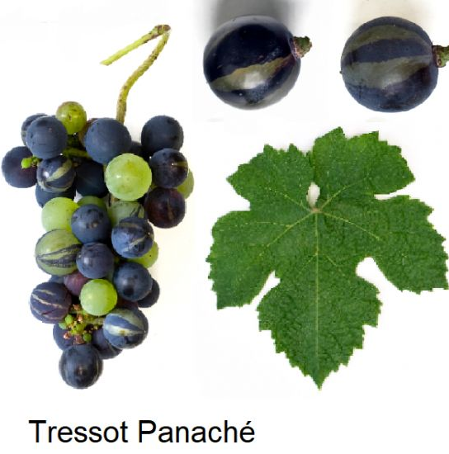
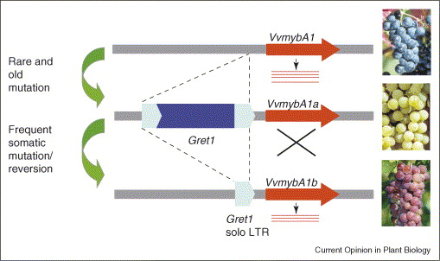
Transposable elements
Transposable elements underly many important agronomic traits or interesting phenotypes, especially somatic mutations or sports

Slide 12
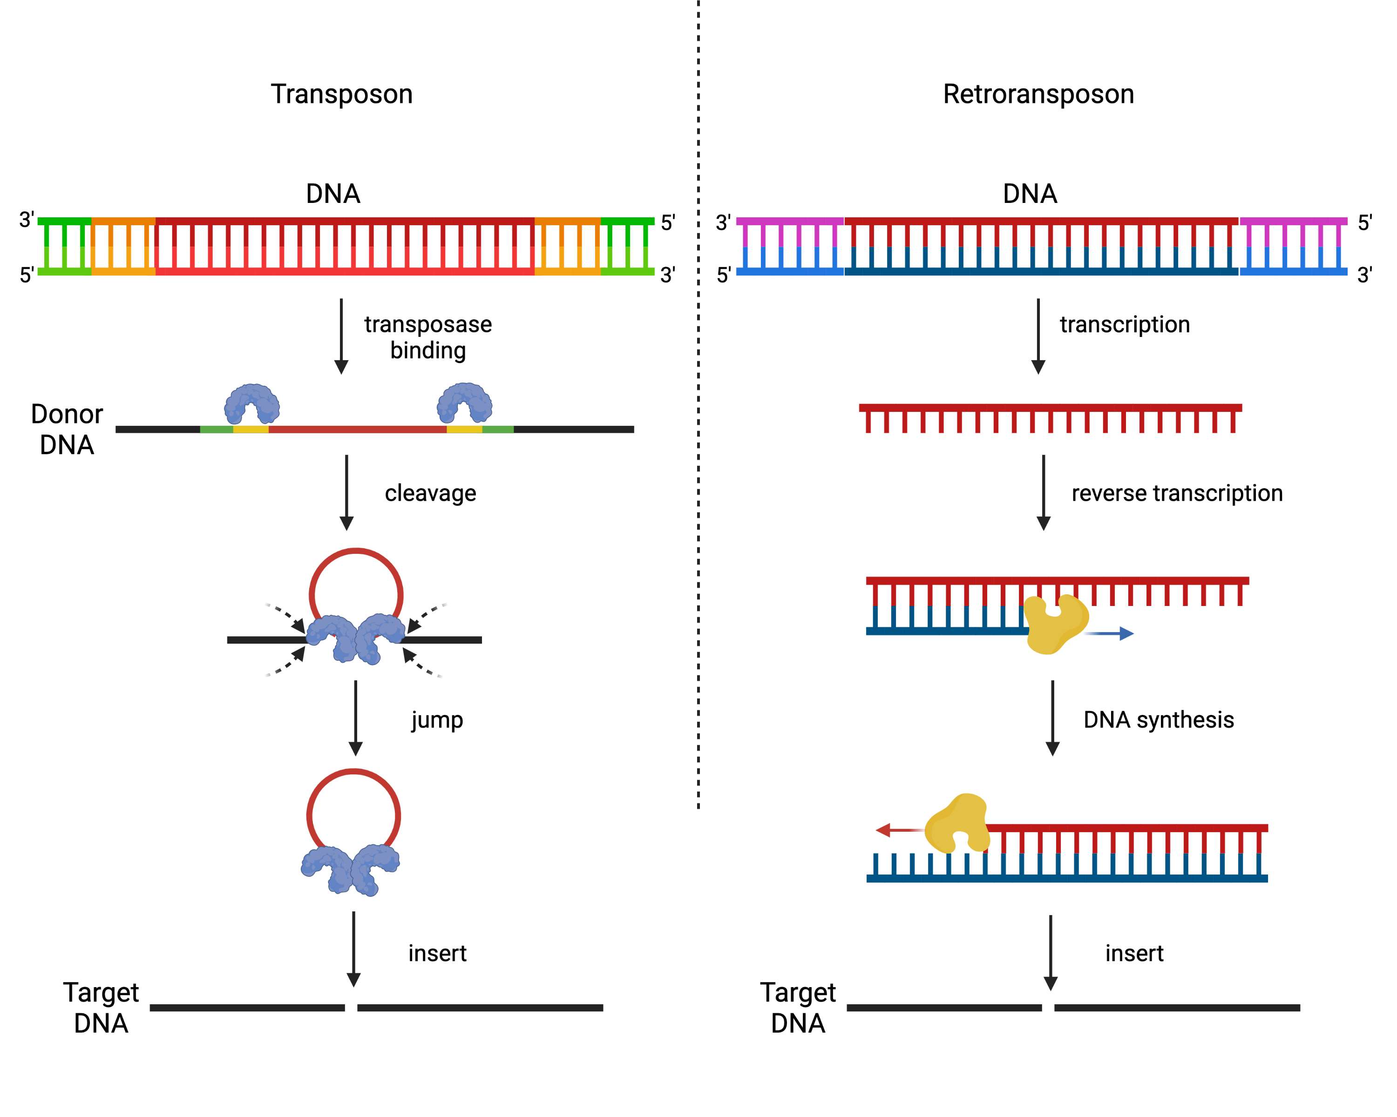
Types of transposable elements
DNA Transposons: Move via a "cut-and-paste" mechanism, where the transposon is excised from one location and inserted into another. This process is typically facilitated by a transposase enzyme that the transposon itself encodes.
Retrotransposons: Move via a "copy-and-paste" mechanism, where the transposon is first transcribed into RNA, which is then reverse-transcribed into DNA. The new DNA copy is inserted into a new location, leaving the original copy behind. This process is facilitated by reverse transcriptase and integrase enzymes, often encoded by the retrotransposon.
Which is more abundant in plant genomes?

Slide 13
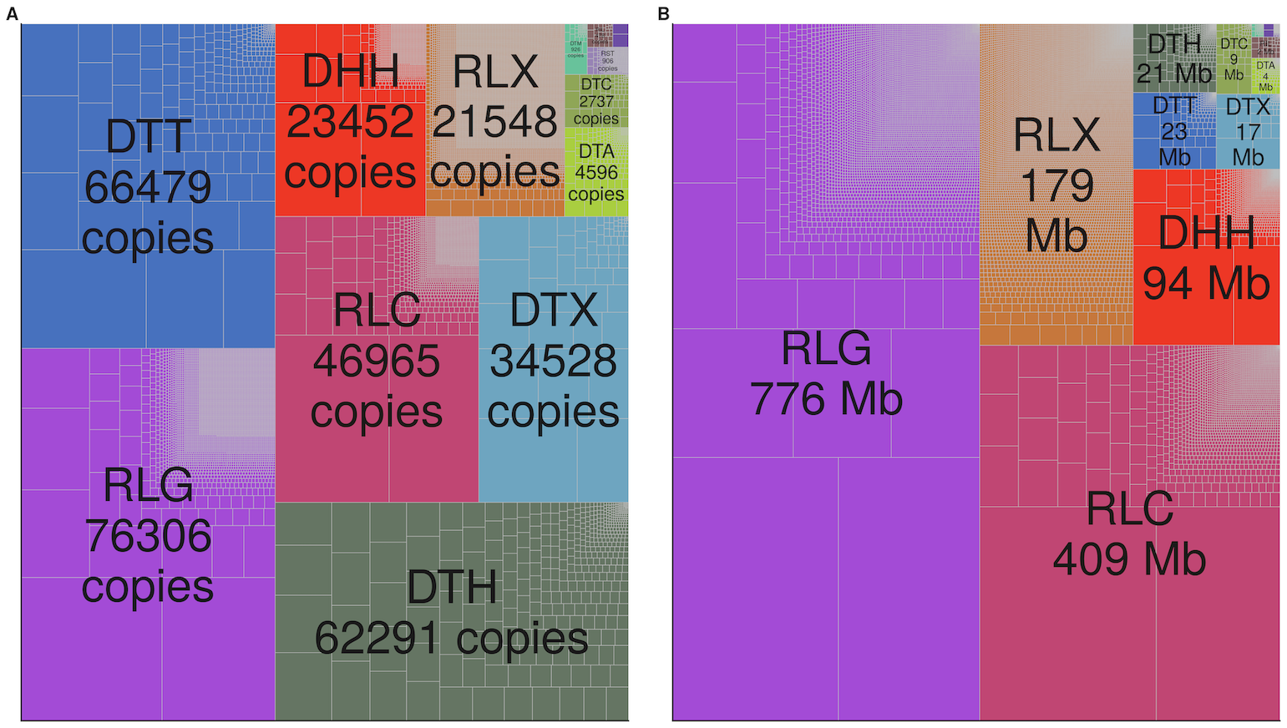
90% of the Maize genome is transposable elements
Skitzer et al. 2021 PLoS Genetics
Copy number of different transposable element families
Total size of TEs within the maize genome

Slide 14
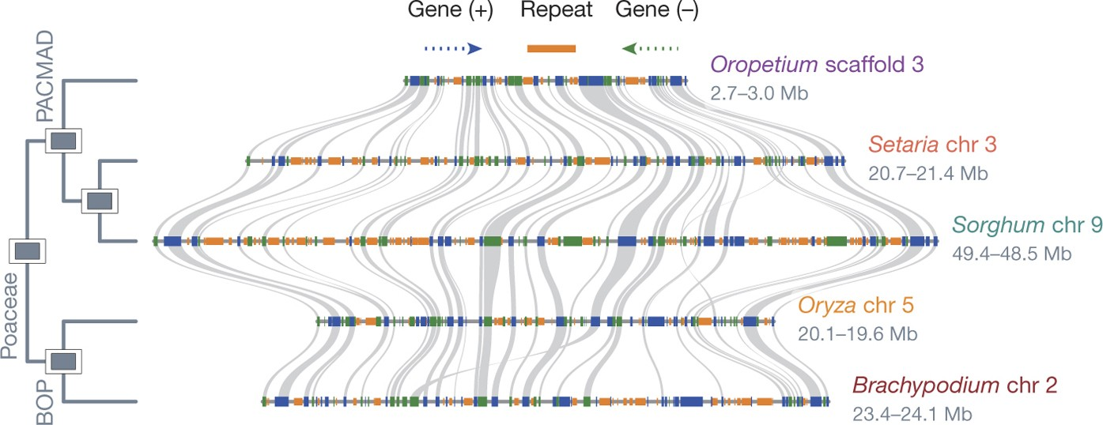
Transposable elements are the major driver of genome size evolution
Smallest grass genome
(240 Mb)
Sorghum genome
(730 Mb)
Plants with small genomes have fewer transposable elements and genes are closer together

Slide 15
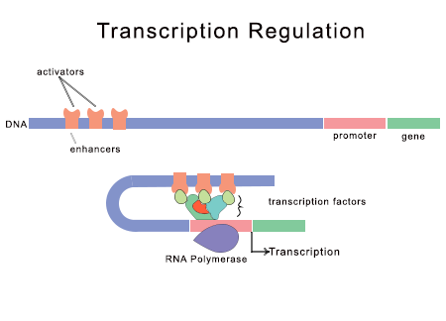
Elements regulating gene expression in plants
Gene expression in plants is tightly regulated by various elements, both at the DNA sequence level and through broader regulatory mechanisms. DNA based regulation:
Promoters: Located just upstream of the gene, these sequences contain binding sites for RNA polymerase and transcription factors to initiate transcription (e.g., TATA box). Can also include additional transcription factor binding sites that enhance or fine-tune the regulation of gene expression.
Enhancers: Distal Regulatory Sequences located far from the gene they regulate and can increase transcription levels by interacting with transcription factors and the transcription machinery.
Silencers: Sequences that can repress gene expression when bound by specific proteins, such as repressor transcription factors. They prevent the binding of RNA polymerase and block activators.
We still don’t know the regulatory elements controlling gene expression in plants very well.

Slide 16
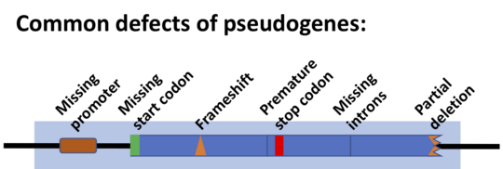
The genome is a graveyard
Genomes are full of relics. Including dead genes, fragments of transposable elements, virus insertions, and other odd things with unknown evolutionary origin.

Slide 17
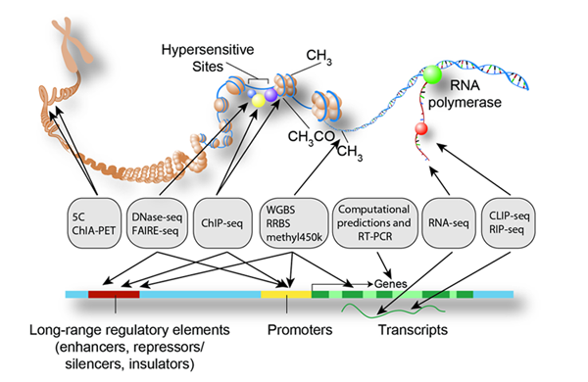
Elements regulating gene expression in plants
How do we identify the functional elements of genomes?
The ENCODE (Encyclopedia of DNA Elements) Consortium is an international collaboration of research groups funded by the National Human Genome Research Institute (NHGRI). The goal of ENCODE is to build a comprehensive parts list of functional elements in the human genome, including elements that act at the protein and RNA levels, and regulatory elements that control cells and circumstances in which a gene is active.

Slide 18
Genome assembly
How do we annotate genomes?
Look for overlaps:
My car broke down in the deep
woods. Suddenly I heard a…
in the deep dark woods. Suddenly
My car broke down in the deep
in the deep dark woods. Suddenly
woods. Suddenly I heard a…
My car broke down in the deep dark woods. Suddenly I heard a…

Slide 19
Genome annotation
How do we annotate genomes?
the dog walked through the corn with the farmer the farmer harvested the corn after the hail storm the dog fell asleep after the farmer harvested the corn the hail storm damaged the apples on the farm the apples on the farm were planted by the farmer the apples on the farm were used to feed the sheep the farmer baked a pie with the apples on the farm the sheep were herded by the dog
The dog walked through the corn with the farmer. The farmer harvested the corn after the hail storm. The dog fell asleep after the farmer harvested the corn. The hail storm damaged the apples on the farm. The apples on the farm were planted by the farmer. The apples on the farm were used to feed the sheep. The farmer baked a pie with the apples on the farm. The sheep were herded by the dog.

Slide 20
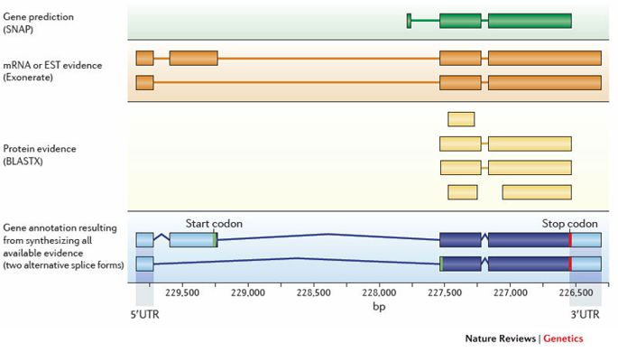
How do we annotate genomes?
A fragment of DNA

Slide 21
How do we annotate genomes?
Structural annotation focuses on identifying the physical elements within the genome, such as genes, exons, introns, and regulatory regions.
Gene Prediction:
Ab initio Prediction: This method uses computational algorithms to identify genes based on DNA sequence features like open reading frames (ORFs), splice sites, start and stop codons, and promoter regions. Tools like AUGUSTUS, Glimmer, or GeneMark are commonly used.
Homology-Based Prediction: This method uses known genes from other organisms (e.g., closely related species) to identify similar genes in the genome being annotated. Tools like BLAST compare the new genome to well-annotated reference genomes.
Transcriptome Evidence:
RNA sequencing (RNA-seq) data is used to identify transcribed regions of the genome. By aligning RNA-seq reads to the genome, researchers can identify expressed genes and confirm gene models. This approach provides information about intron-exon boundaries, alternative splicing, and gene expression levels.
Protein Evidence:
Proteomics data (mass spectrometry of proteins) can also help verify gene predictions by linking DNA sequences to actual proteins being produced in the organism.

Slide 22
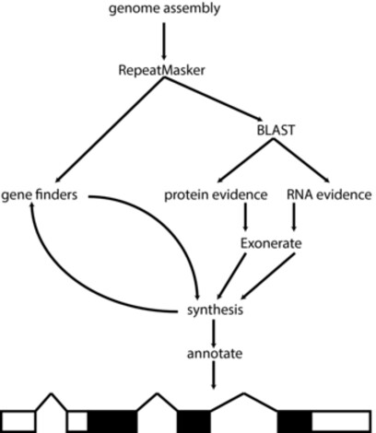
What software do we use for genome annotation?
MAKER-P pipeline for genome annotation
Sequencing diverse plant species of evolutionary, agricultural, and medicinal interest is becoming routine for even small groups - genome annotation and analysis is much less so. The MAKER-P pipeline is designed to make the annotation of novel plant genomes tractable for small groups with limited bioinformatics experience and resources, and faster and more transparent for large groups with more experience and resources. The MAKER-P pipeline generates species-specific repeat libraries, as well as structural annotations of protein coding genes, non-coding RNAs, and pseudogenes.

Slide 23
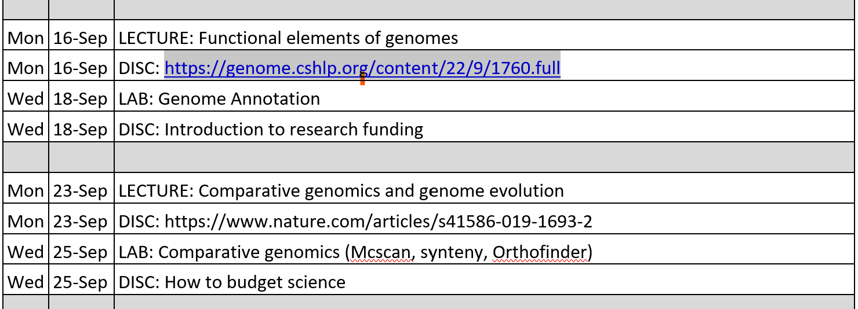
Looking forward

