Slide 1

Single Cell Biology
11-10-25

Slide 2
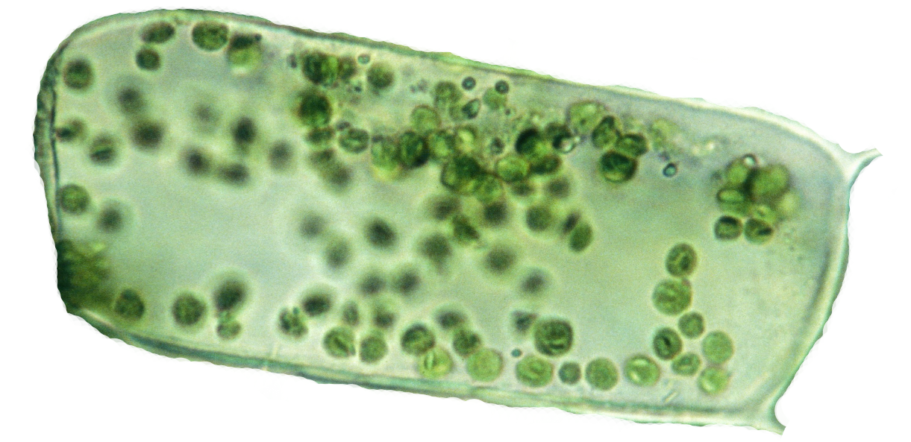
Quantifying gene expression
This is an average plant cell
How many messenger RNAs (mRNAs) are there in a typical plant cell?
The average plant cell contains 100,000-1,000,000 individual messenger RNA (mRNA) molecules (among other types of RNAs).
A typical cell is expressing ~10-15k genes at any time, depending on cell type, time of day, stress, cell division, etc.
mRNA turn over can be rapid (a few seconds) or slow (a few days)
Expression of genes is tightly coordinated and elegant ‘regulatory networks’ control when and where genes are expressed

Slide 3
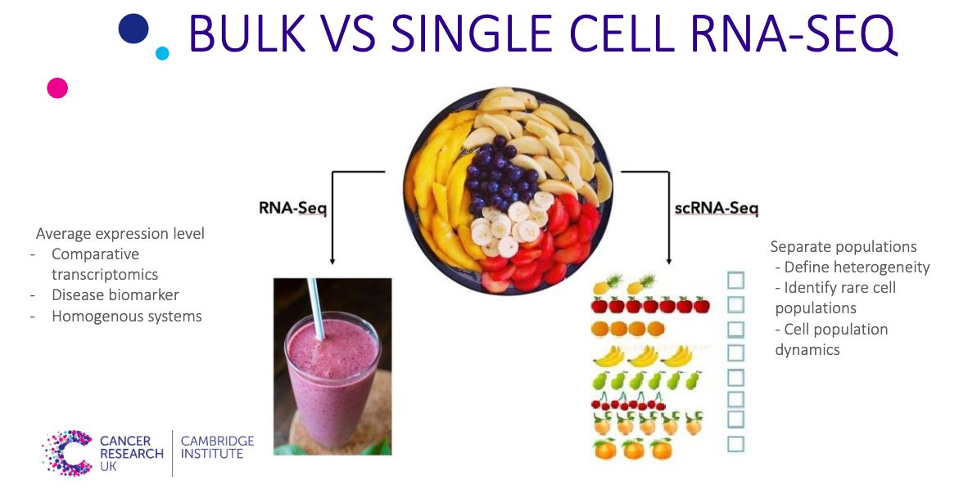
Single Cell RNAseq (scRNAseq)

Slide 4
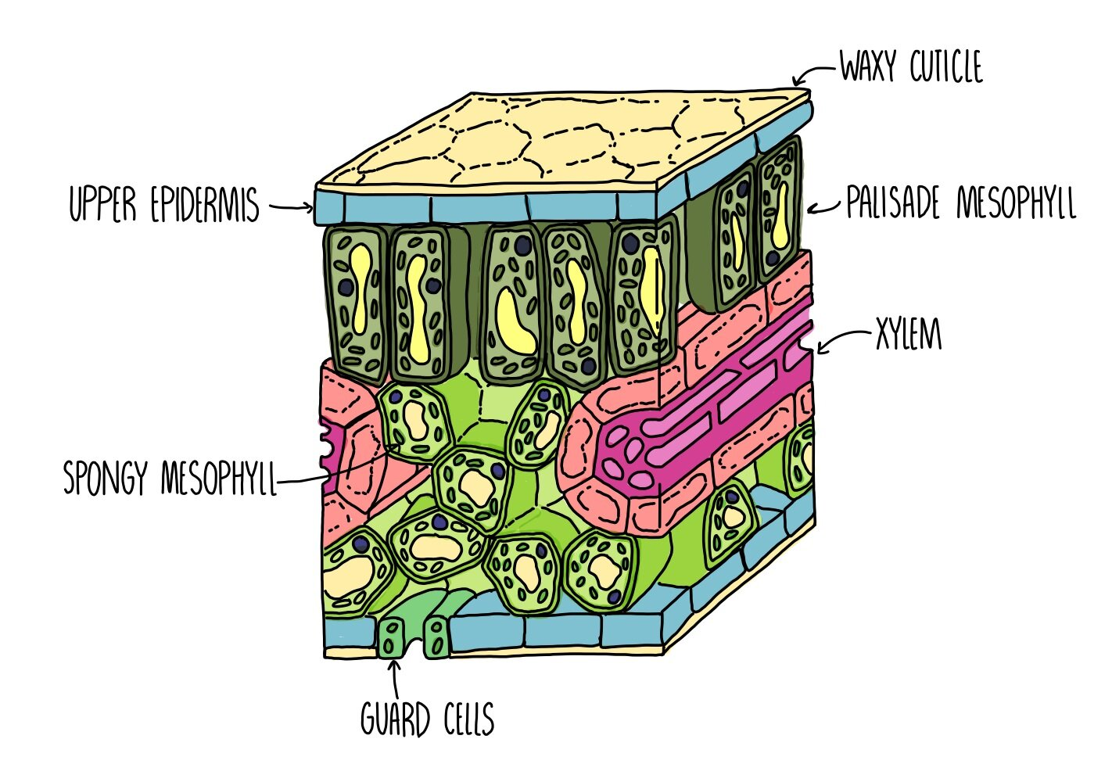
Benefits of single Cell RNAseq
Plant tissues are composed of a dozens to hundreds of cell types, each with distinct roles in processes like photosynthesis, transport, and defense, contributing to the functional diversity within a single tissue.
Bulk RNA sequencing captures an average gene expression profile across all cell types in a sample, which can obscure cell type-specific expression patterns and dilute signals from rare or specialized cells.
Single-cell RNA-seq enables us to identify gene expression signatures in individual cell types, allowing for precise mapping of gene function and revealing how specific genes contribute to cellular roles within complex tissues.

Slide 5
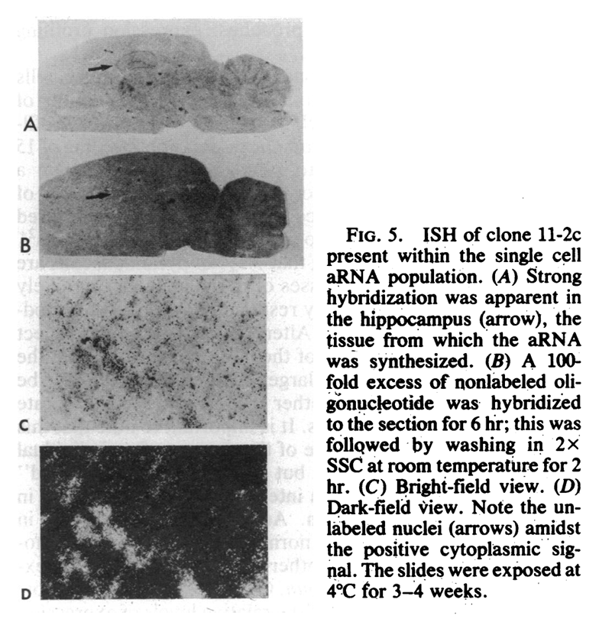
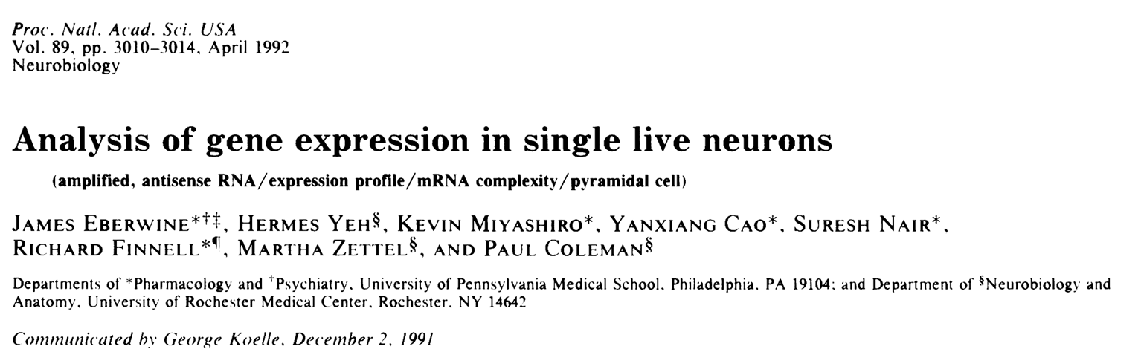
Earliest measures of single cell gene expression: In situ hybridization
Eberwine et al.¹⁰ measured the expression of a handful of individual genes from single cells for the first time in 1992, using a sophisticated approach based on in vivo reverse transcription (RT) followed by amplification through IVT.

Slide 6
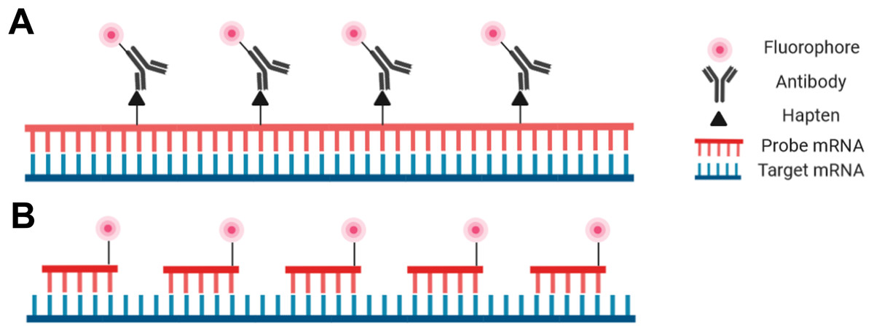
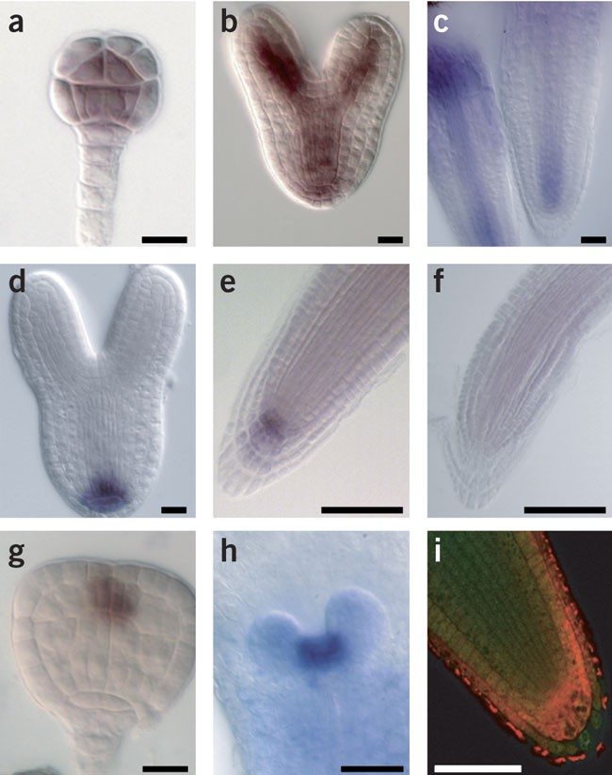
Measuring cell level gene expression: In situ hybridization
In situ hybridization is a technique used to detect specific nucleic acid sequences within fixed tissues or cells, using labeled complementary probes that bind to target RNA or DNA.
Allows for the visualization of gene expression patterns in their native tissue context, helping us study spatial distribution of specific genes or transcripts during development, disease progression, or tissue differentiation.
It can be technically challenging, often requiring complex optimization for probe specificity and tissue permeability, and it typically provides lower resolution and sensitivity compared to newer techniques like single-cell RNA sequencing. Also, only 1 gene at a time!
Hejátko et al. 2006

Slide 7
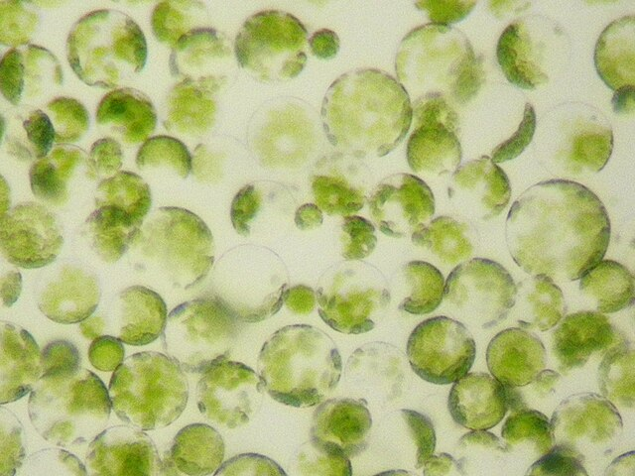

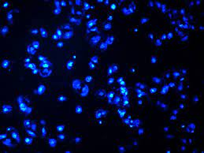
But first, we need to isolate single cells/nuclei from plant tissue
protoplasts
Bulk tissue
Protoplasts are plant cells with their cell wall removed, leaving only the plasma membrane and cellular contents
The enzymatic digestion required to remove cell walls can alter cellular stress responses and gene expression profiles, potentially impacting the accuracy of native cell-state data.
nuclei
Nuclei can be harvested from frozen plant tissues while preserving their integrity
Nuclei-based single-cell RNA sequencing (scRNA-seq) is that it captures only the nuclear RNA, which can limit the detection of fully processed transcripts and cytoplasmic mRNA

Slide 8
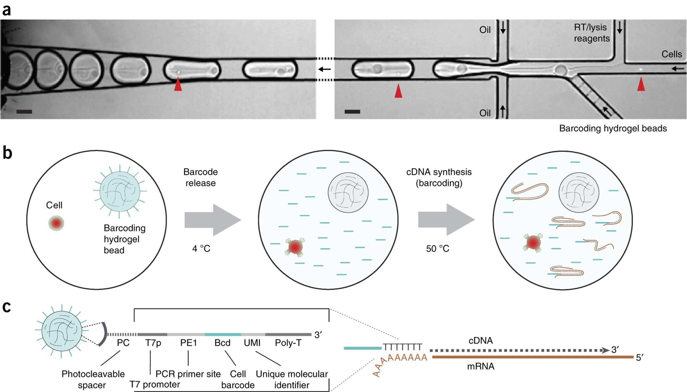
Microfluidics based single cell biology

Slide 9
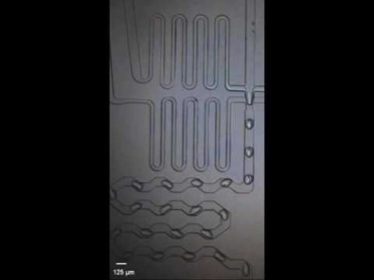
Microfluidics based scRNAseq

Slide 10
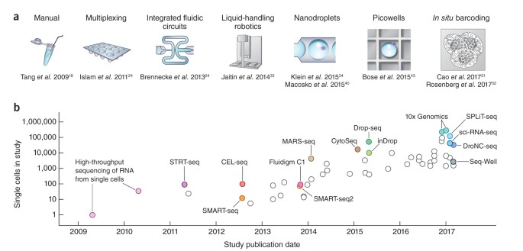
History of single cell sequencing

Slide 11
Single Cell RNAseq (scRNAseq) approaches
Microfluidics (10x Genomics): In this widely used approach, individual cells are captured within microfluidic droplets, where each droplet contains a unique barcode that labels the cell's RNA molecules. This method allows for high-throughput processing, capturing thousands of cells in a single run. 10x Genomics is known for its scalability and ability to handle complex samples but can be limited by the cell types captured and the risk of doublets (two cells in one droplet).
Emulsion-based approaches: In emulsion scRNA-seq, individual cells are encapsulated in oil droplets along with barcoded beads. The oil-water emulsion creates a small, isolated environment for each cell to undergo lysis, allowing its mRNA to bind to barcoded primers on beads. This approach, similar to 10x microfluidics, is high-throughput and cost-effective, but the emulsion formation can be sensitive to cell quality and size, impacting capture efficiency.
Multiplexing: In multiplexing scRNA-seq, cells from different samples are labeled with unique DNA-based barcodes before being pooled for sequencing. This method allows researchers to analyze multiple samples or experimental conditions simultaneously, which can help reduce costs and batch effects. However, multiplexing requires careful optimization of barcode labeling to avoid cross-contamination and ensure accurate sample identification.

Slide 12
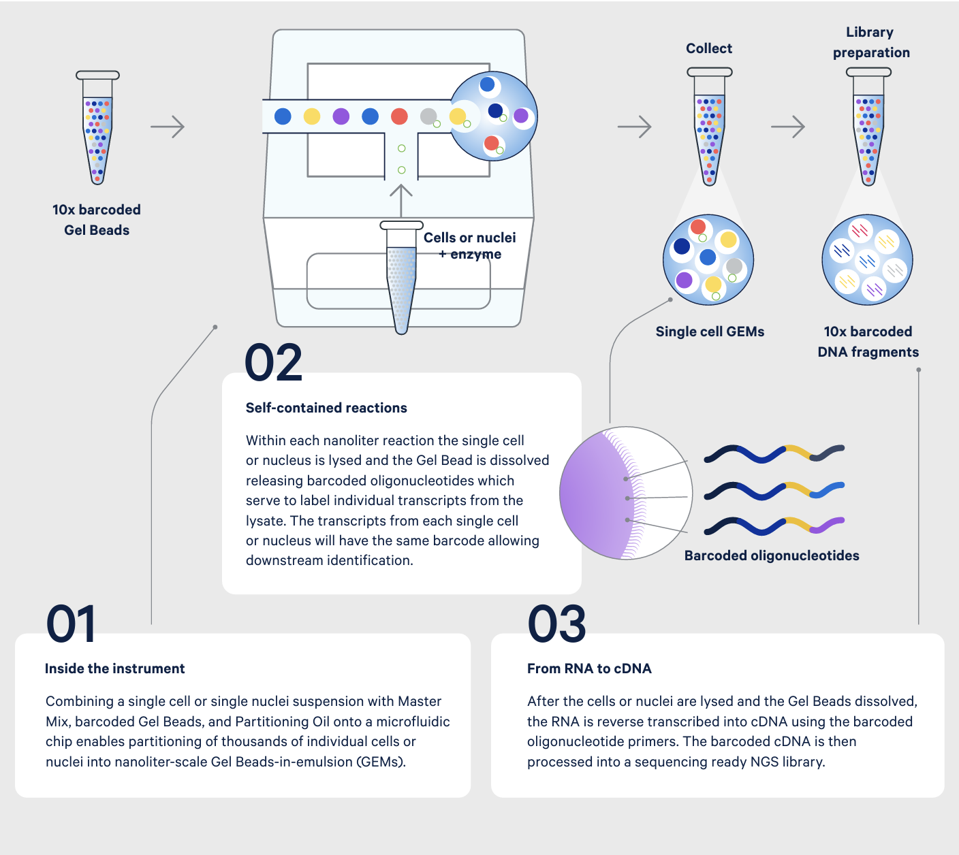
10x Chromium system
The 10x Chromium system uses microfluidics to partition individual cells into nanoliter-sized droplets, each containing a unique barcode. This approach enables the profiling of thousands to tens of thousands of cells in a single run, making it ideal for studies requiring large cell numbers.
It is compatible with various sample types, including dissociated tissues and whole blood, and offers a streamlined workflow with standardized reagents, making it accessible to many labs.
The 10x platform has limitations, such as sensitivity to cell quality, potential for doublets (where two cells are captured in the same droplet, especially with high cell densities), and limited ability to capture very large or fragile cells, which may affect the diversity of cell types represented in the data.
It is relatively expensive per cell compared to other single-cell approaches (think $1-2k per sample of ~10-50k cells)

Slide 13
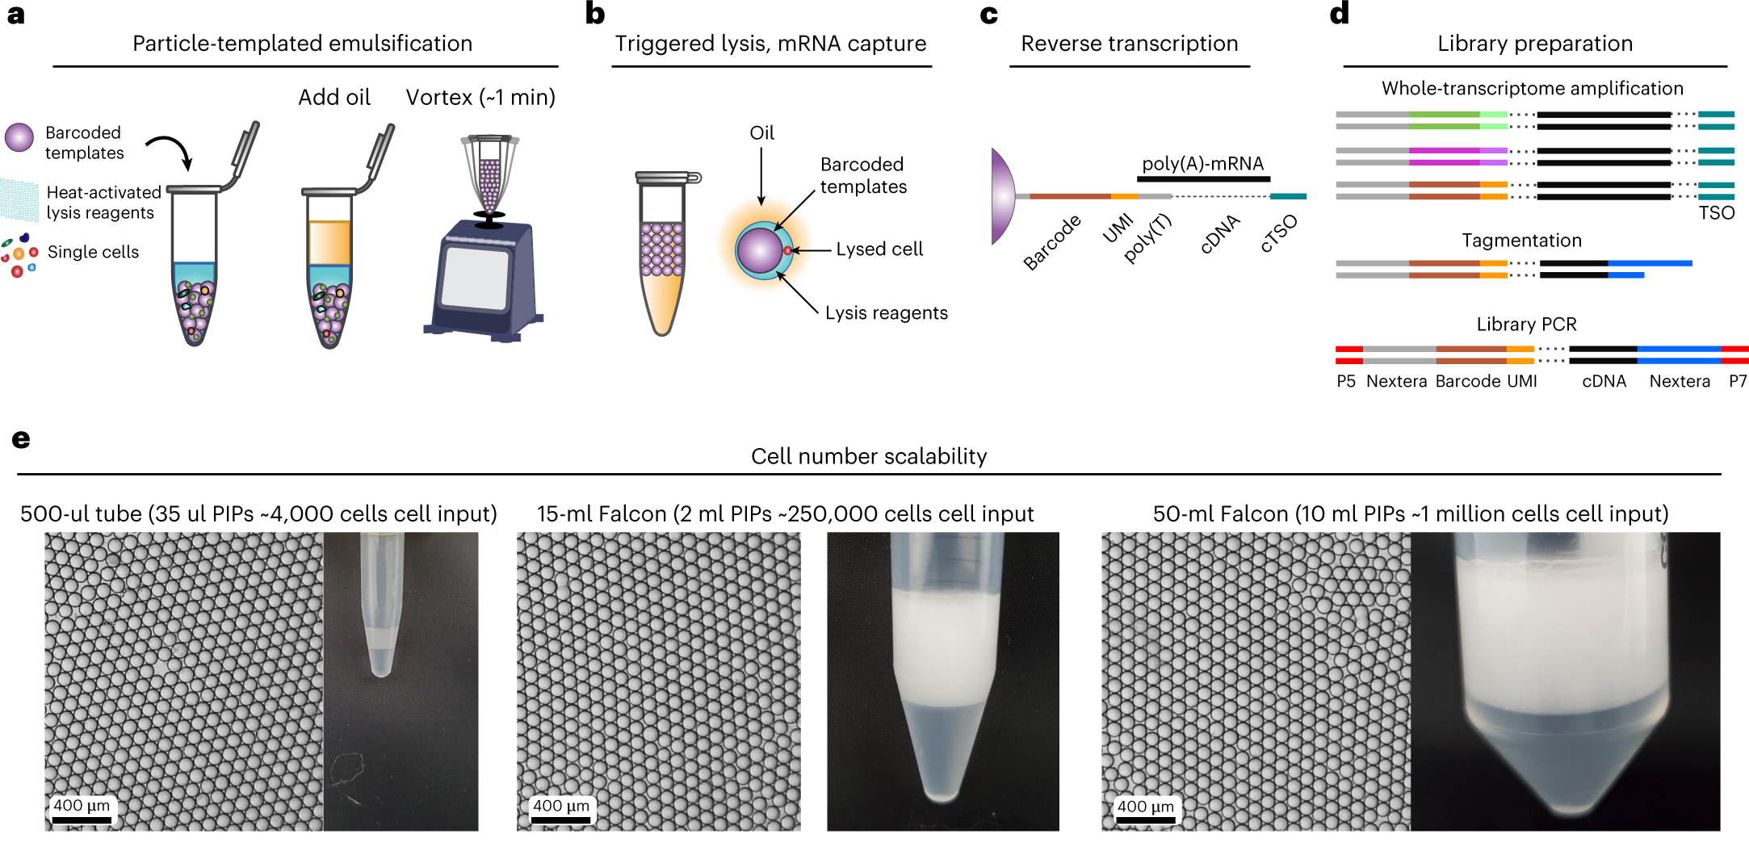
Emulsion based scRNAseq
Particle-templated Instant Partition sequencing (PIP-seq) uses particle-based templates that rapidly isolate individual cells upon contact, creating a microenvironment for cell lysis and RNA capture without the need for traditional microfluidic devices. This enables efficient and rapid cell partitioning directly in a tube.
Unlike other high-throughput methods that require microfluidics, PIP-seq simplifies the process by removing the need for specialized equipment, making it potentially more accessible and scalable for labs with limited resources.
While promising, PIP-seq is relatively new and may have limitations in terms of capture efficiency, consistency in capturing rare cell types.
Clark et al. 2023

Slide 14
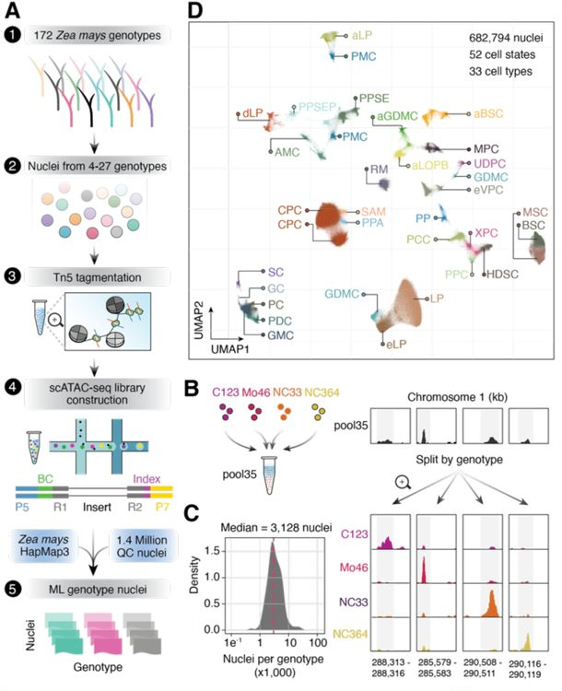
Pooling/multiplexing for scRNAseq
You can combine cells from different plant accessions or ecotypes into a single sequencing run to save on costs and streamline the process.
After sequencing, you can use naturally occurring single nucleotide polymorphisms (SNPs) unique to each accession/ecotype to distinguish and separate the cells into their respective groups.
“∼1.37 million seedling nuclei across 172 distinct maize inbred lines
Following strict thresholding for genotype calls, we retained 682,794 high-quality nuclei (average of 3,970 nuclei per inbred) and identified a total of 108,843 Accessible chromatin regions)”

Slide 15
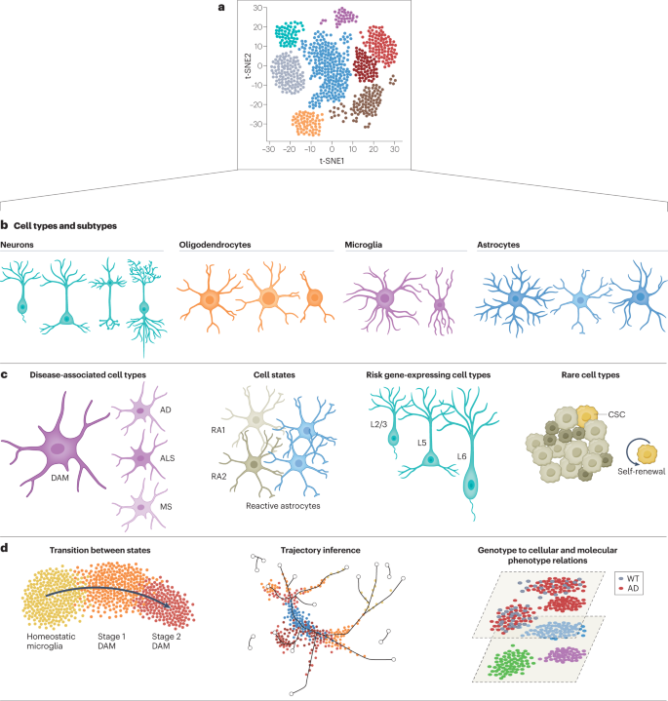
How do we interpret single cell RNAseq data?
t-SNE (t-distributed Stochastic Neighbor Embedding) is a dimensionality reduction technique commonly used in single-cell RNA-seq analysis to visualize high-dimensional gene expression data by grouping similar cells together in a two-dimensional plot, revealing distinct cell populations and relationships.
Each point is a single cell

Slide 16
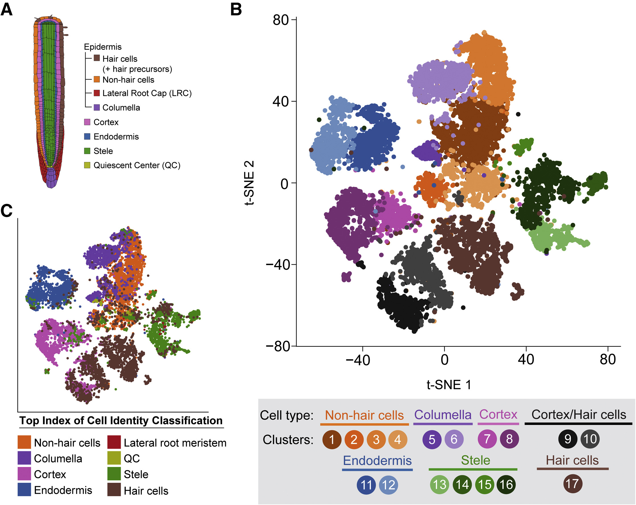
Single Cell RNAseq (scRNAseq) in plants
Identifying distinct cell populations relies on using specific marker genes characteristic of each cell type. These markers help classify cells based on known expression patterns, enabling researchers to distinguish between, for example, root hair cells and guard cells in plants.
Limited knowledge of markers: For many species and tissue types, especially non-model organisms, reliable cell type-specific markers are not well-established, making it difficult to confidently classify cell populations based on existing data.
Marker gene variability: Expression of known markers can vary significantly due to biological and technical noise, environmental conditions, or stress.
Discovery of new cell types: As scRNA-seq reveals previously unknown cell populations, identifying unique markers for these cells requires additional experimental validation, slowing the process of accurate cell identification and annotation in the dataset.

Slide 17
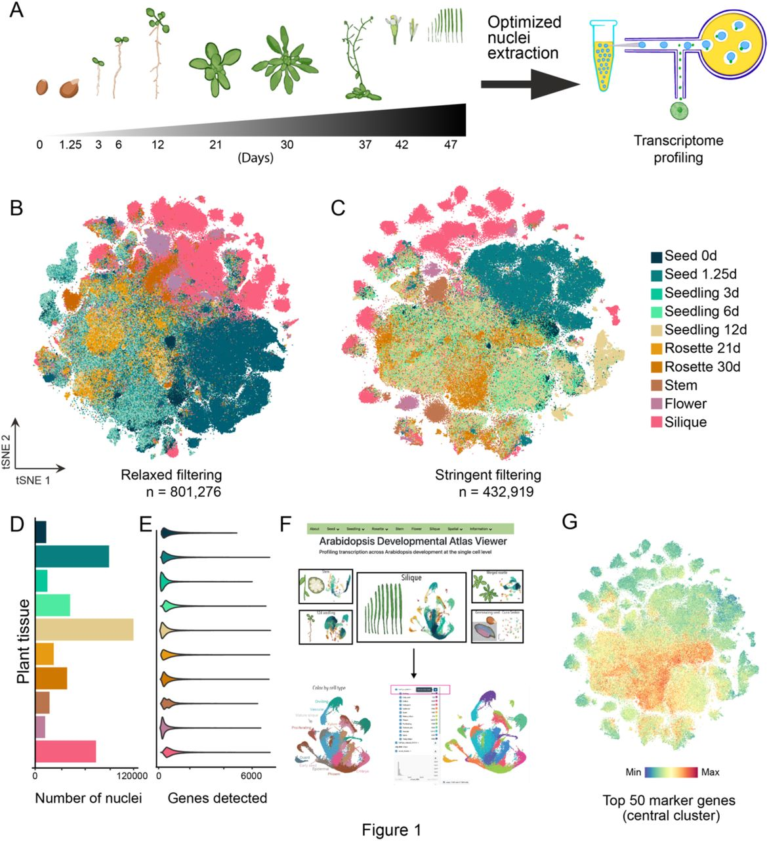
A Single-Nucleus Atlas of Seed-to-Seed Development in Arabidopsis

Slide 18
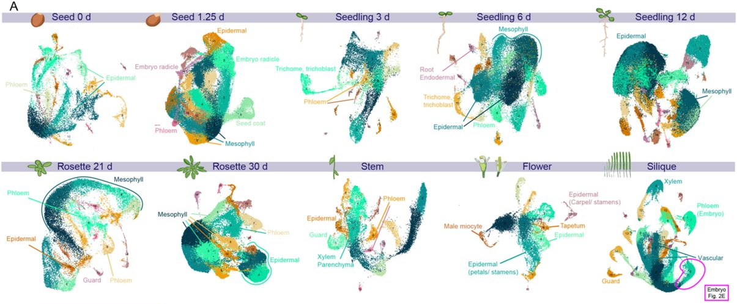
A Single-Nucleus Atlas of Seed-to-Seed Development in Arabidopsis

Slide 19
Limitations of scRNAseq in plants
High cost and resource demands: Single-cell RNA sequencing is an expensive technique ($1-2k per replicate/sample), requiring specialized equipment and reagents, making it less accessible for many research labs, especially when processing large numbers of cells or replicates for diverse conditions.
Difficulty in isolating protoplasts and nuclei across species: Isolating individual cells (protoplasts) or nuclei for scRNA-seq can be technically challenging in plants, particularly for species with rigid cell walls, high levels of secondary metabolites, or complex tissue structures, leading to potential biases in cell-type representation.
Limited availability of cell type-specific markers: For many plant species, especially non-model organisms, there is a lack of well-defined markers for specific cell types, making it challenging to accurately identify and categorize cell populations from scRNA-seq data.
Incomplete gene representation: Plant scRNA-seq data often captures only a subset of the transcriptome, particularly if nuclei-based RNA-seq is used, which can miss fully processed mRNAs, resulting in a partial picture of gene expression that may omit key regulatory or functional genes.
Cell stress and expression artifacts: Protoplast isolation, particularly enzymatic digestion of cell walls, can induce stress responses and alter gene expression profiles, potentially skewing the data away from true native cell states and affecting interpretation.

Slide 20
Limitations of single cell RNAseq
We know the cell types, but where are these cells located within the tissue?
Spatial single-cell RNA sequencing (spatial scRNA-seq) is an advanced technique that combines the power of single-cell RNA sequencing with spatial information about cell location within tissues. Unlike traditional scRNA-seq, which dissociates cells and loses their spatial context, spatial scRNA-seq preserves the original location of each cell within the tissue
Common methods include Spatial Transcriptomics (using barcoded slides) and Slide-seq (using barcoded beads), where tissue sections are placed on arrays that capture mRNA from cells in their exact positions. This spatial information is then combined with high-throughput sequencing to build a map of gene expression patterns.

Slide 21
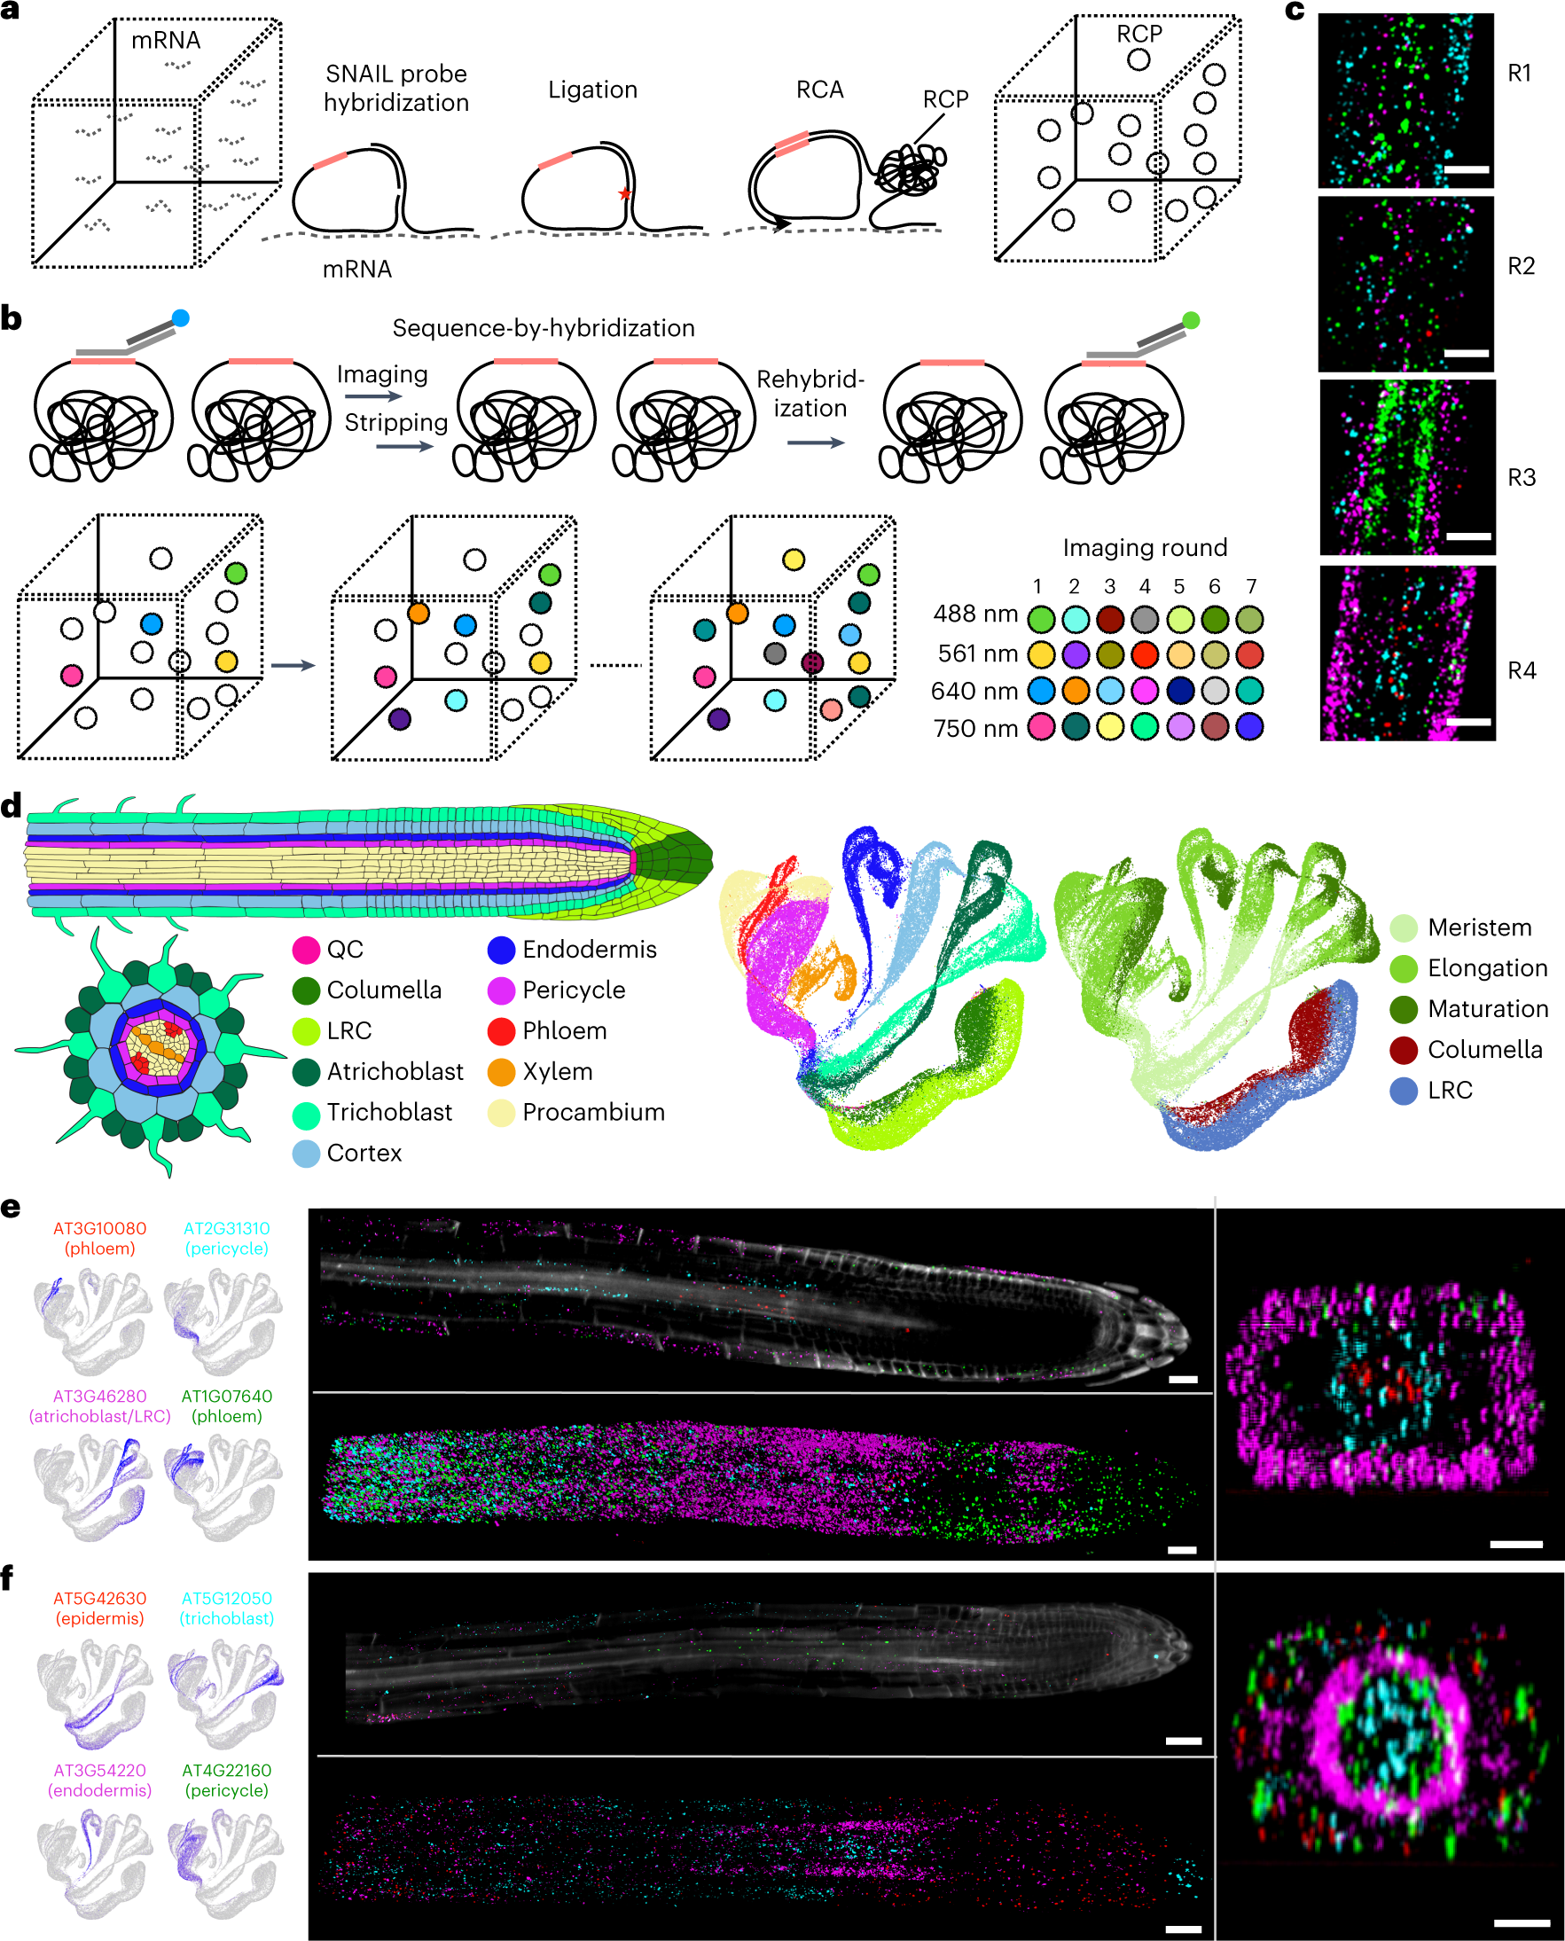
PHYTOMap
PHYTOMap builds on in situ hybridization techniques in plants and in situ sequencing technologies primarily developed in neuroscience. After fixing whole-mount plant tissues, DNA probes (specific amplification of nucleic acids via intramolecular ligation probes or SNAIL probes) with gene-specific barcodes are specifically hybridized on target messenger RNA molecules, circularized and amplified in situ.

Slide 22
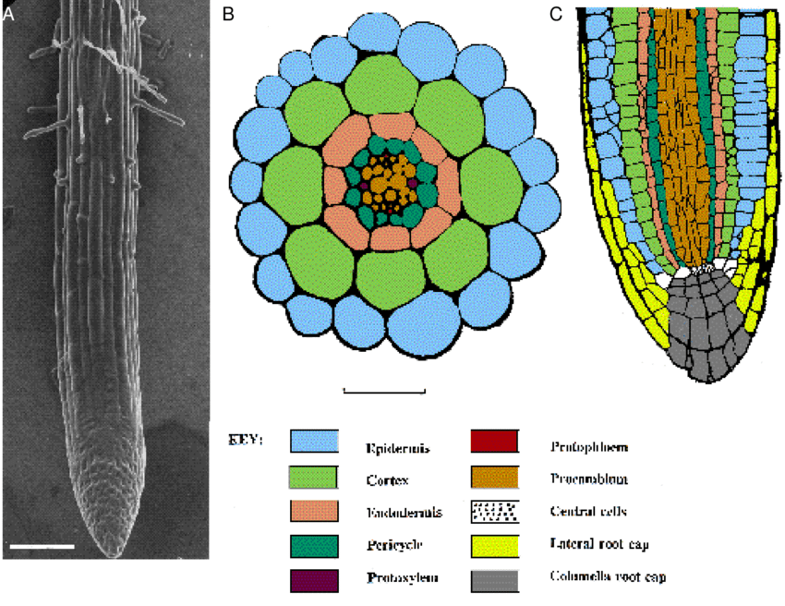
PHYTOMap

Slide 23
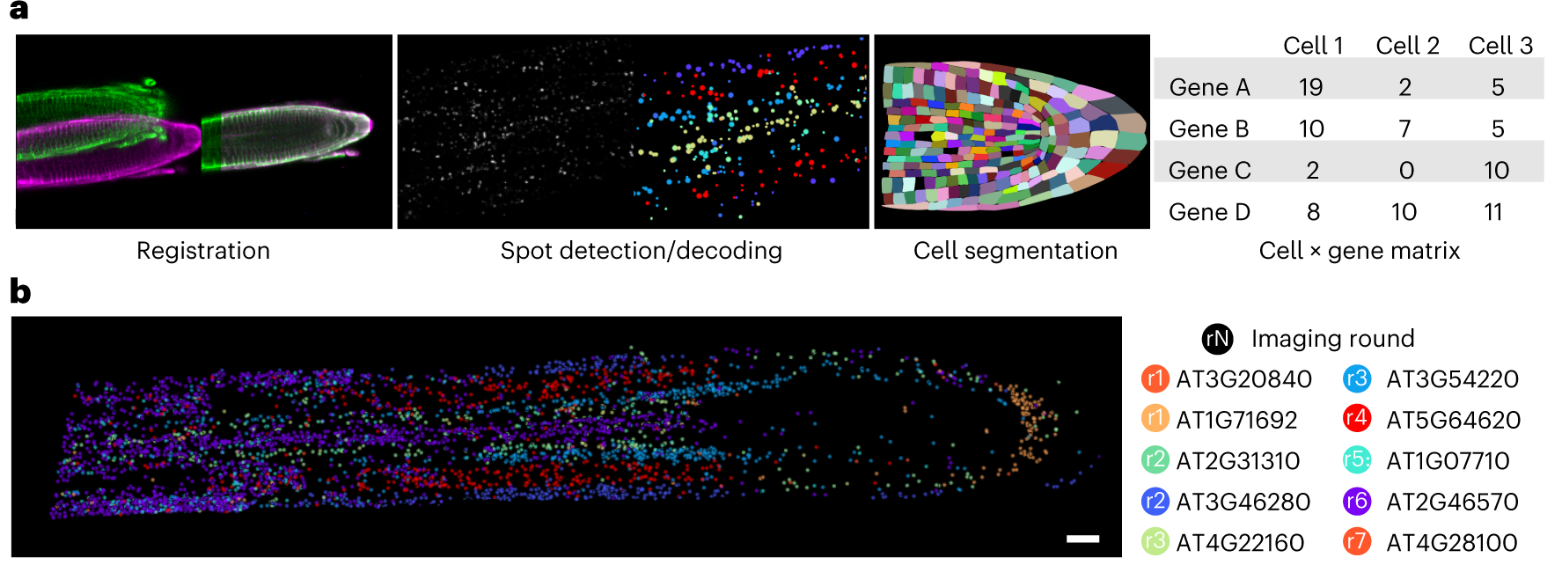
PHYTOMap

Slide 24
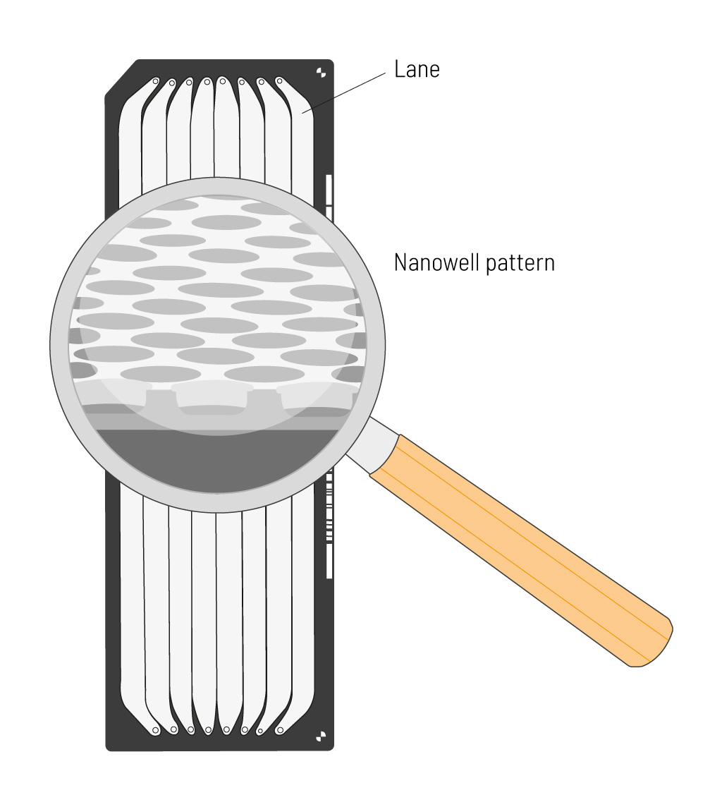
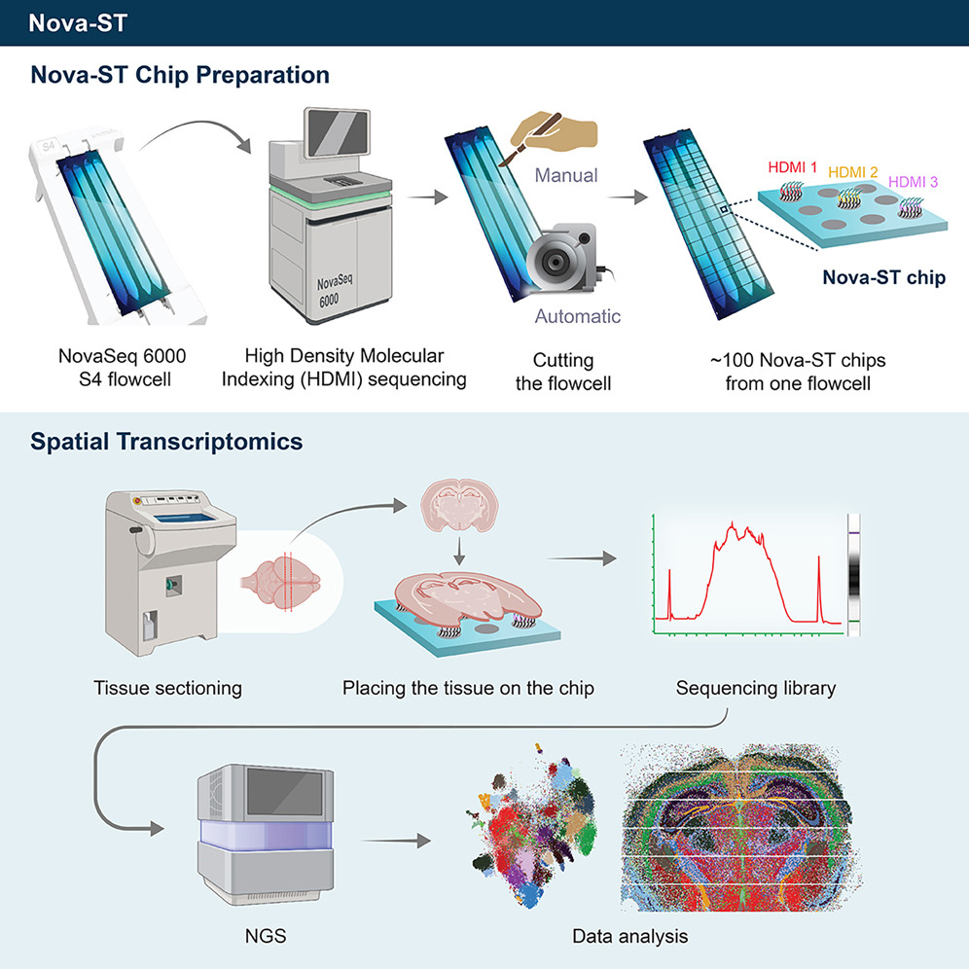
Spatial transcriptomics

Slide 25
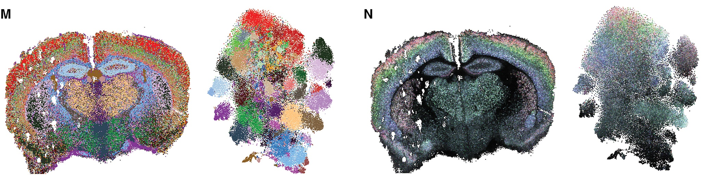
Spatial transcriptomics

Slide 26

Looking forward

