Slide 1

Introduction to RNAseq
9-29-25

Slide 2
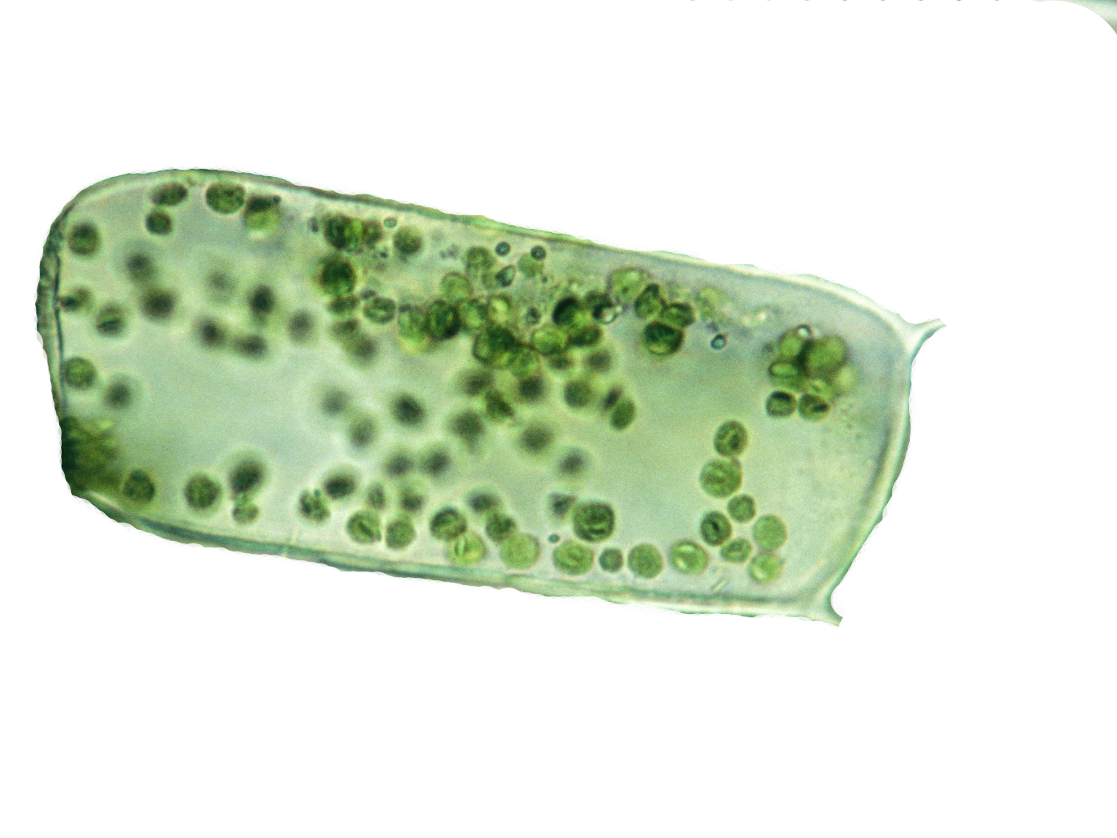
Quantifying gene expression
This is an average plant cell
How many messenger RNAs (mRNAs) are there in a typical plant cell?
The average plant cell contains 100,000-1,000,000 individual messenger RNA (mRNA) molecules (among other types of RNAs).
A typical cell is expressing ~10-15k genes at any time, depending on cell type, time of day, stress, cell division, etc.
mRNA turn over can be rapid (a few seconds) or slow (a few days)
Expression of genes is tightly coordinated and elegant ‘regulatory networks’ control when and where genes are expressed

Slide 3
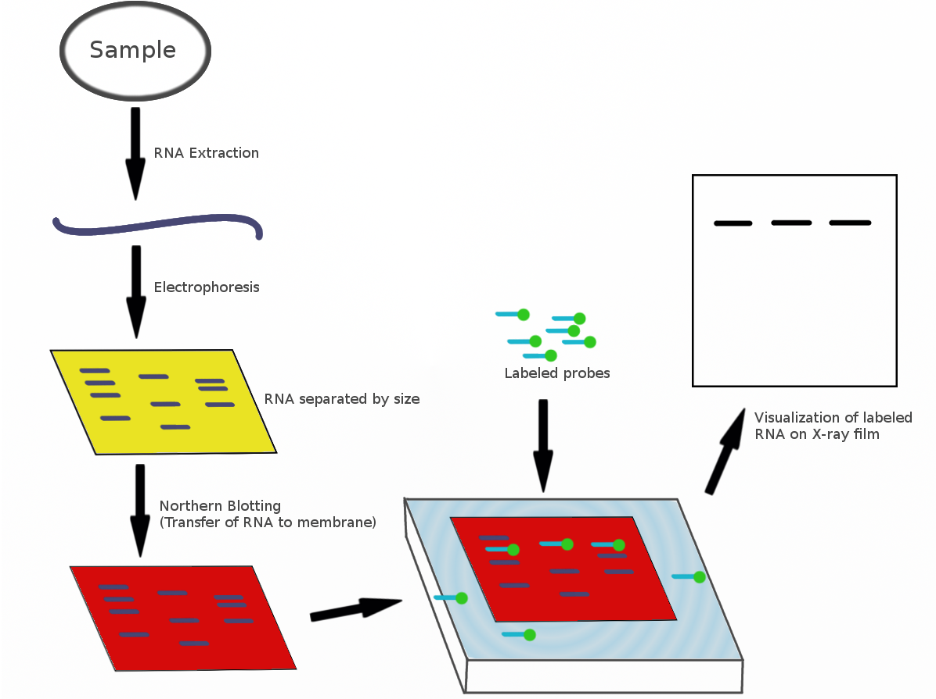
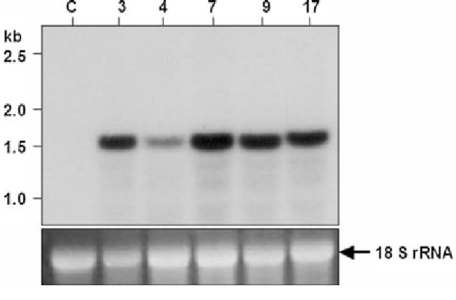
Measuring gene expression: Northern blots
Northern blotting was used to measure gene expression by separating RNA samples on a gel, transferring them to a membrane, and detecting specific mRNA using labeled probes. The intensity of the resulting bands indicated the abundance of target mRNA.

Slide 4
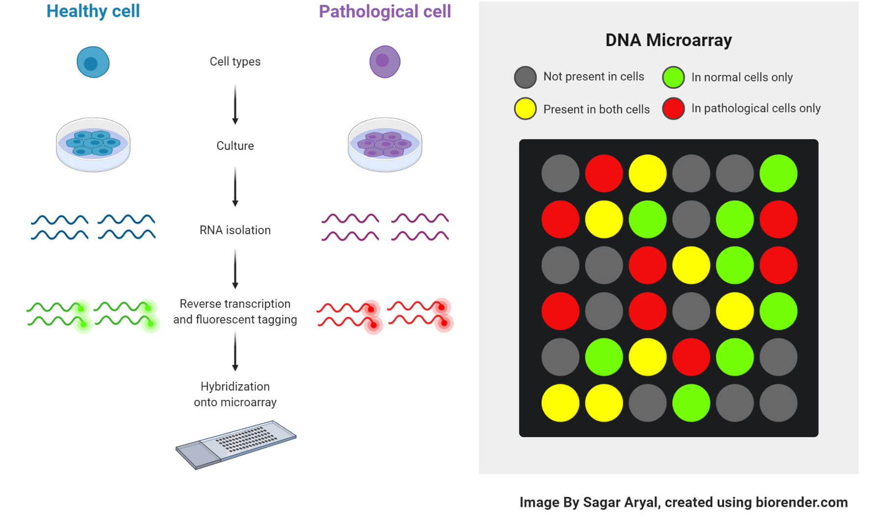
Measuring gene expression: Microarrays
Microarrays measure gene expression by hybridizing fluorescently labeled cDNA from samples onto a chip containing thousands of gene-specific probes, with fluorescence intensity indicating expression levels. While they allow for high-throughput analysis of many genes simultaneously, they are limited by lower sensitivity compared to RNA-seq and can only detect known sequences.

Slide 5
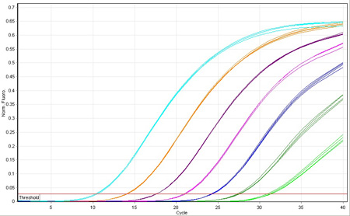
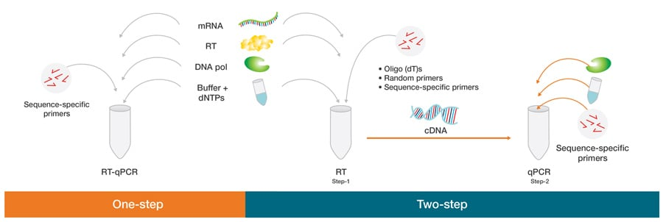
Measuring gene expression: QT-PCR
Quantitative PCR (aka real-time PCR) measures gene expression by amplifying specific cDNA sequences and quantifying the fluorescence emitted during amplification, which correlates with the amount of starting mRNA. It’s highly sensitive and precise but limited to measuring a small number of genes at a time and requires prior knowledge of target sequences.
Q-PCR is widely used today, especially for quick diagnostics

Slide 6
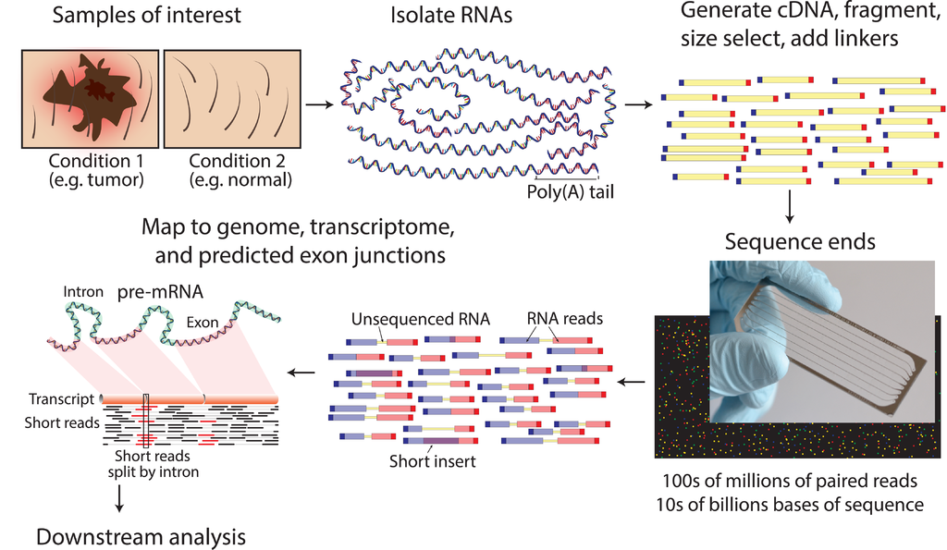
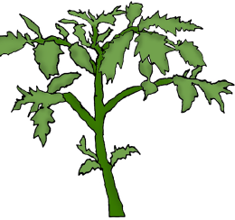
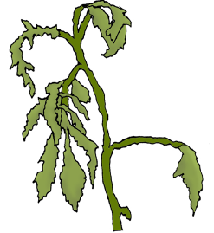
Measuring gene expression: RNAseq

Slide 7
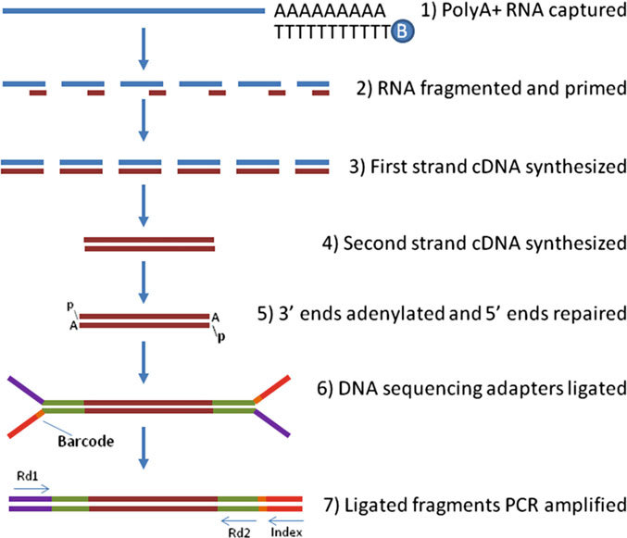
Illumina RNAseq: library preparation
RNA Isolation: Total RNA is extracted from tissue or cells, followed by purification to remove contaminants like DNA, proteins, and other RNAs.
mRNA Enrichment or rRNA Depletion: mRNA Enrichment: Uses oligo(dT) beads to selectively capture polyadenylated (poly-A) mRNA, enriching for coding sequences. rRNA Depletion: Uses probes to remove ribosomal RNA (rRNA), retaining both coding and non-coding RNAs.
cDNA Synthesis: Purified mRNA or RNA is reverse transcribed into complementary DNA (cDNA) using reverse transcriptase.
Fragmentation: cDNA is fragmented to the desired length (typically 200-300 bp) using enzymatic or mechanical methods.
Adapter Ligation: Short DNA adapters are ligated to the fragmented cDNA ends, providing priming sites for PCR amplification and sequencing.
PCR Amplification: The library is amplified to increase the quantity of cDNA and to add sample-specific barcodes for multiplexing.
Quality Control and Quantification: The final library is checked for fragment size distribution, concentration, and purity using methods like Bioanalyzer, Qbit, and sometimes qPCR before sequencing.

Slide 8
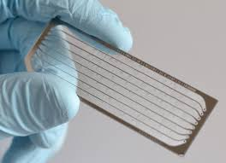
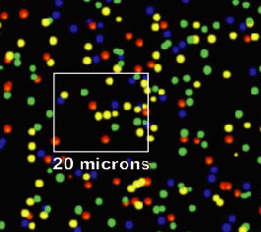
RNAseq: Illumina sequencing
300 million to 10 billion 50-300 bp reads are sequenced on each Illumina flow cell (depending on the mode and machine).
Barcodes are used to bin reads back to original samples. 96 libraries can be pooled together using common barcodes, with multiplexing samples per lane can be higher.
NovaSeq 6000 with S4 flow cells can produce up to 20 billion reads in a single run
Typically, 10-30 million reads are needed per sample/replicate for standard RNAseq . 3’RNAseq samples only needs 1-5 million reads.
Total costs range from $50-$200 per sample, depending on how the library preps are done, the sequencing mode, and scale. Companies usually charge ~$100 for library construction and sequencing.

Slide 9
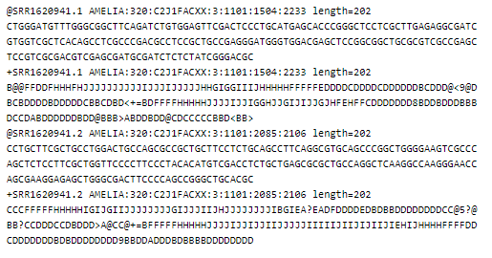
Illumina RNAseq data: Fastq format
Most RNAseq data you get will be pre-binned by sample using the unique barcodes for each sample.
Most Illumina data you will encounter is stored in a .fastq format as shown below. Fastq is like fasta but it also has built in quality scores, which are useful for pre-processing the data.
The first line (starting with @SRR...) is a unique identifier for that read. Remember, experiments can have billions of reads, so the names/identifiers can be quite long.
The second line (starting with ATG...) is the actual sequence. This is the bit we care most about.
The third line (starting with +SRR...) is the same unique identifier for that read.
The fourth line (seemingly random characters) contains the quality scores.

Slide 10
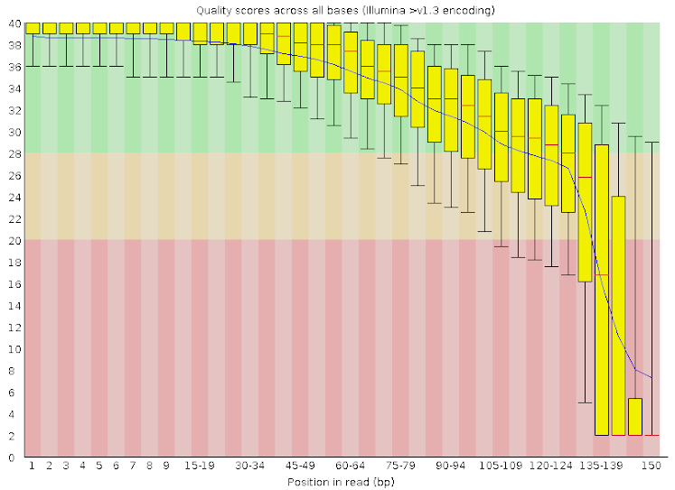
Trimming Illumina reads
Illumina sequencing runs typically take between 10 to 48 hours, depending on the platform and configuration. Read quality tends to decrease over the course of a run, with later cycles producing lower quality reads. The last 10-20 bases of reads often have increased error rates due to signal decay, leading to mismatches and incorrect base calls.
To ensure high-quality data for downstream analyses, it’s recommended to trim low-quality bases and remove adapter sequences. Trimming improves the accuracy of read mapping, transcript assembly, and differential expression analysis, by reducing errors and biases.
Popular tools for trimming include Trimmomatic, Cutadapt, and Fastp, which allow automated removal of low-quality bases and adapters based on defined thresholds.

Slide 11
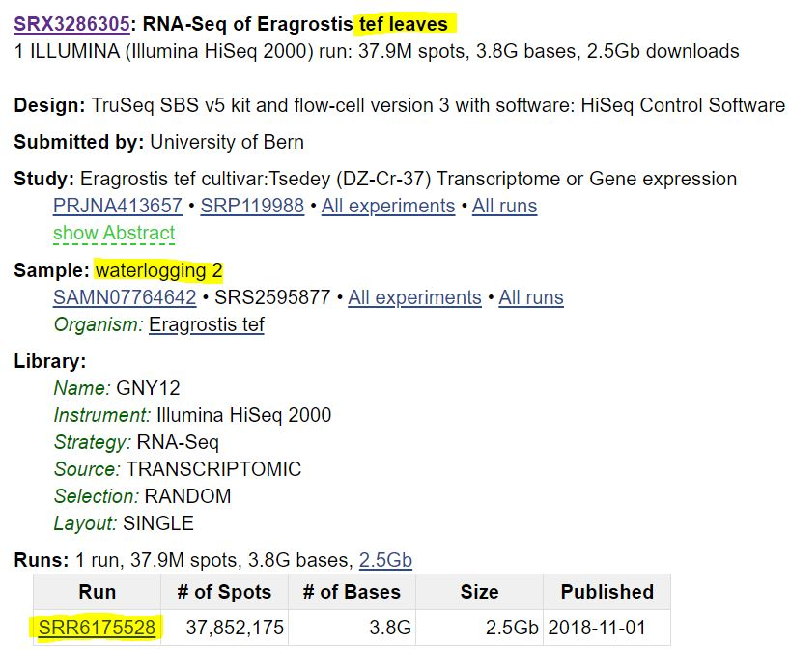
Where is short read data stored?
The Sequence Read Archive (SRA) is a public database hosted by NCBI, designed for the long-term storage and sharing of high-throughput sequencing data, including DNA-seq and RNA-seq.
Researchers typically deposit raw sequence data in SRA after publication to promote transparency and reproducibility of scientific research.
The SRA currently holds petabases (> 1,000,000,000,000,000 bp) of sequence data, making it one of the largest publicly accessible repositories.
Tools like SRA Toolkit allow users to download and process data efficiently.
SRA supports various sequencing data types, including whole genome sequencing, transcriptomics, metagenomics, and more, making it a versatile resource for multiple research fields.
Data is stored in standardized formats such as FASTQ, making it compatible with a wide range of bioinformatics tools.
There are over 1 million plant samples on the SRA, how can we use the wealth of data to answer biological questions?

Slide 12
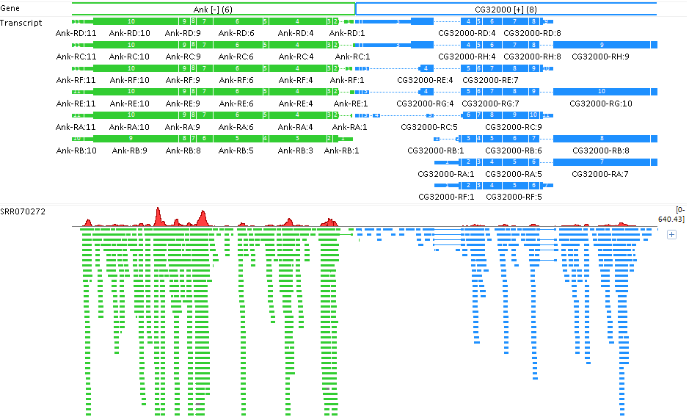
General framework for RNAseq
genes or
genome sequences
Aligned Illumina
reads
Count or quantify
# of reads per gene
800
300
Normalize and conduct downstream analyses
(Differential expression, gene co-expression, etc.)

Slide 13
Trimming Illumina reads
There are many approaches for analyzing gene expression data, which include how reads are aligned/mapped to a reference genome, how we identify differentially expressed genes, and the types of downstream analyses we perform.
Mapping/Alignment:
Mapping-based programs identify the specific regions of the genome where reads originate by performing local alignments. They record the exact coordinates and any mismatches between the read and the reference genome.
The output is typically a large .sam or .bam file that contains detailed information on where each read aligns.
This method is generally slower but highly accurate and essential for certain types of DNA-based analyses, such as variant discovery, chromatin state characterization, and methylation studies.
Quasi-mapping/Pseudoalignment:
Instead of calculating the exact alignment and overlap between each read and the genome, quasi-mapping or pseudoalignment programs use a hash table to quickly determine which transcript or gene a read originates from, without performing full alignments.
The output is a table with gene or transcript counts instead of a .sam file.
These programs are significantly faster and can process millions of reads in just a few minutes, making them ideal for large RNA-seq datasets where exact alignment is not necessary.

Slide 14
Trimming Illumina reads
There are many approaches for analyzing gene expression data, which include how reads are aligned/mapped to a reference genome, how we identify differentially expressed genes, and the types of downstream analyses we perform.
Mapping/Alignment:
HISAT2: A fast and sensitive alignment program designed specifically for RNA-seq data, based on the Burrows-Wheeler Transform and FM-index. Efficiently handles spliced alignments and large genomes, but slow and computationally intensive.
STAR (Spliced Transcripts Alignment to a Reference): A high-performance aligner optimized for RNA-seq data that can rapidly align millions of reads with high accuracy.
Bowtie2: A general-purpose aligner that can map reads to a reference genome. It is often used for DNA sequencing data but is applicable to RNA-seq data as well.
Quasi-mapping/Pseudoalignment:
Kallisto: A lightweight and fast pseudoaligner that assigns reads to transcripts based on k-mer matches without performing full alignments. Extremely fast and memory-efficient, does not produce alignments (can’t be used for all downstream applications), less sensitive to isoform analyses.
Salmon: A fast and versatile program that supports both quasi-mapping and traditional alignment-based quantification.
Selecting between these tools depends on your analysis needs: use alignment-based tools for precision and downstream compatibility, and pseudoaligners for speed and straightforward quantification.

Slide 15
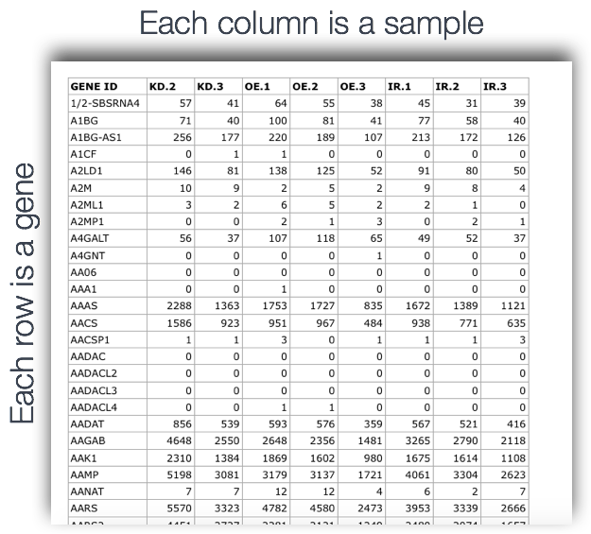
RNAseq dataframes
After mapping and quantification (or pseudoalignment), we are left with a read count table that represents the number of RNA-seq reads mapping to each gene model.
This table can contain raw read counts, which indicate the total number of reads per gene, or normalized values that account for factors such as sequencing depth and gene length. Common normalization metrics include:
RPKM (Reads Per Kilobase of transcript, per Million mapped reads): Normalizes for gene length and sequencing depth across samples.
TPM (Transcripts Per Million): A popular alternative to RPKM that allows comparison of gene expression across samples.
The resulting dataframe can be used for a variety of downstream analyses such as Differential Gene Expression Analysis, gene Co-expression Analysis, or Modeling and Systems Biology Analyses.
Each treatment/tissue will likely have 3-5 replicates, and this info issued for downstream analyses

Slide 16
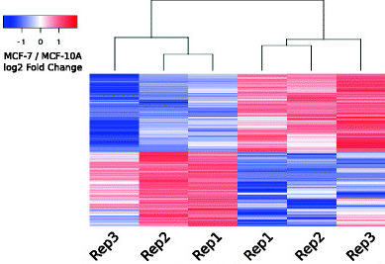
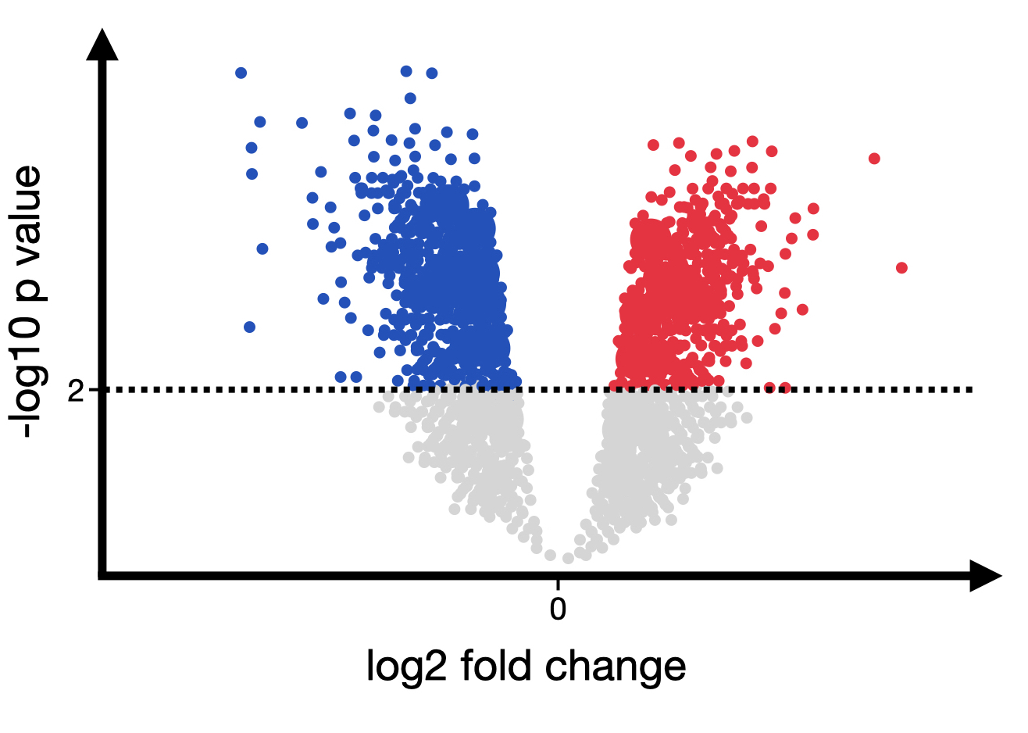
Differential gene expression analysis
Happy plant!
Develop a statistical framework to classify genes as differentially expressed between any two conditions (e.g., stressed vs. control, leaf vs. root).
Tools like DESeq2, and edgeR, are widely used to perform differential expression analysis by modeling read count data and identifying genes with significant changes in expression.
These tools use negative binomial distribution or linear models to estimate expression differences, incorporating sample variance and sequencing depth. Biological replicates are crucial for accurate differential expression analysis, and more replicates increase statistical power and reduce the chance of false positives.
Normalization is performed to account for sequencing depth and library size differences, and variance stabilization techniques are applied to reduce the impact of outliers.
Stressed plant ☹
(drought)

Slide 17
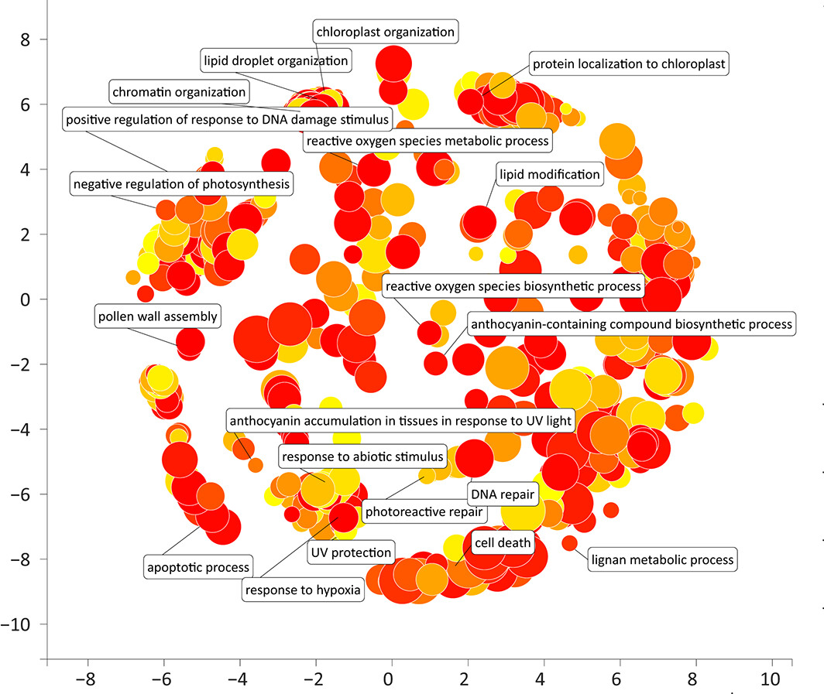
Functional analysis of differentially expressed genes
After identifying differentially expressed genes (DEGs), the next step is to explore their biological significance using functional analysis tools like Gene Ontology (GO) and KEGG pathways.
Gene Ontology (GO) Enrichment Analysis:
GO analysis categorizes DEGs into three main categories: Biological Process (BP), Molecular Function (MF), and Cellular Component (CC). Determine if certain GO terms (e.g., stress response, cell division, or protein binding) are significantly overrepresented among DEGs compared to a background set.
KEGG Pathway Analysis:
KEGG (Kyoto Encyclopedia of Genes and Genomes) maps DEGs to known metabolic and signaling pathways, showing how gene expression changes impact broader cellular functions. Identify which pathways (e.g., glycolysis, photosynthesis, hormone signaling) are enriched with DEGs and may be up- or down-regulated in response to experimental conditions.
Genes upregulated under drought stress

Slide 18
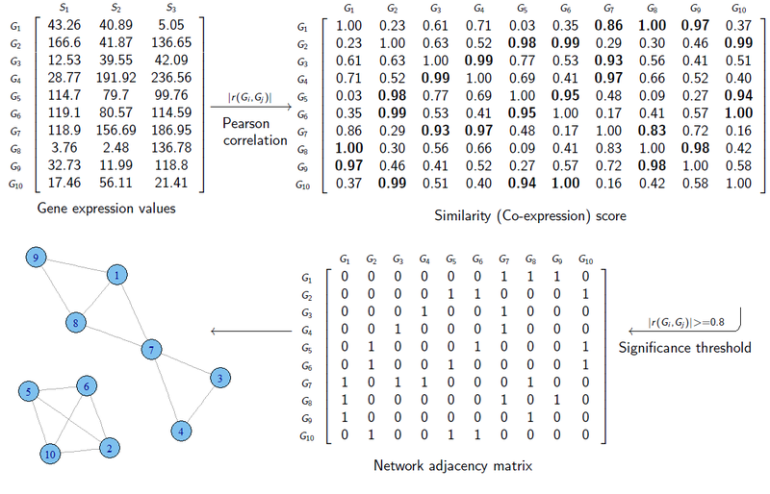
Building a gene co-expression network
Gene co-expression analysis is based on the idea that genes with similar expression patterns across different samples or conditions may be functionally related or regulated by common factors. This method identifies groups of genes, known as co-expression modules, that show coordinated expression, suggesting shared regulatory mechanisms or participation in similar biological processes.

Slide 19
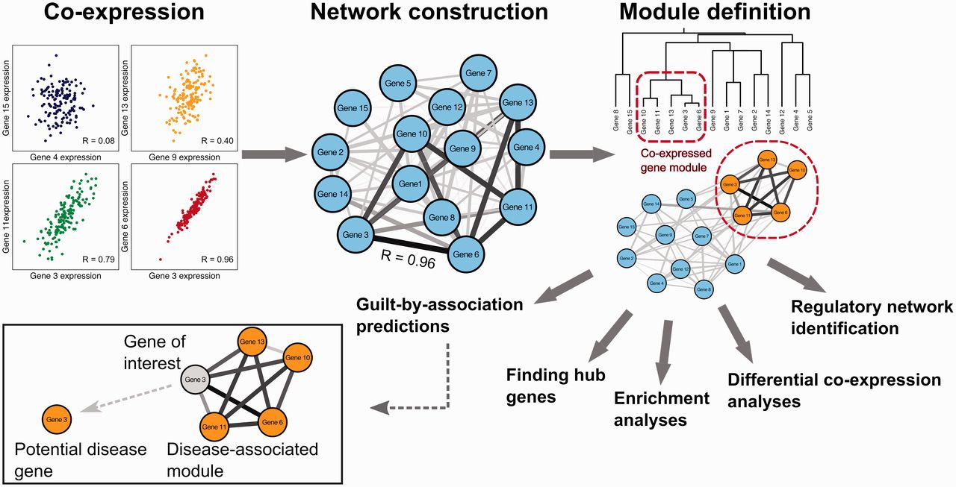
Building a gene co-expression network
van Dam S et al, 2017

Slide 20
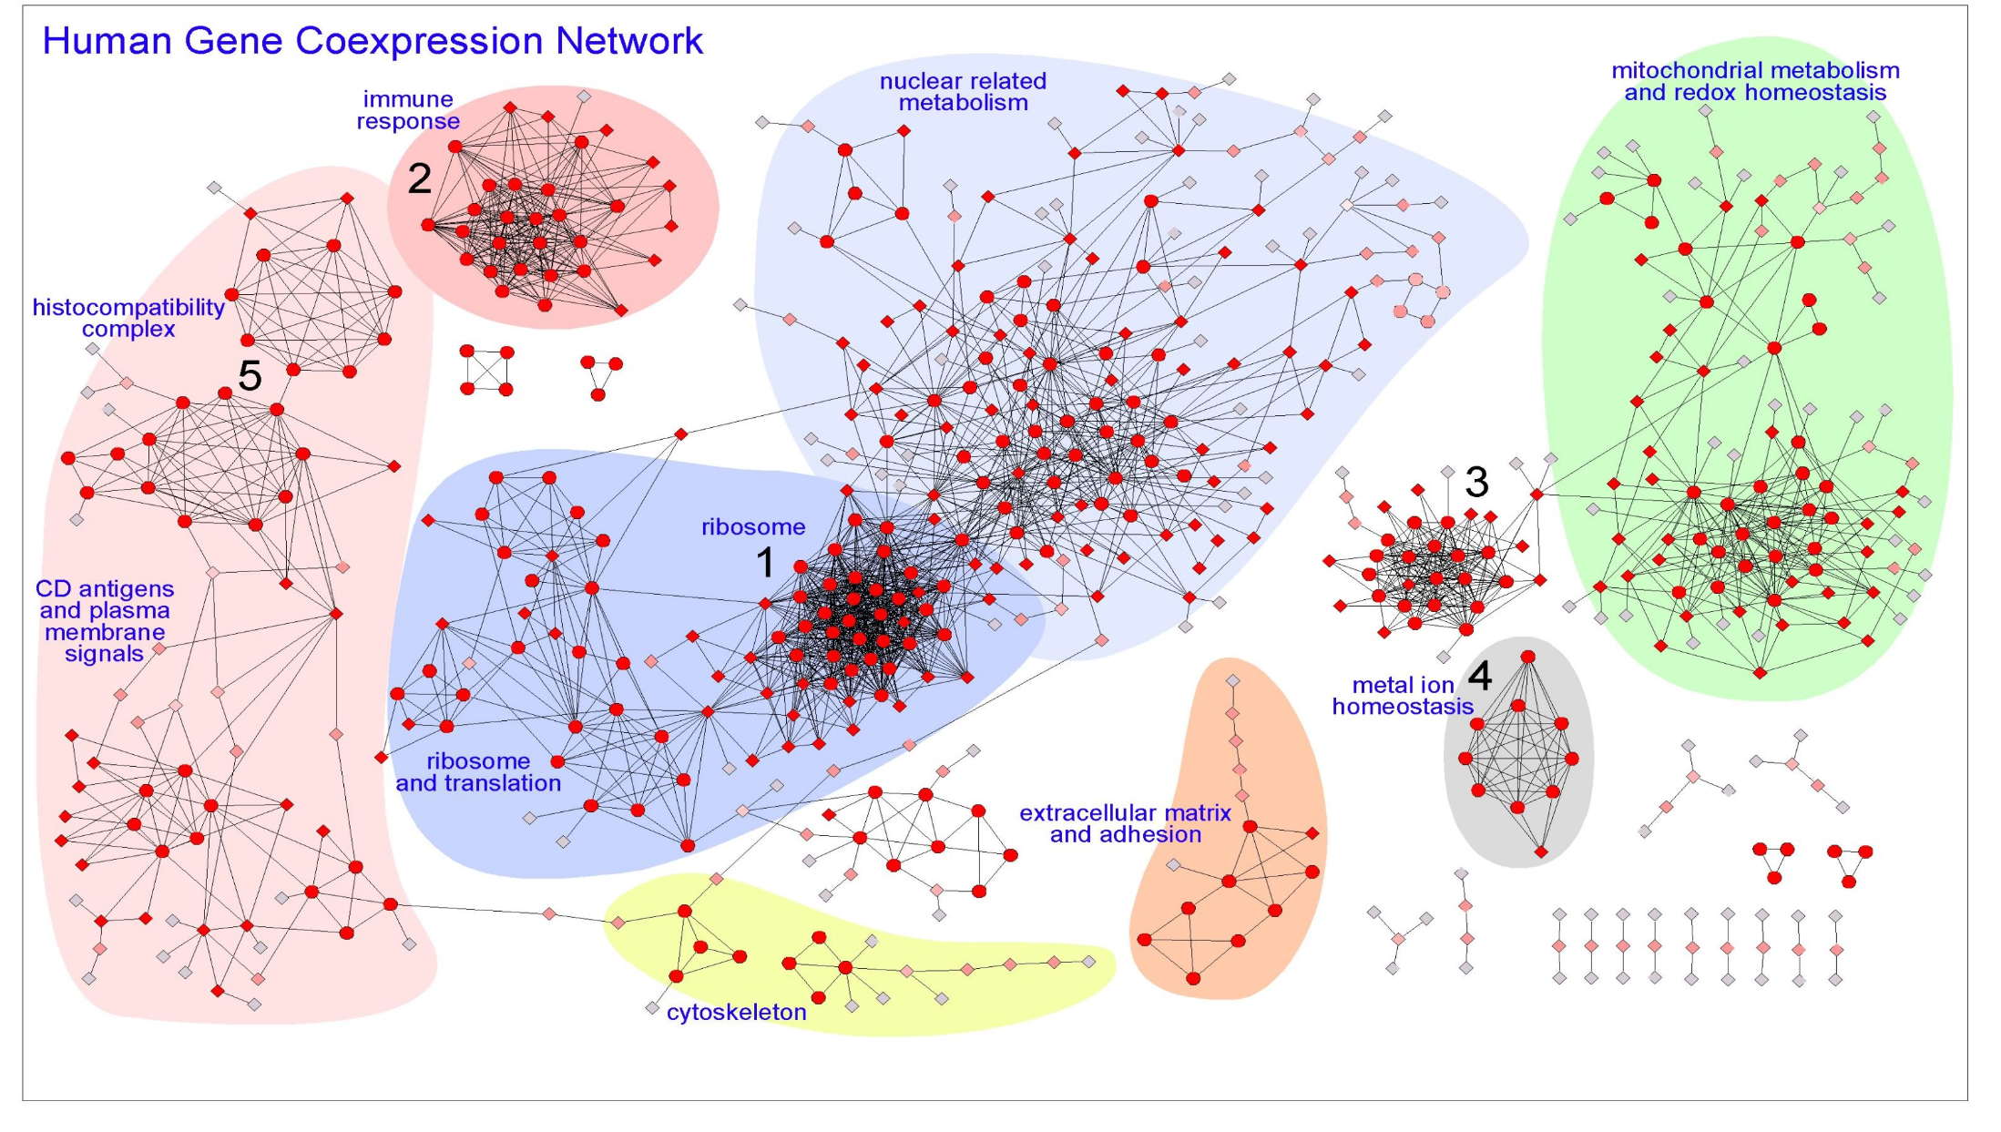
Gene co-expression network

Slide 21
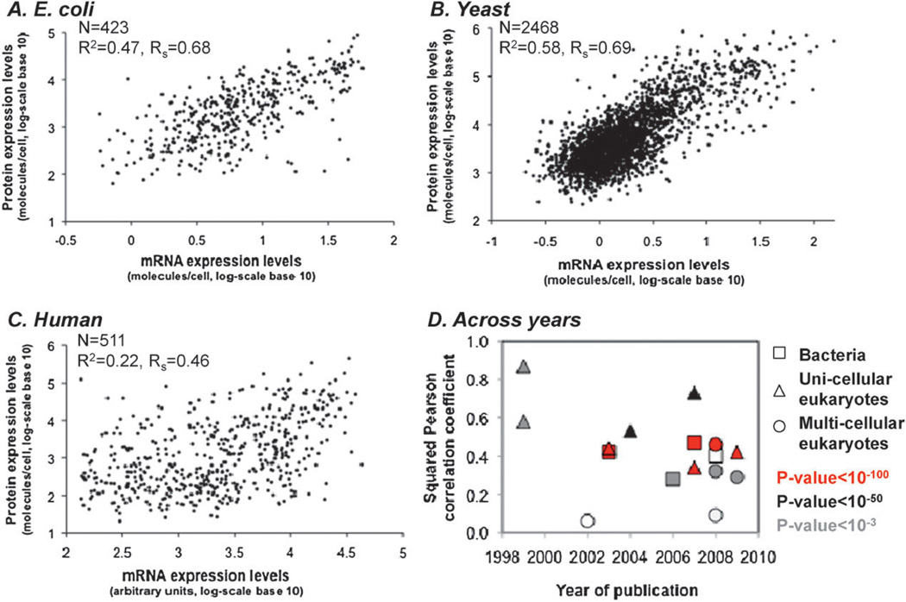
mRNA and protein levels are only moderately correlated

Slide 22
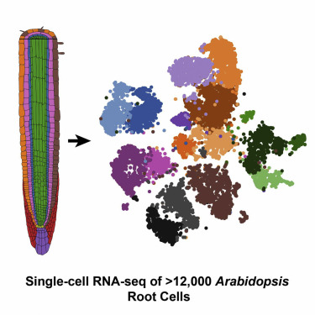
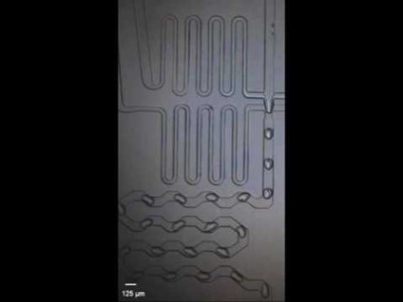
Single Cell RNAseq

Slide 23
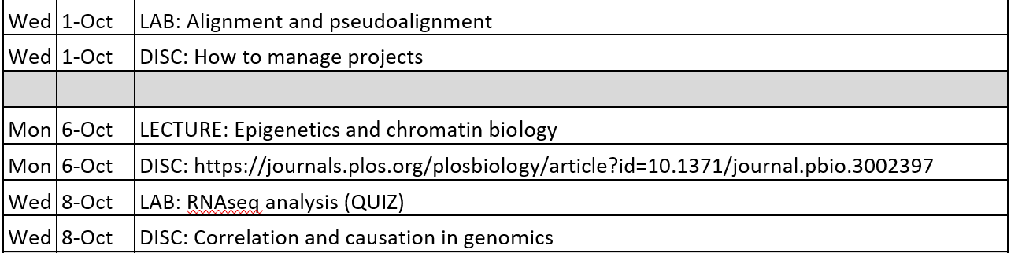
Looking forward

