Slide 1
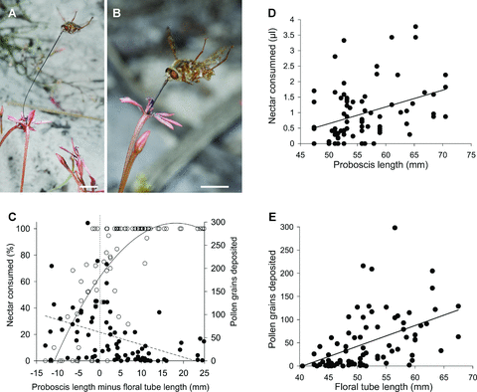
FLIES AND FLOWERS IN DARWIN'S RACE
Evolution, Volume: 63, Issue: 1, Pages: 268-279, First published: 14 January 2009, DOI: (10.1111/j.1558-5646.2008.00547.x)
Notes:
Reciprocal selection between the long‐proboscid fly, M. longirostris, and the long‐tubed iris, L. anceps. (A) The extraordinary elongation of both proboscis and flower tube length suggests either one‐sided adaptation, or coevolution by reciprocal selection. (B) If the proboscis is longer than the nectar tube, the anthers and stigma do not contact the body while the fly potentially drains the nectar. (C) As Darwin hypothesized, the fitness benefits to individual pollinators and plants depended on the relative length of their interacting proboscides and floral tubes. As the balance of armament shifts in favor of the flies, the percentage of nectar consumed increased (open markers; solid line), whereas the number of pollen grains deposited during the same set of interactions decreases (filled markers; dashed line). (D) Nectar tube length imposed directional selection on proboscis length via nectar rewards; (E) simultaneously proboscis length imposed directional selection on tube length via pollen receipt, potentially leading to a coevolutionary arms race. Scale bars = 1 cm. The dotted line indicates where proboscis and tube are of the same length.
IF THIS IMAGE HAS BEEN PROVIDED BY OR IS OWNED BY A THIRD PARTY, AS INDICATED IN THE CAPTION LINE, THEN FURTHER PERMISSION MAY BE NEEDED BEFORE ANY FURTHER USE. PLEASE CONTACT WILEY'S PERMISSIONS DEPARTMENT ON PERMISSIONS@WILEY.COM OR USE THE RIGHTSLINK SERVICE BY CLICKING ON THE 'REQUEST PERMISSIONS' LINK ACCOMPANYING THIS ARTICLE. WILEY OR AUTHOR OWNED IMAGES MAY BE USED FOR NON-COMMERCIAL PURPOSES, SUBJECT TO PROPER CITATION OF THE ARTICLE, AUTHOR, AND PUBLISHER.

