Slide 1
Gatsby.js
A Paris.js talk by Alex / @bobylito

Slide 2

Hi, I’m Alex
Software engineer
Independent contractor
@bobylito / alex@noima.xyz
Loves JS

Slide 3
I’m a static website generator addict
Notes:
Started with Jekyll 8 years ago.
From there multiple projects using and abusing static website generators
Most notably, I have tried to fit JSdoc into static website generators… more than once… and I even talked about it

Slide 4
Two questions
How is gatsby different from other generators?
Is gatsby for you / your next project?
Notes:
How is gatsby different from other SWG?
Is gatsby for you / your next project?

Slide 5
Two questions
How is gatsby different from other generators?
Is gatsby for you / your next project?
Notes:
How is gatsby different from other SWG?
Is gatsby for you / your next project?

Slide 6
Two questions
How is gatsby different from other generators?
Is gatsby for you / your next project?
Notes:
How is gatsby different from other SWG?
Is gatsby for you / your next project?

Slide 7
What is a static website generator?

Slide 8
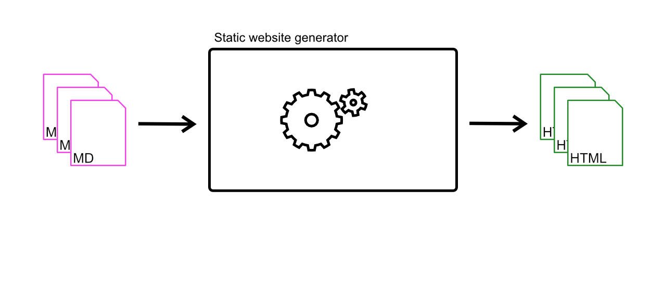
A tool that transforms markup in HTML

Slide 9
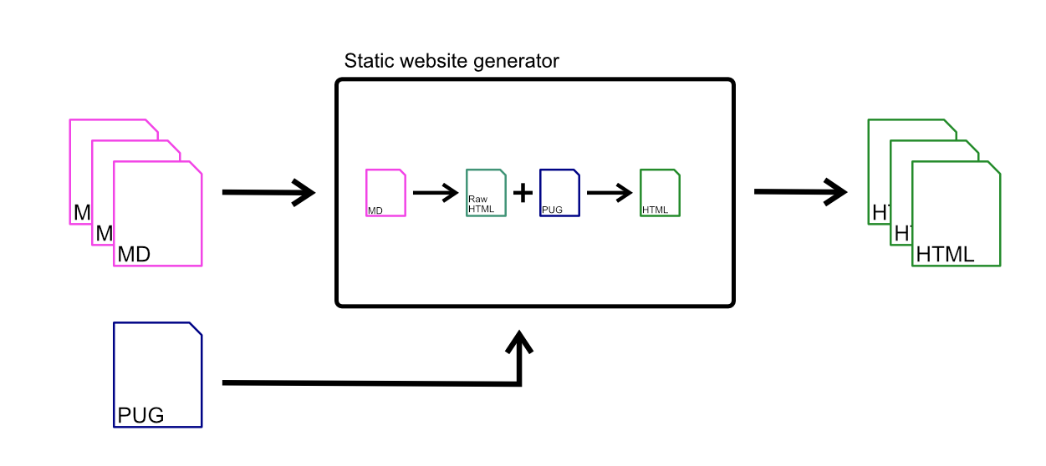
With the help of templates

Slide 10
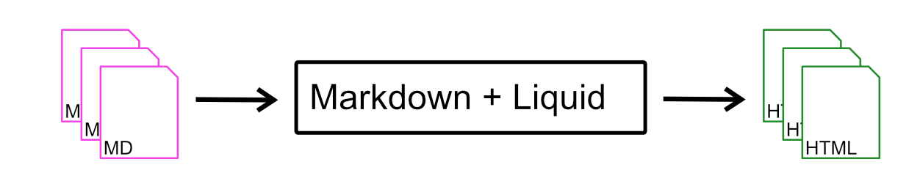

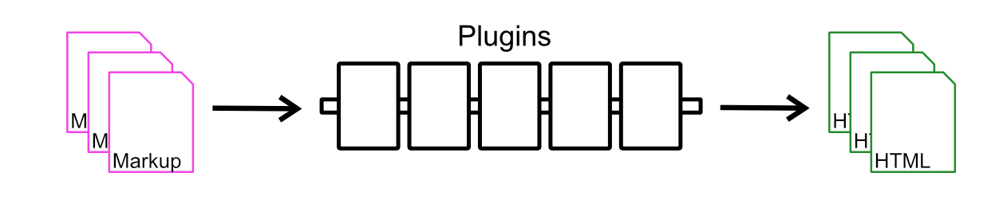

They come in different size and shapes

Slide 11
And they share common properties
Pipelines
Content is the main concern
Templating come second
Content comes from files

Slide 12
Gatsby.js

Slide 13
Templates

Slide 14
Template first!
▾ src/
▸ components/
▸ images/
▾ pages/
404.js
index.js
page-2.js
gatsby-browser.js
gatsby-config.js
gatsby-node.js
gatsby-ssr.js
LICENSE
package-lock.json
package.json
README.md
yarn.lock
React components
Notes:
Template first
Gatsby default template project
src/pages/
Js files
React components acting as templates
Content?

Slide 15

Templates are using React

Slide 16
Templates are also usable in the front-end
No more duplication of templates
Same mindset at runtime and at build time

Slide 17
Content
Notes:
Content plugins
Gatsby is content agnostic
Files
Rest API
DB
GraphQL API

Slide 18
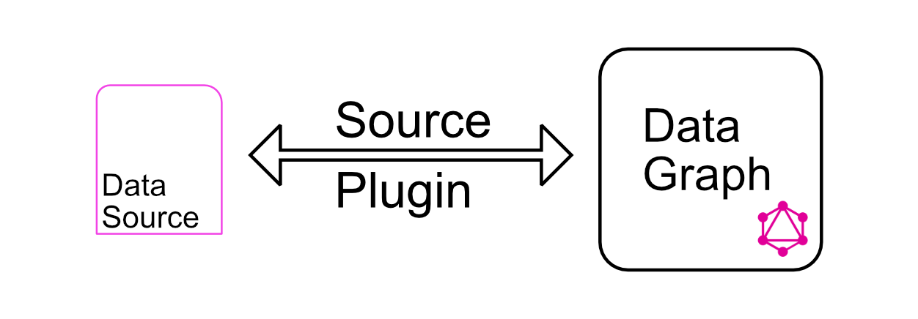
Source plugins
Notes:
Content plugins
Gatsby is content agnostic
Files
Rest API
DB
GraphQL API

Slide 19
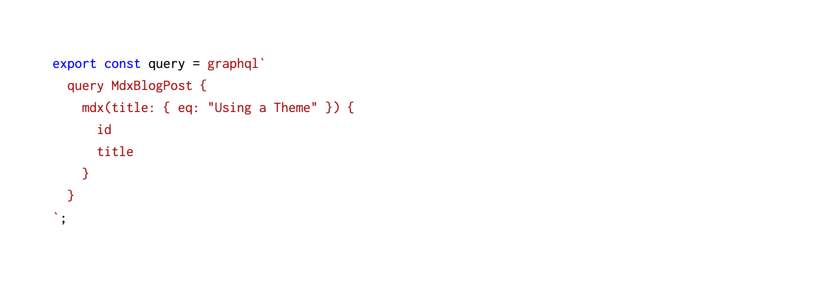
Content plugins - GraphQL MDX example
Notes:
Content plugins
Gatsby is content agnostic
Files
Rest API
DB
GraphQL API

Slide 20






Source agnostic
Files
Headless CMS
Databases
Notes:
Content plugins
Gatsby is content agnostic
Files
Rest API
DB
GraphQL API

Slide 21
Assets are content
Notes:
Therefore graphql, which in turns allows the plugin to add id to assets file names (automagically) and can go even further by optimizing images for different size of display

Slide 22

PNG full resolution
Megabytes
JPEG with just enough quality to look great
Kilobytes
Plugins can optimize assets - image example

Slide 23
Full resolution
Too much for mobile or
Too small for desktop
Different sizes for each screen
Perfect everywhere
Plugins can optimize assets - image example

Slide 24
Generating pages

Slide 25
Create pages API - Two parts
Extension point: createPages
Function: createPage
Notes:
Allow to create pages programmatically
Extension point

Slide 26
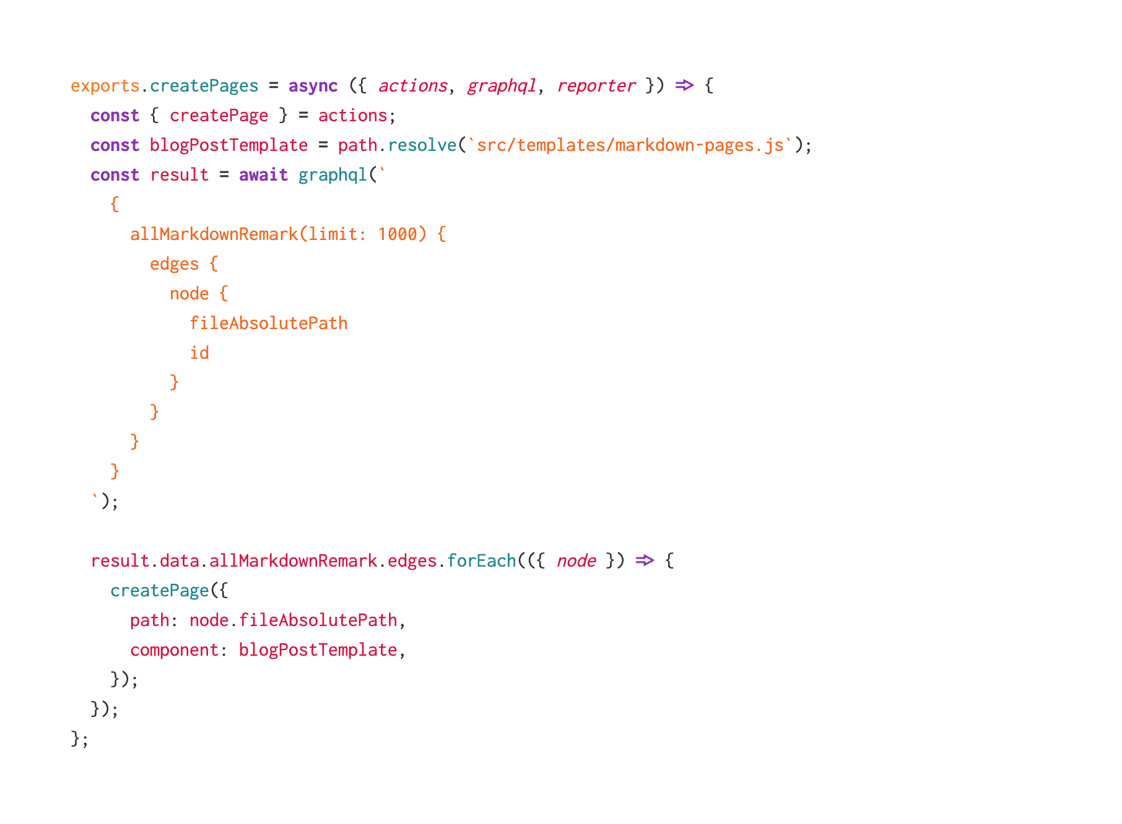
Create pages API - example
Notes:
Allow to create pages programmatically
Extension point

Slide 27
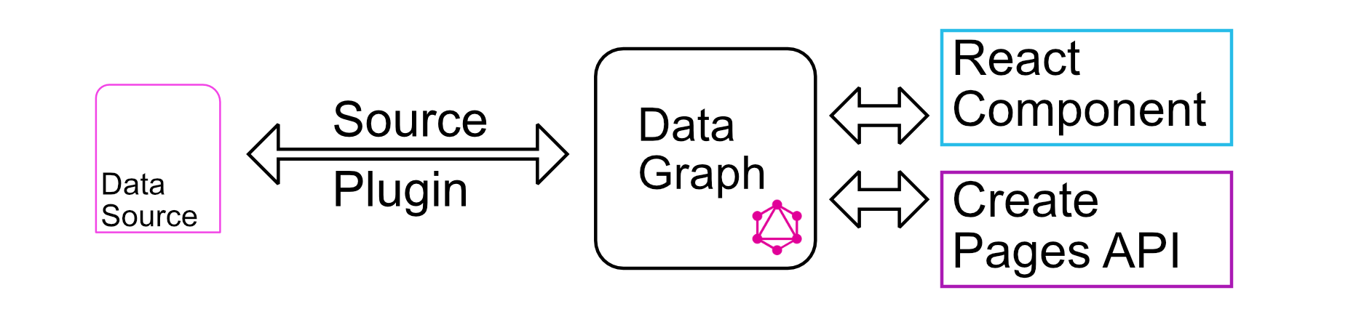
Bringing everything together

Slide 28
Flip the model - get new API powers
Notes:
Templates first
Content from any sources
1 content != 1 page

Slide 29
Is Gatsby right for your next project?

Slide 30
Why not choose Gatsby.js?
Choices / ecosystem
Magic
You have mastered something else

Slide 31
Bad reasons to choose Gatsby.js or not?
X Y Z are using it
Tech: React, GraphQL

Slide 32
Why choose Gatsby.js?
Best practices built-in
You’re building a web app
Well documented
Community

Slide 33
Thanks!
Find me on twitter @bobylito
Looking for a JS freelancer:
alex@noima.xyz

Slide 34
Links and resources
My talk about JSDoc in static website generators
Playlist Detective, a project I built with Gatsby and Algolia
Create pages API
Gatsby image plugin
Gatsby plugin repository

