Slide 1
Playlist Detective
An alternative search for Spotify

Slide 2
Hello I’m Alex
Software engineer
@bobylito
Loves music

Slide 3
Discovering music with playlists
Spotify search is great!
If you are not looking for playlists

Slide 4
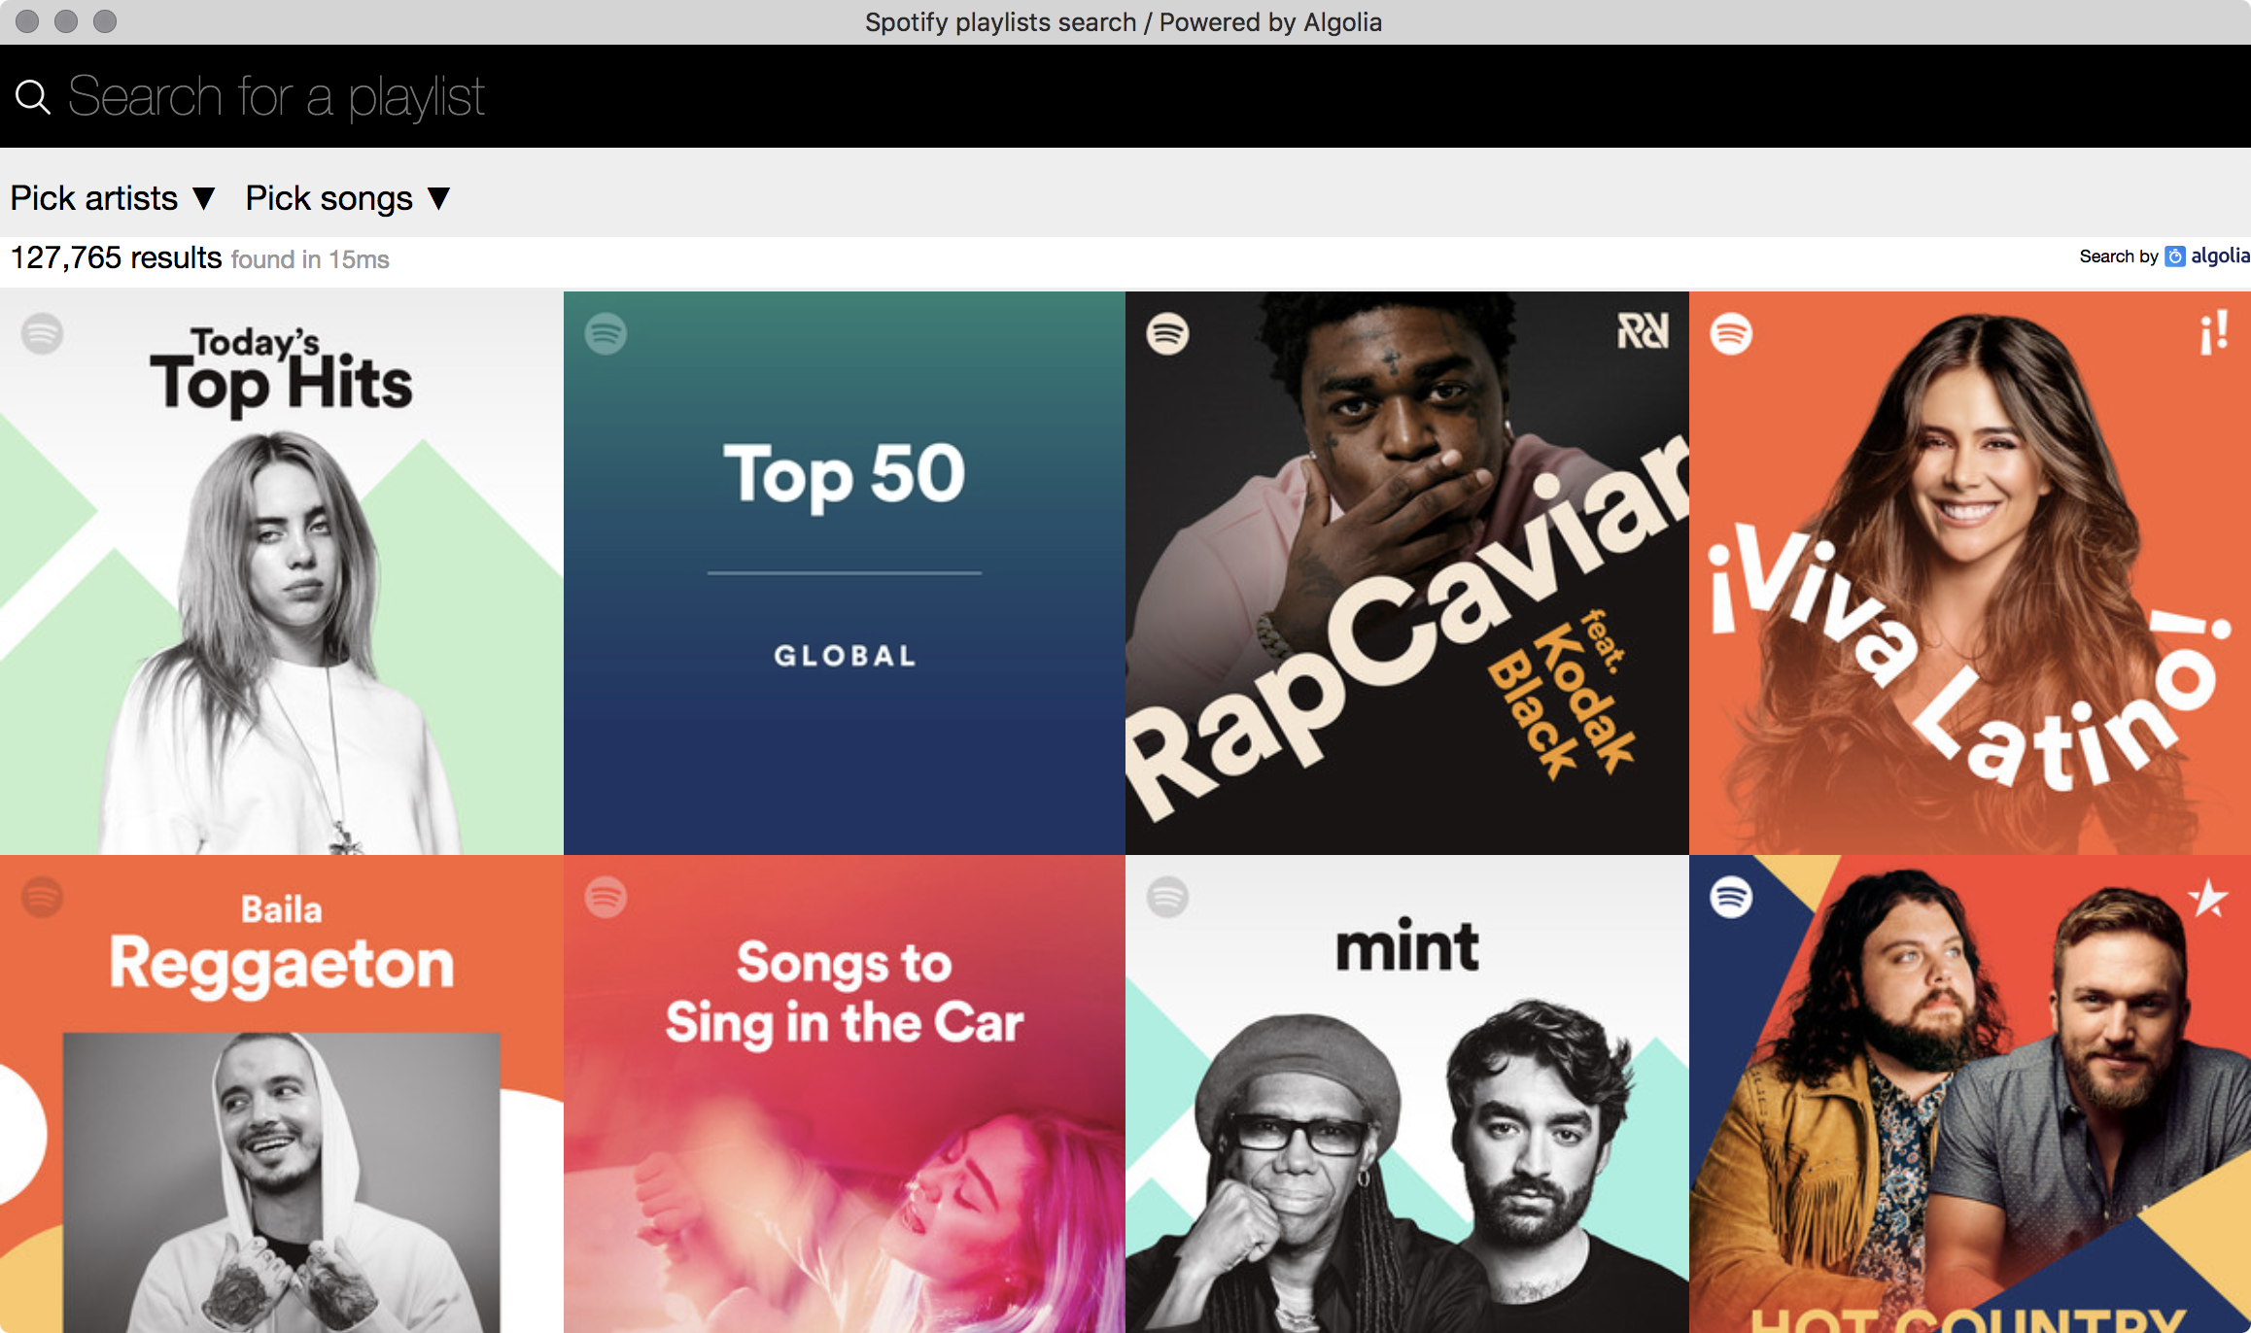

Slide 5
Implementation

Slide 6
Indexing

Slide 7
Spotify Web API 101
Looking for playlists on Spotify?
You first need the user ID of a playlist curator.
/v1/users/{user_id}/playlists
/v1/playlists/{playlist_id}/tracks
/v1/playlists/{playlist_id}

Slide 8


First iteration
Fetch data
1 file per curator
Push to Algolia

Slide 9
Scale breaks everything
It was fine with 150 curators
It broke down with 1800+ curators
Notes:
Extra long updates (24+ hours)
Can’t hold everything in memory anymore
Unnecessary work (a playlist can be found in many curators)

Slide 10
Current indexing script
Fetch data
MongoDB
Push to Algolia

Slide 11
Searching

Slide 12
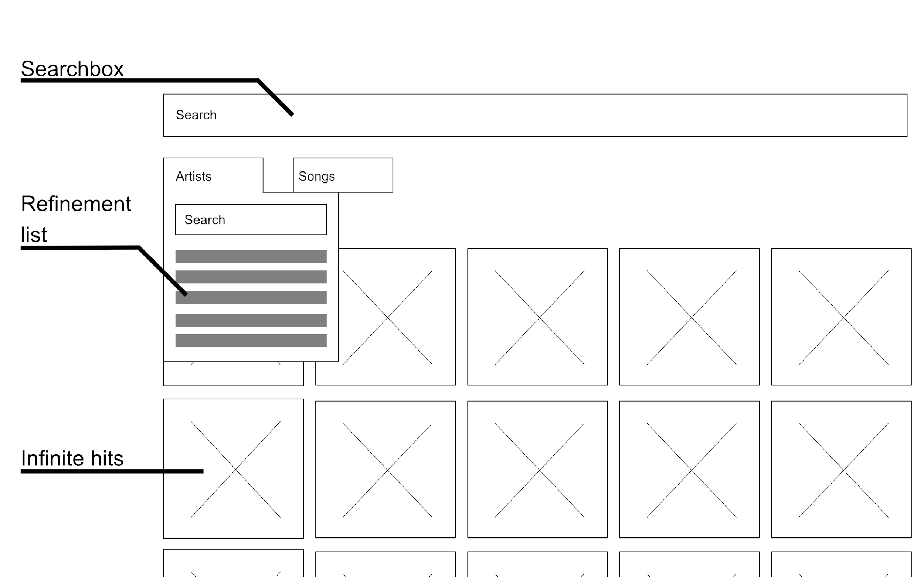

Building the UI is easy

Slide 13
Search for facet values
Search in the search
Songs and artists are facets
Lots of values
Search in them

Slide 14
What now?

Slide 15
Key learnings
Search can be tailored to the user
It’s fine to start with something that do not scale
Be ready to improve what you’ve built

Slide 16
Next
Play with custom rankings
Try to leverage more the dataset

Slide 17
Thanks
https://www.playlistdetective.com/
https://github.com/bobylito/playlistFinder/
@bobylito

