Slide 1
Error404
Making web apps fun and easy to use

Slide 2
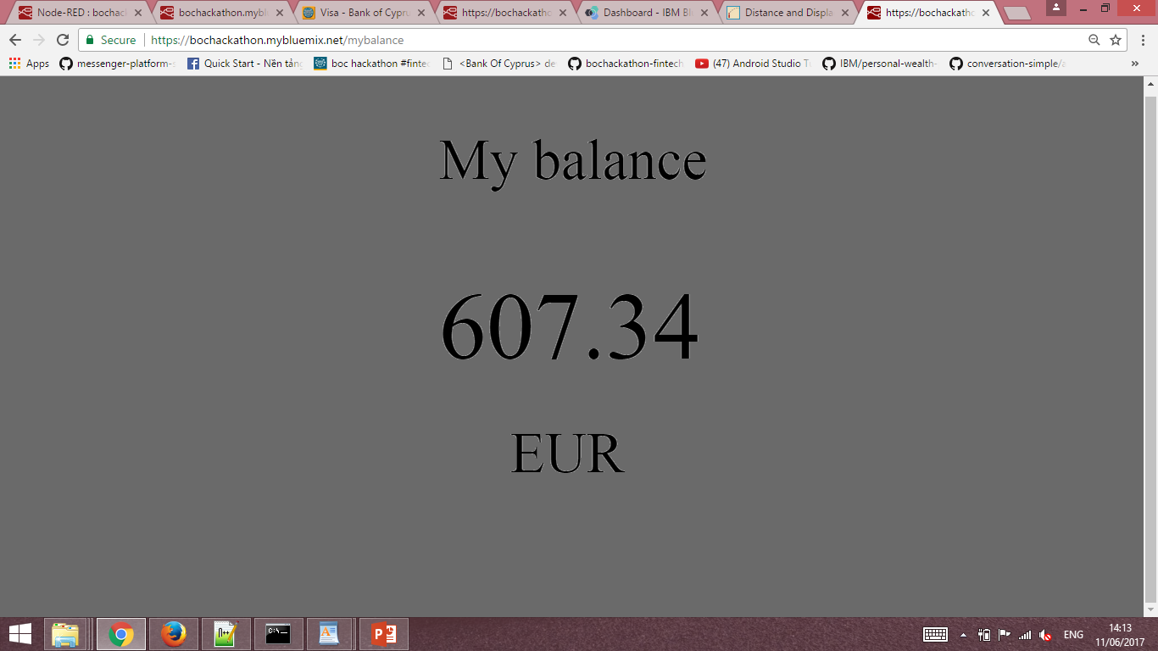
My Balance
Checks user’s account details

Slide 3
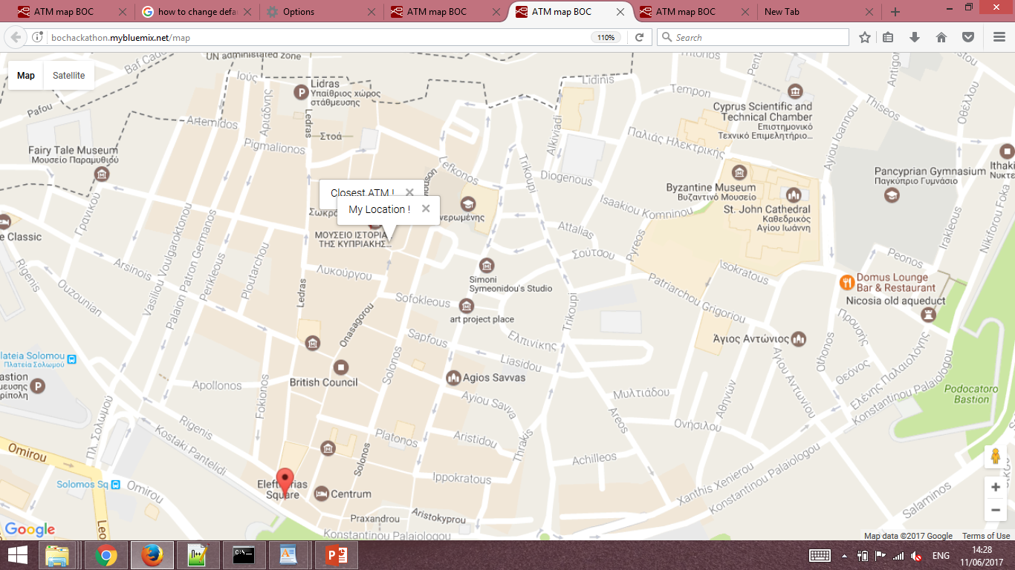
ATM Finder
Finds the closest ATM based on the user’s location

Slide 4
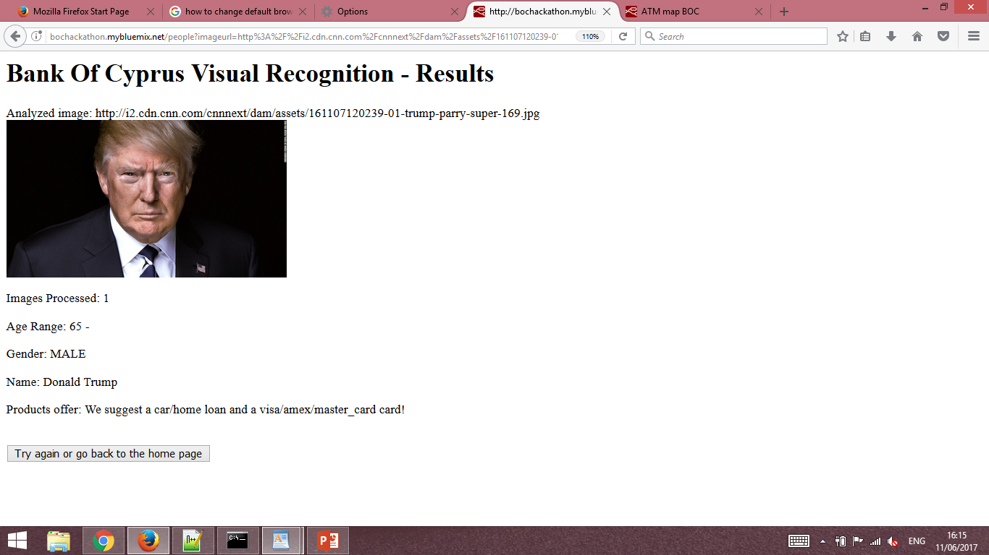
Product finder w/ Visual Recognition
Offers loan and credit card options based on the depicted person/people’s age and celebrity status.

Slide 5
Upcoming Features
Develop a mobile application that will use the web applications and redirect them to the app itself
A web application that where the user will make transactions from their account to another Bank Of Cyprus account.
Implement more Google Map APIs such as the Google Road API
Improve the Visual Recognition web app to make it even more personalized.

Slide 6
Technologies
HTML/CSS
JavaScript and Node.js
BOC API
IMB Bluemix
Node-Red
Cloudant
Visual Recognition(IMB Watson)
Google Maps API
Android Studio and Java*

Slide 7
Demos
Get Balance: http://bochackathon.mybluemix.net/mybalance
Visual Recognition: http://bochackathon.mybluemix.net/people

