Slide 1
FicBot
A way of making money while asleep
Chrysanthos Prodromou
Vasilis Vasilev

Slide 2


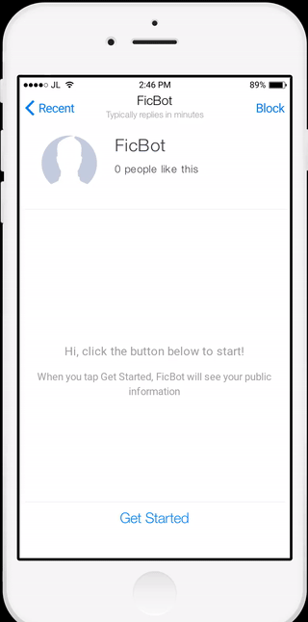
The Idea
Savings Accounts tend to have higher Interest Rates than Current Accounts.
Why not move all our money to our Savings Account and maximize our Interest?
We have the solution!
Full Automation
One time setup
User Friendly
Everything is done through our Message bot
Integrated with BOC API

Slide 3
Earnings on 1M euros
Current Accounts
Interest rate: 0.005
Interest: 1M *0.005 = 5000€ annually
(FicBot earns Interest*7%=350€ )
Savings Account
Interest rate: 0.03
Interest: 1M*0.03 = 30,000€ annually
(FicBot earns Interest*7%=2100€ )
FicBot earns 7% from the Interest earned.

Slide 4

Milestones
June 2017
June 2018
Jan 2018
November 2018
MVP, Proof of Concept
Market Europe (500+ companies)
Expand Worldwide
20000+ companies (Estimated Profit: 42M)
2017 |  |  |  | 2018
First Stable version, Marketing Campaign
Continuous growth
5000+ companies

