Slide 1


Slide 2
Overview
BLOCKCHAIN BASED E-CONTRACTS
AN ADDED LAYER OF TRUST AND MORE EFFICENT TRANSACTIONS
Notes:
One-sentence “wow!” explaining exactly, tactically what you do. There should be no question about what business you are in and who your customer is after this sixty-second description.

Slide 3
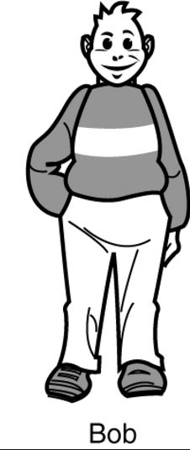
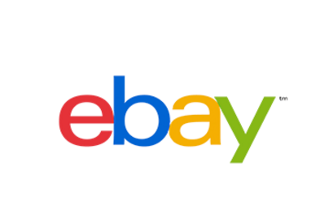
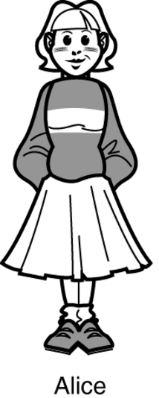
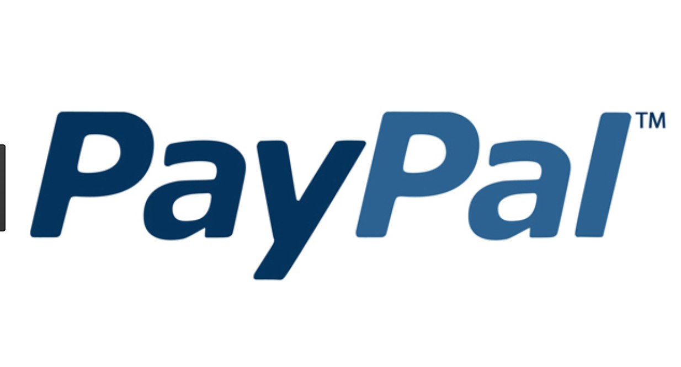
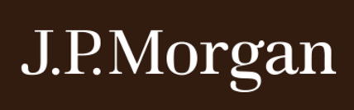
Bob and Alice: Today
%
%
%
%
%
%

Slide 4
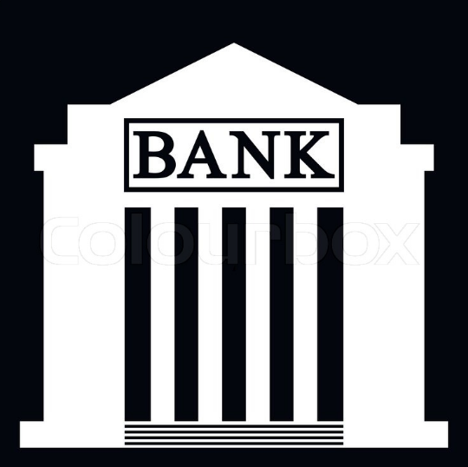
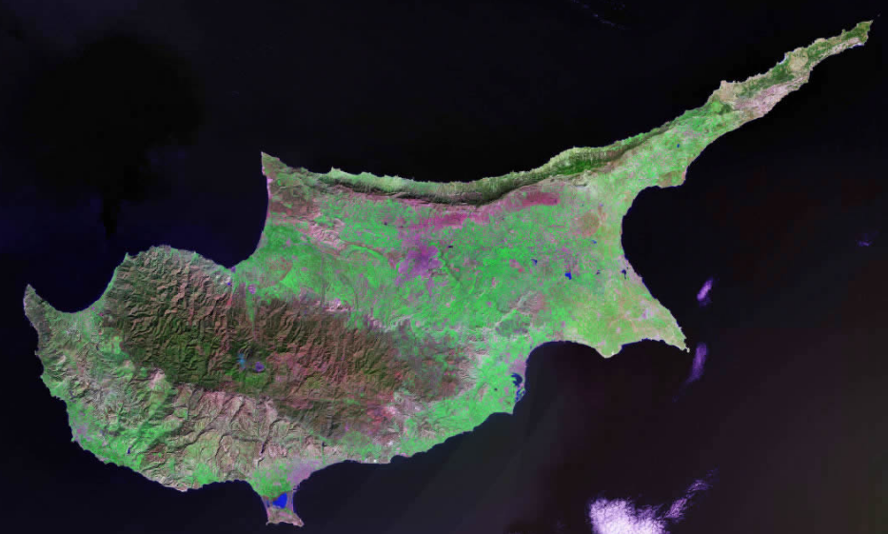

Bob and Alice: Today
%
T

Slide 5
Problem / Opportunity
The pain:
Slow payment and settlement process
Capital controls
Absence of transparancy and lack of auditability
Huge IT infrastructure costs
Trapped liquidity pools for the companies
Verification of transactions is cumbersome and error prone, Costly reconciliations, increased operational risk, higher capital requirements
High transaction fees to those, buying, selling and just exchanging the funds
Inaccessible markets
No access to real time data
Notes:
Explain the pain you solve or opportunity you exploit

Slide 6
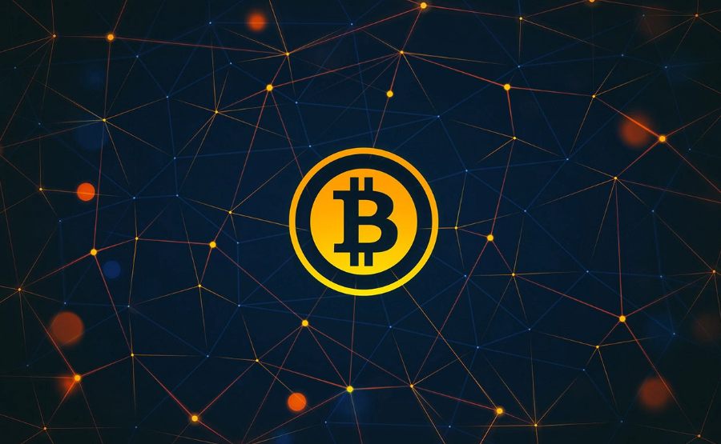
Bitcoin?

Slide 7
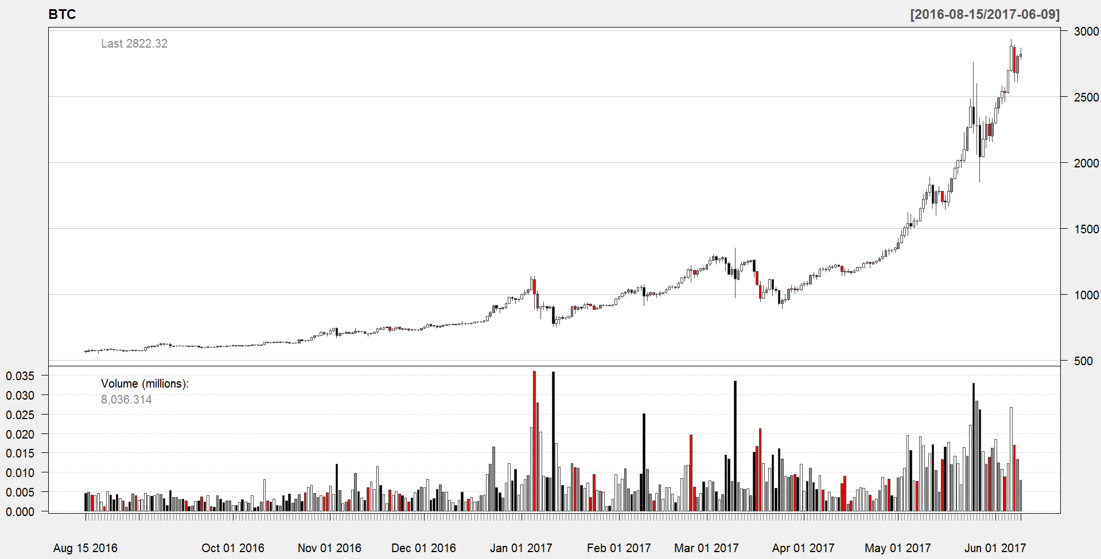
Good luck paying with it

Slide 8
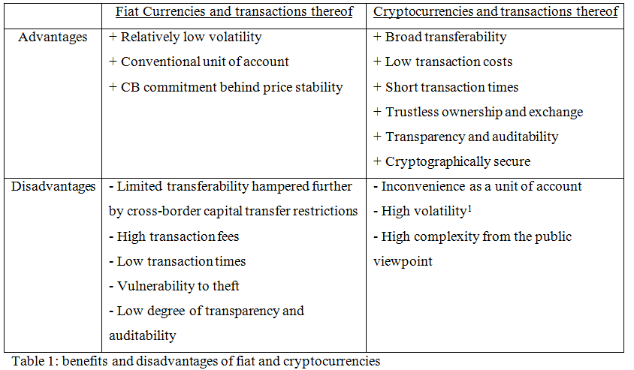
Bob and Alice: Tomorrow
Paysfer offers:
First Hybrid Currency: That, combining the best of two worlds
Notes:
What makes you special? Why will you win? What are your unfair advantages? Why is the field tilted in your direction? It can be technology, relationships, founders.
“We’re smart, hardworking, and really believe” doesn’t cut it. Everybody says that. Hightly unlikely that it’s patents too.

Slide 9
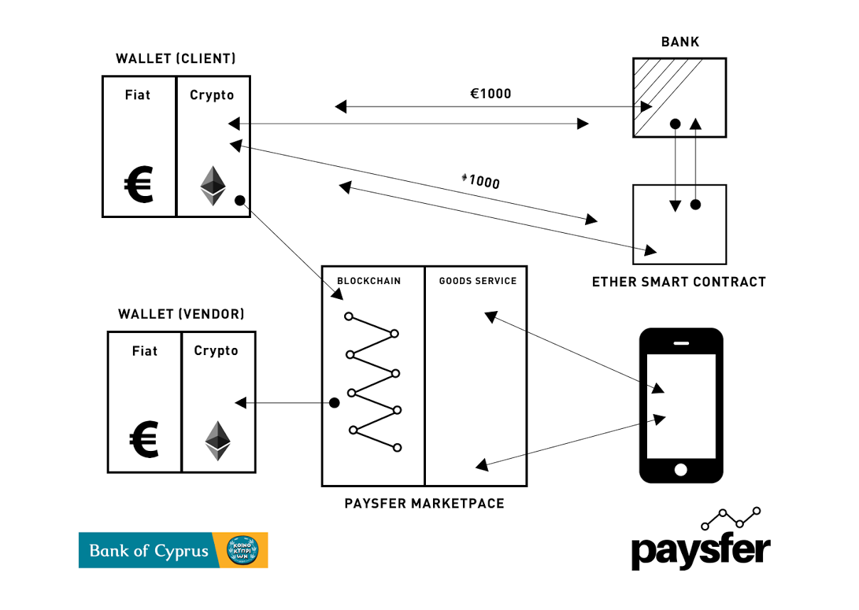
How it works?
Notes:
This is the place to do a demo. Ten minutes is long enough. Try not to get sucked into a long demo so you can’t finish your presentation.

Slide 10
Alice and Bob: tomorrow
Alice:
Fast Transaction
Secured Contract
Cheaper products
Auditability and transparency
Quick dispute resolution
Bob:
Smaller transaction fees
Higher liquidity
Real time transaction data
Access to new markets, customers, goods and services

Slide 11
What about the bank?
Bank of Cyprus
Truly unique value proposition: “First Blockchain Based Banking Product”
Larger customer base
Auditability and transparency
Unlimited horizons for analysis: Big data, etc.
Reduced reconciliation time and cost
Cost savings on getting rid of the idle IT infrastructure
Superior trust
Scalability: expansion at zero marginal cost
(Pricing)
(Value of each customer)
(Customer acquisition cost)
Notes:
How will you make money? Don’t show multiple revenue streams and don’t try to make the point that you’re inventing a new way to make money. Take your best shot and run with it. The most important thing to explain is the assumptions in your business model and how they determined the financial projections in the previous slide.

Slide 12
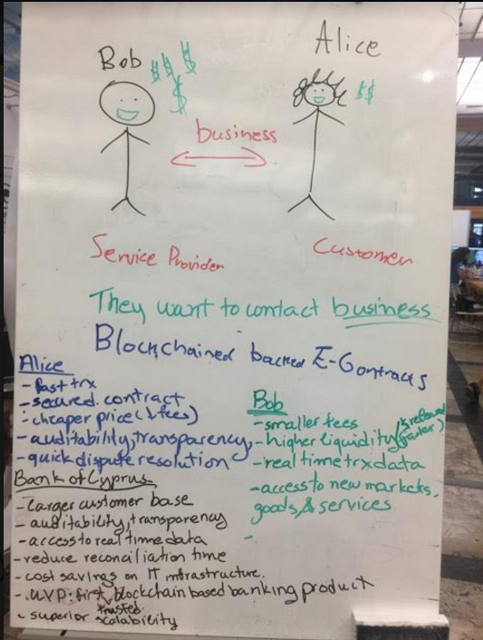
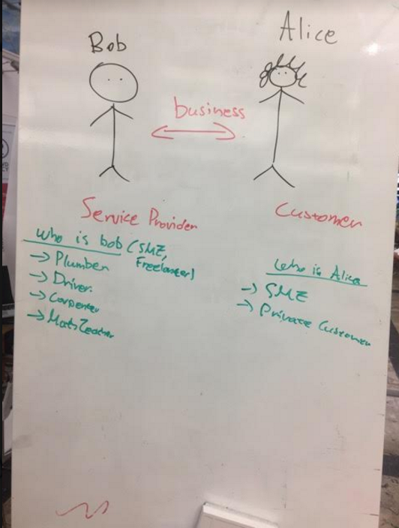

Slide 13
Now, the Demo

