Slide 1






VaxZk
Privacy-First Vaccine Credentials on the Midnight Network
by Tartufo Team

Slide 2




A traveler at border control forced to hand over a full vaccination record
Vaccine certificates expose sensitive data
No user control over personal health data

Slide 3



With VaxZk
ZK-proofs on Midnight: Scan → Vaccinated: YES
Never reveal:
Name, Address, …
Medical history
Issuer details

Slide 4


How?
Health provider issues credential
User stores it in local encrypted private state
User generates zero-knowledge proof
Verifier checks proof on-chain
Trustless verification & Zero data exposure

Slide 5
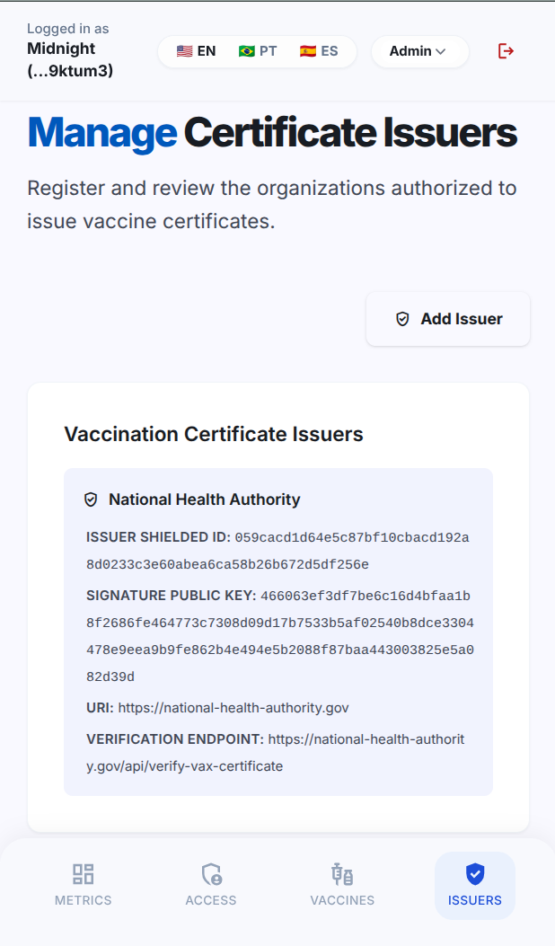
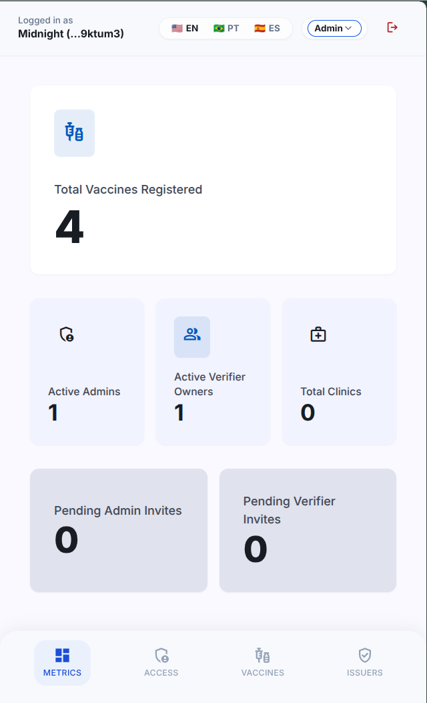
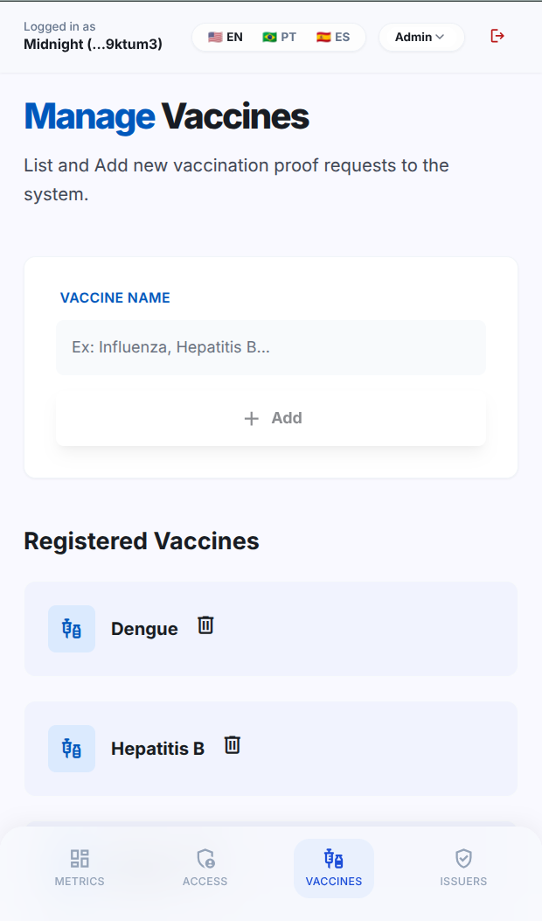
Roles: Admin

Slide 6
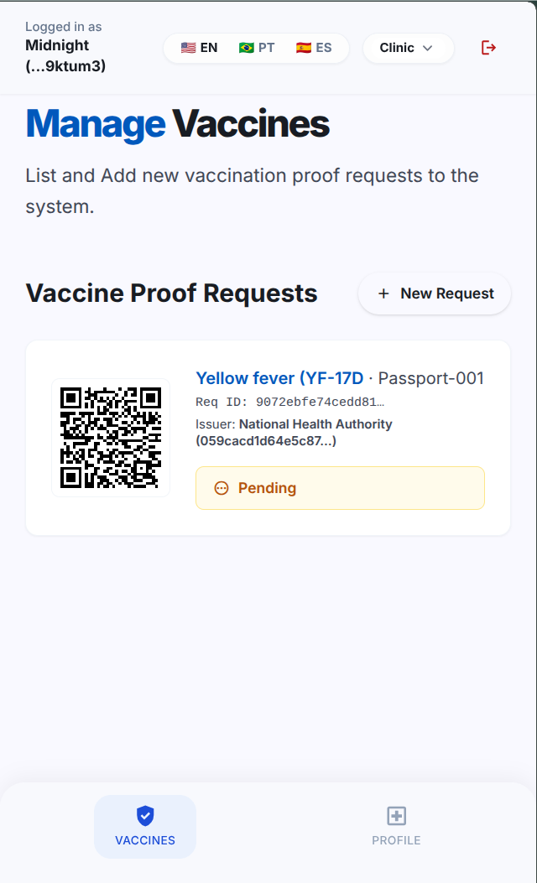
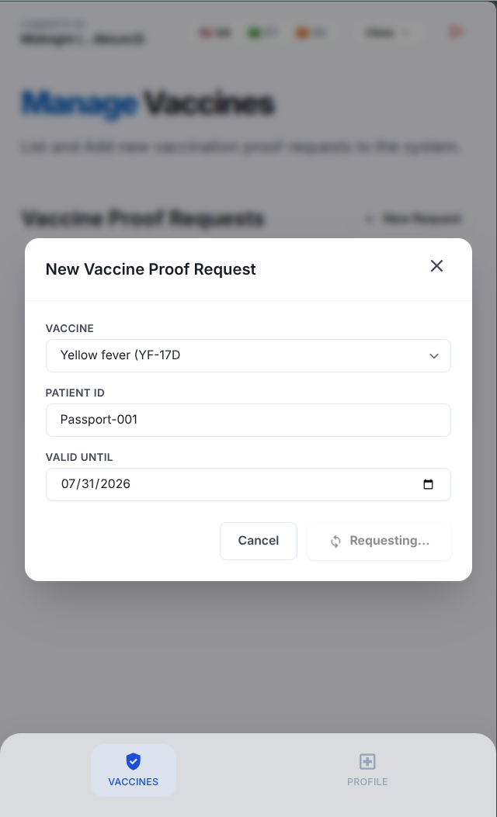
Roles: Verifier

Slide 7

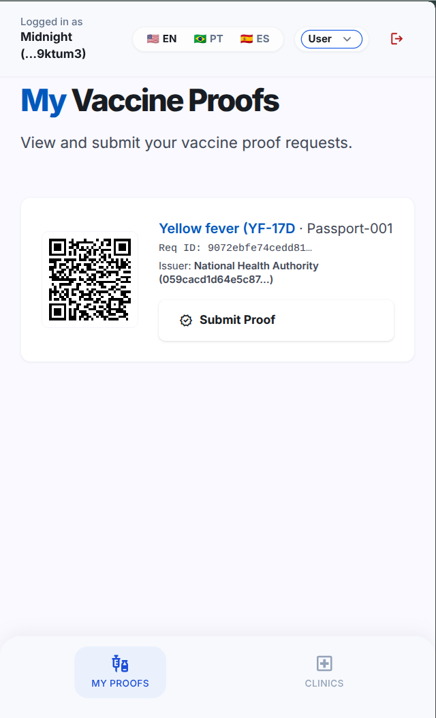
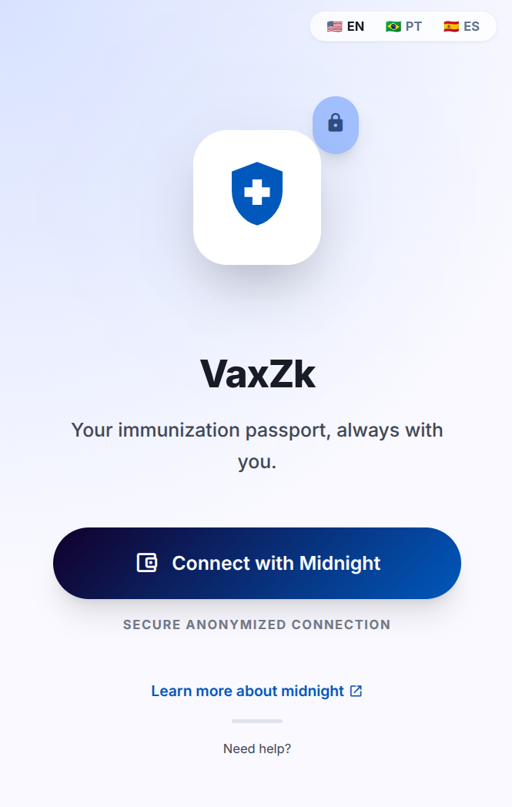
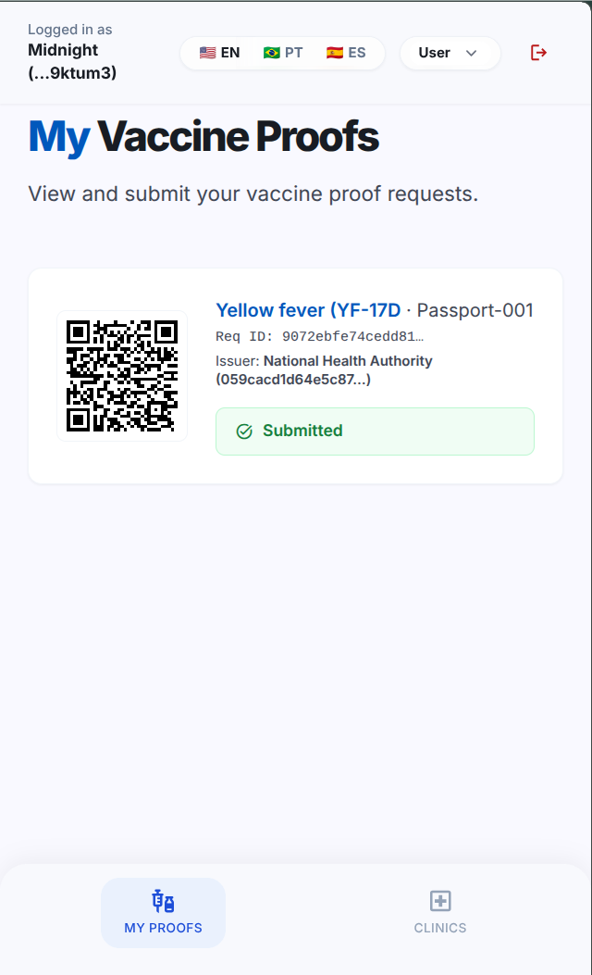
Roles: Prover

Slide 8
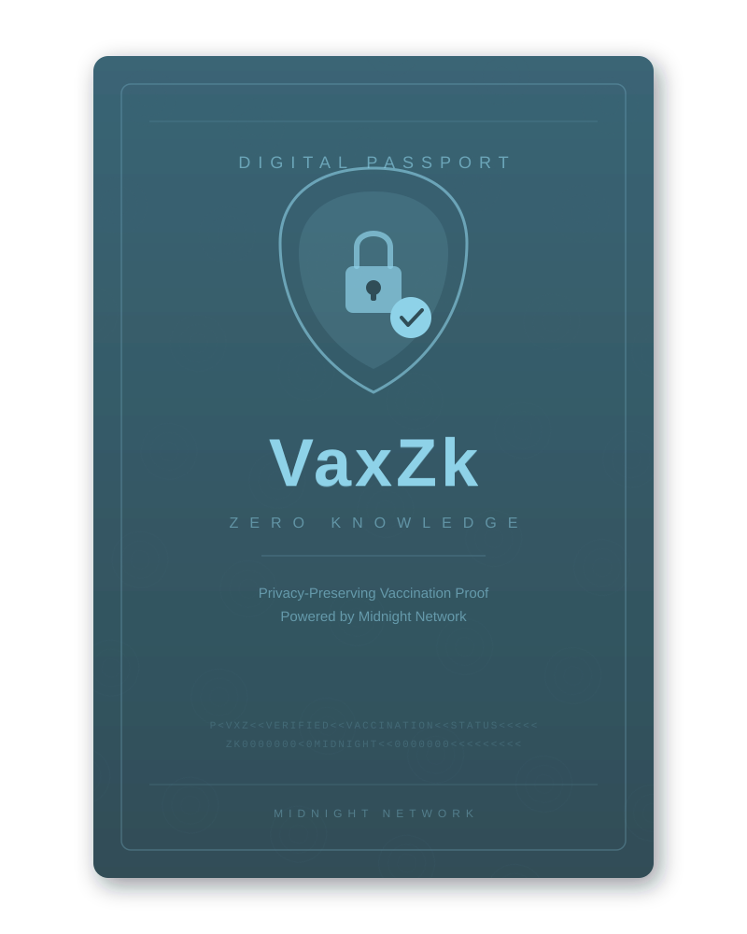

Real-World Use Cases
Workplace compliance
Venues enforce health policies
Visa applications
Cruises, Airlines & Tourism Operators verify travel requirements
…all without becoming data custodians !

Slide 9

Built on Midnight Network
Zero-knowledge proofs
Selective disclosure
Private state + public verification
Verification that respects privacy by design.

Slide 10
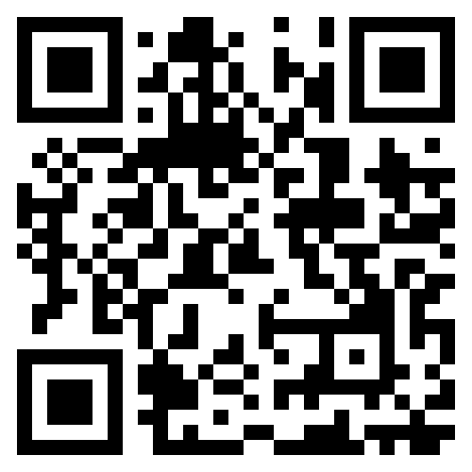
Live Preprod Demo
https://preprod.vaxzk.com.br
Thank you!
Tartufo Team:
Gabriel Viganotti
Marco Santos
github.com/bochaco/vaxzk

