Slide 1
Portfolio Risk Analysis
using Value at Risk
Three-Method Approach · Historical · Parametric · Monte Carlo
MASTER 1 FINANCE
LVMH (Luxury) · Johnson & Johnson (Healthcare) · Lockheed Martin (Defense) NextEra Energy (Renewables) · Apple (Technology)
IAE METZ 2025–2026
January 2020 – December 2024
Equal-Weighted Portfolio · Initial Capital: $10,000
2020–2024 | 1256 trading days
Presented by:
Master 1 Finance — IAE Metz

Slide 2
Context & Objectives
Why measure risk? What does this project answer?
Financial Context
Research Objectives
CONTEXT
Since the 2008 financial crisis, VaR has become the standard regulatory risk metric under Basel III/IV. Every major bank and asset manager is required to report daily VaR figures.
PORTFOLIO RATIONALE
We build a 5-stock US equity portfolio across uncorrelated sectors: luxury goods, healthcare, defense, renewable energy, and technology. The goal is to observe how sectoral diversification affects risk.
PERIOD CHOICE
January 2020 – December 2024 deliberately covers extreme market events: the COVID crash (March 2020), the post-COVID rally, and the 2022 rate-hike bear market. This stress-tests our VaR models against real shocks.
01
Construct a diversified US equity portfolio across 5 distinct sectors using 5 years of daily market data.
02
Compute 1-day VaR at the 95% confidence level using three independent methods.
03
Compare and critically interpret the three VaR estimates — do they converge or diverge, and why?
04
Assess what the VaR figures mean in dollar terms for a $10,000 invested portfolio.
Value at Risk Analysis — Master 1 Finance | IAE Metz — 2026

Slide 3
Portfolio Construction
5 stocks · 5 sectors · Equal weights · $10,000 initial capital
Ticker
Company
Sector
Geography
Weight
LVMUY
LVMH Moët Hennessy Louis Vuitton
Luxury Goods
Europe / Global
20%
JNJ
Johnson & Johnson
Healthcare
USA
20%
LMT
Lockheed Martin
Defense
USA
20%
NEE
NextEra Energy
Renewable Energy
USA
20%
AAPL
Apple Inc.
Technology
USA
20%
DIVERSIFICATION LOGIC — The five sectors have low return correlations. Defence (LMT) and healthcare (JNJ) tend to hold value during equity sell-offs, while technology (AAPL) and luxury (LVMUY) drive growth in risk-on environments. Renewables (NEE) provide exposure to long-term structural growth with low sensitivity to business cycles.
EQUAL WEIGHTING — Each stock receives exactly 20% of capital. This avoids concentration bias and makes the portfolio transparent and reproducible.
Value at Risk Analysis — Master 1 Finance | IAE Metz — 2026

Slide 4
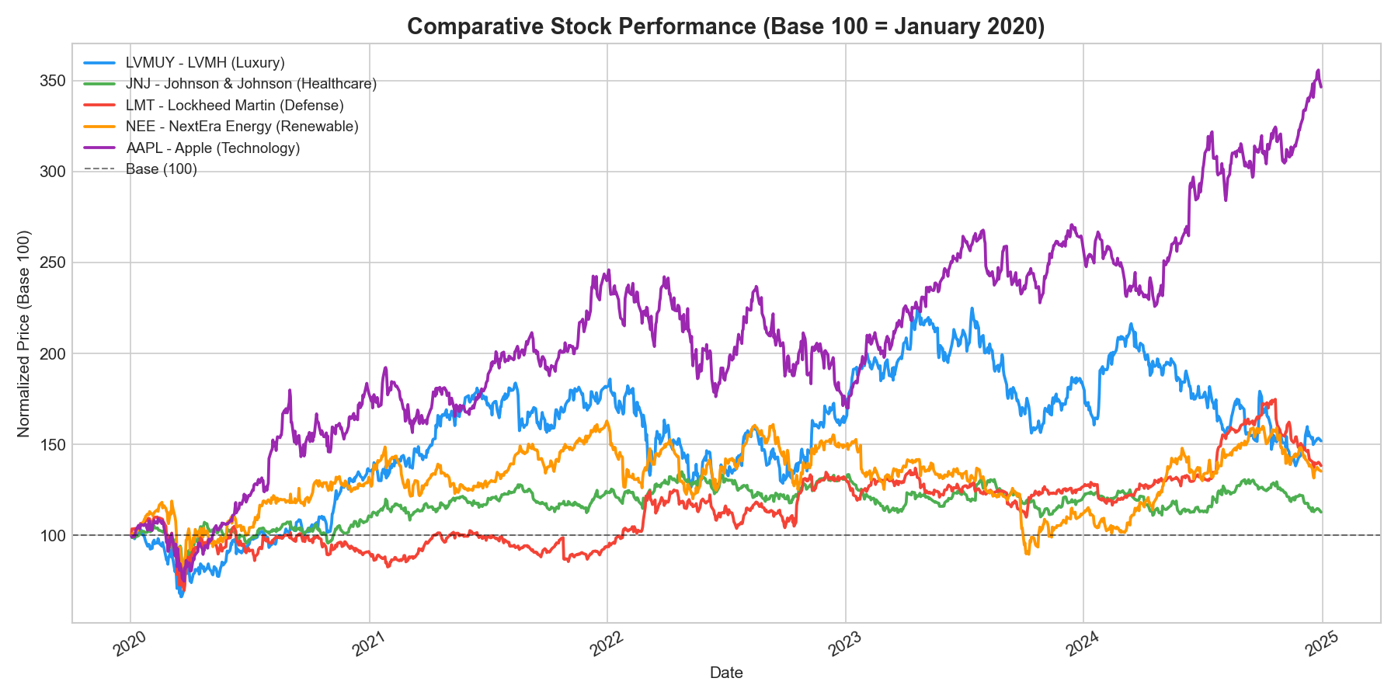
Individual Stock Performance
Normalized to base 100 — January 2020 to December 2024
Key Observations
AAPL — Dominant performer
Apple delivered the strongest cumulative gain, driven by product cycle expansion.
LMT — Defensive outperformer
Lockheed Martin proved resilient through the 2022 market as defense budgets surged post-Ukraine.
NEE — High beta to rates
NextEra lost ground significantly in 2022–23 as rising rates increased its cost of capital (utility sector sensitivity).
LVMUY — Volatile recovery
LVMH recovered from COVID at pace but then corrected in 2024 as China consumption disappointed.
JNJ — Stable anchor
Johnson & Johnson showed the lowest volatility, consistent with its defensive healthcare profile.
Value at Risk Analysis — Master 1 Finance | IAE Metz — 2026

Slide 5
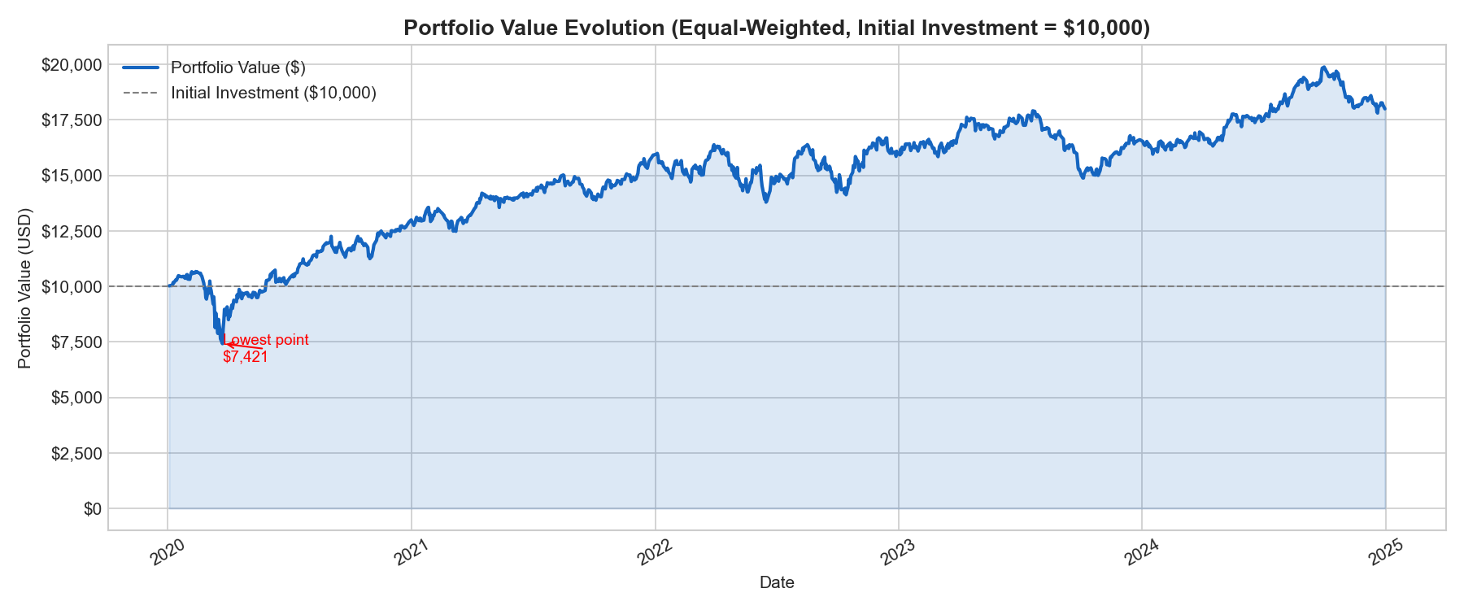
Portfolio Value Evolution
$10,000 invested equally across 5 stocks · Final value: $18,000
Portfolio Narrative
PHASE 1 — COVID Crash (Feb–Mar 2020)
Portfolio dropped sharply to $7,421 (on 2020-03-23). The equal-weight structure meant all sectors were hit, but JNJ and LMT cushioned the fall.
PHASE 2 — Bull Market (2020–2021)
Strong recovery driven by AAPL and LVMUY. The portfolio exceeded the initial $10,000 by mid-2020 and continued to grow through 2021.
PHASE 3 — Rate Hike Bear (2022)
The Fed's aggressive tightening compressed growth valuations. AAPL and NEE dragged the portfolio down. LMT bucked the trend.
PHASE 4 — Recovery (2023–2024)
AI-driven rally in tech and stabilising inflation pushed the portfolio to its final value of $18,000, a gain of 80.0% over the full period.
Initial Capital
Final Value
Total Return
Ann. Return
Worst Day
Ann. Volatility
-10.47%
$10,000
$18,000
+80.0%
+14.8%
20.1%
Value at Risk Analysis — Master 1 Finance | IAE Metz — 2026

Slide 6
Value at Risk — Methodology
Three independent estimation methods · 95% confidence · 1-day horizon
Definition — VaR (95%, 1-day) answers: "What is the maximum loss this portfolio will suffer on a typical bad day, 19 times out of 20?"
01
Historical VaR
02
Parametric VaR
03
Monte Carlo VaR
Uses the actual distribution of past returns.
Assumes portfolio returns follow a Normal distribution.
Simulates 10,000 possible future return scenarios.
· Take all 1256 daily returns (Jan 2020 – Dec 2024)
· Sort returns from worst to best
· Read off the 5th percentile directly
→ No distributional assumption
→ Captures real market events (COVID, 2022 crash)
→ Limitation: future may differ from past
· Mean daily return: 0.0548%
· Daily std deviation: 1.2672%
· Z-score at 5% tail: −1.645
→ Formula: VaR = −(μ + z·σ)
→ Fast and analytically tractable
→ Risk: underestimates fat tails
· Draw 10,000 random returns from N(μ, σ²)
· Same parameters as parametric method
· Take the 5th percentile of simulated outcomes
→ Probabilistic view of the loss distribution
→ Very close to parametric (same inputs)
→ More flexible for complex portfolios
Result: 1.7456%
Result: 2.0295%
Result: 2.0422%
Value at Risk Analysis — Master 1 Finance | IAE Metz — 2026

Slide 7
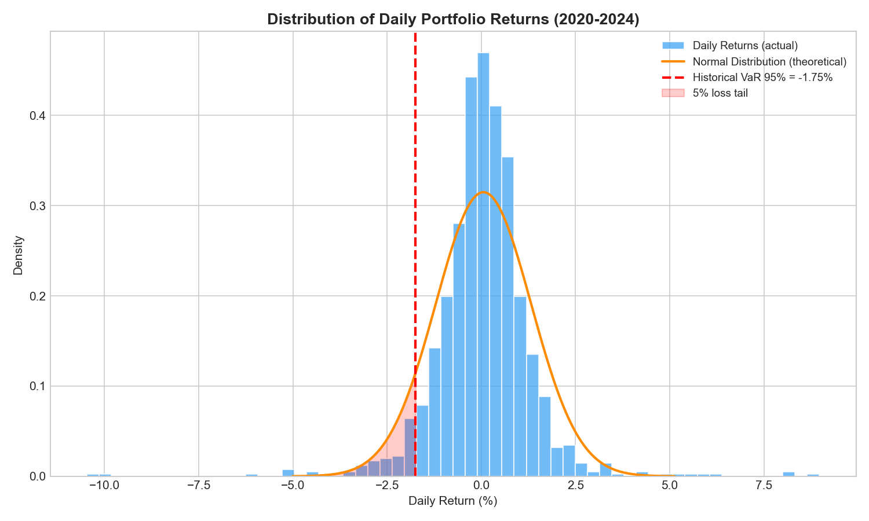
Daily Return Distribution
Histogram of actual returns vs. theoretical normal curve · Historical VaR threshold
Reading the Chart
Central mass — low risk days
The bulk of daily returns cluster tightly around 0%, confirming that most trading days are unremarkable for a diversified portfolio.
Left tail — the loss zone
The red vertical line marks the Historical VaR threshold at −1.75%. On 5% of trading days (≈ 63 days over 5 years), losses exceeded this level.
Normal curve overlay
The orange curve is the theoretical normal distribution fitted to μ = 0.055% and σ = 1.267%. The actual histogram is slightly leptokurtic (more peaked, fatter tails) — typical of equity returns.
Key statistic
Worst single day: -10.47% | Best: +8.97%
Value at Risk Analysis — Master 1 Finance | IAE Metz — 2026

Slide 8
VaR Results — 95% Confidence, 1-Day Horizon
Comparing three methods on the same portfolio
Historical VaR
Parametric VaR
Monte Carlo VaR
Most conservative estimate.
Assumes Gaussian returns.
10,000 simulated scenarios.
1.7456%
2.0295%
2.0422%
−$314 on current portfolio
−$365 on current portfolio
−$368 on current portfolio
Reads directly from the actual distribution of past returns. On the 5th worst percentile of the 1256 observed trading days, the portfolio lost at least 1.75% — or about $314 on the current portfolio value of $18,000.
Derived analytically: VaR = −(μ + z·σ) with μ=0.0548%, σ=1.2672%, z=−1.645. Gives 2.03%, or about $365 in dollar terms.
Simulates 10,000 random draws from N(0.0548%, 1.2672%²). The 5th percentile of simulated outcomes gives 2.04%, or $368.
Lower than parametric → the actual return distribution has a less extreme left tail than a normal curve predicts. Diversification worked.
Higher than Historical → the normal distribution overestimates tail risk here. Parametric VaR is the more conservative parametric estimate.
Near-identical to Parametric (2.0422% vs 2.0295%). Expected: both use the same μ and σ. The 0.01% difference is pure sampling noise from 10,000 draws.
Value at Risk Analysis — Master 1 Finance | IAE Metz — 2026

Slide 9
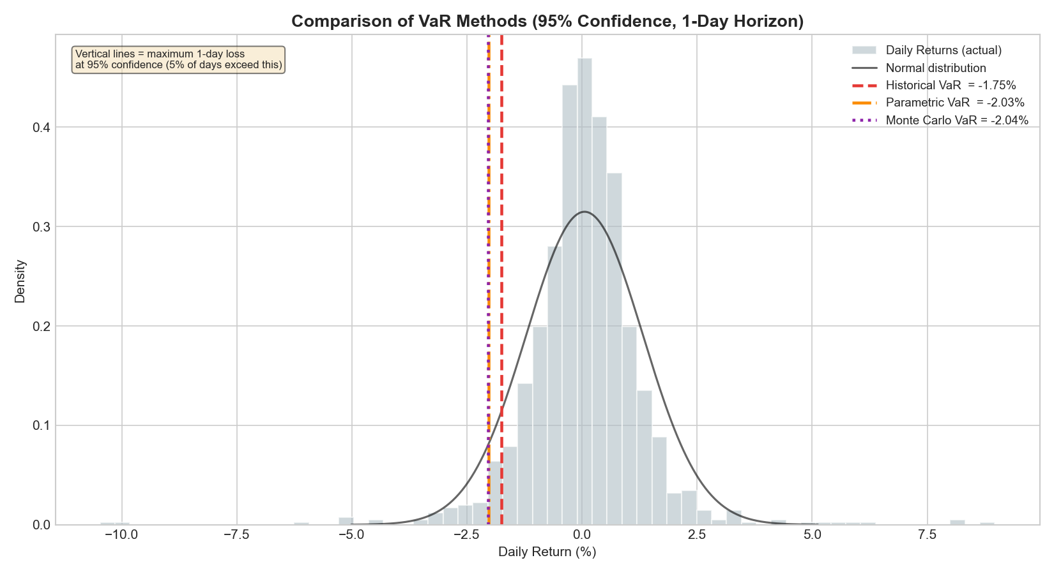
VaR Methods — Side-by-Side Comparison
All three thresholds on the actual return distribution
Comparison Summary
Method
VaR (%)
$ Loss (on $18K)
Assumption
Historical
1.7456%
−$314
None (empirical)
Parametric
2.0295%
−$365
Normal dist.
Monte Carlo
2.0422%
−$368
Normal dist.
KEY FINDING
Historical VaR (1.75%) is 0.28 percentage points lower than the Parametric estimate (2.03%). This gap reveals that the portfolio's actual return distribution is less extreme in its left tail than a pure normal distribution predicts.
WHY DOES THIS MATTER?
A risk manager using only the parametric model would systematically over-provision capital against daily losses. The historical method, anchored to real data, provides a more accurate picture of this specific portfolio's behaviour.
MONTE CARLO ≈ PARAMETRIC
The difference of 0.0127% between MC and Parametric is negligible — a direct consequence of identical input parameters. Monte Carlo's value lies in more complex, multi-asset scenarios.
Value at Risk Analysis — Master 1 Finance | IAE Metz — 2026

Slide 10
Key Findings & Financial Interpretation
What do the VaR numbers mean in practice?
Diversification Benefit
Dollar Translation
Method Convergence
The portfolio's Historical VaR of 1.75% is below the Parametric estimate, confirming that cross-sector diversification reduces extreme tail losses beyond what a single-distribution model captures. Sectors moved counter-cyclically during 2020 and 2022.
On the worst 5% of trading days, the portfolio (valued at $18,000) is expected to lose at least $314 (Historical) to $365 (Parametric). This translates the abstract percentage into a concrete risk budget.
All three methods agree within a 0.30% band. This convergence strengthens confidence in the risk estimate — no single method is an outlier. The Parametric and Monte Carlo methods converge because they share the same mean and volatility inputs.
Critical Limitations — What VaR Does NOT Tell You
▸ VaR is NOT a worst-case loss. It is a threshold exceeded 5% of the time. On those 5% of days, losses can be far larger (this is measured by Expected Shortfall / CVaR).
▸ VaR assumes the past is representative of the future. A structural break (new pandemic, sovereign crisis) can invalidate historical distributions entirely.
▸ The 1-day horizon ignores liquidity risk. Unwinding a $18K portfolio in a crisis may take days, during which losses can compound.
▸ Equal weighting is a simplification. Optimal portfolio construction (mean-variance, risk parity) could reduce VaR further.
Value at Risk Analysis — Master 1 Finance | IAE Metz — 2026

Slide 11
Conclusion
Final VaR Summary
A well-diversified portfolio reduces VaR
Historical
1.7456%
By combining 5 low-correlated sectors, the portfolio's actual 1-day 95% VaR (1.75%) came in below what a normal-distribution model would predict (2.03%). This is a direct quantification of the diversification benefit.
All three methods converge — increasing confidence
Parametric
2.0295%
Historical (1.75%), Parametric (2.03%), and Monte Carlo (2.04%) align within a 0.30% range. This convergence validates the robustness of the estimate and reduces model risk.
Strong risk-adjusted performance over 5 years
Monte Carlo
2.0422%
The portfolio grew from $10,000 to $18,000 (+80.0%) with an annualised return of 14.8% and annualised volatility of 20.1%. VaR remained manageable throughout, including during the COVID shock.
VaR is a starting point, not the full risk picture
Portfolio: $18,000 +80.0% over 5 years
Expected Shortfall (CVaR) should complement VaR to capture losses beyond the threshold. Dynamic rebalancing and correlation monitoring over time are essential for a live portfolio.
95% confidence · 1-day horizon

