Slide 1

Speaker：Hanzhou Tang、Bochuan Wu

Slide 2
Structure
General Idea
-Why we use pre-training model?
-What goes wrong?
The result of this paper
  -Re-thinking ImageNet Pre-training
Detail of model training and testing
    -Methodology
    -Batch Normalization (BN) issue
    -training length issue

Slide 3
Why we use pre-training model?
Pre-train models using large-scale data (e.g., ImageNet) and then to fine-tune the models on target tasks that often have less training data.
Some experiments shows that Pre-training has enabled state-of-the-art results on many tasks, including object detection ,image segmentation, and action recognition.
A path to ‘solving’ computer vision then appears to be paved by pre-training a ‘universal’ feature representation on ImageNet-like data at massive scale. Attempts along this path have pushed the frontier to up to 3000×the size of ImageNet.

Slide 4
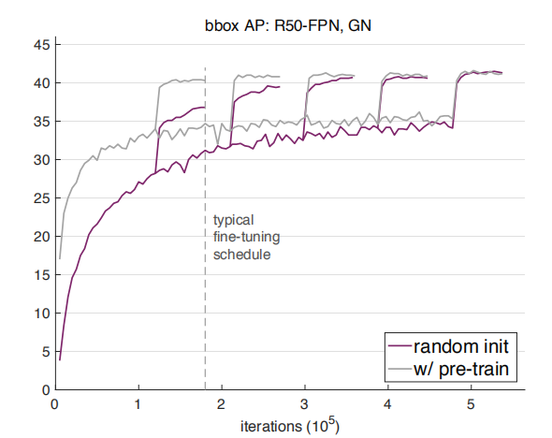
But.....

Slide 5
What goes wrong?
the success of these experiments is mixed:
although improvements have been observed, for object detection in particular they are small and scale poorly with the pre-training dataset size.

Slide 6
Re-thinking ImageNet Pre-training
(i) ImageNet pre-training speeds up convergence, but training from random initialization can catch up after training for a duration.
(ii)Unless the target dataset is too small (e.g., <10k COCO images),it have not necessarily improve accuracy.
(iii)ImageNet pre-training shows no benefit when the target tasks/metrics are more sensitive to spatially well localized predictions.

Slide 7
Methodology
The goal of this experiment is to ablate the role of ImageNet pre_training via controlled experiments that can be done without ImageNet pre-training.
it is desired to enable typical architectures to be trained from scratch under minimal modifications. They describe the two modifications that they find to be necessary, related to batch normalization and training length.

Slide 8
Batch Normalization (BN) issue
Object detectors are typically trained with high resolution inputs, unlike image classifiers. This reduces batch sizes as constrained by memory, and small batch sizes severely degrade the accuracy of BN. This issue can be circumvented if pre-training is used.

Slide 9
Two normalization strategies relieve the small batch issue
(i) Group Normalization (GN):GN’s accuracy is insensitive to batch sizes
(ii) Synchronized Batch Normalization (SyncBN): This increases the effective batch size for BN when using many GPUs, which avoids small batches issue

Slide 10
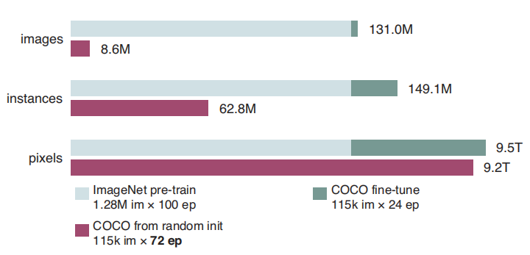
Training length issue
It is unrealistic and unfair to expect models trained from random initialization to converge similarly fast as those initialized from ImageNet pre-training.

