Slide 1
Introduction to pycalphad
Richard Otis
Materials Genome Foundation
December 8, 2020
“From Atomistics to Phase Diagrams” Virtual Workshop

Slide 2
pycalphad = Python + CALculation of PHAse Diagrams
pycalphad is software for designing thermodynamic models, calculating phase diagrams and investigating phase equilibria.
Using CALPHAD-based models, pycalphad predicts properties of materials, including
Transition (e.g., melt) temperatures, phase fractions, solidification, degradation, corrosion, etc.
Anything that can be connected to a chemical or thermodynamic process
Free and open source at pycalphad.org

Slide 3
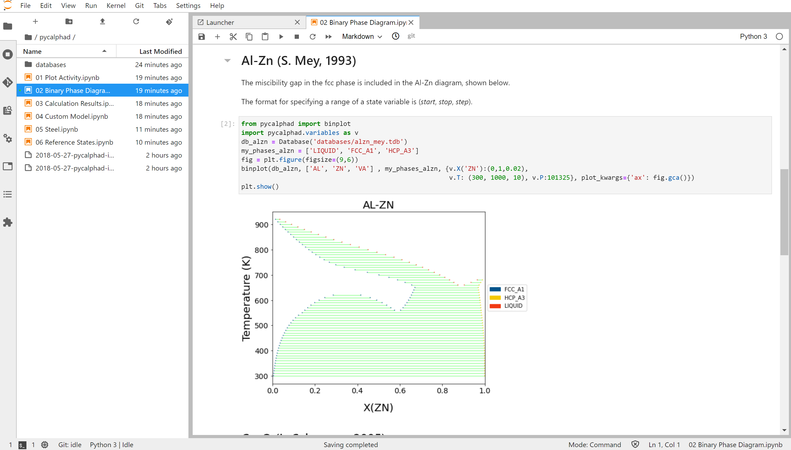
Why use pycalphad
Custom Gibbs energy models
Custom material property models
Digital notebooks
Deploy to Cloud or HPC
Semi-automated database development (via ESPEI)
R. Otis and Z-K. Liu, “pycalphad: CALPHAD-based computational thermodynamics in Python”, Journal of Open Research Software, 5: 1 (2017)

Slide 4

Notable Features in pycalphad 0.8
Improved performance, nearly zero calculation start time
User-specified reference states
Binary and ternary phase diagram plotting
T, P, $μ_{i}$, $x_{i}$ conditions with multiple components
Step/map calculation, global minimization
Support for associates and ionic liquids
IHJ and Xiong magnetic models
Order-disorder model, Two-state model, Einstein model
Windows, Mac, and Linux support
R. Otis, M. Emelianenko, Z. K. Liu, “An improved sampling strategy for global energy minimization of multi-component systems”, Comp. Mat. Sci. 130 (2017) 282–291.

Slide 5
Current Limitations in pycalphad 0.8
In progress: “Advanced” conditions (e.g., amount of a phase)
In progress: Quasichemical model, ternary excess models other than Muggianu
A few TDB features are unsupported (Option “B”, Option “F”, STATUS_BITS, etc…)
Contact us: we can usually help you work around the issue

Slide 6
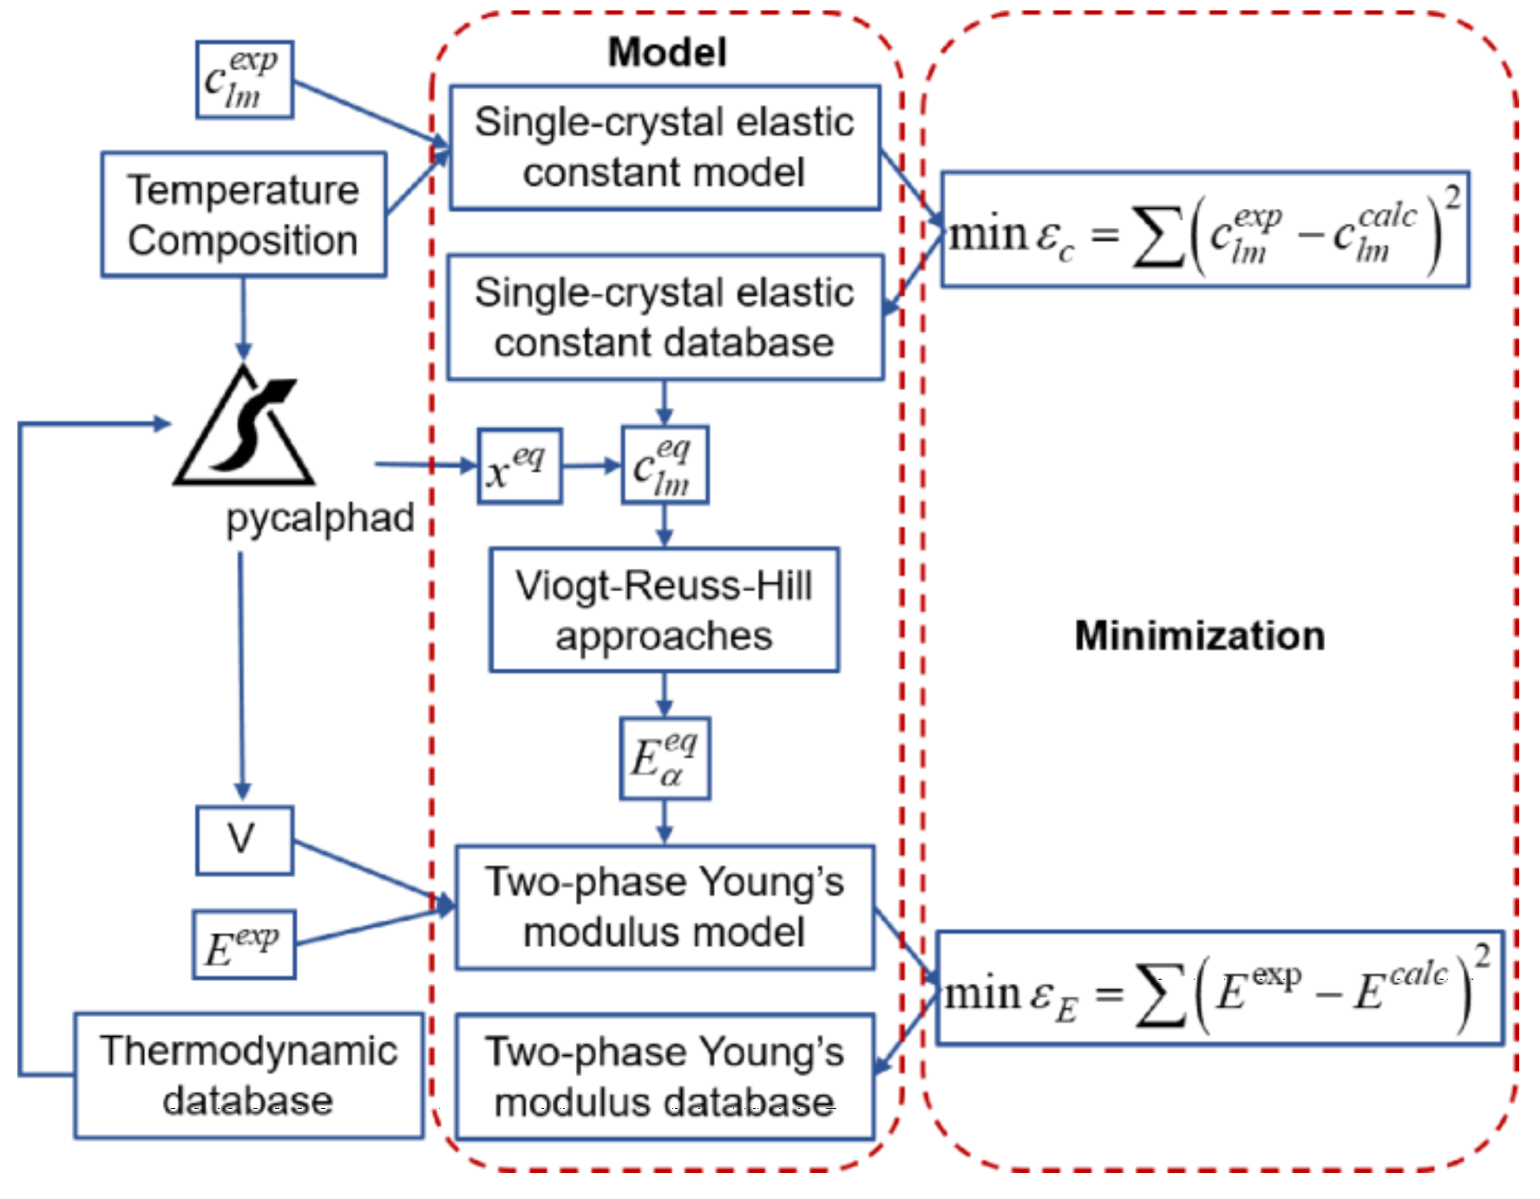
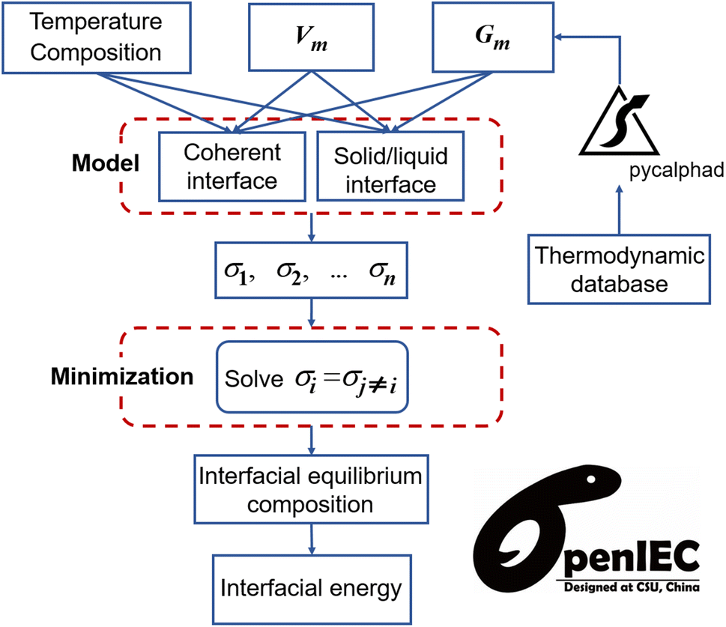
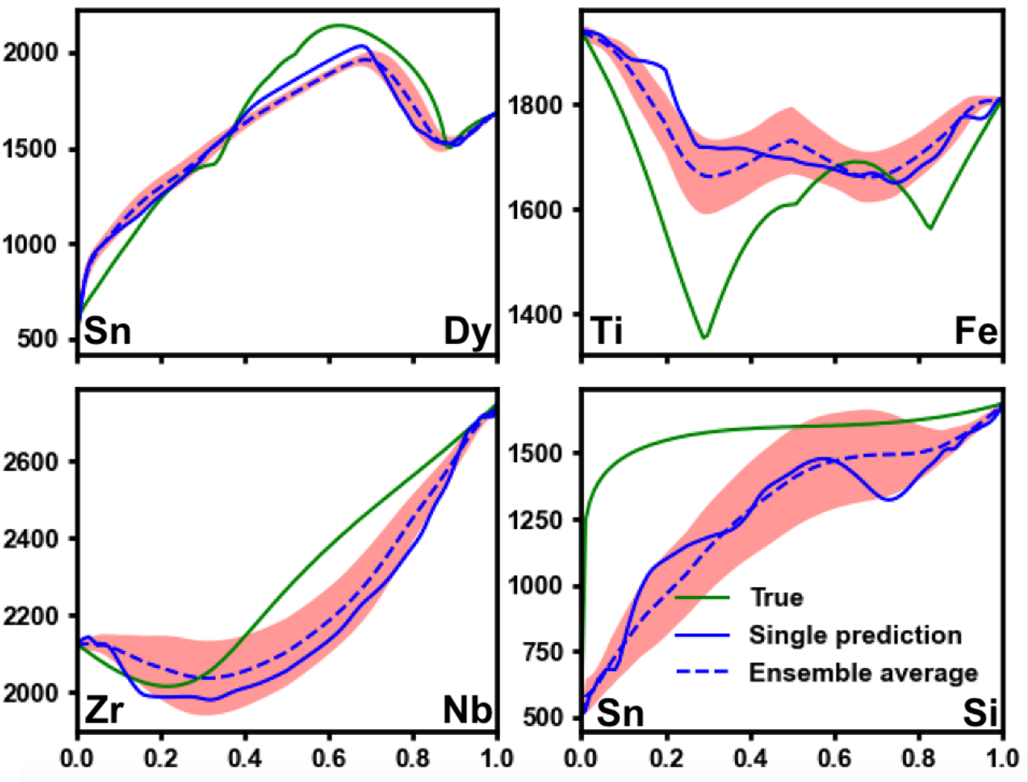
PyCalphad Community Selected Use Cases
Two-phase Elastic Constants
Interfacial Energy
Machine Learning
Y. Shang, et al., Materialia 8, 100500 (2019)
doi: 10.1016/j.mtla.2019.100500
S. Yang, et al., J. Mat. Sci. 54, 10297–10311 (2019)
doi: 10.1007/s10853-019-03639-w
P. Guan and V. Viswanathan (2020)
arXiv:2010.14048v1

Slide 7
Contact Us
richard.otis@materialsgenomefoundation.org
pycalphad.org
Chat with us on Gitter!
gitter.im/pycalphad/pycalphad

