Slide 1
自我介紹(niziima Live)
Notes:
大家好，接下來我會用故事7步驟來說明關於我的故事

Slide 2

1. 目標
Notes:
日本動漫風格的男生，白色頭髮有點像小賈斯汀頭、灰色眼睛，穿著一件黑白帽T，表情冷冷酷酷的，夢想是贏得全國DJ冠軍，身旁有一堆比賽音響設備
我是個熱愛音樂的男大學生，夢想是成為一名專業的DJ，並且希望能參加全國大型音樂派對，累積經驗，讓我的DJ技巧獲得專業的肯定。

Slide 3
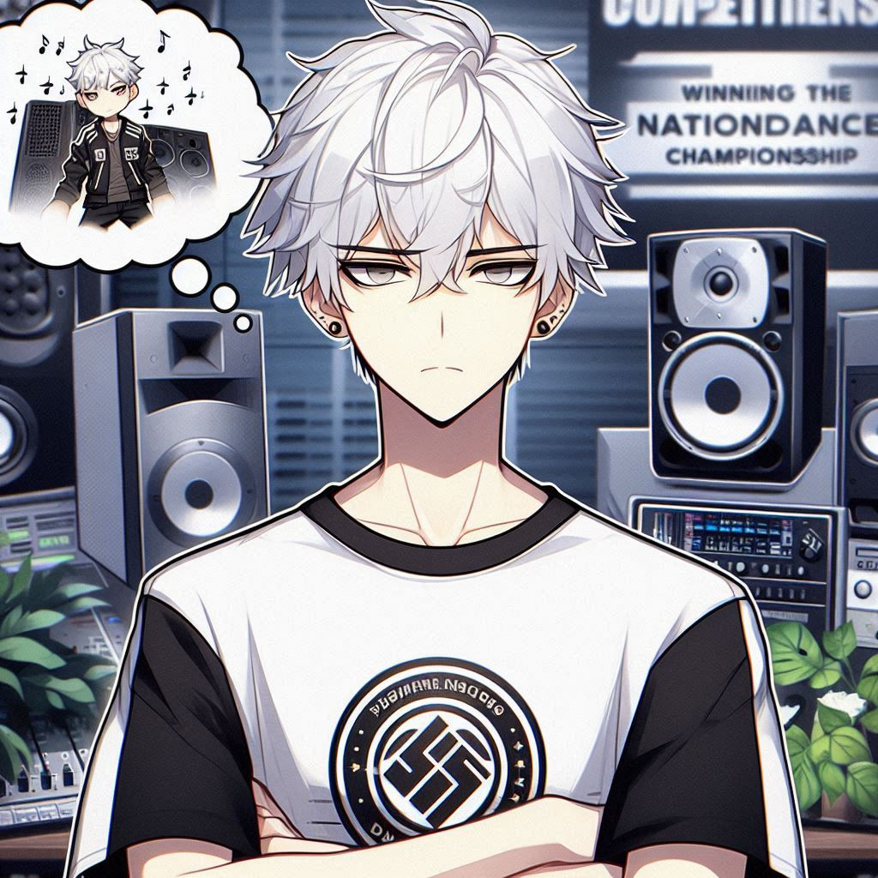
2. 阻礙
Notes:
A male character with white hair, gray eyes, wearing a black and white T-shirt, with a cold expression, there is a bunch of competition sound equipment next to him, and he is thinking how to create music gives me upset looking in his face.
但學業壓力很大，家裡對我的舞蹈夢想並不理解，也認為這不是一個穩定的職業。

Slide 4
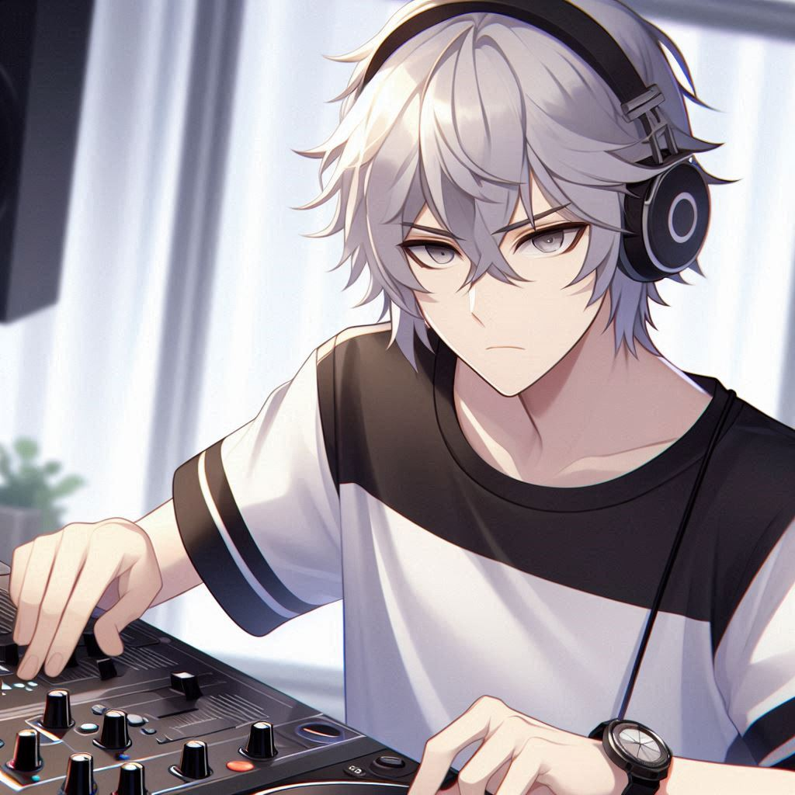
3. 努力
Notes:
A male character with white hair, gray eyes, wearing a black and white T-shirt, with a cold expression, practicing DJ skills with dedication, and creating music that captivates the audience.
儘管如此，我每天課後都會自學音樂混音技術，並在學校的社團活動中進行練習，努力平衡學業和音樂愛好。

Slide 5
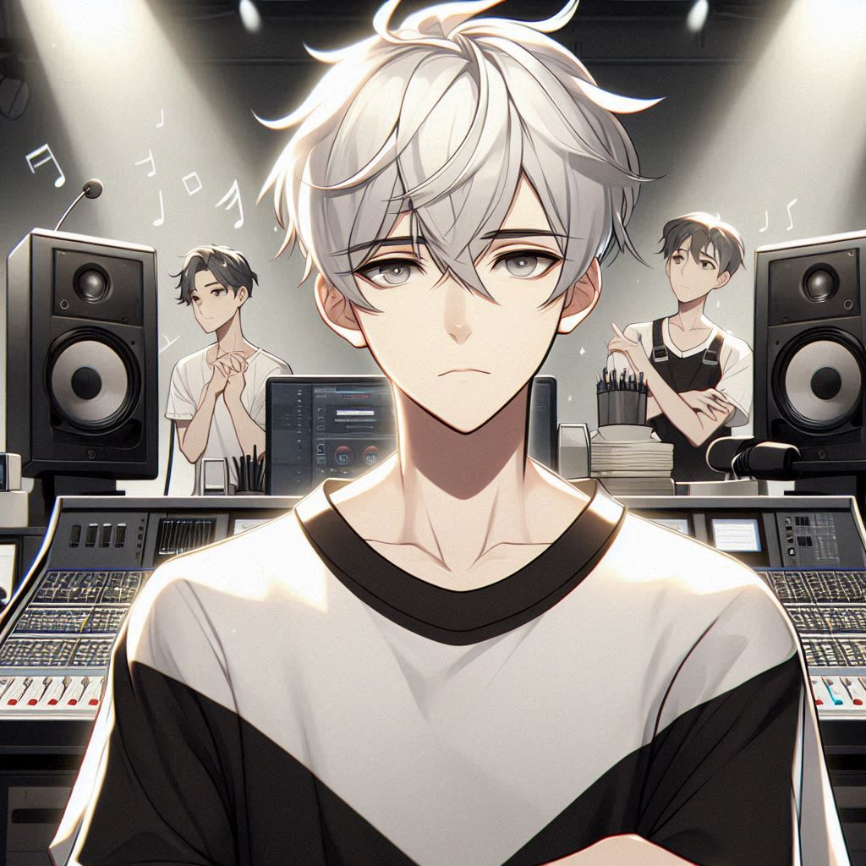
4. 結果
Notes:
A male character with white hair, gray eyes, wearing a black and white T-shirt, with a cold expression, there is a bunch of competition sound equipment next to him, and he is thinking how to create music gives me upset looking in his face.
然而，在一次重要的學校活動上，我因準備不足，設備也出現問題，導致表演不如預期，沒有獲得任何關注，讓我感到非常挫折。

Slide 6

5. 意外
Notes:
A male character with white hair, gray eyes, wearing a black and white T-shirt, with a cold expression, practicing DJ skills with dedication, and creating music that captivates the audience, and give me a picture of the teacher next to him
後來，校內的一位音樂製作老師偶然看到了我的混音作品，認為我有潛力，並推薦我參加當地一個小型音樂節，給我新的表演機會。

Slide 7
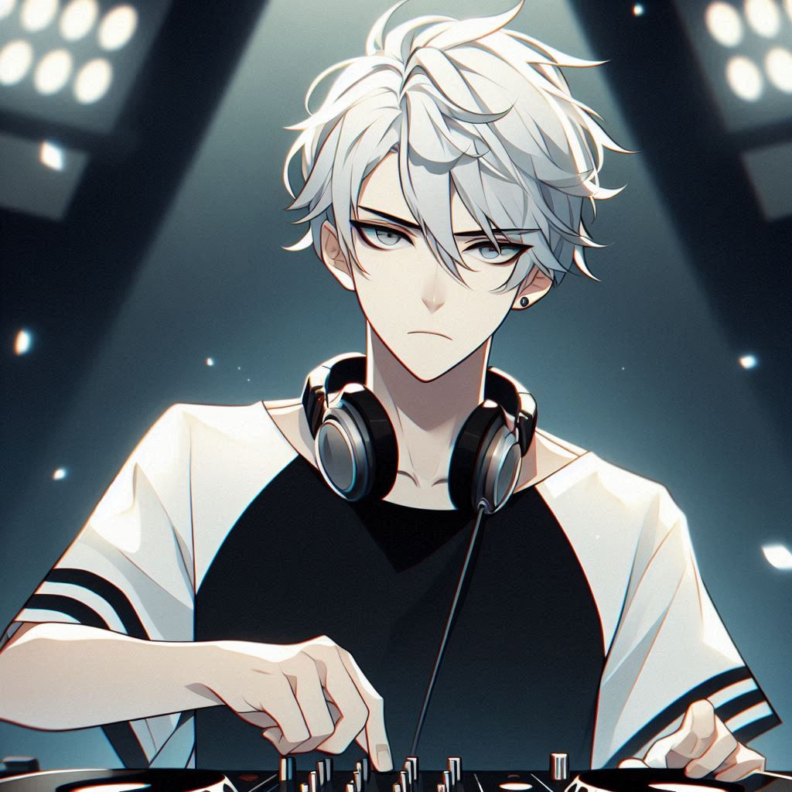
6. 轉彎
Notes:
A male character with white hair, gray eyes, wearing a black and white T-shirt, with a cold expression, practicing DJ skills with dedication, and creating music that captivates the audience, and attending a small music festival.
參加這個小型音樂節不僅讓我積累了更多現場表演的經驗，也幫助我找到信心。這讓我認識到，比起名氣和成功，我真正熱愛的是DJ的創作過程和音樂帶給人的快樂。

Slide 8
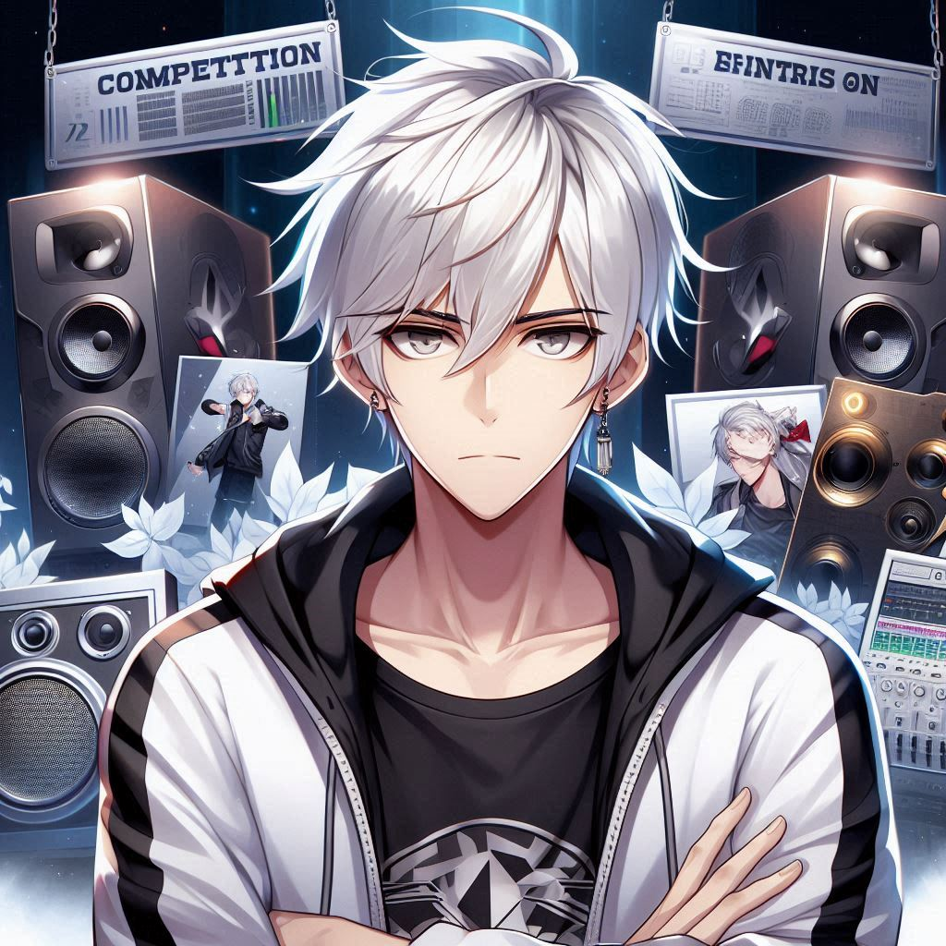
7. 結局
Notes:
A male character with white hair, gray eyes, wearing a black and white T-shirt, with a cold expression, and surrounded by competition audio equipment
經過這段經歷，我決定繼續追求我的DJ夢想，不管未來的結果如何，我會堅持做自己熱愛的事情。

