Slide 1
自我介紹(niziima Live)
Notes:
大家好，接下來我會用故事7步驟來說明關於我的故事

Slide 2

1. 目標
Notes:
日本動漫風格的男生，白色頭髮有點像小賈斯汀頭、灰色眼睛，穿著一件黑白帽T，表情冷冷酷酷的，夢想是贏得全國DJ冠軍，身旁有一堆比賽音響設備
我是個熱愛音樂的男大學生，夢想成為專業DJ，並希望能參加全國大型音樂派對，獲得專業肯定。

Slide 3
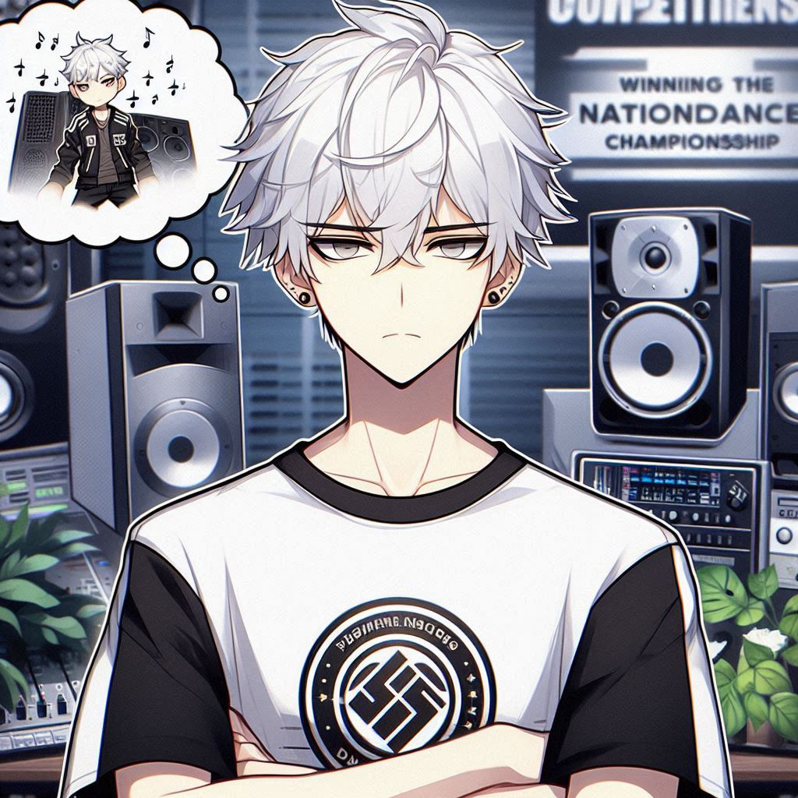
2. 阻礙
Notes:
A male character with white hair, gray eyes, wearing a black and white T-shirt, with a cold expression, there is a bunch of competition sound equipment next to him, and he is thinking how to create music gives me upset looking in his face.
但學業壓力很大，家裡不理解我的音樂夢想，也認為這不是一個穩定的職業。

Slide 4

3. 努力
Notes:
A male character with white hair, gray eyes, wearing a black and white T-shirt, with a cold expression, practicing DJ skills with dedication, and creating music that captivates the audience.
儘管如此，我每天自學混音技術，並在社團活動中進行練習，努力平衡學業和音樂。

Slide 5
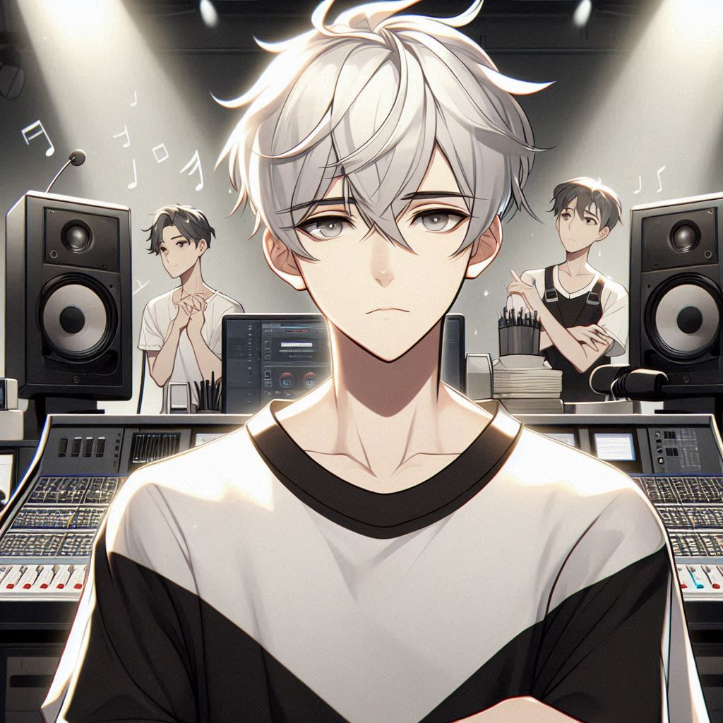
4. 結果
Notes:
A male character with white hair, gray eyes, wearing a black and white T-shirt, with a cold expression, there is a bunch of competition sound equipment next to him, and he is thinking how to create music gives me upset looking in his face.
然而，在一次學校活動中，我因準備不足加上設備問題，導致表演失敗，讓我感到非常挫折。

Slide 6

5. 意外
Notes:
A male character with white hair, gray eyes, wearing a black and white T-shirt, with a cold expression, practicing DJ skills with dedication, and creating music that captivates the audience, and give me a picture of the teacher next to him
就在這時，一位音樂製作老師發現了我的作品，推薦我參加當地小型音樂節，給我新的機會。

Slide 7

6. 轉彎
Notes:
A male character with white hair, gray eyes, wearing a black and white T-shirt, with a cold expression, practicing DJ skills with dedication, and creating music that captivates the audience, and attending a small music festival.
這次表演讓我重新找到信心，也發現比起名氣，我真正熱愛的是DJ創作的過程。

Slide 8

7. 結局
Notes:
A male character with white hair, gray eyes, wearing a black and white T-shirt, with a cold expression, and surrounded by competition audio equipment
經過這次經驗，我決定堅持追夢，不論未來如何，我會繼續做自己熱愛的事情。

