Slide 1
Disinformation Reports
INST408C: Cognitive Security | Fall 2021 | SJ Terp

Slide 2
Disinformation Reporting
Looking at:
Why report mis/disinformation, rumours, conspiracies
How people and groups report
Report formats
Ask yourselves:
Who can respond and how - is the report aimed at them?
Who is this report really for?
What information is in this report
What’s missing
Notes:
(Whose interests does this serve)
(how clearly explained is the methodology. Is it repeatable/ verifiable)
<DS has the same questions>

Slide 3
Reporters, Responders
Reporters
General public
OSINT communities
Disinformation tracking organisations
Responders
Social media platforms
Registrars
Government policymakers
Law enforcement

Slide 4
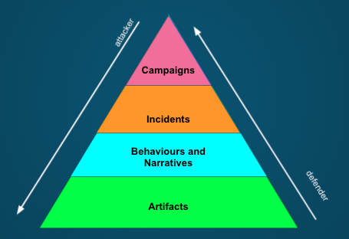
What’s in a report?

Slide 5
These are Streams, not Reports
Botsentinel: themes “trollbots” are promoting
Hamilton68 - public version is feeds from official Russian sites (embassies, RT etc), not trolls.
Ryerson University covid19 misinformation portal
Botswatch dashboard Botswatch dashboard
Indiana University OSOME Decahose
Facebook Datafeed
Uni Arkansas COSMOS Covid19 list

Slide 6
These are Narratives, not reports
Wikipedia list of Covid19 rumours
WHO Covid19 myths list - narratives
Ryerson Claimwatch dashboard
CMU IDEAS Center list of Covid19 disinformation narratives
Indiana Hoaxy (twitter, articles)

Slide 7
Strategic groups: reports
EuVsDisinfo database https://euvsdisinfo.eu/disinformation-cases/
Atlantic Council DFRLab https://medium.com/dfrlab
Graphika https://graphika.com/reports
Facebook https://about.fb.com/news/2021/08/july-2021-coordinated-inauthentic-behavior-report/
FireEye https://www.fireeye.com/blog/threat-research/2020/07/ghostwriter-influence-campaign.html
Many many factchecking orgs https://datastudio.google.com/reporting/a8491164-6aa8-45d0-b609-c70339689127/page/ierzB

Slide 8
OSINT analysts: social media, newspapers
https://twitter.com/brechtcastel/status/1431612326759829513?s=19
https://twitter.com/conspirator0
https://www.vice.com/en/article/93yvmv/qanon-ghostezra-is-robert-randall-smart

Slide 9
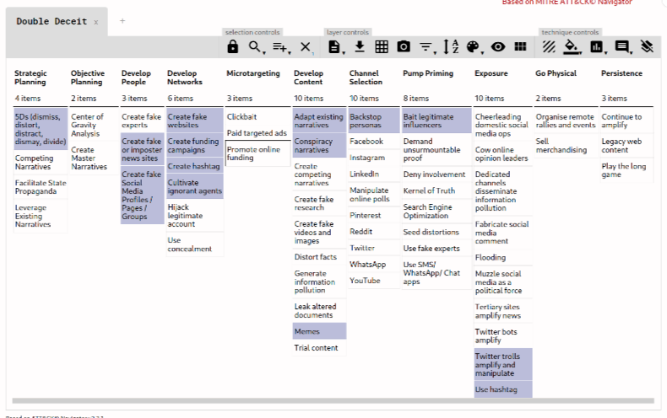
CTI-based groups: incident reports

Slide 10
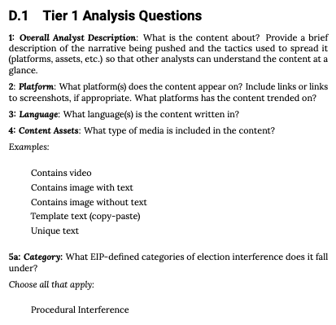
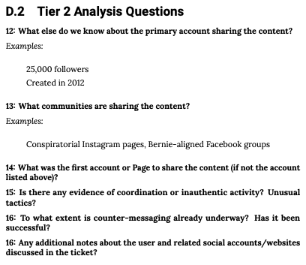
Tactical groups: tickets
https://www.atlanticcouncil.org/in-depth-research-reports/the-long-fuse-eip-report-read/

Slide 11
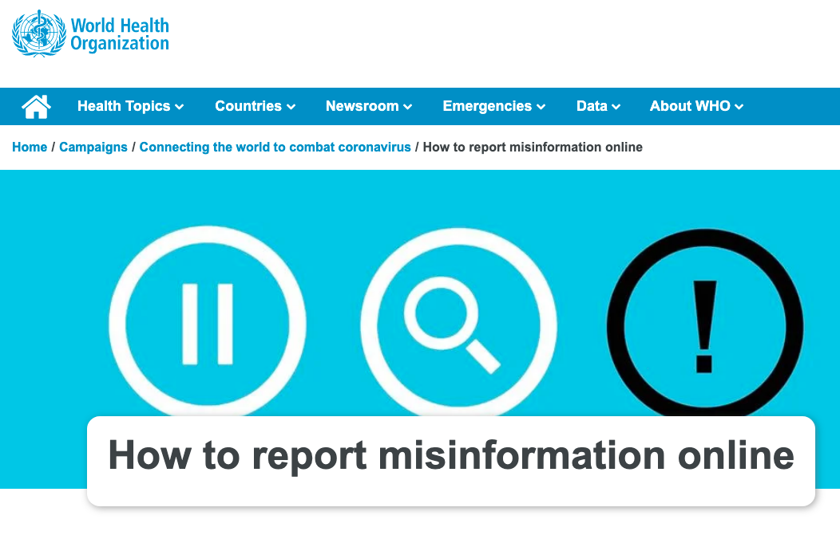
Public: forms, direct messages
https://www.who.int/campaigns/connecting-the-world-to-combat-coronavirus/how-to-report-misinformation-online

