Slide 1
Week 12 class 2: simulations
INST408C: Cognitive Security | Fall 2021 | SJ Terp

Slide 2
INST408C Week
Monday
Games
Wednesday
Simulations
Readings
Roozenbeek, van der Linder “Inoculation theory and Misinformation”, NATO report, 2021
Assignments
Design a cognitive security game
Notes:
Links:

Slide 3
Simulations
Games without the scripts

Slide 4
Games, Sims, Exercises, Red teams
Learning game: fun experience that teaches you something
Useful for training large numbers of people simultaneously
Simulation: imitation of processes and environment
Useful for “what if” automated tests
Tabletop exercise: key people responding to a simulated event
Useful for creating cohesive teams. Often large scale
Red team: test an organisation’s defences by thinking like a bad guy
Useful for finding system vulnerabilities, and predicting future moves
Notes:
Links:
http://www.theknowledgeguru.com/games-vs-simulations-choosing-right-approach/
https://www.edutopia.org/sims-vs-games

Slide 5
How are you doing this? Benefits and risks
Small group of people meet to brainstorm scenarios
Group of people meet to play their own roles during a simulated event
Red team tests defences on wider population

Slide 6
What do we want from simulations?
People stuff
Build resilience
Build skills
Build communities
Future stuff
Reduce surprise
Be prepared

Slide 7
Simulated environments

Slide 8
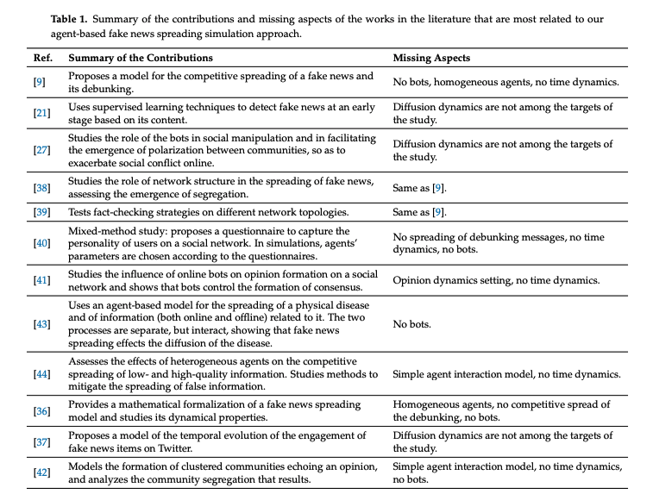
Simulations without people: agent-based models
Notes:
Links
Table from https://www.mdpi.com/1999-5903/13/3/76/pdf
https://theconversation.com/we-made-deceptive-robots-to-see-why-fake-news-spreads-and-found-a-weakness-104776 - modelling spread

Slide 9
Simulations with people: RootzBook
https://aivillage.org/blog/2019/7/31/r00tzbook-a-misinformation-ctf-for-kids

Slide 10
Red Teaming
Thinking like the problem creator

Slide 11
Red Team, Blue Team, Purple Team
Terms from information security
Red team: attack systems, break into defences
Simulate attacks against blue teams, to test network security
Find weaknesses in people, processes, technology
“Ethical hackers”
Blue team:defense team, maintain internal network defences against cyber attacks and threats
Strengthen defences
Purple team: red and blue working together
Stops the “we won but won’t fix it” attitude
You break it, you fix it
Notes:
Links:
https://purplesec.us/red-team-vs-blue-team-cyber-security/

Slide 12
Cyber Security Blue Team Exercises
Activities
Gathers data (Assets, Threats, Vulnerabilities, Controls)
Does risk assessment
Reduces risk through stronger controls: education, patching etc
Monitors system
Exercises
DNS audits - issues with records etc
Digital footprint analysis - who’s behaving strangely
Installing security software
Analysing logs
Vulnerability scanning
etc

Slide 13
Cyber Security Red Team Exercises
Penetration testing: break into system
Social engineering: get access / credentials from staff
Phishing: use emails, fake websites etc to get staff to take actions (e.g. logging into cloned website)
Intercepting data: use packet sniffers, analysers etc to read messages, map networks etc.
Physical attacks: tailgating, picking locks, cloning access cards etc
Notes:
Links:
https://purplesec.us/red-team-vs-blue-team-cyber-security/

Slide 14
Why red team?
Because you learn more when you use different points of view
Learning: Find weaknesses in people, processes, technology
Prediction: get ahead of disinformation creators’ next moves
Recommendation: suggest ways to improve security

Slide 15
Cognitive Security Red Teaming
As above, but for cognitive security
Penetration testing: break into system
Social engineering: get access / credentials from staff
Phishing: use emails, fake websites etc to get staff to take actions (e.g. logging into cloned website)
Intercepting data: use packet sniffers, analysers etc to read messages, map networks etc.
Physical attacks: tailgating, picking locks, cloning access cards etc

Slide 16
Red Team Exercise
Your turn

Slide 17
Exercise rules
You’re limited by your own resources: money, people, time, assets
You’re allowed to outsource
You’re aware of consequences from your actions
You may or may not encounter countermeasures
Any narrative, behaviour, asset you can think of is in bounds
You *will* be asked to fix what you broke before leaving the exercise

Slide 18
Suggested actions
Follow the AMITT Red framework
Set goals
Gather information
Find weaknesses
Plan activities
Prepare
Decide on materials, narratives, behaviours, channels, influencers etc
Exploit weaknesses
Deploy
Measure (and adjust as needed)
Leave
what do you leave in place? What do you keep for the next one etc

Slide 19
Recap: models and frameworks
AMITT Red, AMITT Blue: behaviours
FLICC: behaviours

Slide 20
Disinformation as a service
“Doctor Zhivago’s services were priced very specifically, as seen below:
$15 for an article up to 1,000 characters
$8 for social media posts and commentary up to 1,000 characters
$10 for Russian to English translation up to 1,800 characters
$25 for other language translation up to 2,000 characters
$1,500 for SEO services to further promote social media posts and traditional media articles, with a time frame of 10 to 15 days
Raskolnikov, on the other hand, had less specific pricing:
$150 for Facebook and other social media accounts and content
$200 for LinkedIn accounts and content
$350–$550 per month for social media marketing
$45 for an article up to 1,000 characters
$65 to contact a media source directly to spread material
$100 per 10 comments for a given article or news story”
Notes:
From https://www.recordedfuture.com/disinformation-service-campaigns/
Since then, more ex marketing, spam etc companies have joined in, and actors from countries (using fake groups as cutouts) to individuals (to sway a court case) have used DAAS services.

Slide 21
Scenario1: DaaS
Player: You run a disinformation as a service company
It used to be a marketing company, but disinfo pays better
You’re based in the Philippines
Brief: to run a campaign against a US company
Your customer is a rival company in Russia
They’ve paid you $10,000 for this
And expect results within 2 weeks because there’s a regulatory summit then
Resources:
You have 5 people available
You have existing assets from other campaigns: Social media accounts, fake news websites
Plan: Over to you
What do you do (narratives, techniques etc)? What resources do you need and use? What are your measures of success?

Slide 22
Scenario 2: Pink Slime
Player: you’re a high-profile individual with a network of fake news sites
You started with one site selling alternative health treatments
Then discovered that clicks paid you a lot - especially if you game Google’s algorithms to get top slot
Brief: adtech exchanges are cracking down on your ad funding
What else are you going to do to make money?
How can you maximise this?
Resources:
You have a team of 40 people total. Many of them are managing social media and content on your sites, but you also have web developers, strategists, and access to DaaS companies
You control 400 fake news sites. 40 of these haven’t been found by factcheckers yet
Plan: What do you do (narratives, techniques etc)? What resources do you need and use? What are your measures of success?

Slide 23
Now Start Fixing What you Created
(the harder part)

Slide 24
Mending and patching
Look at your red team results
Which vulnerabilities did you find?
Which controls would you recommend to help fix them?
What did you break?
How can you stop this happening again
What could you do to repair the damage

