Slide 1
Week 13 : Project work
INST408C: Cognitive Security | Fall 2021 | SJ Terp

Slide 2
INST408C Week
Monday
Working session: project preparation
Wednesday
No class (Thanksgiving)
Readings
Assignments
Project summary
Notes:
Links:

Slide 3
Class Project - in two parts
You will produce:
Week 14: Summary of the area you’re planning to work on
Week 15: Presentation on what you’ve found
Notes:
(Whose interests does this serve)
(how clearly explained is the methodology. Is it repeatable/ verifiable)
<DS has the same questions>

Slide 4
Project1: project proposal
Scenario: Your boss wants to check that you can do cognitive security assessments.
You're asked to write an actionable assessment of an area of cognitive security. You get to choose the parameters for this: which country, which communities, which topic. You can also choose the type of assessment; options for this include:
Data science: define a question(s), show insights gained from data analysis
Ecosystem assessment: pick a region / demographic, outline information, threat, and response landscapes
Before you start analysis, you need to write a summary of the area you’re planning to work on; What are the questions you want to ask/ answer, which region/ demographic/ language/topic etc are you interested in, and why. Who is the report written for (you can choose this yourself too), and who can potentially respond to information in it and how.
What is your plan for this work, e.g. where will you gather data for this, which issues do you expect to have doing this, which activities do you expect to perform, who would be useful for you to have access to etc.

Slide 5
Project2: Present your findings
Create a slidedeck showing your findings from your project investigation
Present this in class

Slide 6
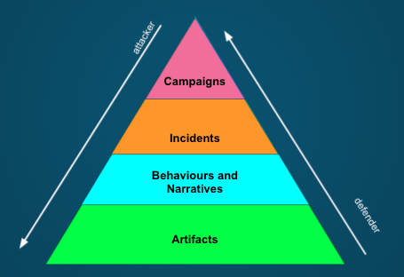
Recap: what’s in a report

Slide 7
Recap: Cognitive Security Ecosystem
Information Landscape
Information seeking
Information sharing
Information sources
Information voids
Threat
Landscape
Motivations
Sources/ Starting points
Effects
Misinformation Narratives
Hateful speech narratives
Crossovers
Tactics and Techniques
Artifacts
Response
Landscape
Monitoring organisations
Countering organisations
Coordination
Existing policies
Technologies
etc
Notes:
There are many actors in this space. We hear a lot about threat actors - these are at different scales, with different capabilities and motivations. They’re learning from each other, and they often interact - for instance, we see t-shirt sellers picking up geopolitical narratives.

Slide 8
Recap: Example Threat Landscape
Motivations
Geopolitics mostly absent
Party politics (internal, inter-party)
Actors
Political parties
Nationstates
Entrepreneurs
Activities
Manipulate faith communities
discredit election process
Discredit/discourage journalists
Attention (more drama)
Potential harms / severities
Assassination
Voting reduction
Sources
WhatsApp
Blogs
Facebook pages
Online newspapers
Media
Routes
Hijacked narratives
Whatsapp to blogs, vice versa
Whatsapp forwarding
facebook to whatsapp
Social media to traditional media
Social media to word of mouth

