Slide 1
Week 6 Class 2:
Building Landscapes
INST408C: Cognitive Security | Fall 2021 | SJ Terp

Slide 2
INST408C Week
Monday
Building landscapes
Wednesday
Building landscapes
Readings
Any country in the OII book
https://theconversation.com/misinformation-disinformation-and-hoaxes-whats-the-difference-158491
Assignments
Create a landscape assessment for a country, vertical, or organisation
Notes:
Links:

Slide 3
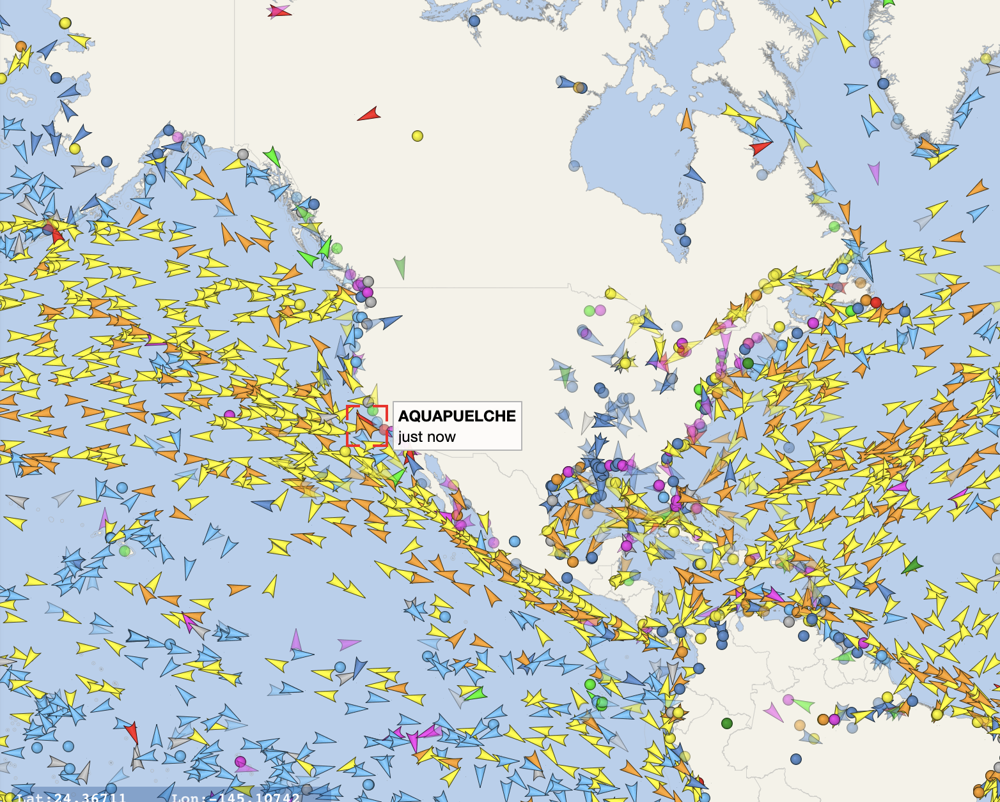
Recap: cognitive security ecosystems
situation assessment
Notes:
Links:
Vesselfinder snapshot, 3rd Oct 2021

Slide 4
Cognitive Security Ecosystem
Information Landscape
Information seeking
Information sharing
Information sources
Information voids
Threat
Landscape
Motivations
Sources/ Starting points
Effects
Misinformation Narratives
Hateful speech narratives
Crossovers
Tactics and Techniques
Artifacts
Response
Landscape
Monitoring organisations
Countering organisations
Coordination
Existing policies
Technologies
etc
Notes:
There are many actors in this space. We hear a lot about threat actors - these are at different scales, with different capabilities and motivations. They’re learning from each other, and they often interact - for instance, we see t-shirt sellers picking up geopolitical narratives.

Slide 5
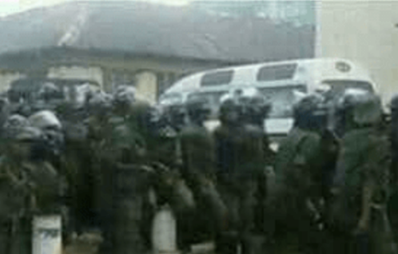
Example Information Landscape
Channels
Traditional Media
Newspapers
Radio - including community radio
TV
Social Media
Facebook
Whatsapp
Twitter
Youtube/ Telegram/ etc
Others
Word of mouth
Influencers
Groups
Messages
Notes:
Looking at information seeking, sharing, and posting behaviours.

Slide 6
Example Threat Landscape
Motivations
Geopolitics mostly absent
Party politics (internal, inter-party)
Actors
Political parties
Nationstates
Entrepreneurs
Activities
Manipulate faith communities
discredit election process
Discredit/discourage journalists
Attention (more drama)
Potential harms / severities
Assassination
Voting reduction
Sources
WhatsApp
Blogs
Facebook pages
Online newspapers
Media
Routes
Hijacked narratives
Whatsapp to blogs, vice versa
Whatsapp forwarding
facebook to whatsapp
Social media to traditional media
Social media to word of mouth

Slide 7
Narratives
Covid isn’t serious
Covid doesn’t exist
Individual medical targets
Medical scams
MMS prevents
Alcohol prevents
etc
Origin myths
Escaped bioweapon
Country x created Covid
US soldiers took Covid to China
Resolution myths
Country y has a Covid cure
Crossover with conspiracies
Covid and 5G
Covid and antivax / anti-Gates
Helicopters spraying for covid
Depopulation conspiracy
Crossover with ‘freedom rights’
Anti- stayathome
2nd amendment
anti-immigration
Usual far-rightwing groups
Geopolitics
China, Iran: covert + overt
“Blue check” disinfo

Slide 8
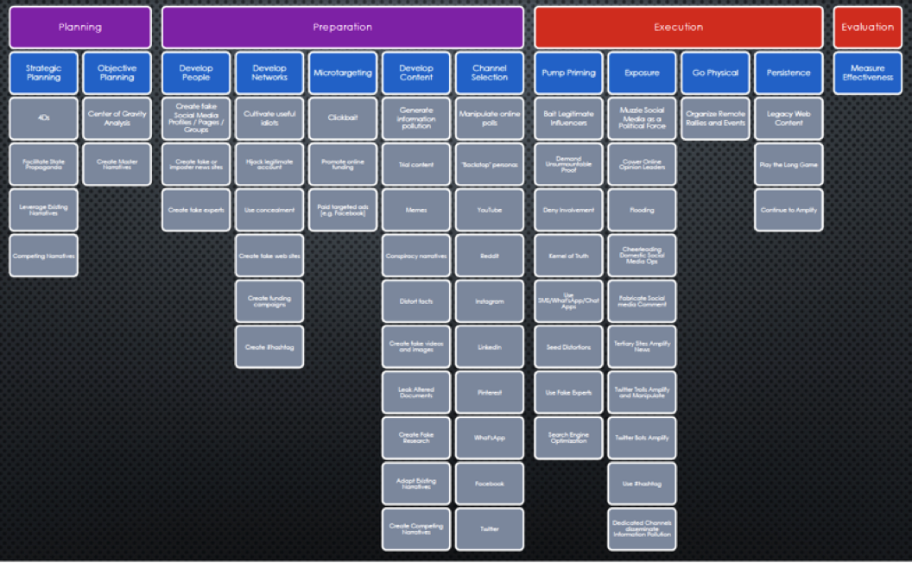
Behaviours
Techniques used in misinformation or disinformation campaigns
Useful to track because they’re often repeated, and we can design mitigations and countermeasures

Slide 9
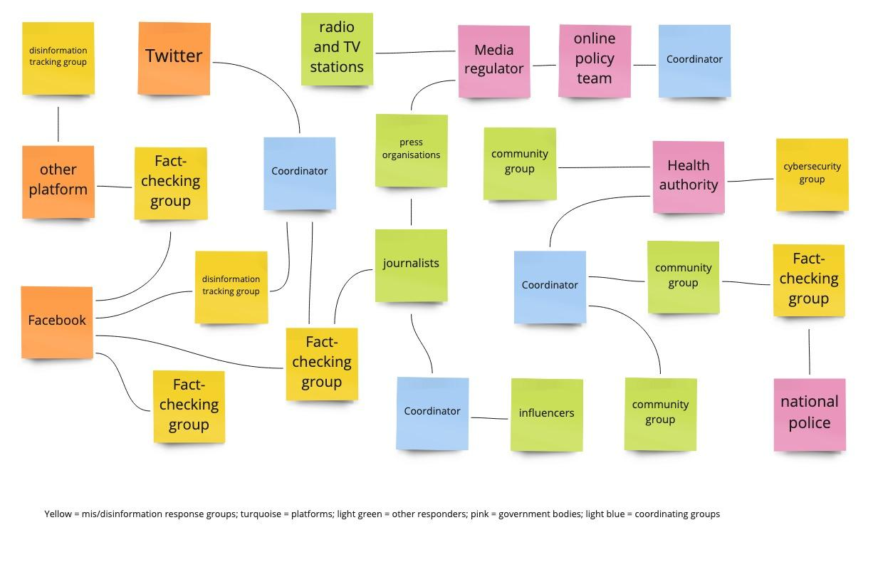
Response landscape

Slide 10
Response Activities (Needs / Work / Gaps)
Risk Reduction
Media and influence literacy
information landscaping
Other risk reduction
Monitoring
Radio, TV, newspapers
Social media platforms
Tips
Response
Messaging
prebunk
debunk
counternarratives
amplification
Actions
removal
other actions
Reach
Analysis
Tier 1 (creates tickets)
Tier 2 (creates mitigations)
Tier 3 (creates reports)
Tier 4 (coordination)

Slide 11
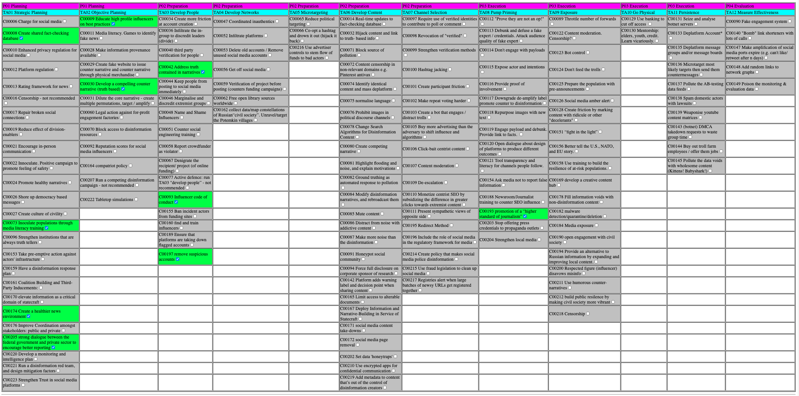
Behaviours
C00009: Educate high profile influencers on best practices
C00008: Create shared fact-checking database
C00042: Address truth contained in narratives
C00030: Develop a compelling counter narrative (truth based)
C00093: Influencer code of conduct
C00193: promotion of a “higher standard of journalism”
C00073: Inoculate populations through media literacy training
C00197: remove suspicious accounts
C00174: Create a healthier news environment
C00205: strong dialogue between the federal government and private sector to encourage better reporting

Slide 12
Mapping an Ecosystem
Inputs, outputs, activities
Notes:
Links:
Vesselfinder snapshot, 3rd Oct 2021

Slide 13
Mapping a CogSec ecosystem
Mapping activities
Define the area / subject
Map information landscape
Map threat landscape
Map response landscape
Examine landscape interactions
Suggest landscape patches
Inputs
Desk surveys
Data analysis
Interviews
Workshop(s)
Outputs
Landscape slideset
Landscape report
Connections
Response recommendations

Slide 14
Desk Survey

Slide 15
Desk survey
Check responder outputs
Areas of interest
Tiers (1,2,3,4?)
Coverage
Frequency
Accessibility
Timeliness
Check overlaps across responder outputs

Slide 16
Desk survey questions
Information landscape
What’s the population size? Demographic profile?
How many people are online, on phones, on social media. Which social media?
What are people searching for online
Are they looking mainly internally, or at other countries’ outputs?
Risk analysis
Is this country in existing known disinfo groups and sites
What’s the chatter like here around known disinformation narratives
Are there networks of disinfo sites here yet?
What are the hot-topic issues that disinfo could use?
Who are the major influencers?
Big questions
How many people are online
What are they looking at and for?
What are the main sources of information and disinformation
What’s from inside the country vs what’s coming in from outside (e.g. Nigeria)
More sensitive questions are around partnering: are there sources of friction amongst responders, are government agencies compromised etc.

Slide 17
Desk survey sources
Big list of response organisations
Local responder websites
Global response sites (Atlantic council etc)
Government websites
OII annual reports https://comprop.oii.ox.ac.uk/wp-content/uploads/sites/127/2021/01/CyberTroop-Report20-FINALv.3.pdf
https://datareportal.com/reports/digital-2020-global-digital-overview
https://worldpopulationreview.com
https://data.humdata.org
Google searches, e.g. Country/cities + mis/disinformation

Slide 18
Data Analysis

Slide 19
Data analysis
Create narratives list
Create search terms list
For this area
This/these communities
This/these languages
This topic
Do social media reach analysis on influencers
Use google search as input on what people are looking for
Use channels list to gather data. Use:
APIs
Web scrapes
By hand
Analyse data for new:
Search terms
Topics / concerns
Influencers
Incidents

Slide 20
Interviews and Workshop

Slide 21
Interviews and workshop(s)
List stakeholders
Find active and potential responders
Desk survey on responders
Interview each responder
Write up
Cross-check with workshop

Slide 22
Interviews
Start with who you are and what you’re doing…
Short interview questions
Long interview questions
Sector-specific interview questions
Election / health etc
Influencers, e.g. bloggers
Media
Response team

Slide 23
Short interview questions
Where do people get their news in <area of interest>
What information sources do people use - offline and online
Which languages do people use with each other - offline and online
How do people connect to each other online?
Which social media do they use
Which messaging apps - and are they 1:1 or in groups
Have you seen any misinformation or hate speech?
Which channels is it on - social media, URLs etc
Are there well-known disinformation or fake news “influencers”? Where do they output information?

Slide 24
Long interview questions: Environment
Where do people get their news in <area of interest>
What information sources do people use - offline and online
Which social media sites do people use most?
How do people find material?
Hashtags?
Country name?
Following influencers?
Traditional news organisations online?
How do people connect to each other online?
Which social media do they use
Which messaging apps do they use? (e.g. SMS, Whatsapp, Telegram etc)
If messaging apps are used, are there public groups on the messaging apps?
Which languages do people use with each other - offline and online
Who are the online influencers?

Slide 25
Long interview questions: Threat
Have you seen any misinformation or hate speech?
Where does misinformation come from?
Is it in radio, newspapers, on TV?
Is it online? If so, which channels is it on - social media, URLs etc
Are there well-known disinformation or fake news “influencers”? Where do they output information?
Does disinformation appear to be well-structured?
Are there fake news sites and accounts in <area>? Are there networks of them?
<check for response-related threats>
E.g. what do you think of legislation related to the online space

Slide 26
Long interview questions: response
We’re looking for skills and evidence in 3 areas:
Identification - finding potential disinformation
Factchecking - assessing identified information though cross-checking, reverse search etc.
Response - combatting disinformation through counter-messaging, debunking etc
Our big questions are:
Does your organisation do any of these things?
Who else is doing this work in the country (or in neighbouring countries, if their techniques could be useful here)?
What do disinformation, misinformation and hate speech look like in <area>.
For both your area of interest, and in general:
Identification
Are there any misinformation tiplines in the country already?
Factchecking
Which information sources do people use for factchecking?
Response
If you see disinformation, what do you do in response?
Who is responding to disinformation? How?
Do debunking pages exist already?
Process
How quickly do you go from finding disinformation, to responding to it?
If I was a member of the public looking for help on misinformation, where would I look?
Do you use identification, fact checking, or response tools? If so, which ones?
Actors’ capacity:
How many staff at secretarial level? How many members?
Existing initiatives ongoing? How many staff involved?
Budget sources and timelines?
Interactions with other stakeholders in this field?

Slide 27
Specific interview questions: elections
General
Which misinformation narratives have you seen around elections?
Who counters these narratives?
How?
Stages
Voter registration
Campaigning
Voting and polling stations
Vote counting
Win declarations
For a slow start: have you seen these narratives?
Voter suppression: None of the parties care about your demographic, so don’t vote
How to vote: e.g. listing the wrong methods (‘text this phone number’), or downplaying valid methods like mail-in voting
Polling stations: Which polling stations are open and/or closed, voting machines are switching votes,
Voter fraud: people are voting twice, non-voters (children, immigrants etc) are voting, dead people are voting,
Vote counting: opposition votes are being thrown away or replaced, ballot stuffing (extra votes are being created), who you voted for isn’t private information,
Winners: a different candidate won,
Languages: spreading disinformation in a language and/or demographic that isn’t being tracked, or reported in.

Slide 28
Specific interview questions: media regulator
Do people try to fake your members’ websites, broadcasts, social media accounts?
How many stations are licensed? un licensed?
How do people report on disinfo?
Do people trust the traditional media?

Slide 29
Reporting out

Slide 30
Landscape report: slideset
Information landscape
Threat landscape
Narratives
Example incidents
Potential issues
Seen in nearby countries
Common narratives for this type of area/event
Creator behaviours (AMITT)
Response landscape
Baseline: mitigation/enablement/operations
Responders graph
Response needs, work, gaps and risks
Response tables:
Risk reduction
monitoring
analysis
Risk response
Responder behaviours (AMITT)
Coordination goals
Supporting technology graph
Notes:
Paper report and slides

Slide 31
Response tables
Risk reduction: Organisation, Media/influence literacy, information landscaping, other risk reduction
Monitoring: Organization, radio/tv/newspapers, social media platforms, tiplines
Analysis: organisation, tier 1, tier 2, tier 3
Risk response: organization, messaging, actions, reach

Slide 32
Workshop
Include all stakeholders
You’re trying to build a response community
Cross-check findings
Run 1+ exercises
Gather feedback

Slide 33
Response recommendations
Strengthening graph of responders
Responder connections
Shared datasets (narratives, search terms etc)
Coordinated efforts
Access to experts
Training
Mitigations
Response gap mitigations (coverage in area, subject, languages etc)
Mis/disinformation mitigations
Influencer connection and training
Response
Protocols
Rolodex
Counters dataset

Slide 34
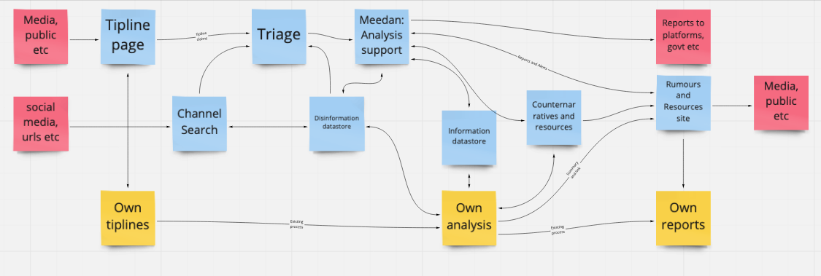
System recommendations
Tagging needs and groups with AMITT labels
Building collaboration mechanisms to reduce lost tips and repeated collection
Designing for future potential surges
Automating repetitive jobs to reduce load on humans
Notes:
Extra important that cross-group interfaces are efficient

Slide 35
Practice Time: Short country summaries

Slide 36
Republic of Moldova / Medical / Coordinator
Information environment
General
Languages: official language is Romanian. Other languages include Russian, Gagauz, and Ukrainian.
Population of about 4 million, in South Caucasus and Western CIS region. Country code is “MD”.
Media and social media use:
The most common social media channels are Facebook, Instagram, and Odnoklassniki
The most common communication tools are TV, Viber, and Telegram
Risk environment
Disinformation channels include facebook and instagram.
Disinformation tactics include fake accounts pretending to be individuals or organisations, memes, flooding web forums, trolls manipulating online debate, “grain of truth” narratives.
Disinformation routes include translations of material from Russian to Moldovan.

Slide 37
Moldova/ Medical/ Coordinator
Response environment
Disinformation response groups include:
StopFals: disinformation watchdog.
Asociatia Presei Independente (API):
Regional: East StratCom Task Force
Response tactics include
Fact-checking - StopFals.
The “Adopt a Troll” campaign, paying individuals to expose troll factories.
The Trolless online tool for spotting inauthentic accounts. Trolless appears to have originated in a hackathon.
Other organisations that could be helpful to infodemic response in Moldova include:
Watchdog.md: Moldovan organisation that covers research and public policy.
DFRlab has investigated disinformation in Moldova.
Facebook took down a set of facebook and instagram accounts in Feb 2019.
Development organisations’ country offices: these include WHO and UNICEF.

Slide 38
Moldova/ Medical / Coordinator
Covid19 Specific
Covid19 narratives seen in Moldova include:
Deaths from other causes are being registered as Covid19 - StopFals
Masks are toxic (made from hazardous waste, cause sideeffects etc) - StopFals
Masks contain worms – StopFals
President refusing to be vaccinated; president was secretly vaccinated in January - StopFals
EU considering Sputnik vaccines - StopFals
Doctors refusing to be vaccinated – StopFals
Coronavirus is a bacterium - StopFals
Background reading
Moldova is covered in the OII case studies for 2019 and 2020.
https://datareportal.com/digital-in-moldova
OII case study 2019
OII case study 2020

Slide 39
Let’s do this
https://docs.google.com/document/d/1bg0rK94s4KWgP5UFpEgOUmMsvd-eLA9oex-04gfQppE/edit#
Sources:
Background
facebook/twitter/mobile use: Datareportal.com
Reuters digital news report
Languages: wikipedia “languages in <countryname>”
Mis/disinformation:
Disinformation incidents: OII 2020
Sites: Mediabiasfactcheck
Active responders: AMITT lists of groups and tools and map
Larger groups: DFRlab, EuVsDisinfo
Google search
Questionsets:
AMITTs: Red and Blue
Assessment questions: Cognitive Security ecosystem assessment
Notes:
Also Ryerson dashboard, google search for disinfo + country.

