Slide 1
Week 7 Class 2:
Responses
INST408C: Cognitive Security | Fall 2021 | SJ Terp

Slide 2
INST408C Week 7
Monday
Responses
Wednesday
Responses
Readings
Assignments
Notes:
Links:

Slide 3

Response
what do we do now?

Slide 4
Response
Responders
Responder types
Building response communities
types of misinformation and disinformation response groups that exist
types of responses that they can and do implement.
how to share information between responding groups.
Responses
Message-based responses: countermessaging, prebunking, debunking
Action-based responses
First, do no harm

Slide 5
Responders

Slide 6
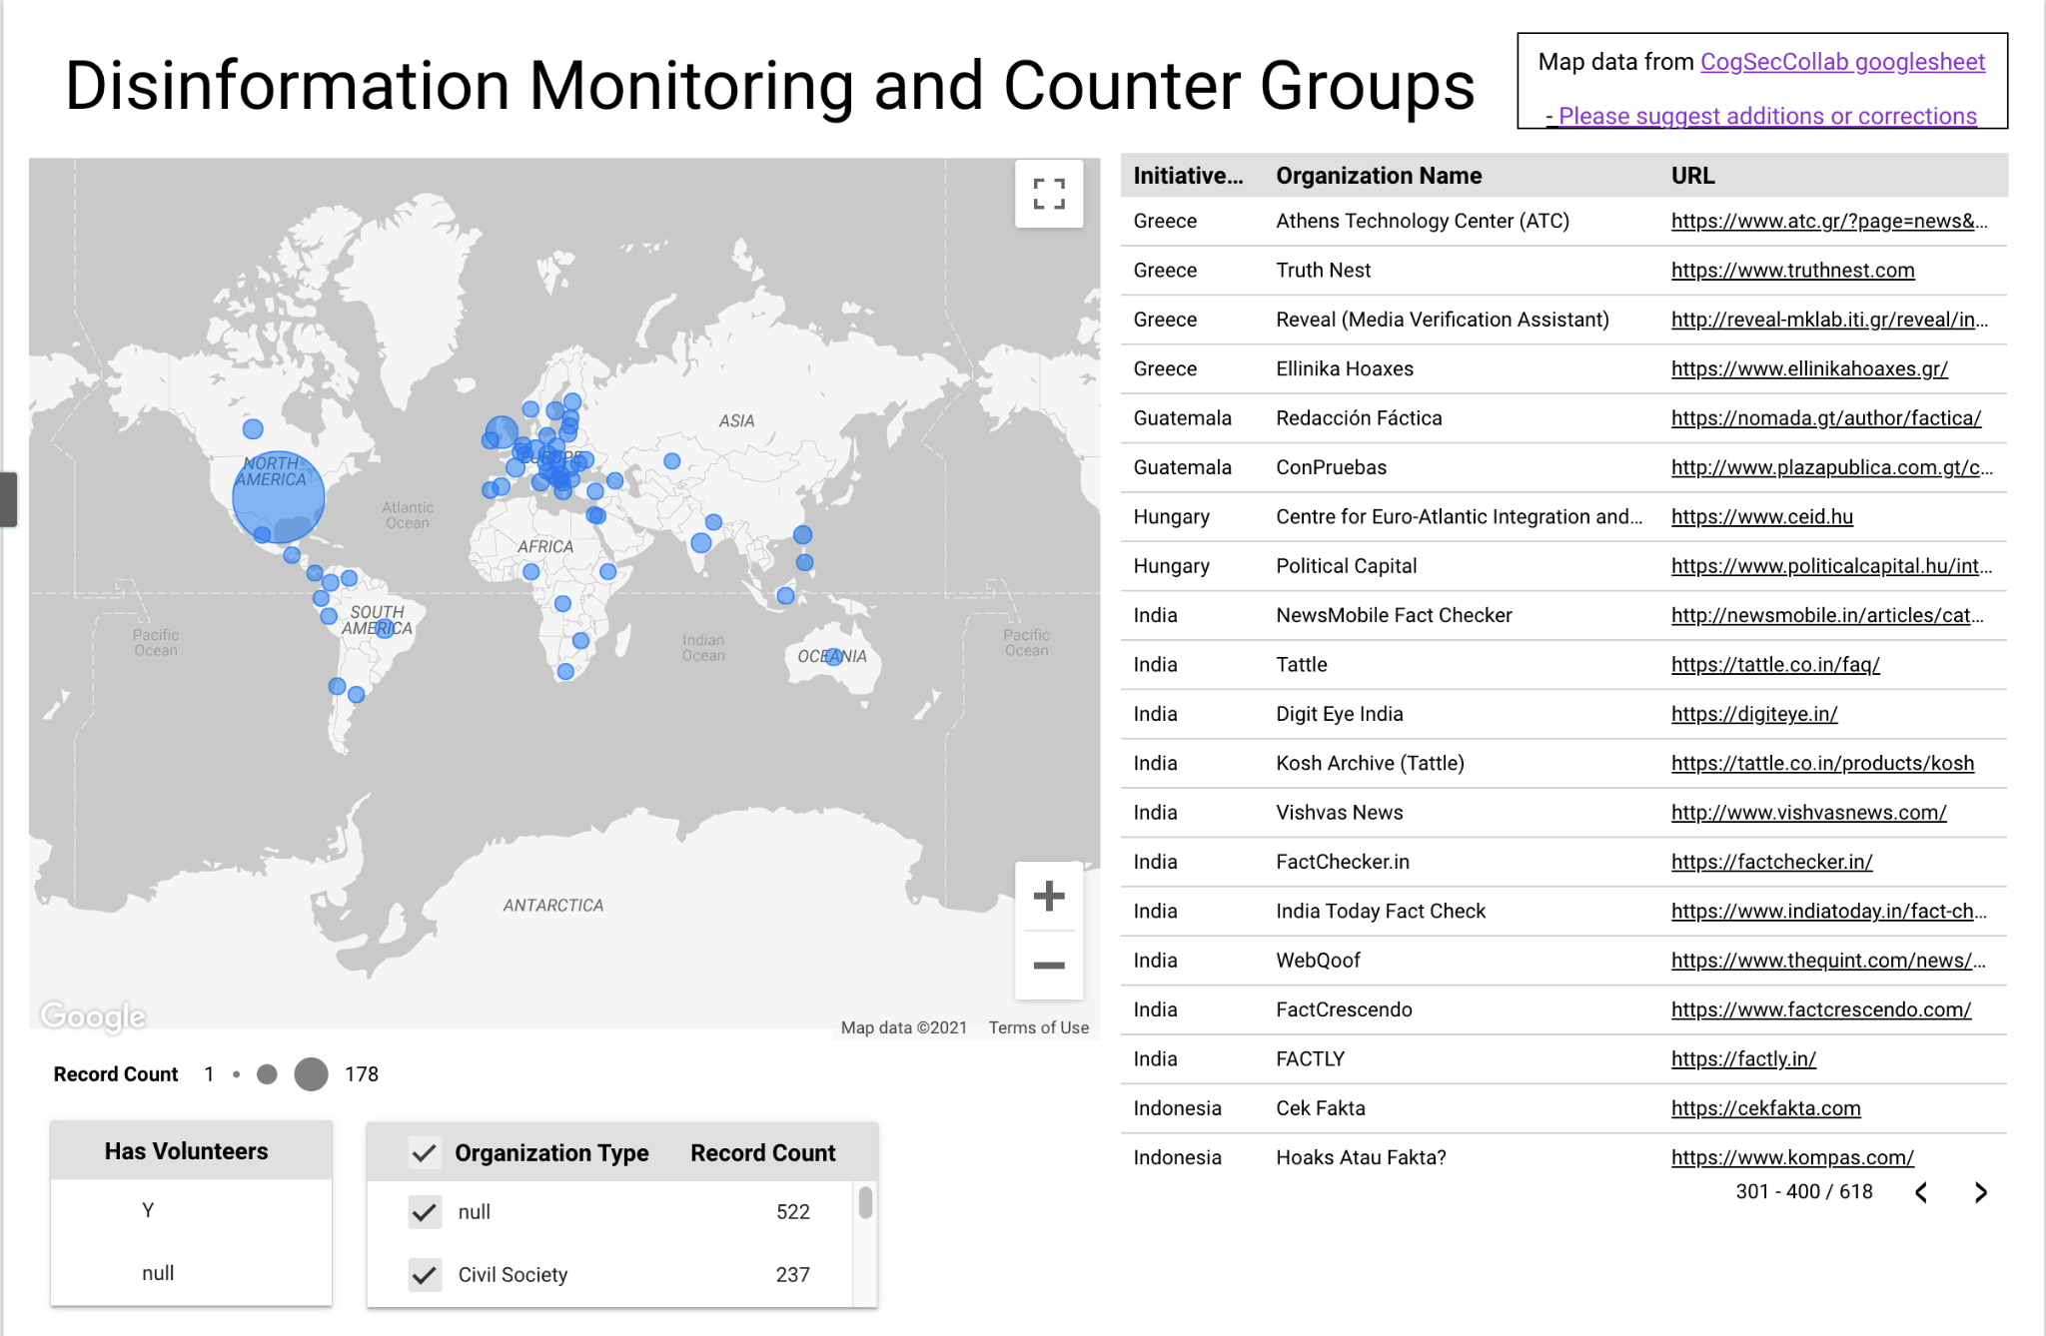
Responder Types
Government/ LE
Platform
Corporation
Media
Educator
Nonprofit
General Public
Community group
Influencer
Notes:
S: Mostly, when people think about cognitive security, they look at platforms, public and government as responders. But as we catalogued counters, we found many types of people, resources and groups who could help, with varying skills, availability, limitations, and resources.

Slide 7
Capabilities and limits
Experience
Existing processes
Access to knowledge
Access to communities
Connections
Place in disaster cycle
Mitigation
Preparation
Response
Recovery
Size / funding
Training
Data storage/use
Type of response (so much fact checking)
Focus (women, media etc)
Legal restrictions
Notes:
At the risk of writing a bunch of SWOT charts…

Slide 8
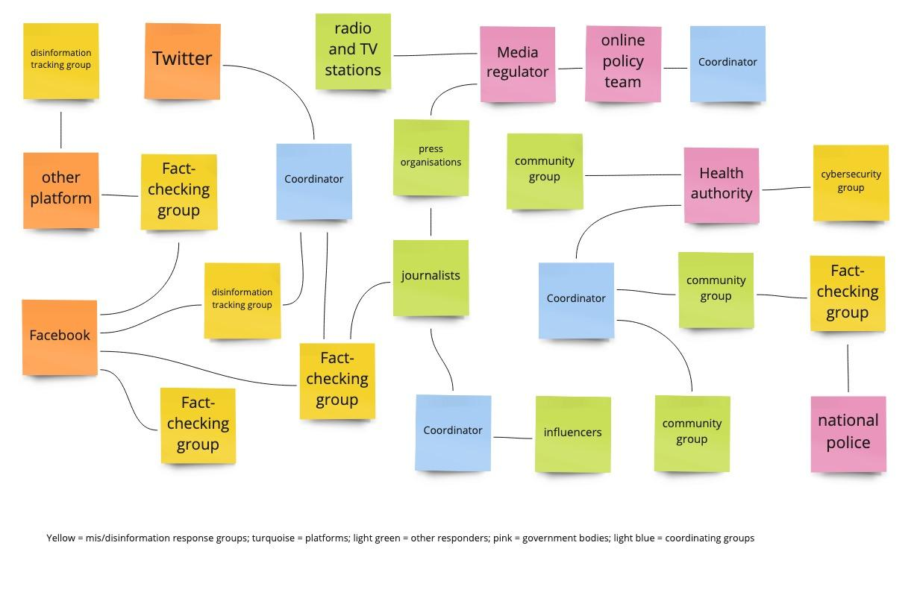
Typical configuration

Slide 9
Responder behaviours

Slide 10
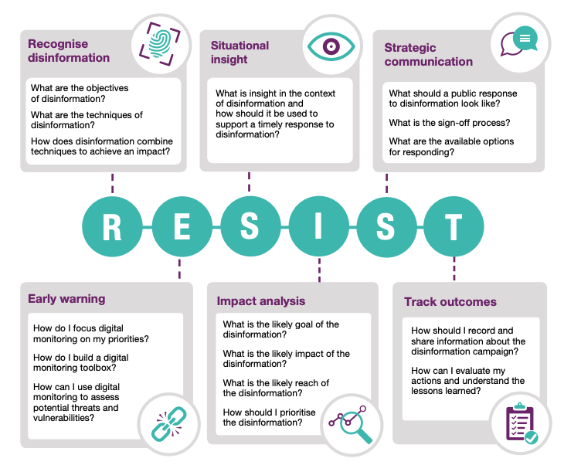
RESIST Framework

Slide 11
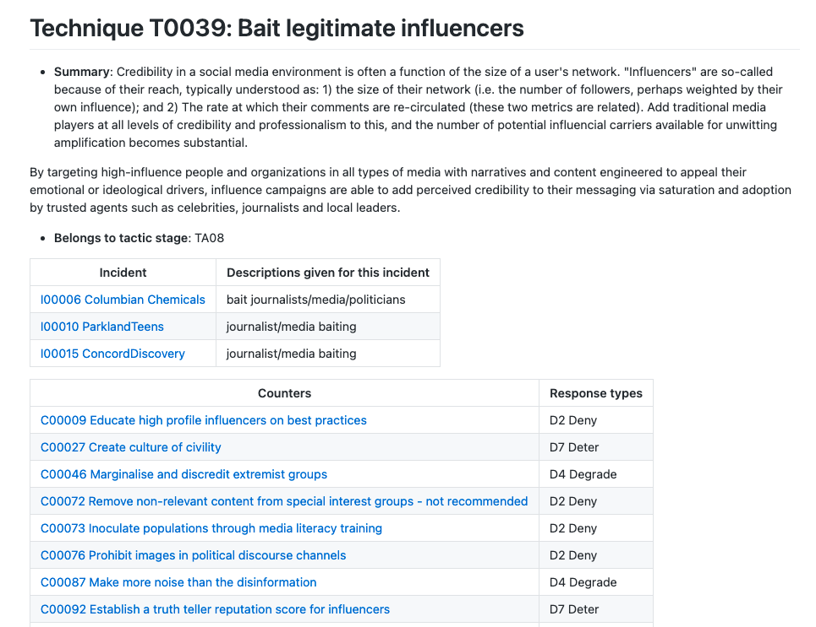
AMITT Blue - the counters in the framework

Slide 12







Intelligence community: Countermeasure categories
DESTROY
DETER
DENY
DETECT
DECEIVE
DISRUPT
DEGRADE
Notes:
Those JP 3-13 descriptions:
Destroy: damage a system or entity so badly that it cannot perform any function or be restored to a usable condition without being entirely rebuilt.
Deter: discourage. We added Deter to the list as a potentially useful category too.
Deny: prevent the adversary from accessing and using critical information, systems, and services.
Deceive: cause a person to believe what is not true. military deception seeks to mislead adversary decision makers by manipulating their perception of reality.
Disrupt: break or interrupt the flow of information.
Degrade: reduce the effectiveness or efficiency of adversary command and control or communications systems, and information collection efforts or means.
(Detect: discover or discern the existence, presence, or fact of an intrusion into information systems. We included Detect because that’s what everyone was doing - looking, not reacting, and we wanted them to get that out of their systems.)
See JP 3-0:

Slide 13
AMITT Blue: Countermeasures Framework
Planning
Preparation
Execution
Evaluation
Strategic Planning
Objective Planning
Develop People
Develop Networks
Microtargeting
Develop Content
Channel Selection
Pump Priming
Exposure
Go Physical
Persistence
Measure Effectiveness
Have a disinformation response plan
Media literacy through games
Find and train influencers
Remove old and unused accounts
Fill information voids
Hijack content and link to information
Rate-limit engagement
Microtarget likely targets with counter messages
Prebunking
DMCA takedown requests
Poison monitoring and evaluation data
Improve stakeholder coordination
Tabletop simulations
Counter-social engineering training
Unravel Potemkin villages
Stem flow of advertising money
Honeypot social community
Redirect searches away from disinfo
Train journalists to counter influence moves
Humorous counter narratives
Spam domestic actors with lawsuits
Bomb link shorteners with calls
Make civil society more vibrant
Make information provenance available
Ban incident actors from funding sites
Verify project before posting fund requests
Buy more advertising than disinformation creators
Corporate research funding full disclosure
Honeypot: fake engagement system
Tool transparency and literacy in followed channels
Mark content with ridicule / decelerants
Seize and analyse botnet servers
Add random links to network graphs
Red team disinformation, design mitigations
Block access to disinformation resources
Address truth in narratives
Encourage people to leave social media
Reduce political targeting
Real-time updates to factcheck database
Bot to engage and distract trolls
Ask media not to report false info
Expire social media likes/ retweets
Enhanced privacy regulation for social media
Educate influencers
Marginalise and discredit extremist groups
Deplatform message groups and boards
Co-opt disinformation hashtags
Remove non-relevant content from special interest groups
Strengthen verification methods
Repurpose images with counter messages
Influencer disavows misinfo
Platform regulation
Buy out troll farm employees / offer jobs
Ensure platforms are taking down accounts
Stop offering press credentials to disinformation outlets
Mentorship: elders, youth, credit
Content moderation
Verified ids to comment or contribute to poll
Engage payload and debunk
Cut off banking access
Shared fact checking database
Legal action against for-profit engagement farms
Name and shame disinformation influencers
Free open library sources
Prohibit images in political Chanels
Revoke whitelist / verified status
Debunk/ defuse fake expert credentials
Dampen emotional reaction
Repair broken social connections
Develop compelling counter narratives
Denigrate funding recipient / project
Social media source removal
Add metadata to original content
Don’t engage with payloads
Remove / rate limit botnets
Pre-emptive action against disinformation team infrastructure
Run competing campaigns
Infiltrate in-groups
Infiltrate disinformation platforms
Add warning labels on sharing
Hashtag jacking
Social media amber alert
Etc
Etc
Etc
Etc
Etc
Etc
Etc
Notes:
This is the AMITT Blue framework: it contains 160 countermoves to the campaign and incident techniques that we analysed with AMITT Red. We used information operations frameworks to create this, specifically the classifications Deny, Disrupt:, Degrade, Deceive:, Destroy, and Deter - for each tactic stage and Red technique.
We’ve partnered with counter-disinformation groups like RealityTeam.org who use targeted counter messaging and metrics to push away disinformation narratives. And we’re currently cleaning this matrix up.

Slide 14
Mitigations

Slide 15
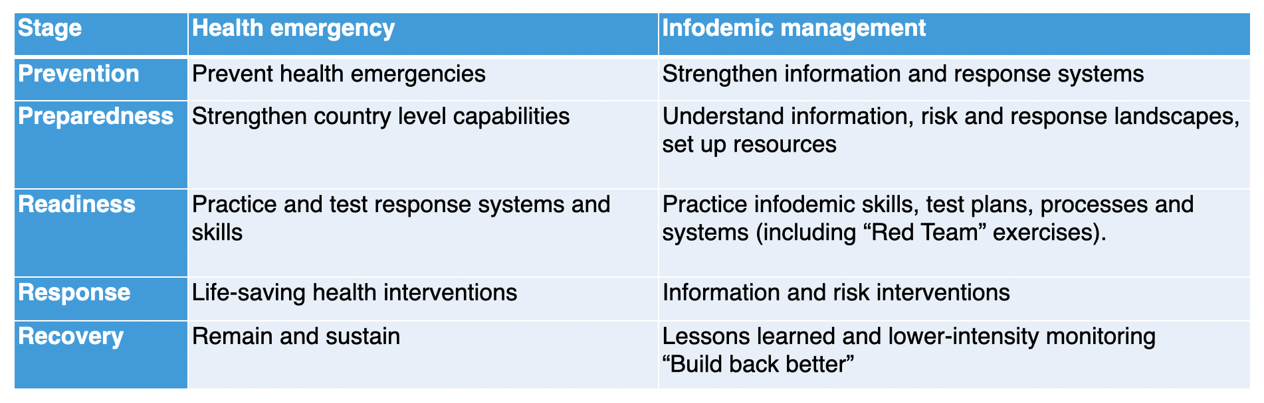
Acting at all crisis stages

Slide 16
Mitigations
Training
General public
Influencers
E.g. Media
responders
Landscape improvement
Removing spoof accounts
Muting superspreaders
Reducing repeat rates
Improving positive influencer effectiveness
Notes:
E.g. WhatsApp reducing number of forwards per hour

Slide 17
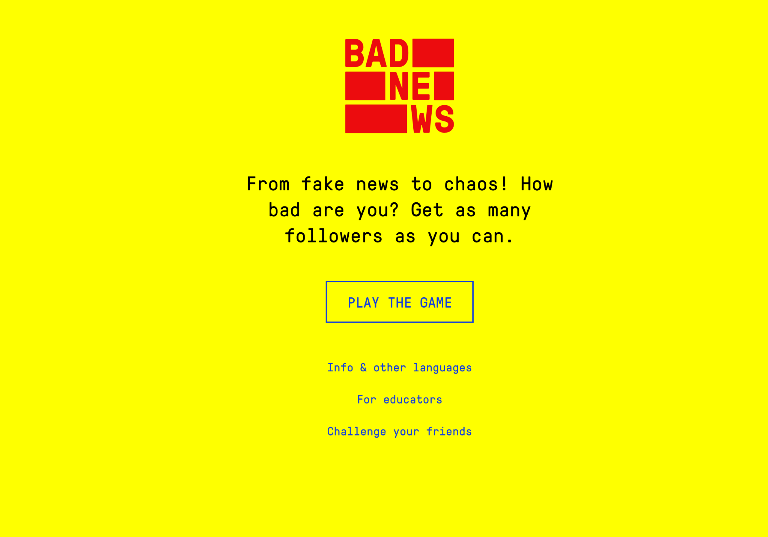
Training

Slide 18
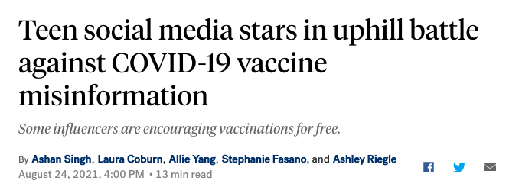
Improve the information/influence environment
Notes:
Report, remove, re-route disinformation isn’t enough. Change the influence space, and build influence capacity in it. Indian aunties. Barbershops. Etc. Train influencers. Meet with response communities, so nobody’s learning about each other as an incident hits. Listen to communities about what they need and how.
Counters information overload
https://www.demdigest.org/a-better-way-to-counter-astroturfing-disinformation-technology-and-democracy-in-transition/

Slide 19
Policies
Platform, Search Engine etc policies
Government policies

Slide 20
Communication-based responses

Slide 21
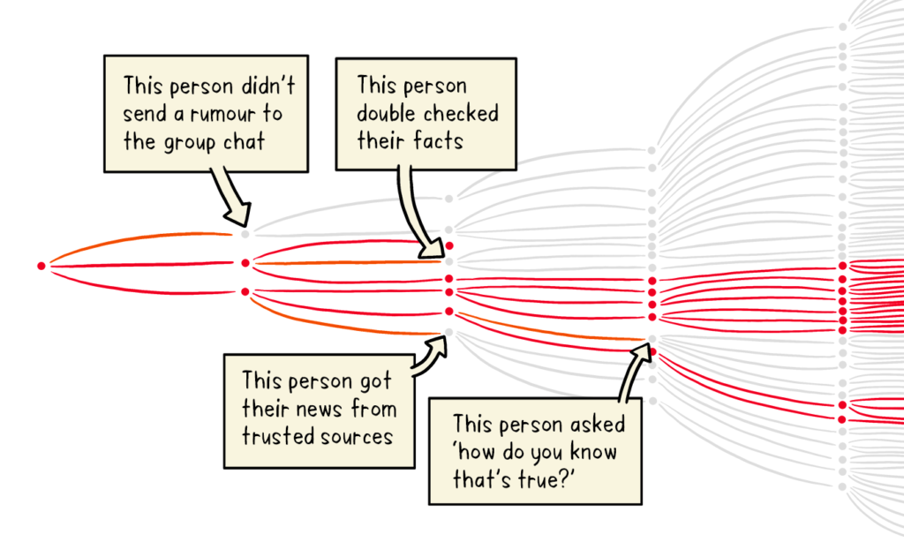
Before a rumour happens: Pre-bunking
Notes:
Prebunking: owning the narrative space before an anticipated narrative becomes widespread. One of the simplest ways to do this is train people on what influence looks like, using training or games.
Truth sandwich: truth, lie, truth
https://firstdraftnews.org/articles/a-guide-to-prebunking-a-promising-way-to-inoculate-against-misinformation/
Image: WHO
Includes playing “Go Viral!”
Counters familiarity backfire

Slide 22

Pre-bunking: types, tips
“fact-based: correcting a specific false claim or narrative
logic-based: explaining tactics used to manipulate
source-based: pointing out bad sources of information”
FirstDraft
Notes:
Image: First draft

Slide 23
Disrupt the narratives: Countermessaging
Notes:
Counters illusory truth bias

Slide 24
Mentioning it: Lakoff’s Truth Sandwich
1 Start with the truth. The first frame gets the advantage.
2 Indicate the lie. Avoid amplifying the specific language, if possible.
3 Return to the truth. Always repeat truths more than lies.
Example: “Never drink bleach. You may have heard that bleach can kill the coronavirus, but this only works on surfaces — not inside your body. Drinking bleach can cause serious illness and death, and it doesn’t cure COVID-19.” - CommunicateHealth
Notes:
https://medium.com/wehearthealthliteracy/the-truth-sandwich-a-better-way-to-mythbust-8021d2cf8730

Slide 25
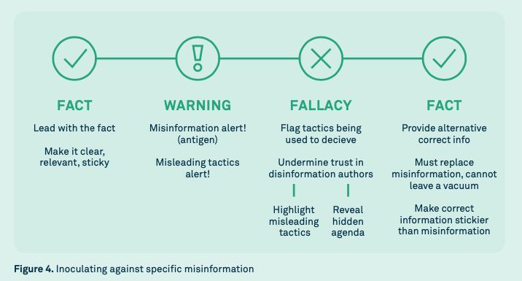
UNICEF truth sandwich
Notes:
Image: UNICEF vaccine misinformation field guide

Slide 26
Engaging: Dennett’s 4 points
1. Attempt to re-express your target’s position so clearly, vividly and fairly that your target says: “Thanks, I wish I’d thought of putting it that way.”
2. List any points of agreement (especially if they are not matters of general or widespread agreement).
3. Mention anything you have learned from your target.
4. Only then are you permitted to say so much as a word of rebuttal or criticism.
Notes:
https://techindc.com/confirmation-bias/3063/
Counters confirmation bias

Slide 27
Environment-based responses

Slide 28
Environment responses
Account / message removal
Rate limiting / soft blocking
Search engine changes (e.g. TikTok, Google etc)
Hashtag flooding / jacking (kPop etc)
Honeypots
Domain white/blacklisting
Rebuilding communities / connections
Expire ability to “like” / reshare

Slide 29
Action-based responses

Slide 30
Disrupt the chain
DESTROY
DETER
DENY
DETECT
DECEIVE
DISRUPT
DEGRADE
Notes:
Those JP 3-13 descriptions:
Destroy: damage a system or entity so badly that it cannot perform any function or be restored to a usable condition without being entirely rebuilt.
Deter: discourage. We added Deter to the list as a potentially useful category too.
Deny: prevent the adversary from accessing and using critical information, systems, and services.
Deceive: cause a person to believe what is not true. military deception seeks to mislead adversary decision makers by manipulating their perception of reality.
Disrupt: break or interrupt the flow of information.
Degrade: reduce the effectiveness or efficiency of adversary command and control or communications systems, and information collection efforts or means.
(Detect: discover or discern the existence, presence, or fact of an intrusion into information systems. We included Detect because that’s what everyone was doing - looking, not reacting, and we wanted them to get that out of their systems.)
See JP 3-0:

Slide 31
e.g.
Remove troll farm ability to act
Cut off banking access
Seize botnet servers
Lawsuits
etc

