Slide 1
Week 8 class 1: setting up investigations - getting started
INST408C: Cognitive Security | Fall 2021 | SJ Terp

Slide 2
INST408C Week 8
Monday
Setting up investigations: getting started
Wednesday
Setting up investigations: getting data
Readings
Assignments
Notes:
Links:

Slide 3
My toolset: data gathering and storage
Data gathering
Crowdtangle
Tineye / Yandex
Hypothes.is
Maltego
Profil3r
CheckUserNames
Hootsuite
Data storage and sharing
CSVs
STIX / TAXII
Archive.org
Analysis
Jupyter notebooks
Python libraries
(Pandas)
Gephi
AMITT Navigator
inVid
BuiltWith
Information sharing
MISP
Ticketing system
Googledocs
Spreadsheets
Response
Googledocs & spreadsheets
Notes:
Ticketing system, e.g. Jira
A good place to start is First Draft’s list of tools: https://start.me/p/vjv80b/first-draft-basic-toolkit

Slide 4
Start an investigation
Your things-to-do list

Slide 5
Start an investigation
Estimate your available resources
People, processes, technology, culture
Plan
Write a response summary
Describe and bound what you’re doing
If you have a list of incidents / investigations, add this to it.
Start situation assessment
Gather principal artefacts
Gather datasets

Slide 6
Plan
(state what you’re doing)

Slide 7
Estimate available resources
People
Availability
Training
Connections
Processes
Coordination
Technology
Toolset
Limitations
Culture
Team safety measures

Slide 8
Describe - and bound - what you’re doing
One page
Basics
Which topic/ event
Which geographical areas
Which communities
Which languages
Which channels
Who needs / can act on this
Starting point
What started this investigation? E.g. An area? An artifact? An anticipated need?

Slide 9
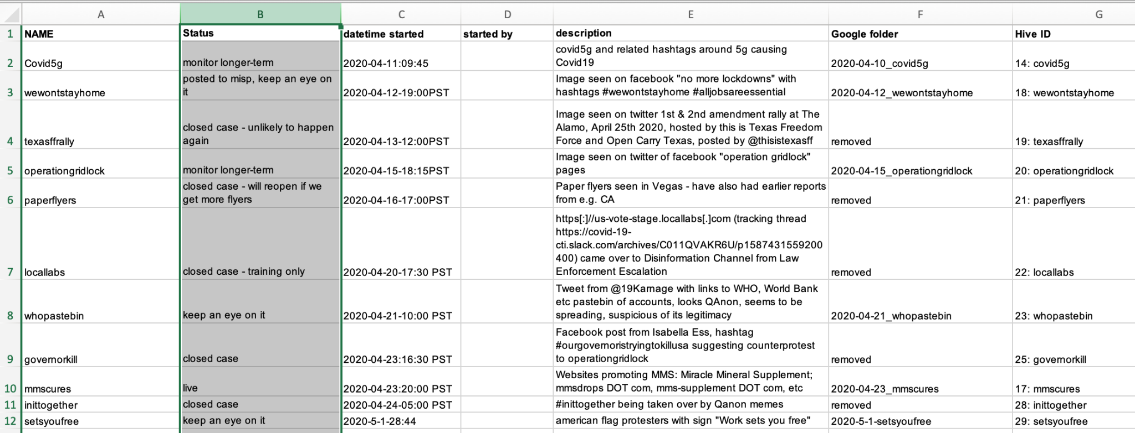
Incident log - simple
Notes:
Other options are a ticketing system (e.g. Jira etc)

Slide 10
Start some lists
(these will help guide you)

Slide 11
Start data analysis
Retrieve or create some lists
Narratives list
Search terms list
For this area
This/these communities
This/these languages
This topic
Social media reach analysis on influencers
Use google search as input on what people are looking for
Try those searches yourself
Use channels list to gather data. Use:
APIs
Web scrapes
By hand
Analyse data for new:
Search terms
Topics / concerns
Influencers
Incidents

Slide 12
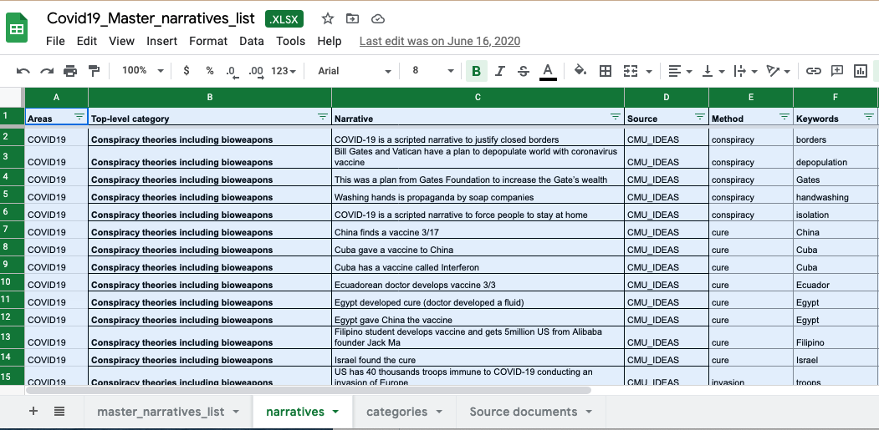
Narratives list

Slide 13
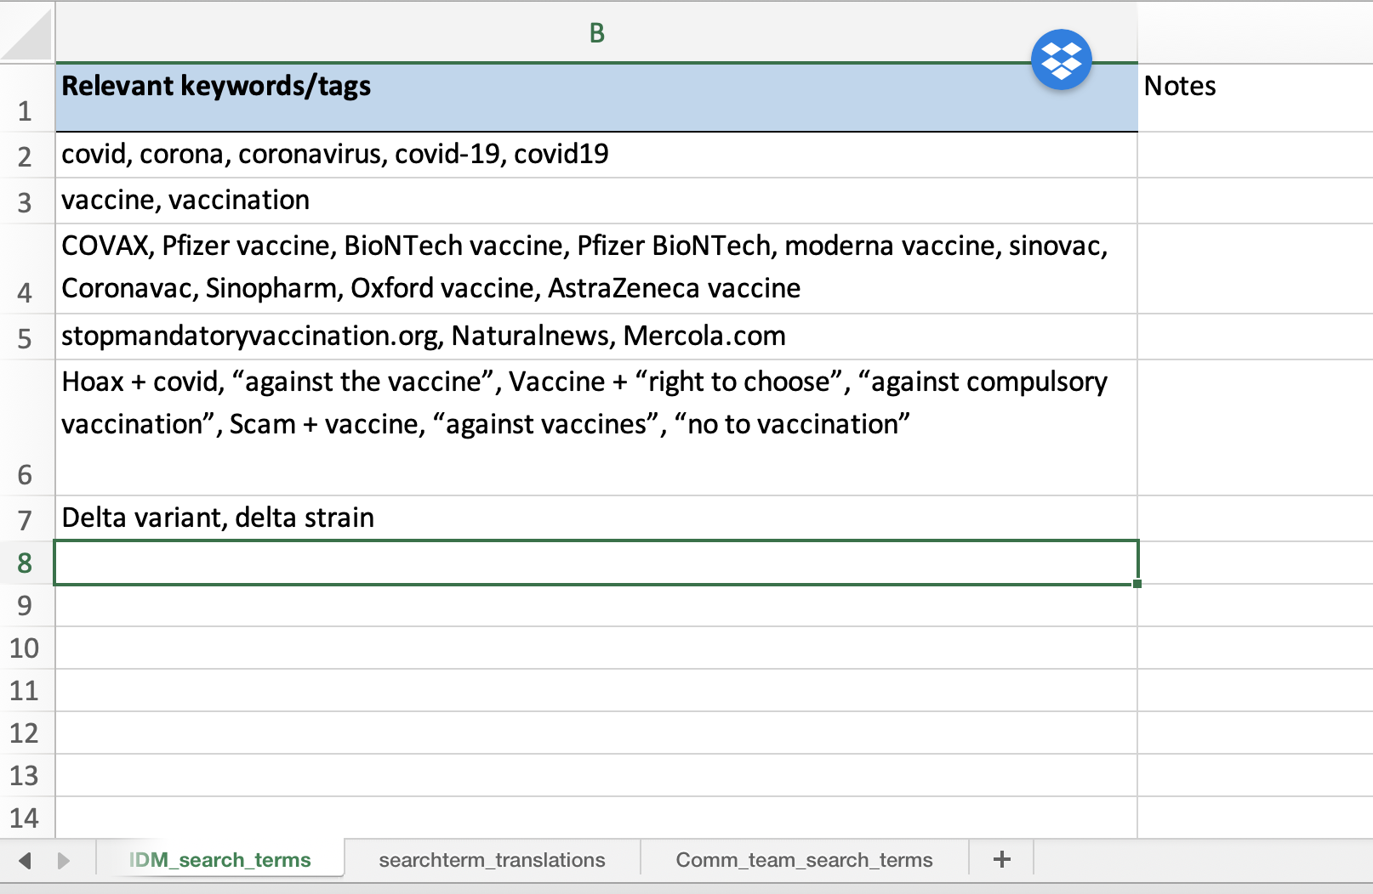
Search terms list

Slide 14
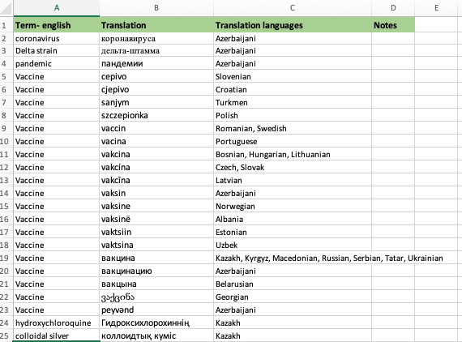
Search Term Translations

Slide 15
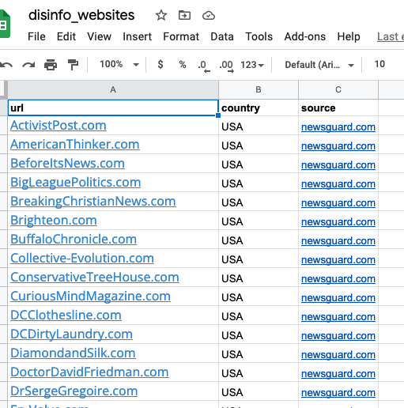
Domains list

Slide 16
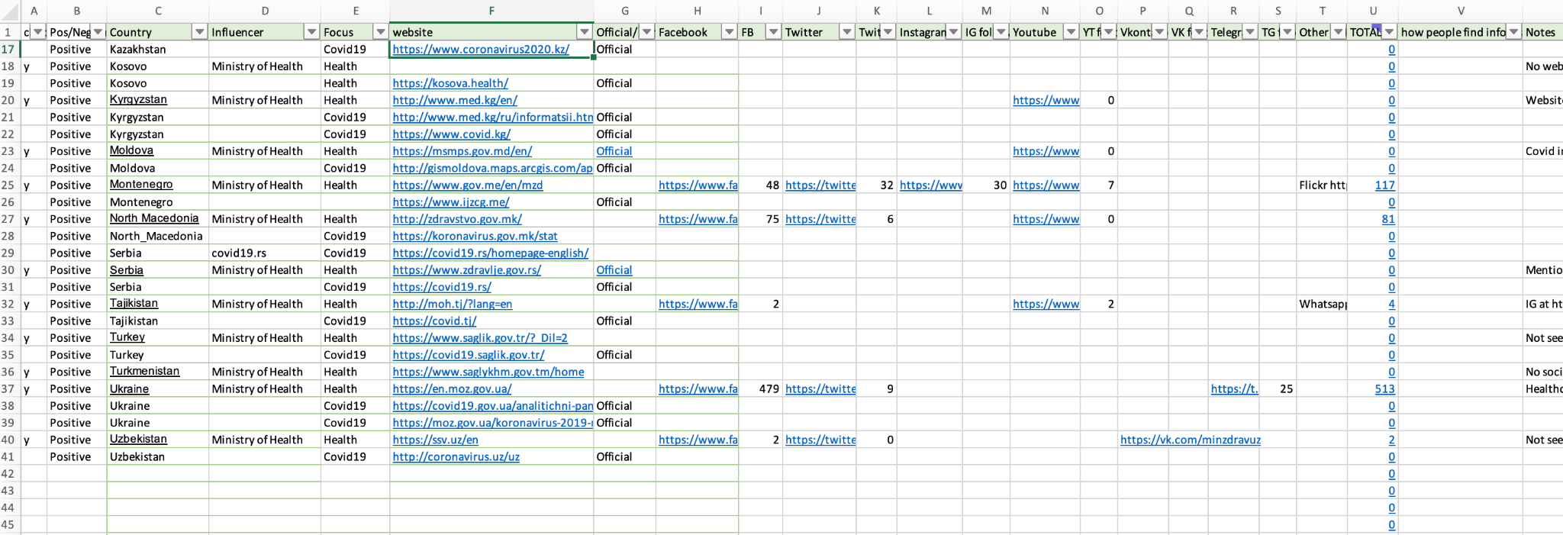
Influencers list

Slide 17
Datasources list
Looking for | data source
Twitter posts | Twitter search Twitter covid19 dataset QCRI covid dataset
Websites | google alerts HealthGuard (misinformation list) Ryerson Uni labelled list of websites
Online searches | Google Trends (people’s searches)
Telegram posts | TGStat
Gab, Parler, 4chan, 8kun, poal, telegram, getter, bitchute posts | Social Media Analysis Toolkit (SMAT)
covid19 misinformation narratives | wikipedia list of covid19 rumours WHO covid19 myths list CMU ideas list of covid19 misinformation narratives Ryerson university Covid19 misinformation portal
Covid19 misinformation automation, spread | Ryerson university Covid19 misinformation portal
Media and news artlcles | GDELT Radio Garden

Slide 18
Gather data
(many ways to do this…)

Slide 19
Start data analysis
Retrieve or create some lists
Narratives list
Search terms list
For this area
This/these communities
This/these languages
This topic
Social media reach analysis on influencers
Use google search as input on what people are looking for
Try those searches yourself
Use channels list to gather data. Use:
APIs
Web scrapes
By hand
Analyse data for new:
Search terms
Topics / concerns
Influencers
Incidents

Slide 20
SAFETY!
Set up social media accounts for investigations.
NOT your personal accounts
“fbclid=” will happen
Some platforms (linkedin etc) will show who’s looking
You’ll need accounts to get into closed platforms / groups

Slide 21
Text data formats
CSV: your all-purpose, most apps can process this, format
Excel: yeah, people will give you these. Use pd.read_excel()
Json: the one with the curly brackets
Xml: the one with the angle brackets

Slide 22
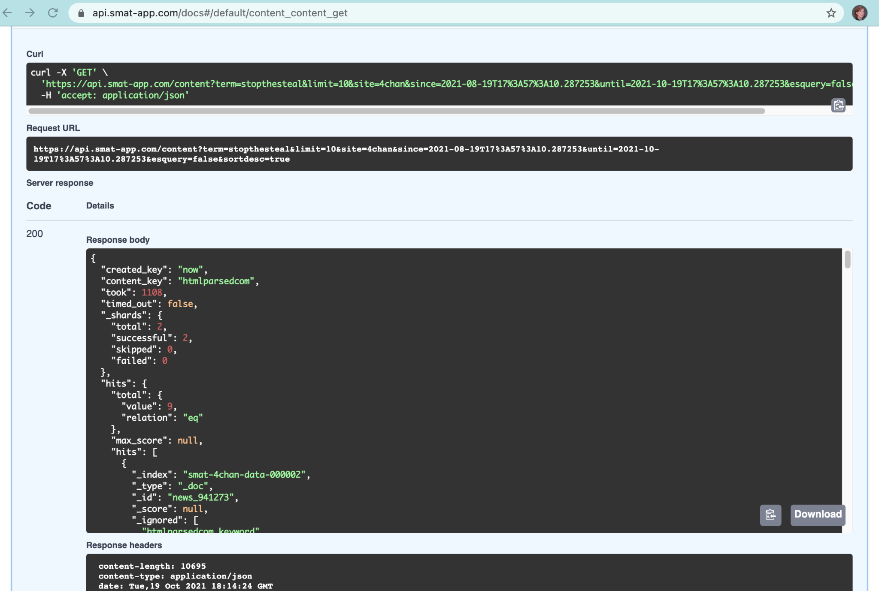
Json
Notes:
SMAT output from search on 4chan for stopthesteal
SMAT api: https://blog.smat-app.com/p/api-advice

Slide 23
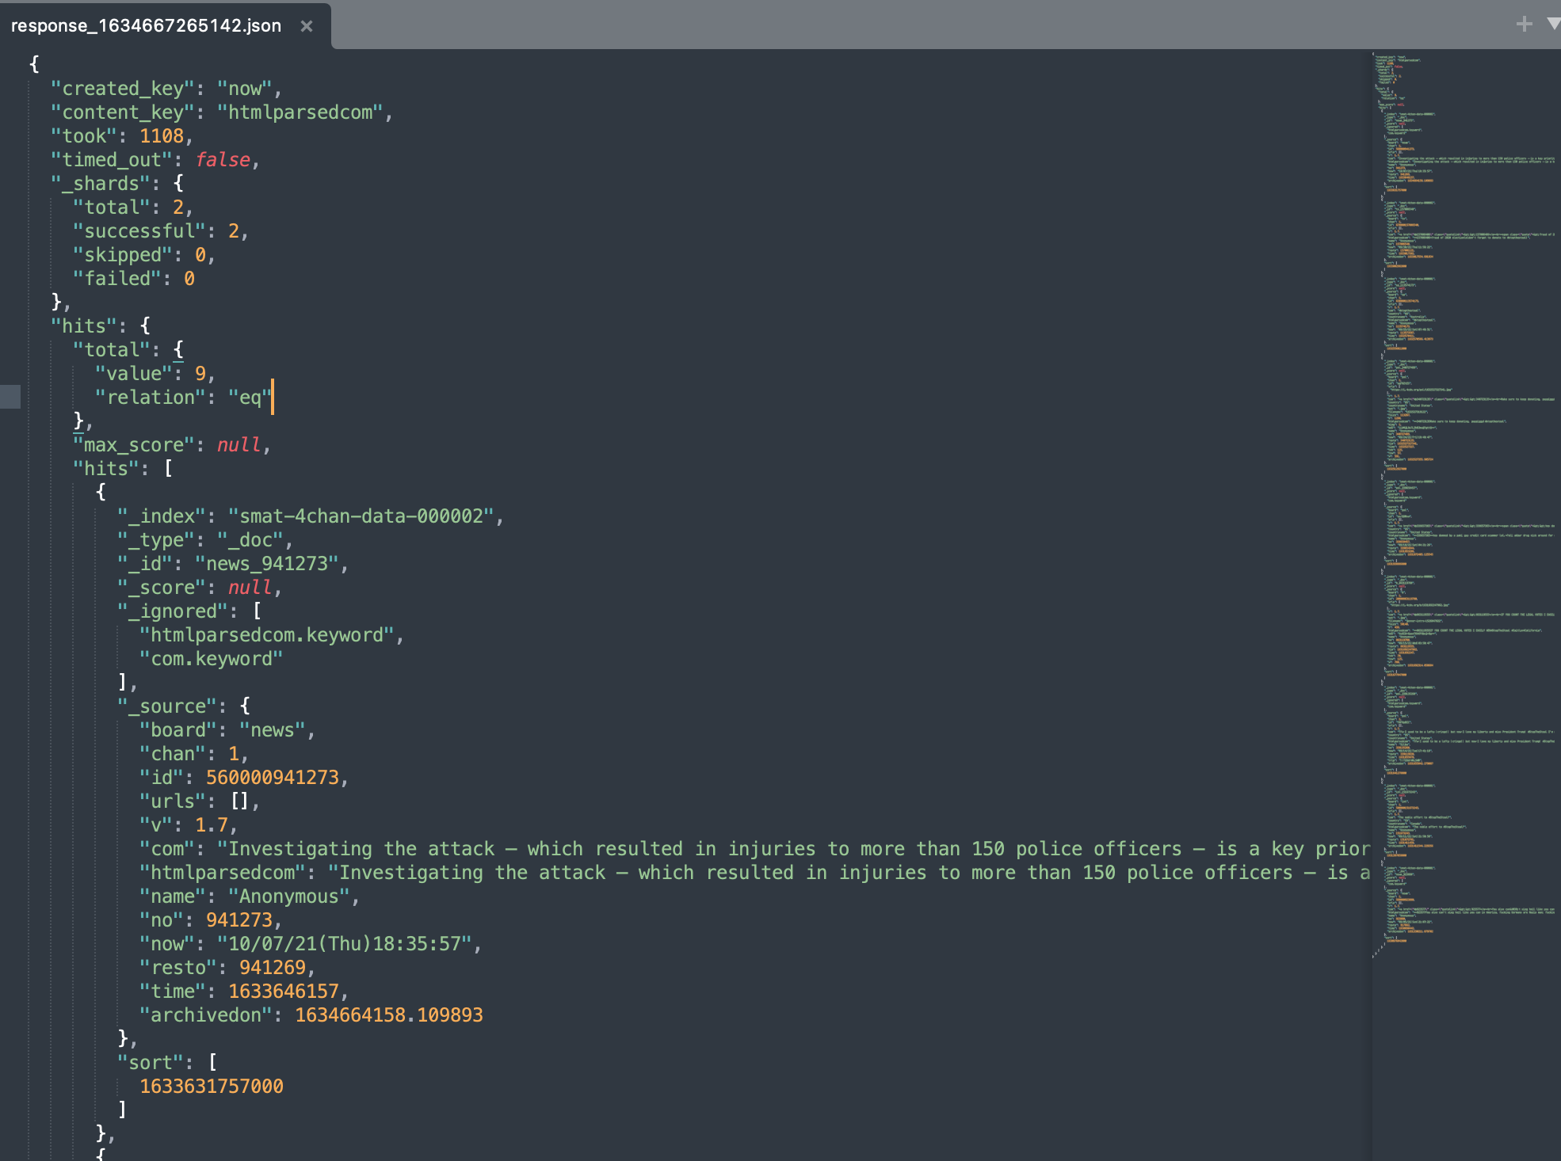
Json

Slide 24
Json
import json
with open(jsonfile, "r") as read_file:
jsondata = json.load(read_file)
smatdata =
import pandas as pd
df = pd.read_json(jsonfile)
# This specific example: nested json inside a larger json file
dfdata = pd.json_normalize(jsondata['hits']['hits'])
Notes:
Useful libraries and functions:
Json: load, loads
Pandas: read_json, json_normalize
Links
https://pandas.pydata.org/pandas-docs/version/1.1.3/reference/api/pandas.read_json.html

Slide 25
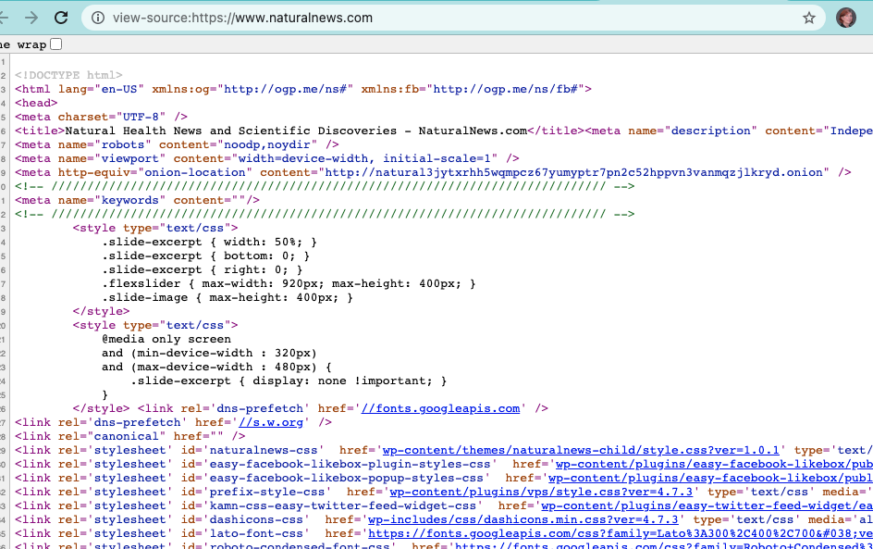
Xml
Notes:
Links:
* https://blog.hubspot.com/website/what-is-xml-file

Slide 26
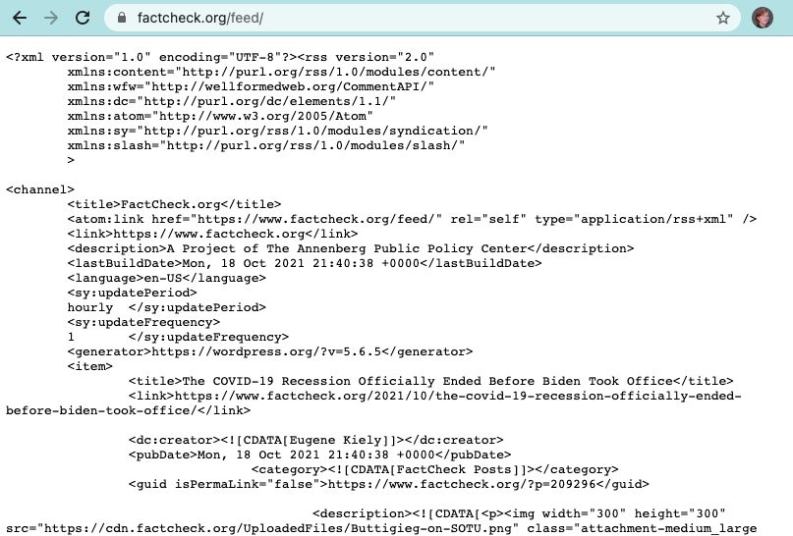
Xml

Slide 27
Xml
Will get to this one…
Notes:
Links
https://practicaldatascience.co.uk/data-science/how-to-read-an-rss-feed-in-python

Slide 28
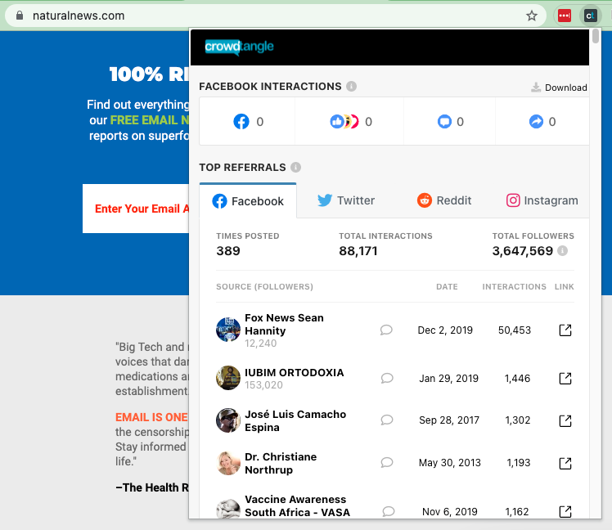
CSV

Slide 29
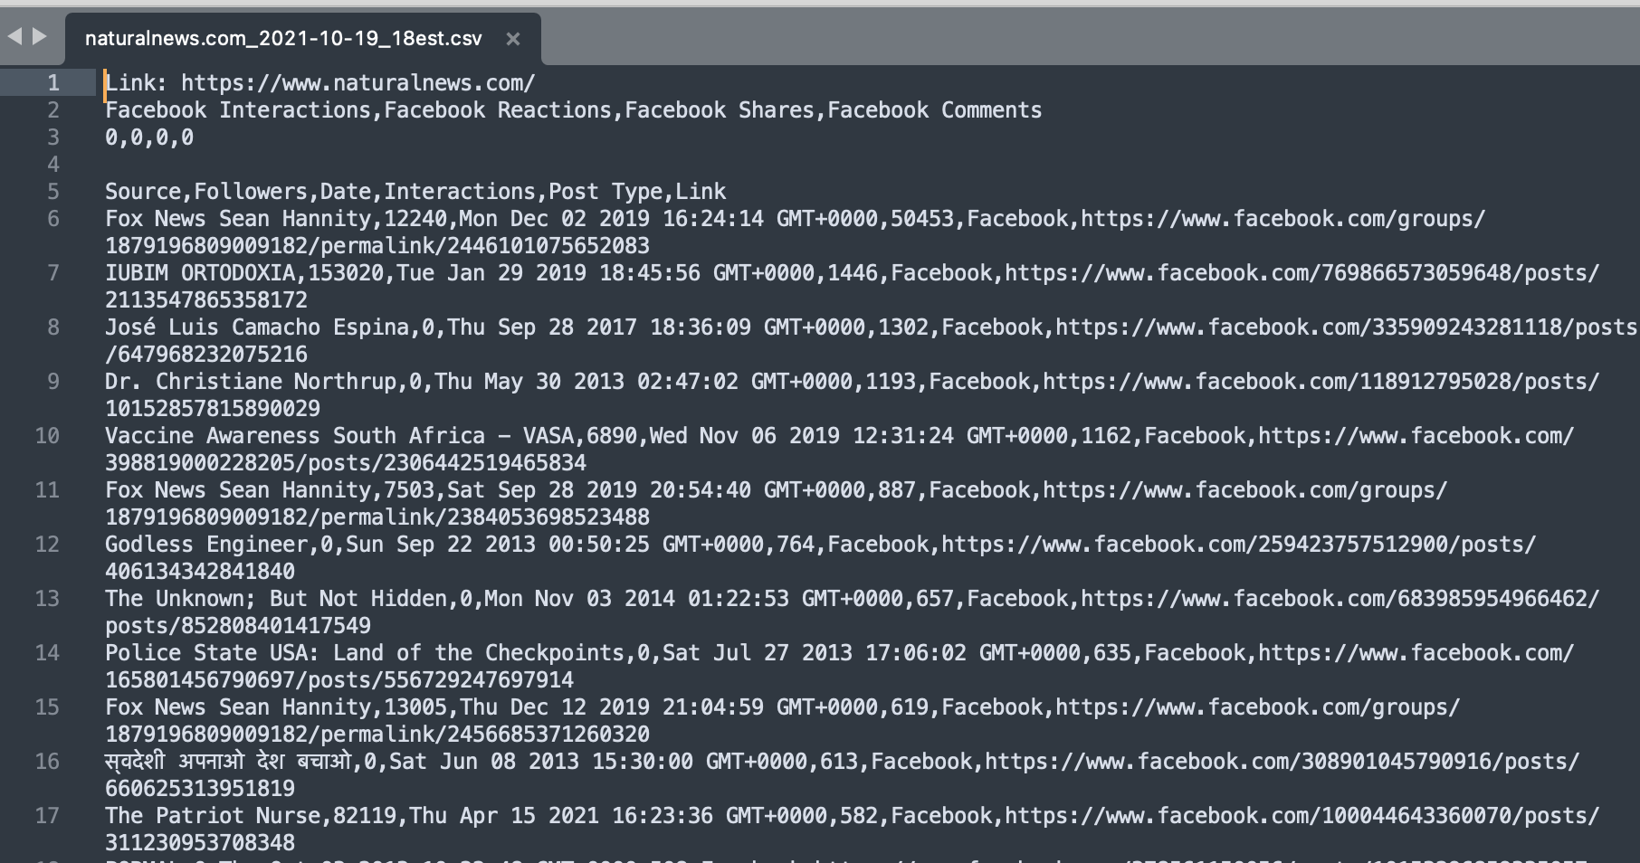
CSV
Notes:
File downloaded from CrowdTangle extension.
Notice all the junk at the top

Slide 30
Github - the gentle introduction
Most of the time it’s going to be “git clone <repoaddress>” from the terminal window
Github desktop takes away a lot of the pain
Notes:
Links
https://guides.github.com/activities/hello-world/
https://docs.github.com/en/desktop/installing-and-configuring-github-desktop

