Slide 1
Week 8 class 2: Getting serious about data
INST408C: Cognitive Security | Fall 2021 | SJ Terp

Slide 2
INST408C Week 8
Monday
Setting up investigations: getting started
Wednesday
Setting up investigations: getting data
Readings
Assignments
Notes:
Links:

Slide 3
Toolset
Jupyter notebook with python
Domain data collection: Builtwith, Hypothes.is
Twitter data collection
Facebook data collection (Crowdtangle, google search)
OSINT tools

Slide 4
Ways to get that sweet sweet data
OSINT
Social media summary tools
Social listening tools
Data downloads: apis, scraping, cut and paste, typing it all in
Crowdsourcing

Slide 5
OSINT
(how to find stuff through detective work)

Slide 6
OSINT: Open Source Intelligence
Open source: data and information available to the general public
Not just the surface web (findable by Google)
(Not the same as Open Source Software, which is a license thing)
Information overload is a thing
Analysis tools help you focus
Don’t start without a plan and places to put things
The web has many many interesting rabbitholes
Notes:
Links
https://www.recordedfuture.com/open-source-intelligence-definition/
https://www.recordedfuture.com/tactical-threat-intelligence/

Slide 7
Other major “INT”s
HUMINT - data from people
IMINT - data from imagery (e.g. aerial and satellite images)
SIGINT - signals interception (radio etc)
  ELINT - electronic signals (e.g. not containing speech or text)
MASINT - signature data (radiation, weather etc)
GEOINT - geospatial data (satellite/ aerial derived data, maps)
Notes:
Links:
https://en.wikipedia.org/wiki/List_of_intelligence_gathering_disciplines

Slide 8
Tool lists
6 tools and techniques (Hoaxy, Crowdtangle, dnslytics, WhoPostedWhat, Facebook Transparency)
Craig Silverman list of verification resources
Bellingcat's online investigation toolkit
Awesome OSINT

Slide 9
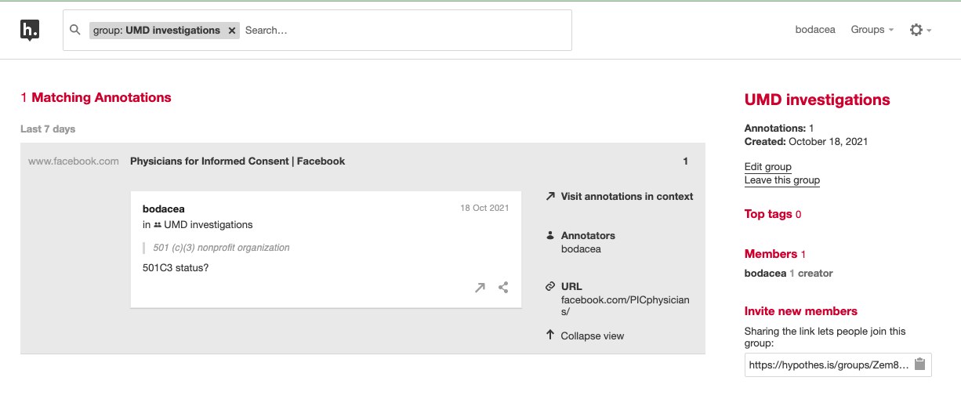
Tool: Hypothes.is
Hypothes.is
Webpage markup

Slide 10
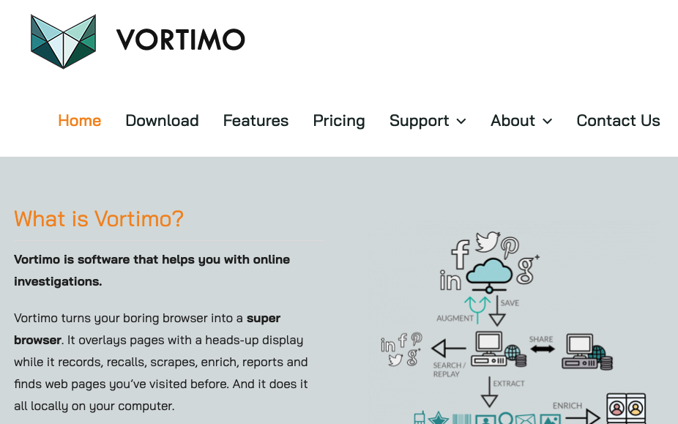
Tool: Vortimo (Vortimo.com)

Slide 11
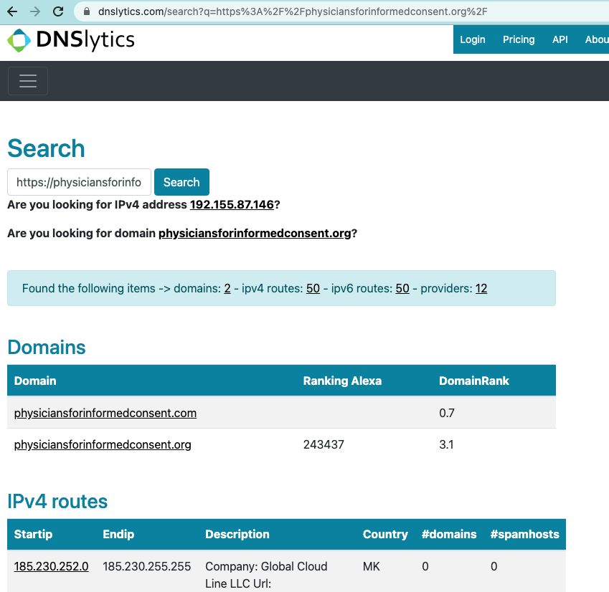
Tool Dnslytics

Slide 12
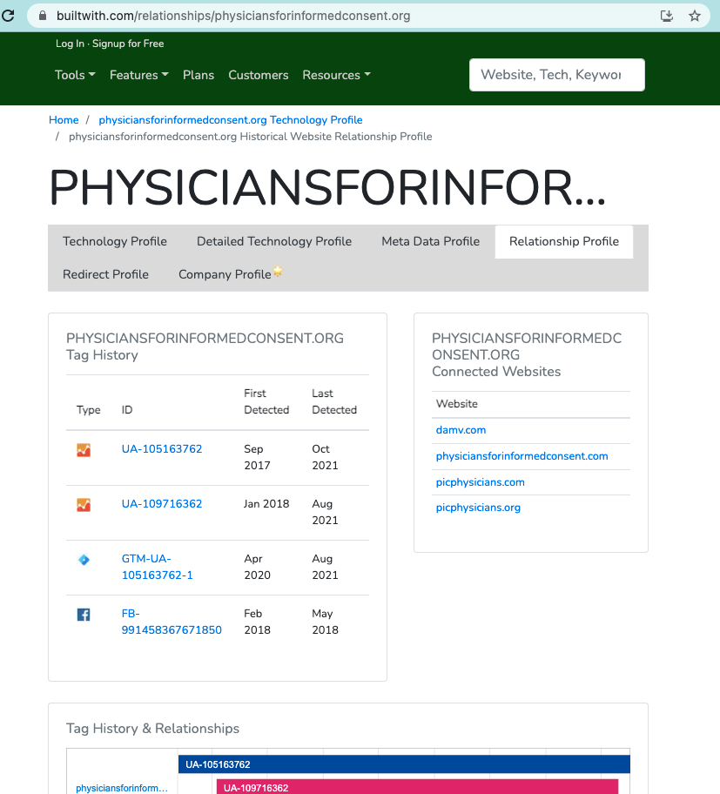
Tool: Builtwith

Slide 13
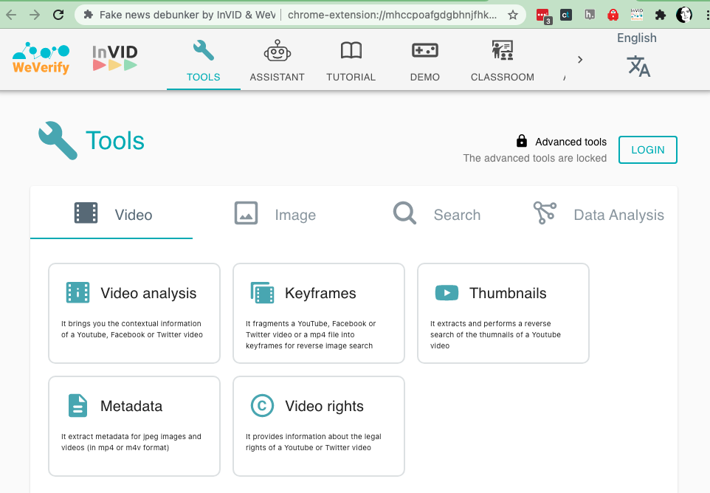
Image toola: InVid (invid-project.eu) and FotoForensics http://fotoforensics.com/
Notes:
https://www.invid-project.eu/tools-and-services/invid-verification-plugin/

Slide 14
Other Tools
Google Trends https://trends.google.com/trends
TGStat - telegram data
Domain tools
  Backlink checkers (websites that link to this one):
    https://ahrefs.com/backlink-checker https://smallseotools.com/backlink-checker/
  Near-duplicate names:
    https://github.com/justinnbt/SnaPy
    https://github.com/topics/typosquatting
  Today’s new domains: https://whoisds.com/newly-registered-domains

Slide 15
Social Media summary tools

Slide 16
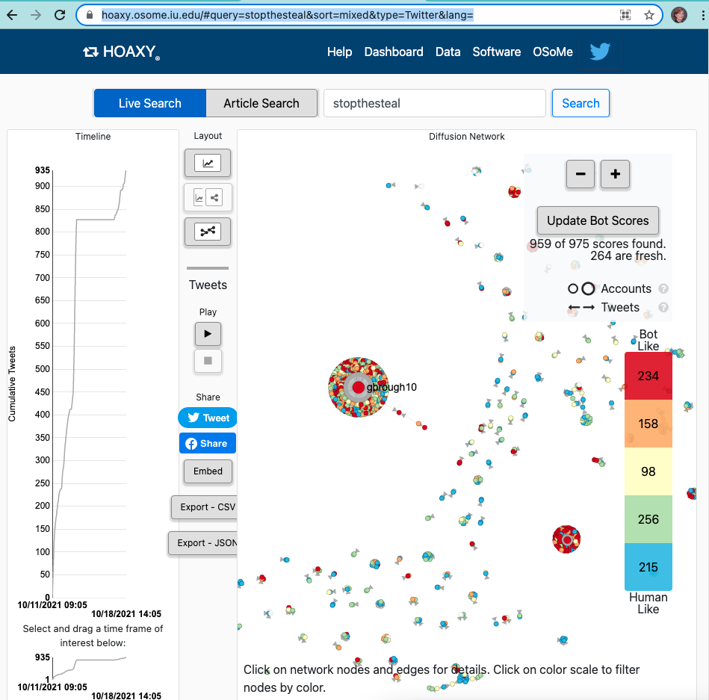
Hoaxy (hoaxy.osome.iu.edu)

Slide 17
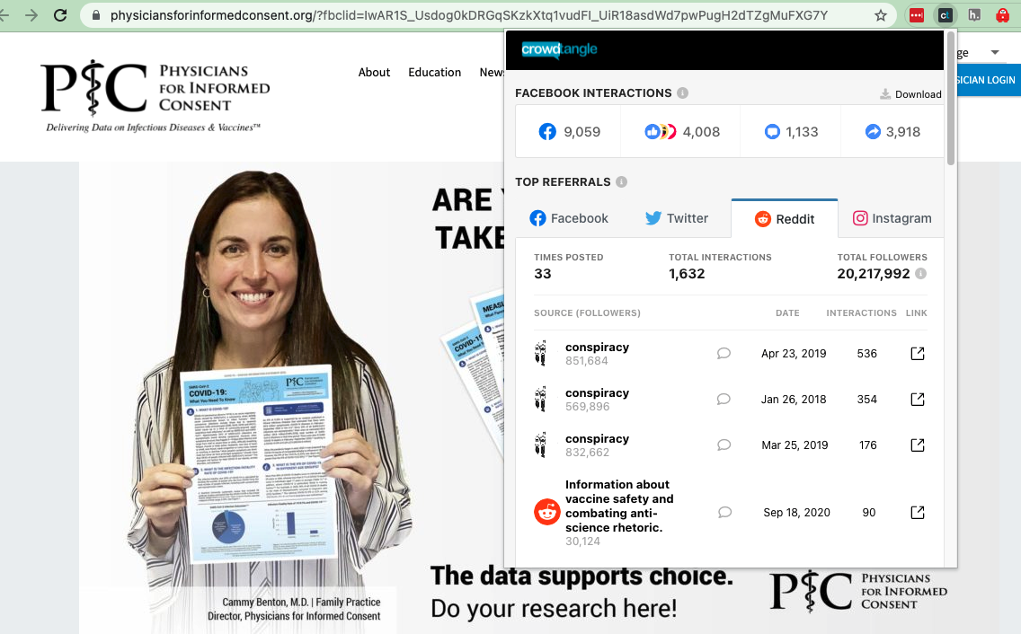
Crowdtangle extension (crowdtangle.com)

Slide 18
Social Iistening tools
(how to use APIs, scraping etc)
Notes:
Links:
“Social listening and monitoring tools”, CDC - part of the “rapid community assessment guide”, 2020.
https://disinfocloud.com/blog/disinfo101-guide -GEC list of tools by type
https://firstdraftnews.org/long-form-article/digitalrecipes/
https://firstdraftnews.org/wp-content/uploads/2019/10/Newsgathering_and_Monitoring_Digital_AW3.pdf

Slide 19
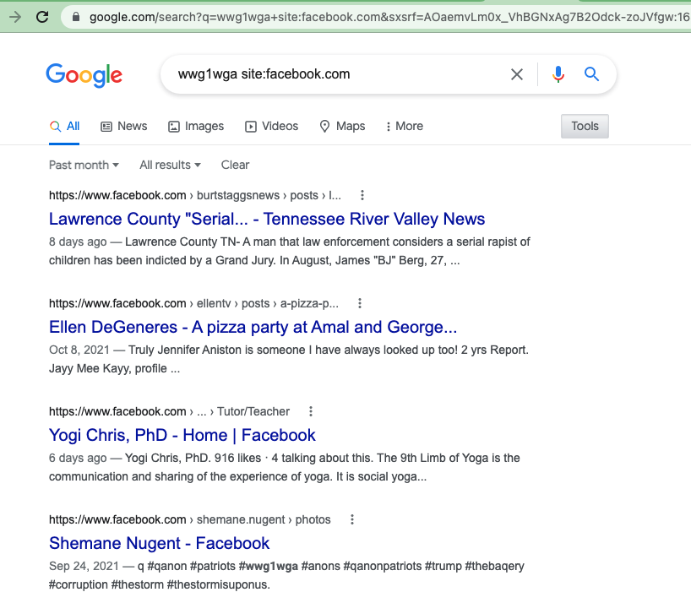
Google dorks
Notes:
Links
https://publicintelligence.net/feds-google-dorking/

Slide 20
Google Dorks
and, or, () : boolean searches
“Words words” : searches for a phrase
-word : excludes this word (or phrase)
Site:xxx.com : restricts to a specific site / URL pattern
-site:xxx.com : excludes this url pattern
Filetype:pdf : only get a specific filetype back
Also
Filters: Most social media searches give you date/time and type options. Use them
Google search is really useful for social media sites with search problems (facebook, youtube)
Notes:
Links
Hank Van Ess, Finding patient Zero https://datajournalism.com/read/handbook/verification-3/investigating-actors-content/finding-patient-zero

Slide 21
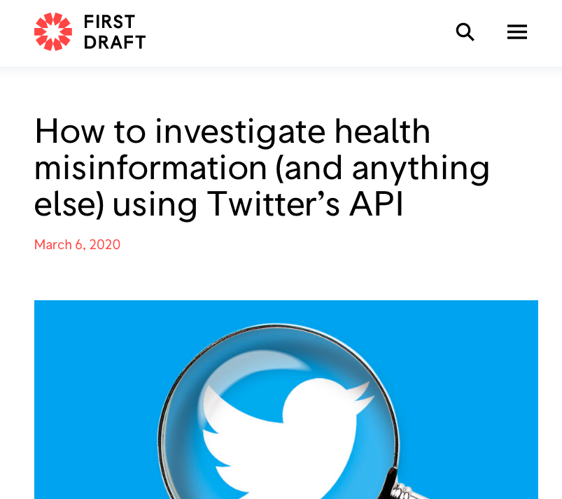
Twitter APIs
Notes:
https://firstdraftnews.org/articles/how-to-investigate-health-misinformation-and-anything-else-using-twitters-api/

Slide 22
Facebook data
Crowdtangle - for URLs
Google search on facebook groups/pages
Graph Tips - puts together search queries for you
Whopostedwhat - facebook accounts

Slide 23
Curated Data Streams
Botsentinel: themes “trollbots” are promoting
Hamilton68 - public version is feeds from official Russian sites (embassies, RT etc), not trolls.
Ryerson University covid19 misinformation portal
  Botswatch dashboard Botswatch dashboard
Indiana University OSOME Decahose
Facebook Datafeed
Uni Arkansas COSMOS Covid19 list

Slide 24
Crowdsourcing
(when you need humans to help)

Slide 25
Building / working with volunteer communities
Match tasks to capabilities and/or train people
Make tasks simple if you can (“sheep looks left or right?”)
Safety first!

Slide 26
Paying for it
E.g. Amazon mechanical turk
Describe the tasks needed
  (Make them simple)
Add data that’s ready for those tasks
Check quality
pay
Notes:
Links
Alternatives to mechanical turk: https://financialwolves.com/mturk-alternatives/

