Slide 1
Week 9 : misinformation data analysis
INST408C: Cognitive Security | Fall 2021 | SJ Terp

Slide 2
INST408C Week
Monday
Artifact features
Wednesday
Artifact analysis
Readings
Assignments
Notes:
Links:

Slide 3
Artifacts
The things you can see

Slide 4
Artifacts
Text
Features include: words, urls, emojis, hashtags, names, titles,
Images
Features include: text, objects, logos, titles
Video
Features include: transcripts, logos, descriptions, titles,
Audio
Features include: speaker, transcripts, titles, descriptions,
Profiles
Accounts, groups, etc.
Etc
brain-computer interfaces etc

Slide 5
Some more datasets
https://covidstates.org/ - covid19 data collected for USA
https://github.com/jgolbeck/fakenews - Jen Golbeck’s tagged domain data
https://github.com/KaiDMML/FakeNewsNet - tagged dataset
https://github.com/compsocial/CREDBANK-data - early data, with topics
https://commoncrawl.org/ extracts and saves text from domains

Slide 6
Organising analysis

Slide 7
Analysis types
Threat intelligence: “information an organization uses to understand the threats that have, will, or are currently targeting the organization. This info is used to prepare, prevent, and identify cyber threats looking to take advantage of valuable resources. “
Intelligence analysis: “process of taking known information about situations and entities of strategic, operational, or tactical importance, characterizing the known, and, with appropriate statements of probability, the future actions in those situations and by those entities”
OSINT: “intelligence produced from publicly available information that is collected, exploited, and disseminated in a timely manner to an appropriate audience for the purpose of addressing a specific intelligence requirement.”
Data science: “the field of study that combines domain expertise, programming skills, and knowledge of mathematics and statistics to extract meaningful insights from data”
Notes:
TI definition: https://www.forcepoint.com/cyber-edu/threat-intelligence
IA definition: https://www.recordedfuture.com/definition-of-intelligence-analysis/ - cool cool, looks like situation awareness definitions of old. E.g WTF is going on, what’s targetting us, what can we do about it?
OSINT definition: https://www.rand.org/content/dam/rand/pubs/research_reports/RR1900/RR1964/RAND_RR1964.pdf (which talks about how OSINT processing used to be simple: translation, then all-source analysis)
Data science is still debated, e.g. wikipedia says “Data science is an inter-disciplinary field that uses scientific methods, processes, algorithms ... in managing a digital data collection. There is still no consensus on the definition of data science and it is considered by some to be a buzzword.”

Slide 8
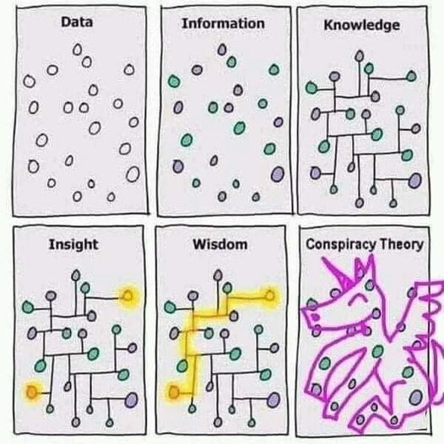
Ahem

Slide 9
Tactical tasks
Credibility/ Verification
Fact-checking: verify article, image, video etc doesn’t contain disinformation.
Source-checking: verify source (publisher, domain etc) doesn’t distribute disinformation.
Network detection
Pinkslime finding: find inauthentic website networks
Network finding: find inauthentic account networks (including botnets)
Activity analysis
Detect computational amplification
Detect fake accounts
(e.g. Look at patterns of account creation dates for popular messages)
Detect, track and analyse narratives

Slide 10
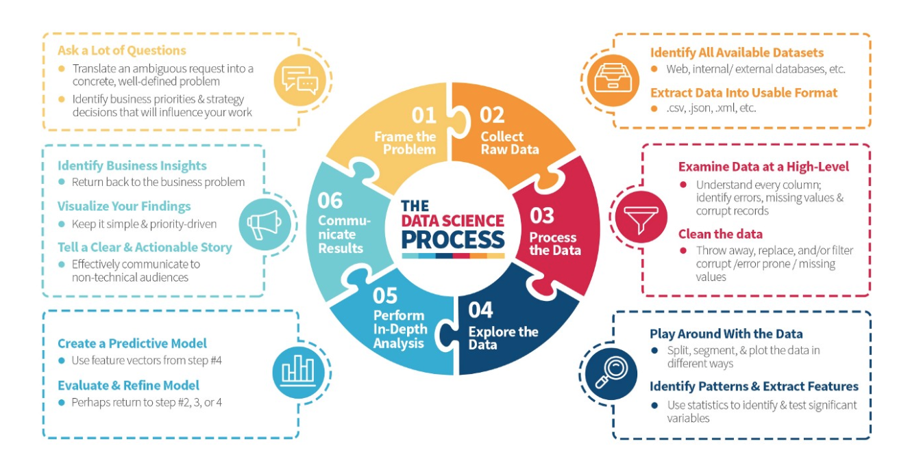
Data Science Process
https://medium.com/the-mission/deconstructing-data-science-breaking-the-complex-craft-into-its-simplest-parts-15b15420df21
Notes:
Read the blogpost btw - it’s a lovely description of what happens in data science.

Slide 11
Basic text analysis
Terms you need to know

Slide 12
Text Processing
Information retrieval
Search
Named entity recognition
Learning
Classification
Clustering
Topic identification/ topic following
Sentiment analysis
Network analysis (words, people etc)
Comprehension
Natural language processing
Translation
Truthiness
Gisting
Creation
Text generation

Slide 13
Cognitive Security: text-based work
Pirolli et al
“Novel computational models of human responses to epidemic information and non-pharmacutical interventions”: Covid19 mask wearing
Models beliefs, attitudes, intentions, behaviour
Tian et al on cross-language rumour detection
Automatic rumour detection
Uses pretrained language models (BERT)
Others
Psycholinguistics, forensic linguistics etc
Notes:
Links:
https://books.google.com/books?hl=en&lr=&id=SMI2EAAAQBAJ&oi=fnd&pg=PA46&ots=Ok6MCC3d85&sig=fKzIQEnjzM9LMO9G4IZhUeZsBvQ#v=onepage&q&f=false
https://datalab-old.csd.auth.gr/wp-content/uploads/publications/GRAVANIS2019201.pdf
https://arxiv.org/pdf/2109.12773.pdf

Slide 14
Common Tools
Python libraries:
Scikit-Learn
NLTK
Gensim
Spacy
Standalone Tools:
GPT2 / GPT3
Weka
Notes:
Longer list: http://en.wikipedia.org/wiki/Social_network_analysis_software

Slide 15
All text is data
(everything is)

Slide 16
Let’s get some raw text
"RT @Loli99704518: @francis66675984 @rafapal Pues sí. Ya podríamos los españoles tomar ejemplo de los serbios. El covid forma parte de un en… RT @KateShemirani: Oh really? Just like with radiation poisoning then. Put enough symptoms down on the diagnosis sheet and you can just abo… RT @KateShemirani: Oh really? Just like with radiation poisoning then. Put enough symptoms down on the diagnosis sheet and you can just abo… @AlbertoRodNews Recordemos #5Jul Día de la independencia y brote del COVID-5G en un desfile sin tapabocas, pensaron que el uniforme era inmune 🧫 RT @KateShemirani: Oh really? Just like with radiation poisoning then. Put enough symptoms down on the diagnosis sheet and you can just abo… RT @Walletwalking1: @Sterling2143 @AAureilus Anyone noticed COVID symptoms are same as 5G exposure. What have they been rolling out in the… RT @ADDiane: Let's tell the people who won't wear masks that it's not for covid, it's for tricking the facial recognition software that dee… Discourse "
import pandas as pd
import json
# Read dataset into a Pandas dataframe
infile = '20200711140613_covid-5g_tweets.json'
with open(infile) as json_file:
jdata = json.load(json_file)
df = pd.DataFrame.from_dict(jdata, orient='index')
df.reset_index(level=0, inplace=True)
df.columns = ['url', 'text']
# stick all the tweets together so we can look
# at them as one big text chunk
alltext = [' '.join(df['text'].to_list())]

Slide 17
One way to look at text: meanings
Syntax: the structure of sentences, a.g. Grammar
Noun-verb order (e.g. German verbs go at the end of a sentence)
Tenses, cases, gender agreements in languages that use them
Semantics: the meanings of sentences
Sensemaking
“Just like with radiation poisoning then”, “Fruit flies like an apple”
Pragmatics: the meaning of sentences, in context
Adding history
Resolving anaphora and filling in other missing information
Notes:
See e.g. https://www.writersdigest.com/write-better-fiction/semantics-vs-syntax-vs-pragmatics-grammar-rules

Slide 18
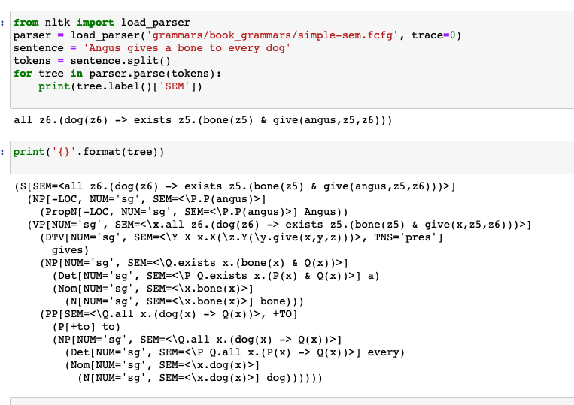
Semantics: using NLTK

Slide 19
Text as “bags of words”
Sentences:
“Oh really?”,
”Just like with radiation poisoning then.”
Words: “just”, “like”, “with”, etc
Trigrams: “jus”, “ust”, “st “, “t l”, “ li”, “lik” “ike”
Bigrams: “just like”, “like with”, “with radiation”, “radiation poisoning”
Stopwords: “with”, “on”, “then”, “what”, “have”, “they”, “been”, “out”, “in”, “the”, etc
"RT @KateShemirani: Oh really? Just like with radiation poisoning then. Put enough symptoms down on the diagnosis sheet and you can just abo… RT @Walletwalking1: @Sterling2143 @AAureilus Anyone noticed COVID symptoms are same as 5G exposure. What have they been rolling out in the… RT @ADDiane: Let's tell the people who won't wear masks that it's not for covid, it's for tricking the facial recognition software that dee… Discourse "

Slide 20
Scikit-Learn’s default English stopwords
['a', 'about', 'above', 'across', 'after', 'afterwards', 'again', 'against', 'all', 'almost', 'alone', 'along', 'already', 'also', 'although', 'always', 'am', 'among', 'amongst', 'amoungst', 'amount', 'an', 'and', 'another', 'any', 'anyhow', 'anyone', 'anything', 'anyway', 'anywhere', 'are', 'around', 'as', 'at', 'back', 'be', 'became', 'because', 'become', 'becomes', 'becoming', 'been', 'before', 'beforehand', 'behind', 'being', 'below', 'beside', 'besides', 'between', 'beyond', 'bill', 'both', 'bottom', 'but', 'by', 'call', 'can', 'cannot', 'cant', 'co', 'con', 'could', 'couldnt', 'cry', 'de', 'describe', 'detail', 'do', 'done', 'down', 'due', 'during', 'each', 'eg', 'eight', 'either', 'eleven', 'else', 'elsewhere', 'empty', 'enough', 'etc', 'even', 'ever', 'every', 'everyone', 'everything', 'everywhere', 'except', 'few', 'fifteen', 'fifty', 'fill', 'find', 'fire', 'first', 'five', 'for', 'former', 'formerly', 'forty', 'found', 'four', 'from', 'front', 'full', 'further', 'get', 'give', 'go', 'had', 'has', 'hasnt', 'have', 'he', 'hence', 'her', 'here', 'hereafter', 'hereby', 'herein', 'hereupon', 'hers', 'herself', 'him', 'himself', 'his', 'how', 'however', 'hundred', 'i', 'ie', 'if', 'in', 'inc', 'indeed', 'interest', 'into', 'is', 'it', 'its', 'itself', 'keep', 'last', 'latter', 'latterly', 'least', 'less', 'ltd', 'made', 'many', 'may', 'me', 'meanwhile', 'might', 'mill', 'mine', 'more', 'moreover', 'most', 'mostly', 'move', 'much', 'must', 'my', 'myself', 'name', 'namely', 'neither', 'never', 'nevertheless', 'next', 'nine', 'no', 'nobody', 'none', 'noone', 'nor', 'not', 'nothing', 'now', 'nowhere', 'of', 'off', 'often', 'on', 'once', 'one', 'only', 'onto', 'or', 'other', 'others', 'otherwise', 'our', 'ours', 'ourselves', 'out', 'over', 'own', 'part', 'per', 'perhaps', 'please', 'put', 'rather', 're', 'same', 'see', 'seem', 'seemed', 'seeming', 'seems', 'serious', 'several', 'she', 'should', 'show', 'side', 'since', 'sincere', 'six', 'sixty', 'so', 'some', 'somehow', 'someone', 'something', 'sometime', 'sometimes', 'somewhere', 'still', 'such', 'system', 'take', 'ten', 'than', 'that', 'the', 'their', 'them', 'themselves', 'then', 'thence', 'there', 'thereafter', 'thereby', 'therefore', 'therein', 'thereupon', 'these', 'they', 'thick', 'thin', 'third', 'this', 'those', 'though', 'three', 'through', 'throughout', 'thru', 'thus', 'to', 'together', 'too', 'top', 'toward', 'towards', 'twelve', 'twenty', 'two', 'un', 'under', 'until', 'up', 'upon', 'us', 'very', 'via', 'was', 'we', 'well', 'were', 'what', 'whatever', 'when', 'whence', 'whenever', 'where', 'whereafter', 'whereas', 'whereby', 'wherein', 'whereupon', 'wherever', 'whether', 'which', 'while', 'whither', 'who', 'whoever', 'whole', 'whom', 'whose', 'why', 'will', 'with', 'within', 'without', 'would', 'yet', 'you', 'your', 'yours', 'yourself', 'yourselves']
Notes:
from sklearn.feature_extraction import text
xxx = list(text.ENGLISH_STOP_WORDS)
xxx.sort()
print('{}'.format(xxx))

Slide 21
Word Importance: Named Entity Recognition
Finds names of people, organisations, locations etc in text
Can use to create social graphs
import spacy
nlp = spacy.load('en_core_web_sm')
sentence = "Bill Gates is selling 5G Covid19 data to Microsoft"
doc = nlp(sentence)
for ent in doc.ents:
print(ent.text, ent.label_)
Bill Gates PERSON
5 CARDINAL
Microsoft ORG
Notes:
See https://www.geeksforgeeks.org/python-named-entity-recognition-ner-using-spacy/

Slide 22
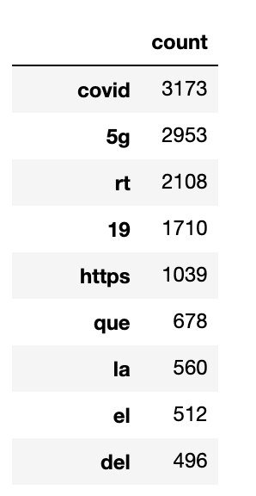
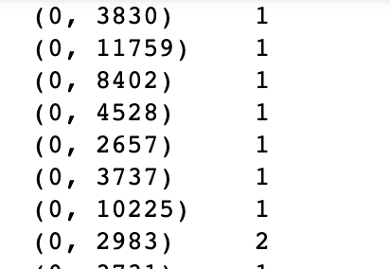
Okay, let’s grab some text
from sklearn.feature_extraction.text import CountVectorizer
count_vect = CountVectorizer(stop_words='english')
word_counts = count_vect.fit_transform(df['text'])
Notes:
# if you want to look at bigrams, try
count_vect = CountVectorizer(ngram_range =(2, 2))

Slide 23
Word Importance: TFIDF
TF: Term Frequency
Word count / (number of words in this document)
“How important (0 to 1) is this word in this document?”
IDF: Inverse Document Frequency
1 / (number of documents this word appears in)
“How common is this word in this corpus?”
TFIDF: how important is this word in this document, in this corpus?
TFIDF = TF * IDF
Important in doc * rare = really important

Slide 24
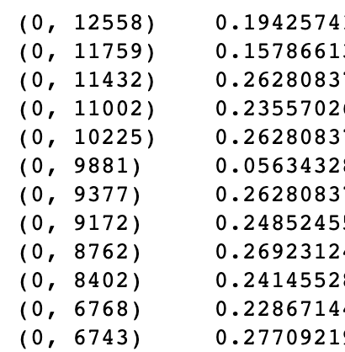
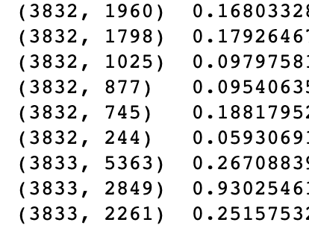
TFIDF: Scikit-learn
from sklearn.feature_extraction.text import TfidfTransformer
tf_transformer = TfidfTransformer(use_idf=True)
tf_features = tf_transformer.fit_transform(word_counts)
Notes:
(word 2849 is ‘dalje’ btw)

Slide 25
Sentiment: (some of) the feels
Word-based: give (some) words positive/negative scores
Use an existing ‘sentiment dictionary’
Score some words, use machine learning on the rest
Document-based: score documents and use machine learning
‘positive’/’negative’ for each sentence
Semantic/pragmatic: use natural language processing
Satire is hard to detect
“Nice work bro!”
Emoticons are a language too
Very positive
Positive
Neutral
Negative
Very negative
Notes:
Examples: https://monkeylearn.com/sentiment-analysis/
Why always 5 things on a scale? Because it’s a Likert scale
Again semantics might matter: aspect-based sentiment analysis = working out *what* people are happy, sad etc about.

Slide 26
Sentiment Dictionaries
>:/ -1
>:[ -1
>:\ -1
>:] 1
>:D 1
>:L -1
>:O -1
>:o -1
>:P 1
>:X -1
>;) -1
>;] 1
>[ -1
>\ -1
Wordstat: https://provalisresearch.com/products/content-analysis-software/wordstat-dictionary/sentiment-dictionaries/
Sentiwordnet: https://github.com/aesuli/SentiWordNet
Emoticon sentiment lexicon: http://people.few.eur.nl/hogenboom/files/EmoticonSentimentLexicon.zip
Notes:
https://www.quora.com/Is-there-a-free-online-sentiment-analysis-service-for-social-media-accounts

Slide 27
Text: other things to look at….
Text as Vectors (“word vectors”)
Classification and clustering algorithms (LDA, SVMs, deep learning etc)
Topic modelling
Natural language processing and the NLTK library
Applications in disinformation response
Notes:
Classic modularity algs: https://www.cs.cmu.edu/~ckingsf/bioinfo-lectures/modularity.pdf

Slide 28
Other artefact analysis features

Slide 29
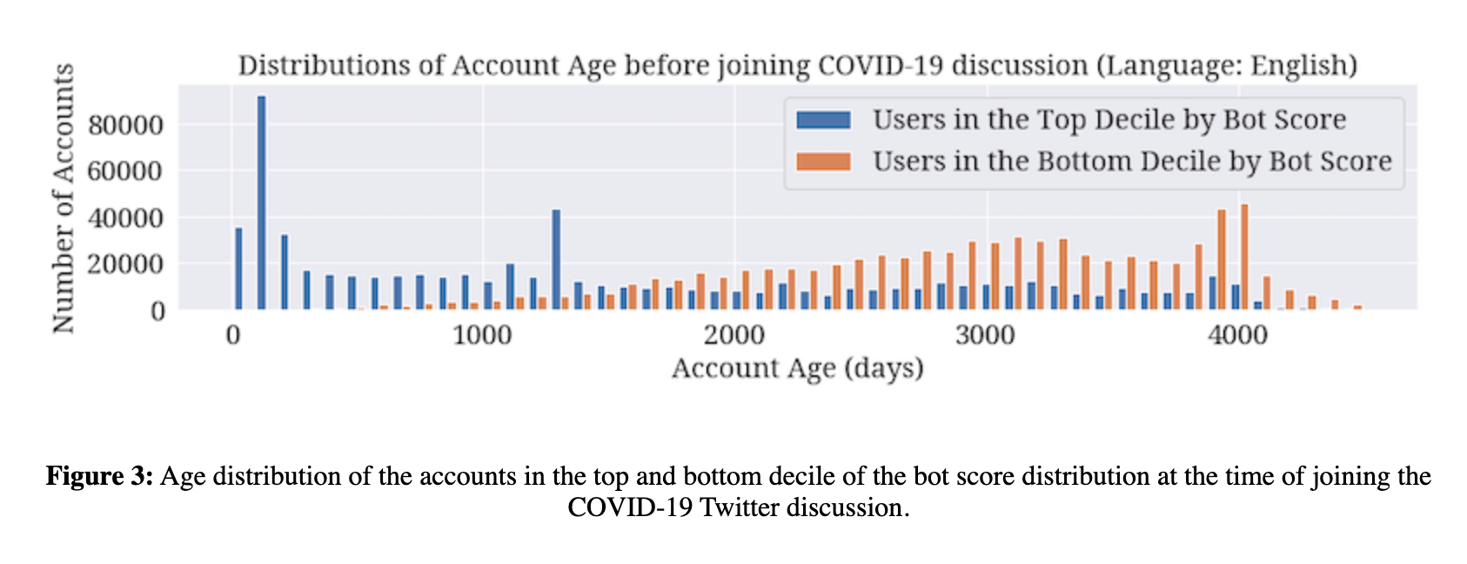
Features, e.g. Emilio Ferrara on Covid19 disinfo
Notes:
https://firstmonday.org/ojs/index.php/fm/article/view/10633/9548

Slide 30
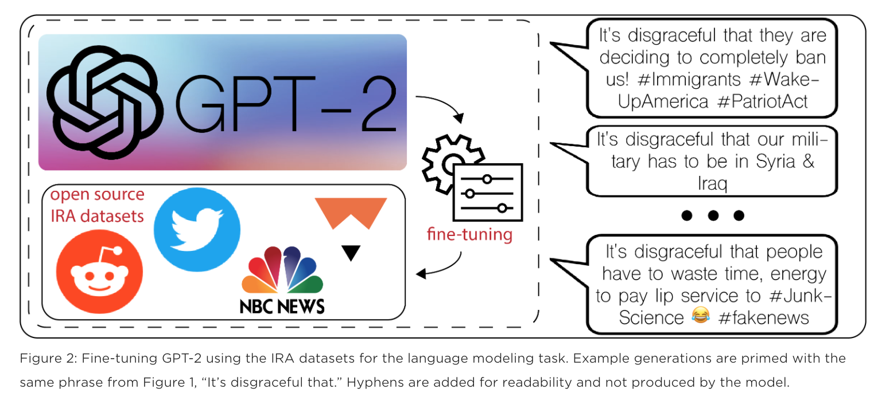
Generating to understand: Fireeye and GPT2
Notes:
Lee Foster, Phil Tully, Sajidur Rahman
https://www.fireeye.com/blog/threat-research/2019/11/combatting-social-media-information-operations-neural-language-models.html

