Slide 1
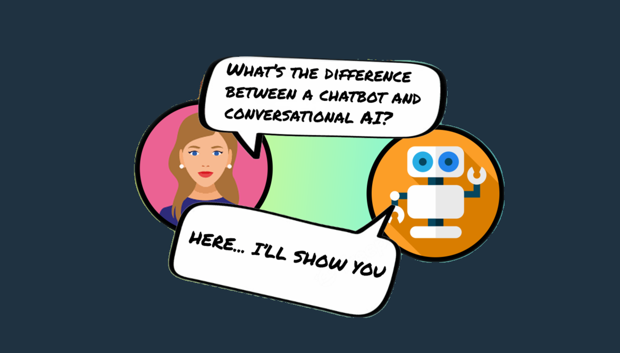

Slide 2
Are Chatbots and AI Agents the Same?
No, chatbots and AI agents are not the same. While they both use AI techniques, they are used for different purposes. Chatbots are used for customer service applications, while AI agents are used for decision-making tasks. Additionally, AI agents are more complex and use more advanced AI techniques such as deep learning and reinforcement learning.

Slide 3
Chatbots
Chatbots are computer programs that simulate human conversations to create better experiences for customers. Some operate based on predefined conversation flows, while others use artificial intelligence and natural language processing (NLP) to decipher user questions and send automated responses in real-time. Conversational AI
Conversational AI is a broader term that refers to AI-driven communication technology such as chatbots and virtual assistants (e.g., Siri or Amazon Alexa). Conversational AI platforms use data, machine learning (ML), and NLP to recognize vocal and text inputs, mimic human interactions, and facilitate conversational flow.

Slide 4
These technologies include NLP, ML, and intelligent analysis. Let’s break that down:
NLP is short for natural language processing. It allows a machine to understand what we say in our natural language.
That is, the way we naturally speak, with slang, abbreviations, mispronunciations and so on.
NLP allows machines to understand voice input as well as text. For instance, with NLP, you don’t need the exact correct syntax for a chatbot to understand you.
ML stands for machine learning. It means that the machine can learn from interactions with us.
So, in the case of conversational machine learning, it allows the machine to use its interactions to inform and create better conversational experiences in the future.
Intelligent analysis is another key function of conversational AI. It’s all about enabling the machine to analyze information to make suggestions and recommendations to us.

Slide 5
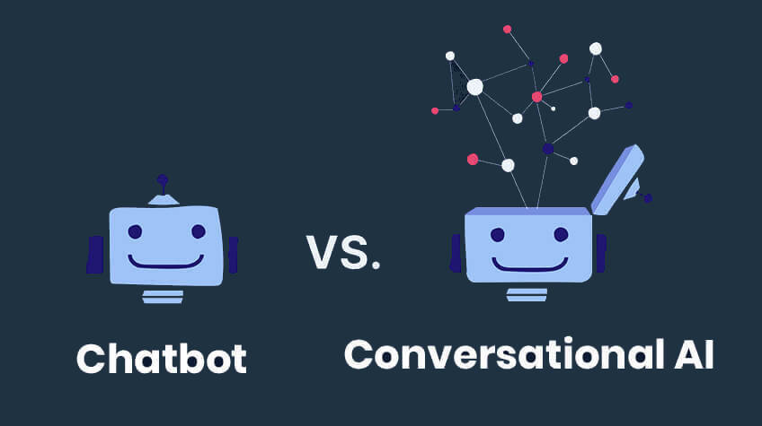

Slide 6
Conversational Al | Chatbot
Capable of voice and text commands, inputs, and outputs | Capable of text only commands, inputs, and outputs
Omnichannel: can be deployed on websites, voice assistants, smart speakers, and call centers | Single channel: can be used as a chat interface only
Natural language processing, understanding, and contextualization | Pre-determined scripted conversational flow
Wide-scope, non-linear, dynamic interactions | Rule-based, canned linear interactions. Cannot handle out of scope tasks
Dialogue focused | Navigational focused
Continual learning and fast iteration cycles | Any update or revision to the pre-defined rules and conversational flow demands reconfiguration
Highly scalable. As the company's database and pages are updated, so does the conversational Al interface | Manual maintenance, updates and revisions = difficult and time-consuming to scale
Easy deployment and integration with existing databases, text corpora | Time-consuming and complicated building process.

Slide 7
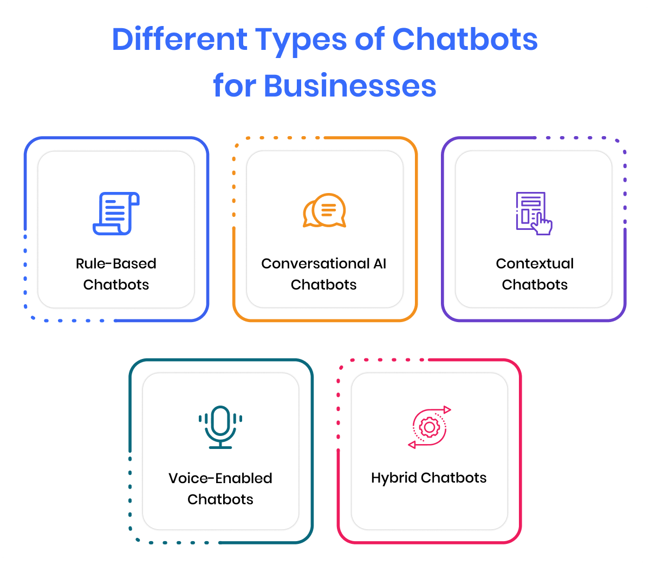

Slide 8
Rule-Based Chatbots
As the name suggests, these chatbots use a series of defined rules. With this type of bots, the communication is through pre-defined rules and a set of questions.
These chatbots are not able to generate their own answers but with an extensive set of answers and smartly designed rules, they can be proved very useful and productive.
These chatbots are also referred to as decision-tree bots and the reason is that rule-based chatbots are guided by a decision tree, the customer or the user is given a set of predefined options that lead to the desired answers.
Rule-based or scripted are the types of chatbots that can be used to answer common questions. For instance, booking a table in a restaurant or buying tickets to the cinema. Followed by a decision tree, the customers are provided a set of predefined options that leads to the relevant answer.

Slide 9
Conversational AI Chatbots
AI-enabled chatbots combine the power of Machine Learning (ML) and Natural Language Processing (NLP) to understand the context and intent of a question before formulating a response.
Such conversational AI bots generate their own answers to more complicated questions using natural-language responses. The more you use and train these bots, the more they learn and the better they operate with the user.
Conversational chatbots are a win over rule-based bots in the identification of user context and intention. They can thus decipher a user’s query and deliver a personalized experience.

Slide 10
Contextual Chatbots
Ever wondered what is a contextual chatbot ? A contextual chatbot is far more advanced than the other bots discussed previously. In order to remember the conversations that happened earlier, these types of chatbots make use of Machine Learning (ML) and Artificial Intelligence (AI), with particular users, to learn and grow with the passage of time.
For example, a contextual chatbot that allows users to order food; the chatbot will store the data from each conversation and learn what the user likes to order. The result is that eventually when a user chats with this chatbot, it will remember their most common order, their delivery address, and their payment information and merely ask if they’d like to repeat this order. Instead of having to respond to several questions the user just has to answer with ‘Yes’ and the food is ready!
Leveraging conversation context is one of the best ways to shorten processes like these via a chatbot.

Slide 11
Voice-Enabled Chatbots
To make conversational interfaces even more vernacular, businesses are now beginning to use voice-based chatbots or voice bots. Voice bots have been on the rise for the last couple of years, with virtual assistants like Apple’s Siri, to Amazon’s Alexa, and why? Because of the convenience they bring. It’s much easier for a customer to speak rather than type. A voice-activated chatbot brings frictionless experiences directly to the end customer.

Slide 12
Hybrid Chatbots
Hybrid chatbots are an amalgamation of simple (rule or script-based) and smart (conversational AI-based) AI-based.
The hybrid chatbot model offers the best of both worlds- the simplicity of the rules-based chatbots, with the complexity of the AI bots.
These bots have some rule-based tasks, and they can understand intent and context. It makes them a balanced tool for businesses to interact with customers.

Slide 13
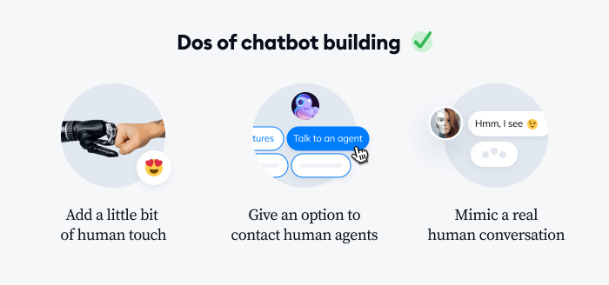

Slide 14
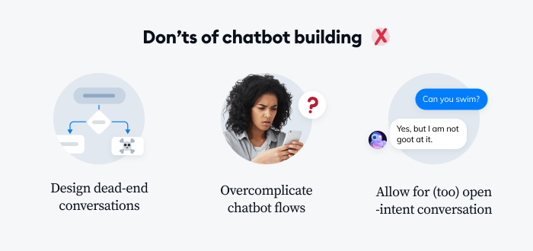

Slide 15
Conclusion
Chatbots are an invaluable tool for businesses, as they can automate customer service and other processes. There are many different types of chatbots available, from voice chatbots to AI chatbots, and each type has its own unique advantages.
No matter what type of chatbot you choose, it is important to make sure that it is properly trained and optimized for your business needs. With the right chatbot, you can improve customer service, increase sales, and streamline processes.

