Slide 1



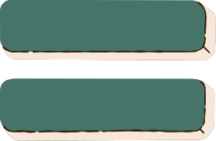

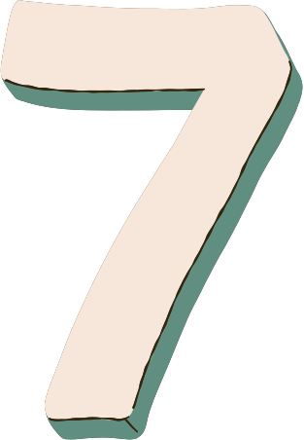
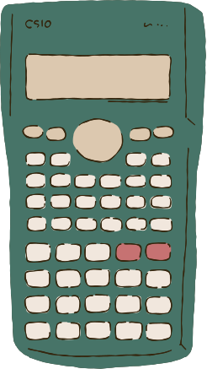

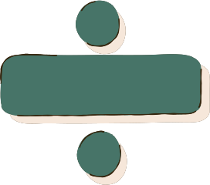
22MAT230
Mathematics for Computing 4
On Kernel-based Variational Autoencoder
Presented by Team 5
Bodapati Sai Krishna – CB.SC.U4AIE24308
Dokku Naga Shiva – CB.SC.U4AIE24315
Enku Sai Mohith – CB.SC.U4AIE24316
Inaganti Mahalakshmi – CB.SC.U4AIE24322

Slide 2
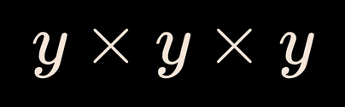
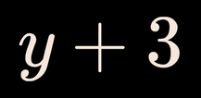
Variational Autoencoder (VAE) is generative model that learn a smooth, probabilistic latent space, allowing them not only to compress and reconstruct data but also to generate entirely new, realistic samples. VAEs capture the underlying structure of a dataset and produce outputs that closely resemble the original data.
Step 1. Encoder (Understanding the Input)
The encoder takes input data like images or text and learns its key features. Instead of outputting one fixed value, it produces two vectors for each feature:
Mean (μ)
Log-variance vector log(σ²)
These parameters define a latent probability distribution q(z | x)
Step 2. Reparameterization Trick
Sample random noise:
ε ~ 𝒩(0, 1)
Answer:
Simplify the expression:

Slide 3
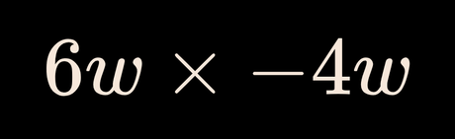
Compute standard deviation:
σ = exp(0.5 · log(σ²))
Generate latent vector:
z = μ + σ · ε
• This trick allows backpropagation through randomness.
Step 3: Decoding
• The latent vector z is passed to the Decoder.
• The Decoder reconstructs the image x̂
Step 4: Reconstruction Loss
Measures how close x̂ is to the original input x.
Common loss functions:
Binary Cross-Entropy (BCE) → for binary images
Mean Squared Error (MSE) → for real-valued images
Question 6

Slide 4
Step 5: KL Divergence Loss
Measures how much the learned distribution q(z | x) differs from the prior p(z) = 𝒩(0, 1)
KL divergence formula:
KL = − 1/2 · ∑ ( 1 + log(σ²) − μ² − σ² )
Step 6: Total Loss
The total VAE loss is the sum of two terms:
L = Reconstruction Loss + KL Divergence Loss
Step 7: Backpropagation
Gradients of the total loss L are computed.
Encoder and Decoder parameters are updated using gradient descent.

Slide 5

Step 8: Image Generation (After Training)
Sample a latent vector. z ~ 𝒩(0, 1)
Pass z directly to the Decoder.
The Decoder generates new, realistic images.

Slide 6

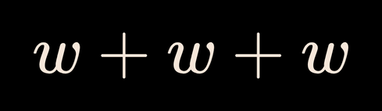
The Objective: Our goal is to generate new data (for example, images) that looks similar to the training data.
To achieve this, we must learn the true probability distribution of the data, denoted as:
p(x)
The Latent Variable (z)
We assume that the observed data x is produced by a hidden (latent) variable called z.
• x = visible data (image, text, etc.)
• z = hidden factors that describe the data
Example
If x is an image of a handwritten digit:
• z represents the underlying concept, such as:
• the digit identity (e.g., number 5)
• style information (tilted, thick strokes, size)
Maths behind VAE
Answer:
Simplify the expression:

Slide 7
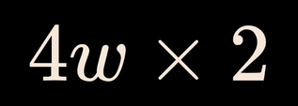

The Generative Process
The VAE assumes data is generated in two steps:
Step 1: Sample the Latent Code
We sample a latent variable from a prior distribution:
z ~ p(z)
(Usually p(z) is a standard normal distribution)
Step 2: Generate the Data
Using the sampled latent variable, we generate the data x :
x ~ p(x | z)
Simplify the expression:

Slide 8
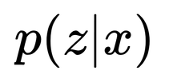


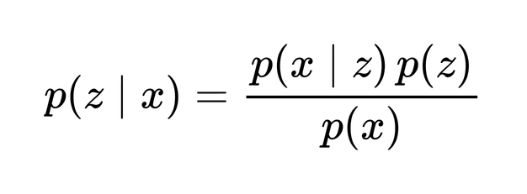
The Mathematical Problem
The Goal:
We want to find the posterior distribution:
Meaning:“Given this specific data point x (for example, an image),what is the exact hidden variable z that produced it?”
Bayes’ Theorem:
Using Bayes’ rule, the posterior is written as:
Where:
• p(z | x) → posterior (what we want)
• p(x | z) → likelihood
• p(z) → prior
• p(x) → evidence (normalization term)
Simplify the expression:

Slide 9
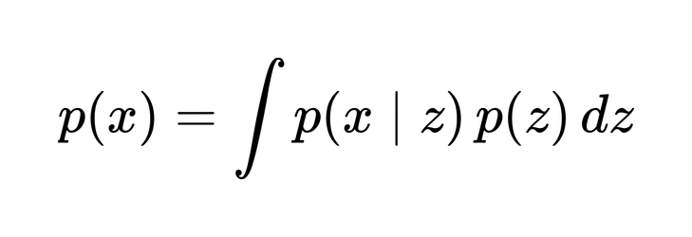

The Core Problem: To compute p(x), we must consider all possible values of z.
This requires integration over z:
Why This Is a Problem
The latent variable z can take infinitely many values
The decoder p(x | z) is a neural network
The integral has no closed-form solution
Result
This computation is mathematically intractable
meaning:
Impossible to compute exactly for complex, real-world data
We cannot directly calculate p(z | x)
Answer
Simplify the expression:

Slide 10
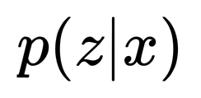
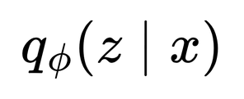
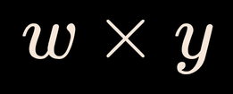
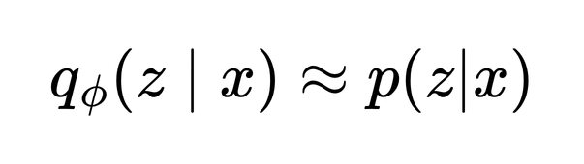
The Solution (Variational Inference):
The Core Idea: Since we cannot compute the true posterior distribution
we approximate it using a neural network.
Instead of finding the exact answer, we find the best possible approximation.
The Encoder (q): We introduce an approximate posterior:
This encoder network learns to map input data x to a distribution over z.
Meaning
In words:
“Our network’s guess of z given x should be as close as possible to the true posterior.”

Slide 11
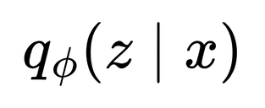


Why Do We Use q Instead of p?
The true posterior p(z | x) is intractable
is chosen to be:
Simple
Easy to compute
Easy to sample from
Usually, qφ(z | x) is a Gaussian distribution defined by:
Mean (μ)
Variance (σ²)
Both μ and σ are produced by the encoder network.
The Objective:
We want to minimize the difference between our guess (q) and the truth (p). We measure this difference using KL Divergence.
Answer:
Simplify the expression:

Slide 12
Approximating the Posterior Distribution
To better approximate the true posterior distribution:
p(z | x)
we introduce an approximate distribution:
q(z | x)
Our goal is to make q(z | x) as close as possible to p(z | x)
KL Divergence Objective:
We achieve this by minimizing the KL divergence between the two distributions:
min KL( q(z | x) || p(z | x) )
KL divergence measures how different two probability distributions are.
Lower KL divergence means the two distributions are more similar.

Slide 13
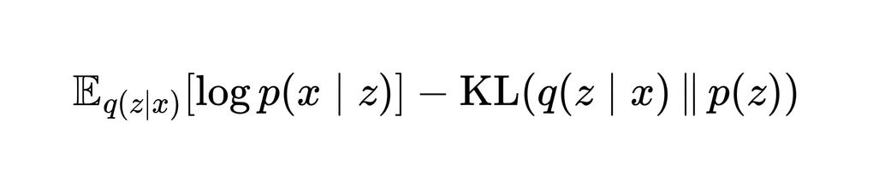
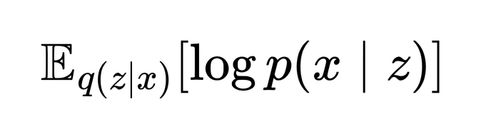
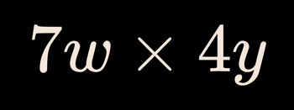
Equivalent Maximization Problem (ELBO)
By simplifying the above minimization problem, it becomes equivalent to maximizing the following objective:
This objective is known as the Evidence Lower Bound (ELBO).
Interpretation of the Two Terms
1. Reconstruction Term
Measures how well the model can reconstruct the input x from z
Encourages accurate reconstruction of the original data
This is called the reconstruction likelihood.
Answer:

Slide 14
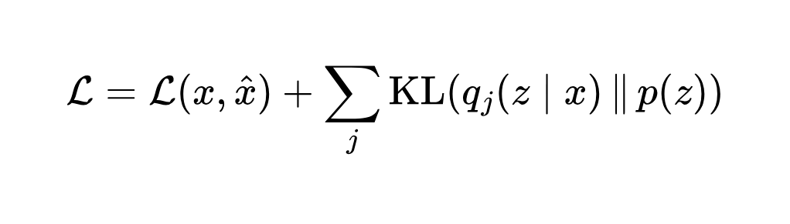


2. Regularization Term
KL( q(z | x) || p(z) )
Ensures that the learned distribution q(z | x) is close to the prior p(z)
Prevents the latent space from becoming disorganized
This term acts as a regularizer
Final Loss Function
The total loss used to train the VAE consists of two parts:
Loss = Reconstruction Loss + KL Divergence Loss
Written as:
Where:
x = original input
x_hat = reconstructed output
j = latent dimension index
Simplify the expression:

Slide 15
What is EVAE?
EVAE is a VAE where the latent distribution is built using an optimal kernel (Epanechnikov) instead of Gaussian, giving sharper reconstructions and better control over KL-divergence.
What is Epanechnikov?
Epanechnikov is a kernel that limits influence to nearby values only. Unlike Gaussian, it has a cutoff, so far-away noise is ignored. This makes density estimation and latent space learning more accurate and less blurry.
What problem in VAE?
VAE assumes the hidden (latent) space is Gaussian, and this assumption is too weak and too strict for real data.

Slide 16
Problems caused by Gaussian assumption in VAE:
Latent space is too simple, VAE makes every input look like bell curve shape, but real data is complex not bell shaped. This leads to features loss.
Posterior collapse, VAE forces latent distribution to match [𝒩(0, 1)] and Encoder stops sending useful information. This leads to useless latent space sometimes and decoder ignores (z).
Blurry images, Gaussian spreads everywhere (−∞ to +∞) no boundary. By this Decoder has many average possibilities, So this results blurry images while generating.
Weak KL regularization control, KL terms in VAE is too strong it forces latent space to stay near to the bell structure (Gaussian),which stops the model from learning rich and useful representations.

Slide 17
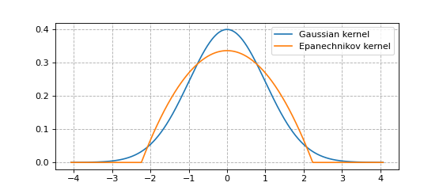
What does EVAE do differently?
EVAE only changes one thing mainly, that is instead of using Gaussian it uses kernel-based distribution in it’s latent space.
What is this Kernel?
Think of a kernel as:
A local bump
Focused around a center
Has clear boundaries
Unlike Gaussian’s spreads everywhere

Slide 18
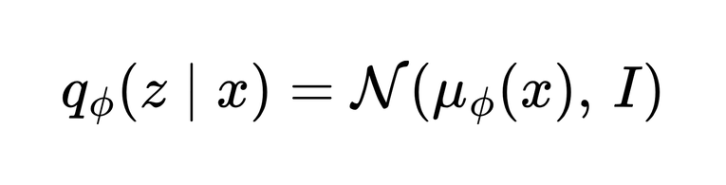
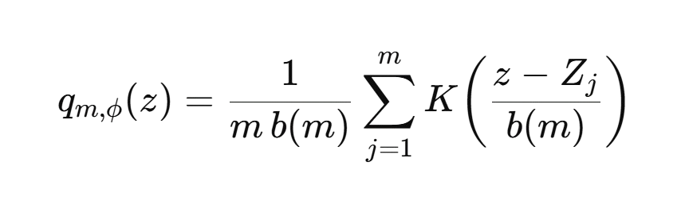
Problem 1: Latent space is too simple
VAE assumes:
here every input is forced to be in bell shape, but real data is complex.
EVAE models the posterior as a kernel density:
here
K(⋅)) → kernel function (Epanechnikov)
Zj → samples from prior
b(m) → small scaling factor (step size)
m → number of samples

Slide 19
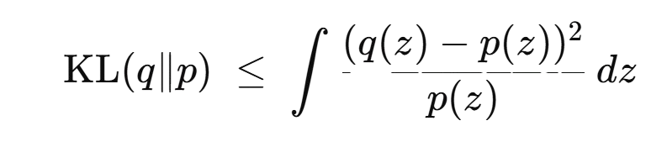
Problem 2: Posterior collapse
VAE minimizes KL divergence: KL(qϕ​(z∣x)∥p(z)) With: p(z)= 𝒩(0, 1)
For Gaussians, KL becomes:
KL=(1/2)||μϕ​(x)||^2
if μϕ is large the big divergence, best solve is μϕ is near to zero, this says that don’t send data greater 1 from data, but data can be larger and loses useful Information.
EVAE does not use exact KL, but uses this inequality to reduce bigger divergence,
What this means:
EVAE minimizes an upper bound
Not the strict KL
Less punishment on encoder

Slide 20
In EVAE objective:
Regularization ≈ (B/n)I(K)
Where:
B → support length (constant)
n → batch size
I(K)=∫(K^2)(t) dt
Result:
Encoder is not forced to zero
Latent space stays informative

Slide 21
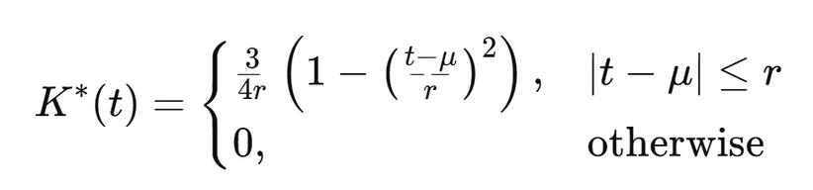
Problem 3: Blurry images (infinite support)
Gaussian has infinite support:
z ∈ (−∞,+∞)
this means :
Very large values possible
Decoder sees many far-away samples
Decoder averages everything
EVAE uses Epanechnikov kernel:
r → radius (controls spread)
μ → center
t is input

Slide 22
Latent sampling in EVAE:
z=b(m)*K(x)+Z
K(x) → kernel output (bounded)
Z → prior sample
this EVAE results:
No extreme latent values
Decoder gets focused information
Images become sharper

Slide 23
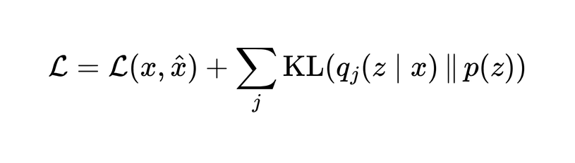
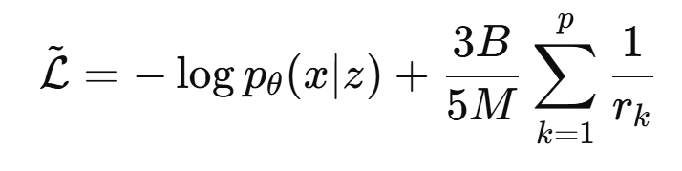
Problem 4: Weak KL regularization control:
VAE loss:
KL strength is:
Fixed
Strong
Uncontrollable
EVAE loss:
M → batch size
p→ latent dimension
rk → kernel radius (learned)
B → control paramete

Slide 24
Interpretation:
B controls regularization strength
Like a volume knob
Result:
Better balance between:
reconstruction
regularization
Richer representations
Calculation of Loss, FID and Sharpness
FID primarily stands for Fréchet Inception Distance, a key metric in AI for evaluating how realistic and diverse images from generative models are by comparing their statistical features to real images; a lower FID score means better quality, with 0 being perfect

Slide 25
VAE Problem | EVAE Solution
Gaussian latent space | Kernel-based latent space
Feature loss | Flexible KDE modeling
Posterior collapse | KL upper bound
Blurry images | Finite support kernel
Strong KL | Tunable regularization

Slide 26
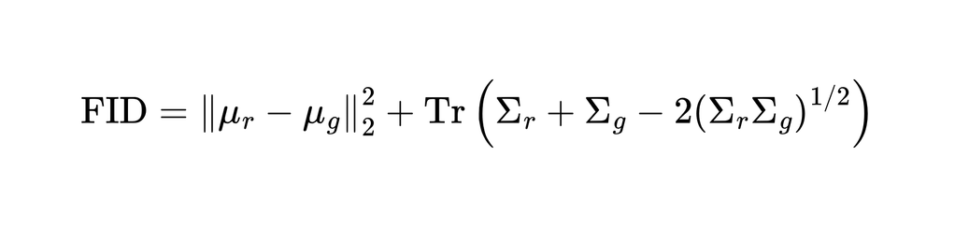
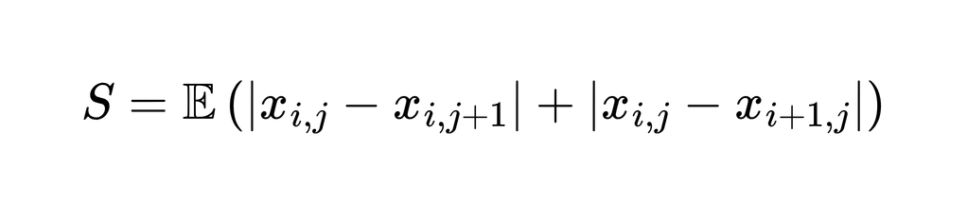
μr​ -Mean of feature vectors extracted from real images using Inception-V3
μg - Mean of feature vectors extracted from generated images
Σr - Covariance matrix of real image features
Σg - Covariance matrix of generated image features
∥μr−μg∥Difference between the centers of the two feature distributions
Tr⁡(⋅) - Trace (sum of diagonal elements of a matrix)
(ΣrΣg)^ 1/2 - Matrix square root of the covariance product
Sharpness
xi,j - Pixel intensity at location (i,j)(i,j)(i,j)
xi,j+1 - Pixel intensity of the right neighbor
xi+1,j - Pixel intensity of the bottom neighbor
|xi,j−xi,j+1∣- Horizontal intensity difference (horizontal edge strength)
∣xi,j−xi+1,j∣- Vertical intensity difference (vertical edge strength)
E[⋅] - Average over all pixels in the image
∇x- Image gradient (rate of intensity change)
∥∇x∥Gradient magnitude (edge strength)

Slide 27
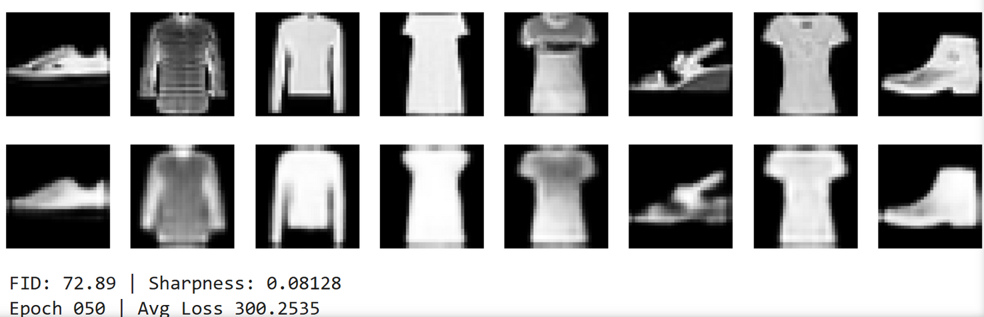
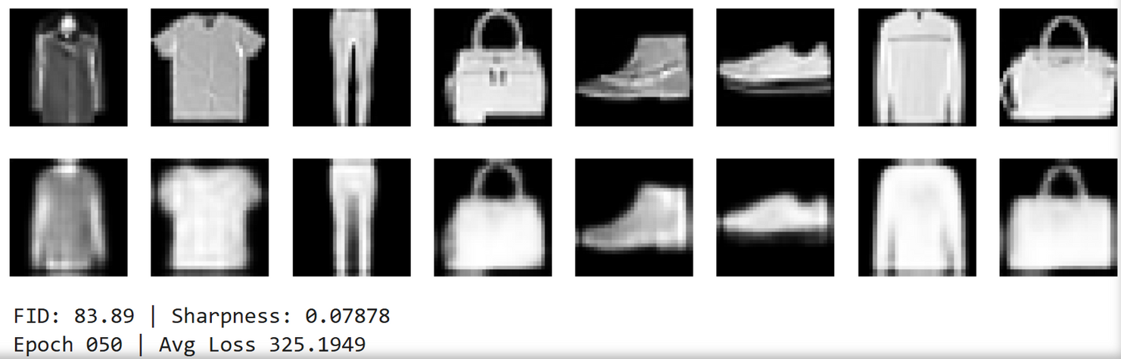
RESULTS
EVAE
VAE

Slide 28
RESULTS Comparison
Epochs | VAE | EVAE
10 | FID : 100.54 Sharpness : 0.07495 Avg Loss : 340.2633 | FID : 91.51 Sharpness : 0.07828 Avg Loss : 319.5354
25 | FID : 85.62 Sharpness : 0.07884 Avg Loss : 327.2664 | FID : 80.13 Sharpness : 0.08170 Avg Loss : 303.8552
50 | FID : 83.89 Sharpness : 0.07878 Avg Loss : 325.1949 | FID : 72.89 Sharpness : 0.08128 Avg Loss : 300.2535

Slide 29

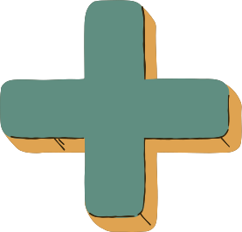
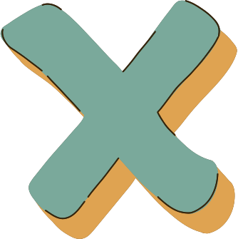
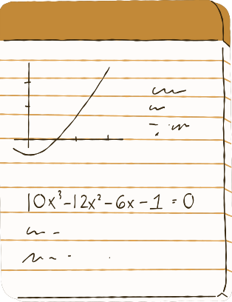



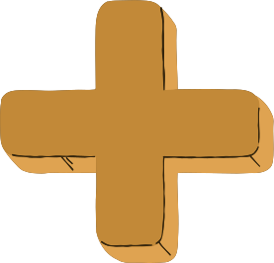
Instructions
Well Done!
This quiz consists of 10 multiple-choice questions. Write your answers on your mini-whiteboard and raise it when your teacher instructs you to do so.
Rate your Understanding...

