Slide 1


22MAT220
Mathematics for Computing 3
ADOM:ADMM-Based Optimization Model
for Stripe Noise Removal
TEAM-6
B SAI KRISHNA - CB.SC.U4AIE24308
D NAGA SHIVA - CB.SC.U4AIE24315
SAI MOHITH E - CB.SC.U4AIE24316
I MAHALAKSHMI - CB.SC.U4AIE24322
SCHOOL OF ARTIFICIAL INTELLIGENCE
1

Slide 2

INTRODUCTION
Remote sensing images (RSI) are essential for Earth observation, climate monitoring, weather prediction, disaster management.
RSI often contains stripe noise due to physical sensor limitations (detector gain/offset differences).
Stripe noise affects Visual quality and Image analysis tasks like classification and object detection.
Hardware upgrades alone cannot completely remove stripe noise.
Image destriping is necessary to preserve image details while removing noise
2

Slide 3


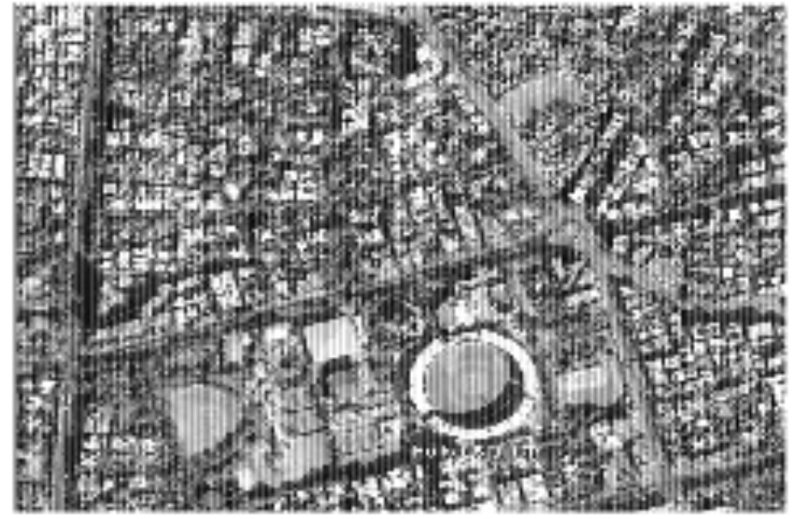
OBJECTIVES
To Remove stripe noise from images while preserving image details like edges and textures.
Detect stripes effectively using weighted norms.
Accelerate optimization with ADMM for fast convergence.
3

Slide 4
PROBLEM STATEMENT
Remote sensing images often contain stripe noise due to sensor limitations.
.This noise degrades image quality and negatively affects downstream tasks such as classification, object detection, and environmental monitoring
Existing destriping methods have limitations:
1. Filtering/statistical methods may blur important image details.
2. Deep learning methods require large datasets and are computationally expensive.
3.Existing optimization methods may over-smooth or converge slowly.
There is a need for an efficient, accurate method to remove stripe noise while preserving image details.
4

Slide 5

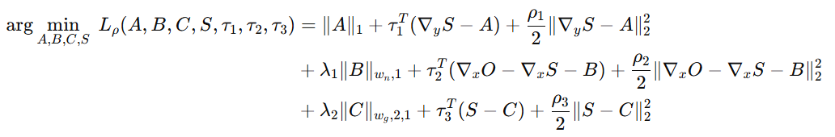
METHODOLOGY
Take a clean image and Generate vertical stripe noise to simulate a noisy observed image:
O=D+Snoise​
where O is observed image D is the clean image and Snoise​ is vertical stripe noise.
Objective Function :
We convert the objective function into the following constrained objective function by introducing auxiliary variables A, B and C for computational efficiency.
Formulate the weighted optimization problem
5

Slide 6

v
where :
τ1, τ2 andτ3 represent the Lagrange multipliers
ρ1, ρ2 and ρ3 are penalty parameters
ADMM ITERATIVE UPDATES :
6

Slide 7
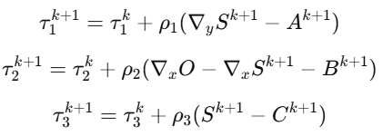

Update Lagrange multipliers :
Iterate until Maximum iterations reached
Convergence:
7

Slide 8

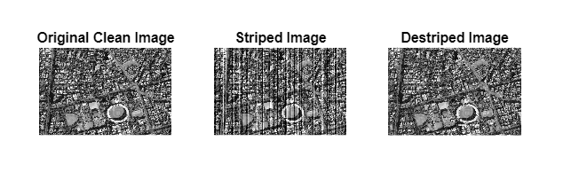
RESULTS
8

Slide 9
THANK YOU
10

