Slide 1
EduLang
Educational Programming Language Compiler
TEAM - 6
Team member’s :
Guide – Dr. V.Anu Ragavi
1. Abhinav - 2420090086
2. Akshith - 2420030207
3. B.Vishvak sai - 2420090024
A custom language with a visual, step-by-step compiler pipeline
EduLang | Educational Programming Language Compiler 01

Slide 2
Project Overview
What is EduLang?
EduLang is a small, custom-designed programming language.
It supports variables, input/output, conditions, loops and arrays.
A compiler dashboard demonstrates how source code moves through each stage.
The project is designed to make compiler concepts easier to understand.
EduLang | Educational Programming Language Compiler 02

Slide 3
Problem Statement
Why build EduLang?
Compiler design contains several abstract stages that can be difficult for beginners to visualize.
Traditional explanations often show separate concepts without connecting them to one program.
Students need a simple way to observe tokens, syntax trees, semantic checks and generated code.
EduLang combines these concepts in one interactive learning environment.
EduLang | Educational Programming Language Compiler 03

Slide 4
EduLang Language Features
Custom syntax and supported constructs
Data types: integer, decimal, String, boolean and character
Input and output: Input(variable), Output(expression)
Control flow: if / else, for ... to ... and while
Arrays: declaration, initialization and indexed access
Comments: single-line comments using //
No main() function or user-defined functions in version 1.0
EduLang | Educational Programming Language Compiler 04

Slide 5
Sample EduLang Program
A short example using variables, conditions and output
integer age = 20
String name = "Abhi"
if age >= 18 {
Output("Adult")
} else {
Output("Minor")
}
Output(name)
EduLang | Educational Programming Language Compiler 05

Slide 6
Compiler Architecture
The path from source code to final output
1. Source Code
EduLang input
2. Lexical Analysis
Token generation
3. Syntax Analysis
Parsing and AST
4. Semantic Analysis
Types and declarations
5. Execution
Program interpretation
6. Intermediate Code
TAC generation
7. Optimization
Code improvement
8. Target Code
Instruction listing
9. Final Output
Program result
EduLang | Educational Programming Language Compiler 06

Slide 7
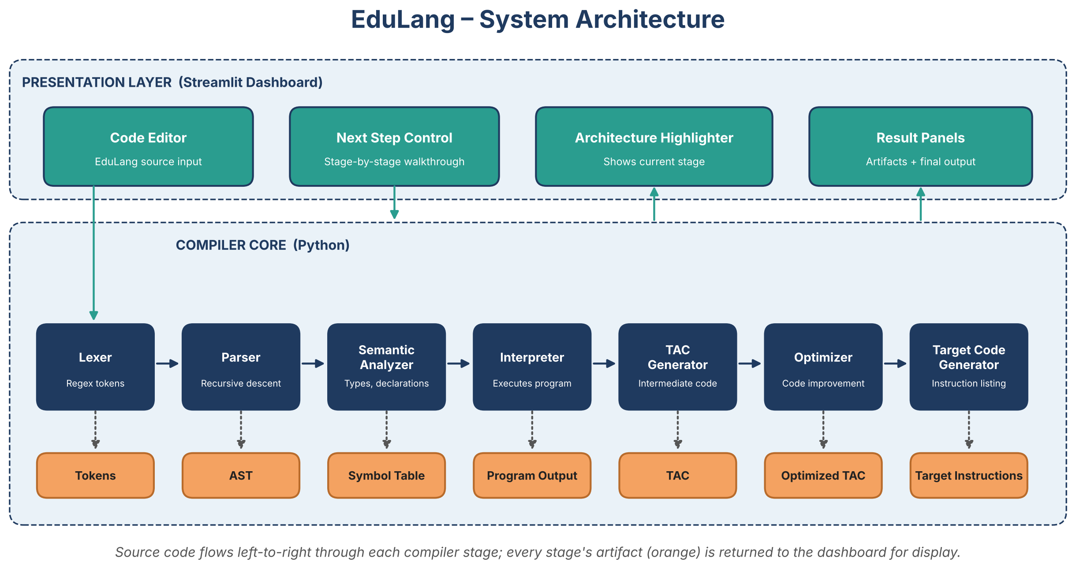
System Architecture
Presentation layer and compiler core of EduLang
EduLang | Educational Programming Language Compiler 07

Slide 8
Interactive Compiler Dashboard
Step-by-step walkthrough
The user enters a program in the EduLang code editor.
The architecture highlights the current compiler stage.
A Next Step button reveals the result of each stage.
The dashboard displays tokens, AST, symbol table, TAC, optimized listing and target instructions.
The final program output appears at the end of the walkthrough.
EduLang | Educational Programming Language Compiler 08

Slide 9
Technology Stack
Tools used to implement the prototype
Python – lexer, parser, semantic checks and interpreter logic
Streamlit – interactive web dashboard and step-by-step interface
Regular expressions – token recognition in lexical analysis
Recursive-descent parsing – syntax analysis and AST construction
Three Address Code style representation – intermediate code display
EduLang | Educational Programming Language Compiler 09

Slide 10
Conclusion & Future Scope
Summary and possible improvements
EduLang provides a practical demonstration of the major compiler stages.
Its custom syntax and dashboard make the compilation process easier to follow.
Future work: stronger optimization, more detailed semantic analysis and native target-code generation.
Additional features could include functions, nested scopes and richer error highlighting.
EduLang | Educational Programming Language Compiler 10

