Slide 1

Analyzing la liga(2014-15 to 2018-19) dataset
Data Preparation And Analysis

Slide 2
Introduction
LaLiga, officially called the Primera Division, represents the peak of Spanish football. With 20 leading teams in action for 38 thrilling matches each season, it's a favorite among football enthusiasts globally. La Liga is renowned for its star players and fierce rivalries. Our research goes beyond mere scores, delving into the league's dynamics. We're focused on uncovering the factors that determine match outcomes, adding valuable insights to the broader narrative of football excellence.”
GitHub Code link: - https://github.com/devendra1007/Project-DPAA.git

Slide 3
Project goals
Goal-Specific Predictions:
Forecast goals scored by each team in a match, offering granular insights into performance.
Home Advantage Dynamics:
Analyze home advantage trends over time, unraveling patterns and interactions against different opponents.
Win Probability Modeling:
Build a robust model predicting win probabilities throughout a match based on full-time score, half-time, and situational factors.
Game States Analysis:
Examine how specific game states, such as score lines and red cards, influence the likelihood of a win, draw, or loss at different stages of a match.
Attendance Impact:
Investigate the correlation between attendance and away team results, uncovering the influence of crowd support.
Goal Scoring Dynamics:
Assess the effectiveness of solo vs. assisted goals, understanding the impact of individual efforts versus team collaboration.
Betting System Evaluation:
Compare various betting systems to identify strategies that yield consistent and reliable results.

Slide 4
Dataset
Our dataset covers six La Liga seasons, from 2014-15 to 2018-19, with a total of 1900 matches. It contains 42 features, including details like match dates, home and away teams, goal stats, shots, fouls, cards, corners, and referee information. This dataset is the backbone of our project, allowing us to thoroughly analyze La Liga match outcomes.
Data Links:
https://www.football-data.co.uk/spainm.php
https://www.football-data.co.uk/notes.txt
https://fbref.com/en/comps/12/2014-2015/schedule/2014-2015-La-Liga-Scores-and-Fixtures

Slide 5

Data cleaning and integration
Loading Data:
Utilize the readxl and read.csv functions in R to load data from multiple CSV and Excel files (e.g., SP1.csv, SP2.csv, attend1.xlsx, attend2.xlsx).
Standardizing Column Names:
Ensure consistency by renaming common columns across datasets (e.g., "HomeTeam" to "Home" and "AwayTeam" to "Away").
Handling Date Formats:
Convert date columns to a consistent format for uniformity.

Slide 6

Data cleaning and integration
Joining Datasets:
Use the inner_join function from the dplyr package to merge datasets based on common columns (e.g., "Home," "Date," "Away").
Creating a Unified Dataset:
Combine the cleaned and joined datasets into a single dataframe for further analysis.

Slide 7
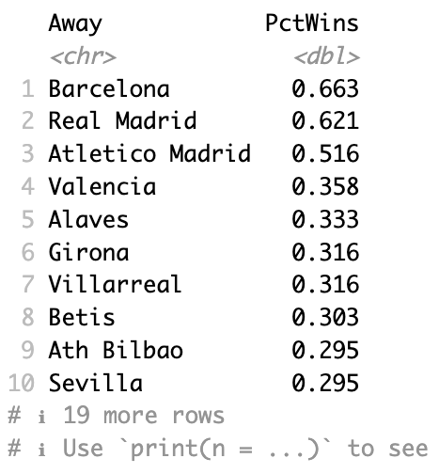
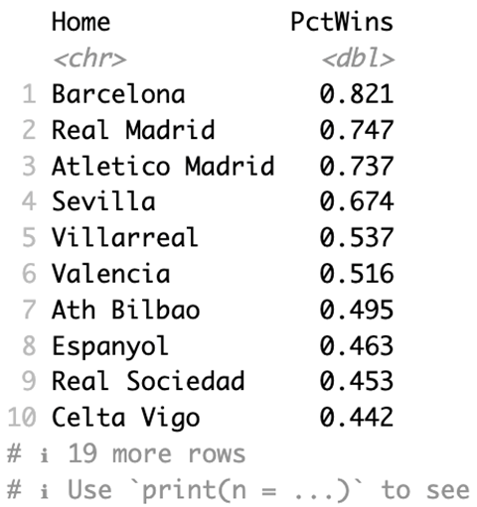
Home And team performance
In our study of the La Liga dataset from the 2014-15 to 2018-19 seasons, we're looking at how teams perform at home compared to when they play away. Understanding this helps us figure out how strong and strategic teams are in different settings—whether they're in their familiar home stadiums or playing in away fixtures.
Home Win Percentage :
Calculation of the percentage of matches won by each team when playing on their home turf.
Provides valuable insights into the team's home advantage and the extent of dominance they exhibit in familiar surroundings.
Away Win Percentage :
Evaluation of the percentage of matches won by each team in away games.
Crucial for assessing a team's performance on unfamiliar turf, reflecting their ability to secure victories in challenging conditions.

Slide 8
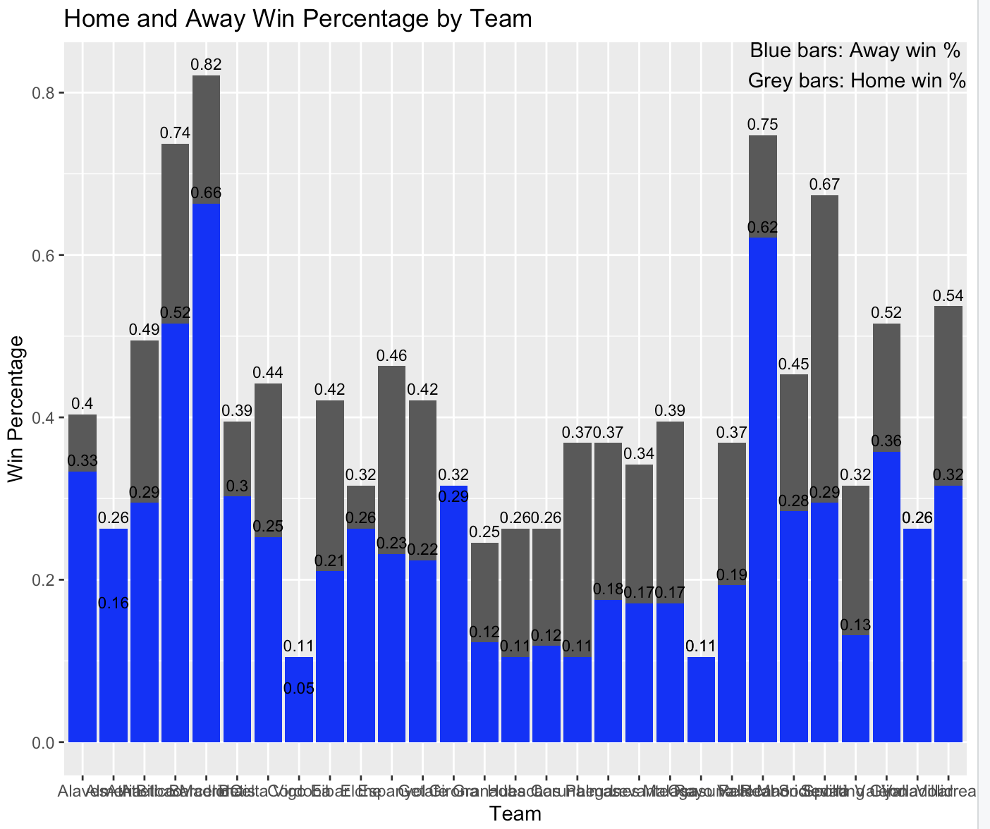
Home And team performance

Slide 9
Attendance and away team performance
Exploring the Influence of Attendance:
A pivotal aspect of our La Liga dataset analysis (2014-15 to 2018-19) involves examining how the presence of spectators affects the away team's performance. We delve into whether the size of the crowd in the stadium plays a role in determining how well the away team performs during matches.
Visualizing the Relationship with Scatter Plots:
To vividly illustrate this connection, scatter plots are utilized. These visual aids demonstrate the correlation between attendance numbers and the goals scored by the away team. The goal is to decipher whether the attendance, be it large or small, has an impact on the away team's goal-scoring ability and, consequently, their overall performance.

Slide 10
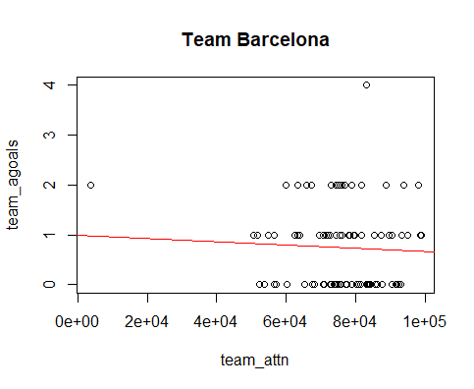
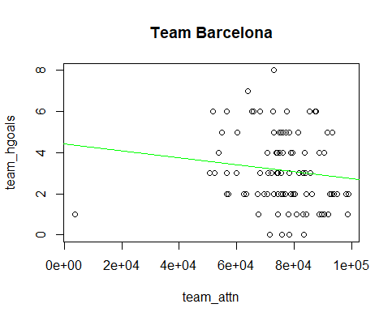
Graphical Representation on away Goals and Home Goals

Slide 11
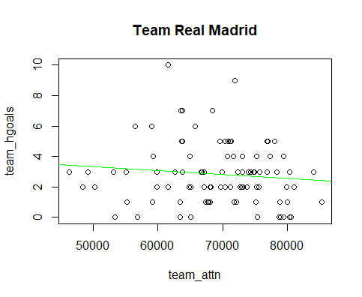
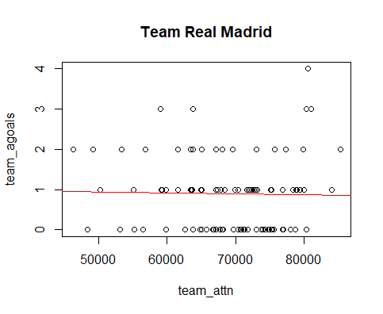
Graphical Representation on away Goals and Home Goals

Slide 12
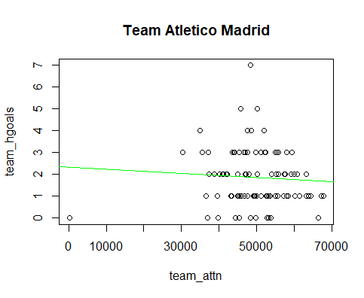
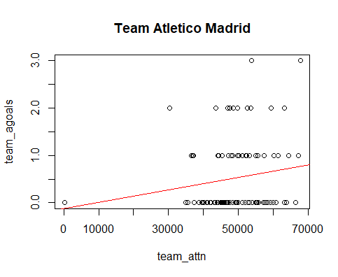
Graphical Representation on away Goals and Home Goals

Slide 13
a model to estimate win probability throughout a match based on available feartures
1. Objective: Develop models predicting match outcomes based on half-state variables for home and away teams.
2. Model Performance: Home team model achieves 62.4% accuracy, slightly higher than the away team model at 61.4%.
3. Sensitivity Analysis: Both models show high sensitivity for "Home Win," but lower sensitivity for "Draw" and "Away Win," indicating limitations.
4. Reliability Concerns: Models are less reliable in predicting draws and away team victories, suggesting the need for more data to improve accuracy in these areas.
5. Evaluation Metrics: Confusion matrices and classification metrics from the caret package were used to comprehensively assess model performance.
6. Room for Improvement: Acknowledge the models' strengths and limitations, emphasizing potential enhancements through additional data sources and feature refinement.
7. Future Directions: Suggest exploring advanced modeling techniques and considering alternative features to boost predictive capabilities for specific match outcomes.

Slide 14
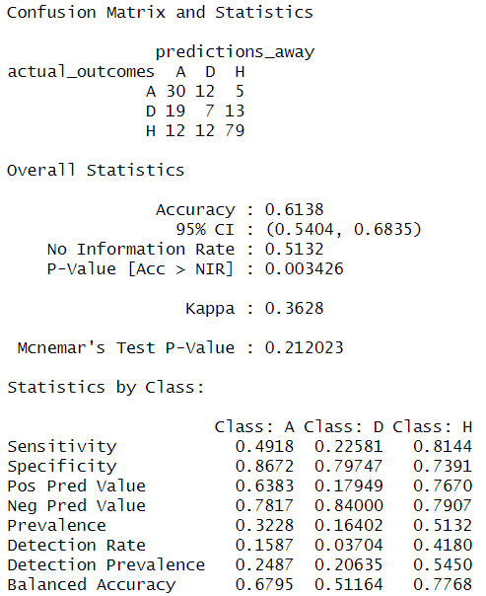
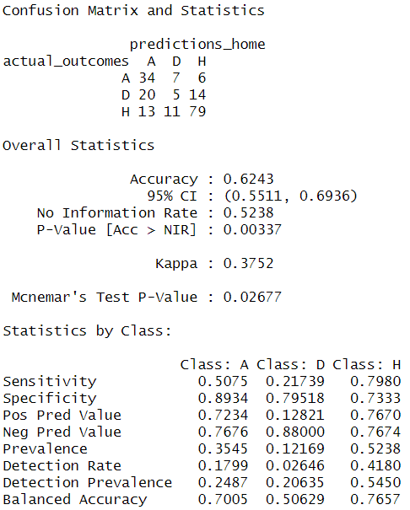
Results

Slide 15
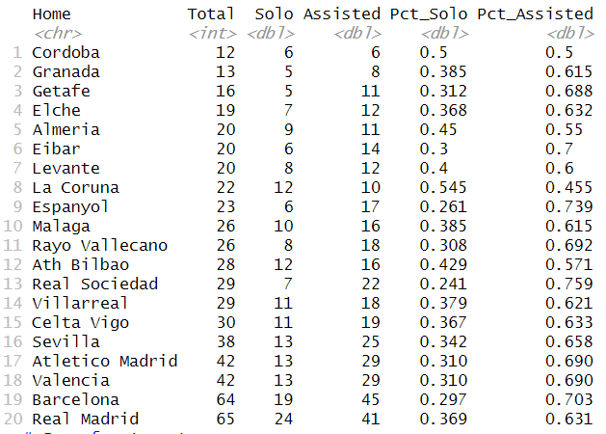
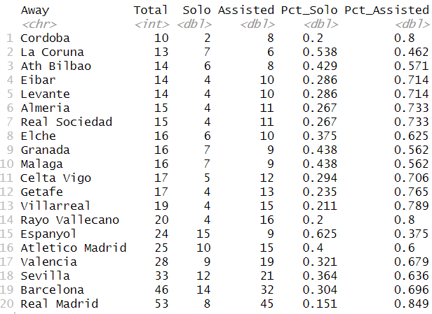
Solo vs assisted goals
In this analysis, we sort each goal into two types: solo goals and assisted goals. Solo goals show individual skill, where a player scores alone. Assisted goals highlight teamwork, where one or more players contribute to the goal. We then compile how many of each type each team scored across the seasons we're looking at. This gives us a clear picture of how teams perform in different aspects of goal-scoring.

Slide 16
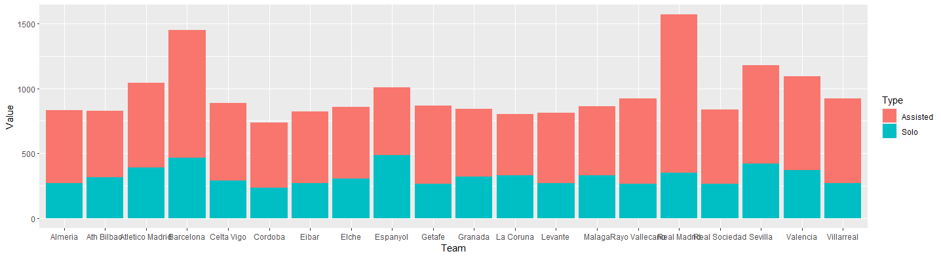
SOLO VS ASSISTED GOALS

Slide 17
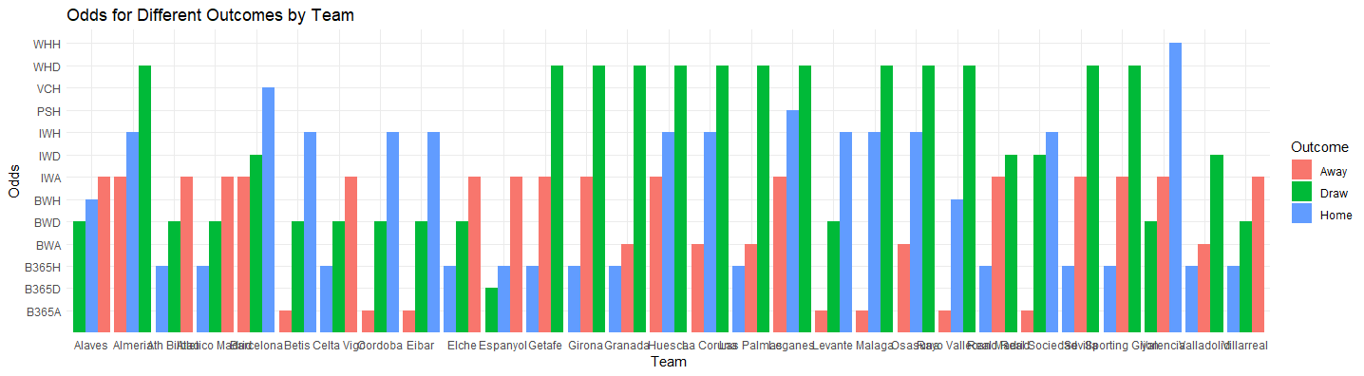
Betting Odds Analysis
Objective: Understand bookmakers' assessments of team result likelihoods.
Betting System Exploration:
We examine various betting systems, including the widely used B365. Understanding these systems provides insights into the intricate world of betting and bookmakers' preferences.
Team-wise Odds Analysis:
To simplify, we use a bar chart to visualize odds for each team, indicating home win, draw, and away win probabilities. This visual representation helps compare odds for different outcomes and provides a holistic view of how bookmakers perceive each team's strengths and weaknesses in the La Liga dataset.

Slide 18
HOME VS AWAY VS DRAW WIN PERCENTAGE
1. Home Win Percentage Analysis:
- Initial focus on calculating each team's overall percentage of home wins, highlighting that Barca and Real Madrid stand out with home win rates exceeding 80% and 75%, respectively.
2. Home Advantage Metrics by Outcome:
- Delving deeper, metrics are segmented by match outcome, offering insights such as win percentages, average home and away goals. Notable findings include Barcelona's higher goal average in home wins compared to away wins.
3. Visualization Through Pie Charts:
- Employing pie charts to visually represent the percentage distribution of match outcomes for each team. Notably, teams with stronger home advantages, like Barca, exhibit larger slices for home wins.
4. Home Advantage Over Time:
- A comprehensive analysis over time, assessing each team's home advantage in terms of win percentage, goals scored, and conceded. The data is grouped by Home team and Year, revealing dynamic trends and variations.
5. Data Insights:
- Highlighting specific insights from the analysis, such as Barcelona's peak home win rate in 2017 dropping to 90% in 2019, variations in home advantages for teams like Real Madrid and Atletico Madrid in different years, and fluctuating trends for teams like Celta Vigo and Athletic Bilbao.
6. Assessment of Newly Promoted Teams:
- Pointing out specific cases, such as newly promoted team Huesca starting with a 0% home win rate in 2018, illustrating the challenges faced by these teams in their initial seasons.
7. Long-Term Home Dominance Visualization:
- Concluding with the importance of plotting HomeWinPct over Years for each team, providing a clear visual representation of how home dominance fluctuates over seasons, offering insights into factors like squad quality, tactics, and management.

Slide 19
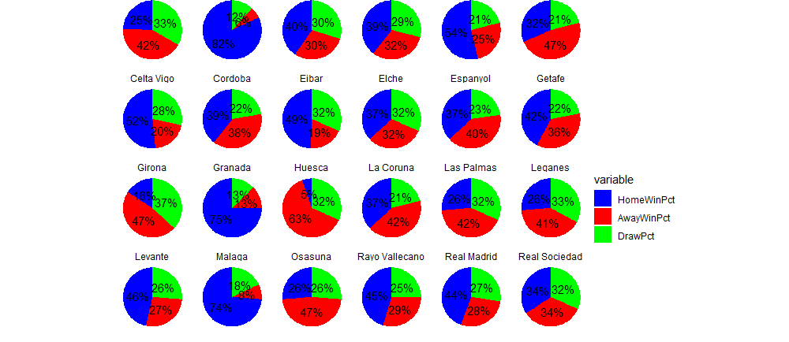

Slide 20
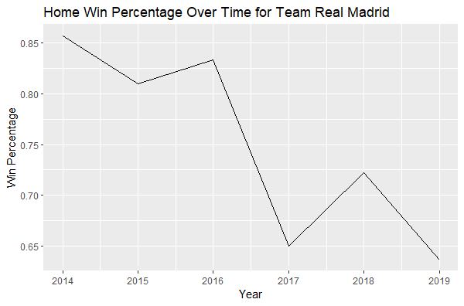
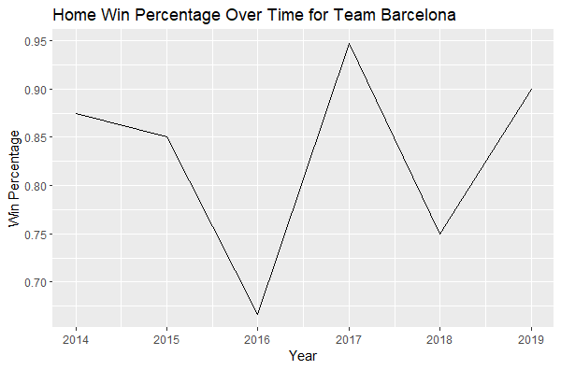
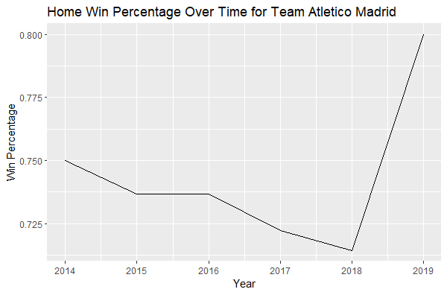
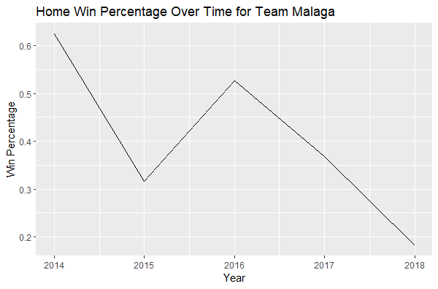

Slide 21
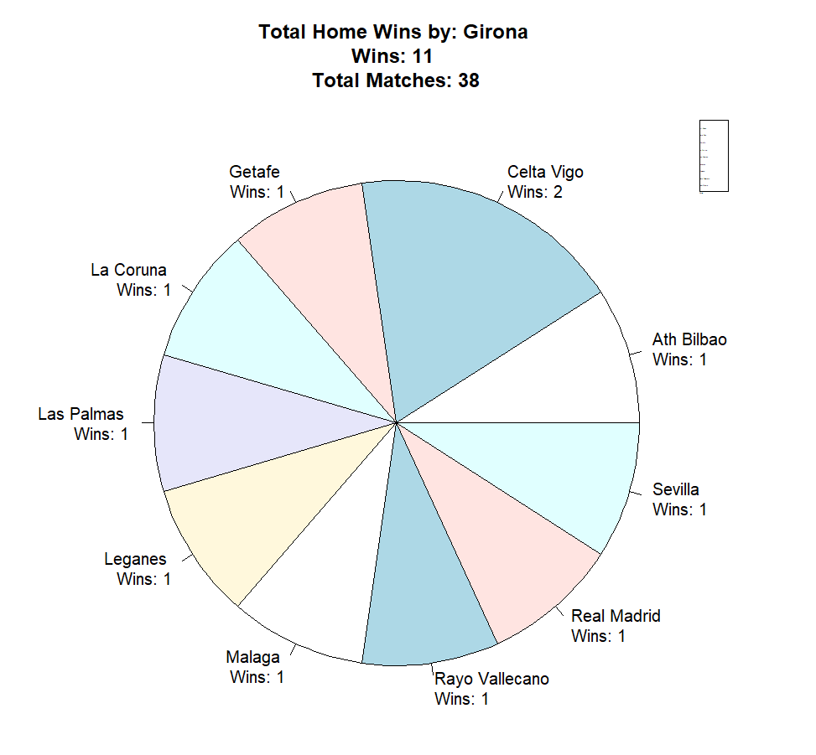
Team wise home win analysis
This visual analysis allows the audience to discern which opponents teams tend to perform better against at home. It sheds light on team-specific strengths and challenges in their home matches, contributing to a nuanced understanding of their overall performance dynamics.

Slide 22
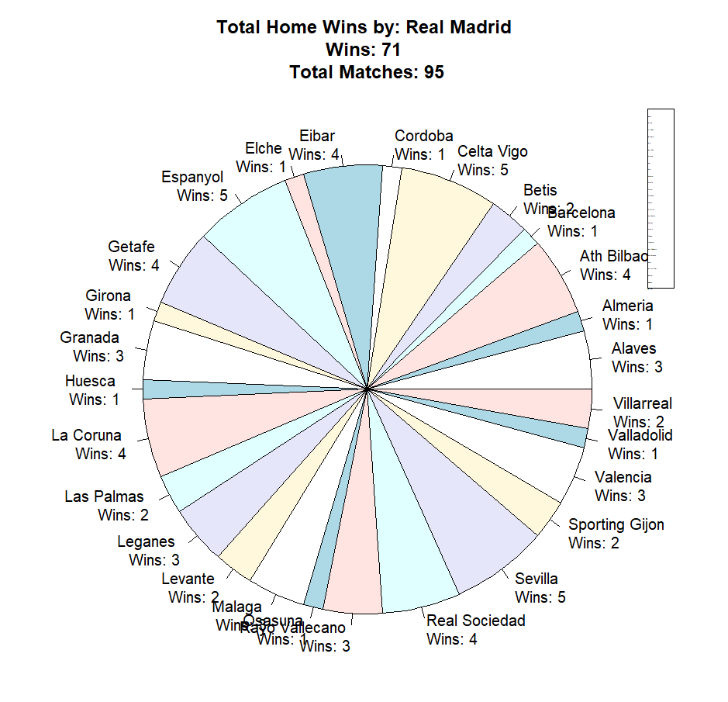
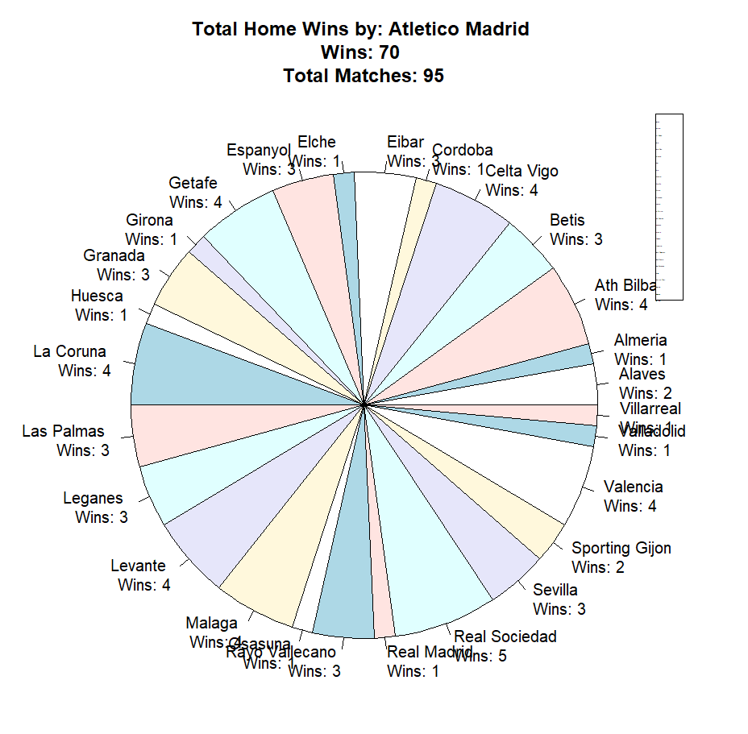
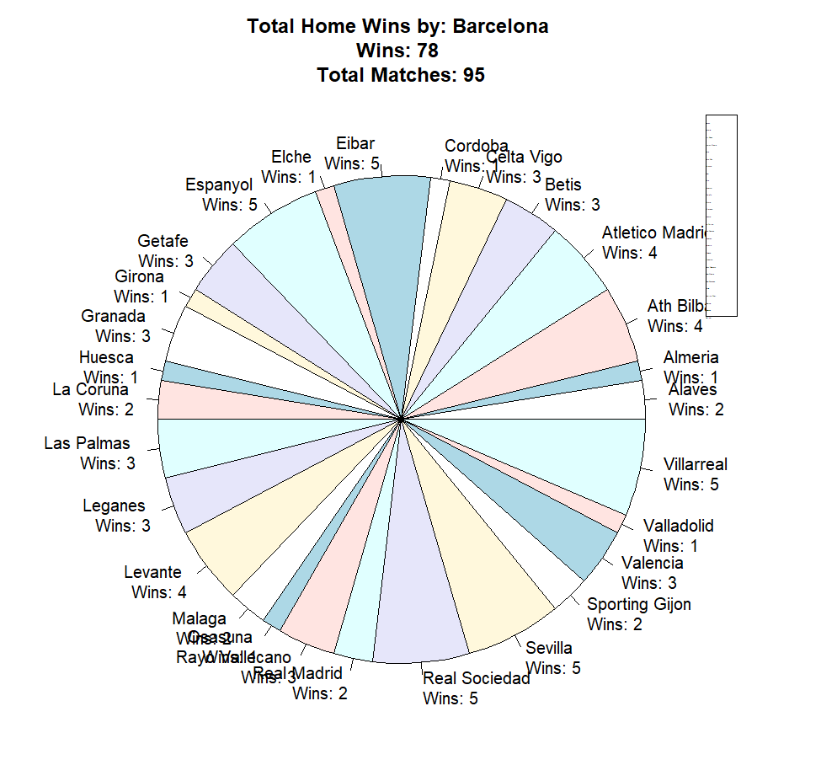
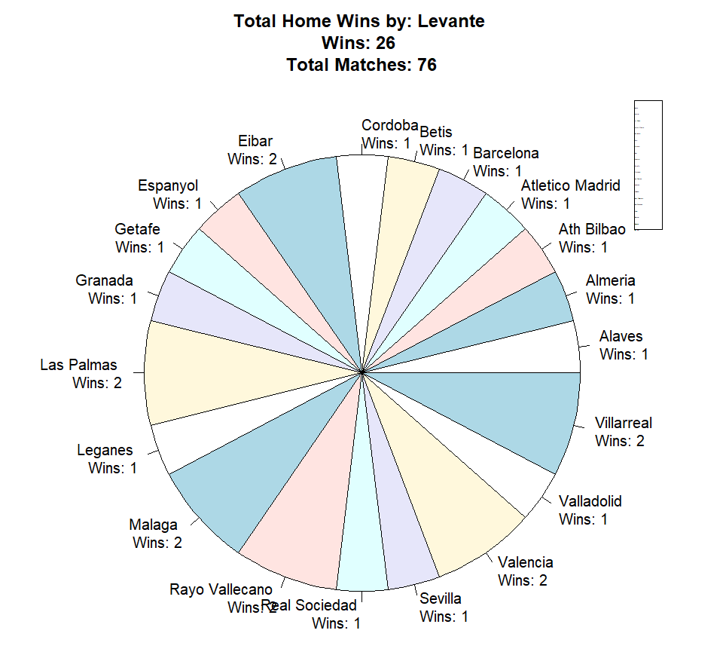
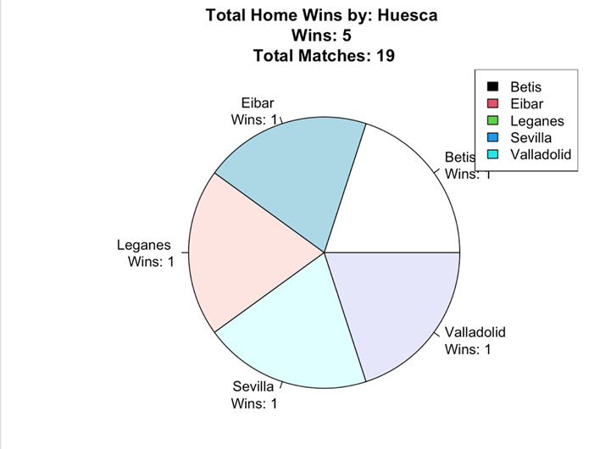

Slide 23

CONCLUSION
In summary, our thorough examination of the LaLiga dataset from 2014–15 to 2018-19, combining statistical analysis and data exploration, provided valuable insights into the complexities of LaLiga football. From predicting goals to understanding home advantage and exploring various factors, our study contributes to the field of sports analytics and sets the stage for future research.

Slide 24

Future scope
The initiative appears promising in the future, focusing on advanced study in LaLiga football dynamics. It aims to improve statistical models by incorporating sophisticated methodologies and machine learning to gain deeper insights into match patterns. By expanding the analysis beyond 2018-19 with real-time data, the initiative serves as both a snapshot and a platform for ongoing exploration and breakthroughs in football prediction. Which can improve the constructed model's accuracy.

Slide 25

THANK YOU

