Slide 1
TrackMe
Group 29
Paul Bodenbenner
Rainer Lankmayr
Benjamin Steinacher
Anna Weber

Slide 2
Overview
Let friends track your position
Show your friends on a map
share your status via a short message and show availability
Information shared:
Name
Location (Distance)
Profile Image
Timestamp
Status

Slide 3
Technical Details
Android Version 4.0
Google Maps API
GPS Sensors / Google Location API
Central User Management on Database Server
On demand location polling
UI Design Pattern: Action Bar + Navigation Drawer

Slide 4
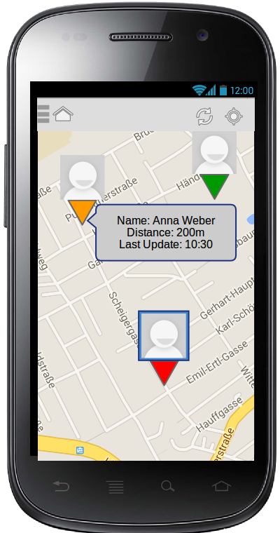
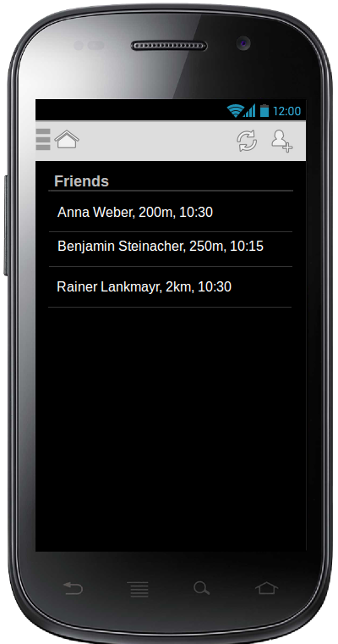

Slide 5
