Slide 1


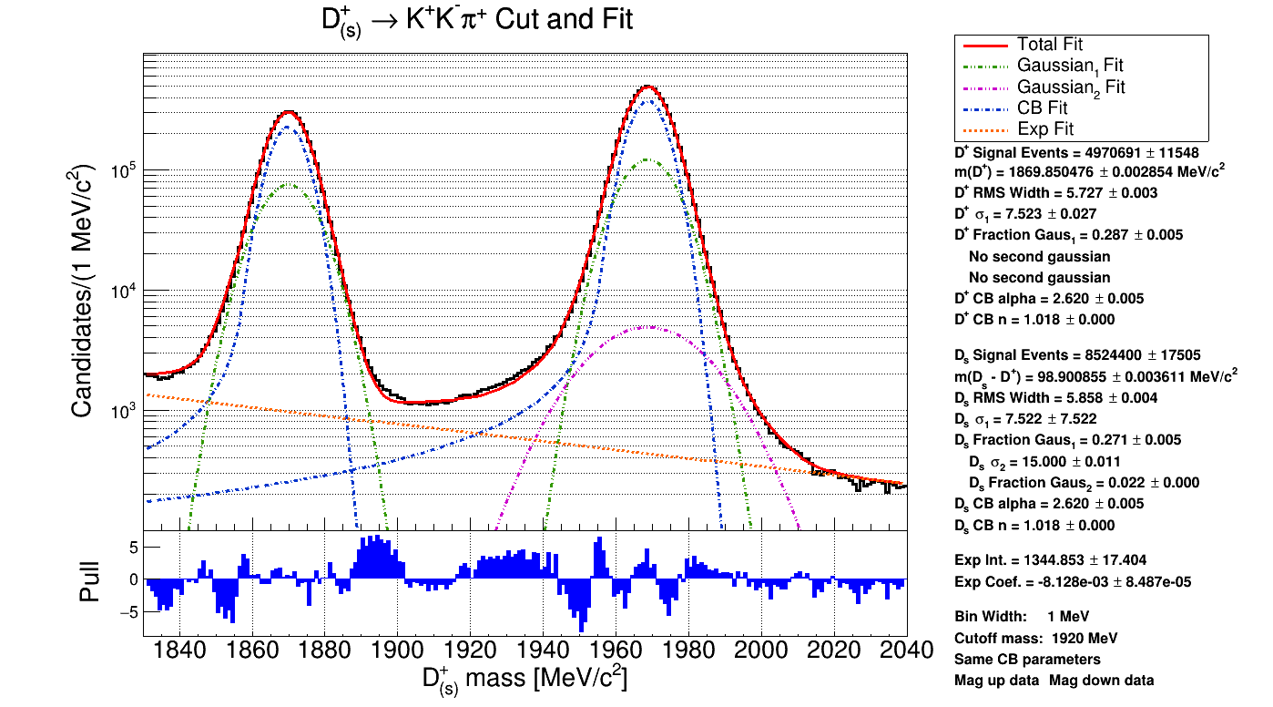
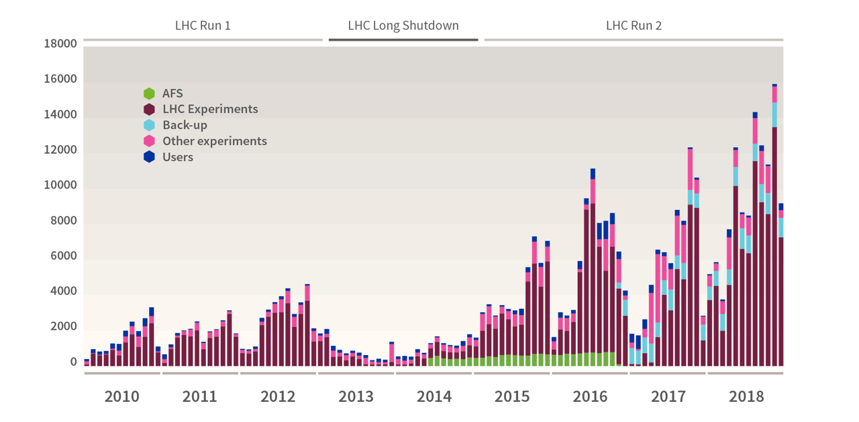
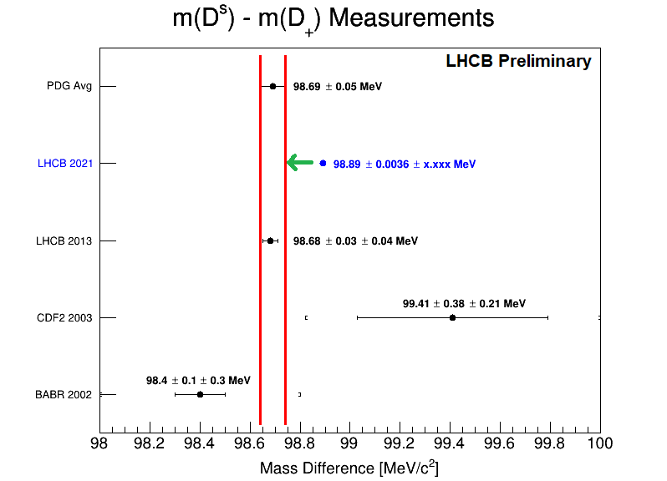
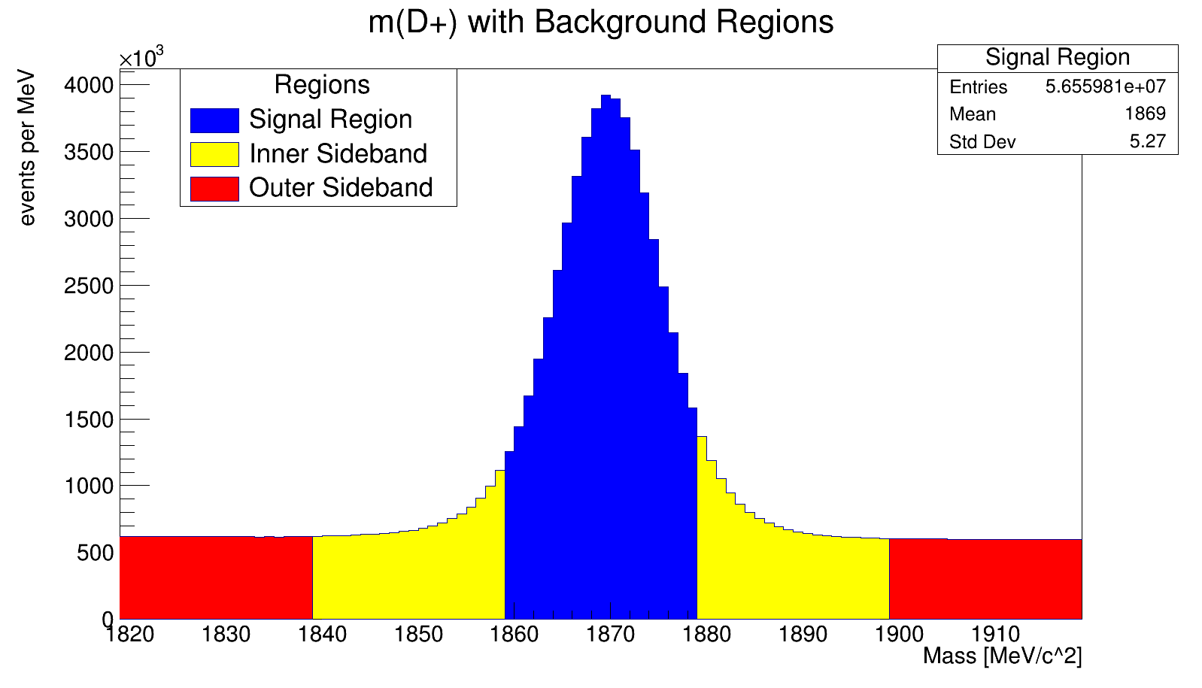

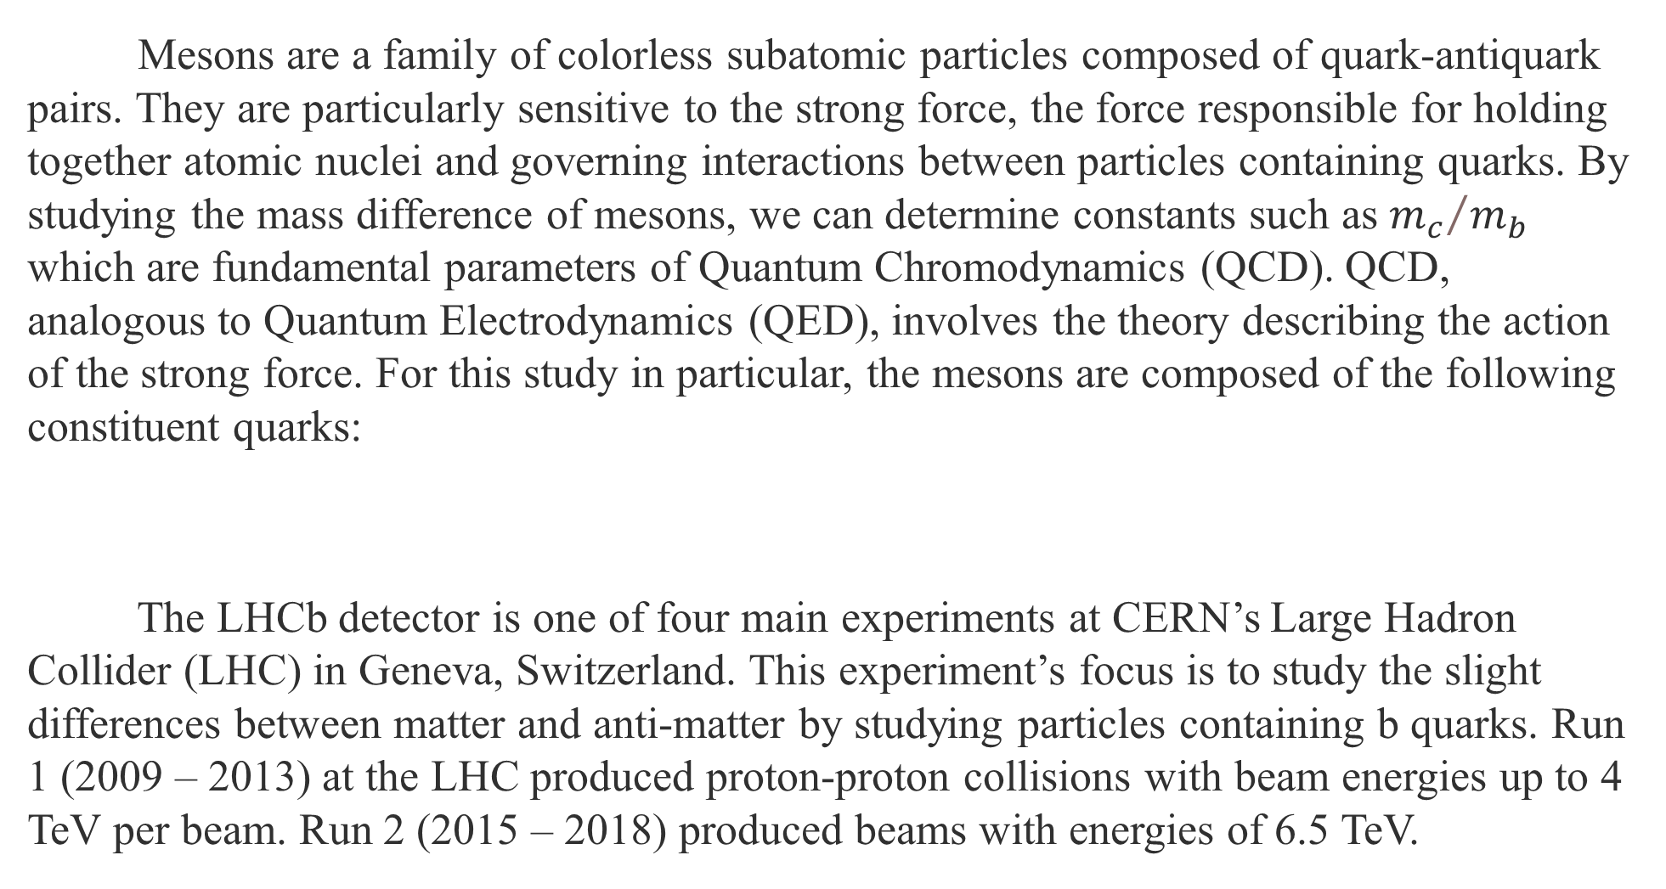
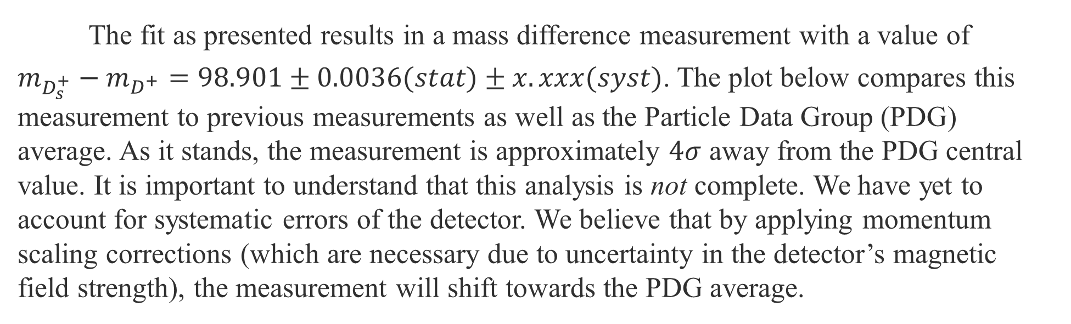
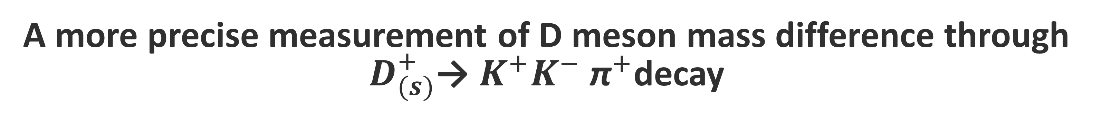
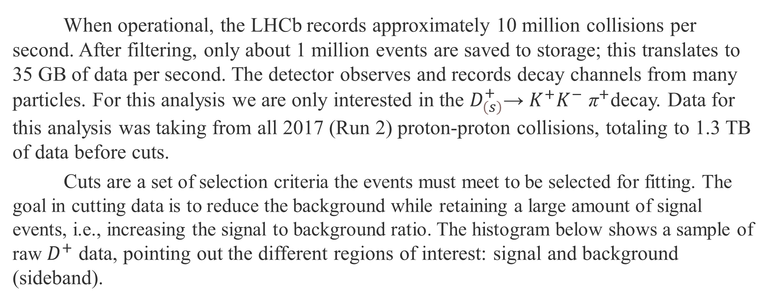
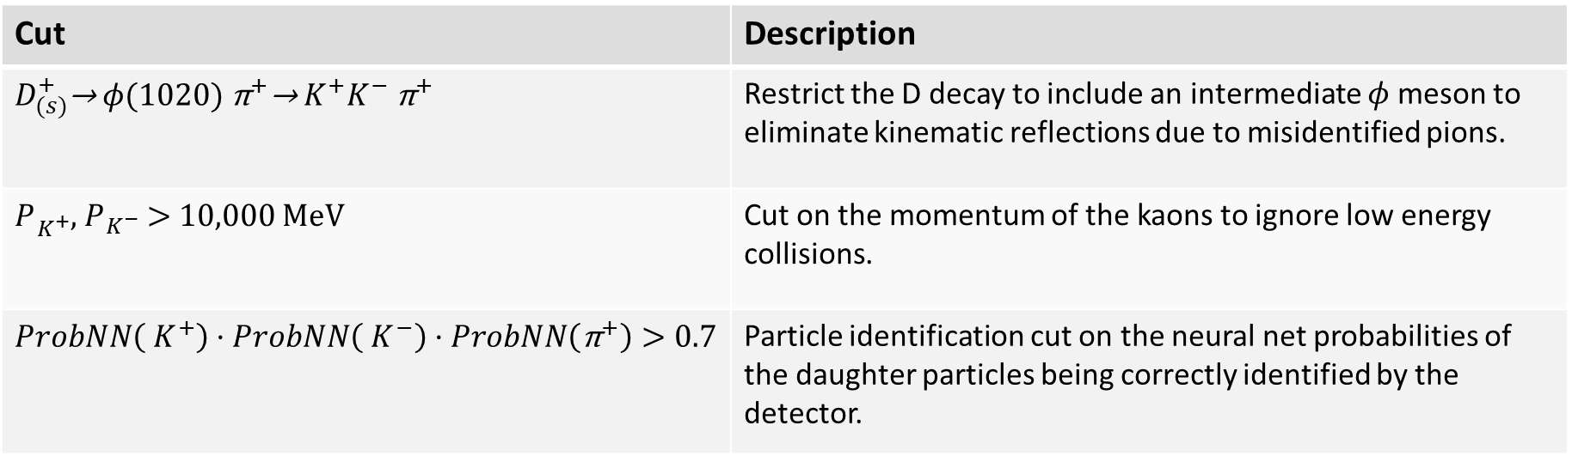

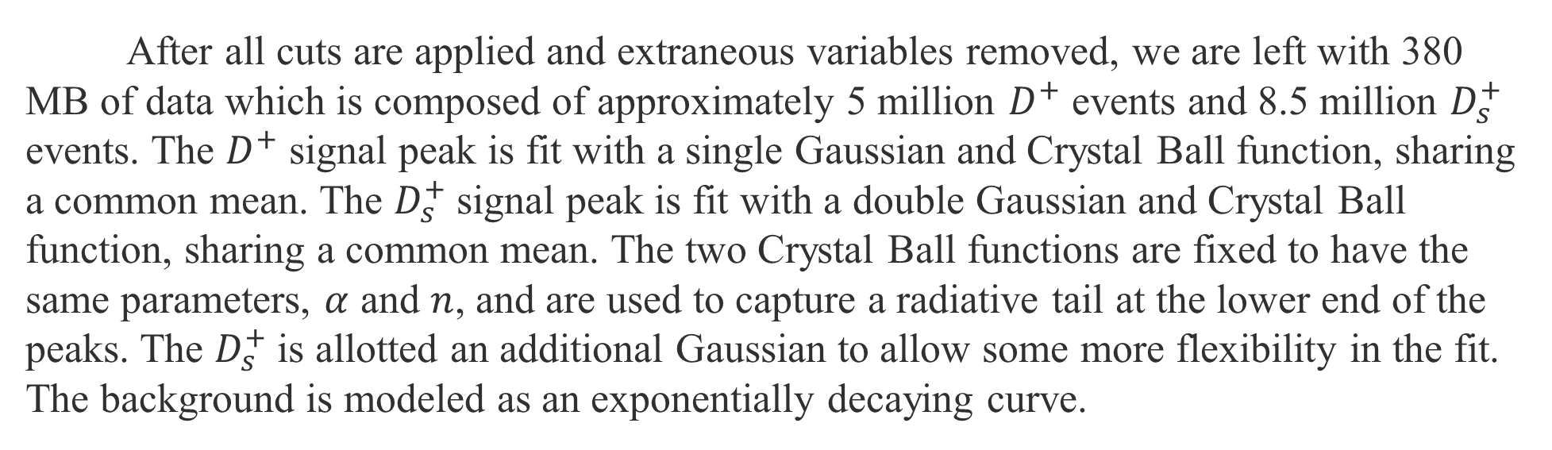
A more precise measurement of D meson mass difference through $D_{(s)}^{+}$→ $K^{+}K^{−}$ ${\text{π}}^{+}$decay
John Bodenschatz
University of Cincinnati
INTRODUCTION
CONCLUSIONS
Mesons are a family of colorless subatomic particles composed of quark-antiquark pairs. They are particularly sensitive to the strong force, the force responsible for holding together atomic nuclei and governing interactions between particles containing quarks. By studying the mass difference of mesons, we can determine constants such as ${m_{c}}/{m_{b}}$ which are fundamental parameters of Quantum Chromodynamics (QCD). QCD, analogous to Quantum Electrodynamics (QED), involves the theory describing the action of the strong force. For this study in particular, the mesons are composed of the following constituent quarks:
The LHCb detector is one of four main experiments at CERN’s Large Hadron Collider (LHC) in Geneva, Switzerland. This experiment’s focus is to study the slight differences between matter and anti-matter by studying particles containing b quarks. Run 1 (2009 – 2013) at the LHC produced proton-proton collisions with beam energies up to 4 TeV per beam. Run 2 (2015 – 2018) produced beams with energies of 6.5 TeV.
After all cuts are applied and extraneous variables removed, we are left with 380 MB of data which is composed of approximately 5 million $D^{+}$ events and 8.5 million $D_{s}^{+}$ events. The $D^{+}$ signal peak is fit with a single Gaussian and Crystal Ball function, sharing a common mean. The $D_{s}^{+}$signal peak is fit with a double Gaussian and Crystal Ball function, sharing a common mean. The two Crystal Ball functions are fixed to have the same parameters, $α$ and $n$, and are used to capture a radiative tail at the lower end of the peaks. The $D_{s}^{+}$is allotted an additional Gaussian to allow some more flexibility in the fit. The background is modeled as an exponentially decaying curve.
$$|D^{+}⟩= \left|c\overline{d}\right\rangle$$
$$|D_{s}^{+}⟩= |c\overline{s}⟩$$
LHCb Preliminary
$D^{+}$ and $D_{s}^{+}$ signal and background fit after all applied cuts. Signal to background ratio ratio $≈400.$
The fit as presented results in a mass difference measurement with a value of
$m_{D_{s}^{+}}−m_{D^{+}}=98.901±0.0036(stat)±x.xxx(syst)$. The plot below compares this measurement to previous measurements as well as the Particle Data Group (PDG) average. As it stands, the measurement is approximately $4σ$ away from the PDG central value. It is important to understand that this analysis is not complete. We have yet to account for systematic errors of the detector. We believe that by applying momentum scaling corrections (which are necessary due to uncertainty in the detector’s magnetic field strength), the measurement will shift towards the PDG average.
Histogram from CERN Computing showing the data (TB) recorded at CERN month-by-month. In 2017, 40 PB of LHC data were recorded on magnetic tapes at the CERN data center.
METHOD
When operational, the LHCb records approximately 10 million collisions per second. After filtering, only about 1 million events are saved to storage; this translates to 35 GB of data per second. The detector observes and records decay channels from many particles. For this analysis we are only interested in the $D_{\left(s\right)}^{+}$→ $K^{+}K^{−}$ ${\text{π}}^{+}$decay. Data for this analysis was taking from all 2017 (Run 2) proton-proton collisions, totaling to 1.3 TB of data before cuts.
Cuts are a set of selection criteria the events must meet to be selected for fitting. The goal in cutting data is to reduce the background while retaining a large amount of signal events, i.e., increasing the signal to background ratio. The histogram below shows a sample of raw $D^{+}$ data, pointing out the different regions of interest: signal and background (sideband).
FUTURE WORK
As suggested above, this analysis has some work yet to be completed. Our priority moving forward will be to focus on the systematic uncertainties and how they will affect our measurement. The green arrow in the left plot indicates the direction we expect our measurement to move after considering systematics.
LHCb Preliminary
REFERENCES
BaBar Collaboration, B. Aubert et al., Measurement of D+ s and D∗+ s production in B meson decays and from continuum e +e − annihilation at √ s = 10.6 GeV, Phys. Rev. D65 (2002) 091104, arXiv:hep-ex/0201041
CERN. (2018, June). Key Facts and Figures – CERN Data Centre.
CERN. (2008). LHCb - Large Hadron Collider beauty experiment. LHCb Public. https://lhcb-public.web.cern.ch/en/Data%20Collection/Triggers-en.html#:%7E:text=When%20LHCb%20is%20up%20and,million%20proton%20collisions%20every%20second.
Fritzsch, H. (2012, September 27). The history of QCD. CERN Courier. https://cerncourier.com/a/the-history-of-qcd/
Jose L. Goity, Chandana P. Jayalath, Strong and Electromagnetic Mass Splittings in Heavy Mesons, arXiv:hep-ph/0701245
LHCb Collaboration, R. Aaij et al., Precision measurement of D meson mass differences, arXiv:hep-ex/1304.6865
Sample of the $D^{+}$ data before cuts are applied. Signal to background ratio $≈8$.
Below is a table of some cuts used and their justifications. Each cut is tested to maximize signal to background ratio while maintaining physically validity.
Cut | Description
$D_{(s)}^{+}$→ $φ(1020)$ ${\text{π}}^{+}\text{→}{ K}^{+}K^{−} {\text{π}}^{+}$ | Restrict the D decay to include an intermediate $φ$ meson to eliminate kinematic reflections due to misidentified pions.
$P_{{ K}^{+}}^{ }$, $P_{{ K}^{−}}^{ }$ > 10,000 MeV | Cut on the momentum of the kaons to ignore low energy collisions.
$$ProbNN\left({ K}^{+}\right)·ProbNN\left({ K}^{−}\right)·ProbNN\left({\text{π}}^{+}\right)>0.7$$ | Particle identification cut on the neural net probabilities of the daughter particles being correctly identified by the detector.
ACKNOWLEDGEMENTS
Dr. Michael Sokoloff for his guidance and assistance throughout the research process.
Peer researchers working on similar topics for the advice they have offered.
The LHCb Organization for answering any and all questions.
This research was made possible thanks to grants from the National Science Foundation

