Slide 1

Heart Disease Prediction Using Machine Learning
Project Supervisor: Mrs. Karthika J
Name of the Student: B. Lakshmi Priya
Register Number: 39110174

Slide 2
Presentation Outline
Course Certificate
Introduction
Hardware and software requirements
Objectives
Ideation map
Project Implementation
Methodology
Source Code
Results
References

Slide 3
Course Certificate

Slide 4
Introduction
Heart disease can be managed effectively with a combination of lifestyle changes, medicine and, in some cases, surgery. With the right treatment, the symptoms of heart disease can be reduced and the functioning of the heart improved.
The final output of my work will be to predict accurately with few tests and attributes the presence of heart disease.

Slide 5
Hardware and Software Requirements
SOFTWARE
Operating System: Windows
Coding Language: Python 3.7
HARDWARE
• Processor – Intel core i5
• Speed – 1.19 GHz
• RAM - 512 MB (min)

Slide 6
Objectives
The main objective of this research is to develop a heart prediction system.
The Heart Disease Prediction System(HDPS) predicts the likelihood of patients getting heart disease.
The overall objective of my work will be to predict accurately with few tests and attributes the presence of heart disease.

Slide 7
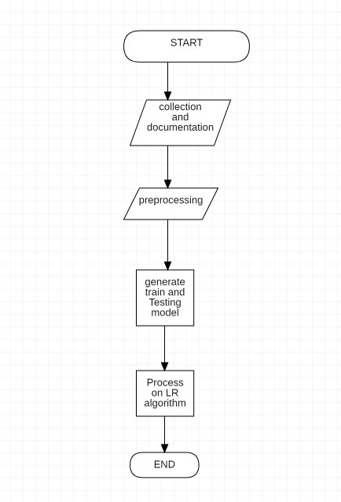
Ideation Map

Slide 8
Project Implementation
The working of the system starts with the collection of data and selecting the important attributes. Then the required data is pre-processed into the required format.
The data is then divided into two parts training and testing data. The algorithms are applied and the model is trained using the training data. The accuracy of the system is obtained by testing the system using the testing data. This system is implemented using the following modules.
1.) Collection of Dataset
2.) Selection of attributes
3.) Data Pre-Processing
4.) Balancing of Data
5.) Disease Prediction

Slide 9
Methodology
Machine learning is the study of computer algorithms that improve automatically through experience.
Usage of machine learning algorithm which is Logistic Regression is used to predict the heart disease.
Logistic regression is one of the most popular Machine Learning algorithms, which comes under the Supervised Learning technique. It is used for predicting the categorical dependent variable using a given set of independent variables.

Slide 10
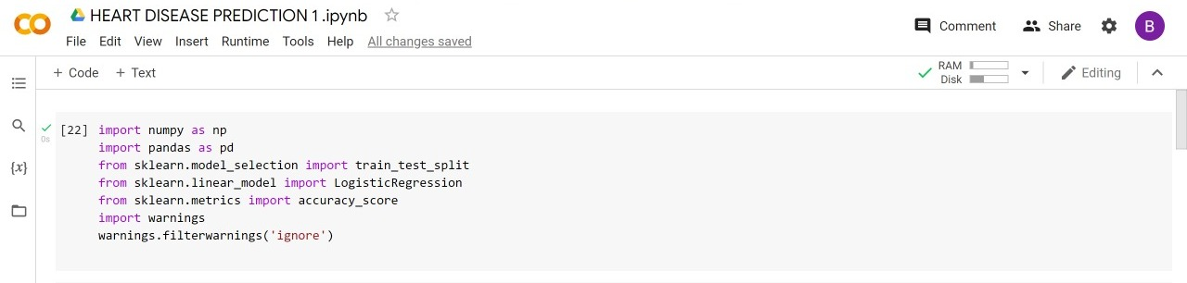
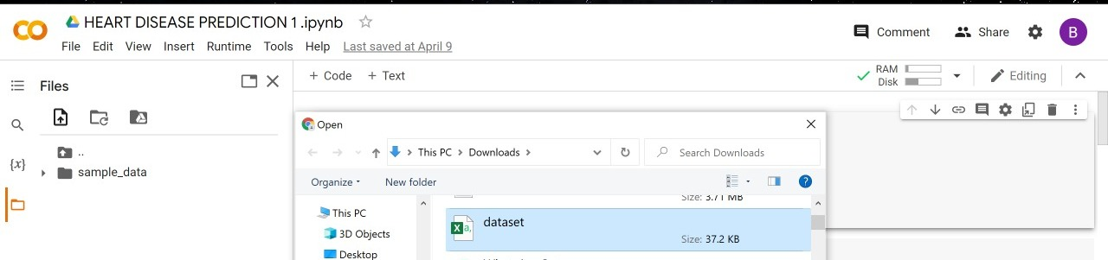
Source code
1)import the numpy , pandas and required sklearn models
2)import the data set

Slide 11
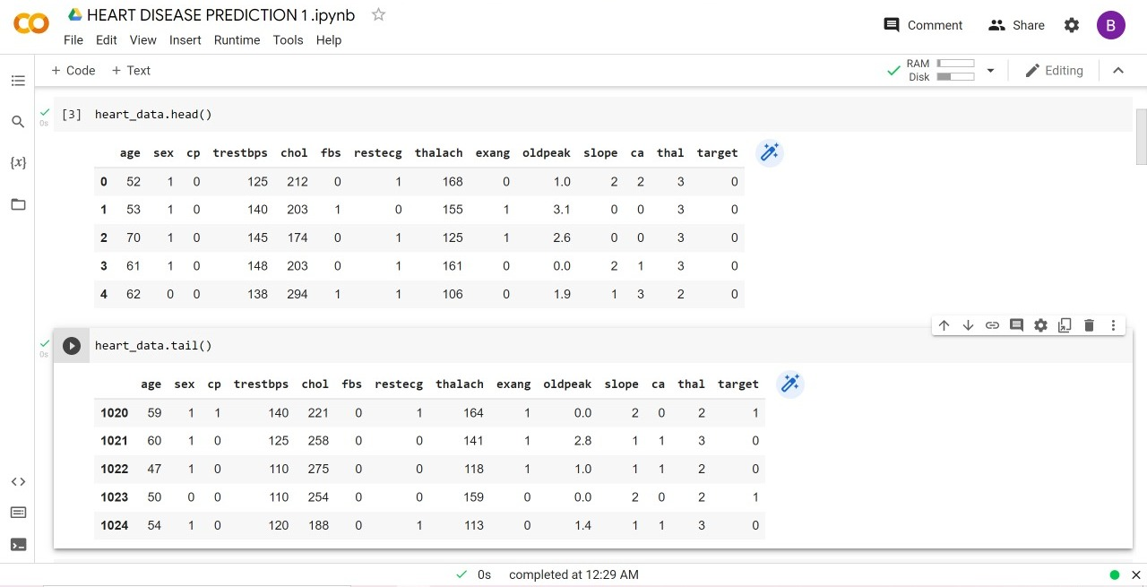
Source code
3)get the head and tail of the data set

Slide 12
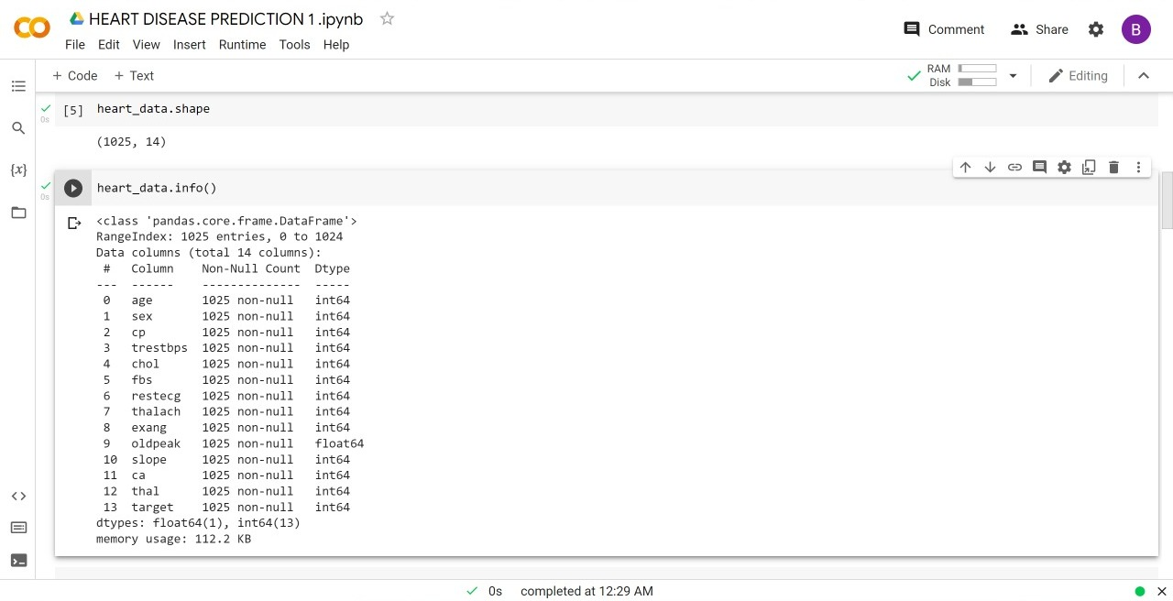
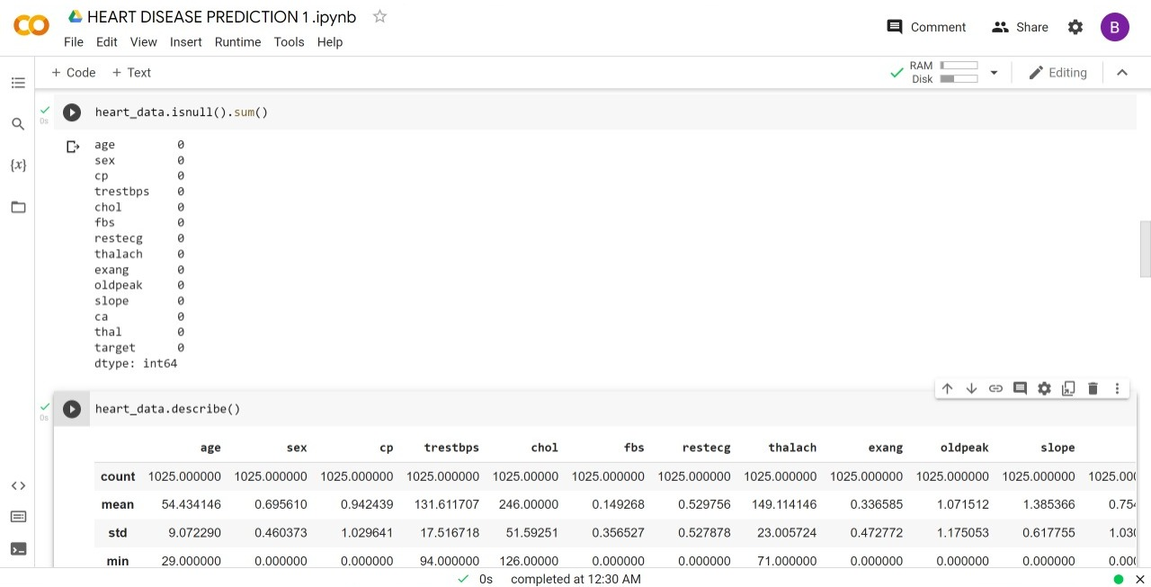
Source code
4)get the shape , info, null values and describe the data from the data set.

Slide 13
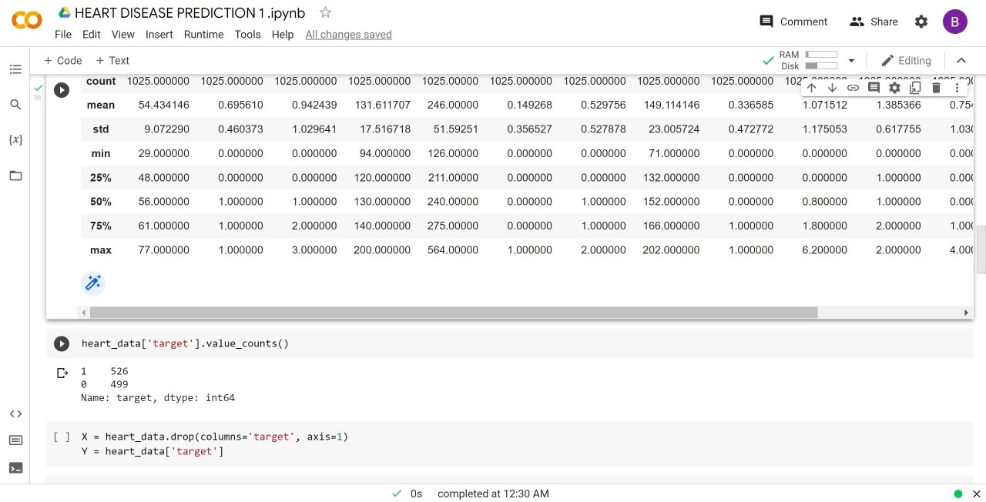
Source code
5)get the target value from the data

Slide 14
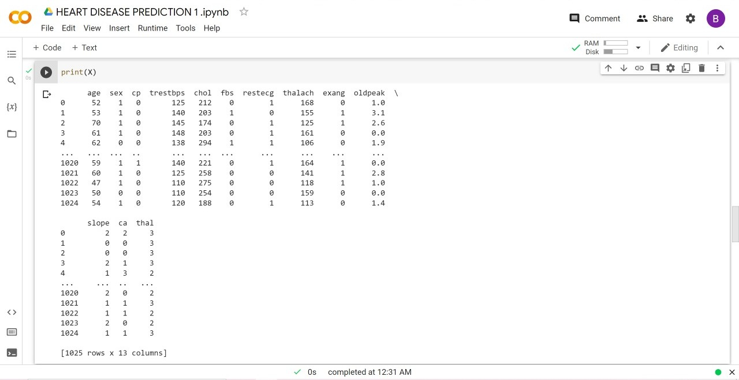
Source code
6) Print x value

Slide 15
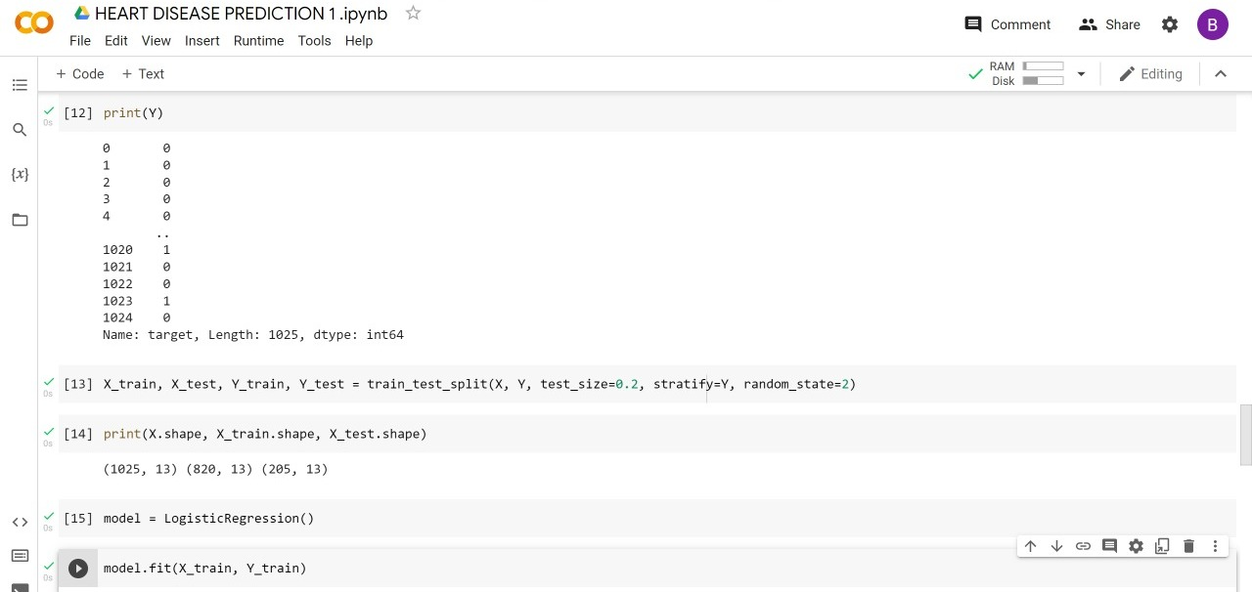
Source code
7) print y value and get the final values of x

Slide 16
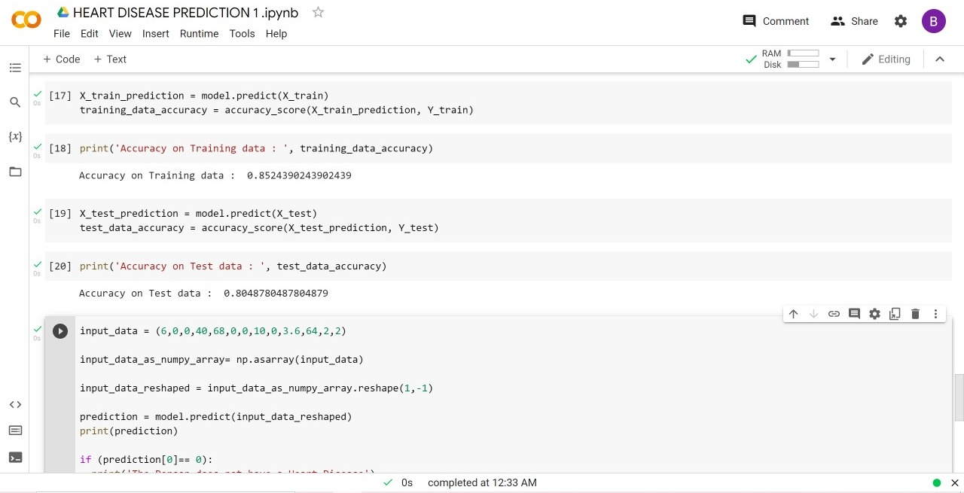
Source code
8)import the prediction models and get the accuracy of training data and test data

Slide 17
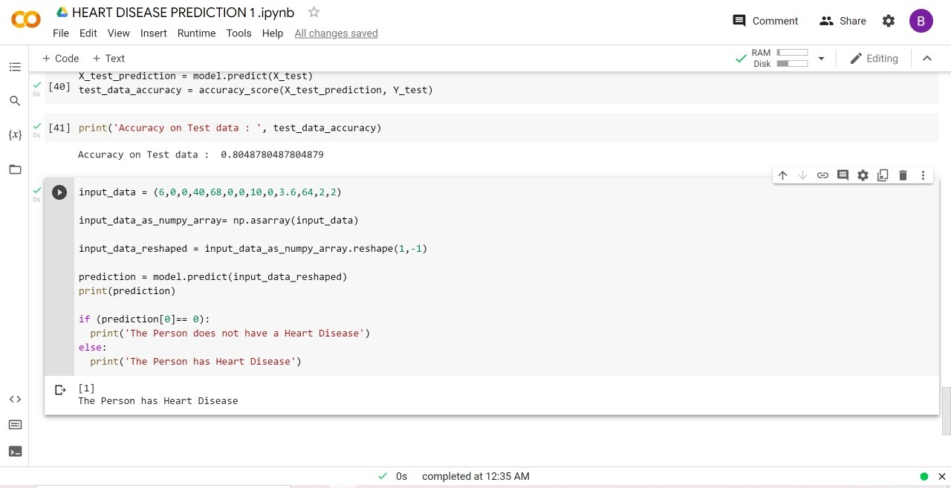
Source code
9)input the data and get the final output whether the patient has heart disease or not

Slide 18
Results
With the increasing number of deaths due to heart diseases, it has become mandatory to develop a system to predict heart diseases effectively and accurately.
The motivation for the study was to find the most efficient ML algorithm for detection of heart diseases.
This study sees the accuracy score of Logistic Regression algorithm for predicting heart disease using UCI machine learning repository dataset.
The result of this study indicates that the Logestic regression algorithm is the efficient algorithm with accuracy score of 85% for prediction of heart disease.

Slide 19
References
Avinash Golande, Pavan Kumar T, Heart Disease Prediction Using Effective Machine Learning Techniques, International Journal of Recent Technology and Engineering, Vol 8, pp.944-950,2019.
T.Nagamani, S.Logeswari, B.Gomathy, Heart Disease Prediction using Data Mining with Mapreduce Algorithm, International Journal of Innovative Technology and Exploring Engineering (IJITEE) ISSN: 2278-3075, Volume-8 Issue-3, January 2019.
Fahd Saleh Alotaibi, Implementation of Machine Learning Model to Predict Heart Failure Disease, (IJACSA) International Journal of Advanced Computer Science and Applications, Vol. 10, No. 6, 2019.
Theresa Princy R,J. Thomas,Human heart Disease Prediction System using Data Mining Techniques, International Conference on Circuit Power and Computing Technologies,Bangalore,2016.
Nagaraj M Lutimath,Chethan C,Basavaraj S Pol.,Prediction Of Heart Disease using Machine Learning, International journal Of Recent Technology and Engineering,8,(2S10), pp 474-477, 2019.

