Slide 1
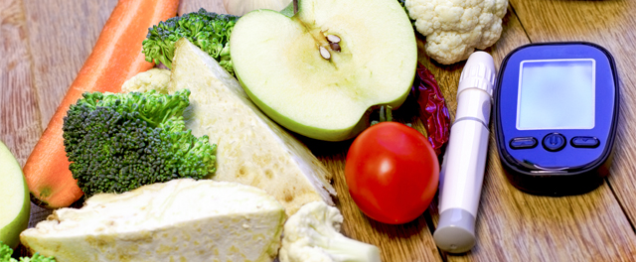
Meal Detection
Technology and Diabetes Management, Assignment

Slide 2

Table of Contents
Introduction
Related Work
Methods
Data prepocessing (splitting, timewindows, variation)
Binary Classifier (unused model)
LSTM model (why this, what is it)
Data & Experiment Setup
Provided dataset
Results
Evaluation
Discussion
Inbalanced Dataset (influence of timewindow)

Slide 3
Introduction – Motivation
The preservation of postprandial glucose levels within the normal range is usually achieved through subjective announcement of meals, in which the user enters information about the time of taking the meals and the amount of carbohydrates. In that case, incorrect or incomplete communications can jeopardize its performance system, contributing to the appearance of postprandial hyperglycemia and hypoglycemia episodes. The integration of automated meal detection modules can eliminate the need for manual user entries and contribute in significantly improving glucose regulation

Slide 4
Related Work I
Reinforcement Learning-Based Adaptive Insulin Advisor for Individuals with Type 1 Diabetes Patients under Multiple Daily Injections Therapy.
Deep Physiological Model for Blood Glucose Prediction in T1DM Patients
A model for early prediction of diabetes. Informatics in Medicine Unlocked
A Deep Learning Framework for Automatic Meal Detection and Estimation in Artificial Pancreas Systems
Detection of a meal using continuous glucose monitoring: implications for an artificial β-cell.

Slide 5
Methods - Data prepocessing

Slide 6
Methods – Binary Classifier

Slide 7
Methods – LSTM Model

Slide 8
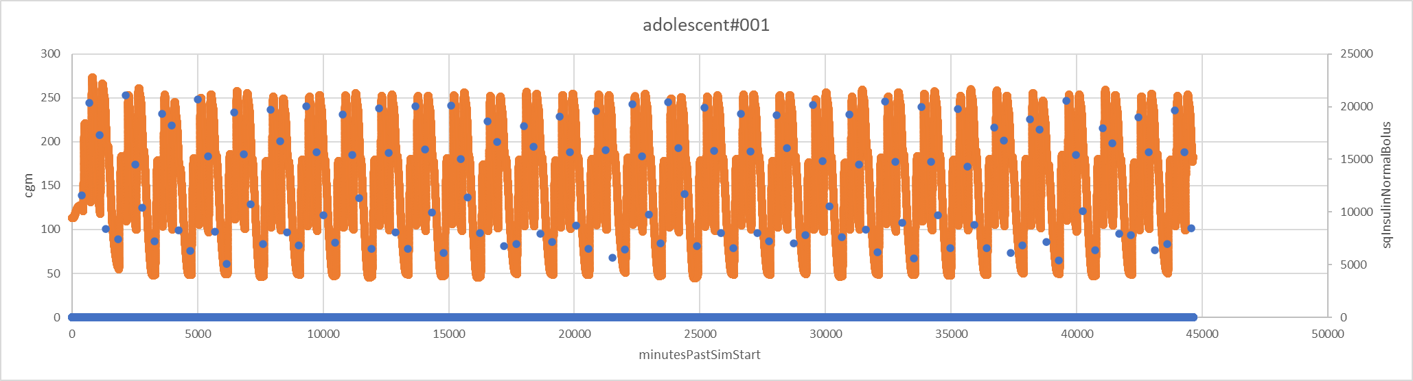
Data & Experiment Setup - Provided Dataset
DMMS.R (Diabetes Mellitus Metabolic Simulator for Research)
30 csv-datasheets à 1 month of simulatet data for type 1 diabetes
sqInsulinNormalBolus, minutesPastSimStart, cgm
10 adults, 10 adolescents, 10 children

Slide 9
Data prepocessing - splitting, timewindows, variation
We split the data 0.8/0.1/0.1 (training/validation/testing)
Just a common ratio
We assigned timewindows of 15/30min
Experimenting with timewindow to get better result
15 minutes after the meal is common timeframe
No normalization => time ran out ☹

Slide 10
Results

Slide 11
Discussion

