Slide 1
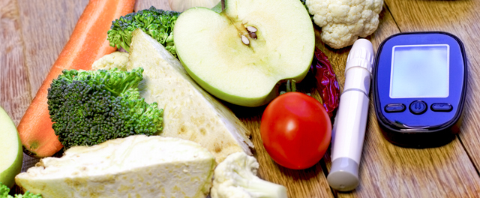
Meal Detection
Technology and Diabetes Management, Assignment

Slide 2

Table of Contents
Introduction
Related Work
Methods
Data prepocessing (splitting, timewindows, variation)
Binary Classifier (unused model)
LSTM model (why this, what is it)
Data & Experiment Setup
Provided dataset
Results
Evaluation
Discussion
Inbalanced Dataset (influence of timewindow)

Slide 3
Introduction – Motivation
State-of-the-art glucose control systems manage to optimally regulate basal insulin infusion, maintaining prandial glucose levels within the normal range, without the requirement of meal announcements by the user, still constitutes a real challenge towards fully automated glycemic control.
The preservation of postprandial glucose levels within the normal range is usually achieved through subjective announcement of meals, in which the user enters information about the time of taking the meals and the amount of carbohydrates. In that case, incorrect or incomplete communications can jeopardize its performance system, contributing to the appearance of postprandial hyperglycemia and hypoglycemia episodes. The integration of automated meal detection modules can eliminate the need for manual user entries and contribute in significantly improving glucose regulation

Slide 4
Related Work I
Reinforcement Learning-Based Adaptive Insulin Advisor for Individuals with Type 1 Diabetes Patients under Multiple Daily Injections Therapy.
Deep Physiological Model for Blood Glucose Prediction in T1DM Patients
A model for early prediction of diabetes. Informatics in Medicine Unlocked
A Deep Learning Framework for Automatic Meal Detection and Estimation in Artificial Pancreas Systems
Detection of a meal using continuous glucose monitoring: implications for an artificial β-cell.

Slide 5
State of The Art

Slide 6
Methods - Data prepocessing

Slide 7
Methods – Binary Classifier

Slide 8
Methods – LSTM Model

Slide 9
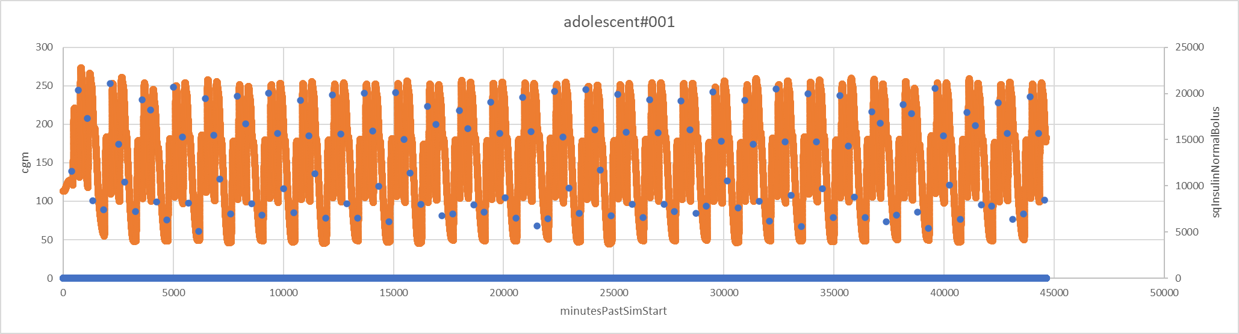
Data & Experiment Setup - Provided Dataset
DMMS.R (Diabetes Mellitus Metabolic Simulator for Research)
30 csv-datasheets à 1 month of simulatet data for type 1 diabetes
sqInsulinNormalBolus, minutesPastSimStart, cgm
10 adults, 10 adolescents, 10 children

Slide 10
Data prepocessing

