Slide 1
Welcome to the
2020
Colorado Cricket League
Annual General Body Meeting
Feb 20th 2021
Notes:
Welcome to the CCL 2020 AGM. We want to start and end on time. So please stay focused.
Housekeeping
General rules for this online meeting. Stay muted unless you want to speak.
One vote from pre nominated member of each club.
If we get disconnected please log back in. We may have a short break at 10:40 am.

Slide 2
AGENDA
Quorum and Housekeeping
(10:00 – 10:10)
Treasurer’s Report
(10:20 – 10:30)
Proposals
(11:00 – 11:30)
Elections
(11:30 – 12:00)
Meeting Adjourned (12:00)
President’s Address
(10:10 – 10:20)
Minor League Cricket
(10:40 – 10:50)
Youth Cricket (10:30 – 10:40)
CACU’s Report
(10:50 – 11:00)
Notes:
We will start once we have a quorum.
A few words from the President.
Sumeet and Jay will talk about their experience in the Minor League.
Treasurer will give us his report on the finances.
CACU will talk about developments on the umpiring scene
And we will dive in into the proposals.
And finally we will have elections for the new officials.

Slide 3
President’s Address
By
Raymond Mascarenhas

Slide 4
COVID
COVID
COVID
USA Cricket Membership
Minor League Cricket
Grounds
Youth Cricket

Slide 5
Treasurer’s Report
By
Murali Krishna

Slide 6
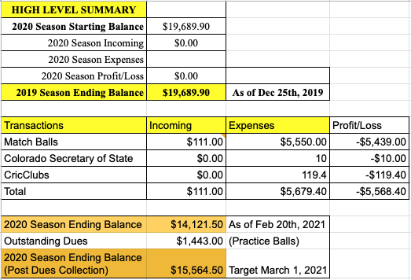

Slide 7
Youth Cricket
By
Zubin Surkari
Notes:
Zubin is heading a youth cricket group within CCL. He has a few words for us.

Slide 8
Minor League Cricket
By
Sumeet Khule
Notes:
Sumeet Khule represented Austin in the 2020 Minor League Cricket tournament. He would like to share his experiences.

Slide 9
CACU’s Report
By
Shravan Kommu
Notes:
Shravan will report for CACU

Slide 10
PROPOSALS

Slide 11
Proposal #1
Playing guidelines
by LCC
League needs to outline COVID guidelines well ahead, so players can prepare themselves before they can start playing.

Slide 12
Proposal #2
Playing guidelines
by LCC
Every playing member should provide proof of vaccination to the club they play for. Clubs should send it to CCL-EC. EC should share the updated list on the league website so that umpires can cross check the list with playing XI. Players not in the list should not be allowed to play.

Slide 13
Proposal #3
Code of Conduct
by CCL-EC
CCL EC and CACU should have the jurisdiction to investigate cricket related incidents that happen in Colorado. If anyone is found to have breached our code of conduct, EC and CACU should be authorized to apply relevant penalties to such players. This will involve changes to our current code of conduct, which can be addressed by a separate committee.

Slide 14
Proposal #4 (If Proposal #3 passes)
Code of Conduct
by CCL-EC
EC and CACU should investigate last year’s incident and apply penalties if applicable.

Slide 15
ELECTIONS

Slide 16
CCL EC
President
Secretary
Treasurer
VP / CACU President
CACU
CACU Scheduler
CACU VP

Slide 17
Meeting Adjourned
See you at the game!

