Slide 1


GOVERNMENT POLYTECHNIC KHAMGOAN
MICROPROJECT OF DSU
Guided by- Prof.N.S.UDAPUKAR
COMPUTER BRANCH
(2022-2023)
Topic Of The Project :- STUDENT ADDMISSION SYSTEM
PRESENTED By:
SR.NO | NAME | ENROLLMENT NO
1 | VARAD DILIP BODHEKAR | 2100210076
2 | Vedant Vishwas Gaygol | 2100210087
3 | Abhay Khumansing Ingle | 2100210088

Slide 2
INDEX
Introduction
Common Operations
Conclusion
Reference

Slide 3
Introduction
WHAT IS A STACK ?
Stack is a linear data structure that follows a particular order in which the operations are performed. The order may be LIFO(Last In First Out) or FILO(First In Last Out).
Consider an example of plates stacked over one another in the canteen. The plate which is at the top is the first one to be removed, i.e. the plate which has been placed at the bottommost position remains in the stack for the longest period of time.

Slide 4
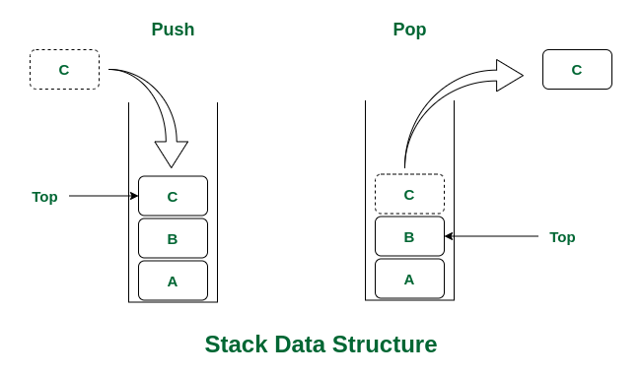

Slide 5
Common Operations
Push()
Pop()
Empty()
Full()
Peek()
Count()
Change()
Diplay()

Slide 6
CONCLUSION
We perform this micro project based on stack concepts.In this micro project main part is stack.But we a used concepts of switch ,do while,if condition,etc .Hence,we perfrom this micro project.

Slide 7
REFERENCE
https://www.geeksforgeeks.org/learn-data-structures-and-algorithms-dsa-tutorial/?ref=ghm
https://www.w3schools.in/data-structures/intro
https://www.programiz.com/dsa
https://www.tutorialspoint.com/data_structures_algorithms/index.html
https://en.wikipedia.org/wiki/Digital_Signature_Algorithm

