Slide 1
CASE STUDY: INTELLIGENT SYSTEMS IN PRODUCTION
REVISED TOPIC
AI-powered Quality Control and Defect Detection in Electronics Assembly
Reducing false calls of automated optical inspection (AOI) with Siemens production data
Yu Han · Melisa Subasi · Meron Hagos · Alejandro Rivas
Team 1 · Guided by Dr. Hamidreza Heidari · 23 October 2026 · github.com/bodhi584/aoi-decision-gate

Slide 2
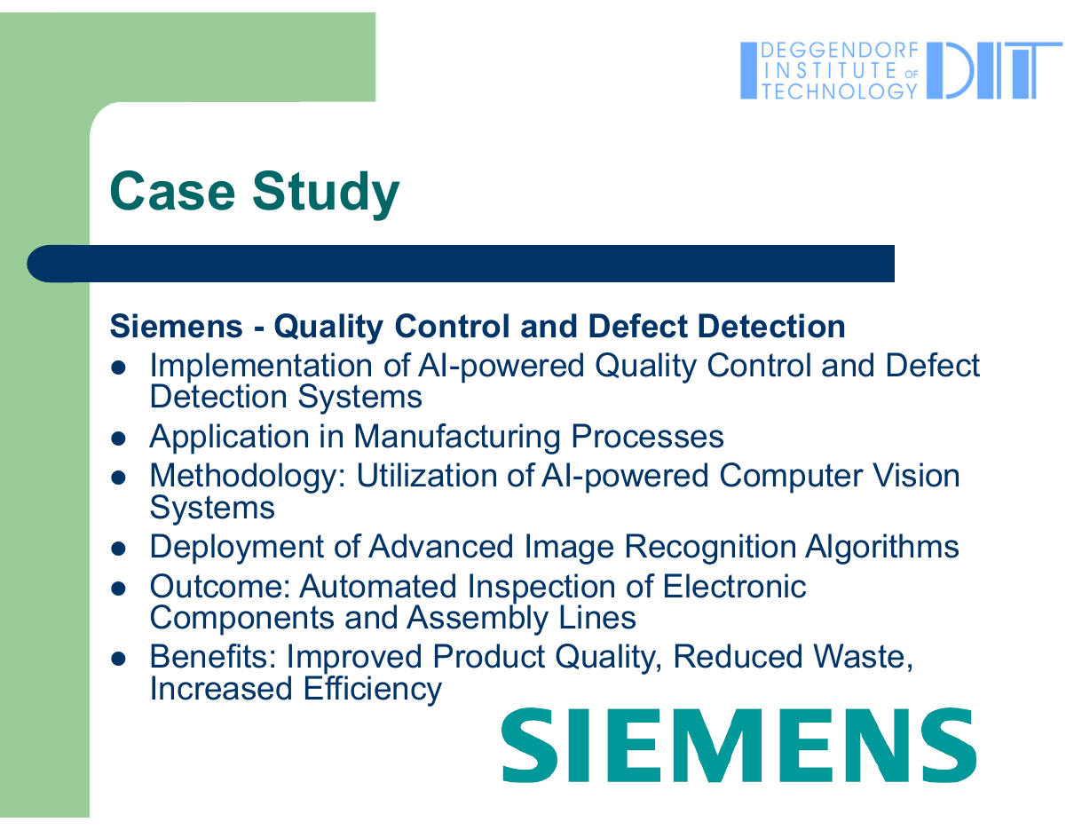

WHERE THE TOPIC COMES FROM
Based on the lecture example: Siemens, p. 18
Lecture slide
Our project
AI-powered quality control and defect detection
AI decides: real defect or false call
Application in manufacturing processes
SMT electronics assembly, after soldering
AI-powered computer vision systems
Works on the AOI camera system’s measurements
Advanced image recognition algorithms
Classifier on AOI image measurements
Automated inspection of electronic components
Real Siemens line data (Bavaria)
Improved quality, reduced waste, efficiency
Fewer manual checks, no extra defects released
AI-powered Quality Control and Defect Detection · Team 1
2

Slide 3
INTRODUCTION AND KEY MOTIVATIONS
Automated inspection in electronics assembly: too many false alarms, today
98 %
21 Oct 2026 · Siemens and NVIDIA, Erlangen electronics factory
AI second check of AOI results: is it a real defect or a false call?
Project targets: about 40 % fewer false calls, reduced manual verification.
of the boards flagged by the AOI machine are fine (false calls) in the Siemens line data.
Every one goes to a manual inspection station: “a major manual labour effort” (Pfab et al. 2024, Siemens).
19 Oct 2026 · Siemens, Erlangen
Factories in high-wage countries need 7–9 % more productivity every year.
Siemens invests €500 million in Erlangen as a showcase for AI in manufacturing.
Sources: Siemens press release, 21 Oct 2026; technology.org, 20 Oct 2026; Pfab et al. 2024, Data in Brief 53:110110
AI-powered Quality Control and Defect Detection · Team 1
3

Slide 4
PROJECT SCOPE
What we will and will not do
Aim
This project aims to explore how an AI-powered decision gate can be integrated after automated optical inspection to release false calls on a real Siemens line, while at most 1 % of defective boards are released.
Includes
Out of scope (current phase)
Data preprocessing: Siemens AOI data, 132 days
Training gradient-boosted trees and a neural network
Integration with a simulation of the line (day by day)
Decision logic: release or manual inspection
Model performance evaluation using standard metrics
Real hardware deployment on a line
Integration with physical AOI machines or MES
Changing the AOI machine or its camera images
Other lines or plants; root causes of defects
AI-powered Quality Control and Defect Detection · Team 1
4

Slide 5
GOALS
Measurable targets, fixed before the main experiments
≤ 1 %
≥ 25 %
Alarm
Defective boards released
False-call boards released
Drift detected
A released defect reaches the customer: the strictest limit. Baseline replay: 2.4–4.6 %.
Each one is a manual inspection saved. Baseline (time order): 8.2 %.
The gate warns when the line has changed and its decisions may no longer hold.
AI-powered Quality Control and Defect Detection · Team 1
5

Slide 6
OBJECTIVES
What the project will achieve
1
Train gradient-boosted trees and a neural network to decide per flagged board: real defect or false call.
2
Integrate the trained models into a day-by-day simulation of the Siemens line.
3
Compare performance to identify the most efficient model and update policy for future deployment.
4
Add a drift alarm that warns when the line has changed.
5
Evaluate models based on precision, recall, defective boards released and manual inspections saved.
AI-powered Quality Control and Defect Detection · Team 1
6

Slide 7
KEY FACTORS
What decides whether the gate helps the line
False-call rate
Each false call costs operator time at the manual station
Missed defects
A released defective board reaches the customer: must stay ≤ 1 %
Drift over time
Materials, settings and products change; last month’s model may not fit
Class imbalance
Only about 1 % of flagged joints are real defects
Label quality
Labels come from operators and may contain errors
AI-powered Quality Control and Defect Detection · Team 1
7

Slide 8
INPUT → SYSTEM → OUTPUT
Where the gate sits on the line
INPUT
SYSTEM (OURS)
OUTPUT
On the line today
AOI data per board
AI decision gate
Release
SMT soldering
AOI camera checks every joint against fixed limits
Flags suspicious boards
~70 measurements per joint
Inspection type
Component type
AOI error code
Classifier trained on past manual-inspection results
Release threshold: at most 1 % of defective boards released
likely false call → next step
Manual inspection
possible defect → operator checks
Today
With the gate (goal)
Every flagged board is checked by hand, and 98 % of them are fine.
Fewer manual checks, same quality: at most 1 % of defective boards released.
AI-powered Quality Control and Defect Detection · Team 1
8

Slide 9
PROJECT FLOW CHART
From the Siemens data to production KPIs
Siemens AOI data
Data preparation
Models
Release threshold
132 days, 39,742 boards
joints → boards, strict time order
trees · neural network
≤ 1 % defective released
Demo and report
Evaluation
Drift alarm
Replay simulation
replay demo, video, report
KPIs, error analysis
line changed? warn
day by day, update policies
Blue boxes: the system we build. White boxes: data and project steps.
AI-powered Quality Control and Defect Detection · Team 1
9

Slide 10
METHODOLOGY
CRISP-DM, evaluated by a replay simulation of the line
1 · Business understanding
2 · Data understanding
3 · Data preparation
4 · Modelling
5 · Evaluation
6 · Deployment
false-call problem, KPIs, limits
structure, imbalance, drift
joints → boards, strict time order
gradient-boosted trees; neural network
replay simulation, production KPIs
replay demo, run instructions
Replay simulation (our “baseline simulation”)
The 132 recorded days are played back in time order. Each day the gate decides every flagged board with a model trained only on earlier days, exactly as on the real line.
We compare update policies (train once, retrain weekly on all past days, retrain on recent days) and measure released false calls, released defects and saved inspections.
Why not a random split? It mixes future and past and overstates what a factory gets (next slides).
AI-powered Quality Control and Defect Detection · Team 1
10

Slide 11
DATA
Real production data published by Siemens
Source
Pfab, Eichler, Mallandur, Rothering (2024), Siemens AG, Data in Brief 53, 110110
Line
One SMT production line of Siemens AG in Bavaria, 132 days
Size
440,274 flagged solder joints on 39,742 boards; 5 inspection types
Features
~70 AOI measurements + component type, error code, angle (anonymised, scaled 0–1)
Label
Manual inspection result: false call or true defect (875 defective boards)
Drift
Early vs. late days separable from measurements alone: AUROC 0.966
Licence
CC BY-NC 3.0 (Siemens AG): downloaded by script, not redistributed
AI-powered Quality Control and Defect Detection · Team 1
11

Slide 12
TECHNOLOGY STACK
Open source, runs on a normal computer
Process | Tool | Purpose
Data | Python, pandas | Load the Siemens data, group joints into boards, keep time order
Models | scikit-learn, PyTorch | Gradient-boosted trees (baseline) and a neural network
Simulation | Python (own replay code) | Play the line back day by day; measure KPIs per policy
Drift alarm | Python, statistics | Detect when the line has changed
Quality | pytest, GitHub Actions | Tests run automatically on every change
Demo | Gradio or Streamlit | Replay the line and show decisions and saved inspections
Code sharing | GitHub | github.com/bodhi584/aoi-decision-gate
Within the lecture topics: neural networks (p. 12, 17), big data processing (p. 10). No large language model. Tools may change as the project progresses.
AI-powered Quality Control and Defect Detection · Team 1
12

Slide 13
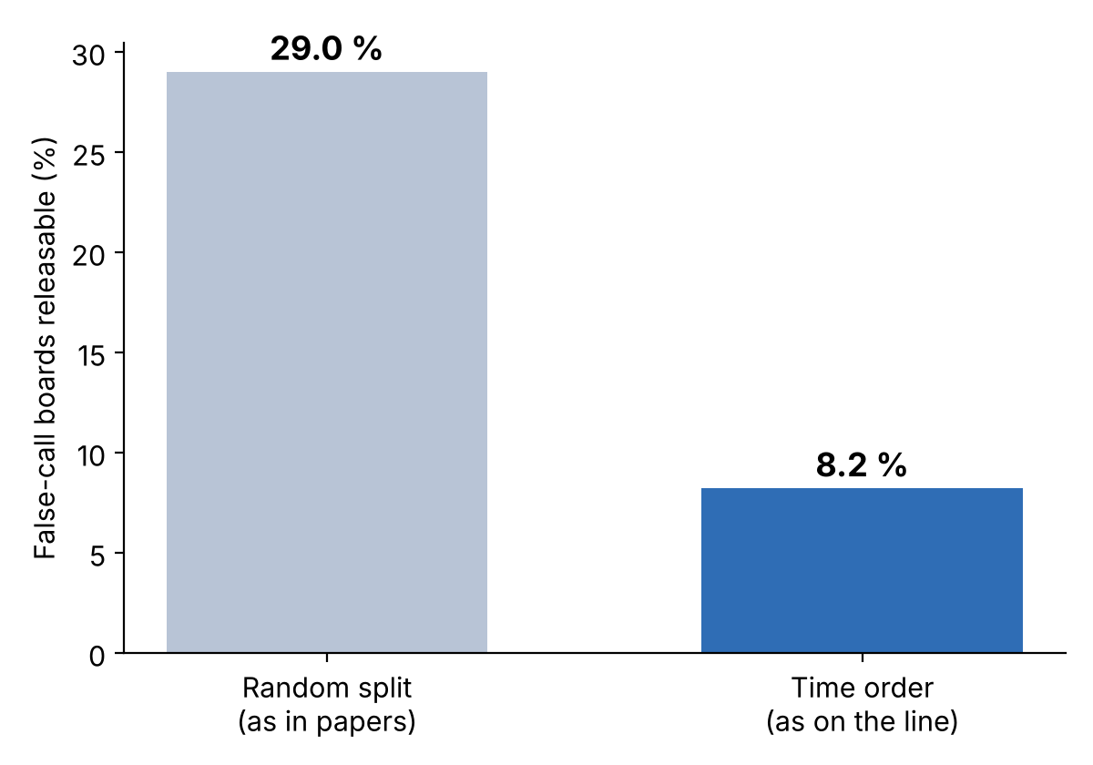
MVP · BASELINE ALREADY RUNS
Time order is much harder than a random split
What it shows
Gradient-boosted trees, trained on the first 70 % of records.
Share of false-call boards that could be released while 99 % of defective boards still go to manual inspection.
Random split: 29 %, AUROC 0.966. Time order: 8.2 %, AUROC 0.889.
The line changes over time: drift is the real challenge, and papers with random splits overstate results.
AI-powered Quality Control and Defect Detection · Team 1
13

Slide 14
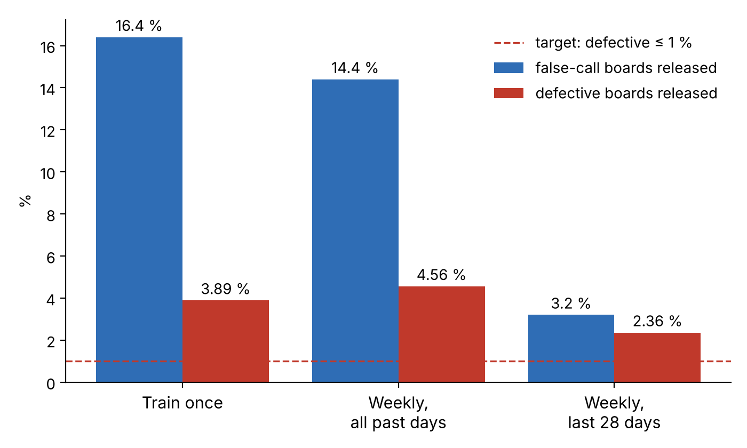
MVP · FIRST REPLAY SIMULATION
Thresholds from past days do not hold on later days
What it shows
39 production days, 17,366 flagged boards replayed.
Up to 16 % of false-call boards released (2,750 manual inspections saved).
But 2.4–4.6 % of defective boards released: the 1 % limit is broken by drift.
→ Core of the project: drift detection and update policy.
AI-powered Quality Control and Defect Detection · Team 1
14

Slide 15
WORKING METHODOLOGY
Four steps, each with a result we can show
Step 1 · Data preparation
Step 2 · Model development
Collected Siemens AOI data: flagged boards, defective & false call (done)
Grouped solder joints into boards; encoded categories
Split data strictly by time into train, validate, test sets
Trained gradient-boosted trees as baseline (running)
Neural network in PyTorch; tuned key parameters
Release threshold: at most 1 % defective boards released
Step 3 · Simulation integration
Step 4 · Evaluation and comparison
Simulated the line day by day (models trained on past days only)
Integrated the models for decision routing; drift alarm
Boards are virtually routed to release or manual inspection
Analyzed precision, recall, defects released, inspections saved
Compared models and update policies to identify the best-performing one
Error analysis; replay demo, video and report
AI-powered Quality Control and Defect Detection · Team 1
15

Slide 16
TEAM
Who does what
Yu Han · team lead
Melisa Subasi
Decision gate and replay simulation (core code), GitHub and tests
Data understanding, evaluation and KPIs, final report editor
Meron Hagos
Alejandro Rivas
Literature review, industrial case (Siemens), demo interface
Experiments: models, drift handling and update policies
AI-powered Quality Control and Defect Detection · Team 1
16

Slide 17
TIMELINE
From proposal to final hand-in (lecture p. 33)
Date | Milestone | What we deliver
20 / 23 Oct | P1 · Proposal + tech stack + MVP | Revised topic, proposal, GitHub, baseline and first replay running
3 Nov | P2 · Core code + baseline sim; test plan + report | Decision gate and replay as core code, all update policies, test plan, literature report
24 Nov | P3 · Feature progress; unit/CI; issues board | Neural network, drift alarm, tests on every push
8 Dec | P4 · Feature progress; unit/CI; issues board | Full evaluation and error analysis
22 Dec | P5 · Demo video + run instructions; packaging | Replay demo, video, run instructions, package
12 Jan | Final presentation, report | Final presentation and report
AI-powered Quality Control and Defect Detection · Team 1
17

Slide 18
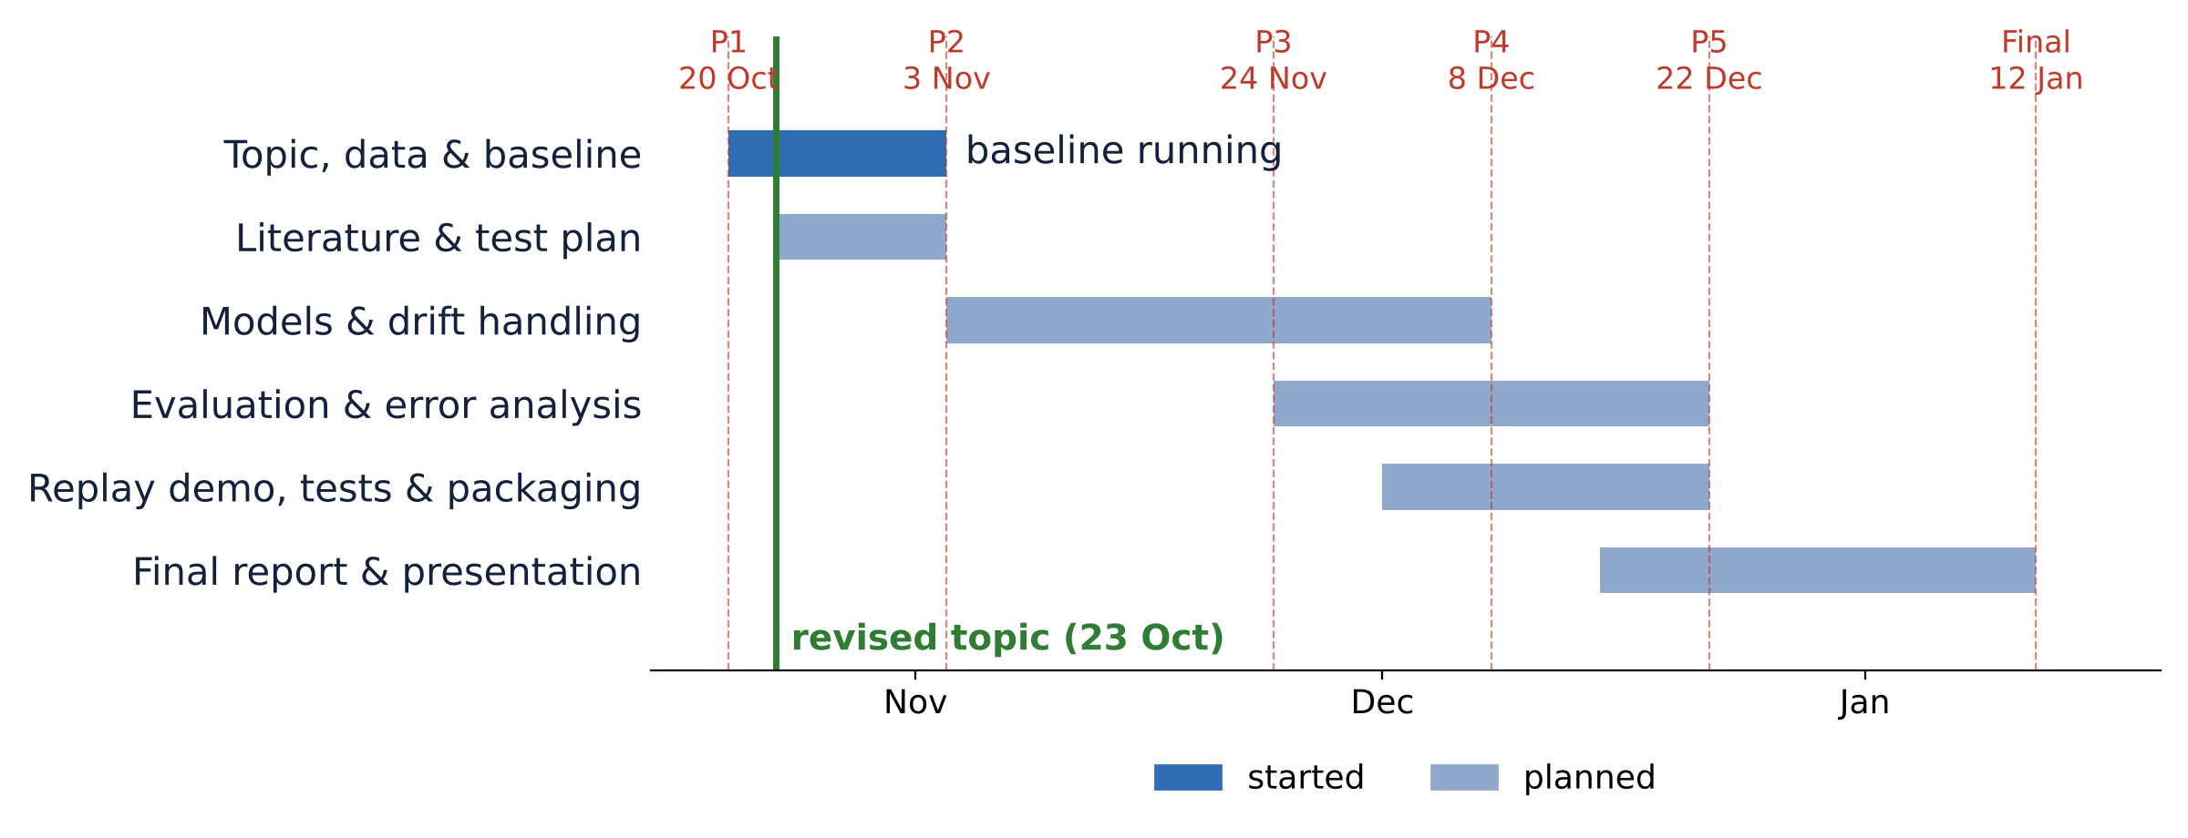
GANTT CHART
Project schedule
AI-powered Quality Control and Defect Detection · Team 1
18

Slide 19
EXPECTED OUTCOMES
What we hand in, concretely: a software prototype
1 · Successfully trained AI decision gate (software)
# planned command-line interface (day 87 = real replay result)
$ aoi-gate train --data history.csv
model saved, threshold set (≤ 1 % defects released)
$ aoi-gate decide --board board_10466.csv
RELEASE (score below threshold: likely false call)
$ aoi-gate replay --policy weekly
day 87: 612 boards, 183 checks saved, 0 defects released
A Python package with a command-line tool. Train it on past inspection records; give it the AOI data of one board; it answers RELEASE or INSPECT, with a score and the main reasons.
2 · Functional line simulation with decision routing
A small web app: pick a day of the Siemens line and see each board’s decision, manual checks saved, defects released and drift alarms.
3 · Comparative performance metrics
Trees vs. neural network, update policies; identification of the most efficient model · result files, tests, demo video, report
In a factory it would run between the AOI machine and the manual inspection station. Connecting it to a real line is not part of the course project. The command names are planned; the day-87 numbers come from our first replay (weekly retraining).
AI-powered Quality Control and Defect Detection · Team 1
19

Slide 20
BILL OF MATERIALS (BOM)
What the project needs
Component | Specification | Quantity | Cost
Data set | Siemens AOI data, Mendeley (CC BY-NC 3.0), 333 MB | 1 | Free
Computer | Normal laptop or Google Colab CPU (no graphics card needed) | 4 (one per member) | Free
Software | Python and open-source libraries | – | Free
Code hosting and tests | GitHub, GitHub Actions | 1 repository | Free
Total cost: 0 €
AI-powered Quality Control and Defect Detection · Team 1
20

Slide 21
SPECIFIC CONDITIONS AND LIMITATIONS
What the project covers, and what it does not
Conditions
Limitations
One Siemens SMT line, five inspection types, 132 days
Gate placed after the AOI, before manual inspection
Decisions per board; at most 1 % defective boards released
Public data only, no personal data
Measurements anonymised: no physical names
Labels from operators may contain errors
No images; no other lines or plants
Licence non-commercial (course use only)
Results hold for this line; other lines need their own data
AI-powered Quality Control and Defect Detection · Team 1
21

Slide 22
SAFETY & ETHICAL CHECKLIST
Keeping it safe and realistic
Checklist
Main risks and fallback
✓ Simulation-only environment; no physical machinery risk
✓ Dataset is anonymized by Siemens (no personal data)
✓ Data used under its licence (non-commercial), not redistributed
✓ Ethical AI principles followed: transparency, fairness, accountability
✓ Avoid dataset bias (strict time split) and ensure reproducibility of results
✓ Safety first in the design: limit on released defects
Drift limits how many false calls can be released safely → fallback: report which drift handling works, which does not, and why
Labels may contain operator errors → error analysis checks suspicious cases
In a real factory a gate needs approval by quality engineers before it may release boards
AI-powered Quality Control and Defect Detection · Team 1
22

Slide 23
FUTURE WORK
From the public data set to a real line, with an industry partner
1 · Industry partner
2 · AOI interface
3 · Shadow mode
4 · Approval, go-live
An electronics plant (e.g. in Bavaria) shares AOI and manual-inspection records under a data agreement.
Read each board’s AOI result from the machine or MES (e.g. IPC-CFX standard or vendor export); send the decision to the repair station.
The gate runs next to the operators on real data and only logs its decisions; nothing is released yet.
Quality engineers compare the logs; if ≤ 1 % defects would have been released, start with one inspection type.
Open questions for this step: interface development per AOI vendor, data access and agreements, and approval by the plant’s quality department.
AI-powered Quality Control and Defect Detection · Team 1
23

Slide 24
BIBLIOGRAPHY
Sources
Pfab, K., Eichler, R., Mallandur, A., Rothering, M. (2024). Data of automated optical inspection of surface-mounted technology electronic production. Data in Brief 53, 110110.
Siemens (21 Oct 2026). Siemens and NVIDIA advance AI-powered PCB inspection from digital twin to factory. Press release.
technology.org (20 Oct 2026). Siemens aims to raise factory automation to 80 % with AI.
Albayari, J., Patra, P., Patel, D., Santos, D. (2025). Enhancing false call detection in automated optical inspection using XGBoost classifier and XAI algorithms. FAIM 2025, Springer.
Schmitt, J., Bönig, J., Borggräfe, T., Beitinger, G., Deuse, J. (2020). Predictive model-based quality inspection using machine learning and edge cloud computing. Advanced Engineering Informatics 45, 101101.
Chapman, P. et al. (2000). CRISP-DM 1.0: Step-by-step data mining guide. SPSS.
Lecture slides, Case Study Intelligent Systems in Production, p. 10, 12, 17, 18, 33.
AI-powered Quality Control and Defect Detection · Team 1
24

Slide 25
Thank you
github.com/bodhi584/aoi-decision-gate
Team 1 · Yu Han · Melisa Subasi · Meron Hagos · Alejandro Rivas

