Slide 1
CASE STUDY: INTELLIGENT SYSTEMS IN PRODUCTION
MILESTONE P2
Binary Classification of AOI Alarms into True Defects and False Calls
Second check of AOI results with supervised machine learning (Siemens production data)
P2: core code and baseline simulation · test plan · report
Yu Han · Melisa Subasi · Meron Hagos · Alejandro Rivas
Team 1 · Guided by Prof. Dr.-Ing. Hamidreza Heidari · 3 November 2026 · github.com/bodhi584/aoi-false-call-classification

Slide 2

PROJECT PROGRESS
Yu Han
Where the project stands
P1
20 Oct
Proposal, tech stack, MVP (revised topic 23 Oct)
done
P2 in short
Literature (36 sources): a second check with machine learning removes false calls on a test set, but the one study that looked at later production days [8] misses 5–15 % of true defects there.
[8] names two causes – drift and an unstable threshold – and two next steps; the literature has methods for both. Those become the two variables of our simulation.
Data: the public Siemens set we use is the same as in [8]; the share of true defects changes over the weeks.
Code: data, classifier + threshold, day-by-day simulation, tests and CI run in the repository.
First result: [8] reproduced one-to-one; a correctly set threshold and retraining both lower the missed defects, but none reaches 1 % yet.
Test plan extended; P1 plan revised: we build on [8] instead of beside it.
Next (P3): the simulation software with retraining and threshold as settings.
P2
3 Nov
Core code + baseline simulation; test plan; report
this phase
P3
24 Nov
Feature progress; unit tests and CI; issues board
next
P4
8 Dec
Feature progress; full evaluation
planned
P5
22 Dec
Demo video, run instructions, packaging
planned
Final
12 Jan
Final presentation and report
planned
Binary Classification of AOI Alarms into True Defects and False Calls · Team 1 · P2
2
Notes:
Left: all milestones of the Software & Simulation track (lecture). Right: what this phase (P2) delivered. Mention that the literature review sharpened the research question.

Slide 3
LITERATURE · PART 1 · THE PROBLEM
Melisa Subasi
AOI: what it is, how it works, why false calls matter now
≈ 99 %
1 · What AOI is and where it is used [2]
In electronics assembly (SMT), a camera system inspects every solder joint after soldering: it measures the joint and compares the measurements with fixed limits. (Abu Ebayyeh & Mousavi 2020, review)
of the solder joints that AOI flags are false calls [8]
2 · How it works on a real line, and the problem [5], [8]
If one measurement is outside its limit, the board goes to a manual inspection station; an operator decides: true defect or false call. Almost all alarms are false calls, so operators mostly check good boards. (Pfab et al. 2024, data article; Pfab & Rothering 2025)
Every flagged board is checked again by a person. Siemens line, 132 days, 440,274 flagged joints [5].
3 · Why it matters now [4]
Siemens is adding a second inspection step that decides whether an AOI alarm is a real defect or a false call; target 40 % fewer false calls, a target, not a result. (Siemens press release, Oct 2026)
Binary Classification of AOI Alarms into True Defects and False Calls · Team 1 · P2
3
Notes:
Three steps, three kinds of sources. Step 1, what AOI is: a peer-reviewed review [2]. Step 2, how it works on a real line and how many alarms are false: the data article of the Siemens line [5] and the core paper [8]. Step 3, why now: the Siemens press release [4]. [1] (zero-defect manufacturing review) is the general background in the report; not needed on the slide.

Slide 4
LITERATURE · PART 2 · HOW IT IS ADDRESSED
Melisa Subasi
Second check with machine learning: three studies, one baseline
Study | Data | Classifiers | Tested on later periods? | Code public?
[6] Thielen et al. 2020 | own, 1,144 / 4,264 components, not public | kNN, neural network, random forest | no; threshold tuned on the evaluation data | no
[7] Albayari et al. 2026 | Siemens AG; not stated whether the public set | XGBoost, RF, DNN, kNN | no; several train–test splits | no
[8] Pfab & Rothering 2025 | Siemens, public [5] | kNN, RF, balanced RF, XGBoost, AutoML | yes: 5 later slices, 5–15 % missed defects | yes, with run logs
What all three show
Why [8] is our core paper
A classifier on AOI measurements recognises false calls on a test set from the same period; random forests are among the best models [6], [8].
Same public data as ours, published code and run logs, and the only study that tests later production periods. We can repeat it exactly and build on it.
Binary Classification of AOI Alarms into True Defects and False Calls · Team 1 · P2
4
Notes:
We found three studies that put a supervised classifier after the AOI on tabular AOI measurements (image-based deep learning is out of scope). All three work on a test set from the same period. Only [8] evaluates later production periods, and only [8] publishes data, code and run logs. That makes [8] our core paper and baseline. From [6] we take the idea to fix the missed defects first and count saved checks second; from [7] that the same classifier types work on Siemens data and that explainability methods exist.

Slide 5
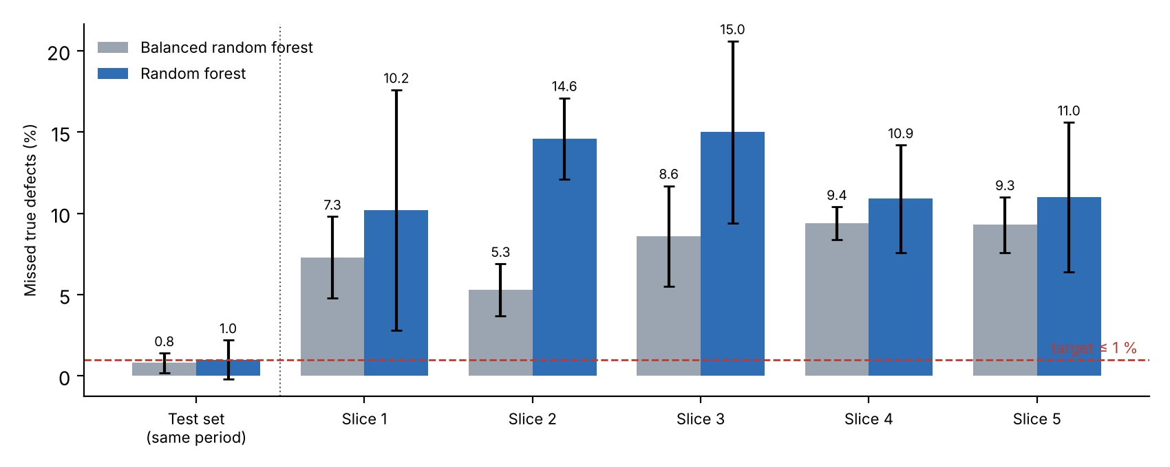
LITERATURE · PART 3 · THE CORE PAPER
Melisa Subasi
[8] in detail: works on the test set, fails on later production days
Two causes named in [8]
The model was trained once, on the first half of the data. On a test set from the same period it meets the target. On the five later periods it misses 5–15 % of the true defects.
Cause 1 – drift: the production line changes over time, so a model trained on old data stops fitting [21]–[23]. The same happens in welding, chip making and sensor data [24]–[26].
Cause 2 – threshold: the cut-off between “defect” and “false call” was set once on old data; [8] itself calls this unstable, and [28] explains why it cannot guarantee the 1 % limit.
[8] names both as possible next steps and tests neither.
Binary Classification of AOI Alarms into True Defects and False Calls · Team 1 · P2
5
Notes:
Figure from Tables IV and V of Pfab & Rothering (2025). Cause: dataset shift / concept drift (Moreno-Torres 2012, Gama 2014, Lu 2019); manufacturing cases (Bauer 2025, Shim 2021, Jourdan 2021). The paper also names an unstable threshold method.

Slide 6
FROM LITERATURE TO OUR QUESTION
Meron Hagos
Chain of evidence
Fails over time
Two causes
Methods exist
Works elsewhere
Open for AOI
train once → 5–15 % missed defects later [8]
drift [21]–[27] and an unstable threshold method [8], [28]
threshold: [28]–[30]; retraining: [22], [27], [31]–[33]
fraud detection, <1 % positives [35]; semiconductor materials line [36]
named by [8] as next steps, not tested for the second check of AOI results
Pfab & Rothering (2025), Sec. VII: “… potential next steps to stabilize the modeling by improving the method for setting the threshold and handling the distribution drifts within the dataset.”
Our simulation focuses on exactly these two steps: the threshold method and drift (retraining).
Binary Classification of AOI Alarms into True Defects and False Calls · Team 1 · P2
6
Notes:
Each box has a source in the report. The last box is our project.

Slide 7
METHODS FROM THE LITERATURE
Meron Hagos
The two next steps of [8] become the variables of our simulation
Variable | Option | What it does | Sources
Threshold | as in [8] | set once on the training data, as [8] did | [8]
 | with a safety margin | set so that the 1 % limit holds with 95 % confidence; needs about 300 known true defects | [28]
 | re-set for the current period | adjust the cut-off when the share of true defects changes, even before new labels arrive | [29], [30]
Retraining | off | train once, as in [8] | [8]
 | fixed schedule | retrain every period / week / day on all data so far, or on a recent window | [22], [31], [35], [36]
 | triggered by drift | retrain only when the error rate starts to rise | [32], [33]
Every option comes from a published method; the simulation shows its effect on missed defects and released false calls next to [8].
Binary Classification of AOI Alarms into True Defects and False Calls · Team 1 · P2
7
Notes:
Tong et al. 2018: limiting the empirical error to alpha does not guarantee the bound; an order statistic of a left-out sample does, if the sample is large enough: n >= log(delta)/log(1-alpha), i.e. 299 true defects for 1 % at 95 % confidence. Saerens 2002 / Lipton 2018: re-set the threshold when the defect share changes, also without labels. Drift: Gama 2014 (sliding window baseline), Widmer & Kubat 1996 (window of recent examples), Gama 2004 (DDM, retrain when error rises), Bifet & Gavalda 2007 (ADWIN adaptive window), Dal Pozzolo 2018 and Gao 2026 (scheduled retraining works; frequency matters most).

Slide 8
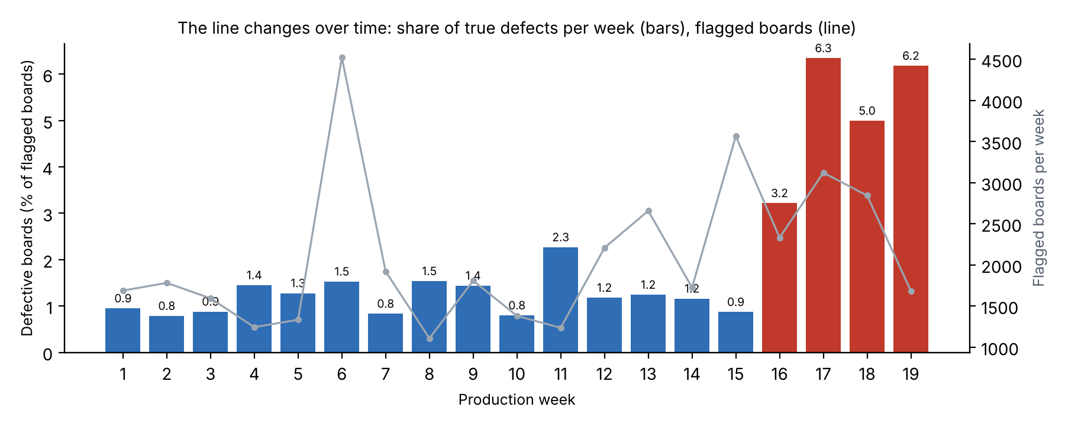
DATA UNDERSTANDING
Meron Hagos
The line changes over time
Facts (our analysis)
440,274 flagged joints, 39,742 boards, 132 days
97.8 % of flagged boards are false calls
Share of defective boards: 0.8–2.3 % per week, then 3.2–6.3 % in the last 4 weeks
Drift test: early vs. late days separable, AUROC 0.974
Binary Classification of AOI Alarms into True Defects and False Calls · Team 1 · P2
8
Notes:
Notebook: notebooks/data_understanding.ipynb. Drift test: a classifier that sees only AOI measurements separates the first 30 % of days from the last 30 % with AUROC 0.974 (0.5 = no change).

Slide 9
OUR SIMULATION
Alejandro Rivas
Input → simulation → output
INPUT
VARIABLES
OUTPUT
Recorded Siemens production
What operation would change
Per production period
AOI measurements of each flagged solder joint, in time order [5]
published models and settings of [8]
Retraining: off / on, frequency (per slice → weekly → daily)
Threshold: as in [8] / set correctly / set on recent days
Missed true defects (%)
False calls released (%) = manual checks saved
next to the result of [8]
Reference lines from [8]: ≤ 1 % missed true defects, ≥ 40 % false calls released.
Later (P3–P5): a software with these variables as settings and charts of both outputs.
Binary Classification of AOI Alarms into True Defects and False Calls · Team 1 · P2
9
Notes:
The simulation: the published models of Pfab & Rothering run over the recorded production days; the variables are what a plant would do in operation. The outputs are always shown next to the published result (train once). The targets of [8] are reference lines, not our pass/fail criterion.

Slide 10
METHOD
Alejandro Rivas
Replication of Pfab & Rothering (2025): one factor at a time
 | (a) Paper exactly | (b) Train once, threshold re-estimated | (c) Retrain
Data split | same as [8] | same | same
Models, hyper-parameters, seeds | RF, balanced RF; logged values; 10 seeds | same | same
Threshold | value logged in [8] | their method, applied to the final model | same method, new data
Training | once | once | before each of the 5 later slices
Purpose | reproduce [8] | (a) vs (b) = effect of the threshold | (b) vs (c) = effect of retraining
Counted per solder joint, as in [8]: missed true defects (%) and false calls released (%). We assume the manual check labels every joint, so retraining always has fresh labels (best case).
Binary Classification of AOI Alarms into True Defects and False Calls · Team 1 · P2
10
Notes:
Their source code and run logs are public (GitLab), so we use the same split, models, hyper-parameters, seeds and threshold method. While reading their code we found that the stored threshold comes from the last optimisation step, not the best one; variant (b) uses the correct one. Limitation: we assume labels also for released joints.

Slide 11
CORE CODE AND BASELINE SIMULATION
Alejandro Rivas
What runs in the repository
Part | File | What it does
Data | aoi_classification/data.py | load the Siemens data, boards, time order
Classifier + threshold | aoi_classification/model.py | train, score, threshold for 99 % recall
Baseline simulation | aoi_classification/simulation.py | day by day: train on earlier days only
Replication | scripts/replicate_pfab2025.py | one-to-one repeat of [8], train once vs. retrain
Classifier screening | scripts/compare_classifiers.py | 13 classifiers, 8 families, same split
Tests + CI | tests/, GitHub Actions | 10 tests on Windows, macOS, Linux
Tools: Python, pandas, scikit-learn, imbalanced-learn, matplotlib, Jupyter · Data: Mendeley (CC BY-NC 3.0), not stored in the repo
Binary Classification of AOI Alarms into True Defects and False Calls · Team 1 · P2
11
Notes:
All numbers on the slides come from files in results/. Commands are in the README.

Slide 12
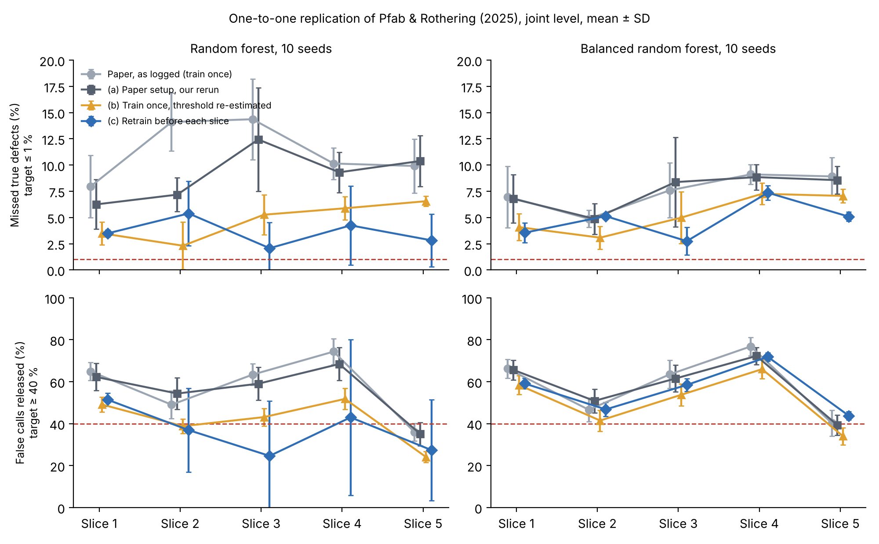
FIRST SIMULATION RESULTS
Alejandro Rivas
[8] reproduced; a correct threshold and retraining both help
Reproduction ✓
Our rerun of [8] gives the same numbers: 7.5 % missed defects with balanced RF.
Retraining: small gain
Balanced RF: 5.3 → 4.8 % missed, 50.7 → 56.0 % released.
RF: 4.7 → 3.6 % missed, but fewer released.
Threshold matters most
Only fixing the threshold: 7.5–9.1 % → 4.7–5.3 % missed.
Nothing reaches the 1 % line yet — that is the work for P3.
Binary Classification of AOI Alarms into True Defects and False Calls · Team 1 · P2
12
Notes:
Mean over 5 later slices and 10 seeds. Balanced RF: (a) 7.5 % = paper 7.5 %. Retraining: balanced RF 5.3 % -> 4.8 % missed and 50.7 % -> 56.0 % released; RF 4.7 % -> 3.6 % missed but 41.4 % -> 36.7 % released. Correcting the threshold alone: 7.5-9.1 % -> 4.7-5.3 %.

Slide 13
TEST PLAN
Yu Han
How we check the code and the numbers
Group | Examples | Status
Data (D1–D7) | labels 0/1, no missing values, time order, checksum | 4 exist, rest P3
Classifier + threshold (C1–C7) | threshold rule, all models run, same seed = same result | 4 exist, rest P3
Simulation (S1–S4) | model only knows earlier days | 1 exists, rest P3
Replication (R1–R4) | same split as [8]; (a) reproduces [8]; retraining uses only earlier data; 10 seeds | new
KPIs (K1–K5) | missed defects ≤ 1 %, false calls released ≥ 40 %; every number from results/ | open
Unit tests run on every push (CI, three operating systems). A KPI that is not reached is a result, not a failed test.
Binary Classification of AOI Alarms into True Defects and False Calls · Team 1 · P2
13
Notes:
Full plan in docs/test_plan.md. The replication tests R1-R4 are new for the refined question.

Slide 14
RESULT OF THE LITERATURE REVIEW
Yu Han
Revision of the P1 proposal after finding the core paper [8]
 | What [8] already did | P1 plan (23 Oct) | Revised plan (P2)
Second check | classifier after AOI on the Siemens data; on a same-period test set ≤ 1 % missed defects | build our own second check | use the check of [8] as baseline (one-to-one)
Over time | evaluated on 5 later slices with a static model: 5–15 % missed defects | day-by-day simulation in time order | day-by-day simulation of operation on top of [8]: the part they did not do
Causes | names drift and the threshold method; tests neither | not known yet | address both: retraining against drift; a correctly set threshold
Models | random forest, balanced random forest (also kNN, XGBoost, AutoML) | logistic regression, random forest, neural network | same as [8], so results are comparable; model choice matters little [13]
Comparison | targets ≤ 1 % missed, ≥ 40 % false calls released | recall ≥ 99 %, specificity ≥ 20 % (board level) | same metrics as [8]; compared with their later-slice results
Unchanged: Siemens AOI data [5] · input → system → output · tools (Python, scikit-learn) · milestones
Binary Classification of AOI Alarms into True Defects and False Calls · Team 1 · P2
14
Notes:
Normal in a project: as understanding deepens, the plan is revised. The literature review found that Pfab & Rothering (2025) had already built the second check on the same data. Their evaluation is in time order (five later slices), but the model is static: trained once, threshold set once. On the later slices it fails. They name two possible causes, drift and the threshold method, and test neither. So we revise P1: keep their check as the baseline and add what operation would do.

Slide 15
NEXT STEPS
Yu Han
Towards P3 (24 Nov)
Simulation software
Retraining frequency
one screen: retraining and threshold as settings; charts of missed defects and false calls released next to [8]
daily, every 3 days, weekly, per slice: how far do missed defects drop? [36]
Threshold with confidence
More model families
order statistic with enough left-out true defects [28]; re-set for the current period [29], [30]
gradient boosting, neural network, logistic regression in the same setup
Binary Classification of AOI Alarms into True Defects and False Calls · Team 1 · P2
15
Notes:
Gao et al. 2026: retraining frequency matters more than the window. Saerens 2002: when the defect share changes, the threshold must follow.

Slide 16
APPENDIX · REFERENCES
References (1/4) — each is summarised in the bibliography report
[1]
F. Psarommatis, G. May, P.-A. Dreyfus, and D. Kiritsis, "Zero defect manufacturing: state-of-the-art review, shortcomings and future directions in research," Int. J. Production Research, vol. 58, no. 1, pp. 1–17, 2020, doi: 10.1080/00207543.2019.1605228.
open
[2]
A. A. R. M. Abu Ebayyeh and A. Mousavi, "A review and analysis of automatic optical inspection and quality monitoring methods in electronics industry," IEEE Access, vol. 8, pp. 183192–183271, 2020, doi: 10.1109/ACCESS.2020.3029127.
open
[3]
P. Martinek, I. M. Putrama, O. Krammer, and A. Geczy, "Short review on machine learning optimization methods in surface mounted electronics assembly technologies," in Proc. 46th Int. Spring Seminar on Electronics Technology (ISSE), 2023, pp. 1–6, doi: 10.1109/ISSE57496.2023.10168524.
open
[4]
Siemens, "Siemens and NVIDIA advance AI-powered PCB inspection from Digital Twin to factory," press release, Plano, TX, USA, Oct. 21, 2026. [Online]. Available: https://news.siemens.com/en-us/siemens-nvidia-pcba-digital-twin-factory/
open
[5]
K. Pfab, R. Eichler, A. Mallandur, and M. Rothering, "Data of automated optical inspection of surface-mounted technology electronic production," Data in Brief, vol. 53, Art. no. 110110, Apr. 2024, doi: 10.1016/j.dib.2024.110110. Data: Mendeley Data, v2, doi: 10.17632/99jzmh9658.2.
open
[6]
N. Thielen, D. Werner, K. Schmidt, R. Seidel, A. Reinhardt, and J. Franke, "A machine learning based approach to detect false calls in SMT manufacturing," in Proc. 43rd Int. Spring Seminar on Electronics Technology (ISSE), Demanovska Valley, Slovakia, 2020, pp. 1–6, doi: 10.1109/ISSE49702.2020.9121044.
open
[7]
J. Albayari, P. Patra, D. Patel, and D. Santos, "Enhancing false call detection in automated optical inspection using XGBoost classifier and XAI algorithms," in Flexible Automation and Intelligent Manufacturing (FAIM 2025), Lecture Notes in Mechanical Engineering. Cham, Switzerland: Springer, 2026, pp. 509–530, doi: 10.1007/978-3-032-05610-8_51.
open
[8]
K. Pfab and M. Rothering, "Towards improved research methodologies for industrial AI: a case study of false call reduction," arXiv:2506.14521 [cs.LG], Jun. 2025. Source code and run logs: https://gitlab.com/research9841542/FCR_1.
open
[9]
M. Fernandez-Delgado, E. Cernadas, S. Barro, and D. Amorim, "Do we need hundreds of classifiers to solve real world classification problems?" J. Machine Learning Research, vol. 15, no. 90, pp. 3133–3181, 2014.
open
Binary Classification of AOI Alarms into True Defects and False Calls · Team 1 · P2
16

Slide 17
APPENDIX · REFERENCES
References (2/4) — each is summarised in the bibliography report
[10]
L. Grinsztajn, E. Oyallon, and G. Varoquaux, "Why do tree-based models still outperform deep learning on typical tabular data?" in Advances in Neural Information Processing Systems 35 (NeurIPS 2022), Datasets and Benchmarks Track, 2022.
open
[11]
R. Shwartz-Ziv and A. Armon, "Tabular data: deep learning is not all you need," Information Fusion, vol. 81, pp. 84–90, 2022, doi: 10.1016/j.inffus.2021.11.011.
open
[12]
V. Borisov, T. Leemann, K. Sessler, J. Haug, M. Pawelczyk, and G. Kasneci, "Deep neural networks and tabular data: a survey," IEEE Trans. Neural Networks and Learning Systems, vol. 35, no. 6, pp. 7499–7519, 2024, doi: 10.1109/TNNLS.2022.3229161.
open
[13]
D. McElfresh, S. Khandagale, J. Valverde, V. Prasad C, G. Ramakrishnan, M. Goldblum, and C. White, "When do neural nets outperform boosted trees on tabular data?" in Advances in Neural Information Processing Systems 36 (NeurIPS 2023), Datasets and Benchmarks Track, 2023.
open
[14]
N. Hollmann, S. Muller, L. Purucker, A. Krishnakumar, M. Korfer, S. B. Hoo, R. T. Schirrmeister, and F. Hutter, "Accurate predictions on small data with a tabular foundation model," Nature, vol. 637, no. 8045, pp. 319–326, 2025, doi: 10.1038/s41586-024-08328-6.
open
[15]
L. Breiman, "Random forests," Machine Learning, vol. 45, no. 1, pp. 5–32, 2001, doi: 10.1023/A:1010933404324.
open
[16]
C. Chen, A. Liaw, and L. Breiman, "Using random forest to learn imbalanced data," Dept. of Statistics, University of California, Berkeley, Tech. Rep. 666, 2004.
open
[17]
T. Chen and C. Guestrin, "XGBoost: a scalable tree boosting system," in Proc. 22nd ACM SIGKDD Int. Conf. Knowledge Discovery and Data Mining, 2016, pp. 785–794, doi: 10.1145/2939672.2939785.
open
[18]
F. Pedregosa et al., "Scikit-learn: machine learning in Python," J. Machine Learning Research, vol. 12, pp. 2825–2830, 2011.
open
Binary Classification of AOI Alarms into True Defects and False Calls · Team 1 · P2
17

Slide 18
APPENDIX · REFERENCES
References (3/4) — each is summarised in the bibliography report
[19]
H. He and E. A. Garcia, "Learning from imbalanced data," IEEE Trans. Knowledge and Data Engineering, vol. 21, no. 9, pp. 1263–1284, Sep. 2009, doi: 10.1109/TKDE.2008.239.
open
[20]
T. Fawcett, "An introduction to ROC analysis," Pattern Recognition Letters, vol. 27, no. 8, pp. 861–874, Jun. 2006, doi: 10.1016/j.patrec.2005.10.010.
open
[21]
J. G. Moreno-Torres, T. Raeder, R. Alaiz-Rodriguez, N. V. Chawla, and F. Herrera, "A unifying view on dataset shift in classification," Pattern Recognition, vol. 45, no. 1, pp. 521–530, 2012, doi: 10.1016/j.patcog.2011.06.019.
open
[22]
J. Gama, I. Zliobaite, A. Bifet, M. Pechenizkiy, and A. Bouchachia, "A survey on concept drift adaptation," ACM Computing Surveys, vol. 46, no. 4, Art. no. 44, pp. 1–37, 2014, doi: 10.1145/2523813.
open
[23]
J. Lu, A. Liu, F. Dong, F. Gu, J. Gama, and G. Zhang, "Learning under concept drift: a review," IEEE Trans. Knowledge and Data Engineering, vol. 31, no. 12, pp. 2346–2363, Dec. 2019, doi: 10.1109/TKDE.2018.2876857.
open
[24]
J. C. Bauer, S. Trattnig, F. Vieltorf, and R. Daub, "Handling data drift in deep learning-based quality monitoring: evaluating calibration methods using the example of friction stir welding," J. Intelligent Manufacturing, vol. 37, no. 2, pp. 759–774, 2025, doi: 10.1007/s10845-025-02569-6.
open
[25]
J. Shim, S. Cho, E. Kum, and S. Jeong, "Adaptive fault detection framework for recipe transition in semiconductor manufacturing," Computers & Industrial Engineering, vol. 161, Art. no. 107632, 2021, doi: 10.1016/j.cie.2021.107632.
open
[26]
N. Jourdan, S. Sen, E. J. Husom, E. Garcia-Ceja, T. Biegel, and J. Metternich, "On the reliability of machine learning applications in manufacturing environments," in NeurIPS 2021 Workshop on Distribution Shifts, 2021, arXiv:2112.06986.
open
[27]
P. Kadlec, R. Grbic, and B. Gabrys, "Review of adaptation mechanisms for data-driven soft sensors," Computers & Chemical Engineering, vol. 35, no. 1, pp. 1–24, 2011, doi: 10.1016/j.compchemeng.2010.07.034.
open
Binary Classification of AOI Alarms into True Defects and False Calls · Team 1 · P2
18

Slide 19
APPENDIX · REFERENCES
References (4/4) — each is summarised in the bibliography report
[28]
X. Tong, Y. Feng, and J. J. Li, "Neyman-Pearson classification algorithms and NP receiver operating characteristics," Science Advances, vol. 4, no. 2, Art. no. eaao1659, 2018, doi: 10.1126/sciadv.aao1659.
open
[29]
M. Saerens, P. Latinne, and C. Decaestecker, "Adjusting the outputs of a classifier to new a priori probabilities: a simple procedure," Neural Computation, vol. 14, no. 1, pp. 21–41, 2002, doi: 10.1162/089976602753284446.
open
[30]
Z. C. Lipton, Y.-X. Wang, and A. Smola, "Detecting and correcting for label shift with black box predictors," in Proc. 35th Int. Conf. Machine Learning (ICML), PMLR vol. 80, 2018, pp. 3122–3130.
open
[31]
G. Widmer and M. Kubat, "Learning in the presence of concept drift and hidden contexts," Machine Learning, vol. 23, pp. 69–101, 1996, doi: 10.1007/BF00116900.
open
[32]
J. Gama, P. Medas, G. Castillo, and P. Rodrigues, "Learning with drift detection," in Advances in Artificial Intelligence – SBIA 2004, Lecture Notes in Computer Science, vol. 3171. Berlin, Germany: Springer, 2004, pp. 286–295, doi: 10.1007/978-3-540-28645-5_29.
open
[33]
A. Bifet and R. Gavalda, "Learning from time-changing data with adaptive windowing," in Proc. 7th SIAM Int. Conf. Data Mining (SDM), 2007, pp. 443–448, doi: 10.1137/1.9781611972771.42.
open
[34]
L. J. Tashman, "Out-of-sample tests of forecasting accuracy: an analysis and review," Int. J. Forecasting, vol. 16, no. 4, pp. 437–450, 2000, doi: 10.1016/S0169-2070(00)00065-0.
open
[35]
A. Dal Pozzolo, G. Boracchi, O. Caelen, C. Alippi, and G. Bontempi, "Credit card fraud detection: a realistic modeling and a novel learning strategy," IEEE Trans. Neural Networks and Learning Systems, vol. 29, no. 8, pp. 3784–3797, 2018, doi: 10.1109/TNNLS.2017.2736643.
open
[36]
M. Gao, J. M. Perathoner, A. L. Bonin, S. Eulig, and G. Klesse, "Robust and reliable AI for predictive quality in semiconductor materials manufacturing with MLOps and uncertainty quantification," arXiv:2605.07752 [cs.LG], 2026.
open
Binary Classification of AOI Alarms into True Defects and False Calls · Team 1 · P2
19

Slide 20
Repository
github.com/bodhi584/aoi-false-call-classification
Thank you
Team 1 · Yu Han · Melisa Subasi · Meron Hagos · Alejandro Rivas

